Slide 1




Case Study Corner
xx
Automotive Category
Brand success stories highlighted through real-world multiscreen TV case studies

Slide 2





16 Automotive category ‘real world’ case studies showcasing how multiscreen TV drives business outcomes across the funnel
Upper Funnel Outcomes
Awareness
Multiscreen TV campaigns that expand reach and drive brand recall against a brand’s best customer prospects*
Sampling of ‘awareness-based’ outcomes that can be measured:
Reach / Reach Extension / Incremental Reach
Ad / Brand Recall
Cost Efficiencies (Reach / Targeted IMPs)
Mid-to-Lower Funnel Outcomes
Action
Multiscreen TV campaigns that increase the likelihood the intended audience will be motivated to act*
Sampling of ‘action-based’ outcomes that can be measured:
Conversion Rates (website traffic,
app downloads, subscription sign-ups,
tune-in, foot traffic)
Sales / Revenues
Optimizations / ROI
Cost Efficiencies (Conversions)
Full-Funnel Outcomes
Awareness + Action
Multiscreen TV campaigns that expand reach and drive brand recall while also increasing the likelihood that the intended audience will be motivated to act*
Sampling of full-funnel outcomes:
Reach → Brand Recall → Conversion Rates → Sales → Optimizations →
Cost Efficiencies
*based on campaign KPIs
This information is exclusively provided to VAB members and qualified marketers.
PAGE 2

Slide 3
Upper Funnel
Case Studies
Awareness
Multiscreen TV campaigns expand reach
and drive brand recall against a brand’s
best customer prospects
Sampling of ‘awareness-based’ outcomes that can be measured:
    Reach / Reach Extension / Incremental Reach
    Ad / Brand Recall
    Cost Efficiencies (Reach / Targeted IMPs)
How Multiscreen TV drives
Awareness
This information is exclusively provided to VAB members and qualified marketers.
PAGE 3

Slide 4


Category:
Automotive
Auto brand drove double-digit incremental reach through optimized buy
+14%
Impressions from the AND-based buy vs. traditional
Challenge
Auto brand sought to extend the reach of their campaign against truck buyers
Solution
Utilizing ‘Define + Find’ within Ampersand’s audience-based buying solution, The AND Platform, the brand optimized their buy across more networks and dayparts based on target audience viewership data
Target Segment
Truck Intenders
Results
While adhering to market specific CPM and weekly impression goals, the optimized buy lifted total impressions by 14%
Company / Platform
Ampersand’s The AND Platform / Data-driven linear
Test Campaign | # of Dayparts | # of Networks | Total Impressions
4Q’19 (Traditional Buy) | 3 | 11 | 3,575,600
4Q’20 (AND-based Buy) | 7 | 25 | 4,061,500
TRUCK Campaign by Daypart - Washington DC
Traditional Buy
4Q’19
AND-Based Buy
4Q’20
58%
of time spent by the target audience segment was spent outside of Primetime
Source: Ampersand, “Automotive Brand” Test Campaign: The AND Platform.
This information is exclusively provided to VAB members and qualified marketers.
PAGE 4

Slide 5



Category:
Automotive (Luxury)
A luxury auto advertiser’s streaming campaign on Tubi delivered on cross-channel incremental reach
Challenge
A luxury auto advertiser wanted to extend the reach of their video campaign beyond linear TV
Solution
Tubi partnered with TVSquared who combined ACR and digital measurement to understand the incremental reach that Tubi offered beyond the advertiser's linear investments
Target Segment
Household Income $75K+
Results
89% of Tubi’s audience was incremental to the linear buy, and only 3% of media volume overlapped between Tubi and linear campaigns
Company / Platform / Media Type
Tubi / Streaming + Linear TV / OTT + Linear TV
LINEAR
OTT
89%
of Tubi’s Audience was incremental to linear investments
 | Share of Impressions | Reach of Proportion | Avg. Frequency
OTT | 14% | 12% | 3.4
LINEAR | 83% | 86% | 2.8
OVERLAP | 3% | 1% | 6.3
Source: Tubi, Case study: Tubi drives incremental reach. Campaign time period: 6/16/21-6/30/21. ACR and digital measurement via TVSquared.
This information is exclusively provided to VAB members and qualified marketers.
PAGE 5

Slide 6




Category:
Automotive (Luxury)
A luxury brand achieved incremental reach among unexposed audiences by targeting qualified segments across OTT
Challenge
A luxury automotive brand wanted to drive incremental reach of those who hadn’t seen their linear ad, while controlling and optimizing frequency of ad-exposed viewers by tercile
Solution
Created a custom suppression segment comprised of viewers already exposed to brand’s ad on linear, layered with granular digital qualifiers
Targeted new, qualified audiences across OTT, as well as retargeted light & medium ad-exposed viewers across digital
Delivered cross-screen reach & frequency reporting to identify overlap of ad exposed audiences across linear & digital to ensure the brand’s ad reached the right viewers, at the right time
Target Segment
Auto intenders who had not previously engaged with the brand
Third-party audience who have been exposed via linear TV
Results
VideoAmp measured 3.2MM in incremental reach across OTT, an increase of 74% vs. linear TV, for an overall cost savings of $701K
Company / Platform / Media Type
VideoAmp / Streaming + Multiscreen (non-linear) / OTT
3.2MM
74%
$701K
Incremental Reach Across OTT
Increase Reach Compared to Linear
In Overall Cost Savings
Source: VideoAmp, Case study: Luxury Automotive Brand Leaves No Household Behind with 3.2M Incremental Reach Across OTT. Campaign time period: February 2019.
This information is exclusively provided to VAB members and qualified marketers.
PAGE 6

Slide 7
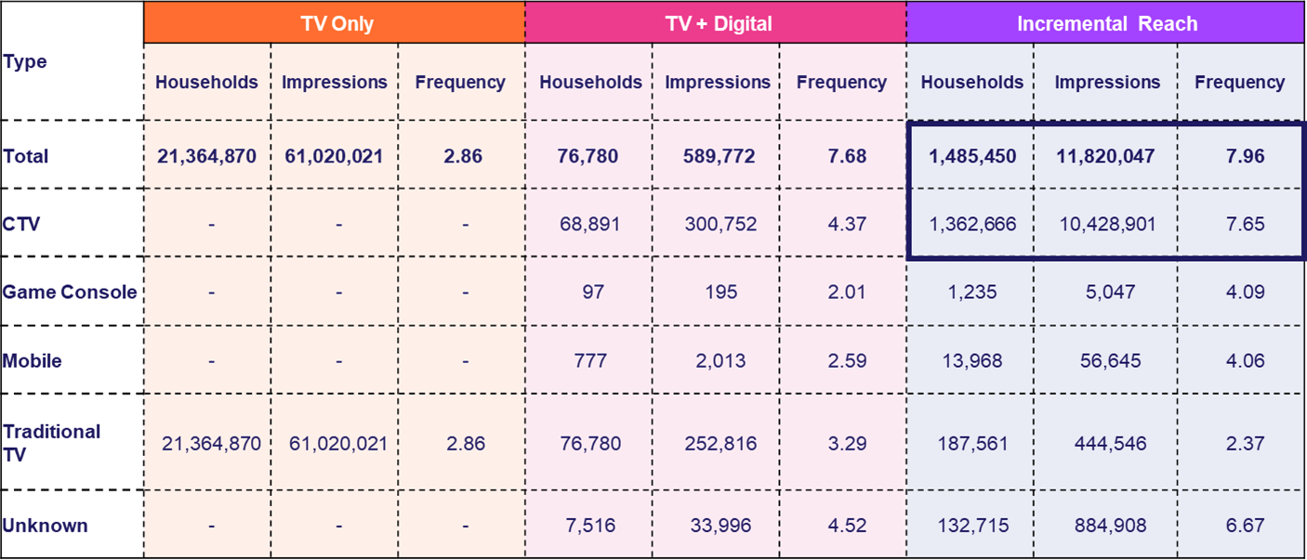
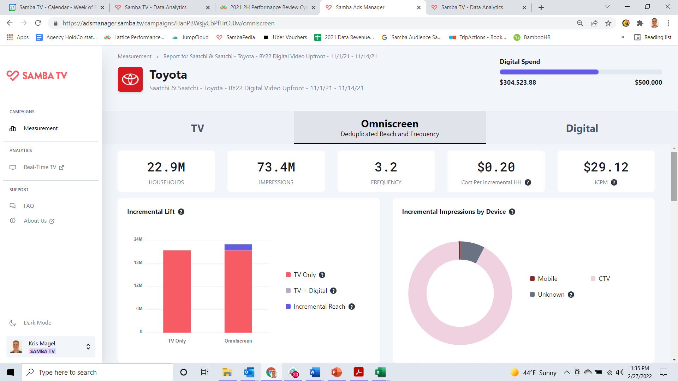


Category:
Automotive
Samba TV provided real-time measurement to an auto manufacturer so they could optimize incremental reach
Challenge
A major auto manufacturer sought to offset Linear TV over-frequency and maximize incremental reach to avoid oversaturating targeted viewers
Audience Measurement Innovation
Samba ACR data was used to create reach-enhancing audiences for addressable CTV targeting
As the client’s linear TV and CTV campaign rolled out, Samba’s Incremental Reach Measurement Dashboard enabled a real-time view of the incremental delivery of various target audiences
and tactics, enabling dynamic in-campaign target and tactic optimization
Target Segment
Multiple custom unexposed and light-viewing
target cohorts
Learnings
Achieved live and dynamic understanding of unreached (and over-reached) audiences, enabling optimization of media spend/allocation
Campaign delivered 95% incremental impressions
and +6.9% incremental omni-screen reach
Company / Viewing Source / Media Type
Samba TV / Automated Content Recognition (ACR) / Linear, CTV, Online Video
over 90% of CTV measured as incremental to client’s Linear TV campaign
Source: Samba TV, Automotive Case Study. Campaign time period: November 2021.
This information is exclusively provided to VAB members and qualified marketers.
PAGE 7

Slide 8

Category:
Automotive
An auto brand partnered with DIRECTV to increase reach of its high-value audiences via Addressable TV
Challenge
A domestic auto brand wanted to expand reach of their High Value Audience (HVA)* and improve frequency management
Measurement Innovation
The brand utilized DIRECTV’s Addressable Reach-Frequency Optimization offering to target and reach only the HVA target underexposed to their National media campaign
Target Segment
Custom HVA Target developed using data from Neustar, a Transunion company
Unreached or underexposed to brand’s national campaign from previous quarter
Learnings
The brand was able to see Addressable TV’s impact on:
  Incremental reach of the High Value Audience target, as well as the multicultural subsegments of that audience
  Impression distribution against underexposed audiences
Company / Viewing Source / Media Type
DIRECTV / Set-top Box / Addressable Linear TV + VOD
The addressable campaign increased reach of the brand’s HVA HHs not exposed to the
national campaign from 47% to 85%, including positive lifts across multicultural audiences
HVA HH Reach
% of HHs Reached by National Campaign and National + DIRECTV Addressable
+79% lift
vs. National
+78% lift
vs. National
+47% lift
vs. National
+145% lift
vs. National
Adding Addressable to the advertiser’s overall campaign significantly increased
the share of impressions against the campaign’s lighter exposed HHs
Weekly Frequency
Difference Between National Campaign and National + DIRECTV Addressable
Source: DIRECTV, Automotive Case Study. Campaign time period: Q2 2022. Analysis conducted within DIRECTV footprint.
Case study results are based on individual campaign factors. DIRECTV makes no performance warranties. Data Source: Neustar & DIRECTV Viewership Data. *High Value Audience (HVA) is a custom target built using data from Neustar, a Transunion company, overlaid with viewership data to understand who was unreached or underexposed. Incremental reach within DIRECTV footprint.
This information is exclusively provided to VAB members and qualified marketers.
PAGE 8

Slide 9
Category:
Automotive
DIRECTV helped an auto brand increase reach across multicultural audiences via Addressable TV
Challenge
An auto brand wanted to attain incremental reach against viewers lightly exposed to the national campaign while also better managing impression and frequency distribution
Solution
7-week National + Addressable media campaign
Target Segment
Custom target and deciles 0-6 of brand’s national campaign from previous quarter
Learnings
Integration of addressable with the National campaign resulted in significant increases in HH reach across three multicultural audiences
Company / Viewing Source / Media Type
DIRECTV Viewership + Third-party data, Linear + Addressable TV
Multicultural HH Reach
% of HHs reached by
Source: DIRECTV, Automotive + Addressable Case Study. Campaign time period: 2Q-3Q ‘22. Case study results are based on individual campaign factors. DIRECTV makes no performance warranties. Data Source: Third-party data & DIRECTV Viewership Data. Incremental reach within DIRECTV footprint.
This information is exclusively provided to VAB members and qualified marketers.
PAGE 9

Slide 10

Category:
Automotive
An automotive advertiser partnered with Canoe and leveraged their Addressable Linear and VOD platforms to reach 3 specific in-market auto shopper groups across 34MHHs
Challenge
An automotive advertiser sought a customized messaging and campaign approach to target 3 distinct buyer segments. They required the emotive storytelling power of TV, along with its wide-scale reach but also needed to ensure the right creative message was delivered to the intended target audience
Measurement Innovation
A Canoe Addressable campaign was planned across 4 Programming groups on national programmer’s Linear and VOD inventory. The cross-platform TV campaign targeted 3 audience segments across 16 TV Networks
Target Segments
3 unique In-market for auto segments
Learnings
By mining Canoe delivery data, it was determined that, in aggregate, the 14 VOD networks provided greater reach than the 2 Linear network due to the diverse pool of premium content available across the Programmer’s VOD networks
National Linear TV delivered the greatest network-specific reach against the target audiences. Building on that, there were specific VOD networks that performed nearly as well as the primary Linear network
Company / Viewing Source / Media Type
Canoe / AMC, Fox, TelevisaUnivision, WarnerBrothers Discovery Linear Addressable and VOD Addressable inventory / Linear and Cable STB VOD
Campaign Results
Unique Target Reach
by Platform and Programmer
Unique Target Reach
by Network
More Reach
on VOD
+33%
Diversity of Networks Delivers Greater Reach
Source: Canoe, Automotive Case study. Campaign time period: April – September 2022.
This information is exclusively provided to VAB members and qualified marketers.
PAGE 10

Slide 11
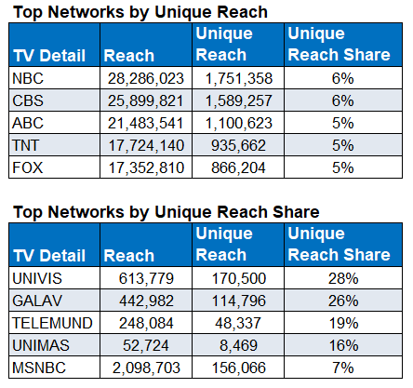
Category:
Automotive
Actionable insights from Samba TV enabled a major auto marketer to more effectively balance their digital vs. TV strategy
Challenge
A major automotive brand wanted to understand the interplay between their Linear TV and Digital media, seeking insights to increase efficiency & impact
Audience Measurement Innovation
Samba TV’s True Reach and Frequency (TRF) measurement provided insights into how the campaign performed across TV and Digital tactics, ultimately supporting the need for more balanced digital vs. Linear TV media mix going forward
Target Segment
U.S. HHs
Learnings
45% of Digital-delivered HH’s were incremental to the campaign (high unique reach factor)
Digital delivered a CPIR* 1/10th the cost of Linear TV
Within TV, Hispanic Networks delivered a far greater share of unique vs. duplicated audiences
Linear TV vs. Digital frequency required balancing
Company / Viewing Source / Media Type
Samba TV / Automated Content Recognition (ACR) / Linear, CTV, Online Video
Enabled by Samba TV’s True Reach & Frequency Measurement & Dashboards
2.6MM
Digital Only Exposed HHs
17.4
Average Frequency
17.7
TV
4.42
Digital
Source: Samba TV, Automotive Case Study. Campaign time period: February – June 2021. *Cost per incremental reach.
This information is exclusively provided to VAB members and qualified marketers.
PAGE 11

Slide 12


Category:
Automotive E-commerce
iSpot.tv’s user level data enabled DriveTime, an auto e-retailer, to optimize frequency and boost their ROAS
Challenge
In order to maximize ROAS, one of the largest used vehicle retailers in the US, DriveTime needed deeper insight into incremental results at the network level, as well as optimal frequency before diminishing returns
Audience Measurement Innovation
Using iSpot.tv’s Integrated User Level Data (IULD), DriveTime tied linear TV ad exposures to conversion events at the individual device level and tallied
the number of impressions per device
Through a lift analysis using an unexposed control group, iSpot.tv calculated incremental conversion events aligned to frequency of impressions
Spend and conversion rates at the individual network level was also looked at to calculate the Cost Per Incremental Visit (CPIV), also mapped to frequency
Target Segment
Any potential DriveTime customer segment
Learnings
The first linear TV ad impression had the highest incremental response rate at 60% with the incremental response rate diminishing as frequency increases
The rate at which TV ad response decreases as frequency increases was calculated to determine
optimal frequency for each TV network
Company / Viewing Source / Media Type
iSpot.tv / Smart TV / Linear TV
Incremental Response Calculations – Bounce TV Network (w/o 2/14/22) example
The first linear TV ad imp has the highest incremental response rate at 60% (160 index)
Frequency
Response
Baseline
Base
Incremental
Total
Index
Index
Lift
TV Count
0
1
1
160
100
60
7,543
Baseline for Base Freq 3
0
2
2
186
100
86
2,976
0
3
3
205
100
105
1,869
Baseline for Base Freq 1
1
1
2
186
160
26
Response Rate (Indexed)
2,523
1
2
3
205
160
45
1,128
1
3
4
220
160
60
662
2
1
3
205
186
19
1,572
2
2
4
220
186
34
666
2
3
5
233
186
48
436
3
1
4
220
205
15
1,060
3
2
5
233
205
29
398
3
3
6
244
205
39
271
Base Frequency: Impressions delivered through other networks (not Bounce)
Incremental Frequency: Impressions delivered through Bounce
Total Frequency: Sum of the previous two
iSpot IULD Impressions: 135k
Distinct Devices: 40k – 3.5 Avg Frequency
Audience Size: 160k – 25% Reach
Source: iSpot.tv, case study: DriveTime x iSpot.TV. Campaign time period: Q1 2022. Conversion events are driven by website traffic.
This information is exclusively provided to VAB members and qualified marketers.
PAGE 12

Slide 13
Mid-To-Lower Funnel
Case Studies
Action
Multiscreen TV campaigns increase the likelihood that the intended audience will be motivated to act
(e.g., make a purchase, download an app, sign-up
for a subscription, make a booking, etc.)
Sampling of ‘action-based’ outcomes that can be measured:
    Conversion Rates (website traffic, app downloads, subscription sign-ups, tune-in, foot traffic)
    Sales / Revenues
    Optimizations / ROI
    Cost Efficiencies (Conversions)
How Multiscreen TV drives
Action
This information is exclusively provided to VAB members and qualified marketers.
PAGE 13

Slide 14

Category:
Automotive
A geo-targeted, audience-based campaign drove website traffic for an automotive brand
Challenge
An auto brand sought to efficiently maximize reach and drive website traffic with an audience-based, cross-platform campaign
Solution
An audience-based TV campaign ran across 41 networks, with 70% of impressions running outside primetime
Enhanced with 20% of overall investment in a targeted streaming campaign to support and expand overall reach
Entire campaign was geographically targeted to the area where majority of sales originated
Target Segment
In-market for new vehicles
Results
Nearly half (43%) of households reached via streaming were incremental to TV. Campaign also generated a positive impact on website traffic, increasing immediate visitors to brand’s website +419 in one month
Company / Platform / Media Type
Effectv / ‘Effectv Streaming’*** + Linear TV / Linear TV, Connected TV (CTV) STB VOD, Mobile & Web
AWARENESS*
CONSIDERATION**
TV Outcomes
Streaming Outcomes
Web Results
+13%
more likely for TV viewers
to be in the target audience
78%
of targeted impressions came from an audience-based campaign with the remainder from fixed programming
43%
of households reached with streaming were incremental to TV
21%
of streaming impressions delivered were to households with no TV service
81%
of streaming impressions were served via the TV screen
+419
Immediate visitors to their website within one month
2+
Visits within the month from these immediate visitors
Source: Effectv, Automotive Case Study. Based on analysis of Effectv Streaming advertising campaigns (2021); Web site results provided by TVSquared analysis. Time period: February 2021. *The “Awareness” portion of the analysis consisted of aggregated ad exposure data of viewing by Comcast households. **The “Consideration” portion of the analysis consisted of third-party web site evaluation by TVSquared; Immediate visitors are defined as additional (above pre-determined baseline) web site visitors occurring within 30 minutes of a cable TV ad airing. ***’Effectv Streaming’ consists of premium, mostly long-form video across multiple devices including Connected TV (CTV), set-top-box VOD (STB VOD), mobile and web.
This information is exclusively provided to VAB members and qualified marketers.
PAGE 14

Slide 15



Category:
Automotive
An AMC campaign on Canoe Addressable drove increased website visits for an automotive brand
Challenge
An automotive advertiser wanted to drive website traffic during the month of February 2021
Solution
A 4-week addressable campaign was launched using Experian pixel data to measure website traffic and compare impact on custom audience target compared to an unexposed control group
Target Segment
Custom audience category target built jointly
by AMC and Canoe
Results
A statistically significant +13.0% increase in overall website visitors can be attributed to the addressable ad campaign on AMC
All website page-specific lifts were positive and most were statistically significant, with sport model page seeing the largest significant lift of +19.5%
Company / Platform
605 Media, Canoe, AMC Networks /
Linear and VOD Addressable
% of Website Visitors Attributed to Addressable Ad Campaign
Target vs. Control
+13%
vs. control
Source: AMC On Canoe Addressable Case Study. Charter and Comcast addressable files, Experian pixel tracked visits to the automotive brand’s website. Sample Dates: 1/25/21 - 2/28/21 . Except where otherwise noted, displayed viewership data is reported at the household level. 605 and Comcast Viewership Data - Viewership Dates: 1/25/2021 - 2/28/2021. Website Visit Measurement Dates: 1/25/2021 - 3/7/2021. Measurement note: Treatment (addressable campaign target) and control groups were comparable across demographic factors, including: income, age, race, and home ownership. The treatment effect was measured as the difference in conversion rates between the control and treatment groups
This information is exclusively provided to VAB members and qualified marketers.
PAGE 15

Slide 16

Category:
Automotive
An automotive brand utilized 605 to understand which platforms drove the highest engagement via website visits
Challenge
An auto brand wanted to understand which tactics from their cross-platform campaign have an impact on driving consumers to website pages specific to a new car model
Audience Measurement Innovation
To determine causal impact, 605 utilized a “Matched Control” to remove outside influences and biases. This is done by applying machine learning methods to match each “treated” household to unexposed households that compose a “Matched Control” group
Target Segment
Conversion was measured both for any page on the Auto website, and at the page level for five distinct model-related pages
Learnings
The national linear campaign drove a +12% increase in website visitors. On top of this, cross platform targeted ads produced an additional +11% increase, indicating that the campaign is driving even further conversions
Out of all three platforms, OLV drove the highest engagement with +>100% lifts across most pages. Digital delivery increased digital engagement with the brand
Exposed households that converted tended to be younger, highly educated, and earn higher incomes
Company / Viewing Source / Media Type
605 / Automated Content Recognition (ACR), Set-Top Box / Linear TV, Addressable, Addressable VOD, Digital
 | All Reached Households |  |  |  |  | Uniquely Reached Households
Platform | Impressions | Reach | % Reach Overall | % Reach per Platform | Average Frequency | Unique Reach | % Unique Reach | Average Frequency
Full Campaign | 2,832,587 | 660,435 | 16.5% | — | 4.3 | — | — | —
Addressable Linear | 1,247,772 | 422,678 | 10.5% | 22.5% | 3.0 | 360,348 | 85.3% | 2.9
Addressable VOD | 1,226,973 | 250,710 | 6.2% | 6.9% | 4.9 | 188,544 | 75.2% | 4.9
OLV | 357,842 | 49,577 | 1.2% | 14.0% | 7.2 | 49,074 | 99.0% | 7.2
Effect Size
(percentage point difference)
% Visiting Auto Website
Source: 605, Case study: Campaign for Automotive Brand. Campaign time period: 4/5/2021 – 6/13/2021. OLV = online video. Percentage point differences are compared to the matched control group.
This information is exclusively provided to VAB members and qualified marketers.
PAGE 16

Slide 17








Category:
Automotive
Leading auto manufacturer shifted to an addressable + data-driven TV strategy which drove incremental sales revenue
Challenge
A leading auto manufacturer set a goal to increase sales in the NY area for five specific model vehicles
Solution
To ensure the initiative focused on the most qualified in-market prospects, NYI created spot addressable and linear TV campaigns exposing messaging to four target auto segments
Target Segment
Four targeted auto segments
Results
By concentrating on the four auto segments, conversion among those homes skyrocketed: four of the five models experienced an incremental lift; net incremental sales revenue increased $7.1M with most sales occurring with two months of seeing the first ad
Company/ Platform
NY Interconnect / Addressable TV, Data-driven linear
Results / ROI
Additional Key Findings
Target Model Vehicles Only
336 Incremental sales
+6% Incremental lift in sales
ROI
Net Incremental Sales Revenue: $7.1M
$4.53 per dollar spent
Households exposed to the campaign purchased 6,302 target model vehicles
Four of the five models experienced positive sales lift outcomes
Three of the models ranked among the Top 3 in share within their respective competitive classes;
One of the models ranked #1 in its competitive class
Increased ad exposure had a positive impact as the conversion rate increased along with the number of exposures
The majority of sales occurred 60 days after first being exposed to the ad
Source: NY Interconnect, Case study: Addressable TV Collaboration Drives Up Sales. NY DMA, Conversion analysis based on set-top box ad exposure matched to Experian Automotive sales data. Incremental Lift = (Exposed Buy Rate – Unexposed Buy rate)/Unexposed Buy rate), Incremental Sales = (Exposed Households * (Exposed Buy Rate – Unexposed Buy Rate). Spot Addressable TV – Altice, Linear TV – Charter, Comcast. Campaign time period: 4Q ’19.
This information is exclusively provided to VAB members and qualified marketers.
PAGE 17

Slide 18

Category:
Automotive
Through advanced TV targeting, a luxury auto brand drove sales lifts and achieved buy rates that beat national benchmarks
Challenge
A leading luxury auto manufacturer sought to increase sales for their compact SUV just as they were releasing an all-new design
Solution
Using NBCU’s AdSmart audience targeting solution, the brand ran a national TV campaign across the NBCU portfolio to reach their custom target. IHS Markit was utilized to measure the impact of the campaign on driving sales lift for the advertising SUV and the advertiser overall.
Target Segment
Custom IHS Market ‘In-Market Luxury Auto Intenders’
Results
By implementing a targeted data-driven TV campaign, the brand saw a +10% total sales lift for their advertised SUV and the buy rate beat national benchmarks
Company / Platform
NBCU’s AdSmart solution / Data-driven linear
NBCU AdSmart Exposure Drove Sales Lift
Advertised SUV
+10%
Total Sales Lift
+7%
In-Target Sales Lift
2.5X
Higher In-Target Buy Rate
(vs. Non-Target)
Advertiser Overall
+11%
Total Sales Lift
+4%
In-Target Sales Lift
3X
Higher In-Target Buy Rate
(vs. Non-Target)
NBCU AdSmart Buy Rate Beat National Benchmarks
Advertised SUV
Advertiser Overall
2X
Higher Total Buy Rate
1.3X
Higher Total Buy Rate
4X
Higher In-Target Buy Rate
3X
Higher In-Target Buy Rate
This information is exclusively provided to VAB members and qualified marketers.
PAGE 18

Slide 19

Category:
Automotive
A geo-targeted multiscreen TV campaign with tailored creative had a direct impact on sales for a local Ford dealership
Challenge
A local Ford dealership was looking to expand their primary customer base and conquest sales from competitive dealerships in a geography 20+ miles south of their location
Solution
Spectrum Reach developed new creative with new relevant, targeted messaging to use in a multiscreen campaign aimed at Ford customers
In partnership with Experian and IHS Markit, Spectrum was able to isolate exposed / unexposed viewers to measure the direct impact of the campaign on business outcomes
Target Segment
Ford Car & Truck Buyers
Results
Reach: A total of 94,975 HHs were exposed to a Ford Dealer Commercial
Sales: Exposed homes bought a total of 185 cars – essentially, 1 car sold for every 500 homes exposed to an ad
Scale: Spectrum HHs accounted for 61% of all Palm Coast Ford sales for the 3-month time period. Among that group, 80% were exposed to the ad
Company / Platform
Spectrum Reach / Linear TV, streaming TV and addressable online video, display and search
Overall Dealership Multiscreen Impact
+52%
+8%
+13%
Site Traffic
Leads
Sales
Overall Dealership Conversion Lift
Conquest Geography Sales Lift
121.25%
263%
The unique messaging and introduction of Multiscreen TV in the conquest geography drove sales up by 263%
Those exposed to the ad were more than 2X as likely to buy a new vehicle from Palm Coast Ford vs. unexposed
Source: Spectrum Reach, Custom Case study: How Campaign Attribution Made Palm Coast Ford, a Believer in Multiscreen Media. Data partners: Experian, IHS Markit. Campaign time period: Dec 14, 2020 – Feb 28, 2021. Traffic, Leads and Sales based on purchased made by exposed HH within 90 days of exposure. Conquest: sales during
Oct-Dec 2021 compared to Jan-Apr, 2021.
This information is exclusively provided to VAB members and qualified marketers.
PAGE 19

Slide 20
Awareness
How Multiscreen TV drives
Full-Funnel Outcomes
Multiscreen TV campaigns expand reach
and drive brand recall against a brand’s
best customer prospects
Action
Multiscreen TV campaigns increase the likelihood
that the intended audience will be motivated to act
(e.g., visit a website, download an app, sign-up
for a subscription, make a purchase, etc.)
Case Studies
This information is exclusively provided to VAB members and qualified marketers.
PAGE 20

Slide 21

Category:
Automotive
An optimized test led to an audience-based TV campaign which drove incremental reach, increased sales and cost efficiencies for the local auto dealership
Challenge
Tate Automotive (Dodge, Chrysler, Jeep) in Glen Burnie, Maryland sought to increase sales by expanding their customer base while achieving cost efficiencies
Solution
Following a small test based on a data-driven TV campaign with Effectv, which showed that incremental reach is achieved within a broader schedule, the brand applied those learnings to a full-scale audience-based campaign utilizing more than twice as many networks as the previous year
Target Segment
In-Market for a New Vehicle
Results
The full-scale audience-based campaign led to:
  Greater efficiencies: +24% YoY investment increase vs. +46% YoY increase in target HH reach (vs. traditional campaign in 2019)
  Sales: 160 cars sold, #1 brand dealer in the state
Company / Platform
Effectv’s Audience Intelligence for Local / Data-driven linear
Traditional vs. Targeted Campaign
Campaign | # of Networks | Target Reach | Frequency
August 2019 | 12 | 48% | 3.7
August 2020 | 34 | 70% | 11.1
August 2020 Results
160
Cars Sold
#1
Brand Dealer
in the State
August 2020: Full Scale, Audience-Based Campaign
Campaign Target HH Reach
In-Market for a New Vehicle
+20% incremental reach for Sports/News
50%
reach for audience targeted schedule
Source: Effectv, Automotive Case Study. *AIL = Audience Intelligence for Local, Effectv’s audience-based video solution. The test campaign ran between June-July 2020.
This information is exclusively provided to VAB members and qualified marketers.
PAGE 21

Slide 22







Want more? VAB has a wealth of case studies across additional categories
Consumer Packaged Goods (CPG)
Entertainment & Tune-In
Financial Services & Insurance
Health, Wellness & Beauty
Pharmaceuticals
Restaurants
Retail
Access more case studies at www.thevab.com
This information is exclusively provided to VAB members and qualified marketers.
PAGE 22

Slide 23








Want more? VAB also has case studies organized across multiscreen TV platforms including linear TV and streaming / CTV
Stream On
How can a convergent TV strategy drive business
results for my brand?
Proven Strategies & Tactics In Audience-Based TV Buying
Opportunities in VOD Addressable
Q1 ‘22 Today’s Innovations in Measurement
Q2 ‘22 Today’s Innovations in Measurement
Q3 ‘22 Today’s Innovations in Measurement
Q4 ‘22 Today’s Innovations in Measurement
Access more case studies at www.thevab.com
This information is exclusively provided to VAB members and qualified marketers.
PAGE 23

Slide 24


About VAB
VAB plays a dual role in the video advertising industry. We are leading the change to bring about a more innovative and transparent marketplace. We also provide the insights and thought leadership that enables marketers to develop business-driving marketing strategies.
Drawing on our marketing expertise, we simplify the complexities in our industry and discover new insights that transform the way marketers look at their media strategy.
We are committed to your business growth and proud to offer VAB members, brand marketers and agencies complimentary access to our continuously-growing Insights library. Get immediate access at theVAB.com.
This information is exclusively provided to VAB members and qualified marketers.
PAGE 24

