Slide 1



April, 2020
As Time Goes By
How Media Consumption Is Helping America Cope

Slide 2


About VAB
VAB is an insights-driven organization that inspires marketers to reimagine their media strategies resulting in fully informed decisions.
Drawing on our marketing expertise, we simplify the complexities in our industry and discover new insights that transform the way marketers look at their media strategy.
Simplify
We save you time by bringing you the latest data & actionable takeaways you can use to inform your marketing plans.
Discover
We keep you one step ahead with the latest thinking so you can create innovative, forward-looking strategies.
Transform
We help you build your brand by focusing on core marketing principles that will help drive tangible business outcomes.
PAGE 2

Slide 3
Agenda
1
5
News Bulletin
Importance of news during COVID-19
Objective and Methodology
2
6
Advertising Impact
Understanding consumers’ perceptions amid the crisis
Key Takeaways for Marketers
Summary of key findings
3
Overall Media Usage
Confined to their homes, how are people spending their time?
7
Implications for Marketers
4
Sports Shifts
Fans seek more content in lieu of live sports
8
Appendix
Multicultural Insights

Slide 4
As Time Goes By: How Media Consumption is Helping Americans Cope
Overview and Methodology
Overview
As part of our effort to help marketers keep abreast of consumers’ changing behaviors during the COVID-19 pandemic we recently conducted a custom study gauging changes in consumers’ media habits, views on brands and how they feel about advertising right now.
With time on their hands, consumers are not only increasing their time with media, they are exploring new media, technology and platforms. Entertainment, gathering information and staying connected are driving consumers to broaden their media horizons. Marketers would be wise to seize this opportunity and connect with these large-scale audiences, who are paying attention and engaging with media, in a new, unexpected way. The “elusive” Millennial and Gen Z audiences are tuning into multiscreen television in mass, engaging with a variety of content in both live and streaming environments.
This report provides insights to help guide marketers as they seek to assess consumer behavior, social interaction and how these changing behaviors impact their brands.
Methodology
VAB commissioned Lucid to conduct an online survey between April 1 – April 3, 2020. The results are based on 1,004 adult 18+ U.S. respondents in households that subscribe to cable, telco, internet TV or satellite TV. The respondents cover all age groups, races and ethnic backgrounds.
This information is exclusively provided to VAB members and qualified marketers. Further distribution is prohibited.
PAGE 4

Slide 5




Key Takeaways for Marketers
Consumers are using their increased time to engage with media, becoming more comfortable with tech and relying on TV more than ever
TV is a Lifeline
Sports Fans Stay Tuned In
News, News & More News
Time for Tech
TV is the center of the home, with 83% of respondents agreeing “they can’t imagine not having a television right now.” Even three-quarters of Gen Z and Millennials share this sentiment. TV is keeping us entertained and informed while we #stayhome.
Although live sports have been put on hold, sports fans continue their viewing; they’ve replaced sports with news & entertainment programming, particularly movies.
Not only are people turning to TV news right now, they believe TV is the most reliable news source.
Gen Z are the only cohort who are relying on social media more than TV for their news.
With time on our side, consumers are experimenting with new skills, technology and platforms. These new skills are leading to an increase in comfort and usage across all devices, including Zoom calls, Smart TVs, and all streaming services.
This information is exclusively provided to VAB members and qualified marketers. Further distribution is prohibited.
PAGE 5

Slide 6

Overall Media Usage
Confined to their homes, how are people spending their time?

Slide 7

Media is helping us get through the COVID-19 outbreak, a sentiment echoed throughout other industry research
Media Usage Since COVID-19 Outbreak
P18+
Source: VAB / Lucid ‘Media Usage In The Time of COVID-19 Survey,’ April 2020. Survey base: P18+ & household subscribes to cable, telco, internet TV or satellite TV (n=1,004). Q1: Overall, please choose the statement below that best describes your media usage since the outbreak of the COVID-19 Pandemic.
This information is exclusively provided to VAB members and qualified marketers. Further distribution is prohibited.
PAGE 7
PAGE 1

Slide 8
Media usage is on the rise across all demos
Media Usage Since COVID-19 Outbreak
Source: VAB / Lucid ‘Media Usage In The Time of COVID-19 Survey,’ April 2020. Survey base: P18+ & household subscribes to cable, telco, internet TV or satellite TV (n=1,004). Q1: Overall, please choose the statement below that best describes your media usage since the outbreak of the COVID-19 Pandemic.
This information is exclusively provided to VAB members and qualified marketers. Further distribution is prohibited.
PAGE 8
PAGE 1

Slide 9








The #1 way people are coping during this stressful time is watching TV and movies
Ways To Deal With Stress During the COVID-19 Pandemic
% of respondents who agree
P18+
77%
65%
42%
41%
TV & Movies
Music
Cooking & Baking
Social
Media
40%
34%
29%
25%
Video
Games
Self
Care
Hang With
Family
Learn Something New
Source: VAB / Lucid ‘Media Usage In The Time of COVID-19 Survey,’ April 2020. Survey base: P18+ & household subscribes to cable, telco, internet TV or satellite TV (n=1,004). Q8: During this Pandemic, are any of the following helping you deal with stress?
This information is exclusively provided to VAB members and qualified marketers. Further distribution is prohibited.
PAGE 9

Slide 10

Media is not just helping us cope; we are also using it as a means of distraction from COVID-19 news
“I regularly seek distractions from COVID-19 news”
Top 2 Box (Agree Completely or Agree Somewhat)
Source: VAB / Lucid ‘Media Usage In The Time of COVID-19 Survey,’ April 2020. Survey base: P18+ & household subscribes to cable, telco, internet TV or satellite TV (n=1,004). Q6: Thinking of your behavior during the COVID-19 Pandemic, please indicate below how much you agree or disagree with the following statements , top 2 box (agree completely or agree somewhat)
This information is exclusively provided to VAB members and qualified marketers. Further distribution is prohibited.
PAGE 10

Slide 11



TV has become the centerpiece of the household, with 8 out of 10 people saying they couldn’t imagine not having a television right now
% of respondents who agree with the statement
P18+
83%
72%
70%
67%
“I couldn't imagine not having a television set right now”
“Watching TV or movies together as a family has become more common”
“I binge watch more TV shows or movies”
“TV has become the central focus of our home”
Source: VAB / Lucid ‘Media Usage In The Time of COVID-19 Survey,’ April 2020. Survey base: P18+ & household subscribes to cable, telco, internet TV or satellite TV (n=1,004). Q7: Thinking of your behavior since the start of COVID-19, please indicate below how much you agree or disagree with the following statements & Q9: Thinking of your behavior during the COVID-19 Pandemic, please indicate below how much you agree or disagree with the following statements
This information is exclusively provided to VAB members and qualified marketers. Further distribution is prohibited.
PAGE 11

Slide 12




With live TV experiencing the biggest increase since COVID-19 began
Social media is also seeing gains as people use it to stay connected with friends & family
% Of Respondents Who Increased Usage By Platform Since COVID-19 Outbreak
P18+
57%
55%
54%
Live TV
Social
Media
SVOD
Service
37%
35%
31%
23%
Video
Games
Streaming Music
AVOD
Service
Podcasts
Source: VAB / Lucid ‘Media Usage In The Time of COVID-19 Survey,’ April 2020. Survey base: P18+ & household subscribes to cable, telco, internet TV or satellite TV (n=1,004). Q2: When thinking about how you’ve spent your time during the COVID-19 Pandemic, have you increased, decreased or spent the same amount of time with the following media? SVOD: Subscription Video On Demand (e.g. Netflix, Amazon Prime Video), AVOD: Ad-Supported Video On Demand (e.g. Tubi, Roku).
This information is exclusively provided to VAB members and qualified marketers. Further distribution is prohibited.
PAGE 12

Slide 13
Life stage appears to be a driving force across much of the platform usage growth, as Gen X & HHs with children increase usage across their preferred media
Increase In Platform Usage Since COVID-19 Outbreak
% of respondents who increased usage
Source: VAB / Lucid ‘Media Usage In The Time of COVID-19 Survey,’ April 2020. Survey base: P18+ & household subscribes to cable, telco, internet TV or satellite TV (n=1,004). Q2: When thinking about how you’ve spent your time during the COVID-19 Pandemic, have you increased, decreased or spent the same amount of time with the following media? SVOD: Subscription Video On Demand (e.g. Netflix, Amazon Prime Video), AVOD: Ad-Supported Video On Demand (e.g. Tubi, Roku).
This information is exclusively provided to VAB members and qualified marketers. Further distribution is prohibited.
PAGE 13

Slide 14



With more time in their day, consumers are utilizing new platforms and discovering the full functionality of their existing devices
% of respondents who agree with the statement
P18+
84%
66%
54%
“I have more time to watch/listen/read media”
“I am more open to trying new types of media”
(e.g. new streaming services, podcasts, social media platforms, etc)
“I have learned how to use more features on my smart TV or a TV related device/platform”
Source: VAB / Lucid ‘Media Usage In The Time of COVID-19 Survey,’ April 2020. Survey base: P18+ & household subscribes to cable, telco, internet TV or satellite TV (n=1,004). Q9: Thinking of your behavior during the COVID-19 Pandemic, please indicate below how much you agree or disagree with the following statements
This information is exclusively provided to VAB members and qualified marketers. Further distribution is prohibited.
PAGE 14

Slide 15
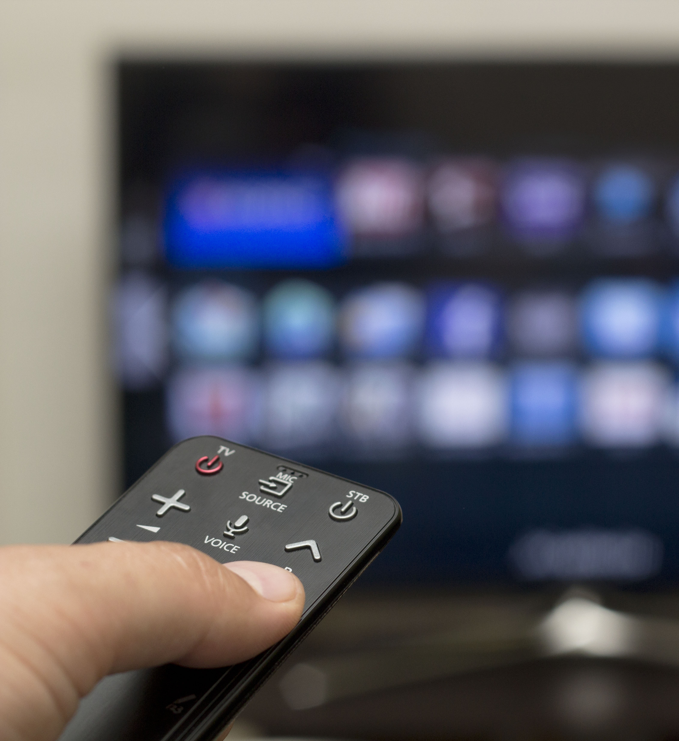
Including exploring new features on their smart TVs and connected devices
“I have learned how to use more features on my
smart TV or a TV related device/platform”
Top 2 Box (Agree Completely or Agree Somewhat)
Source: VAB / Lucid ‘Media Usage In The Time of COVID-19 Survey,’ April 2020. Survey base: P18+ & household subscribes to cable, telco, internet TV or satellite TV (n=1,004). Q9: Thinking of your behavior during the COVID-19 Pandemic, please indicate below how much you agree or disagree with the following statement, top 2 box (agree completely or agree somewhat).
This information is exclusively provided to VAB members and qualified marketers. Further distribution is prohibited.
PAGE 15

Slide 16



And sampling both ad-supported and subscription streaming services
Since the COVID-19 Pandemic, have you done any of the following?
P18+
37%
36%
9%
Watched a free streaming service
Added a new streaming service
Unsubscribed from a streaming service
(e.g. Roku, Pluto or Tubi)
(i.e., Apple TV+, Netflix, etc.)
(i.e., Apple TV+, Netflix, etc.)
Source: VAB / Lucid ‘Media Usage In The Time of COVID-19 Survey,’ April 2020. Survey base: P18+ & household subscribes to cable, telco, internet TV or satellite TV (n=1,004). Q10: Since the COVID-19 Pandemic, have you done any of the following? Note: Percentages don’t add to 100% because it excludes “none of the above” response.
This information is exclusively provided to VAB members and qualified marketers. Further distribution is prohibited.
PAGE 16

Slide 17
Young Adults along with HHs with kids are the drivers behind the growth of streaming services
Since the COVID-19 Pandemic, have you done any of the following?
% of respondents who done the following
(i.e. Roku, Tubi, or PlutoTV)
(i.e., Apple TV+, Netflix, etc.)
Source: VAB / Lucid ‘Media Usage In The Time of COVID-19 Survey,’ April 2020. Survey base: P18+ & household subscribes to cable, telco, internet TV or satellite TV (n=1,004). Q10: Since the COVID-19 Pandemic, have you done any of the following? Note: Percentages don’t add to 100% because it excludes “none of the above” response.
This information is exclusively provided to VAB members and qualified marketers. Further distribution is prohibited.
PAGE 17

Slide 18
While all media is a source of entertainment, each provides a second core role in people’s lives
Movies help viewers escape reality, social media acts as entertainment and video games help people stay in touch with their friends
Reasons For Platform Usage Since COVID-19 Outbreak
% of respondents who use the following platforms for a reason
Source: VAB / Lucid ‘Media Usage In The Time of COVID-19 Survey,’ April 2020. Survey base: P18+ & household subscribes to cable, telco, internet TV or satellite TV (n=1,004). Q4: During the COVID-19 pandemic, what are the primary reasons you utilized the media below? Does not equal 100% due to the ability to choose multiple responses. SVOD: Subscription Video On Demand (e.g. Netflix, Amazon Prime Video), AVOD: Ad-Supported Video On Demand (e.g. Tubi, Roku).
This information is exclusively provided to VAB members and qualified marketers. Further distribution is prohibited.
PAGE 18
PAGE 1

Slide 19


Phones, social media and video chats have enabled us to social distance, while connecting with family and friends
% of respondents who agree with the statement
P18+
78%
76%
51%
“To stay informed and keep in touch with friends I am using my phone more often”
“Social media is essential to stay in touch with friends and family”
“I have tried a new service for the first time to communicate with friends or family”
(e.g. Zoom, Skype, Facetime, etc)
Source: VAB / Lucid ‘Media Usage In The Time of COVID-19 Survey,’ April 2020. Survey base: P18+ & household subscribes to cable, telco, internet TV or satellite TV (n=1,004). Q7: Thinking of your behavior since the start of COVID-19, please indicate below how much you agree or disagree with the following statements & Q9: Thinking of your behavior during the COVID-19 Pandemic, please indicate below how much you agree or disagree with the following statements.
This information is exclusively provided to VAB members and qualified marketers. Further distribution is prohibited.
PAGE 19

Slide 20



While Gen Z is using video games to stay in touch with their friends, affluent targets are turning to podcasts to learn something new, and multicultural audiences are mastering TV related tech
63% Hispanic
66% Non-Hispanic Black
learned to use more features on Smart TV or TV related devices
28%
of P18-24 are playing video games to
keep in touch with friends
16%
of affluent respondents use podcasts to
learn something new
Source: VAB / Lucid ‘Media Usage In The Time of COVID-19 Survey,’ April 2020. Survey base: P18+ & household subscribes to cable, telco, internet TV or satellite TV (n=1,004). Q4: During the COVID-19 pandemic, what are the primary reasons you utilized the media below? Does not equal 100% due to the ability to choose multiple responses.
This information is exclusively provided to VAB members and qualified marketers. Further distribution is prohibited.
PAGE 20

Slide 21
Sports Shifts
Fans seek more content in lieu of live sports

Slide 22
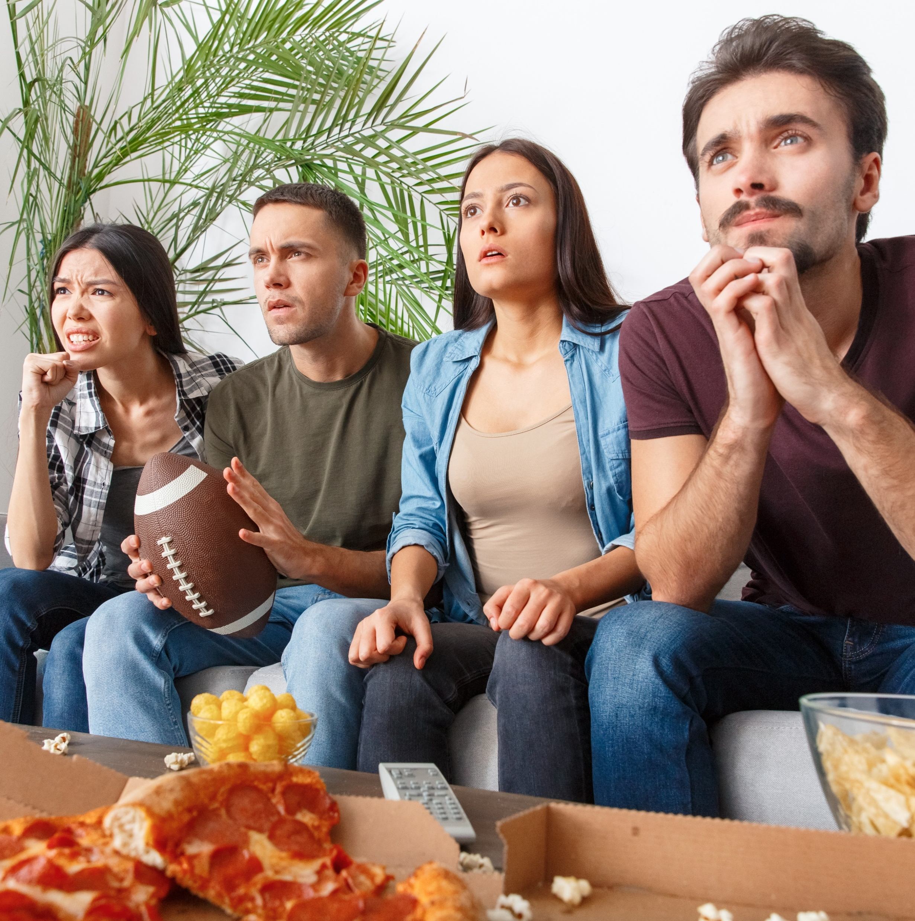
Since the COVID-19 outbreak,
all live sports have been cancelled taking away major advertising opportunities for marketers and leaving sports fans without their favorite live TV events.
So, how has TV viewing been affected and how have sports fans adjusted without their favorite TV sporting events?
This information is exclusively provided to VAB members and qualified marketers. Further distribution is prohibited.
PAGE 22

Slide 23

The cancellation of live sports is not keeping sports fans from watching TV, nearly three-fourths are watching more or the same amount of TV during the COVID-19 Pandemic
Due to COVID-19 virtually all live sports have been pulled off the air.
As a result, are you watching more, less or the same amount of TV?
Source: VAB / Lucid ‘Media Usage In The Time of COVID-19 Survey,’ April 2020. Survey base: P18+, household subscribes to cable, telco, internet TV or satellite and viewers that previously watched live sports (n=797). Q12: Due to COVID-19 virtually all live sports have been pulled off the air. As a result, are you watching more, less or the same amount of TV? Excludes respondents who did not watch live sports.
This information is exclusively provided to VAB members and qualified marketers. Further distribution is prohibited.
PAGE 23
PAGE 1

Slide 24



That includes all demos, across gender, race and ethnicity
Viewers Watching More Or The Same Amount Of TV Since The Cancellation of Live Sports
Adults 18-34: 71%
Male: 72%
Non-Hispanic Black: 78%
Adults 35-54: 73%
Female: 79%
Hispanic: 68%
Adults 55+: 81%
Source: VAB / Lucid ‘Media Usage In The Time of COVID-19 Survey,’ April 2020. Survey base: P18+, household subscribes to cable, telco, internet TV or satellite and viewers that previously watched live sports (n=797). Q12: Due to COVID-19 virtually all live sports have been pulled off the air. As a result, are you watching more, less or the same amount of TV? Excludes respondents who did not watch live sports.
This information is exclusively provided to VAB members and qualified marketers. Further distribution is prohibited.
PAGE 24

Slide 25
Like everyone, sports fans are turning to the news since the outbreak, along with entertainment programming, especially movies
TV Programming That Has Replaced Live Sports TV Since COVID-19 Outbreak
% of respondents who replace sports programming with other TV content
Source: VAB / Lucid ‘Media Usage In The Time of COVID-19 Survey,’ April 2020. Survey base: P18+, household subscribes to cable, telco, internet TV or satellite and viewers that previously watched live sports (n=797). Q13.When you are watching TV, what type(s) of programming are you watching as a replacement for your live sports viewing? Does not equal 100% due to the ability to choose multiple responses. Excludes respondents who did not watch live sports.
This information is exclusively provided to VAB members and qualified marketers. Further distribution is prohibited.
PAGE 25
PAGE 1

Slide 26

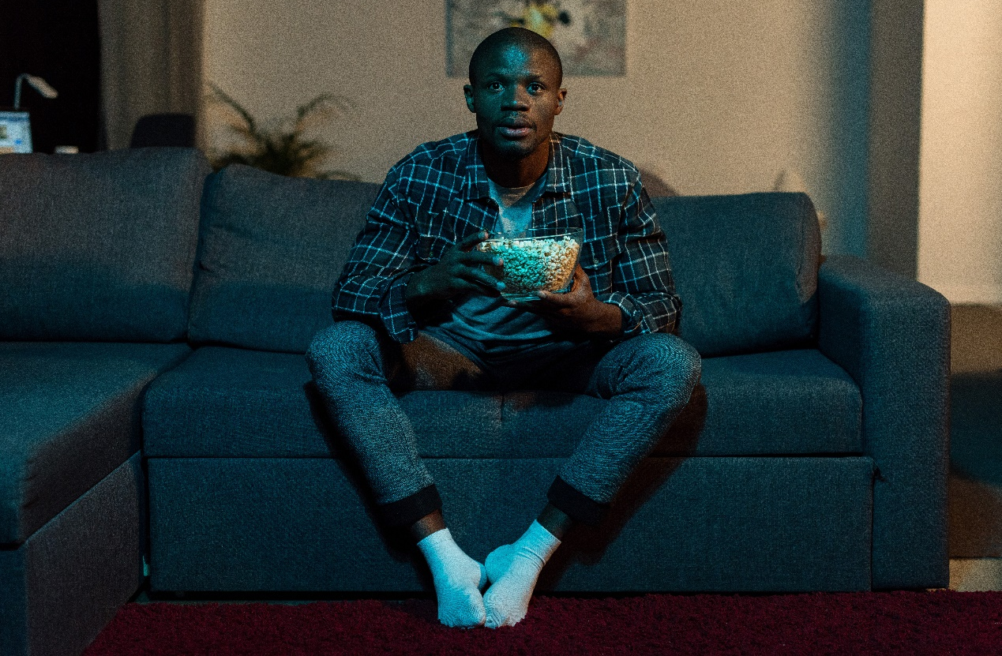

Male, older and more affluent sports viewers are replacing their sports TV viewing with news
Viewers That Replaced Sports Programming With News While Watching TV
Adults 18-34: 36%
Male: 59%
$100k+ HHI: 63%
Adults 35-54: 58%
Female: 45%
Married: 60%
Adults 55+: 67%
Source: VAB / Lucid ‘Media Usage In The Time of COVID-19 Survey,’ April 2020. Survey base: P18+, household subscribes to cable, telco, internet TV or satellite and viewers that previously watched live sports (n=797). Q13.When you are watching TV, what type(s) of programming are you watching as a replacement for your live sports viewing? Does not equal 100% due to the ability to choose multiple responses. Excludes respondents who did not watch live sports.
This information is exclusively provided to VAB members and qualified marketers. Further distribution is prohibited.
PAGE 26

Slide 27
Meanwhile younger generations are replacing sports programming with entertainment content
TV Programming That Has Replaced Live Sports TV Since COVID-19 Outbreak
% of viewers who replace sports programming with other TV content
Source: VAB / Lucid ‘Media Usage In The Time of COVID-19 Survey,’ April 2020. Survey base: P18+, household subscribes to cable, telco, internet TV or satellite and viewers that previously watched live sports (n=797). Q13.When you are watching TV, what type(s) of programming are you watching as a replacement for your live sports viewing? Does not equal 100% due to the ability to choose multiple responses. Excludes respondents who did not watch live sports.
This information is exclusively provided to VAB members and qualified marketers. Further distribution is prohibited.
PAGE 27

Slide 28
News Bulletin
Importance of news during COVID-19

Slide 29



Even while we try to keep ourselves distracted, the news has become more of our focus these days
% of respondents who agree with the statement
P18+
74%
77%
48%
“I check the news for updates multiple times per day”
“I read/watch different media outlets throughout the day so I can make sure I’m fully informed”
“I have switched my news source or started following/watching/listening to a new source”
Source: VAB / Lucid ‘Media Usage In The Time of COVID-19 Survey,’ April 2020. Survey base: P18+ & household subscribes to cable, telco, internet TV or satellite TV (n=1,004). Q6: Thinking of your behavior during the COVID-19 Pandemic, please indicate below how much you agree or disagree with the following statements & Q7: Thinking of your behavior since the start of COVID-19, please indicate below how much you agree or disagree with the following statements. , top 2 box (agree completely or agree somewhat)
This information is exclusively provided to VAB members and qualified marketers. Further distribution is prohibited.
PAGE 29

Slide 30
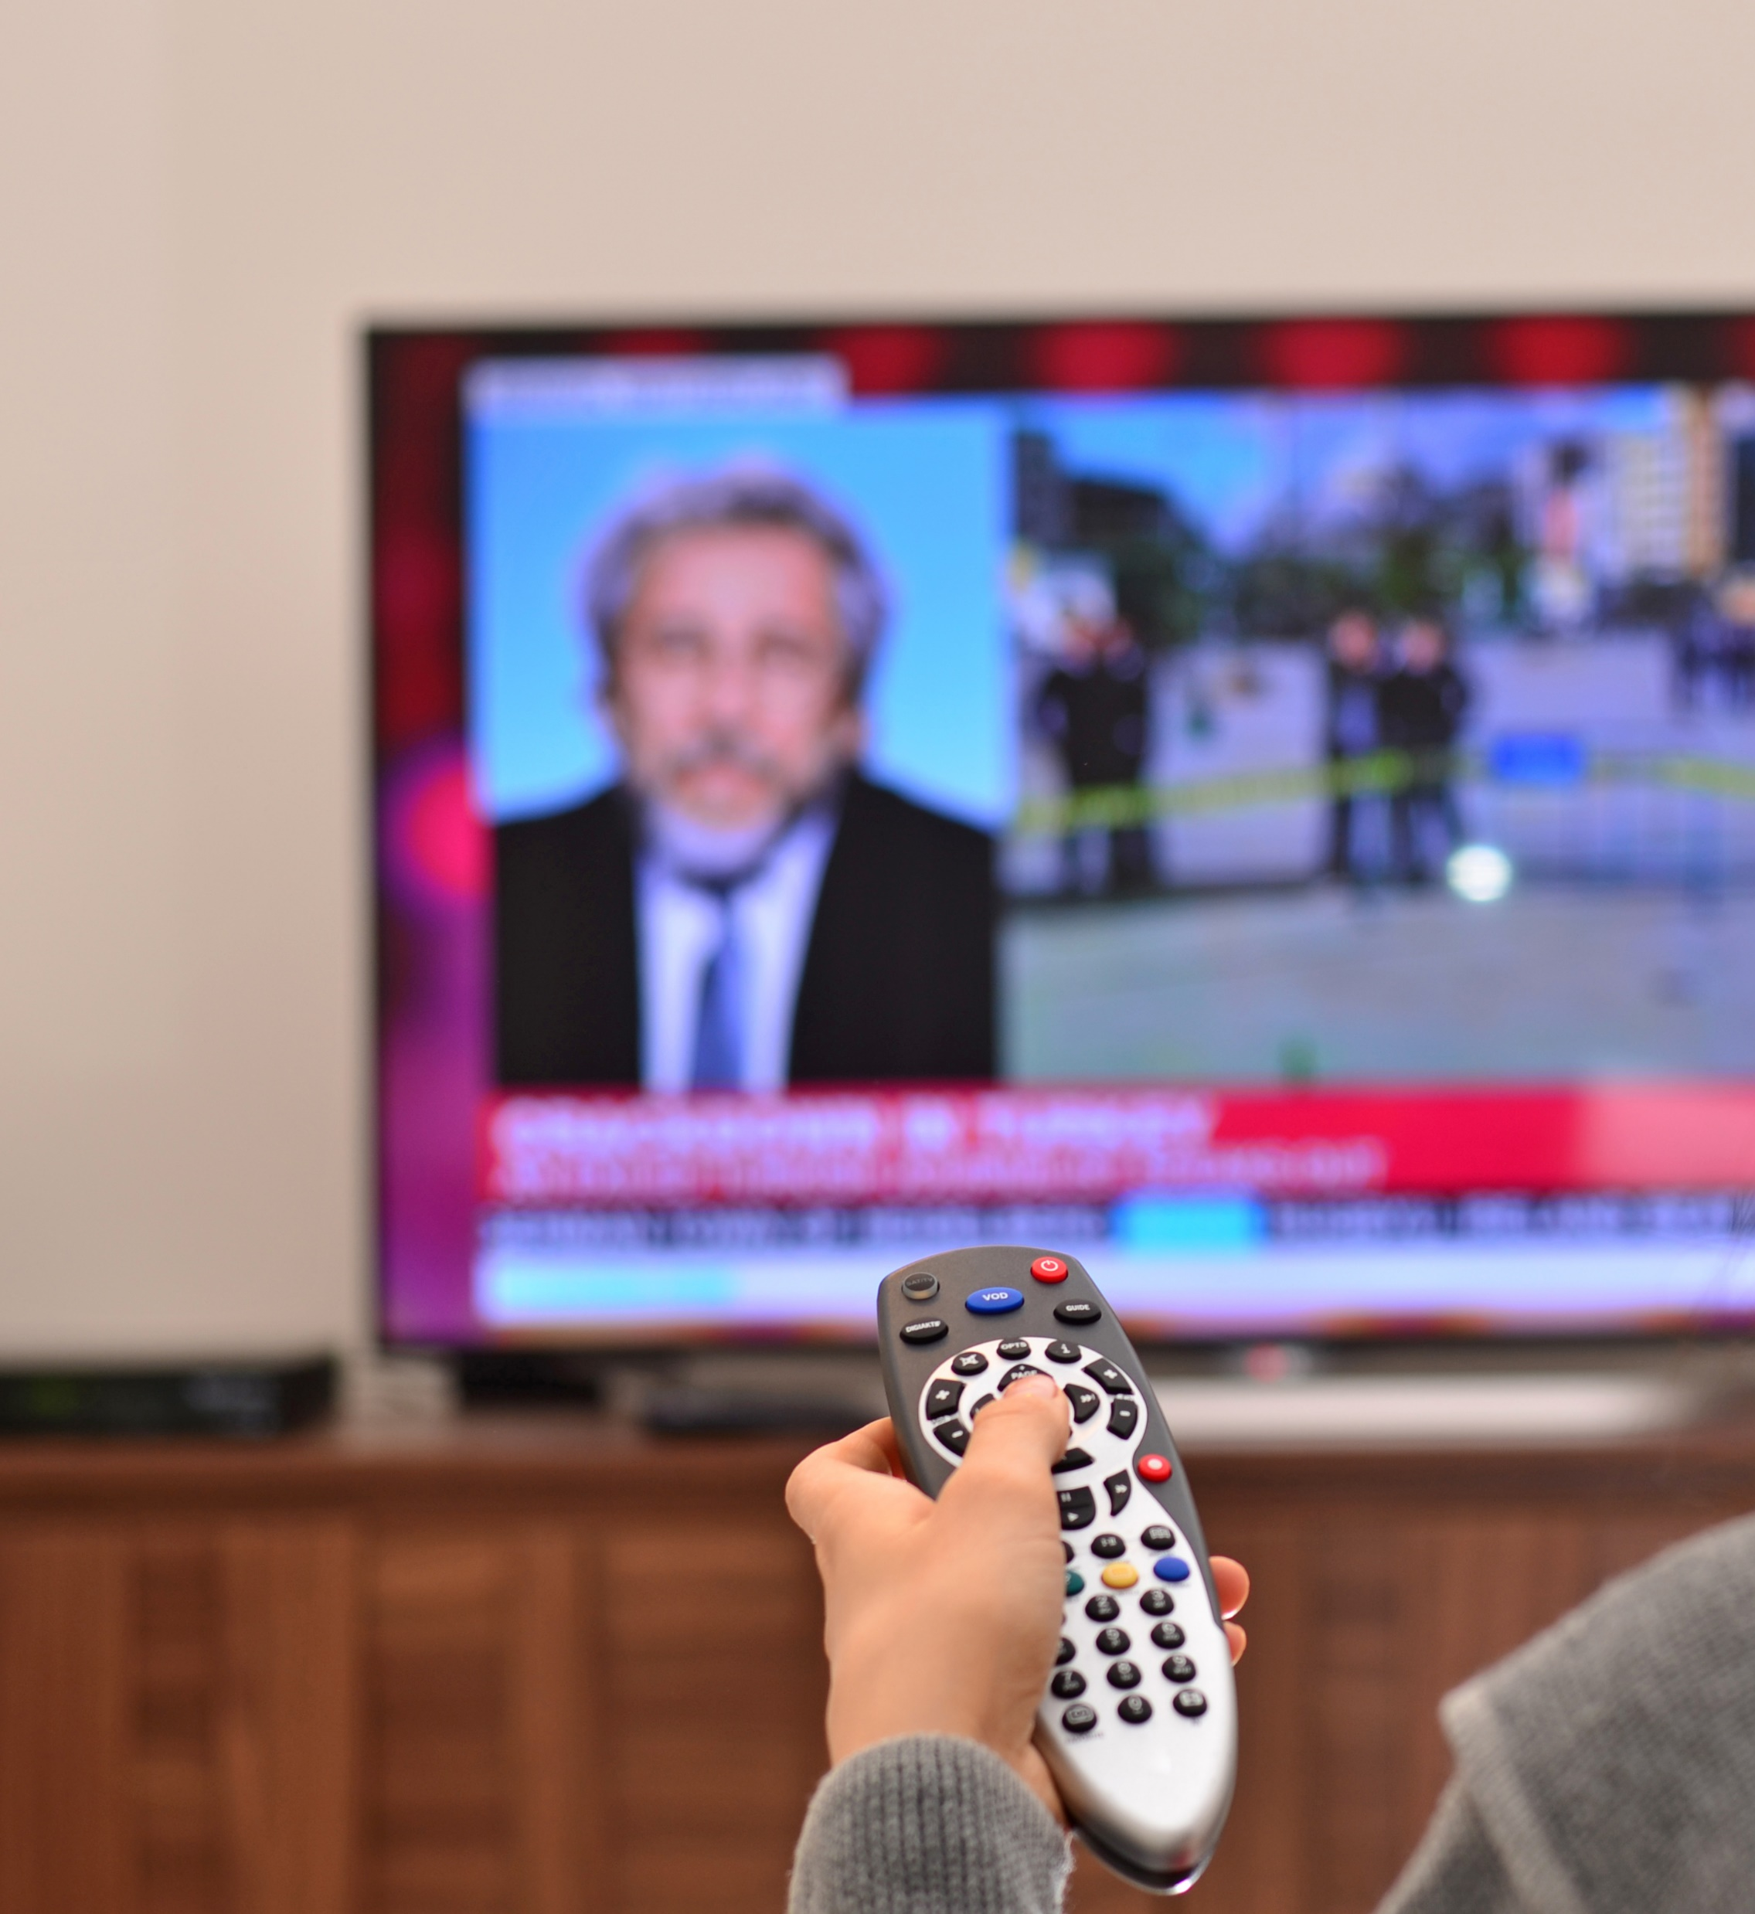
Almost 50% of viewers have at least one TV always set to a news channel
“At least one TV in my home is set to a news channel at all times”
Top 2 Box (Agree Completely or Agree Somewhat)
Source: VAB / Lucid ‘Media Usage In The Time of COVID-19 Survey,’ April 2020. Survey base: P18+ & household subscribes to cable, telco, internet TV or satellite TV (n=1,004). Q6: Thinking of your behavior during the COVID-19 Pandemic, please indicate below how much you agree or disagree with the following statements , top 2 box (agree completely or agree somewhat)
This information is exclusively provided to VAB members and qualified marketers. Further distribution is prohibited.
PAGE 30

Slide 31
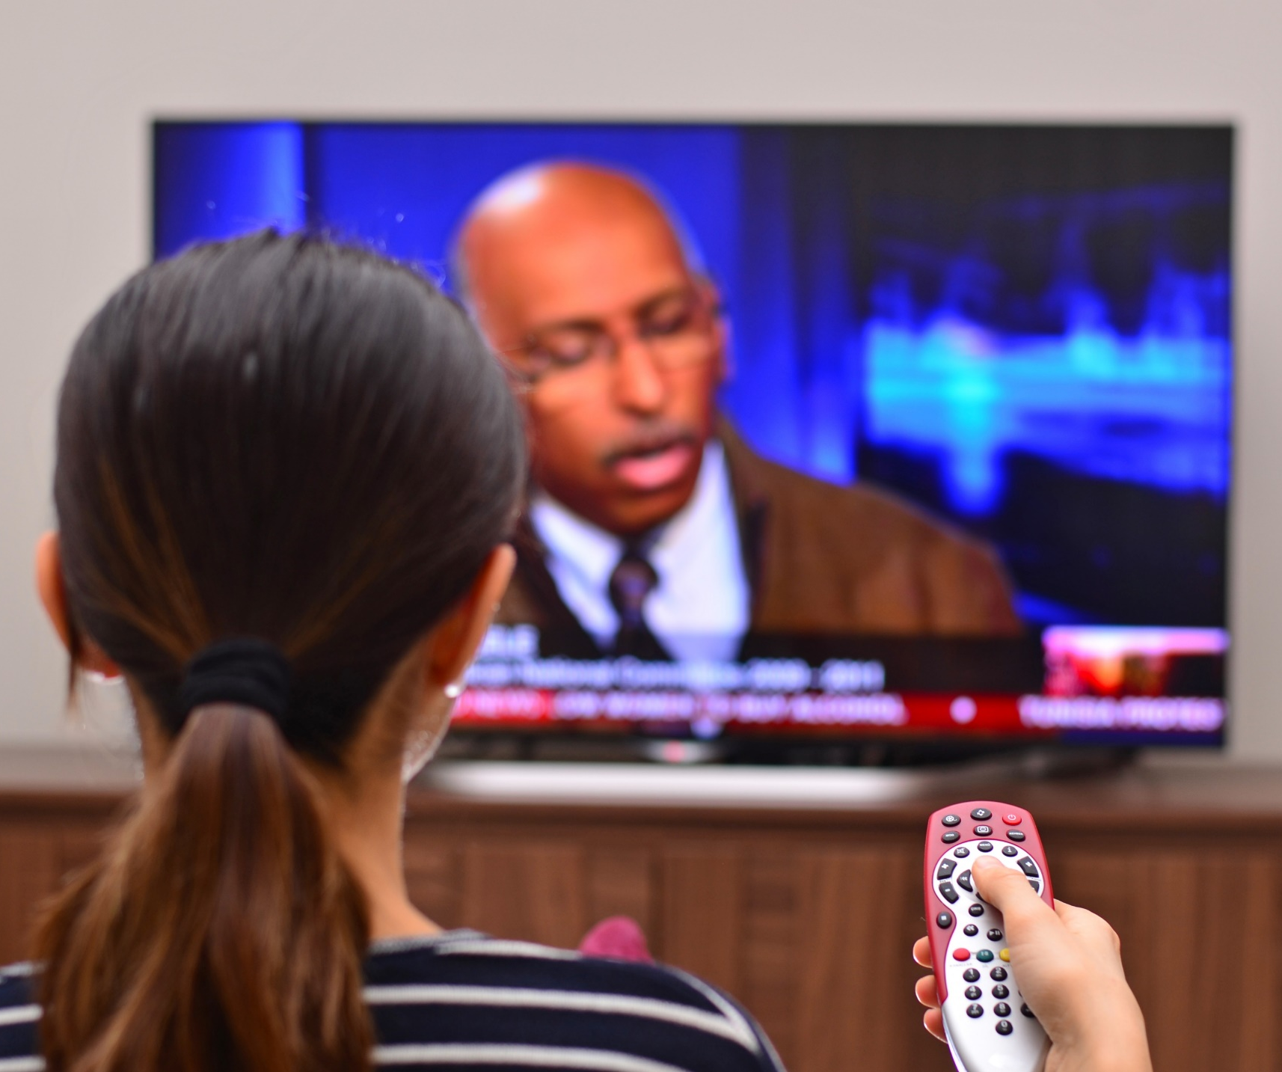
Adults are choosing television as their primary source for acquiring news - above other platforms like social media, newspapers and radio
Primary Sources for Acquiring News Since COVID-19 Outbreak
% of respondents who acquire news through the following platforms
P18+
Source: VAB / Lucid ‘Media Usage In The Time of COVID-19 Survey,’ April 2020. Survey base: P18+ & household subscribes to cable, telco, internet TV or satellite TV (n=1,004). Q5: What are the primary sources you have been using to acquire your news?. Does not equal 100% due to the ability to choose multiple responses.
This information is exclusively provided to VAB members and qualified marketers. Further distribution is prohibited.
PAGE 31
PAGE 1

Slide 32


Not only are more people choosing live television for news, it’s also a trusted source for viewers
% of respondents who agree with the statement
P18+
78%
77%
49%
“Television news (national & local) is the most reliable source for information and news on COVID-19”
“I am relying on TV news to help my decisions regarding me and/or my family's safety”
“At least one TV in my home is set to a news channel at all times”
Source: VAB / Lucid ‘Media Usage In The Time of COVID-19 Survey,’ April 2020. Survey base: P18+ & household subscribes to cable, telco, internet TV or satellite TV (n=1,004). Q6: Thinking of your behavior during the COVID-19 Pandemic, please indicate below how much you agree or disagree with the following statements & Q7: Thinking of your behavior since the start of COVID-19, please indicate below how much you agree or disagree with the following statements. , top 2 box (agree completely or agree somewhat)
This information is exclusively provided to VAB members and qualified marketers. Further distribution is prohibited.
PAGE 32

Slide 33

With a heightened interest in news, younger adults and HH with kids have either switched their news source, or added another source to stay updated during COVID-19
“I have switched my news source or started following/watching/listening to a new source”
Top 2 Box (Agree Completely or Agree Somewhat)
Source: VAB / Lucid ‘Media Usage In The Time of COVID-19 Survey,’ April 2020. Survey base: P18+ & household subscribes to cable, telco, internet TV or satellite TV (n=1,004). Q7: Thinking of your behavior since the start of COVID-19, please indicate below how much you agree or disagree with the following statements.
This information is exclusively provided to VAB members and qualified marketers. Further distribution is prohibited.
PAGE 33
PAGE 1

Slide 34
Advertising Impact
Understanding consumers’ advertising perceptions amid the crisis

Slide 35


Brands should not worry about a negative perception with advertising in COVID-19 news coverage or programming
% of respondents who agree with the statement
P18+
70%
75%
“I feel it is appropriate for companies to advertise in COVID-19 related news programming”
“I would not boycott a company because it advertised in COVID-19 related programming”
Source: VAB / Lucid ‘Media Usage In The Time of COVID-19 Survey,’ April 2020. Survey base: P18+ & household subscribes to cable, telco, internet TV or satellite TV (n=1,004). Q16: In general, do you feel it’s appropriate for companies to advertise in COVID-19 related news programming? & Q17: Would you boycott a company because it advertised in COVID-19 related programming?
This information is exclusively provided to VAB members and qualified marketers. Further distribution is prohibited.
PAGE 35

Slide 36
Even younger, generally more skeptical millennials feel it’s appropriate for companies to advertise in COVID-19 related news programming
% of respondents who agree with the statement
Source: VAB / Lucid ‘Media Usage In The Time of COVID-19 Survey,’ April 2020. Survey base: P18+ & household subscribes to cable, telco, internet TV or satellite TV (n=1,004). Q16: In general, do you feel it’s appropriate for companies to advertise in COVID-19 related news programming? & Q17: Would you boycott a company because it advertised in COVID-19 related programming?
This information is exclusively provided to VAB members and qualified marketers. Further distribution is prohibited.
PAGE 36

Slide 37
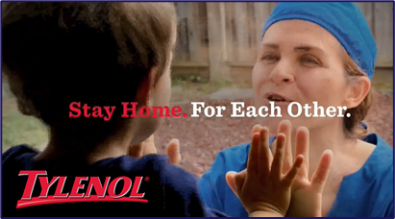

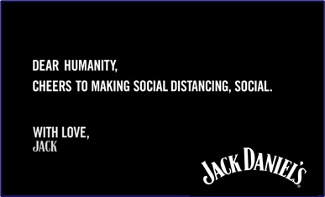

Companies choosing to share COVID-19 specific messaging can gain positive brand perceptions
“Companies with specific COVID-19 related advertising messages positively impacts my perception of the brand”
% that agree with the statement
52%
of all respondents
Source: VAB / Lucid ‘Media Usage In The Time of COVID-19 Survey,’ April 2020. Survey base: P18+ & household subscribes to cable, telco, internet TV or satellite TV (n=1,004). Q14: Some companies have created specific COVID-19 related advertising messages (e.g. Guinness, Ford, Burger King, Verizon). How do these types of advertisements typically impact your perception of a brand?
This information is exclusively provided to VAB members and qualified marketers. Further distribution is prohibited.
PAGE 37
PAGE 1

Slide 38



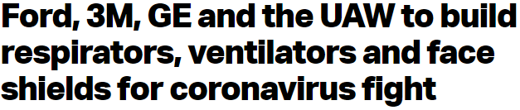
Companies who demonstrate an authentic commitment to helping communities during this crisis will likely increase purchase intent
“I am more likely to purchase a product or service from companies that are lending resources or helping local communities during the crisis”
% that agree with the statement
55%
of all respondents
Source: VAB / Lucid ‘Media Usage In The Time of COVID-19 Survey,’ April 2020. Survey base: P18+ & household subscribes to cable, telco, internet TV or satellite TV (n=1,004). Q15: Some companies are lending resources (e.g. Comcast donating free internet, Ford, 3M and GE Healthcare making healthcare equipment), or helping local communities during the crisis (Miller Lite starts ‘virtual tip jar’ to support out-of-work bartenders). How does this affect your likelihood to purchase a product or service from this company?
This information is exclusively provided to VAB members and qualified marketers. Further distribution is prohibited.
PAGE 38
PAGE 1

Slide 39
Implications for Marketers
TV is a Lifeline
Sports Fans Stay Tuned In
News, News & More News
Time for Tech
Media is playing a key role in consumers’ lives during this crisis, with TV taking center stage. Marketers should seize this opportunity and reinforce their brand communication in the most relevant platform, especially while the younger generations are tuning in.
Although live sports have been put on hold, sports fans have continued their TV viewing. Marketers would be remiss if they forget about these fans. Hit them with the messages they need to keep your brand top of mind.
Not only are people turning to TV news right now, they believe TV is the most reliable source for news. Consumers, including Millennials, are comfortable with brands advertising in COVID-19 news programs. Marketers should not be afraid to advertise there.
Comfort with new media, tech and platforms is providing marketers an opportunity to connect with large-scale audiences, in a new, unexpected way. Marketers should test something new that captures consumers’ attentions, converting them into loyal customers.
This information is exclusively provided to VAB members and qualified marketers. Further distribution is prohibited.
PAGE 39

Slide 40


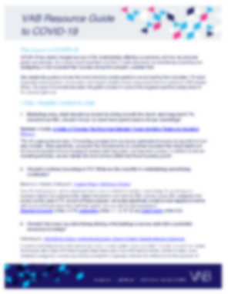

Thank You
Creators
Kathy Grey
Reed Kiely
Karolina Guillen
SVP, Research Innovation kathyg@thevab.com
Insights Manager
reedk@thevab.com
Senior Insights Analyst
karolinag@thevab.com
Interested in learning more? Check out this related content:
VAB Bulletin
Video Viewing In The Time of COVID-19
A Second Look
10 Slides To Guide You Through The COVID 19 Pandemic
COVID-19 Insights
VAB Resource Guide To COVID-19
*VAB Members Exclusive
PAGE 3

Slide 41

Get immediate access to the VAB Insights library
We’ve answered hundreds of marketers’ questions.
Our guides, reports, webinars and videos provide actionable insights to help marketers navigate today’s video landscape and think differently about their strategy.
We are committed to your business growth and proud to offer brand marketers and agencies complimentary access to our continuously growing Insights library.
Get Access at theVAB.com or visit us here
PAGE 41

Slide 42

Appendix:
Multicultural Insights

Slide 43

Media usage since the COVID-19 outbreak has increased across multicultural audiences just as it has across the general population
Media Usage Since COVID-19 Outbreak
Source: VAB / Lucid ‘Media Usage In The Time of COVID-19 Survey,’ April 2020. Survey base: P18+ & household subscribes to cable, telco, internet TV or satellite TV (n=1,004). Q1: Overall, please choose the statement below that best describes your media usage since the outbreak of the COVID-19 Pandemic.
This information is exclusively provided to VAB members and qualified marketers. Further distribution is prohibited.
PAGE 43
PAGE 1

Slide 44
Key demos, including multicultural audiences have become even more reliant on their TVs
Behavior During COVID-19 Outbreak
Top 2 Box (Strongly Agree or Agree)
(ex. Amazon Firestick, Chromecast, or apps on my TV, etc.)
Source: VAB / Lucid ‘Media Usage In The Time of COVID-19 Survey,’ April 2020. Survey base: P18+ & household subscribes to cable, telco, internet TV or satellite TV (n=1,004). Q9: Thinking of your behavior during the COVID-19 Pandemic, please indicate below how much you agree or disagree with the following statements
This information is exclusively provided to VAB members and qualified marketers. Further distribution is prohibited.
PAGE 44

Slide 45
Hispanics are even more open to trying new media & technology during their quarantine
Behavior During COVID-19 Outbreak
Top 2 Box (Strongly Agree or Agree)
(e.g. new streaming services, podcasts, social media platforms, etc)
(e.g. Zoom, Skype, Facetime, etc)
Source: VAB / Lucid ‘Media Usage In The Time of COVID-19 Survey,’ April 2020. Survey base: P18+ & household subscribes to cable, telco, internet TV or satellite TV (n=1,004). Q9: Thinking of your behavior during the COVID-19 Pandemic, please indicate below how much you agree or disagree with the following statements
This information is exclusively provided to VAB members and qualified marketers. Further distribution is prohibited.
PAGE 45

Slide 46
While Live TV has seen the biggest usage increase among the general population, streaming video services are on the rise among Hispanics
Increase In Platform Usage Since COVID-19 Outbreak
% of respondents who increased usage
Source: VAB / Lucid ‘Media Usage In The Time of COVID-19 Survey,’ April 2020. Survey base: P18+ & household subscribes to cable, telco, internet TV or satellite TV (n=1,004). Q2: When thinking about how you’ve spent your time during the COVID-19 Pandemic, have you increased, decreased or spent the same amount of time with the following media?
This information is exclusively provided to VAB members and qualified marketers. Further distribution is prohibited.
PAGE 46

Slide 47
Multicultural targets are even more inclined to add new streaming services including ad supported streaming; however, they have cut services more than the general population
Behavior During COVID-19 Outbreak
% of respondents who done the following
(i.e. Roku, Tubi, or PlutoTV)
(i.e., Apple TV+, Netflix, etc.)
Source: VAB / Lucid ‘Media Usage In The Time of COVID-19 Survey,’ April 2020. Survey base: P18+ & household subscribes to cable, telco, internet TV or satellite TV (n=1,004). Q10.Since the COVID-19 Pandemic, have you done any of the following? Note: Percentages don’t add to 100% because it excludes “none of the above” response.
This information is exclusively provided to VAB members and qualified marketers. Further distribution is prohibited.
PAGE 47

Slide 48

As with the general population, different media fulfill different needs for multicultural audiences
Live TV & Ad-Supported Streaming Services are more heavily relied on for entertainment than the general population & Video Gaming is used more often as a means to stay in touch by more multicultural cohorts
Reasons For Platform Usage Since COVID-19 Outbreak
% of respondents who use a platform for a reason
Live TV
AVOD Service
Video Games
 | Information | Entertain
Total | 69% | 47%
Hispanic | 68% | 50%
Non Hispanic White | 73% | 45%
Non Hispanic Black | 60% | 51%
 | Entertain
Total | 44%
Hispanic | 50%
Non Hispanic White | 41%
Non Hispanic Black | 49%
 | Stay in Touch
Total | 15%
Hispanic | 24%
Non Hispanic White | 11%
Non Hispanic Black | 18%
Source: VAB / Lucid ‘Media Usage In The Time of COVID-19 Survey,’ April 2020. Survey base: P18+ & household subscribes to cable, telco, internet TV or satellite TV (n=1,004). Q4: During the COVID-19 pandemic, what are the primary reasons you utilized the media below? Does not equal 100% due to the exclusion of “not applicable” responses.
This information is exclusively provided to VAB members and qualified marketers. Further distribution is prohibited.
PAGE 48
PAGE 1

Slide 49
Everyone is turning to TV for their news, but Black and Hispanic audiences are more apt to get their news from social media or streaming news/online videos than the general population
Primary Sources for Acquiring News Since COVID-19 Outbreak
% of respondents who acquire news through the following platforms
Source: VAB / Lucid ‘Media Usage In The Time of COVID-19 Survey,’ April 2020. Survey base: P18+ & household subscribes to cable, telco, internet TV or satellite TV (n=1,004). Q5: What are the primary sources you have been using to acquire your news?. Does not equal 100% due to the ability to choose multiple responses.
This information is exclusively provided to VAB members and qualified marketers. Further distribution is prohibited.
PAGE 49
PAGE 1

Slide 50
Having at least one TV always set to a news channel is even more prevalent among multicultural respondents than the general population
“At least one TV in my home is set to a news channel at all times”
Top 2 Box (Agree Completely or Agree Somewhat)
Source: VAB / Lucid ‘Media Usage In The Time of COVID-19 Survey,’ April 2020. Survey base: P18+ & household subscribes to cable, telco, internet TV or satellite TV (n=1,004 Q7. Thinking of your behavior since the start of COVID-19, please indicate below how much you agree or disagree with the following statements.
This information is exclusively provided to VAB members and qualified marketers. Further distribution is prohibited.
PAGE 50

Slide 51
Brands should not be afraid to advertise in COVID-19 news coverage
or programming
% of respondents who agree with the statement
Source: VAB / Lucid ‘Media Usage In The Time of COVID-19 Survey,’ April 2020. Survey base: P18+ & household subscribes to cable, telco, internet TV or satellite TV (n=1,004). Q16. In general, do you feel it’s appropriate for companies to advertise in COVID-19 related news programming? & Q17. Would you boycott a company because it advertised in COVID-19 related programming?
This information is exclusively provided to VAB members and qualified marketers. Further distribution is prohibited.
PAGE 51

Slide 52
Companies that are sharing positive messages and helping communities during this crisis are positively impacted
% of respondents who agree with the statement
Source: VAB / Lucid ‘Media Usage In The Time of COVID-19 Survey,’ April 2020. Survey base: P18+ & household subscribes to cable, telco, internet TV or satellite TV (n=1,004). Q14. Some companies have created specific COVID-19 related advertising messages (e.g. Guinness, Ford, Burger King, Verizon). How do these types of advertisements typically impact your perception of a brand? & Q15. Some companies are lending resources (e.g. Comcast donating free internet, Ford, 3M and GE Healthcare making healthcare equipment), or helping local communities during the crisis (Miller Lite starts ‘virtual tip jar’ to support out-of-work bartenders). How does this affect your likelihood to purchase a product or service from this company?
This information is exclusively provided to VAB members and qualified marketers. Further distribution is prohibited.
PAGE 52

