Slide 1
Any Given Minute:
Solving The Multi-Screen Measurement Paradox

Slide 2
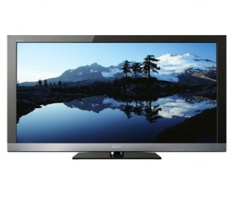



Currently Two Different Measurement Standards Exist By Platform With Each Focused On A Distinct Set Of Metrics
TV Platform
Digital Platforms
Nielsen
Reach %
Average Rating
Average Frequency
Impressions (actual audience)
Average Minutes
comScore / Nielsen
Unique Visitors / Viewers
Total Page Views
Visits
Video Views
Total Minutes
Buyers and sellers are hamstrung by these different measurement methods which is why each platform is typically analyzed separately even though the same brands and content are consumed across screens.

Slide 3
There’s A Need To Reconcile Digital Metrics With TV Measurement And Speak One Common Language To Level The Playing Field
Why? Because…
Digital
Television
Streams
Average Audience
(rating)
Unique Viewers
Average Audience
(rating)
Video / Page Views
Average Audience
(rating)
Global Stats
U.S. Audience
(universe)
First Party Unaudited Data
Third Party Audited Data

Slide 4
There’s Also A Need To Differentiate Between So-Called “Big” Numbers & Actual “Meaningful” Numbers Across Screens
Digital measurement, and making sense of what provides truly needle-moving scale, goes beyond just streams, video starts or page views.
There’s an array of different metrics & terminology that digital properties use to tout their “bigness”:
But just because a number looks big in a vacuum is it actually meaningful, especially when compared to a TV audience?
Views
Likes
Posts
Downloads
Pins
Swipes
Streams
Uploads
Calls
Rides
Tweets
Snaps
*Important to note, Global statistics are also typically used when digital metrics are quoted publicly

Slide 5
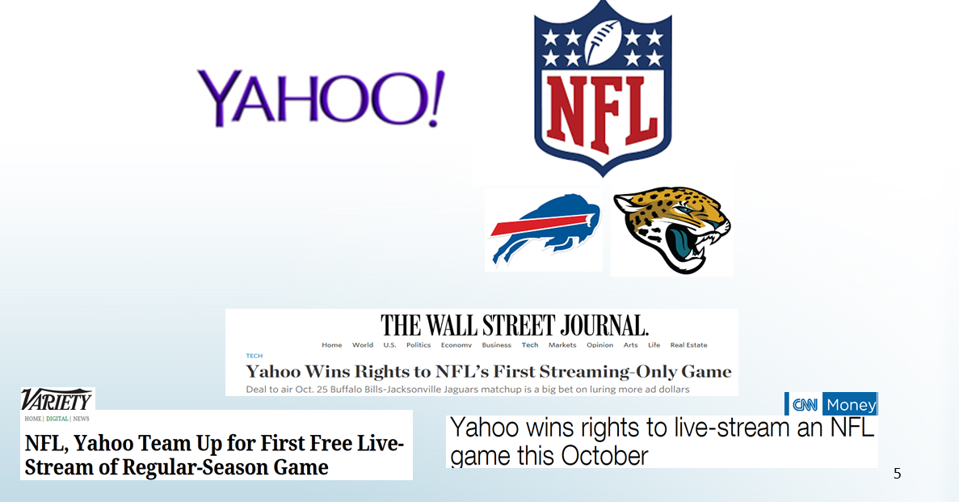
Case In Point, Yahoo’s Streaming Of An NFL Regular Season Game This Past Season
On October 25th, 2015 at 9:30a ET, Yahoo! made headline news by being the first website to ever live stream an NFL game across the world for free when the Buffalo Bills played the Jacksonville Jaguars

Slide 6
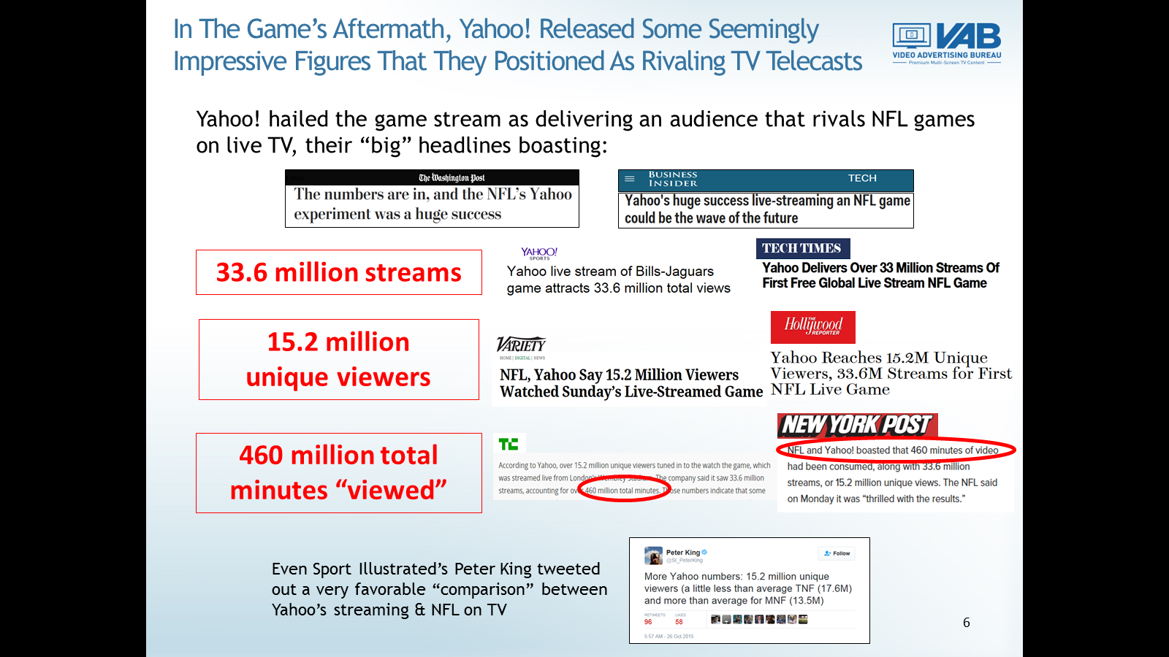
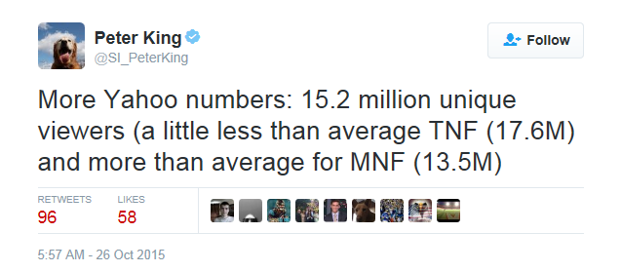
In The Game’s Aftermath, Yahoo! Released Some Seemingly Impressive Figures That They Positioned As Rivaling TV Telecasts
Yahoo! hailed the game stream as delivering an audience that rivals NFL games on live TV, their “big” headlines boasting:
33.6 million streams
15.2 million
unique viewers
460 million total minutes “viewed”
Even Sports Illustrated’s Peter King tweeted out a very favorable “comparison” between Yahoo’s streaming & NFL on TV

Slide 7
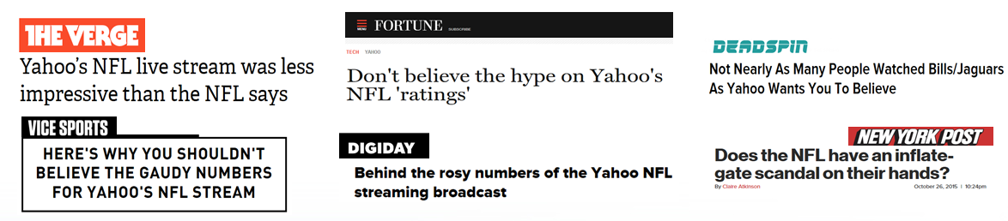
But A Deeper Dive Into The Numbers Told A Vastly Different Story;
A Much Less Impressive One For Yahoo!
Many in the press though called Yahoo! for a “false start” quickly after they published their streaming figures:
Why? Because when looking at key measurements within respective media:
Digital
Television
Streams
Average Audience
(rating)
Unique Viewers
Average Audience
(rating)
Global Stats
U.S. Audience

Slide 8
This Is The Multi-Screen Measurement Paradox:
Digital Metrics Do Not Equate To Television’s Average Ratings
Looking at the Yahoo! streaming figures through a similar lens as the standard TV measurement, average audience, the comparable results are much different:
Based on the “total minutes viewed” (# of streams is rather irrelevant) and length of the game (195 mins), the average streamer only watched for around 30 minutes which meant there was an average viewership per minute of 2.36 million
Since approximately 33% were outside of the country, this meant there was an:
average U.S. audience of approximately 1.64 million
In comparison, NFL telecasts on TV (afternoon & night games) have an:
average audience of 18.2 million viewers
While 460 million total minutes viewed may seem like a “big” number, the Yahoo! streamed game marked the lowest average audience ever for a nationally available NFL game (in fact, average NFL TV telecasts were 11x higher than the Yahoo! stream)
NFL On Yahoo! Streaming
NFL On TV
The Real Truth
Source for “NFL on TV” and comparison to Yahoo! streaming audience: Nielsen’s “Year in Sports Media Report” February 2015

Slide 9
“Leveling The Playing Field” With Common Metrics That Are Truly Comparable Across Screens
To create a singular language for comparison purposes, metrics commonly associated with only one type of content – such as video starts, page views or streams – need be set aside in favor of measurements that are equally applicable across media.
So what are these equally applicable measurements?
Unique Audience: the number of adults who view a given platform or piece of content during a specified time period (daily, weekly, monthly)
  We’d stress audience over reach % since a percentage can vary based on the universe
Average Time Spent Per Visitor / Viewer: the measure of time spent engaging with each platform or piece of content by person during a specified time period
Total Minutes Spent: the measure of total time spent engaging with each platform or piece of content by everyone who has engaged with it during a specified time period
Average Audience: the measure of adults engaging with each platform or piece of content in an average minute during a specified time period

Slide 10
“Average Audience” Is A Dynamic Comparable Metric To Utilize When Evaluating Media Across Screens
Average Audience is a formula that takes into consideration three critical measurements that are applicable across media – unique audience, average minutes viewed and total minutes.
Here’s the formula:
First Step:
X
Average Minutes Viewed/Per Visitor
Unique Audience
=
Total Minutes Viewed
Second Step:
/
Total Minutes Viewed
Total Minutes In Measured Time Period
(ex. 44,640 in a 31-day month)
=
Average Audience
In our analyses, “average audience” is factored based on a 24-hour day for digital properties since they’re “always on” and the average during the totality of time that a network or program is on the air
Not only does this metric take into account three interrelated measurements but it also provides a good snapshot of true scale on a platform or piece of content at any given time
  “Average audience” is also a very relevant metric from a time perspective since a large majority of video ads run between :15 - :60 long
*“Average Audience” is also a key metric used in the “How Long” section of Nielsen’s Quarterly Comparable Metrics Report

Slide 11
Any Given Minute:
By Platform / Device

Slide 12
ON ANY DEVICE:
Where Is The Audience In Any Given Minute?
“How Long”
A18+
PC
Smartphone
Tablet
Source: Nielsen Comparable Metrics Report Q3 2015; Data based on average week between July 17th – August 30th, 2015. A18+ UE = 240,160,000.
Video & Social Network is a subset of each device’s (App+Web)

Slide 13
TV’s Average Audience Among Millennials Far Surpasses Any Other Device
“How Long”
A18-34
PC
Smartphone
Tablet
Source: Nielsen Comparable Metrics Report Q3 2015; Data based on average week between July 17th – August 30th, 2015. A18-34 UE = 72,210,000.
Video & Social Network is a subset of each device’s (App+Web)

Slide 14
ALL EYES ON VIDEO:
Where Are People Watching Video During An Average Minute?
“How Long”
A18+
Source: Nielsen Comparable Metrics Report Q3 2015; Data based on average week between July 17th – August 30th, 2015. A18+ UE = 240,160,000

Slide 15
Among Adults 18-34, TV Accounts For 88% Of Total Video Consumption During An Average Minute
“How Long”
A18-34
Source: Nielsen Comparable Metrics Report Q3 2015; Data based on average week between July 17th – August 30th, 2015. A18-34 UE = 72,210,000

Slide 16





















Any Given Minute:
Multi-Screen TV Brands Vs. Ad-Tech Properties
Ad-Tech properties selection criteria: 20 popular websites / apps were selected by demo (A18+; A18-34) from within the “Top 100 Properties” (based on unique visitors) in comScore December 2015
Note: “average audience” for digital properties reflect any user activity on their website, not just video consumption, as measured by comScore

Slide 17
A18+ Average Audience (000) Comparison
Ad-Supported TV Brands Vs. Popular Websites
Multi-Screen TV Brands Deliver A Much Higher Average Audience During Any Given Minute Than 20 Popular Websites Combined
Digital Properties
Multiscreen (TV + online)
Source: comScore MediaMetrix Key Measures (multiplatform), December 2015; A18+. Nielsen R&F Program Report, Live + SD, Total Day. December 1-31, 2015; A18+. “Average Audience” is based on the average minute, which is factored across the full month for websites and TV. TV Brands include linear TV and TV-related websites. Digital website measurement includes all visitor activity, not just video consumption.

Slide 18
A18+ Average Audience (000) Comparison
Ad-Supported TV Brands Vs. Popular Websites
Multi-Screen TV Brands’ Average Audience Is Over Seven Times That Of The Largest Website, Facebook
Multiscreen (TV + online)
Source: comScore MediaMetrix Key Measures (multiplatform), December 2015; A18+. Nielsen R&F Program Report, Live + SD, Total Day. December 1-31, 2015; A18+. “Average Audience” is based on the average minute, which is factored across the full month for websites and TV. TV Brands include linear TV and TV-related websites. Digital website measurement includes all visitor activity, not just video consumption.

Slide 19
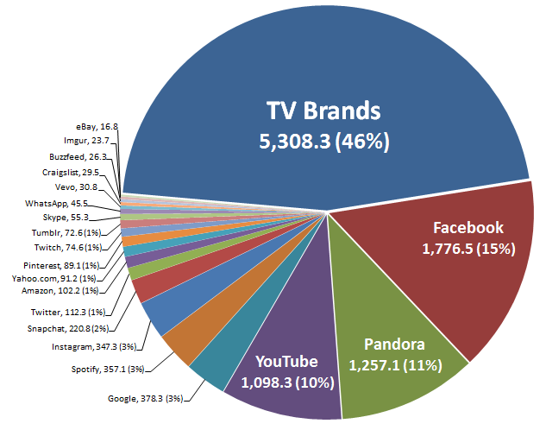
A18-34 Average Audience (000) Comparison
Ad-Supported TV Brands Vs. Popular Websites
Against Millennials, Multi-Screen TV Brands Deliver An Average Audience That’s On Par With 20 Popular Websites Combined
Multiscreen (TV + online)
Digital Properties
Source: comScore MediaMetrix Key Measures (multiplatform), December 2015; A18-34. Nielsen R&F Program Report, Live + SD, Total Day. December 1-31, 2015; A18-34. “Average Audience” is based on the average minute, which is factored across the full month for websites and TV. TV Brands include linear TV and TV-related websites. Digital website measurement includes all visitor activity, not just video consumption.

Slide 20
A18-34 Average Audience (000) Comparison
Ad-Supported TV Brands Vs. Popular Websites
THE MILLENNIAL MINUTE:
What Platforms Get The Millennial Audience At Any Given Moment?
Multiscreen (TV + online)
Source: comScore MediaMetrix Key Measures (multiplatform), December 2015; A18-34. Nielsen R&F Program Report, Live + SD, Total Day. December 1-31, 2015; A18-34. “Average Audience” is based on the average minute, which is factored across the full month for websites and TV. TV Brands include linear TV and TV-related websites. Digital website measurement includes all visitor activity, not just video consumption.

Slide 21
Any Given Minute:
Ad-Tech Properties Vs. TV Content

Slide 22
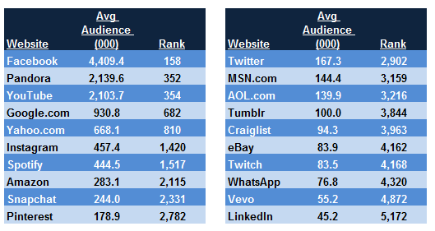
Where Would Top Websites Rank Among Ad-Supported TV Programs?
Based on A18+ Average Audience
Only One Ad-Tech Website Would Rank Within The Top 200 TV Programs On Average Audience
Source: comScore MediaMetrix Key Measures (multiplatform), December 2015; A18+. Nielsen Npower, Live + SD, Total Day. December 1-31, 2015; A18+.
“Average Audience” is based on the average minute, which is factored across the full month for websites and across program run time for TV.
Digital website measurement includes all visitor activity, not just video consumption.

Slide 23
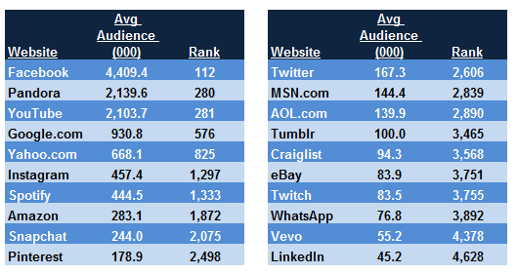
Where Would Top Websites Rank Among Ad-Supported TV Programs?
Based on A18+ Average Audience
The Results Are Similar Even When Sports Programs Are Excluded
Source: comScore MediaMetrix Key Measures (multiplatform), December 2015; A18+. Nielsen Npower, Live + SD, Total Day. December 1-31, 2015; A18+,
excluding sports. “Average Audience” is based on the average minute, which is factored across the full month for websites and across program run time for TV.
Digital website measurement includes all visitor activity, not just video consumption.

Slide 24
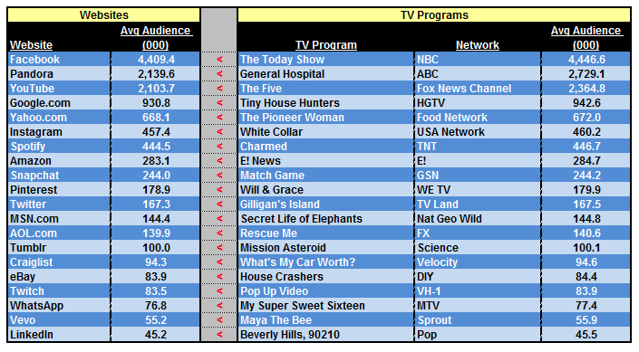
A18+ Average Audience Comparison
Popular Websites Vs. Comparable Ad-Supported TV Programs
PLATFORMS VS. PROGRAMS:
If Ad-Tech Platforms Were TV Programs, Where Would They Rank in Average Audience?
Source: comScore MediaMetrix Key Measures (multiplatform), December 2015; A18+. Nielsen Npower, Live + SD, Total Day. December 1-31, 2015; A18+.
“Average Audience” is based on the average minute, which is factored across the full month for websites and across program run time for TV.
Digital website measurement includes all visitor activity, not just video consumption.

Slide 25
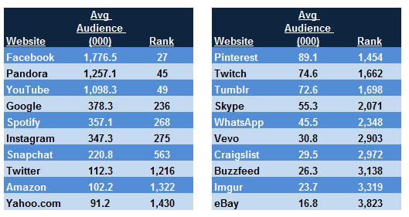
Where Would Top Websites Rank Among Ad-Supported TV Programs?
Based on A18-34 Average Audience
Only Three Of The Most Popular Younger-Skewing Websites Would Rank Within TV’s Top 200 Programs Against Millennials
Source: comScore MediaMetrix Key Measures (multiplatform), December 2015; A18-34. Nielsen Npower, Live + SD, Total Day. December 1-31, 2015; A18-34.
“Average Audience” is based on the average minute, which is factored across the full month for websites and across program run time for TV.
Digital website measurement includes all visitor activity, not just video consumption.

Slide 26
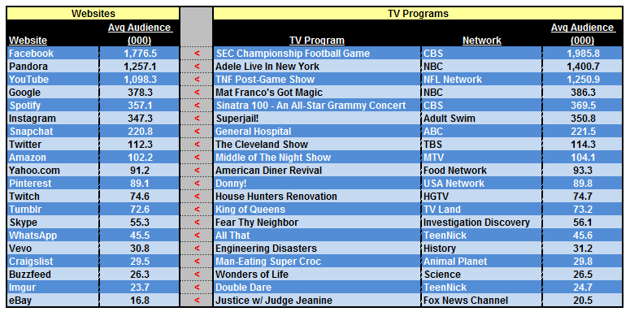
A18-34 Average Audience Comparison
Popular Websites Vs. Comparable Ad-Supported TV Programs
There Are Also Interesting Results When Popular “Millennial” Websites Are Compared To TV Shows With A Similar Young Audience
Source: comScore MediaMetrix Key Measures (multiplatform), December 2015; A18-34. Nielsen Npower, Live + SD, Total Day. December 1-31, 2015; A18-34.
“Average Audience” is based on the average minute, which is factored across the full month for websites and across program run time for TV.
Digital website measurement includes all visitor activity, not just video consumption.

Slide 27
Using Comparable Metrics To Dispel Myths:
Unique Audience, Average / Total Minutes Spent, Average Audience

Slide 28
Using Comparable Metrics Help Dispel Late Night TV Myths And Provide Proper Perspective And Context
Myth Example #1: YouTube draws larger audiences to their channels for content from popular late night hosts like Jimmy Fallon or Conan O’Brien than linear TV does
This myth is perpetuated by some people trying to compare YouTube’s unique visitors to TV’s average audience rating, but as we’ve explained: unique visitors average audience / rating
The Tonight Show Starring
Jimmy Fallon
Conan
Metric
Total Unique Visitors (000) / Cume Audience Reach (000)
Average Minutes / Viewer
Total Minutes Viewed (000)
Average Audience (000)
YouTube | Linear TV
6,843 | 50,452
16.7 | 64.8
114,252 | 3,269,398
2.6 | 3,360.7
YouTube | Linear TV
2,546 | 21,521
14.9 | 43.0
37,845 | 925,953
0.8 | 477.3
Fact: Far more people are more engaged for far more time with late night content on the Television while YouTube serves as a complementary platform for viral clips
Source: comScore Video Metrix Key Measures (desktop only), YouTube Partners Report, December 2015; A18+ (The Tonight Show Starring Jimmy Fallon @ YouTube / TeamCOCO @ YouTube). Nielsen Npower / R&F Program Report, Live + SD, December 1-31, 2015; A18+. “Average Audience” is based on the average minute, which is factored across the full month for YouTube and across program run time for TV.

Slide 29
Millennials Still Prefer To Consume Late Night TV Content Through The Television Than Online
Myth Example #1: YouTube draws much larger millennial audiences to their channels than linear TV for content from popular late night hosts like Jimmy Fallon or Conan O’Brien
This myth is perpetuated when some people try to compare YouTube’s unique visitors to TV’s average audience rating, but as we’ve explained: unique visitors average rating
The Tonight Show Starring
Jimmy Fallon
Conan
Metric
Total Unique Visitors (000) / Cume Audience Reach (000)
Average Minutes / Viewer
Total Minutes Viewed (000)
Average Audience (000)
YouTube | Linear TV
3,437 | 7,325
20.0 | 43.6
68,638 | 318,959
1.5 | 381.9
YouTube | Linear TV
1,499 | 5,212
17.6 | 52.9
26,319 | 275,651
0.6 | 146.8
Fact: Far more millennials are more engaged for far more time with late night content on the Television while YouTube serves as a complementary platform for viral clips
Source: comScore Video Metrix Key Measures (desktop only), YouTube Partners Report, December 2015; A18-34 (The Tonight Show Starring Jimmy Fallon @ YouTube / TeamCOCO @ YouTube). Nielsen Npower / R&F Program Report, Live + SD, December 1-31, 2015; A18-34. “Average Audience” is based on the average minute, which is factored across the full month for YouTube and across program run time for TV.

Slide 30
Using Comparable Metrics Also Help Dispel The Facebook Vs. Super Bowl Myth
Myth Example #2: “Facebook has a ‘Super Bowl’ on mobile everyday”
By the numbers:
Utilizing available comparable metrics for daily vs. program measurement
Metric
Average Audience (000)
Desktop: Average Audience (000)
Mobile: Average Audience (000)
Total Minutes Viewed (000)
Desktop: Total Minutes (000)
Mobile: Total Minutes (000)
Facebook (average day in Feb ‘16) | Super Bowl 50 (February 7th, 2016)
4,388.3 | 95,813.2
1,092.7 | N/A
3,295.7 | N/A
6,319,193 | 18,151,306
1,573,430 | N/A
4,745,763 | N/A
Fact: Total “time spent” viewing last year’s Super Bowl was almost four times higher than time spent on Facebook mobile and almost three times that of total Facebook consumption
Source: comScore Media Metrix Key Measures (multiplatform), February 2016 A18+. Nielsen Npower / R&F Program Report, Live + SD, February 7th, 2016; A18+. “Average Audience” represents the average minute audience which is factored across the full month for Facebook and across program run time for TV. Facebook daily “time spent” metrics are estimated based on VAB’s “average audience” analysis of comScore February 2016 data.

Slide 31
The Facebook Vs. Super Bowl Myth Is Even Busted Amongst Millennials
Myth Example #2: “Facebook has a ‘Super Bowl’ on mobile everyday”
By the numbers:
Utilizing available comparable metrics for daily vs. program measurement
Metric
Average Audience (000)
Desktop: Average Audience (000)
Mobile: Average Audience (000)
Total Minutes Viewed (000)
Desktop: Total Minutes (000)
Mobile: Total Minutes (000)
Facebook (average day in Feb ‘16) | Super Bowl 50 (February 7th, 2016)
1,624.7 | 22,685.4
270.4 | N/A
1,354.2 | N/A
2,500,841 | 3,510,606
416,273 | N/A
2,084,568 | N/A
Fact: Total “time spent” viewing last year’s Super Bowl among millennials was 68% higher than time spent on Facebook mobile and 40% higher than Facebook consumption
Source: comScore Media Metrix Key Measures (multiplatform), February 2016; A18-34. Nielsen Npower / R&F Program Report, Live + SD, February 7th, 2016; A18-34. “Average Audience” represents the average minute audience which is factored across the full month for Facebook and across program run time for TV. Facebook daily “time spent” metrics are estimated based on VAB’s “average audience” analysis of comScore February 2016 data.

Slide 32
Using Comparable Metrics Also Help Dispel BuzzFeed’s Notion That Their Reach Rivals Television
Myth Example #3: BuzzFeed’s reach now rivals that of the largest TV networks
By the numbers:
Metric
Total Unique Visitors (000) / Cume Audience Reach (000)
Average Minutes / Visitor
Total Minutes Viewed (000)
Average Audience (000)
BuzzFeed | Rank Vs. TV Networks
80,442 | #26
20.5 | Last*
1,651,406 | #108
37.0 | #114
Fact: Not only would BuzzFeed not break the top #25 on reach among TV networks but it would also be one of the lowest-ranked properties on average audience and against “time spent” metrics
Source: comScore Media Metrix Key Measures (multiplatform), December 2015; P2+. Nielsen Npower / R&F Program Report, Live + SD, December 1-31, 2015; P2+. “Average Audience” is based on the average minute, which is factored across the full month for Buzzfeed and TV networks.
*Last among the 124 Nielsen-measured TV networks

Slide 33


For More Information Visit Us Online TheVAB.com
Follow us: @VideoAdBureau
Like us: facebook.com/VideoAdvertisingBureau

