Slide 1

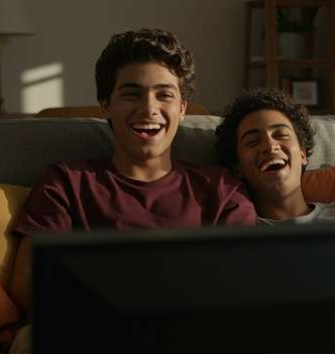



Free For All
Understanding The Growth of FAST Through Three Key Questions

Slide 2


FAST is transforming the streaming landscape and capturing audiences at scale
Free ad-supported streaming TV (FAST) has rapidly grown from
its early nascency into one of the most dynamic platforms in streaming, attracting viewers with no fees and minimal barriers to entry. Today, over one third of the U.S. population is tuning in and engagement continues to climb each year as audiences spend more time with these services.
When we first examined the category in 2022, FAST was only beginning to capture attention. Since then, it has matured into a mainstream viewing destination. Audiences are drawn to a wide mix of programming - from popular entertainment to live content like sports and news - that keep them coming back habitually.
This updated report answers three key questions, revealing today’s FAST landscape, the content fueling engagement and the viewers that are leading advertisers to increase their investment each year in these services and channels.
This information is exclusively provided to VAB members and qualified marketers
PAGE 2

Slide 3



In this report, we will answer three key questions around FAST’s rise, the content that resonates and why the audience matters to brands
1
2
3
How is FAST transforming the way people stream TV?
What kind of content is fueling audience engagement?
Why are FAST viewers an attractive audience to advertisers?
This information is exclusively provided to VAB members and qualified marketers
PAGE 3

Slide 4


FAST is rapidly scaling as a free, ad-supported streaming option, driving strong growth in audience, usage and time spent
1
2
3
How is FAST transforming the way people stream TV?
What kind of content is fueling audience engagement?
Why are FAST viewers an attractive audience to advertisers?
This information is exclusively provided to VAB members and qualified marketers
PAGE 4

Slide 5

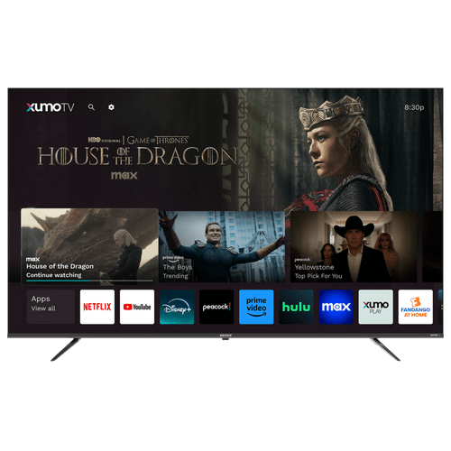
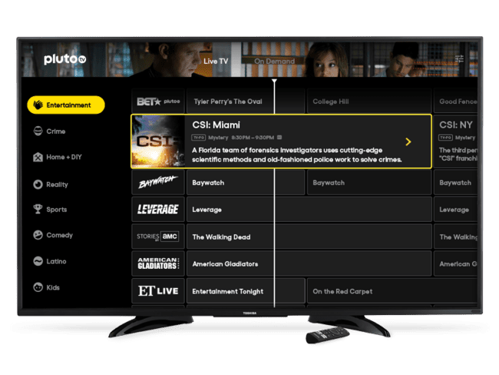



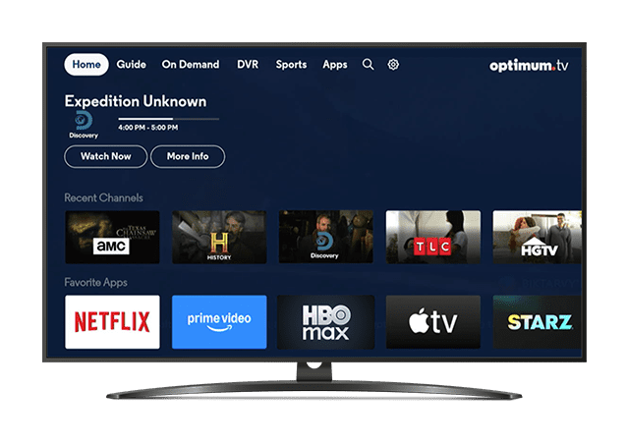
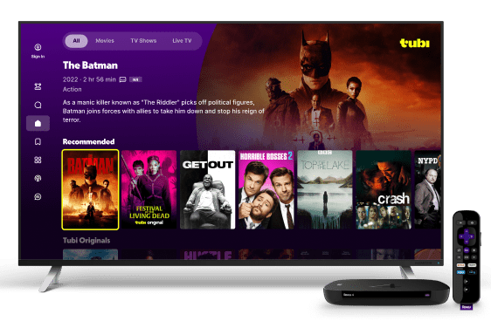
FAST delivers free, ad-supported TV that combines live channels with on-demand flexibility in a fully digital experience
Free ad-supported streaming TV (FAST) services are among the most accessible viewing options, available across connected TVs, mobile devices and desktops. Typically, no log-in is required, though some platforms may ask viewers to download an app or sign in.
FAST combines the lean-back experience of live, scheduled channels with the flexibility of on-demand libraries, allowing viewers to watch linear-style programming or select content on their own terms.
Its defining value is bringing together both live and on-demand viewing in a single ad-supported environment that feels as familiar as traditional TV
yet is fully digital and broadband-delivered.
Note: Above screenshots reflect a sampling of FAST service interfaces.
This information is exclusively provided to VAB members and qualified marketers
PAGE 5

Slide 6
With many on-demand and paid services available, FAST offers a free, frictionless viewing experience that complements other video platforms
SVOD w/o Ads
SVOD w/ Ads
FAST
vMVPD
Traditional TV
MVPD VOD
Option to stream either live linear channels or on-demand content
Option to
stream either
live feeds of linear channels or on-demand content
Watch live or time-shifted content through an MVPD or antenna
Viewing Experience
On-Demand vs. Live Scheduled Programming
Stream content on-demand
on viewer’s schedule
Stream content on-demand
on viewer’s schedule
Watch content on-demand on viewer’s schedule through an MVPD
Ad Experience
Ad-Free vs. Ad-supported
Ad-supported
(‘limited ad’ options also available)
Ad-free
Ad-supported
Ad-supported
Ad-supported
Ad-supported
Some services are free &
ad-supported, while others are offered as part of a SVOD / AVOD hybrid service at a lower cost with limited ads
Paid MVPD subscription or free channels through
Over-the-Air (OTA) access
Free to watch in exchange for viewing ads
(Log-ins are available but
not necessary)
Business Model
Paid vs. Free
Paid monthly or annual subscription
Paid monthly or annual subscription
Paid MVPD subscription
Note: SVOD refers to ‘subscription video-on-demand’. MVPD (Multichannel Video Programming Distributor) reflects a cable, telco, or satellite provider. vMVPD refers to Virtual Multichannel Video Programming Distributors.
This information is exclusively provided to VAB members and qualified marketers
PAGE 6

Slide 7


























The FAST ecosystem is growing as major players scale up and independents carve out unique niches
Sampling of FAST Services Currently Available in the U.S.
Media Company-Owned FAST Services
(Paramount)
(Comcast)
(Fox Corp.)
(TelevisaUnivision)
(Altice)
(E. W. Scripps Company)
(NBCU / Warner Bros. Discovery)
(Trooh Media)
(The Weather Group LLC)
(Dish)
(Canela Media)
(Kartoon Studios)
(Thinking Media)
Device / OEM-Owned FAST Services
(Roku)
(LG)
(Samsung)
(Vizio)
(Xperi)
Independent FAST Services
Download our 4-part series from 2022, The FAST and the Curious, to see what the ecosystem looked like a few years ago.
This information is exclusively provided to VAB members and qualified marketers
PAGE 7

Slide 8

Almost five hundred more channels have become available over the last two years, offering viewers greater choice and content variety
+57%
Increase in number of available FAST channels since mid-2023, with 1,318 channels available in the U.S
(vs. 837 channels in 2023)
Source: VAB analysis of Gracenote Data Hub, August 2025.
This information is exclusively provided to VAB members and qualified marketers
PAGE 8

Slide 9
Over a third of the population – more than 100 million U.S. viewers - now watch FAST, with growth projected to continue through 2026
U.S. FAST Viewers
In Millions
% of U.S. pop
30%
32%
33%
35%
36%
Source: EMARKETER, Over a Third of the Population Will Be Watching FAST This Year, March 2025. Note: individuals of any age who watch videos or stream TV via app or website at least once per month on a free-to-access ad-supported platform that primarily offers professionally produced content; examples include Pluto TV, The Roku Channel, and Tubi; excludes all subscription OTT services, Twitch and YouTube. Download Staying Current on Streaming: The Latest on Connected TV Consumer Behaviors to get more insights on streaming trends & behaviors.
This information is exclusively provided to VAB members and qualified marketers
PAGE 9

Slide 10



Viewers are spending considerably more time watching FAST channels, an increase of more than 50% over the last few years
FAST accounts for 8% of daily time spent with digital video, up from 6% three years ago
+54%
increase in time spent with FAST between 2022 & 2025
(0:13 vs. 0:20 average time spent per day)
Source: EMARKETER Forecast, U.S. Average Time Spent Per day with Free Ad-Supported Streaming TV (FAST), June 2025. Note: Ages 18+; includes all time spent watching video on FAST platforms via any device; FAST platforms are free-to-access ad-supported platforms that primarily offer professionally produced content; examples include Pluto TV, The Roku Channel, and Tubi; excludes all subscription OTT services, Twitch, and YouTube; includes time spent watching ad-supported video-on-demand (AVOD) on FAST platforms. Download Staying Current on Streaming: The Latest on Connected TV Consumer Behaviors to get more insights on streaming trends & behaviors.
This information is exclusively provided to VAB members and qualified marketers
PAGE 10

Slide 11

The growth of FAST is outpacing other premium streaming platforms like vMVPDs and SVODs
Growth in U.S. App Usage on Devices Using Streaming Platform Apps
March ‘23 vs. March ‘25
FAST
(Free Ad-Supported Streaming TV)
vMVPD
(Virtual Multichannel Video Programming Distributor)
SVOD
(Subscription Video On Demand)
+109%
+50%
+34%
Source: LG Ad Solutions, The Big Shift 2025. LG Ad Solutions Device Data, 2025. Based on March 2025 survey of 1,133 U.S. CTV Viewers. All respondents were U.S. adults with an internet-connected TV (CTV).
This information is exclusively provided to VAB members and qualified marketers
PAGE 11

Slide 12


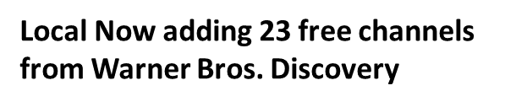


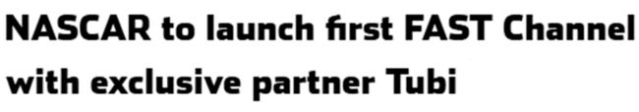
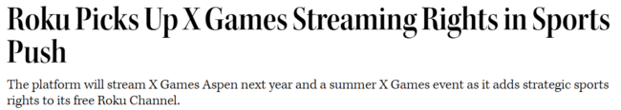


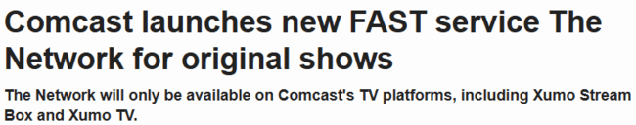
Partnerships and live programming are reshaping FAST as audiences grow, with more sports and marquee events still to come
6/25/2025
9/30/2025
1/16/2025
8/18/2025
12/18/2024
5/28/2025
9/18/2024
2/14/2025
This information is exclusively provided to VAB members and qualified marketers
PAGE 12

Slide 13

FAST is a go-to for entertainment, sports, and news, driving strong engagement from younger audiences
1
2
3
How is FAST transforming the way people stream TV?
What kind of content is fueling audience engagement?
Why are FAST viewers an attractive audience to advertisers?
This information is exclusively provided to VAB members and qualified marketers
PAGE 13

Slide 14





FAST viewers are drawn to streaming by a mix of fresh originals and nostalgic favorites, with access to series and movies both new and old
‘What drives you to want to use a new streaming service?’
% of FAST viewers (top 5 ranked)
65%
61%
44%
32%
29%
Access to original series / movies exclusive to service
Access to movies
(old and new)
Access to series that no longer air on traditional
TV networks
(e.g., Friends, How I Met Your Mother,
Friday Night Lights, etc.)
Access to series that are currently airing on traditional TV networks
(e.g., The Walking Dead, The Good Place, This Is Us, etc.)
Access to documentary / informational programming
Source: VAB analysis of MRI-Simmons 2025 August Cord Evolution Study, A18+. FAST viewers (44% of A18+ streaming population) include respondents who have watched the following services in the past 30 days: LG Channels, Local Now App, Plex, Pluto TV, Roku Channel, Samsung TV Plus, Tubi, Vizio WatchFree+, Xumo Play.
This information is exclusively provided to VAB members and qualified marketers
PAGE 14

Slide 15











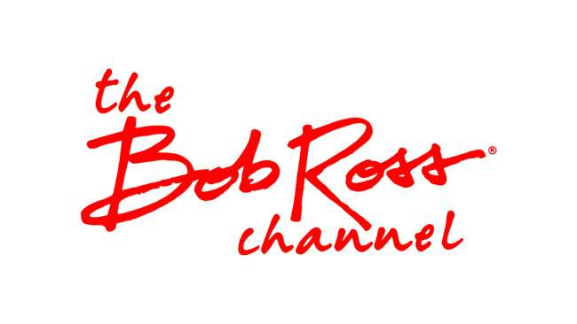





FAST offers services with a wide mix of content libraries and live programs, with sports and news emerging as key drivers of engagement
Sampling of the Types of Content That Can Be Watched on FAST Services
Bingeable Shows
Hit series, reality TV and crime favorites people love to rewatch
Breaking News
24/7 live updates from trusted national and local sources
Live Sports
Games, highlights and league channels that keep fans coming back
Movies On Demand
Free films across every genre refreshed with new titles all the time
Live Specials & Events
Award shows, concerts and real-time cultural moments
Niche Genre Channels
Curated content for passionate fan bases across unique interests
This information is exclusively provided to VAB members and qualified marketers
PAGE 15

Slide 16
Entertainment tops FAST in channel and program counts, with news and sports also heavily represented
News content made up 9.9% of FAST programming in 3Q 2025, a more than 2% increase from 7.8% in the prior quarter*
Source: Gracenote, Beyond Nostalgia, March 2025. Gracenote Global Video Data, February 2025. *Cablefax, Free Channels Rising as Cordless News Destination, 9/16/25.
This information is exclusively provided to VAB members and qualified marketers
PAGE 16

Slide 17






FAST is becoming a destination for live content that viewers desire from streaming platforms, especially sports, music and news
Types of live events that most influence viewing habits across free and paid streaming platforms
% of respondents
56%
46%
45%
Major Sports Leagues
(i.e., NBA, Premier League)
Concerts
News Updates
27%
24%
17%
Awards Shows
Minor Sports
(i.e., High School, Olympic Sports, etc.)
Talk Shows
Source: Amagi, Global FAST Report, August 2025. N = 500+ U.S. households comprising diverse income groups.
This information is exclusively provided to VAB members and qualified marketers
PAGE 17

Slide 18
Live content resonates most with younger audiences, who are turning to FAST for easy access to TV without the commitment to traditional pay-TV
Usage of FAST Services to Watch Live Content
Among TV Content Viewers Who Watch Live TV
40%
of A18+ TV content viewers watch live content on FAST services
Source: Horowitz Research, State of Media, Entertainment & Tech, 2025.
This information is exclusively provided to VAB members and qualified marketers
PAGE 18

Slide 19

“Live content is becoming a defining feature of FAST, not just in sports but across genres that benefit from real-time engagement. What we’re seeing now is a shift in how audiences consume free streaming — they’re not just browsing channels but tuning in for moments that matter.
As the FAST ecosystem matures, platforms and content providers can build more dynamic, event-driven programming strategies that are aimed at driving loyalty and monetization.”
Srinivasan KA, Director & President, Global Business of Amagi
NRF Press Release, 4/2/2025
This information is exclusively provided to VAB members and qualified marketers
PAGE 19

Slide 20


Viewers are spending more time with individual FAST channels, signaling stronger engagement, less channel surfing and greater ad opportunities
+25%
growth in average channel session duration — the amount of time viewers spend watching
a single channel before switching —
over the past year
Source: Wurl, The CTV Trends Report: Advertiser Edition, 2025.
This information is exclusively provided to VAB members and qualified marketers
PAGE 20

Slide 21




At the same time, viewers continue to explore more broadly, sampling an average of nine channels across a mix of genres, TV series and news
Breakdown of FAST Consumption by Channel Type
% of respondents who use Free AVOD / FAST to watch live TV channels
9
average number of
FAST channels watched
(vs. 5 in 2024)
Genre channels that air shows fitting a theme, like crime, reality, westerns, etc.
Binge channels that air the same show all day*
News channels
Source: TiVo, Video Trends Report Q2 2025. *e.g., Star Trek, Baywatch, Hell's Kitchen, etc.
This information is exclusively provided to VAB members and qualified marketers
PAGE 21

Slide 22
FAST services offer a greater mix of fresh programming content and feature a larger share of more recent titles than SVOD platforms
Share of Available Video Content by Production Years
SVOD vs. FAST
Source: Gracenote as cited in a company blog, March 31, 2025. Note: includes TV shows and movies; SVOD includes Amazon Prime Video, Netflix, Disney+ / Hulu, Paramount+, and Apple TV+; numbers do not add up to 100% due to rounding read as 13.9% of all content available on FAST services was produced before 1990.
This information is exclusively provided to VAB members and qualified marketers
PAGE 22

Slide 23
FAST attracts a highly engaged and increasingly younger, more affluent audience that is receptive to positive ad experiences
1
2
3
How is FAST transforming the way people stream TV?
What kind of content is fueling audience engagement?
Why are FAST viewers an attractive audience to advertisers?
This information is exclusively provided to VAB members and qualified marketers
PAGE 23

Slide 24



FAST viewers are engaging audiences who spend significant time with TV content, with a strong preference for live programming like sports
% of FAST viewers who agree with the following statements
85%
62%
61%
say they love streaming TV shows
say they like to stream
live sports
say they love to watch live TV
Source: VAB analysis of MRI-Simmons 2025 August Cord Evolution Study, A18+. FAST viewers (42% of A18+ streaming population) include respondents who have watched the following services in the past 30 days: LG Channels, Local Now App, Plex, Pluto TV, Roku Channel, Samsung TV Plus, Tubi, Vizio WatchFree+, Xumo Play. Reflects respondents who answered ‘somewhat agree’ or ‘strongly agree.
This information is exclusively provided to VAB members and qualified marketers
PAGE 24

Slide 25
The median household income of FAST viewers has increased by 12% over the last three years
FAST Viewer Household Income
2022
2025
HHI $100K+: 39%
HHI $100K+: 44%
FAST Viewer Median HHI: $79K
FAST Viewer Median HHI: $89K
Source: VAB analysis of MRI-Simmons 2022 and 2025 August Cord Evolution Study, A18+. 2025 FAST viewers (42% of A18+ streaming population) include respondents who have watched the following services in the past 30 days: LG Channels, Local Now App, Plex, Pluto TV, Roku Channel, Samsung TV Plus, Tubi, Vizio WatchFree+, Xumo Play.
This information is exclusively provided to VAB members and qualified marketers
PAGE 25

Slide 26
The FAST audience has also gotten slightly younger as household incomes have increased
FAST Viewer Age Summary
2022
2025
A18-34:
31%
vs. A18+: 29%
A18-34:
32%
vs. A18+: 29%
FAST Viewer Median Age: 45.4
FAST Viewer Median Age: 44.2
Source: VAB analysis of MRI-Simmons 2022 and 2025 August Cord Evolution Study, A18+. 2025 FAST viewers (42% of A18+ streaming population) include respondents who have watched the following services in the past 30 days: LG Channels, Local Now App, Plex, Pluto TV, Roku Channel, Samsung TV Plus, Tubi, Vizio WatchFree+, Xumo Play.
This information is exclusively provided to VAB members and qualified marketers
PAGE 26

Slide 27

Most FAST viewers are cord cutters or cord nevers who are seeking a cable-like experience without the commitment - but with the ads
61% of FAST viewers are ‘cord cutters’ or ‘cord nevers’
Source: VAB analysis of MRI-Simmons 2025 August Cord Evolution Study, A18+. 2025 FAST viewers (42% of A18+ streaming population) include respondents who have watched the following services in the past 30 days: LG Channels, Local Now App, Plex, Pluto TV, Roku Channel, Samsung TV Plus, Tubi, Vizio WatchFree+, Xumo Play.
This information is exclusively provided to VAB members and qualified marketers
PAGE 27

Slide 28
FAST viewers rate ads more favorably, thanks to a steady nine-minute ad load that balances monetization with a positive viewing experience
Average Commercial Minutes Per Hour on FAST*
54%
of FAST viewers feel that the platforms handle ads / promotions better than other providers
(vs. 3% who answered ‘worse’)
Source: Hub Entertainment Research, Fast and Curious: Why Viewers Are Embracing Free TV, January 2025.. Base: TV Source Watched and Assigned – Show Included Ads or Promotions. FAST Respondents – n = 732. Q: Think about the way ads or promotions were handled during this show – the number of ads, how long the ad breaks were, how relevant the ads or promotions were for you personally, etc. Overall, would you say that the way ads were handled was….. Reflects respondents who answered ‘a lot better’ or ‘a little better’. Other ‘providers’: AVOD, vMVPD, and MVPD. *Wurl Analytics, The CTV Trends Report 2024. Note: Based on data across Wurl’s partnerships with more than 4,000 FAST channels and streaming services.
This information is exclusively provided to VAB members and qualified marketers
PAGE 28

Slide 29
FAST ad revenue has doubled since 2021 and is set to keep growing, signaling its rising adoption as an ad platform in the streaming ecosystem
Free Ad-Supported Streaming TV (FAST) U.S. Revenue
In Billions
+101%
vs. 2021
Source: S&P Global Market Intelligence Kagan estimates; industry data; company data. Data compiled December 2024.
This information is exclusively provided to VAB members and qualified marketers
PAGE 29

Slide 30

“FAST channels are reshaping the streaming landscape, and their rapid growth proves what we already know - consumers love free. The real opportunity for advertisers is with premium FAST services that deliver trusted, brand-safe content at scale and keep viewers highly engaged.”
Daniel Spinosa, President, Premion
This information is exclusively provided to VAB members and qualified marketers
PAGE 30

Slide 31

FAST is reshaping streaming with free quality content, engaged viewers and strong advertiser appeal
1
2
3
How is FAST transforming the way people stream TV?
What kind of content is fueling audience engagement?
Why are FAST viewers an attractive audience to advertisers?
Viewers are embracing quality content without the paywall, which now includes more sports, live events and other marquee programming
The ecosystem is rapidly expanding with more channels and players
FAST is emerging as a hub for live and on-demand entertainment, like sports and news
Viewers are watching
longer and exploring more channels that feature fresh, new content
FAST viewers are deeply engaged younger audiences with growing household incomes
FAST’s appeal is fueling rapid revenue growth and making it a key player in the streaming ad market
This information is exclusively provided to VAB members and qualified marketers
PAGE 31

Slide 32

Adults over 50 account for 36% of the total population and nearly half of all adults
FAST has grown from nascency to mainstream, becoming a central part of the streaming ecosystem with free ad-supported access across live and on-demand programming at scale
As FAST continues to expand, viewers are spending more time with services and individual channels, creating more ad opportunities across a wide mix of entertainment, sports and news programming
FAST viewers represent a valuable and growing younger audience, defined by steady engagement, rising household income and an openness to ads
For marketers, FAST delivers scale and momentum, with growing content and advertising investment and an outlook of sustained growth into the future
Key Marketer Takeaways
This information is exclusively provided to VAB members and qualified marketers
PAGE 32

Slide 33
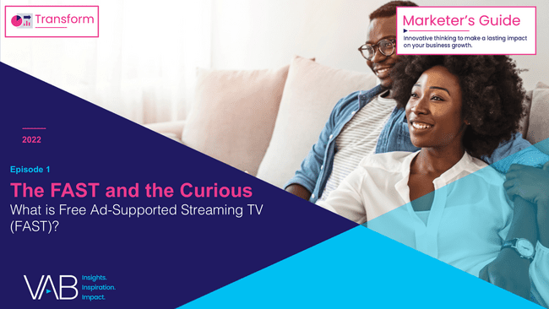
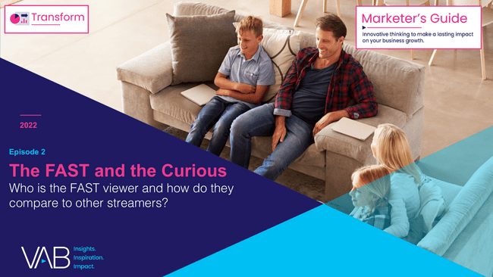
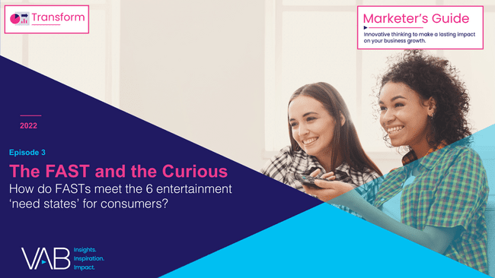
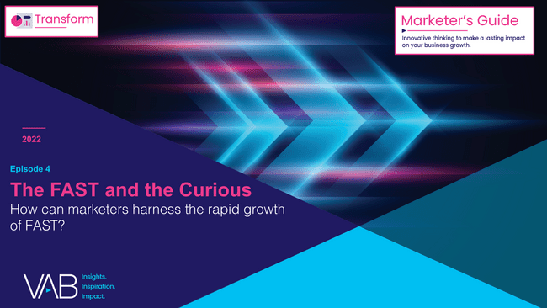
Revisit our original series to understand where the market stood in 2022 to understand the progress FAST has made over the last three years
Click report covers above to download
This information is exclusively provided to VAB members and qualified marketers
PAGE 33

Slide 34
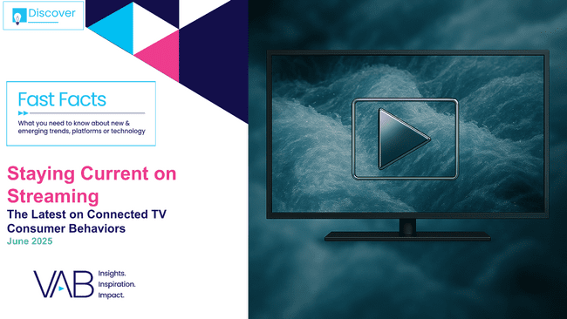
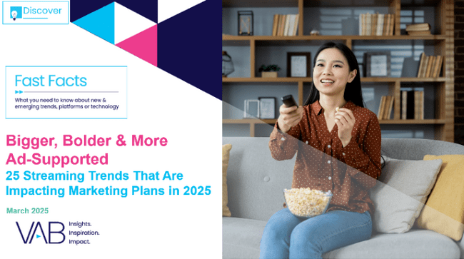
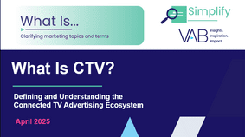

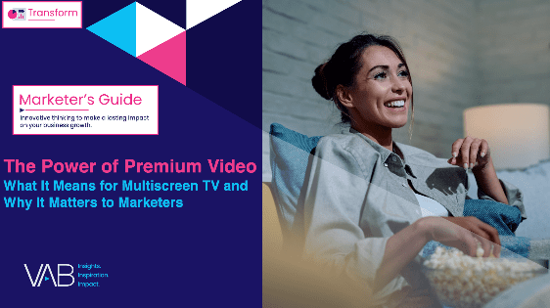
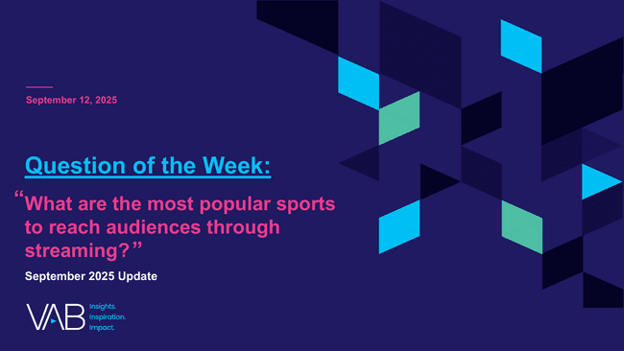

Creators
Jason Wiese
Leah Montner-Dixon
EVP, Strategic Insights & Measurement
jasonw@thevab.com
Director, Audience & Behavioral Insights
leahm@thevab.com
Staying Current on Streaming
The Latest on Connected TV Consumer Behaviors – June 2025
Bigger, Bolder & More Ad-Supported
25 Streaming Trends That Are Impacting
Marketing Plans in 2025
Discover more
Looking for more data, insights and takeaways? Check out this related VAB content
Visit our Streaming Video Resources Hub
for the latest consumption stats, trends and advertising opportunities.
What Is CTV?
Defining and Understanding the Connected TV Advertising Ecosystem
The Rise of Shoppable TV
Bringing Commerce and Premium Video Together
The Power of Premium Video
What It Means for Multiscreen TV
and Why It Matters to Marketers
What are the most popular sports to reach audiences through streaming?
This information is exclusively provided to VAB members and qualified marketers
PAGE 34

Slide 35


About VAB
VAB plays a dual role in the video advertising industry. We are leading the change to bring about a more innovative and transparent marketplace. We also provide the insights and thought leadership that enables marketers to develop business-driving marketing strategies.
Drawing on our marketing expertise, we simplify the complexities in our industry and discover new insights that transform the way marketers look at their media strategy.
We are committed to your business growth and proud to offer VAB members, brand marketers and agencies complimentary access to our continuously-growing Insights library. Get immediate access at theVAB.com.
This information is exclusively provided to VAB members and qualified marketers
PAGE 35

