Slide 1


December 2025
Anonymized Look
on How Currency Vendors See
Key Audiences

Slide 2
(Anonymized) Comparative Looks at
How Three “Big Data” Currency Vendors See Crucial Audiences
Three Vendors on HH & P25-54 Trends:
You will see TWO are in very tight agreement, and one is a negative outlier (particularly on P25-54)
Age Composition Analytics of THREE Vendors on P55+ & P25-54 Trends:
You will see TWO are in much tighter range, while one is a divergent outlier (very heavy P55+)
This information is exclusively provided to VAB members and qualified marketers
PAGE 2

Slide 3
What Having Multiple Big Data Currency Options Might Look Like:
Broadcast + Cable, All Genres, All Languages
2025 vs. 2023
2023
2024
2025
“Vendor A”
HH Audience
# (000)
24,290
22,864
20,279
-4,011
# Diff +/-
-1,426
-2,585
% Diff +/-
-5.9%
-11.3%
-16.5%
2023
2024
2025
P25-54 Aud.
# (000)
7,505
6,539
5,446
-2,059
# Diff +/-
-964
-1,093
% Diff +/-
-12.9%
-16.7%
-27.4%
This information is exclusively provided to VAB members and qualified marketers
PAGE 3

Slide 4
What Having Multiple Big Data Currency Options Might Look Like:
Broadcast + Cable, All Genres, All Languages
2025 vs. 2023
2023
2024
2025
“Vendor B”
HH Audience
# (000)
29,424
27,897
27,223
-2,201
# Diff +/-
-1,527
-647
% Diff +/-
-5.2%
-2.4%
-7.5%
2023
2024
2025
P25-54 Aud.
# (000)
13,191
11,646
10,843
-2,348
# Diff +/-
-1,545
-803
% Diff +/-
-11.7%
-6.9%
-17.8%
54
This information is exclusively provided to VAB members and qualified marketers
PAGE 4

Slide 5
What Having Multiple Big Data Currency Options Might Look Like:
Broadcast + Cable, All Genres, All Languages
2025 vs. 2023
2023
2024
2025
“Vendor C”
HH Audience
# (000)
29,007
27,223
26,245
-2,762
# Diff +/-
-1,784
-978
% Diff +/-
-6.2%
-3.6%
-9.5%
2023
2024
2025
P25-54 Aud.
# (000)
14,193
12,826
11,930
-2,263
# Diff +/-
-1,367
-896
% Diff +/-
-9.6%
-7.0%
-15.9%
This information is exclusively provided to VAB members and qualified marketers
PAGE 5

Slide 6
What Having Multiple Big Data Currency Options Might Look Like:
Cable Only, All Genres, All Languages
2025 vs. 2023
2023
2024
2025
“Vendor A”
HH Audience
# (000)
14,475
13,183
11,216
-3,259
# Diff +/-
-1,292
-1,967
% Diff +/-
-8.9%
-14.9%
-22.5%
2023
2024
2025
P25-54 Aud.
# (000)
4,808
4,021
3,168
-1,640
# Diff +/-
-787
-853
% Diff +/-
-16.4%
-21.2%
-34.1%
This information is exclusively provided to VAB members and qualified marketers
PAGE 6

Slide 7
What Having Multiple Big Data Currency Options Might Look Like:
Cable Only, All Genres, All Languages
2025 vs. 2023
2023
2024
2025
“Vendor B”
HH Audience
# (000)
15,912
14,626
13,603
-2,309
# Diff +/-
-1,286
-1,023
% Diff +/-
-8.1%
-7.0%
-14.5%
2023
2024
2025
P25-54 Aud.
# (000)
7,041
6,129
5,396
-1,645
# Diff +/-
-912
-773
% Diff +/-
-12.9%
-12.0%
-23.4%
This information is exclusively provided to VAB members and qualified marketers
PAGE 7

Slide 8
What Having Multiple Big Data Currency Options Might Look Like:
Cable Only, All Genres, All Languages
2025 vs. 2023
2023
2024
2025
“Vendor C”
HH Audience
# (000)
13,652
12,619
11,796
-1,856
# Diff +/-
-1,033
-823
% Diff +/-
-7.6%
-6.5%
-13.6%
2023
2024
2025
P25-54 Aud.
# (000)
6,685
6,020
5,293
-1,393
# Diff +/-
-665
-727
% Diff +/-
-10.0%
-12.1%
-20.8%
This information is exclusively provided to VAB members and qualified marketers
PAGE 8

Slide 9
What Having Multiple Big Data Currency Options Might Look Like:
Broadcast Only, All Genres, All Languages
2025 vs. 2023
2023
2024
2025
“Vendor A”
HH Audience
# (000)
9,815
9,681
9,063
-752
# Diff +/-
-134
-618
% Diff +/-
-1.4%
-6.4%
-7.7%
2023
2024
2025
P25-54 Aud.
# (000)
2,695
2,518
2,278
-417
# Diff +/-
-177
-240
% Diff +/-
-6.6%
-9.5%
-15.5%
This information is exclusively provided to VAB members and qualified marketers
PAGE 9

Slide 10
What Having Multiple Big Data Currency Options Might Look Like:
Broadcast Only, All Genres, All Languages
2025 vs. 2023
2023
2024
2025
“Vendor B”
HH Audience
# (000)
13,489
13,277
13,622
+132
# Diff +/-
-212
+344
% Diff +/-
-1.6%
+2.6
+1.0%
2023
2024
2025
P25-54 Aud.
# (000)
6,136
5,524
5,449
-688
# Diff +/-
-612
-75
% Diff +/-
-10.0%
-1.4%
-11.2%
This information is exclusively provided to VAB members and qualified marketers
PAGE 10

Slide 11
What Having Multiple Big Data Currency Options Might Look Like:
Broadcast Only, All Genres, All Languages
2025 vs. 2023
2023
2024
2025
“Vendor C”
HH Audience
# (000)
15,355
14,604
14,449
-907
# Diff +/-
-751
-156
% Diff +/-
-4.9%
-1.1%
-5.9%
2023
2024
2025
P25-54 Aud.
# (000)
7,507
6,806
6,637
-870
# Diff +/-
-702
-168
% Diff +/-
-9.3%
-2.5%
-11.6%
This information is exclusively provided to VAB members and qualified marketers
PAGE 11

Slide 12
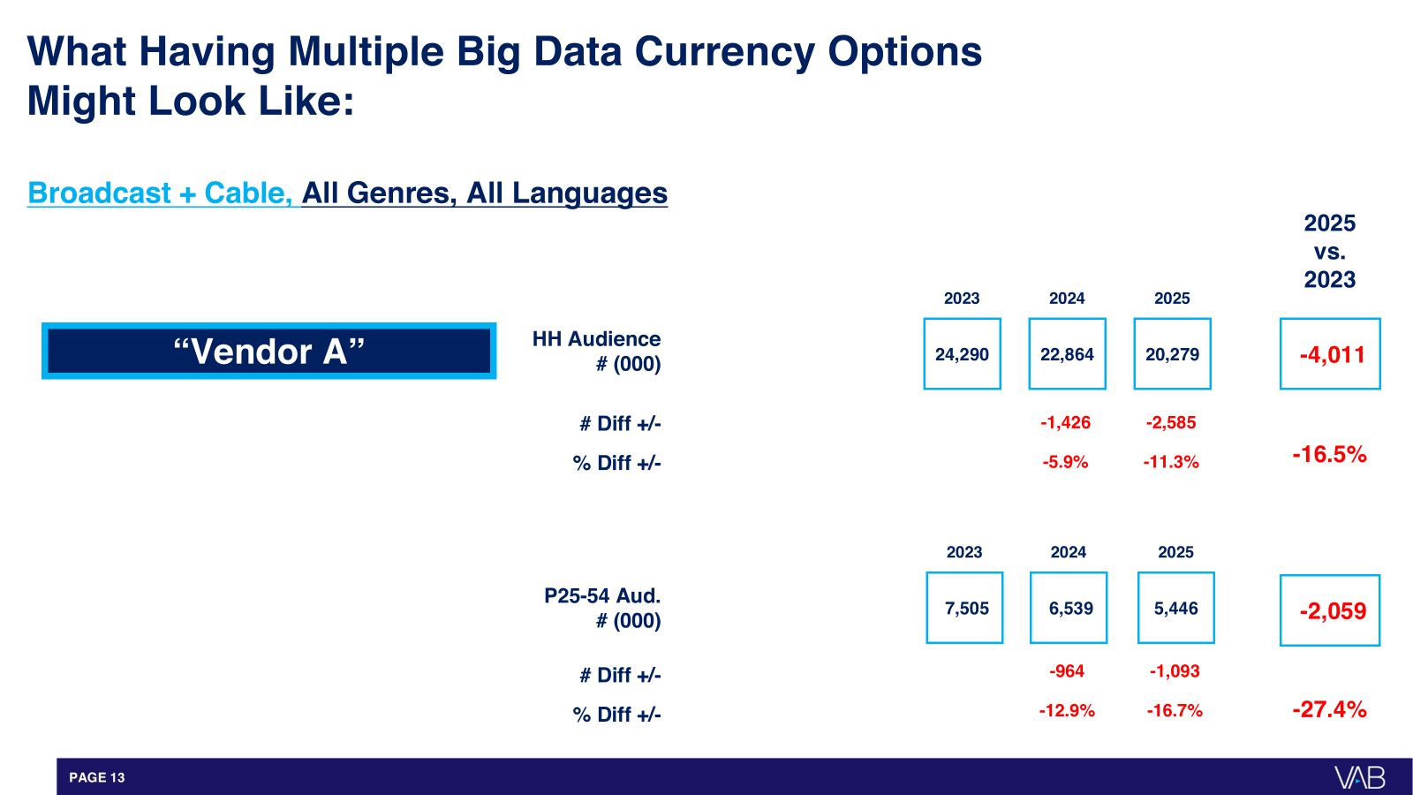


A Powerful 2025 Story - Three Anonymized Vendors on 25-54
There were always two in pretty tight agreement - and one severe negative outlier:
Vendors B&C
Within:
B&C Avg. % Higher
Versus A:
2025 Cable-Only (P25-54):
1.9%
+67%
2025 Broadcast + Cable (P25-54):
9%
+106%
2025 Broadcast-Only (P25-54):
18%
+158%
This information is exclusively provided to VAB members and qualified marketers
PAGE 12
PAGE 4

Slide 13
“Vendor C”: All Ad Supported Networks - Monthly Trend
“Vendor C”: All Ad Supported Networks – Monthly Trend: January 2023 - June 2025
Audience Comp Based on Persons Level Demo Data/HH
Source: Anonymized Big Data Age Comps, January 2023 – June 2025, P25-54 & P55+.
This information is exclusively provided to VAB members and qualified marketers
PAGE 13

Slide 14
“Vendor B”: All Ad Supported Networks - Monthly Trend
“Vendor B”: All Ad Supported Networks – Monthly Trend: January 2023 - June 2025
Audience Comp Based on Persons Level Demo Data/HH
Source: Anonymized Big Data Age Comps, January 2023 – June 2025, P25-54 & P55+.
This information is exclusively provided to VAB members and qualified marketers
PAGE 14

Slide 15
“Vendor A”: All Ad Supported Networks - Monthly Trend
“Vendor A”: All Ad Supported Networks – Monthly Trend: January 2023 - June 2025
Audience Comp Based on Persons Level Demo Data/HH
Source: Anonymized Big Data Age Comps, January 2023 – June 2025, P25-54 & P55+.
This information is exclusively provided to VAB members and qualified marketers
PAGE 15

Slide 16
“Vendor C”: Ad Supported Cable Networks - Monthly Trend
“Vendor C”: Ad Supported Cable Networks – Monthly Trend: January 2023 - June 2025
Audience Comp Based on Persons Level Demo Data/HH
Source: Anonymized Big Data Age Comps, January 2023 – June 2025, P25-54 & P55+.
This information is exclusively provided to VAB members and qualified marketers
PAGE 16

Slide 17
“Vendor B”: Ad Supported Cable Networks - Monthly Trend
“Vendor B”: Ad Supported Cable Networks – Monthly Trend: January 2023 - June 2025
Audience Comp Based on Persons Level Demo Data/HH
Source: Anonymized Big Data Age Comps, January 2023 – June 2025, P25-54 & P55+.
This information is exclusively provided to VAB members and qualified marketers
PAGE 17

Slide 18
“Vendor A”: Ad Supported Cable Networks - Monthly Trend
“Vendor A”: Ad Supported Cable Networks – Monthly Trend: January 2023 - June 2025
Audience Comp Based on Persons Level Demo Data/HH
Source: Anonymized Big Data Age Comps, January 2023 – June 2025, P25-54 & P55+.
This information is exclusively provided to VAB members and qualified marketers
PAGE 18

Slide 19
“Vendor C”: Broadcast Networks - Monthly Trend
“Vendor C”: Broadcast Networks – Monthly Trend: January 2023 - June 2025
Audience Comp Based on Persons Level Demo Data/HH
Source: Anonymized Big Data Age Comps, January 2023 – June 2025, P25-54 & P55+.
This information is exclusively provided to VAB members and qualified marketers
PAGE 19

Slide 20
“Vendor B”: Broadcast Networks - Monthly Trend
“Vendor B”: Broadcast Networks – Monthly Trend: January 2023 - June 2025
Audience Comp Based on Persons Level Demo Data/HH
Source: Anonymized Big Data Age Comps, January 2023 – June 2025, P25-54 & P55+.
This information is exclusively provided to VAB members and qualified marketers
PAGE 20

Slide 21
“Vendor A”: Broadcast Networks - Monthly Trend
“Vendor A”: Broadcast Networks – Monthly Trend: January 2023 - June 2025
Audience Comp Based on Persons Level Demo Data/HH
Source: Anonymized Big Data Age Comps, January 2023 – June 2025, P25-54 & P55+.
This information is exclusively provided to VAB members and qualified marketers
PAGE 21

Slide 22
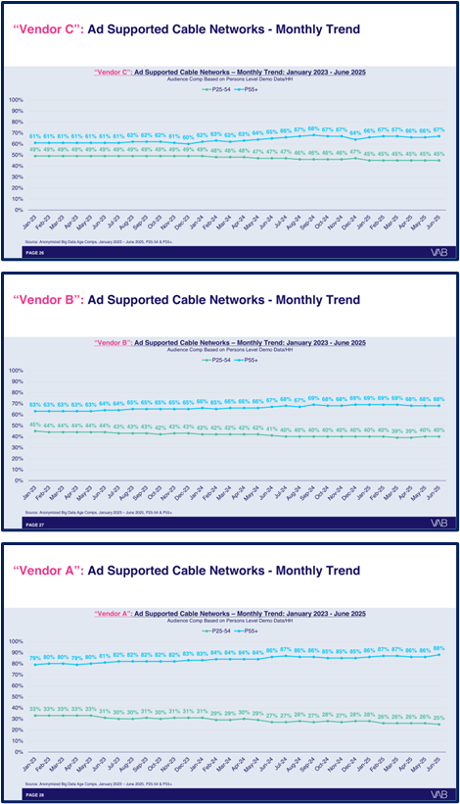
The Clear “Why” - Three Anonymized Vendors on Age Comp
There were two in pretty good alignment - and one older outlier:
Avg. B&C
25-54 / 55+:
Vendor A
25-54 / 55+:
2025 Cable-Only:
42% / 67%
25% / 88%
2025 Broadcast + Cable:
42% / 70%
24% / 89%
2025 Broadcast-Only:
41% / 73%
23% / 91%
This reveals a major dis-connect on age composition
This information is exclusively provided to VAB members and qualified marketers
PAGE 22
PAGE 4

Slide 23
(Anonymized) Comparative Looks at
How Three “Big Data” Currency Vendors See Crucial Audiences
Three Vendors on HH & P25-54 Trends:
You will see TWO are in very tight agreement, and one is a negative outlier (particularly on P25-54)
Age Composition Analytics of THREE Vendors on P55+ & P25-54 Trends:
You will see TWO are in much tighter range, while one is a divergent outlier (very heavy P55+)
This information is exclusively provided to VAB members and qualified marketers
PAGE 23

Slide 24

Click here to download recent report
on audience measurement
This information is exclusively provided to VAB members and qualified marketers
PAGE 24

