Slide 1

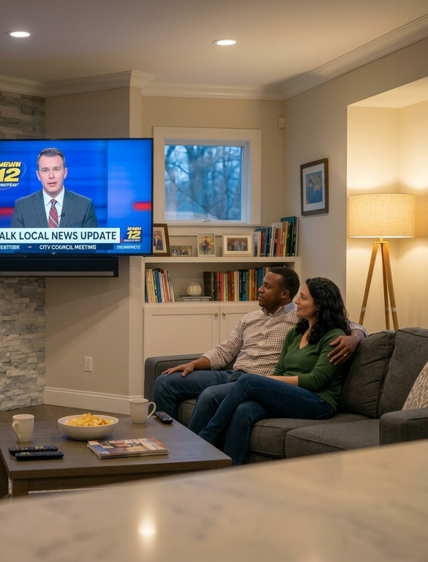


And That’s The Way It Is
How TV News Provides Scale, Attention & Engagement For High-Value Audiences

Slide 2
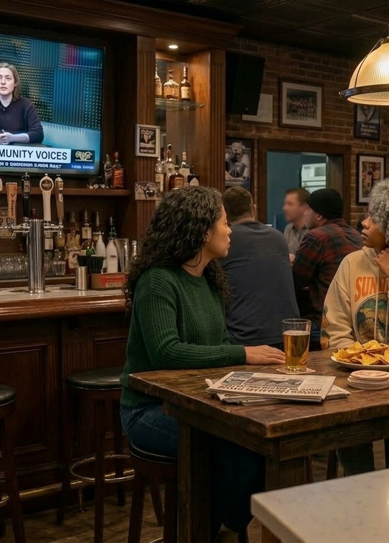

Multiscreen TV news plays a central role in keeping influential audiences informed
From breaking headlines and defining political moments to local community updates, multiscreen TV news keeps high-value audiences connected to the stories shaping their world. In a media environment filled with misinformation and noise, it continues to stand out for its reliability, quality, accuracy and integrity.
Based on a custom survey VAB conducted in partnership with Dynata,
our first guide explored the behaviors and attitudes of people across the spectrum of political involvement and party affiliation. This latest report explores perceptions and viewership of TV news versus other media platforms among three key audiences that are valued by advertisers
for their buying power and influence: adults 35-54, $100K+ household income and full-time employed.
The results underscore the value of multiscreen TV news as a credible, brand safe platform for reaching influential audiences at scale, especially in comparison with social platforms and technologies like AI. Across ad-supported linear and streaming, multiscreen TV news also
offers advertisers an outcomes-driven environment that pairs trust
and attention with meaningful consumer engagement.
See appendix for greater details behind the custom study methodology and make-up of the 2,319 A18+ U.S. respondents. Survey fielded in December 2025.
This information is exclusively provided to VAB members and qualified marketers.
PAGE 2

Slide 3



We examined behaviors and sentiments among high-value audience segments to understand the role TV news plays in their lives
Three Key Groups Examined in This Analysis
Adults 35-54
Household Income $100K+
Employed Full-Time
Source: Dynata, Media Consumption and Political Sentiment survey, fielded December 2025 (n=2,319). Survey base: A18+ U.S. respondents. A35-54 respondents (n=766), Household Income $100K+ respondents (n=420), Employment Status – Full Time respondents (n=826).
This information is exclusively provided to VAB members and qualified marketers.
PAGE 3

Slide 4

1
TV news provides clear value through timely, useful and credible information, standing out for its everyday relevance and positive impact for advertisers

Slide 5
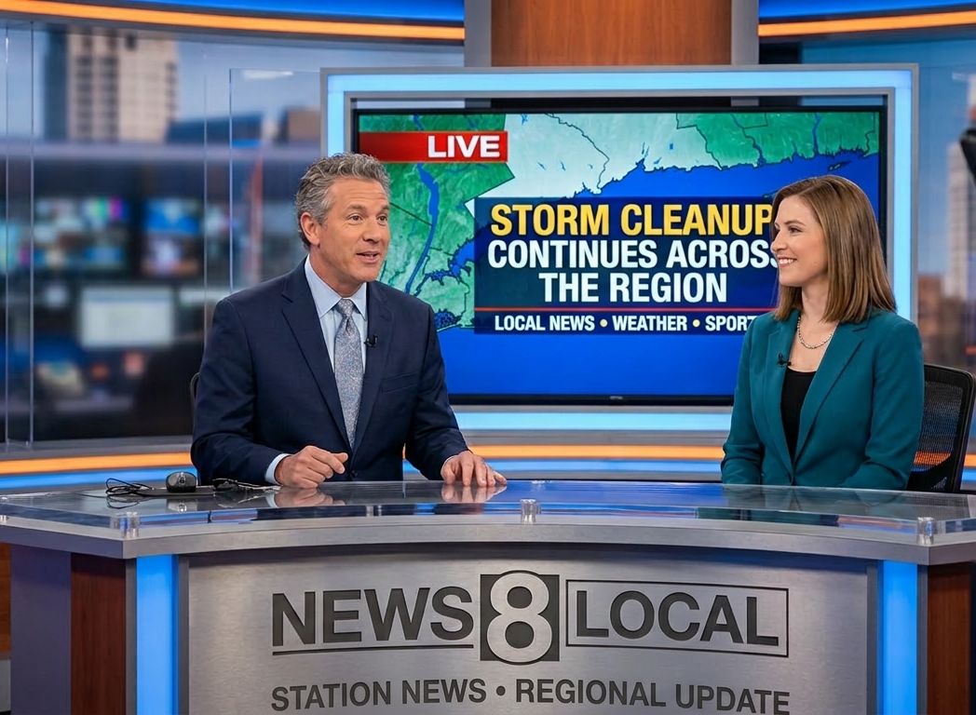

Watching TV news – both local and national – is a habitual behavior for many in high-value audience segments
% of respondents who watch local TV news in a typical week
% of respondents who watch national TV news in a typical week
54%
of A35-54
64%
of HHI $100K+
57%
of Full-Time Employed
45%
of A35-54
62%
of HHI $100K+
51%
of Full-Time Employed
Source: Dynata, Media Consumption and Political Sentiment survey, fielded December 2025 (n=2,319). Survey base: A18+ U.S. respondents. Q3. In a typical week, which of the following do you watch on TV? Base = TV Respondents. A35-54 respondents (n=672), Household Income $100K+ respondents (n=387), Employment Status – Full Time respondents (n=740).
This information is exclusively provided to VAB members and qualified marketers.
PAGE 5

Slide 6
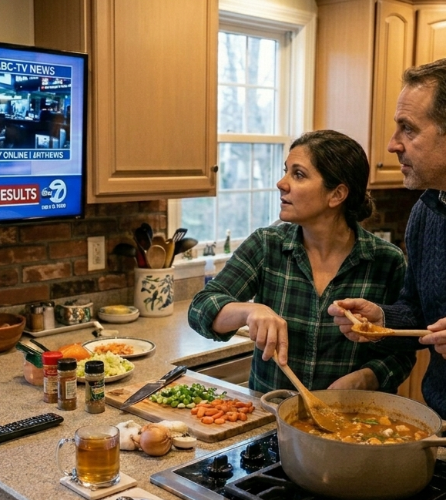
About half of these high-value audience cohorts say they’re watching more TV news, which highlights its growing importance in their daily lives
Even 58% of adults 18-34 are watching more TV news, highlighting how important credibility in news is important for all generations
% of respondents who are watching more TV news now vs. last year
52%
of A35-54
46%
of HHI $100K+
56%
of Full-Time Employed
Source: Dynata, Media Consumption and Political Sentiment survey, fielded December 2025 (n=2,319). Survey base: A18+ U.S. respondents. Q9. Please rate your agreement with the following statements [Top 2 Box – ‘Agree’, ‘Strongly Agree’]. Base = All News Respondents. A18-34 respondents (n=301), A35-54 respondents (n=422), Household Income $100K+ respondents (n=298), Employment Status – Full Time respondents (n=492).
This information is exclusively provided to VAB members and qualified marketers.
PAGE 6

Slide 7

Staying informed on current events is the #1 reason people tune in, which speaks to the immediacy and engagement of TV news
% of respondents who say the main reason they watch news on TV is to stay informed about current events
43%
of A35-54
43%
of HHI $100K+
41%
of Full-Time Employed
Source: Dynata, Media Consumption and Political Sentiment survey, fielded December 2025 (n=2,319). Survey base: A18+ U.S. respondents. Q5. What is the main reason you watch news on TV? Base = All News Respondents. A35-54 respondents (n=766), Household Income $100K+ respondents (n=420), Employment Status – Full Time respondents (n=740). Respondents could select any media.
This information is exclusively provided to VAB members and qualified marketers.
PAGE 7

Slide 8
High-Value audiences particularly appreciate TV news as a timely, relevant source for breaking news and local community information
% of respondents who are satisfied with the following…
Speed of breaking news coverage on TV
Information about my community from local TV news
Source: Dynata, Media Consumption and Political Sentiment survey, fielded December 2025 (n=2,319). Survey base: A18+ U.S. respondents. Q10. Please indicate your overall level of satisfaction with the following. Reflects respondents who answered ‘satisfied’ or ‘very satisfied’ & ‘dissatisfied’ or ‘very dissatisfied.’ Base = All News Respondents. A35-54 respondents (n=422), Household Income $100K+ respondents (n=298), Employment Status – Full Time respondents (n=492).
This information is exclusively provided to VAB members and qualified marketers.
PAGE 8

Slide 9
In fact, they’re much more likely to go to TV news first over social media for breaking news coverage and updates on major news stories
% of respondents who go to the following media first for the following
Breaking News
Quick Updates on a Major Story
Source: Dynata, Media Consumption and Political Sentiment survey, fielded December 2025 (n=2,319). Survey base: A18+ U.S. respondents. Q8. Where do you go first for the following information? Base = All News Respondents.
A35-54 respondents (n=422), Household Income $100K+ respondents (n=298), Employment Status – Full Time respondents (n=492).
This information is exclusively provided to VAB members and qualified marketers.
PAGE 9

Slide 10
TV news is also their top source by far for vital information that personally impacts their daily lives, like weather and traffic
% of respondents who go to the following media first for the following
Weather Forecast
Traffic Updates
Source: Dynata, Media Consumption and Political Sentiment survey, fielded December 2025 (n=2,319). Survey base: A18+ U.S. respondents. Q8. Where do you go first for the following information? Base = All News Respondents.
A35-54 respondents (n=422), Household Income $100K+ respondents (n=298), Employment Status – Full Time respondents (n=492).
This information is exclusively provided to VAB members and qualified marketers.
PAGE 10

Slide 11
This everyday relevance extends across a broader mix of local news topics like sports, human interest stories, elections and investigative reporting
% of respondents who watch the following segments on their local news channels
55% of A18-34
51% of A18-34
42% of A18-34
40% of A18-34
Source: Dynata, Media Consumption and Political Sentiment survey, fielded December 2025 (n=2,319). Survey base: A18+ U.S. respondents. Q7. Do you watch any of the following segments on your local news channels? Base = All News Respondents. A35-54 respondents (n=766), Household Income $100K+ respondents (n=420), Employment Status – Full Time respondents (n=740). *e.g. community events, human interest stories, etc. **e.g. entertainment, health & wellness, etc.
This information is exclusively provided to VAB members and qualified marketers.
PAGE 11

Slide 12
Local TV news provides perspective, positive community connection, relevancy and credibility that resonates with high-value audiences
% of respondents who agree with the following statements about local TV news
Source: Dynata, Media Consumption and Political Sentiment survey, fielded December 2025 (n=2,319). Survey base: A18+ U.S. respondents. Q9. Please rate your agreement with the following statements [Top 2 Box – ‘Agree’, ‘Strongly Agree’]. Base = All News Respondents. A35-54 respondents (n=422), Household Income $100K+ respondents (n=298), Employment Status – Full Time respondents (n=492).
This information is exclusively provided to VAB members and qualified marketers.
PAGE 12

Slide 13

Credibility creates a halo effect for brands, as viewers are more than twice as likely to have a higher opinion of the advertisers in local TV news
This positive halo effect extends to younger adults as well, with 47% of A18-34 expressing a more favorable view of advertisers in local TV news
% of respondents who have a better opinion of brands that advertise during local TV news
Source: Dynata, Media Consumption and Political Sentiment survey, fielded December 2025 (n=2,319). Survey base: A18+ U.S. respondents. Q9. Please rate your agreement with the following statements [Top 2 Box – ‘Agree’, ‘Strongly Agree’ vs. Bottom 2 Box – ‘Disagree’, ‘Strongly Disagree’]. Base = All News Respondents. A18-34 respondents (n=301), A35-54 respondents (n=422), Household Income $100K+ respondents (n=298), Employment Status – Full Time respondents (n=492).
This information is exclusively provided to VAB members and qualified marketers.
PAGE 13

Slide 14
Having a better opinion of an advertiser enhances brand reputation and drives a higher likelihood of purchase intent within TV news environments
High-income households and employed viewers are more than 2x more likely than not to buy from advertisers seen during national TV news
% who say ads shown in the following would make them either ‘more likely’ or ‘less likely’ to purchase
Following a breaking news story on my local TV news channel
During national TV news
31% of A18-34 are more likely to purchase a product advertised following a breaking news story on their local TV news channel
(vs. 25% who are less likely to purchase)
28% of A18-34 are more likely to purchase a product advertised during national TV news
(vs. 22% who are less likely to purchase)
Source: Dynata, Media Consumption and Political Sentiment survey, fielded December 2025 (n=2,319). Survey base: A18+ U.S. respondents. Q35. Would any of the following impact your willingness to purchase a product or service after seeing an ad? Base = Ad Exposed Respondents. A18-34 respondents (n=493), A35-54 respondents (n=524), Household Income $100K+ respondents (n=306), Employment Status – Full Time respondents (n=594).
This information is exclusively provided to VAB members and qualified marketers.
PAGE 14

Slide 15
2
At a time when audiences are navigating more noise and information uncertainty, TV news stands out for its trust, balance and credibility

Slide 16
TV news earns strong appreciation for its unbiased perspective among high-value audiences
Among adults 18-34, 51% value the neutral approach of TV news programs (vs. 20% who are dissatisfied)
% of respondents who are satisfied with the following…
Unbiased perspective in TV news reports
Source: Dynata, Media Consumption and Political Sentiment survey, fielded December 2025 (n=2,319). Survey base: A18+ U.S. respondents. Q10. Please indicate your overall level of satisfaction with the following. Reflects respondents who answered ‘satisfied’ or ‘very satisfied’ & ‘dissatisfied’ or ‘very dissatisfied.’ Base = All News Respondents. A18-34 respondents (n=301), A35-54 respondents (n=422), Household Income $100K+ respondents (n=298), Employment Status – Full Time respondents (n=492).
This information is exclusively provided to VAB members and qualified marketers.
PAGE 16

Slide 17
Strong viewer satisfaction on accuracy and reporting quality reinforces TV news as a trusted journalistic resource
% of respondents who are satisfied with the following…
Accuracy of TV news reports
Quality of journalism / reporting on TV news
66% of A18-34
64% of A18-34
Source: Dynata, Media Consumption and Political Sentiment survey, fielded December 2025 (n=2,319). Survey base: A18+ U.S. respondents. Q10. Please indicate your overall level of satisfaction with the following. Reflects respondents who answered ‘satisfied’ or ‘very satisfied’ & ‘dissatisfied’ or ‘very dissatisfied.’ Base = All News Respondents. A35-54 respondents (n=422), Household Income $100K+ respondents (n=298), Employment Status – Full Time respondents (n=492).
This information is exclusively provided to VAB members and qualified marketers.
PAGE 17

Slide 18
In fact, TV is the most trusted news source as both local and national TV far outpaces search, social media and AI across these audiences
Collectively, households with an income of $100K+ are almost 13x more likely to trust TV news than social media platforms
% of respondents who trust the following media sources the most
69%
75%
71%
Source: Dynata, Media Consumption and Political Sentiment survey, fielded December 2025 (n=2,319). Survey base: A18+ U.S. respondents. Q11. Please rank your level of trust with information from the following sources. Based on respondents who ranked media #1 = ‘I trust this source the most’. Base = All News Respondents. A35-54 respondents (n=422), Household Income $100K+ respondents (n=298), Employment Status – Full Time respondents (n=492).
This information is exclusively provided to VAB members and qualified marketers.
PAGE 18

Slide 19
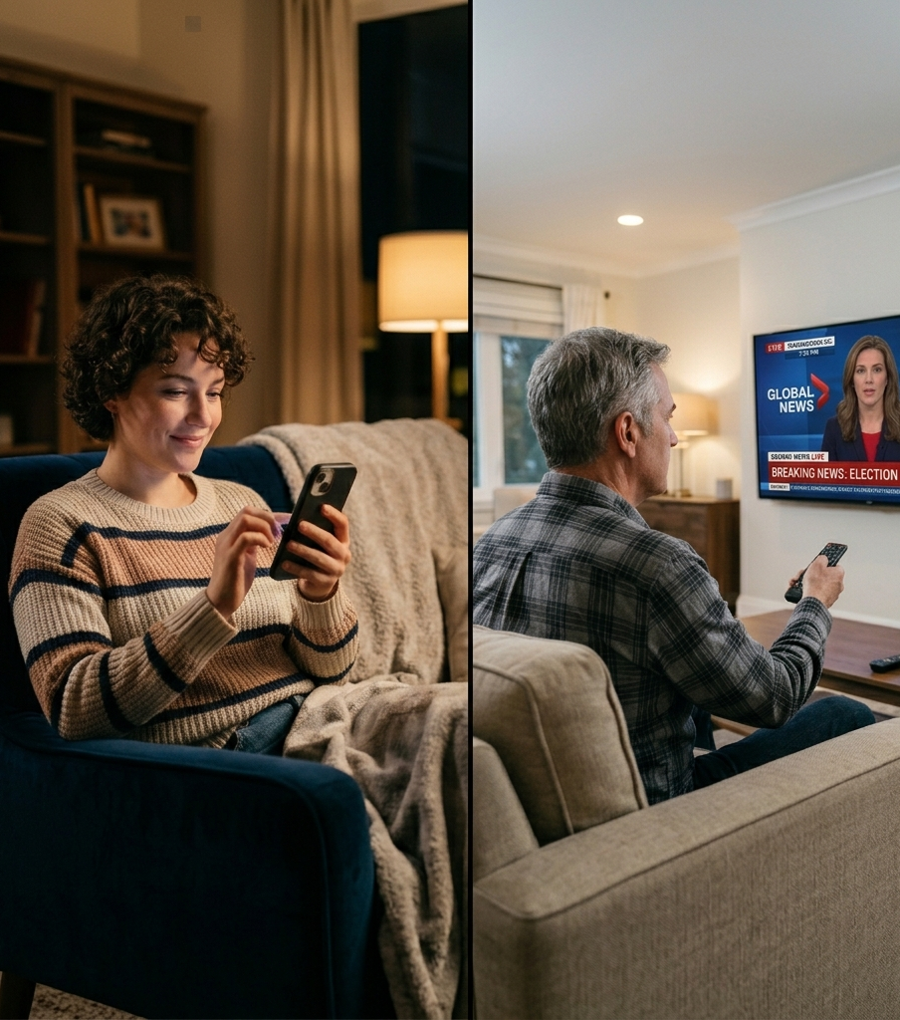
TV news is more likely to be seen as providing positive representations of moderate and bipartisan views compared to social media
% more likely to feel TV news offers positive representations
of moderate or bipartisan views vs. social media*
A35-54
HHI $100K+
Full-Time Employed
+20%
more likely
(34% vs. 29%)
+42%
more likely
(40% vs. 29%)
+15%
more likely
(38% vs. 33%)
Source: Dynata, Media Consumption and Political Sentiment survey, fielded December 2025 (n=2,319). Survey base: A18+ U.S. respondents. Q29. How would you rate the representation of moderate or bipartisan views in the following media? Based on respondents who selected ‘excellent’ or ‘good’ [Top 2 Box]. Base = Total Respondents. A35-54 respondents (n=766), Household Income $100K+ respondents (n=420), Employment Status – Full Time respondents (n=826). *Social media posts on platforms such as Instagram, Facebook.
This information is exclusively provided to VAB members and qualified marketers.
PAGE 19

Slide 20
Conversely, social media is seen as a far greater source of fake or misleading information, underscoring TV’s much stronger credibility
Adults 18-34 also see a clear credibility gap, with 41% saying social media often contains inaccurate information (vs. 16% for TV)
Which source, if any, do you believe is the most likely to provide fake or misleading information?
% of respondents
2.3x
4.5x
3x
Source: Dynata, Media Consumption and Political Sentiment survey, fielded December 2025 (n=2,319). Survey base: A18+ U.S. respondents. Q30. Which source, if any, do you believe is the most likely to provide fake or misleading information? Base = Total Respondents. A35-54 respondents (n=766), Household Income $100K+ respondents (n=420), Employment Status – Full Time respondents (n=826).
This information is exclusively provided to VAB members and qualified marketers.
PAGE 20

Slide 21
As distrust grows, there is also widespread concern about AI in media which directly impacts the legitimacy of news content on digital platforms
Unease around AI in media is universal, with even 87% of adults 18-34 expressing some degree of concern
Are you concerned about the use of AI in the media?
% of respondents
86%
of A35-54 are concerned
92%
of HHI $100K+ are concerned
88%
of Full-time Employed are concerned
Source: Dynata, Media Consumption and Political Sentiment survey, fielded December 2025 (n=2,319). Survey base: A18+ U.S. respondents. Q37. Are you concerned about the use of AI in the media? Base = Total Respondents. A18-34 respondents (n=744), A35-54 respondents (n=766), Household Income $100K+ respondents (n=420), Employment Status – Full Time respondents (n=826).
This information is exclusively provided to VAB members and qualified marketers.
PAGE 21

Slide 22
3
When it comes to political engagement, TV news plays an important role in candidate discovery, issue engagement and action

Slide 23
TV news is the dominant source of information across audiences when it comes to staying informed on key national political issues
HHI $100K+ show the strongest preference for TV news, being 2x more likely to use it to stay informed vs. social media
Which of the following do you use to stay informed about key national political issues?
% of respondents
Source: Dynata, Media Consumption and Political Sentiment survey, fielded December 2025 (n=2,319). Survey base: A18+ U.S. respondents. Q20. Which of the following do you use to stay informed about key national political issues (e.g. the economy)? Voter Respondents = I am a registered voter,’ or ‘I am planning to vote in the midterm/local elections in 2026’ or ‘I typically vote with a mail-in ballot.’ A35-54 respondents (n=546), Household Income $100K+ respondents (n=379), Employment Status – Full Time respondents (n=663). TV news = national or local. Social media posts = Instagram, TikTok, X, Facebook, etc. Discussion-based social media = Reddit, X, Bluesky, etc.
This information is exclusively provided to VAB members and qualified marketers.
PAGE 23

Slide 24
People are more likely to first learn about candidates on TV where election debates, town halls and advertising build early awareness
Affluent audiences are 2x more likely to first hear about political candidates on TV than on social media
Where are you most likely to learn about a political candidate and their views for the first time?
% of respondents
Source: Dynata, Media Consumption and Political Sentiment survey, fielded December 2025 (n=2,319). Survey base: A18+ U.S. respondents. Q19. Where are you most likely to learn about a political candidate and their views for the first time? Base = Voter Respondents = I am a registered voter,’ or ‘I am planning to vote in the midterm/local elections in 2026’ or ‘I typically vote with a mail-in ballot.’ A35-54 respondents (n=546), Household Income $100K+ respondents (n=379), Employment Status – Full Time respondents (n=663). TV = linear TV or streaming. Social Media = Instagram, TikTok, X, Facebook, etc.
This information is exclusively provided to VAB members and qualified marketers.
PAGE 24

Slide 25
Trusted over social media for political news, national TV news is the ‘go to’ for election results while local TV news is the first place for local politics
% of respondents who go to the following media first for the following
Election Results
Local Politics
Source: Dynata, Media Consumption and Political Sentiment survey, fielded December 2025 (n=2,319). Survey base: A18+ U.S. respondents. Q8. Where do you go first for the following information? Base = All News Respondents.
A35-54 respondents (n=422), Household Income $100K+ respondents (n=298), Employment Status – Full Time respondents (n=492).
This information is exclusively provided to VAB members and qualified marketers.
PAGE 25

Slide 26
TV offers a full range of engaging political content throughout the election season including interviews, debates, conventions and election results
In an election year, which of the following types of content do you typically engage with?
% of respondents
58% of A18-34
50% of A18-34
31% of A18-34
40% of A18-34
17% of A18-34
Source: Dynata, Media Consumption and Political Sentiment survey, fielded December 2025 (n=2,319). Survey base: A18+ U.S. respondents. Q22. In an election year, which of the following types of content do you typically engage with? Base = Voter Respondents = I am a registered voter,’ or ‘I am planning to vote in the midterm/local elections in 2026’ or ‘I typically vote with a mail-in ballot.’ A35-54 respondents (n=546), Household Income $100K+ respondents (n=379), Employment Status – Full Time respondents (n=663).
This information is exclusively provided to VAB members and qualified marketers.
PAGE 26

Slide 27
This engaging content creates an environment where many people will take action after seeing a political ad on TV to learn more information
z
Have you done any of the following after seeing a political ad on TV?
% of respondents
Visited the candidate’s
social media
Checked voter registration
status / polling station
Use a voice assistant (e.g. Siri, Alexa) to learn more about the candidate or issue
Scan a QR code / text the phone number to learn more about the candidate or issue
29%
20%
16%
10%
A35-54
30%
23%
15%
10%
HHI $100K+
Full-Time Employed
35%
26%
21%
14%
Source: Dynata, Media Consumption and Political Sentiment survey, fielded December 2025 (n=2,319). Survey base: A18+ U.S. respondents. Q34. Have you done any of the following after seeing a political ad on TV? Base = Ad Exposed Respondents. A35-54 respondents (n=420), Household Income $100K+ respondents (n=257), Employment Status – Full Time respondents (n=501).
This information is exclusively provided to VAB members and qualified marketers.
PAGE 27

Slide 28
Viewer engagement also increases the likelihood of buying from advertisers that are adjacent to political programming or political ads
High-income households are 114% more likely than not to buy from advertisers during a political debate or town hall
% who say ads shown in the following would make them either ‘more likely’ or ‘less likely’ to purchase
During a political debate / town hall
Right after a political ad
32% of A18-34 are more likely to purchase a product advertised during a political debate / town hall
(vs. 21% who are less likely to purchase)
27% of A18-34 are more likely to purchase a product advertised right after a political ad
(vs. 21% who are less likely to purchase)
Source: Dynata, Media Consumption and Political Sentiment survey, fielded December 2025 (n=2,319). Survey base: A18+ U.S. respondents. Q35. Would any of the following impact your willingness to purchase a product or service after seeing an ad? Base = Ad Exposed Respondents. A18-34 respondents (n=493), A35-54 respondents (n=524), Household Income $100K+ respondents (n=306), Employment Status – Full Time respondents (n=594).
This information is exclusively provided to VAB members and qualified marketers.
PAGE 28

Slide 29
TV news is a crucial connection within the regular schedule of high-value audiences, as roughly half
or more adults 35-54, affluent households and
full-time employed viewers tune in every week
In a noisy world filled with misinformation and disinformation, TV news stands apart from social media, online search and AI on trust, journalism quality, accuracy and credibility
From discovery to decision, TV outperforms by driving awareness of critical issues and political candidates and igniting consumer action for
both political and non-political advertisers
Trust and credibility translates to impact for advertisers, as TV news environments lift brand perception and increase likelihood to purchase
Key Marketer Takeaways
This information is exclusively provided to VAB members and qualified marketers.
PAGE 29

Slide 30

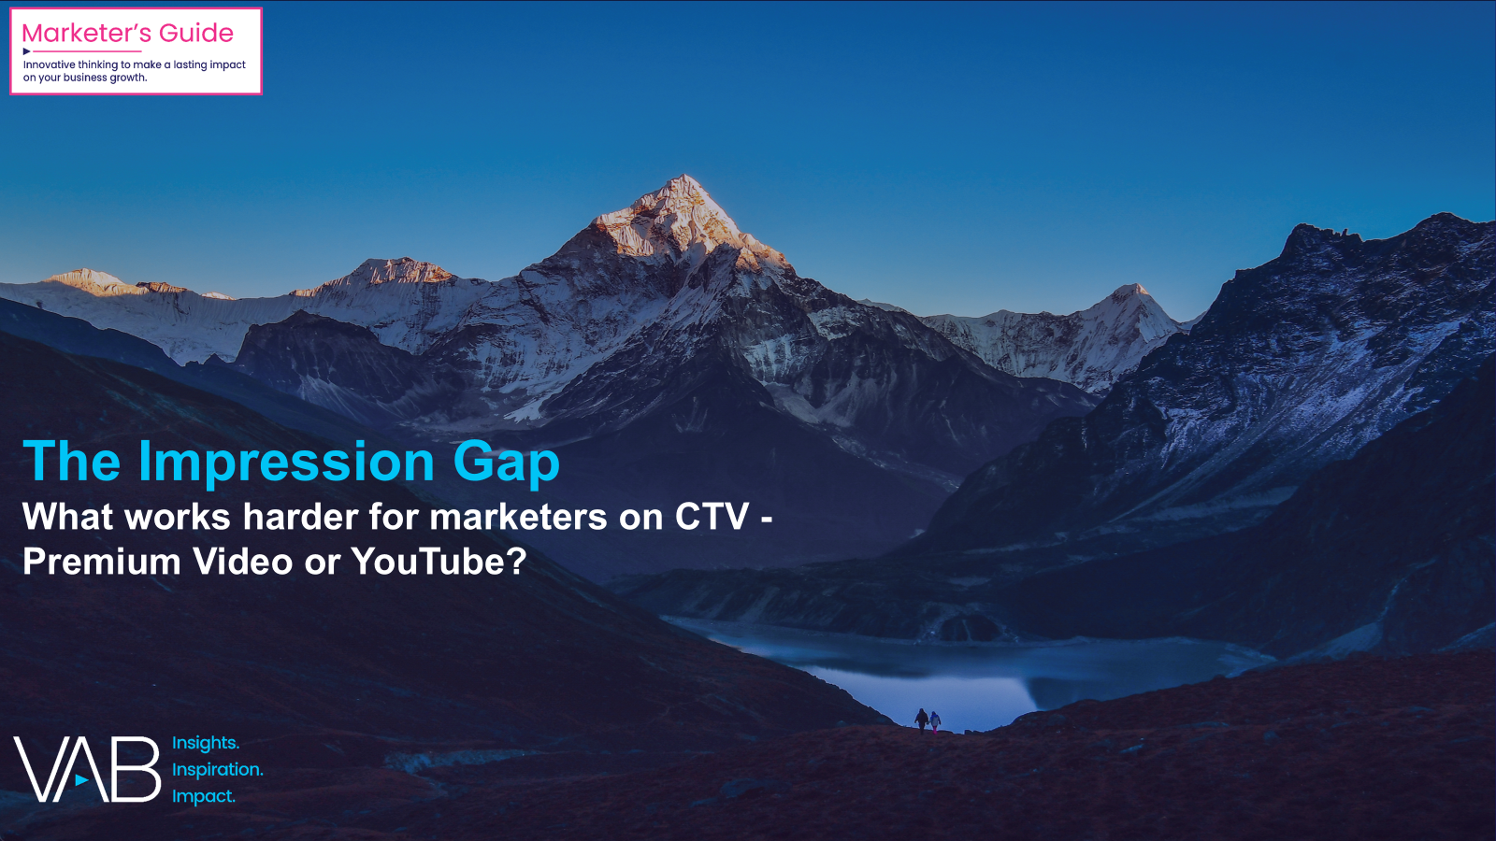



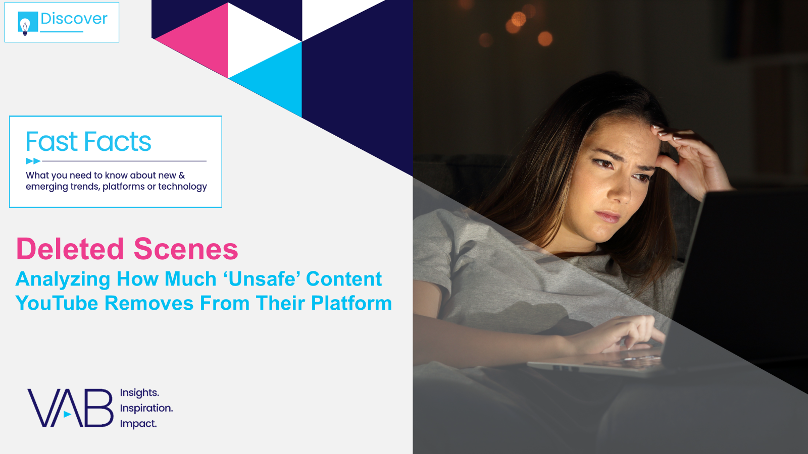

Creators
Jason Wiese
Leah Pujalte
EVP, Strategic Insights & Measurement
jasonw@thevab.com
VP, Audience & Behavioral Insights
leahm@thevab.com
Karolina Guillen
Amanda Cashman
The Lead Story
How Multiscreen TV Drives Cross-Partisan Engagement for Political Ad Campaigns
The Impression Gap
What Works Harder for Marketers on CTV – Premium Video or YouTube?
Associate Director, Insights, Strategy & Analytics karolinag@thevab.com
Insights Analyst
amandac@thevab.com
Discover more
Looking for more data, insights and takeaways? Check out this related VAB content
The Credibility Crisis
How People Find Trusted News Amidst a Wave of Misinformation
The Illusions of the Internet
Uncovering the Fallacies & Realities
of Audience, Advertising & Content
Visit the VAB’s Political Marketing Resource Center to stay informed during prime election seasons.
The Power of Premium Video
What it Means for Multiscreen TV and Why it Matter to Marketers
Deleted Scenes
Analyzing How Much ‘Unsafe’ Content YouTube Removes From Their Platform
VAB Members, brand marketers and agencies get free and immediate access to VAB’s content library. Get access at theVAB.com
This information is exclusively provided to VAB members and qualified marketers.
PAGE 30

Slide 31


About VAB
VAB plays a dual role in the video advertising industry. We are leading the change to bring about a more innovative and transparent marketplace. We also provide the insights and thought leadership that enables marketers to develop business-driving marketing strategies.
Drawing on our marketing expertise, we simplify the complexities in our industry and discover new insights that transform the way marketers look at their media strategy.
We are committed to your business growth and proud to offer VAB members, brand marketers and agencies complimentary access to our continuously-growing Insights library. Get immediate access at theVAB.com.
This information is exclusively provided to VAB members and qualified marketers.
PAGE 31

Slide 32
Appendix:
Custom Study Methodology & Respondent Demographics

Slide 33

Custom Study Methodology
In December 2025, VAB conducted a survey with Dynata to understand how Americans engage with political and news content across today’s fragmented media landscape.
The results are based on 2,319 U.S. adults 18+. This study examines where voters turn for trustworthy information and how they evaluate journalistic integrity in today’s media landscape.
The analysis explores the evolving role of multiscreen TV news and highlights how traditional and streaming TV environments continue to inform and engage audiences within a rapidly changing news ecosystem.
This information is exclusively provided to VAB members and qualified marketers.
PAGE 33

Slide 34
Respondents age 35 to 54 and affluent adults skew more White, while full-time employed audiences are slightly more diverse
Respondent Race
13%
Hispanic / Latino Descent
11%
Hispanic / Latino Descent
9%
Hispanic / Latino Descent
16%
Hispanic / Latino Descent
Source: Dynata, Media Consumption and Political Sentiment survey, fielded December 2025 (n=2,319). Survey base: A18+ U.S. respondents. D3. Which of the following best describes you? Voter respondents (n=1,514), Non-Voter respondents (n=680), Republican respondents (n=636), Democrat respondents (n=612), Independent respondents (n=546).
This information is exclusively provided to VAB members and qualified marketers.
PAGE 34

Slide 35
Regional makeup is fairly consistent overall, though affluent respondents skew a bit more toward the Pacific and Northeast
Respondent Region
Source: Dynata, Media Consumption and Political Sentiment survey, fielded December 2025 (n=2,319). Survey base: A18+ U.S. respondents. D5. What state do you live in? [REGION]. A35-54 respondents (n=766), Household Income $100K+ respondents (n=420), Employment Status – Full Time respondents (n=826).
This information is exclusively provided to VAB members and qualified marketers.
PAGE 35

Slide 36
Affluent and full-time employed respondents are more educated overall, with higher shares holding college and advanced degrees
Respondent Education
37%
College Degree or Higher
39%
College Degree or Higher
69%
College Degree or Higher
46%
College Degree or Higher
Source: Dynata, Media Consumption and Political Sentiment survey, fielded December 2025 (n=2,319). Survey base: A18+ U.S. respondents. D8. What is the highest level of education that you have completed? A35-54 respondents (n=766), Household Income $100K+ respondents (n=420), Employment Status – Full Time respondents (n=826). Numbers may not add to 100% due to exclusion of ‘none of the above’ and ‘prefer not to answer’ responses which amounted to 0% - 1% for most respondents.
This information is exclusively provided to VAB members and qualified marketers.
PAGE 36

