Slide 1


February 21, 2025
Question of the Week:
“
Where do ad dollars go when they’re spent with Google?
”

Slide 2

Analyzing Google’s advertising revenue by segment and what it means for marketers
As Google has long frustrated the advertising industry through semi-opaque summaries of ad campaigns, including undisclosed media placements, we turned to the financial industry where certain disclosures are mandatory to see what more we could learn from Google’s latest 10-K filing within a regulated SEC-compliant investors’ environment.
Alphabet announced their fiscal year 2024 earnings in early February and provided data on how marketer dollars are being spent across their three ad revenue segments:
Google Search & Other
  Represents revenues generated on Google search properties (including revenues from traffic generated by search distribution partners who use Google.com as their default search in browsers, toolbars, etc.) and other Google owned and operated properties like Gmail, Google Maps, and Google Play
YouTube Ads
  Includes revenues generated on YouTube properties
Google Network
  Includes revenues generated on Google Network properties participating in AdMob, AdSense, and Google Ad Manager
Based on certain disclosures of these segments, we analyzed Google advertising revenues to better understand several questions and what it means for marketers:
What is the allocation by segment?
What does this allocation mean for ad campaign transparency?
What questions should marketers be asking to their media partners?
This information is exclusively provided to VAB members and qualified marketers.
PAGE 2

Slide 3

A look into Alphabet’s financials on Google ad revenue across segments

Slide 4
In 2024, Alphabet reported almost $265 billion in total global advertising revenue, with 14% attributed to YouTube
Alphabet/Google: Global Advertising Revenue Share by Segment
FY 2024
Note: Alphabet’s 10-K does not provide any segmentation of video ad revenue
(and it can’t be assumed that ‘YouTube ads’ is 100% video, or ‘Google Search & Other’ is only non-video)
Source: Alphabet SEC company 10-K filings via SEC Edgar Search, for fiscal year ended 12/31/24. "Google Search & Other" represents revenues generated on: Google search properties (including revenues from traffic generated by search distribution partners who use Google.com as their default search in browsers, toolbars, etc.), and other Google owned and operated properties like Gmail, Google Maps, and Google Play. ‘YouTube ads’ includes revenues generated on YouTube properties. ‘Google Network’ includes revenues generated on Google Network properties participating in AdMob, AdSense, and Google Ad Manager. Reflects gross revenue which includes the dollars that Google pays in traffic acquisition costs (TAC) to partner sites.
This information is exclusively provided to VAB members and qualified marketers.
PAGE 4

Slide 5
‘Google Search & Other’ is nearly a $200 billion business which now represents three-quarters of Alphabet’s total global ad revenue
Alphabet/Google: Global Advertising Revenue
$ in Billions
$264.6
$237.9
%
$224.5
%
11%
%
13%
15%
14%
13%
13%
Google Search & Other
+$35.6B
(+22%)
vs. ‘22
74%
75%
72%
Source: Alphabet SEC company 10-K filings via SEC Edgar Search, for fiscal year ended 12/31/24. "Google Search & Other" represents revenues generated on: Google search properties (including revenues from traffic generated by search distribution partners who use Google.com as their default search in browsers, toolbars, etc.), and other Google owned and operated properties like Gmail, Google Maps, and Google Play. ‘YouTube ads’ includes revenues generated on YouTube properties. ‘Google Network’ includes revenues generated on Google Network properties participating in AdMob, AdSense, and Google Ad Manager. Reflects gross revenue which includes the dollars that Google pays in traffic acquisition costs (TAC) to partner sites.
This information is exclusively provided to VAB members and qualified marketers.
PAGE 5

Slide 6

How much is ‘Other’? Independent third-party research has found that ~7% of Google Search spend goes to undefined platforms
6.7%
of examined Google search campaign ad budget was spent on Google Search Partners & Display Expansion
Analysis included tens of thousands of Google Search campaigns, totaling over a billion USD.
Source: Adalytics Research LLC, ‘Does A Lack of Transparency Create Brand Safety Concerns For Search Advertisers?’ report, November 2023. Based on Adalytics dataset access to over a billion (USD) dollars’ worth of search ad campaigns data from various Fortune 500 brands, media agency, non-profits, and SMBs. For each of these brands, agencies, and non-profits, Adalytics analyzed how many impressions, conversions, clicks, and spend was distributed on Google search (such as google.com or google.co.uk), versus the Search Partners network. The search ad campaigns’ datasets included tens of thousands of search ad campaigns, over a billion USD (or foreign currency equivalents) in search media spend, tens of billions of search ad impressions and billions of ad clicks.
This information is exclusively provided to VAB members and qualified marketers.
PAGE 6

Slide 7
Using third-party research directionally, ‘Other’ within the ‘Google Search & Other’ segment is estimated to represent at least $13 billion in ad revenue
‘Google Search & Other’ Ad Revenues vs. ‘Other’ Google Search Ad Revenues
2022
2023
2024
‘Google Search & Other’
From Alphabet’s 10-K Filings
$162.5B
$175.0B
$198.1B
Est. % Share for ‘Other’
Based on Adalytics Research
6.7%
6.7%
6.7%
$10.9B
$11.7B
$13.3B
Est. Ad Revenue for ‘Other’
Based on Adalytics Research
Source: Alphabet SEC company 10-K filings via SEC Edgar Search, for fiscal year ended 12/31/24. "Google Search & Other" represents revenues generated on: Google search properties (including revenues from traffic generated by search distribution partners who use Google.com as their default search in browsers, toolbars, etc.), and other Google owned and operated properties like Gmail, Google Maps, and Google Play. Reflects gross revenue which includes the dollars that Google pays in traffic acquisition costs (TAC) to partner sites. Adalytics Research LLC, ‘Does A Lack of Transparency Create Brand Safety Concerns For Search Advertisers?’ report, November 2023, see page 6 for more methodological details.
This information is exclusively provided to VAB members and qualified marketers.
PAGE 7

Slide 8
Based on ‘Google Network’ and our estimates for ‘Other,’ ~$44 billion (17%) of Alphabet’s total ad revenues potentially comes from undefined platforms
Alphabet/Google: Global Advertising Revenue Share by Segment
FY 2024
Google Platforms vs. Distribution Partners
Source: Alphabet SEC company 10-K filings via SEC Edgar Search, for fiscal year ended 12/31/24. "Google Search & Other" represents revenues generated on: Google search properties (including revenues from traffic generated by search distribution partners who use Google.com as their default search in browsers, toolbars, etc.), and other Google owned and operated properties like Gmail, Google Maps, and Google Play. ‘YouTube ads’ includes revenues generated on YouTube properties. ‘Google Network’ includes revenues generated on Google Network properties participating in AdMob, AdSense, and Google Ad Manager. Reflects gross revenue which includes the dollars that Google pays in traffic acquisition costs (TAC) to partner sites. Adalytics Research LLC, ‘Does A Lack of Transparency Create Brand Safety Concerns For Search Advertisers?’ report, November 2023, for more methodological details see page 6, for ‘Other’ methodology see page 7.
This information is exclusively provided to VAB members and qualified marketers.
PAGE 8

Slide 9




How Much is $44 Billion? Google’s ad revenue from undefined platforms is on par with global print media spend and much more than outdoor or radio
Estimated Global Advertising Revenues by Media
2024
Print
Google Network & ‘Other’
Outdoor
Radio
$43.7
Billion
$43.6
Billion
$36.2
Billion
$29.3
Billion
Source: Alphabet SEC company 10-K filings via SEC Edgar Search, for fiscal year ended 12/31/24. ‘Google Network’ includes revenues generated on Google Network properties participating in AdMob, AdSense, and Google Ad Manager. Reflects gross revenue which includes the dollars that Google pays in traffic acquisition costs (TAC) to partner sites. Totaled numbers may equal not total due to rounding. Adalytics Research LLC, ‘Does A Lack of Transparency Create Brand Safety Concerns For Search Advertisers?’ report, November 2023, for more methodological details see page 6, for ‘Other’ methodology see page 7. S&P Global Market Intelligence Kagan, Global Advertising Expenditure Forecasts, December 2024.
This information is exclusively provided to VAB members and qualified marketers.
PAGE 9

Slide 10
Over the last three years, an estimated $130 billion has potentially been allocated to undefined platforms and websites through Google ad buys
Alphabet/Google: Global Advertising Revenue Share by Source
$ in Billions
$43.7
$43.0
$43.7
vs. ‘22
vs. ‘23
-$1.5B
(-5%)
-$0.9B
(-3%)
+$0.8B
(+7%)
+$1.6B
(+14%)
Source: Alphabet SEC company 10-K filings via SEC Edgar Search, for fiscal year ended 12/31/24. ‘Google Network’ includes revenues generated on Google Network properties participating in AdMob, AdSense, and Google Ad Manager. Reflects gross revenue which includes the dollars that Google pays in traffic acquisition costs (TAC) to partner sites. Totaled numbers may equal not total due to rounding. Adalytics Research LLC, ‘Does A Lack of Transparency Create Brand Safety Concerns For Search Advertisers?’ report, November 2023, for more methodological details see page 6, for ‘Other’ methodology see page 7.
This information is exclusively provided to VAB members and qualified marketers.
PAGE 10

Slide 11
Furthermore, 86% of Google’s global ad revenues overall may come from non-transparent and largely unaudited media beyond ‘YouTube ads’
Alphabet/Google: Global Advertising Revenue Share by Source
FY 2024
Non-transparent,
largely unaudited media
Google Search & Other + Google Network
Source: Alphabet SEC company 10-K filings via SEC Edgar Search, for fiscal year ended 12/31/24. "Google Search & Other" represents revenues generated on: Google search properties (including revenues from traffic generated by search distribution partners who use Google.com as their default search in browsers, toolbars, etc.), and other Google owned and operated properties like Gmail, Google Maps, and Google Play. ‘YouTube ads’ includes revenues generated on YouTube properties. ‘Google Network’ includes revenues generated on Google Network properties participating in AdMob, AdSense, and Google Ad Manager. Reflects gross revenue which includes the dollars that Google pays in traffic acquisition costs (TAC) to partner sites.
This information is exclusively provided to VAB members and qualified marketers.
PAGE 11

Slide 12
Google’s non-transparent, largely unaudited media accounts for $228 billion in global ad revenues, an increase of $33 billion over the last three years
Alphabet/Google: Global Advertising Revenue
$ in Billions
+$33.2B
(+17%)
vs. ‘22
$228.4
$195.2
$206.3
Source: Alphabet SEC company 10-K filings via SEC Edgar Search, for fiscal year ended 12/31/24. "Google Search & Other" represents revenues generated on: Google search properties (including revenues from traffic generated by search distribution partners who use Google.com as their default search in browsers, toolbars, etc.), and other Google owned and operated properties like Gmail, Google Maps, and Google Play ‘Google Network’ includes revenues generated on Google Network properties participating in AdMob, AdSense, and Google Ad Manager. Reflects gross revenue which includes the dollars that Google pays in traffic acquisition costs (TAC) to partner sites.
This information is exclusively provided to VAB members and qualified marketers.
PAGE 12

Slide 13
What are the risks associated with
non-transparent, largely unaudited
media placements?

Slide 14

Lack of transparency from Google can create misaligned incentives which could lead to poor ad decisions, especially among small businesses
8/26/24
9/3/24
Google Sought to Pay Agencies Hundreds
of Millions to Sway Media Buys
Antitrust documents detail how Google planned to incentivize agencies in 2018
Agencies Continue to Receive Perks From Media Owners That Aren't Disclosed to Clients
Misaligned incentives can lead to wasted media spend
Arielle Garcia, director of intelligence at industry watchdog Check My Ads, who formerly worked at ad-buying giant UM, described the program as benefitting Google. Garcia has first-hand knowledge of Google’s program, she said.
“[Google] tends to recommend things that benefit themselves more so than advertisers,” Garcia said.
Incentive programs between large media companies and agencies continue to lead to poor advertising decisions and less transparency for smaller clients, 10 sources from agencies, brands, and publishers told ADWEEK.
Small and medium-sized clients were less likely to have stipulations in their contracts with agencies to ensure incentive programs are disclosed, the first buyer source said.
Medium-sized buyers would spend more with Google, “and then the rebates would come and they would typically go back to the agency or go back to the bigger clients,” the first buyer said.
What makes Google completely different “to another publisher or media vendor that participates in upfront negotiations is that the universe that you can transact through Google’s platform is endless,” the media auditor source said.
For instance, to fulfill a minimum spend commitment under an incentive program with a TV company, there are a finite number of shows in which agencies can buy airtime. But with Google, much more inventory is on the table, making it more likely brands don’t know which exact Google media their agency is buying, the source continued.
This information is exclusively provided to VAB members and qualified marketers.
PAGE 14

Slide 15
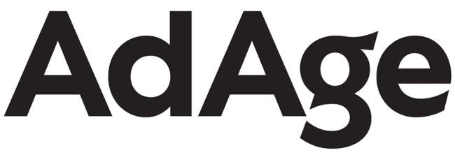

Due to industry pressures, Google has been refunding some advertisers and offering only ‘limited’ transparency into their ad practices
12/28/23
GOOGLE MULLS MORE DATA SHARING AND CONTROL AFTER REPORT OF SEARCH ADS ON PORN AND OTHER PROBLEM SITES
12/13/23
Google Will Share Limited Search Partner Site Placement Info With Advertisers
12/7/23
8/14/23
GOOGLE REPAYS ADVERTISERS AFTER REPORT OF LOW-QUALITY ADS
Google’s Temporary Opt-Out; Finding Your Fans
4/18/23
8/15/23
GOOGLE GIVES POST-COOKIE AD TECH UPDATE
Google Doles Out Refunds After Adalytics Drama
3/29/23
GOOGLE EXPANDS VISIBILITY INTO WHO’S BEHIND ITS ADS
This information is exclusively provided to VAB members and qualified marketers.
PAGE 15

Slide 16












Google also faces multiple legal settlements and fines for antitrust violations, deceptive advertising and privacy concerns
2/14/2025
2/4/2025
2/4/2025
Google must face mobile phone privacy class action, possible trial
Judge Blocks Apple's Attempt to Halt Google Search Antitrust Lawsuit
China launches an antitrust probe into Google. Here’s what it means
9/11/23
11/14/22
2/14/2025
Google pays nearly $392 million to settle sweeping location-tracking case
Two weeks into 2025 and Google is already battling another antitrust investigation
Google’s search engine dominance is at the center of the biggest US antitrust trial in decades
5/12/23
1/5/23
Pax­ton Announces $8 Mil­lion Set­tle­ment with Google Over the Big Tech Company’s Decep­tive Advertising
Google To Pay $23M To End Decade-Old Data Privacy Suit
12/15/23
Google will face a class-action antitrust lawsuit from small advertisers
1/24/23
12/30/22
DOJ SUES GOOGLE OVER DIGITAL AD MARKET DOMINANCE
AG Racine Announces Google Must Pay $9.5 Million for Using "Dark Patterns" and Deceptive Location Tracking Practices that Invade Users' Privacy
12/28/23
12/19/23
12/3/2024
Google agrees to settle $5 billion lawsuit accusing it of tracking Incognito users
Google to Pay $700 Million in Play Store Settlement
U.S. Proposes Breakup of Google to Fix Search Monopoly
In a landmark antitrust case, the government asked a judge to force the company to sell its popular Chrome browser.
This information is exclusively provided to VAB members and qualified marketers.
PAGE 16

Slide 17
What should marketers be asking of their media partners?

Slide 18





Marketers should demand full campaign transparency and verification from their media partners
Complete transparency on…
True verification
The full lifecycle of all video ad units within your campaign by
media partner
All calculations
of video ad impressions by media partner
The granular details of exact ad placements, by type and inventory source, across each media partner
The composition of ad placement types and inventory sources in audience metrics such as reach calculations by media partner
Have media partners bring in a truly independent third party to provide transparency on
a now-permanent basis
Also, the FreeWheel Council for Premium Video and VAB have partnered to advocate for the value of premium standards. Click below to download and learn more!
Buying Premium Video: A Definitive Checklist
This information is exclusively provided to VAB members and qualified marketers.
PAGE 18

Slide 19

Although certain financial disclosures are mandatory
to be SEC-compliant, Alphabet’s 10-K filing still leaves several important questions unanswered for their advertising partners:
  Segmentation of video ad dollars are not provided; therefore, it is a challenge to understand how dollars are being allocated by video, display, etc.
  Extremely limited information is provided on what inventory is included within ‘Google Network’ and ‘Google Search & Other’
  The non-specific labeling of ‘Google Network’ and ‘Other’ means that there are tens of billions of dollars that are allocated to opaque placements annually
The $44 billion of Google’s ad revenue attributed to undefined platforms (‘Google Network’ and ‘Other’) is on par with the global ad revenues of print media and much higher than OOH and radio global ad revenues
It’s imperative for marketers to demand full campaign transparency and verification from media partners to ensure all ad placements are in proper environments
Key Marketer Takeaways
PAGE 19
This information is exclusively provided to VAB members and qualified marketers.

Slide 20
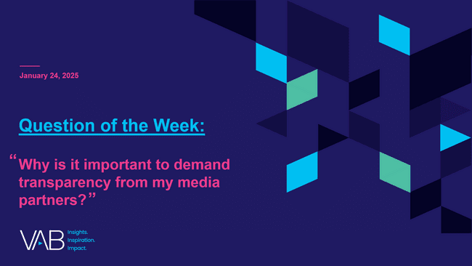

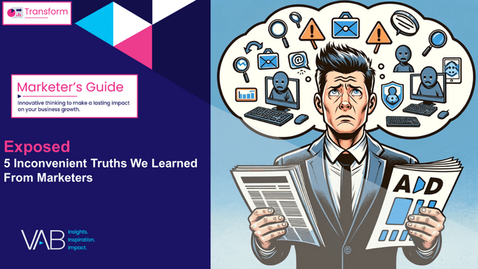
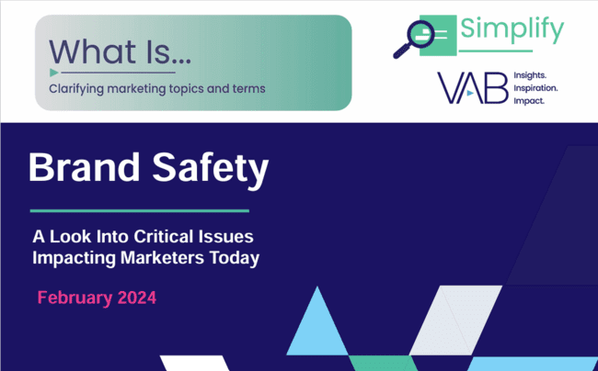

Download these other VAB resources to understand more about the importance of transparency, brand safety and quality within ad campaigns
19 pages
49 pages
51 pages
11 pages
This information is exclusively provided to VAB members and qualified marketers.
PAGE 20

Slide 21


About VAB
VAB plays a dual role in the video advertising industry. We are leading the change to bring about a more innovative and transparent marketplace. We also provide the insights and thought leadership that enables marketers to develop business-driving marketing strategies.
Drawing on our marketing expertise, we simplify the complexities in our industry and discover new insights that transform the way marketers look at their media strategy.
We are committed to your business growth and proud to offer VAB members, brand marketers and agencies complimentary access to our continuously-growing Insights library. Get immediate access at theVAB.com.
This information is exclusively provided to VAB members and qualified marketers.
PAGE 21

