Slide 1


VAB – INSIGHTS REPORT - 2019
.................
America’s Newest Pastime
The Rise Of News & Politics As ‘Sport’

Slide 2
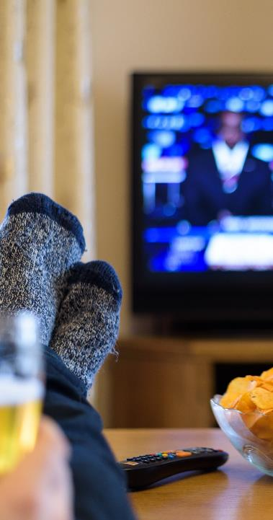

The Rise Of News & Politics As ‘Sport’
The World Series. The Super Bowl. The NBA Finals. The Stanley Cup. The Presidential Election Debates. The Comey Testimony. State of the Union Address. The Kavanaugh Confirmation Hearings. Today, politically-charged news events are some of the most watched programming in the country, rivalling even the most popular live sporting events.
How popular has news & politics become? Did you know that just as many Americans watched the 2016 Presidential Election debates as they did the Super Bowl, and aggregated time spent watching the debates was 81% higher? And this year, the current primary debates are already delivering an unprecedented number of viewers early in the 2020 election cycle.
There’s no debate that news & politics have transformed into a new ‘sport’ fueled by endless breaking stories and a 24-hour news cycle. Just like traditional sports, continuous news coverage ignites passion among viewers – they tweet, post, share, watch and gather together to debate current events just like they would the ‘big game.’ Some even badge themselves with politically-affiliated merchandise much like they do with their favorite sports teams.
Whether people are watching at home, getting updates on the go, or viewing out-of-home with friends or family, multiscreen TV is the clear preference as the #1 most trusted source for news and is nearly ubiquitous among adults amidst skyrocketing news consumption over the past few years.
Most importantly, advertisers have taken note of the increased viewership and ‘sport-like’ interest and passion exhibited by TV news viewers and are taking action as national TV spending in the news genre has increased 30% over the last three years.
2
This information is exclusively provided to VAB members and qualified marketers. Further distribution is prohibited.

Slide 3
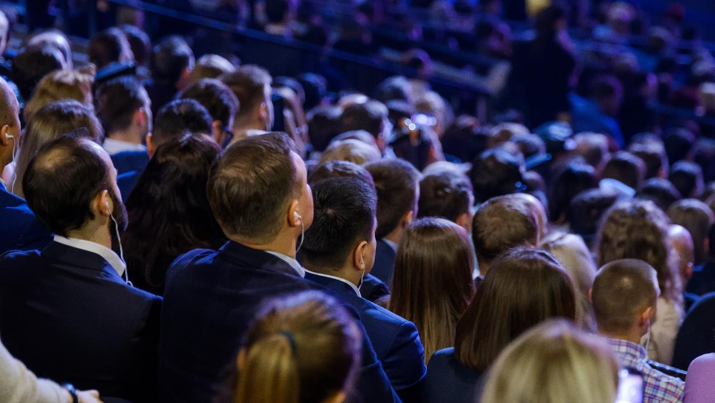
The ‘Sport’ Of News: A Passion On Par With The Big Leagues

Slide 4



In today’s highly charged political climate, Presidential Election debates have become one of America’s largest spectator events with a unique audience that rivaled the Super Bowl during the last cycle.
Furthermore, aggregated time spent viewing the 2016 election debates was 81% higher than the Super Bowl.
Tale of the Tape
Super Bowl 50
(2016)
‘15 – ‘16 Presidential
Election Debates*
Unique Viewers
112.74 Million
112.72 Million
Average Minutes Viewed Per Viewer
142 Minutes
257 Minutes
+81%
Total Hours Viewed
266 MM Hours
482 MM Hours
Source: Super Bowl 50: VAB analysis of Nielsen NPower R&F Program Report, Live, A18+, 2/7/2016. *Presidential Election Debates: VAB analysis of Nielsen NPower R&F Program Report, Total Day, Live, A18+, 8/1/2015 – 11/1/2016, reflects cume unduplicated unique reach & time spent over 21 Primary & General Election debates across 32 network airings during this time period. MM = million
4
This information is exclusively provided to VAB members and qualified marketers. Further distribution is prohibited.

Slide 5
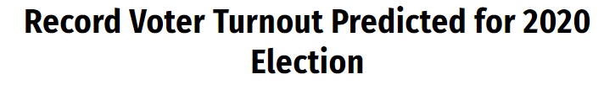



And Now The Current Primary Debates Are Already Delivering An Unprecedented Number Of Viewers Early In The 2020 Election Cycle Amid Predictions Of Record Voter Turnout
Interest is extremely high and people are passionate about staying informed
on where the candidates stand on today’s issues
Jul 17, 2019
Jun 27, 2019
Jun 28, 2019
Note: Super Bowl LIII (2019) cume A18+ audience was 106.4 MM per VAB analysis of Nielsen NPower R&F Program Report.
5
This information is exclusively provided to VAB members and qualified marketers. Further distribution is prohibited.

Slide 6












From A Broader Perspective, Politically-Charged News Events Have Also Become Major Televised Spectacles In Their Own Right And Are On Par With Big Sporting Events
Jun 9, 2017
Sep 28, 2018
Feb 6, 2019
(41.1MM)*
2017 NBA Finals: Golden State vs. Cleveland
P2+ Avg Audience (000): 19,343
CFP National Championship:
Clemson Tigers vs. Alabama Crimson Tide
P2+ Avg Audience (000): 22,817
Falcons-Saints NFL Thanksgiving
P2+ Avg Audience (000): 20,721
June 9, 2017
Jan 7, 2019
Nov 22, 2018
Feb 28, 2019
Jul 9, 2019
Rose Bowl: Washington vs. Ohio State
P2+ Avg Audience (000): 15,326
2019 MLB Home Run Derby
P2+ Avg Audience (000): 4,887
July 8, 2019
Jan 1, 2019
Source: Sports Programming Audience - VAB analysis of Nielsen NPower, Total Day, Live, P2+. Reflects ad-supported cable TV / broadcast TV, live originals/premieres only, January – December 31, 2017, 2018 & 2019. Both news and sporting events exclude digital audiences through MVPD / network TV apps. *State of the Union Address audience reflects Live P2+ cume unduplicated unique reach across 6 network airings (CNN, NBC, CBS, MSNBC, Fox Business Network & Fox News Channel).
6
This information is exclusively provided to VAB members and qualified marketers. Further distribution is prohibited.

Slide 7
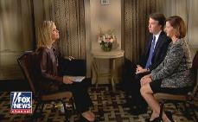

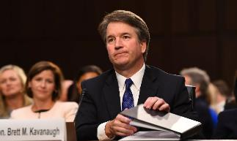
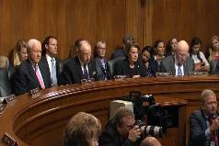

These Politically-Charged News Events Create Enormous Conversation, Both Offline And Online, And Gain Heavy Traction On Social Media Just Like Live Sports
‘A Week On Twitter During A Major News Event’
Example: Judge Brett Kavanaugh Confirmation Hearings
Monday
Related Trending Topics
Friday
9/24/18 - Ashley Kavanaugh interviewed on Fox News’ The Story with Martha MacCallum
9/26/18 - President Trump calls allegations against Kavanaugh false at his press conference
9/27/18 - Judge Brett Kavanaugh’s Senate Judiciary Committee
Confirmation Hearings
9/28/18 – Senate Judiciary Committee votes on
Judge Kavanaugh
Related Trending Topic on 9/24:
Ashley Kavanaugh (#9)
Related Trending Topics on 9/26:
#TrumpPressConference (#1)
George Washington (#4)
#TrumpPresser (#8)
Related Trending Topics on 9/27:
Lindsey Graham (#1)
#KavanaughHearing (#2)
#KavanaughFord (#5)
#KavanaughConfirmationHearings (#6)
Durbin (#7)
Merrick Garland (#8)
Kamala Harris (#9)
Judge Kavanaugh (#10)
Related Trending Topics on 9/28:
#KavanaughVote (#2)
…and with over 25 million views, the 13-minute long ‘Kavanaugh Hearing’ sketch featuring Matt Damon on 9/29 became the most watched Saturday Night Live clip on YouTube of the ‘18-’19 season
(#) = highest trending rank achieved on the night
Source: VAB custom analysis of Top 10 trending Twitter Topics each night (8:30p, 9:30p, 10:30p, 11:30p) during 4-week time period (9/24/2018 – 10/21/2018). Results include both “direct” and “related” TV topics.
Excerpted from #TVisSocial #FallSeason #Ep4: How ‘Live’ TV Drives Continuous Online Conversations. Download the full guide to learn more: https://thevab.com/insight/tvissocial-fall-season. YouTube view total as of 9/5/19.
7
This information is exclusively provided to VAB members and qualified marketers. Further distribution is prohibited.

Slide 8













It’s Not Just Big News Events That Capture America’s Attention – News Programming Rivals That Of Popular Sporting Events During Any Day Of The Week
Example: A Week In May
Program P18+ Average Audience (000): News vs. Sports Programming
Monday
(5/6/19)
Tuesday
(5/7/19)
Wednesday
(5/8/19)
Thursday
(5/9/19)
Friday
(5/10/19)
Saturday
(5/11/19)
Sunday
(5/12/19)
3,469
7,132
6,953
3,312
2,840
2,091
1,971
1,861
1,956
2,339
1,158
1,182
438
439
Shepard Smith Reporting
2019 Stanley Cup Playoffs:
Sharks vs. Avalanche
CBS This Morning
2019 NBA Playoffs: Sixers vs. Raptors
Cuomo
Prime Time
MLB: Mariners vs. Yankees
Special Report w/ Bret Baier
2019 Stanley Cup Playoffs: Hurricanes vs. Bruins
ABC World News Tonight
2019 NBA Playoffs: Warriors vs. Rockets
Justice w/ Judge Jeanine
2019 Stanley Cup Playoffs:
Sharks vs. Blues
This Week w/ George Stephanopoulos
PGA Tour:
AT&T Byron Nelson 2019
Source: VAB Analysis of Nielsen NPower R&F Program Report, Total Day, Live+SD, A18+. Reflects broadcast TV / national cable TV; based on days in week of May 6th, 2019. Analysis examined programs within the following genres: News, News Documentary & Political vs. Sports Events. Programming – Monday: Shepard Smith Reporting (Fox News Channel) vs. 2019 Stanley Cup Semi Playoffs: Sharks vs. Avalanche (NBCSN); Tuesday: CBS This Morning (CBS) vs. 2019 NBA Playoffs: Philadelphia 76ers vs. Toronto Raptors (TNT); Wednesday: Cuomo Prime Time (CNN) vs. MLB Weekday: Seattle Mariners vs. New York Yankees (ESPN); Thursday: Special Report With Bret Baier (Fox News Channel) vs. 2019 Stanley Cup Semi Playoffs – Carolina Hurricanes Vs. Boston Bruins (NBCSN); Friday: ABC World News Tonight (ABC) vs. 2019 NBC Playoffs: Golden State Warriors vs. Houston Rockets (ESPN); Saturday: Justice with Judge Jeanine (Fox News) vs. 2019 Stanley Cup Semi Playoffs: Sharks vs. Blues (NBC); Sunday: This Week with George Stephanopoulos (ABC) vs. AT&T Byron Nelson 2019 PGA Tour (CBS).
8
This information is exclusively provided to VAB members and qualified marketers. Further distribution is prohibited.

Slide 9
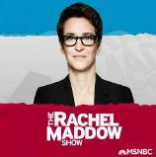





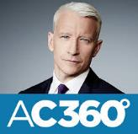





Millions Of Fans Also Connect With Their Favorite Politically-Charged Talk & Debate News Programs On Social Media, More So Than They Do With Sports Commentary Shows
TV News Programming
Sports Programming
9.7MM Followers
4.2MM Followers
2.8MM Followers
1.4MM Followers
1.2MM Followers
323.5K Followers
1.3MM Followers
607.6K Followers
596K Followers
278.4K Followers
54.8K Followers
37.1K Followers
Followers as of 8/29/2019
9
This information is exclusively provided to VAB members and qualified marketers. Further distribution is prohibited.

Slide 10
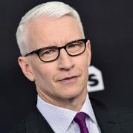
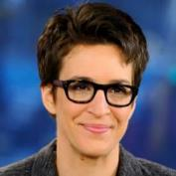

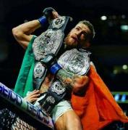
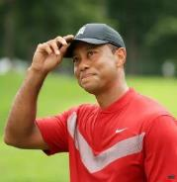
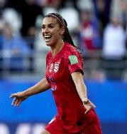
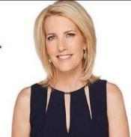
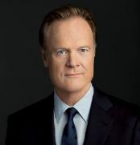
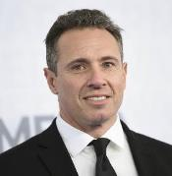

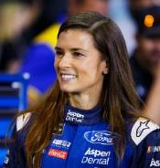
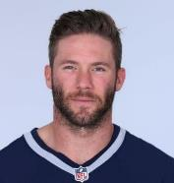
This Connection Extends To News Personalities Who Have Social Media Followings
That Are Equivalent To, Or Greater Than, Some Of The World’s Most Popular Athletes
TV News Personalities
Professional Athletes
Anderson Cooper
Rachel Maddow
Sean Hannity
Conor McGregor
Tiger Woods
Alex Morgan
10MM Followers
9.7MM Followers
4.2MM Followers
7.7MM Followers
6.5MM Followers
4MM Followers
Laura Ingraham
Lawrence O’Donnell
Chris Cuomo
Mike Trout
Danica Patrick
Julian Edelman
2.8MM Followers
2.6MM Followers
1.4MM Followers
2.6MM Followers
1.8MM Followers
1.3MM Followers
Followers as of 8/29/2019
10
This information is exclusively provided to VAB members and qualified marketers. Further distribution is prohibited.

Slide 11
Fast Fact
The average OOH News viewer is
38 years old, makes $73K a year & has a college/graduate degree (48%)
Beyond digital connections, TV news has evolved into a social activity just like sports.
When people watch it out-of-home, they’re typically viewing with a tight circle of family or friends.
Socializing around televised news events appeals most to upscale, educated, younger professionals.
Those Who Watch the News Out-of-Home Prefer to Do So With Family (60%), Friends (51%) & Colleagues (25%)
Source: Nielsen, Affluent & Educated: A New Age for Out-of-Home News Viewing On Linear TV During Election Time, Nielsen’s Out-of-Home News Survey, 11/9-11/13 General Population. Education based on College Graduate or Graduate Degree Only; Base: all respondents 18+
11
This information is exclusively provided to VAB members and qualified marketers. Further distribution is prohibited.

Slide 12
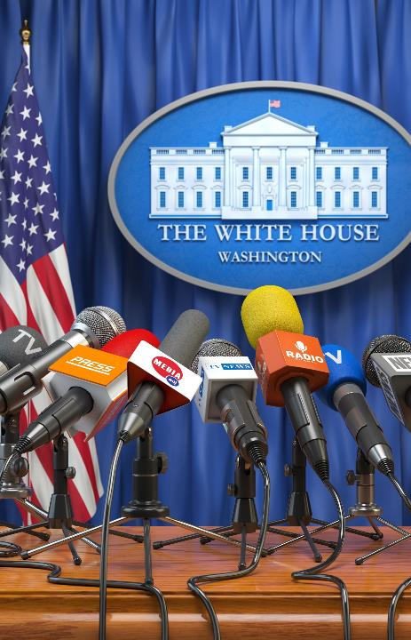

Political News In Particular Is Getting People Out Of The House Where They Can Connect With Their Community On Current Issues
Source: Nielsen, Affluent & Educated: A New Age for Out-of-Home News Viewing On Linear TV During Election Time, Nielsen’s Out-of-Home News Survey, 11/9-11/13 General Population. Base: Respondents who watched cable news in the past week. *Respondents can choose multiple options.
12
This information is exclusively provided to VAB members and qualified marketers. Further distribution is prohibited.

Slide 13
Just Like Sports, People Will Watch News Events At Restaurants, Bars Or Someone’s Home
And Get Quick Updates At Work, On The Go or When Traveling So They’re Always ‘In The Know’
Source: News - Nielsen, Affluent & Educated: A New Age for Out-of-Home News Viewing On Linear TV During Election Time, Nielsen’s Out-of-Home News Survey, 11/9-11/13 General Population. Base: all respondents 18+, Where Did You View News Programming OOH in the Past Week? Sports - VAB analysis of Nielsen Fall Sports, Game On: Driving Brand Engagement and Co-Viewing On Linear TV With Out-Of-Home Audiences; 2019. Reflects multiple responses chosen from respondents in Nielsen’s Out-of-Home Fall Sports Location Survey, General Population (10/29-10/31). Base = All respondents 18+. Respondents can select multiple locations.
13
This information is exclusively provided to VAB members and qualified marketers. Further distribution is prohibited.

Slide 14
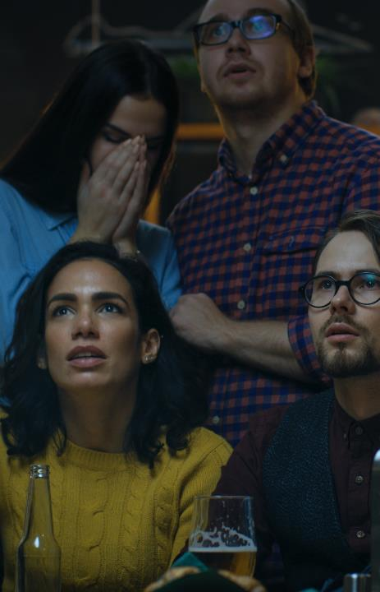






Although Politics Used To Be Off-Limits, Bars Are Now Embracing Televised News Events With Viewing Parties And Drinking Games
Jun 8, 2017
Feb 26, 2019
Jun 26, 2019
Jul 29, 2019
14
This information is exclusively provided to VAB members and qualified marketers. Further distribution is prohibited.

Slide 15

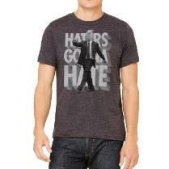





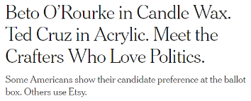






And When Attending TV Watch Parties, Some Take Their Fanaticism A Step Further By Badging Themselves With Politically-Affiliated Merchandise Much Like They Would Do With Their Favorite Sports Teams
15
This information is exclusively provided to VAB members and qualified marketers. Further distribution is prohibited.

Slide 16

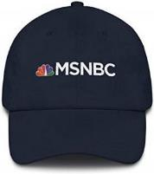





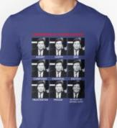

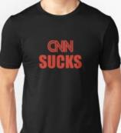

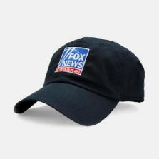
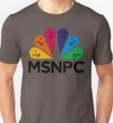

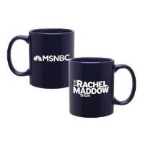
This sense of ‘team pride’ extends to their favorite TV news networks & personalities as well…
…and like a true rivalry, viewers even broadcast their feelings about supposed ‘opposition’ networks
16
This information is exclusively provided to VAB members and qualified marketers. Further distribution is prohibited.

Slide 17
This pride and passion exists because TV is at the epicenter of skyrocketing news consumption and TV news viewing is nearly ubiquitous among American adults
Source: VAB Analysis of Nielsen NPower R&F Program Report, Total Day, Live+7, A18+, A18-49 & A25-54. Reflects national cable TV, Spanish language cable TV, broadcast TV, Spanish language broadcast TV; based on 2018 calendar year. Includes the following genres: News, documentary news & info & Political.
17
This information is exclusively provided to VAB members and qualified marketers. Further distribution is prohibited.

Slide 18
With breaking news happening almost daily, and accompanied by 24-hour television coverage, ad-supported TV news has a
‘12-month season’
with rather consistent reach throughout
the year
Annual Monthly Average
75%
Source: VAB Analysis of Nielsen NPower R&F Program Report, Total Day, Live+7, A18+. Reflects national cable TV, Spanish language cable TV, broadcast TV, Spanish language broadcast TV; based on standard calendar months in 2018 & 2019. Includes the following genres: News, Documentary news/info & Political.
18
This information is exclusively provided to VAB members and qualified marketers. Further distribution is prohibited.

Slide 19
TV news viewership experienced a significant spike across major demos during the height of the 2016 election cycle and has held steady through the end of 2018
+34%
vs. 2014
+15%
vs. 2014
+5%
vs. 2014
Source: VAB Analysis of Nielsen NPower R&F Program Report, Total Day, Live+7, A18+, A18-49 & A25-54. Reflects national cable TV, Spanish language cable TV, broadcast TV, Spanish language broadcast TV; based on calendar years for 2014, 2016 & 2018. Includes the following genres: News, documentary news & info & Political.
19
This information is exclusively provided to VAB members and qualified marketers. Further distribution is prohibited.

Slide 20
With a seemingly never-ending news cycle filled with almost daily breaking news stories, over 40 billion hours
of national TV news are now being consumed annually by adults, a 34% increase vs. 2014
+34%
vs. 2014
+11%
vs. 2014
Flat
vs. 2014
Source: VAB Analysis of Nielsen NPower R&F Program Report, Total Day, Live+7, A18+, A18-49 & A25-54. Reflects national cable TV, Spanish language cable TV, broadcast TV, Spanish language broadcast TV; based on calendar years for 2014, 2016 & 2018. Includes the following genres: News, documentary news & info & Political.
20
This information is exclusively provided to VAB members and qualified marketers. Further distribution is prohibited.

Slide 21
In addition to scale, TV is also a very trusted media.
More people prefer getting their news from Television than any other source.
Source: Pew Research Center, Americans Still Prefer Watching to Reading the News – and Mostly Still Through Television, survey conducted July 30 – August 12, 2018.
21
This information is exclusively provided to VAB members and qualified marketers. Further distribution is prohibited.

Slide 22





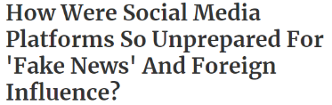
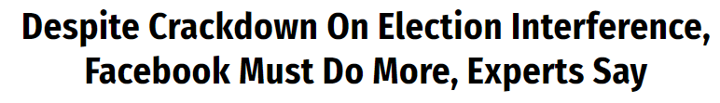
The Appeal Of TV As A Trusted Source Has Become More Pronounced As Major
Social Media Platforms Have Been The Subject Of Their Own Breaking News Stories
Over the last few years, top digital platforms have frequently been in the spotlight for scandals involving ‘fake news’ and foreign meddling
Oct 17, 2018
Nov 6, 2018
Dec 17, 2018
Jul 9, 2019
Jul 2, 2019
22
This information is exclusively provided to VAB members and qualified marketers. Further distribution is prohibited.

Slide 23



Because of these highly publicized scandals, it’s no surprise that a large majority of people - regardless of age, gender, ethnicity or party affiliation – are very concerned about the amount of fake news on social media platforms
“I Am Concerned By The Amount Of Fake News On Social Media”
% Who Agree
Source: VAB / Research Now Poll of Registered or Likely Voters A18+; June 2018. Q23: How much do you agree or disagree with the following statements? I am concerned by the amount of fake news on social media. Respondents who answered Agree or Strongly Agree. Total Respondents=1,003. Download the full guide to learn more: https://thevab.com/insight/its-matter-trust-undecided-voter
23
This information is exclusively provided to VAB members and qualified marketers. Further distribution is prohibited.

Slide 24














People are flocking to trusted online news sources in the wake of
‘fake news’ scandals on social media platforms.
The reach of TV-branded digital news platforms on mobile has increased 50%
in the last four years and is now nearly ubiquitous…
…Over 9 out of 10 Adults 18-34 access TV-branded news online.
TV-Branded Digital News Platforms’ Mobile Unique Visitors (000)
+50%
vs. 2015
+36%
vs. 2015
+15%
vs. 2015
% Reach of Internet Universe
66%
87%
93%
77%
88%
92%
71%
94%
96%
Source: VAB analysis of Comscore Audience Duplication, multiplatform (web and mobile), June 2019, P18+, P18-34 & P25-54 (Desktop P2+; Mobile P18+), Unduplicated unique visitors based on a custom created News TV Branded Website subcategory which includes digital platforms such as ABC, NBC, CBS, FOX, MSNBC, CNN, BBC & Bloomberg news properties. % Reach of Internet Universe based on VAB analysis of ‘Total Internet’ unique visitors, Comscore MediaMetrix, multiplatform media trend data.
Sampling of Streaming Mobile Apps
24
This information is exclusively provided to VAB members and qualified marketers. Further distribution is prohibited.

Slide 25


When It Comes Specifically To The Political Category, The Majority Of The
Top 5 Digital Platforms For Adults 18+ Throughout The Year Are TV Brands
Top 5 Politics Digital Platform Rank By Total Minutes Viewed (P18+)
January
February
March
April
May
June
1)
1)
1)
1)
1)
1)
2)
2)
2)
2)
2)
2)
3) Politico
3) Politico
3) Politico
3) Politico
3) Politico
3) Politico
4) TheHill.com
4) TheHill.com
4) TheHill.com
4) TheHill.com
4) TheHill.com
4) TheHill.com
5)
5)
5)
5)
5)
5)
July
August
September
October
November
December
1)
1)
1)
1)
1)
1)
2)
2)
2) Politico
2) Politico
2) Politico
2)
3) Politico
3) Politico
3)
3)
3)
3) Politico
4) TheHill.com
4) TheHill.com
4)
4)
4)
4) TheHill.com
5)
5)
5) TheHill.com
5) TheHill.com
5) TheHill.com
5)
Source: VAB analysis of Comscore MediaMetrix, multiplatform media trend data, January-December 2018; politics category, P18+
25
This information is exclusively provided to VAB members and qualified marketers. Further distribution is prohibited.

Slide 26
With so many viewers reliant on, and engaged with, TV news as their #1 trusted source for information, advertisers have taken notice…
…And because of that, annual TV spending in the news genre has increased 30% since 2015 with more brands advertising each year.
2,194
2,103
2,190
2,218
2,279
2,395
# of Advertisers
Source: VAB Analysis of Nielsen Ad Intel data, reflects national cable TV, Spanish language cable TV, broadcast TV, Spanish language broadcast TV; based on calendar years. Includes the following genres: News, News-general, documentary news, & info & political. # of advertisers based on Parent Company.
26
This information is exclusively provided to VAB members and qualified marketers. Further distribution is prohibited.

Slide 27

Key Takeaways
The never-ending action of news & politics has created a passion and interest level that’s on par with traditional sports
In fact, just as many adults collectively watched the 2016 Presidential Election debates as they did Super Bowl 50, and aggregated time spent viewing the debates was 81% higher than the Super Bowl
Furthermore, politically-charged news events ignite a similar passion as live sports: people talk about both incessantly online and they gather with others to watch and debate the news just like they would do with the ‘big game’
As the #1 trusted source for news, multiscreen TV is the people’s preference and now over 40 billion hours of national TV news are being consumed by adults annually, a 34% increase since 2014
Advertisers have taken notice of the passion and mass interest by the news & politics viewer and are taking action – national TV spending in the news genre has increased 30% over the last three years
27

Slide 28
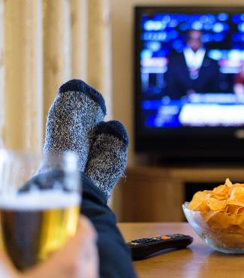




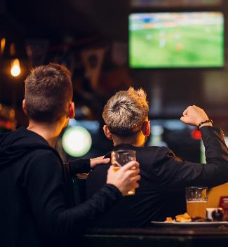




In Summary, The Characteristics Of Sports & Sports Fandom
Are Now Universal Within The World Of News & Politics
Mass Reach & Scale
Continuous
TV Coverage
TV Everywhere
Out-of-Home Viewing
The World
of
News & Politics
Merchandise / Badging
Social Conversation
Pundits
(Talk & Debate)
Celebrity
(Personalities)
28
This information is exclusively provided to VAB members and qualified marketers. Further distribution is prohibited.

Slide 29



Contact Us
Jason Wiese
SVP, Director of Strategic Insights
jasonw@thevab.com
Join Our Email List
Leah Montner-Dixon
Insights Manager
leahm@thevab.com
VAB
@VABintel

