Slide 1




An American Phenomenon:
The Growing Influence and Value of Asian American Consumers

Slide 2


Asian Americans are rising tastemakers
with more robust buying power than
the average American household
Why is this important to marketers?
As the fastest growing of the nation’s four largest ethnic groups, their population has nearly doubled over the last decade. Additionally, their comparatively higher household income and education level is fueling the segment’s spending power. These factors combined have helped strengthen Asian Americans’ influence on media and culture through
the rise of popular programming and content.
Marketers have an opportunity to drive incremental growth
by authentically connecting with Asian Americans who are a
fast-growing, lucrative group with the propensity to influence trends and opinions.
This information is exclusively provided to VAB members and qualified marketers. Further distribution is prohibited.
PAGE 2

Slide 3

Asian Americans have a powerful influence on culture, however they are often misrepresented in media

Slide 4


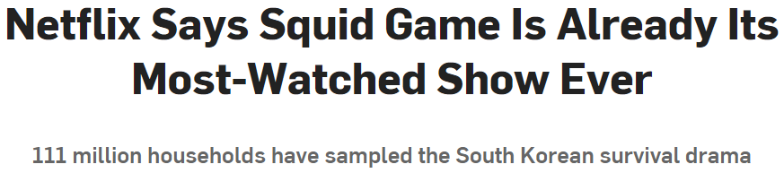

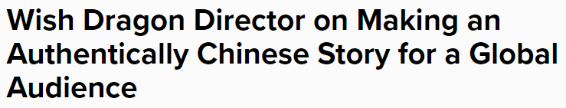




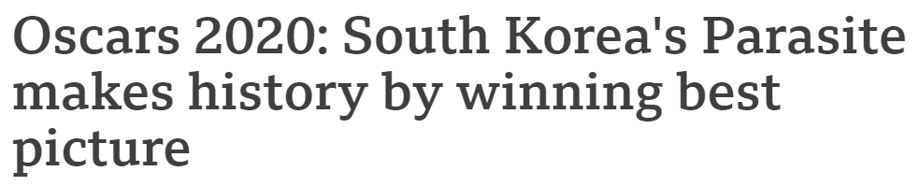
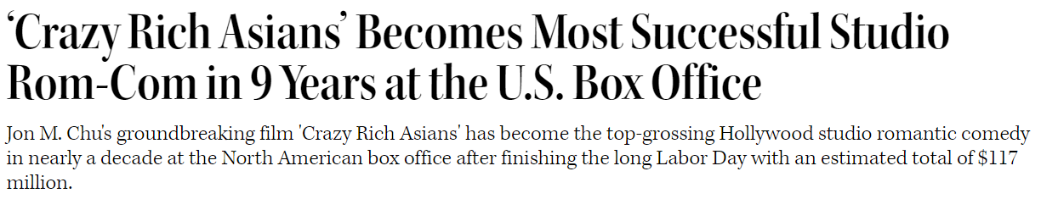

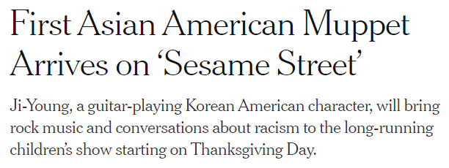



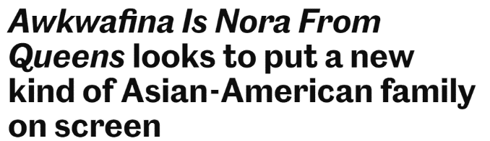
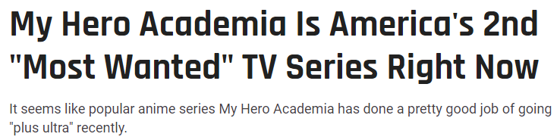



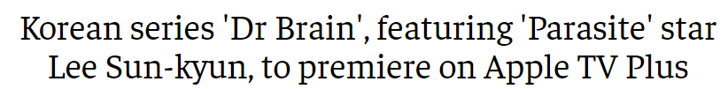
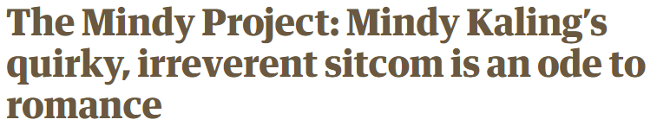
Asian Americans’ influence on mainstream media has been growing significantly, as illustrated by the rising popularity of TV programs and movies featuring Asian characters and culture
October 13, 2021
September 24, 2021
June 28, 2021
July 4, 2021
February 10, 2020
September 3, 2018
November 15, 2021
January 20, 2020
August 2, 2020
March 14, 2021
October 25, 2021
October 3, 2021
April 26, 2021
This information is exclusively provided to VAB members and qualified marketers. Further distribution is prohibited.
PAGE 4

Slide 5

Despite their strong presence in popular culture, Asian Americans are often misrepresented or underrepresented, which highlights the need for more authentic inclusion both on screen and behind the scenes
% of surveyed members of API communities
in the entertainment industry…
…who believe representation means ‘Portraying a group of people in an authentic way on screen’
98%
  …who feel representation in Hollywood is inadequate
On Screen
Behind the Scenes
93%
95%
Source: Geena Davis Institute on Gender in Media, I am Not a Fetish or Model Minority,: Redefining What it Means to Be API in the Entertainment Industry, August 2021. Data based on online survey of 329 respondents who identified as API (Asian Pacific Islander).
This information is exclusively provided to VAB members and qualified marketers. Further distribution is prohibited.
PAGE 5

Slide 6

“The more positive role models we have, the more positive news and things that we have, the better that we can see ourselves reflected in society, and then that helps us elevate ourselves to a higher level"
Jimmy Wong
Star of Netflix’s Wish Dragon
CNET, 7/12/21
This information is exclusively provided to VAB members and qualified marketers. Further distribution is prohibited.
PAGE 6

Slide 7

Representation and relatability are key components of attracting Asian American audiences to TV programs, which underscores the importance of creating content with diverse casts and storylines
% of Asian A18+ who agree with the following statements
‘I’m more likely to watch a TV show with compelling storylines that feature topics relevant to my life’
(i.e., social issues, family & community values, etc.)
‘I’m more likely to watch a show if I find the
main TV personalities or characters relatable’
50%
46%
vs. Non-Asian A18+ Population: 44%
vs. Non-Asian A18+ Population: 42%
Source: VAB / Dynata ‘Multicultural Video Engagement Survey,’ August 2019. Q7: What qualities make you more likely to watch a TV program? Select any or all that apply . Asian American/Pacific Islander = 100 Respondents; Non-Asian Population = 902 respondents.
This information is exclusively provided to VAB members and qualified marketers. Further distribution is prohibited.
PAGE 7

Slide 8

Asian Americans are also most likely to feel underrepresented in advertising, with 62% saying they ‘rarely’ or ‘never’ see people who look like them
73% of Asian Americans say brands need to create culturally diverse advertising in order to stay relevant in an increasingly more diverse society
% who said they feel they’re rarely, if ever, represented in advertising materials*
62%
41%
32%
24%
Asian Americans
Hispanic Americans
Black Americans
White Americans
Source: MRI-Simmons Spring 2021 Doublebase, ‘It is important for companies to create advertising that is culturally diverse in order to stay relevant’ [any agree]. Morning Consult, data based on survey of among 1,000 Asian adults (conducted October 12-19, 2020), 999 Hispanic adults (conducted October 14-19, 2020), 2000 Black adults (conducted June 18-26, 2020), and 1,722 white adults (conducted June 18-21, 2020), with margins of error of +/-2% to +/-3%. *Like TV commercials and sponsored content pots on social media.
This information is exclusively provided to VAB members and qualified marketers. Further distribution is prohibited.
PAGE 8

Slide 9
To authentically engage with influential Asian American consumers, brands can act by developing DEI-targeted initiatives, increasing representation in ads and promoting relevant products
Source: Ipsos, Fresh Lab U.S. Online Syndicated Community, 2021 (n=117 self-identified AAPI respondents). ‘AAPI’: Asian American Pacific Islander.
This information is exclusively provided to VAB members and qualified marketers. Further distribution is prohibited.
PAGE 9

Slide 10
Asian Americans are a diverse
and fast-growing segment with higher education and income levels, making them an attractive audience for advertisers

Slide 11
“When people think Asians in America, they think California, Hawaii. But this population is not a West Coast phenomenon. It’s now an American phenomenon"
Neil G. Ruiz
Associate Director of Race & Ethnicity Research, Pew Research Center
New York Times 8/21/21
This information is exclusively provided to VAB members and qualified marketers. Further distribution is prohibited.
PAGE 11

Slide 12
Asian Americans are the fastest growing multicultural segment
of the U.S. population having doubled in size over the last twenty years
U.S. Asian American Population
in thousands
+99%
vs. 2000
U.S. Hispanic Pop:
+75%
vs. 2000
U.S. Black Pop:
+35%
vs. 2000
Source: VAB analysis of U.S. Census Bureau data, Population by Race Alone or in Combination and Age for the United States: 2000, Current Population Survey, Annual Social and Economic Supplement, 2010, Monthly Population Estimates by Age, Sex, Race, and Hispanic Origin for the United States: April 1, 2010 to July 1, 2020.
This information is exclusively provided to VAB members and qualified marketers. Further distribution is prohibited.
PAGE 12

Slide 13

More than half of Asians in the U.S. were born outside of America, representing a significant segment of the country’s immigrant population
Asians are projected to become the nation’s largest immigrant group, surpassing Hispanics by 2055
% of U.S. Immigrant Population
57%
of Asian Americans were born
outside of the U.S.
vs. 14% of all Americans
Source: Pew Research Center, Key facts about Asian Americans, a diverse and growing population, 4/29/21. Pew Research Center estimates for 1965-2015 based on adjusted census data; Pew Research Center projections for 2025-2065. Note: White, Black and Asian populations include those who report being only one race and are not Hispanic. Asians include Pacific Islanders. Hispanics are of any race. ‘Other’ races shown but not labeled.
This information is exclusively provided to VAB members and qualified marketers. Further distribution is prohibited.
PAGE 13

Slide 14
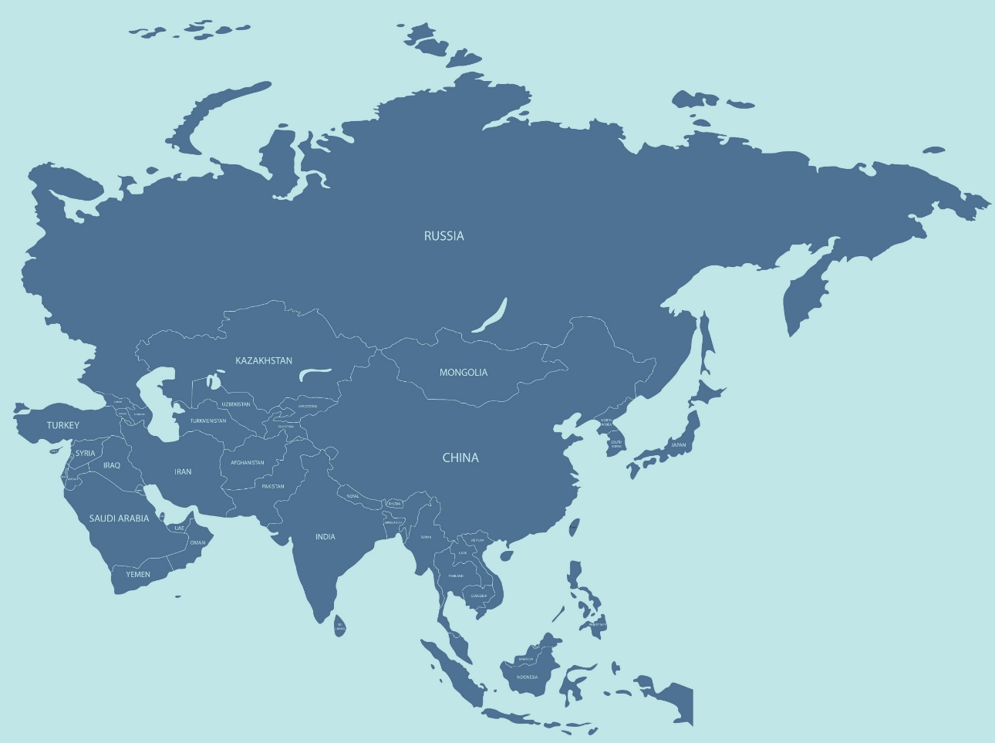
Asians in the U.S. are culturally diverse, representing more than 20 different countries across East Asia, Southeast Asia and the Indian subcontinent
However, just six of the origin groups account for 85% of the U.S. Asian population
% of U.S. Asian Population by Country of Origin
Source: Pew Research Center analysis of 2019 American Community Survey 1-year estimates (Census data). Note: “All Others’ includes the category “Other Asian, not specified”. Figures do not add to 100% because individuals identifying with more than one Asian group are included in all groups. *Includes those identifying as Taiwanese. **Includes Pakistani, Thai, Cambodian, Hmong, Laotian, Taiwanese, Bangladeshi, Nepalese, Burmese, Indonesian, Sri Lankan, Malaysian, Mongolian, Bhutanese and Okinawan.
This information is exclusively provided to VAB members and qualified marketers. Further distribution is prohibited.
PAGE 14

Slide 15
While one-third of the U.S Asian population speaks only English at home,
the remaining two-thirds speak another language, highlighting the importance
of in-language entertainment and advertising to engage with them
All U.S. Asians
U.S. Born Asians
Foreign Born Asians
% who are proficient in speaking English
% who are proficient in speaking English
% who are proficient in speaking English
Proficient
Less than proficient
Proficient
Less than proficient
Proficient
Less than proficient
% who speak the following languages at home
% who speak the following languages at home
% who speak the following languages at home
Source: Pew Research Center analysis of 2017-2019 American Community Survey (OPUMS). Data represents Asian Americans ages 5 and older. Note: figures for all Asians include mixed-race and mixed-group populations, regardless of Hispanic origin. Top five spoken languages shown. Those who are proficient in English include those who say they speak “only English” or speak the language “very well”. Chinese includes languages such as Cantonese and Mandarin. Hindi includes languages such as Urdu and Bengali.
This information is exclusively provided to VAB members and qualified marketers. Further distribution is prohibited.
PAGE 15

Slide 16

Their higher household income and education level compared to the average adult makes them a very valuable consumer segment for marketers
Highest Education Level Completed
Asian American Median Household Income
$94,718
vs. $67,521
for average U.S. HHI
Source: U.S. Census Bureau, Current Population Survey, 2021 Annual Social and Economic Supplement (CPS ASEC). U.S. Census Bureau, Current Population Survey, 2020 Annual Social and Economic Supplement. ‘Bachelor’s+ includes Bachelor’s degree, Master’s degree, Professional degree or Doctoral degree.
This information is exclusively provided to VAB members and qualified marketers. Further distribution is prohibited.
PAGE 16

Slide 17




Driven by their greater buying power and discretionary spending, Asian Americans are influential shoppers with an appetite for new trends and products
34% of Asian adults 18+ (vs. 25% of non-Asian adult 18+ pop) say that people often come to them for advice before buying new things
Average Annual Expenditures
2020
‘I’m usually / always the first among my friends / colleagues to try…..’
% of Asian A18+ who agree
+13%
vs. Average Household
37% (120 index)
New Food products
34% (133 index)
New Technology products
34% (122 index)
New Products or services
21% (140 index)
New Clothing styles
(xxx) = index vs. Non-Asian A18+ Population
Source: VAB analysis of Consumer Expenditure Survey data, U.S. Bureau of Labor Statistics, 2020. VAB analysis of MRI-Simmons Spring 2021 Doublebase. Based on respondents who agree (top 2 box – strongly agree or somewhat agree).
This information is exclusively provided to VAB members and qualified marketers. Further distribution is prohibited.
PAGE 17

Slide 18
Asian Americans are a highly connected audience, creating a strong opportunity for advertisers
to engage them

Slide 19
Asian Americans are ‘well-connected,’ spending more time per week streaming video and social networking than non-Hispanic Whites
P18+ Average Weekly “Time Spent” – Q3 ’20
(Hrs:Mins Among U.S. Population)
Weekly Reach (based on U.S. Population)
81%
65%
49%
54%
80%
83%
Source: Nielsen, Hope and Action: The Growing Influence of Asian Americans, May 2021. Nielsen Total Audience Report, March 2021, hours:minutes among users, P18+. Internet Connected Device = devices connected to the TV that are used to stream content such as Apple TV, Roku, Google Chromecast, Amazon Fire TV, Smartphone, Computer/Laptops, etc. (inclusive of smart TV app usage).
This information is exclusively provided to VAB members and qualified marketers. Further distribution is prohibited.
PAGE 19

Slide 20
Asian Americans act as influencers, often using social media platforms to engage with brands and promote their favorite TV programs
% of Asian adults 18+ who agree with the following statements
‘I enjoy content posted by my favorite brands on social media’
‘Social media is a way for me to tell people about companies & products I like’
Brand Interactions
37%
(Index vs. A18+: 118)
30%
(Index vs. A18+: 122)
‘I like to watch clips from TV shows on social media’
‘I use social media to
talk about shows I watch’
TV Program Interactions
36%
(Index vs. A18+: 132)
21%
(Index vs. A18+: 114)
Source: VAB analysis of MRI-Simmons Spring 2021 Doublebase; P18+. Based on respondents who agree (top 2 box – strongly agree or somewhat agree).
This information is exclusively provided to VAB members and qualified marketers. Further distribution is prohibited.
PAGE 20

Slide 21
With an appetite for the newest video content, Asian Americans are increasingly turning to streaming services to access more entertainment
Their desire for content has drawn Asian American audiences to free, ad-supported streaming services, and the growth in their use of these services is outpacing that of subscription streaming services making them a viable target for marketers’ streaming campaigns
% of Asian adults 18+ that have ‘streamed in the past 12 months’
% change in Asian adults 18+ streamers who have access to a…
July ‘18 vs. July ‘21
+16%
vs. 2018
+28%
+16%
Free / Ad-Based
streaming service
Subscription streaming service
Source: VAB analysis of MRI-Simmons Cord Evolution Study, July 2018 vs. July 2021. Access to free/ad-based vs. subscription streaming service: Base = ‘Streamed in the past 12 months.’ Free Streaming services (e.g., Pluto TV, YouTube, Tubi, etc.). Subscription services may include ads or limited ad load tiers.
This information is exclusively provided to VAB members and qualified marketers. Further distribution is prohibited.
PAGE 21

Slide 22
The Asian American population, which continues to outpace the growth of all other ethnic groups in the U.S.,
is ripe for greater marketer engagement. This diverse segment has nearly doubled in size over the last decade alone, and with comparatively high household incomes and discretionary spend, they have grown significantly in value.
Marketers can connect authentically by recognizing
the nuances of this influential and diverse community, striving for greater representation of Asian Americans
in both media and advertising and investing in relevant platforms like ad-supported streaming services.
Key Marketer Takeaways
This information is exclusively provided to VAB members and qualified marketers. Further distribution is prohibited.
PAGE 22

Slide 23
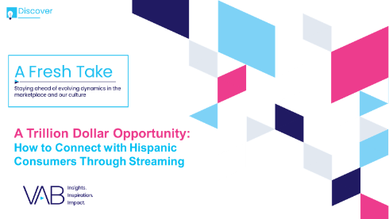

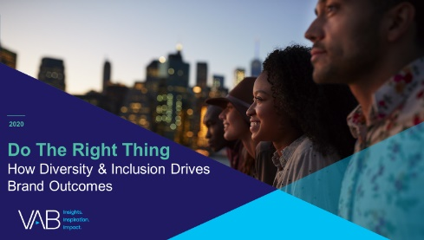
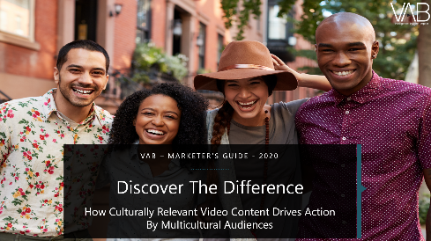
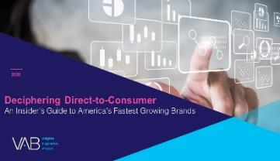
Creators
Jason Wiese
Leah Montner-Dixon
SVP, Director of Strategic Insights
jasonw@thevab.com
Associate Insights Director
leahm@thevab.com
Karolina Guillen
Insights Manager
karolinag@thevab.com
A Trillion Dollar Opportunity
How to Connect with Hispanic Consumers Through Streaming
A Fresh Take On
Engaging Black Consumers
Discover more
Looking for more data, insights and takeaways? Check out this related VAB content
To find out more on the unique media consumption behaviors and cultural trends of multicultural consumers, visit our Multicultural Marketing Resource Center.
Do The Right Thing
How Diversity & Inclusion Drives Brand Outcomes
Discover The Difference
How Culturally Relevant Video Content Drives Action By Multicultural Audiences
VAB Members, brand marketers and agencies get free and immediate access to VAB’s content library. Get access at theVAB.com
This information is exclusively provided to VAB members and qualified marketers. Further distribution is prohibited.
PAGE 23

Slide 24

About VAB
VAB is an insights-driven organization that inspires marketers to reimagine their media strategies resulting in fully informed decisions.
Drawing on our marketing expertise, we simplify the complexities in our industry and discover new insights that transform the way marketers look at their media strategy.
Discover
We keep you one step ahead with the latest thinking so you can create innovative, forward-looking strategies.
Simplify
We save you time by bringing you the latest data & actionable takeaways you can use to inform your marketing plans.
Transform
We help you build your brand by focusing on core marketing principles that will help drive tangible business outcomes.
We are committed to your business growth and proud to offer VAB members, brand marketers and agencies complimentary access to our continuously-growing Insights library. Get immediate access at theVAB.com.
This information is exclusively provided to VAB members and qualified marketers. Further distribution is prohibited.
PAGE 24

