Slide 1
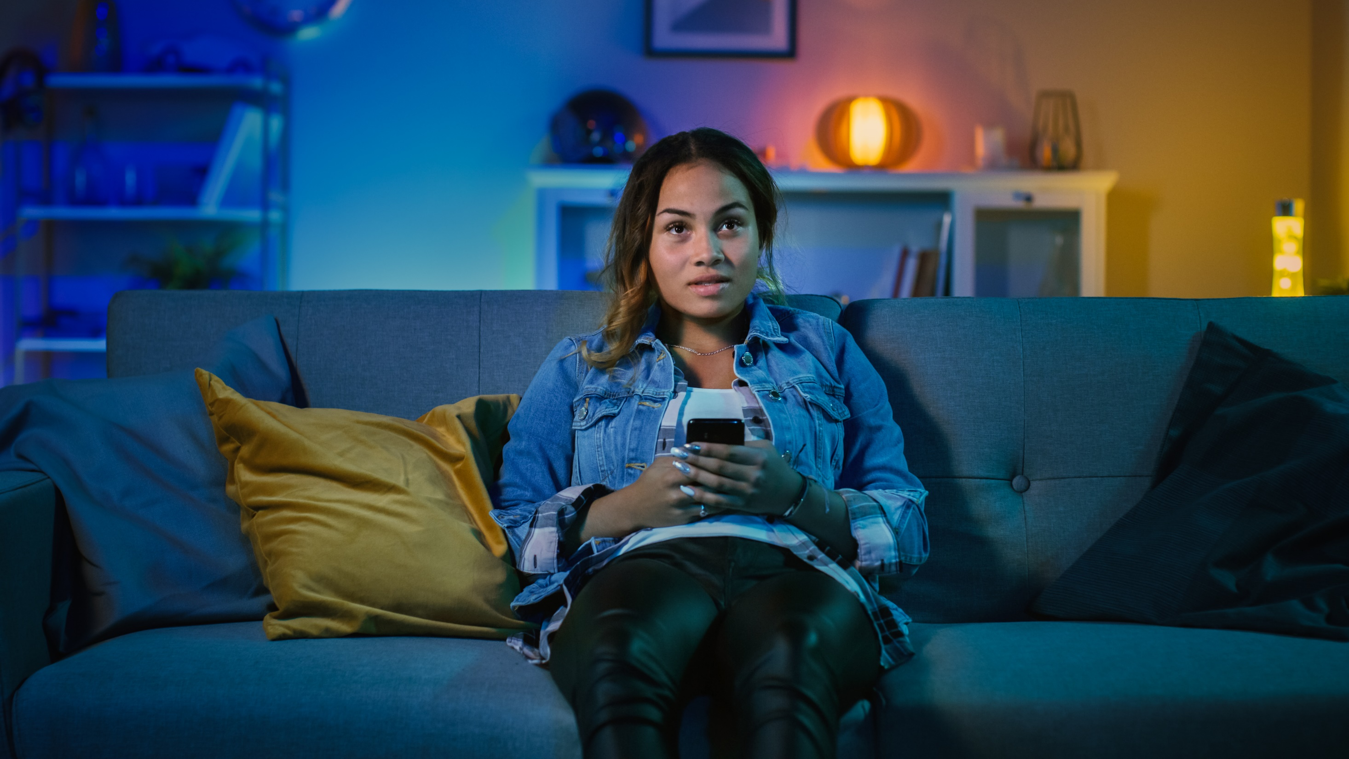


2020
#AloneTogether
Culture in the Time of COVID-19

Slide 2

About VAB
VAB is an insights-driven organization that inspires marketers to reimagine their media strategies resulting in fully informed decisions.
Drawing on our marketing expertise, we simplify the complexities in our industry and discover new insights that transform the way marketers look at their media strategy.
Simplify
We save you time by bringing you the latest data & actionable takeaways you can use to inform your marketing plans.
Discover
We keep you one step ahead with the latest thinking so you can create innovative, forward-looking strategies.
Transform
We help you build your brand by focusing on core marketing principles that will help drive tangible business outcomes.
This information is exclusively provided to VAB members and qualified marketers. Further distribution is prohibited.
PAGE 2

Slide 3
Contents
1
4
Video & Beyond: A Deeper Dive Into Culture During COVID-19
Introduction
2
5
Video at the Center of Culture During COVID-19
What Marketers Need To Know
3
Ad-Supported TV As The Cultural Cornerstone of Society

Slide 4
What You’ll Learn…
How video programming and content has clearly become our primary ‘conversation fuel’ during this time of physical and emotion isolation
How real-time social platforms like Twitter act as a mirror reflecting what our society is most passionate about, motivated by, and attentive to during this unprecedented time of uncertainty
By understanding what content is trending and what inspires conversation, how marketers can build connections to committed, engaged and attentive viewers
This information is exclusively provided to VAB members and qualified marketers. Further distribution is prohibited.
PAGE 4

Slide 5



TV has become the centerpiece of the household, with 8 out of 10 people saying they couldn’t imagine not having a television during the pandemic
% of respondents who agree with the statement
P18+
83%
70%
67%
“I couldn't imagine not having a television set right now”
“I binge watch more TV shows or movies”
“TV has become the central focus of our home”
Source: VAB’s 'As Time Goes By: How Media Consumption Is Helping America Cope’. VAB / Lucid ‘Media Usage In The Time of COVID-19 Survey,’ April 2020. Survey base: P18+ & household subscribes to cable, telco, internet TV or satellite TV (n=1,004). Q7: Thinking of your behavior since the start of COVID-19, please indicate below how much you agree or disagree with the following statements & Q9: Thinking of your behavior during the COVID-19 Pandemic, please indicate below how much you agree or disagree with the following statements
This information is exclusively provided to VAB members and qualified marketers. Further distribution is prohibited.
PAGE 5

Slide 6







Since the start of COVID-19, live TV and social media are experiencing the biggest increase in consumption
Overall, 84% of respondents say they have more time to watch/listen/read media since the COVID-19 outbreak
% of respondents who increased usage by platform since COVID-19 outbreak
P18+
57%
55%
54%
Live TV
Social
Media
SVOD
Service
37%
35%
31%
23%
Video
Games
Streaming Music
AVOD
Service
Podcasts
Source: VAB’s 'As Time Goes By: How Media Consumption Is Helping America Cope’. VAB / Lucid ‘Media Usage In The Time of COVID-19 Survey,’ April 2020. Survey base: P18+ & household subscribes to cable, telco, internet TV or satellite TV (n=1,004). Q2: When thinking about how you’ve spent your time during the COVID-19 Pandemic, have you increased, decreased or spent the same amount of time with the following media? & Q9: Thinking of your behavior during the COVID-19 Pandemic, please indicate below how much you agree or disagree with the following statements. SVOD: Subscription Video On Demand (e.g. Netflix, Amazon Prime Video), AVOD: Ad-Supported Video On Demand (e.g. Tubi, Roku).
This information is exclusively provided to VAB members and qualified marketers. Further distribution is prohibited.
PAGE 6

Slide 7




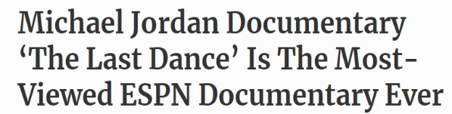















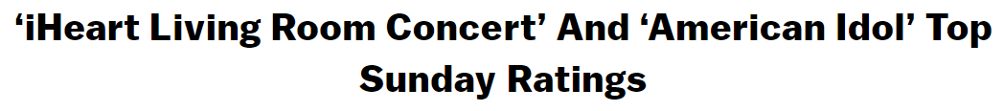





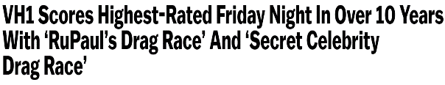








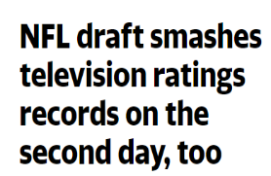
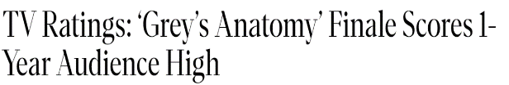












During the COVID-19 lockdown, many popular series and program ‘specials’ across TV and streaming services have achieved record ratings and viewership
This information is exclusively provided to VAB members and qualified marketers. Further distribution is prohibited.
PAGE 7

Slide 8

Video at the Center of Culture During COVID-19

Slide 9

Quantifying Culture in the Time of COVID-19
With outside physical interactions limited, social media became
the bellwether for understanding culture during the lockdown, particularly Twitter which is a platform for ‘real time’ social engagement built around what people are talking about ‘right now.’
To take the cultural pulse of the country, we analyzed the top 10 trending Twitter topics each night over the first six weeks of country-wide lockdown orders (March 16th - April 26th).
Since trending topics are ever-changing, we monitored two “points in time” each night to capture what people are talking about online throughout the evening: 9:30p and 11:00p.
Trending topics based on video content include two types which have been aggregated within this analysis:
  Direct: specific ‘official’ hashtags of entertainment shows, sports content or news programming
  Related: topics associated with specific video programming including athletes (ex. football players being selected in the 2020 NFL Draft), show characters, celebrity personalities, and specific video platform-related news references
*Geography reflects United States-based Twitter Top 10 Trending data
Note: Twitter skews towards a millennial audience – P18-34 account for 34% of users and 52% of total time spent on the platform (Comscore, MediaMetrix Key Measures multiplatform data, March 2020).
This information is exclusively provided to VAB members and qualified marketers. Further distribution is prohibited.
PAGE 9

Slide 10

Video content accounted for three-quarters of the top 10 Twitter trending topics at night during the six-week analysis
% of Video Topics in the Top 10 During Primetime
(March 16th – April 26th)
vs. 11% for non-video platform related pandemic topics
Source: VAB custom analysis of Top 10 trending Twitter Topics each night (9:30p & 11p) aggregated during the analysis time period (3/16/2020 – 4/26/2020). Results include both ‘direct’ and ‘related’ topics.
This information is exclusively provided to VAB members and qualified marketers. Further distribution is prohibited.
PAGE 10

Slide 11




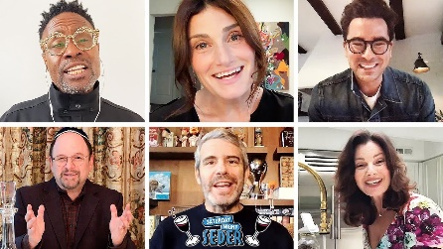







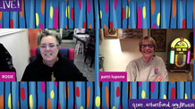
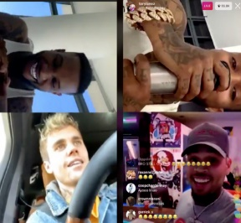
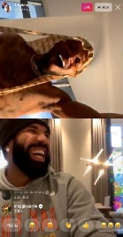








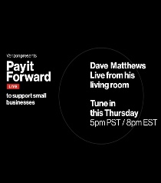
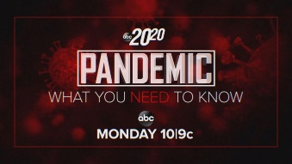
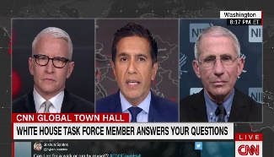


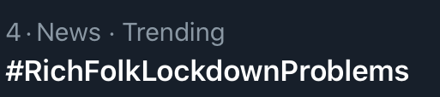

In contrast to many of the organic Twitter trending topics about COVID-19, video provides a fun, lighthearted and safe space for users with comforting content about and around the pandemic
Sampling of Pandemic-Related Topics By Platform
(March 16th – April 26th)
Ad-Supported TV
Other Video Platforms
Organic Twitter Topics
Source: VAB custom analysis of Top 10 trending Twitter Topics each night (9:30p & 11p) aggregated during the analysis time period (3/16/2020 – 4/26/2020). Results include both ‘direct’ and ‘related’ topics. Other Video Platforms feature Dropkick Murphy’s livestreamed concert, Saturday Night Seder, The Rosie O’Donnell Show, Quarantine Radio, Kayzo Unleashed, BangBangCon, and Verizon’s Pay It Forward Live. Non-Video pandemic-related tweets feature hashtags and topics that trended. Video-related pandemic topics include news programs such as town halls and the Coronavirus task force daily briefings, televised benefit concerts and other programming that is explicitly related to the pandemic.
This information is exclusively provided to VAB members and qualified marketers. Further distribution is prohibited.
PAGE 11

Slide 12


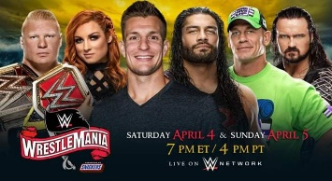

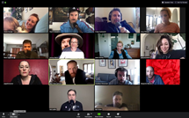
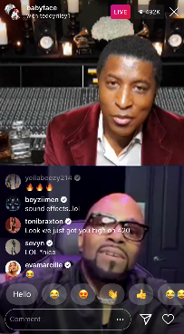


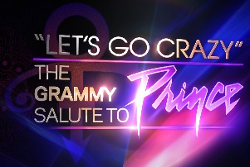
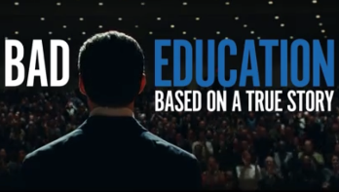

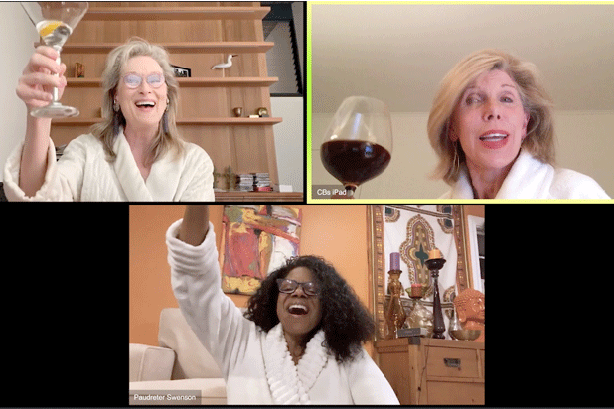
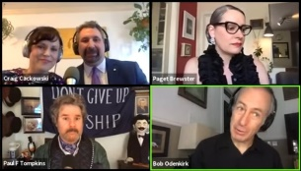

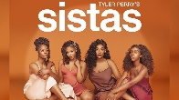






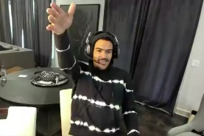
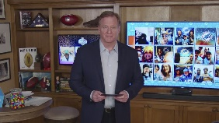
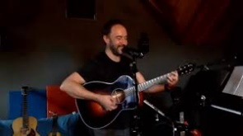
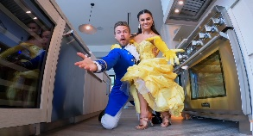
The most ‘talked about’ video content was a mix of professionally-produced, user-generated and ‘at home’ remote programming
A Sampling of Trending Professionally-Produced, User-Generated & ‘Hybrid’ Video Content
(March 16th – April 26th)
Professionally-Produced Content
User-Generated Content
(YouTube, Instagram, Facebook, etc)
‘Remote’ Programming From Professional Content Producers
Source: VAB custom analysis of Top 10 trending Twitter Topics each night (9:30p & 11p) aggregated during the analysis time period (3/16/2020 – 4/26/2020). Results include both ‘direct’ and ‘related’ topics
This information is exclusively provided to VAB members and qualified marketers. Further distribution is prohibited.
PAGE 12

Slide 13



























































Viewers chatted about programming on 59 different video platforms and networks
66% of adults say they are more open to trying new types of media (new streaming services, social media platforms, etc) since the COVID-19 outbreak
Ad-Supported TV (38+)
Instagram (1)
YouTube (1)
WWE (1)
Public / Pay-TV (3)
Other Social Media (2)
Netflix (1)
Other Video Platforms (12+)
Source: VAB’s 'As Time Goes By: How Media Consumption Is Helping America Cope’. VAB / Lucid ‘Media Usage In The Time of COVID-19 Survey,’ April 2020. Survey base: P18+ & household subscribes to cable, telco, internet TV or satellite TV (n=1,004). Q9: Thinking of your behavior during the COVID-19 Pandemic, please indicate below how much you agree or disagree with the following statements. VAB custom analysis of Top 10 trending Twitter Topics each night (9:30p & 11p) aggregated during the analysis time period (3/16/2020 – 4/26/2020). Results include both ‘direct’ and ‘related’ topics. Ad-supported TV Networks count (+) because TV-related news topics can be trending due to coverage across multiple TV news networks and Other Video Platforms count (+) because some events were streamed across multiple platforms. (#) = number of networks/platforms within each grouping that have trended.
This information is exclusively provided to VAB members and qualified marketers. Further distribution is prohibited.
PAGE 13

Slide 14
Over 144 individual pieces of content trended indicating appeal across a wide variety of ages, life stages and interests
At least one video-related topic trended everyday of the six-week analysis, covering a variety of genres including live news specials, reality TV, scripted dramas, movies, sports-related updates, gaming, music live streams, etc
% of Top 10 Trending Programs / Content by Platform
Source: VAB custom analysis of Top 10 trending Twitter Topics each night (9:30p &11p) (3/16/2020 – 4/26/2020). Results include both ‘direct’ and ‘related’ topics. Various Video Platforms include Epic Games, and various concert streaming partners.
This information is exclusively provided to VAB members and qualified marketers. Further distribution is prohibited.
PAGE 14

Slide 15
Social media is particularly popular among multicultural audiences,
27% of total trending topics were related to subjects, content and programming that specifically featured people of color or a diverse cast
% of Top 10 ‘Diversity-Focused’ Trending Topics by Platform
(March 16th – April 26th)
86% of total topics were video-based
Source: VAB custom analysis of Top 10 trending Twitter Topics each night (9:30p & 11p) aggregated during the analysis time period (3/16/2020 – 4/26/2020). Results include both ‘direct’ and ‘related’ topics. Other video platforms include Facebook Live, HBO, Netflix, Twitter and YouTube. NFL is excluded from the count of topics due to the mainstream nature of the sport and online conversations.
This information is exclusively provided to VAB members and qualified marketers. Further distribution is prohibited.
PAGE 15

Slide 16
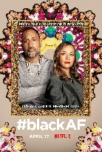

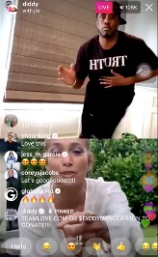


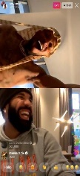


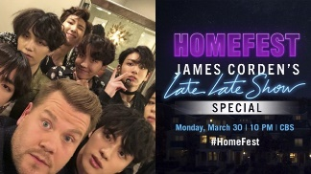





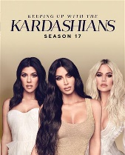

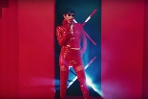







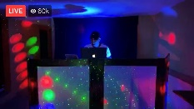






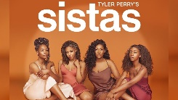
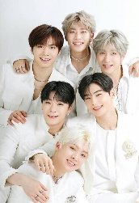
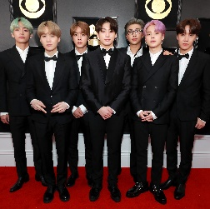
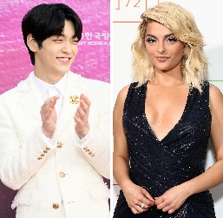
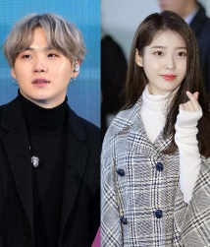
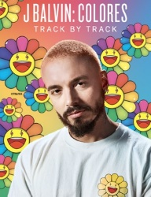
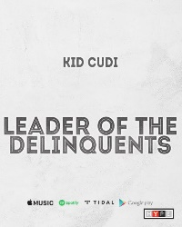






Diversity-focused social conversations during the pandemic were led
by ad-supported TV, streaming programs, Instagram Live music battles,
K-Pop streaming events and news about upcoming album releases
Diversity-Featured Programming / Content Trends In The Top 10 By Platform
(March 16th – April 26th)
Ad-Supported TV (23+)
Other Video Platforms (15+)
K-Pop and Album Releases (13+)
Source: VAB custom analysis of Top 10 trending Twitter Topics each night (9:30p & 11p) aggregated during the analysis time period (3/16/2020 – 4/26/2020). Results include both ‘direct’ and ‘related’ topics. Various Video Platforms include YouTube, Netflix, Fortnite, Facebook Live, Twitch, and HBO. Ad-supported TV Networks count (+) because TV-related news topics can be trending due to coverage across multiple TV news networks and Other Video Platforms count (+) because some events were streamed across multiple platforms. (#) = number of programs / content within each grouping that have trended. Music shown is a sampling of content. Various Video Content features Bad Bunny’s music video for ‘Yo Perreo Sola’, Diddy and J.Lo reuniting on Instagram Live, Tommy Torres performing live via YouTube, DJ Yamil on Facebook Live, and Quarantine Radio on Instagram Live. Music features several K-Pop artists and groups including Astro, BTS, Soobin and Bebe Rexha, along with album releases from J Balvin and Kid Cudi.
This information is exclusively provided to VAB members and qualified marketers. Further distribution is prohibited.
PAGE 16

Slide 17

Major Takeaways: Video at the Center
of Culture During COVID-19
At 75% of trending topics, video programming and content clearly stands out in its ability to get people talking and connecting
Video programming trends every day, demonstrating there is always something brand safe yet “talkworthy” to tap into
The variety and number of individual pieces of content that trended indicate the enormous appeal of video – and premium video specifically - across people of different ages (especially younger adults), lifestages and interests
Multicultural audiences, in particular, are highly engaged on social media and enjoy discussing their favorite video content and TV programs within online communities
This information is exclusively provided to VAB members and qualified marketers. Further distribution is prohibited.
PAGE 17

Slide 18

Ad-Supported TV As The Cultural Cornerstone of Society

Slide 19

People have always enjoyed the communal aspect of TV viewing, however during lockdown the next best thing to in-person contact was being ‘alone together’ within shared-interest TV communities on social media platforms
% of Ad-Supported TV Topics in the Top 10 During Primetime
(March 16th – April 26th)
Source: VAB custom analysis of Top 10 trending Twitter Topics each night (9:30p & 11p) aggregated during the analysis time period (3/16/2020 – 4/26/2020). Results include both ‘direct’ and ‘related’ topics. VAB’s custom study, Committed: Exploring Millennials' Meaningful Relationship With TV Programming.
This information is exclusively provided to VAB members and qualified marketers. Further distribution is prohibited.
PAGE 19

Slide 20
Therefore, it’s no surprise, ad-supported TV made up over half of all trending topics in the Twitter top 10
Across video platforms only, ad-supported TV drove 72% of total video-related trending topics
Source: VAB custom analysis of Top 10 trending Twitter Topics each night (9:30p & 11p) aggregated during the analysis time period (3/16/2020 – 4/26/2020). Results include both ‘direct’ and ‘related’ topics. Other Video Platforms include Amazon Prime Video, Blaze TV, Disney+, Epic Games, Kotaku, Nintendo, PlayStation, Shudder, TikTok, Twitch, Vudu, Xbox and various concert streaming partners. Other Social Media includes Facebook Live & Twitter.
This information is exclusively provided to VAB members and qualified marketers. Further distribution is prohibited.
PAGE 20

Slide 21
At least one ad-supported TV program trended almost every night while the next closest platform was Instagram at almost 50% of nights
An ad-supported TV program trended #1 on almost three-quarters of the nights within the six-week analysis
# of Nights When Programming / Content Trended Within Top 10 Topics by Platform
(March 16th – April 26th)
98%
48%
40%
29%
14%
7%
7%
5%
# of Nights Platforms Trended #1
71%
(30)
12%
(5)
7%
(3%)
7%
(3)
2%
(1)
2%
(1)
2%
(1)
5%
(2)
Source: VAB custom analysis of Top 10 trending Twitter Topics each night (9:30p &11p) (3/16/2020 – 4/26/2020). Results include both ‘direct’ and ‘related’ topics. Other Social Media includes Facebook Live & Twitter. Other Video Platforms include Amazon Prime Video, Blaze TV, Disney+, Epic Games, Kotaku, Nintendo, PlayStation, Shudder, TikTok, Twitch, Vudu, Xbox and various concert streaming partners. Six week analysis = 42 days.
This information is exclusively provided to VAB members and qualified marketers. Further distribution is prohibited.
PAGE 21

Slide 22


























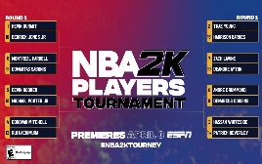


























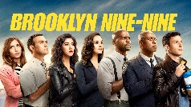





















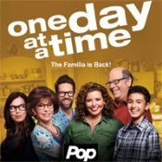












The 92 ad-supported TV programs that trended reflect a variety of live and recorded programming within the entertainment, sports and news genres
Ad-Supported TV Programs That Trended in the Top 10
Source: VAB custom analysis of Top 10 trending Twitter Topics each night (9:30p &11p) (3/16/2020 – 4/26/2020). Results include both ‘direct’ and ‘related’ topics.
This information is exclusively provided to VAB members and qualified marketers. Further distribution is prohibited.
PAGE 22

Slide 23
Entertainment made up over three-fourths of TV programs that trended in the top 10, filling any potential void created by the absence of live sports
Ad-Supported TV Topics by Genre Within Top 10 Trending Topics
(March 16th – April 26th)
Genre | % of Topics
Entertainment | 64%
Sports | 21%
News | 15%
Note: news-related trending topics had to be based primarily on a televised event to be attributed to ad-supported TV
(ex. Coronavirus Task Force Briefing, Town Halls, interviews on news programs, etc)
Source: VAB custom analysis of Top 10 trending Twitter Topics each night (9:30p & 11p) aggregated during the analysis time period (3/16/2020 – 4/26/2020). Results include both ‘direct’ and ‘related’ topics.
This information is exclusively provided to VAB members and qualified marketers. Further distribution is prohibited.
PAGE 23

Slide 24








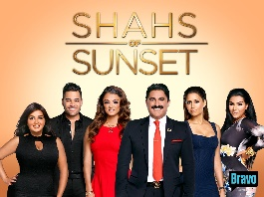

























People turned to and talked about, ‘comfort’ entertainment that offered escapism, competition, community and a sense of connection while in isolation
Entertainment TV Programs Within Top 10 Trending Topics By Genre
‘At-Home’ Concerts
Escapism (Drama & Comedy)
Reality
Competition
Relationship / Dating
Wrestling
Source: VAB custom analysis of Top 10 trending Twitter Topics each night (9:30p & 11p) aggregated during the analysis time period (3/16/2020 – 4/26/2020). Results include both ‘direct’ and ‘related’ topics
This information is exclusively provided to VAB members and qualified marketers. Further distribution is prohibited.
PAGE 24

Slide 25






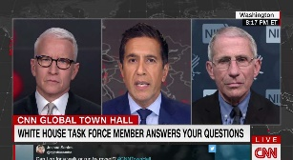










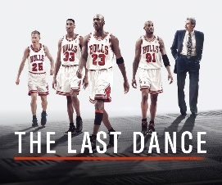





Many of these conversations became a daily ritual each week throughout the lockdown
This ‘appointment TV’ extended to an appointment with their devices as well so that viewers could connect and engage with fellow fans each week on social media during isolation
Ad-Supported TV Programs That Trended in the Top 10 During at Least 3 of the 6 Weeks Analyzed*
Monday
Tuesday
Wednesday
Thursday
Friday
Saturday
Sunday
Source: VAB custom analysis of Top 10 trending Twitter Topics each night (9:30p & 11p) aggregated during the analysis time period (3/16/2020 – 4/26/2020). Results include both ‘direct’ and ‘related’ topics. Programs shown represent programs that trended on the same day of the week in at least 3 of the 6 weeks monitored. *Not all programs aired throughout the entire six-week analysis, therefore we've also included programs that trended at least twice when it represented at least half of their episodes during the time period: : Monday - The Bachelor: Listen to Your Heart, Supernatural, Manifest; Tuesday - This Is Us, Schitts Creek; Wednesday - The Challenge: Total Madness; Thursday - Grey's Anatomy, The Real Housewives of NYC; Friday - Blue Bloods; Sunday - The Walking Dead, The Last Dance.
This information is exclusively provided to VAB members and qualified marketers. Further distribution is prohibited.
PAGE 25

Slide 26
Virtually every night of the week, the majority of Twitter’s top 10 trending topics were about ad-supported TV
Six-Week Time Period: % of Total Top 10 Trending Topics that are Based on Ad-Supported TV Content
Monday
Tuesday
Wednesday
Thursday
Friday
Saturday
Sunday
Average
68%
37%
63%
63%
60%
28%
58%
w/o 3/16
70%
35%
60%
30%
55%
15%
40%
w/o 3/23
90%
45%
55%
40%
60%
15%
55%
w/o 3/30
80%
35%
50%
80%
60%
0%
35%
w/o 4/6
60%
15%
65%
55%
60%
50%
55%
w/o 4/13
70%
30%
60%
80%
45%
50%
90%
w/o 4/20
40%
60%
85%
95%
80%
40%
70%
Source: VAB custom analysis of Top 10 trending Twitter Topics each night (9:30p & 11p) aggregated during the analysis time period (3/16/2020 – 4/26/2020). Results include both ‘direct’ and ‘related’ topics.
This information is exclusively provided to VAB members and qualified marketers. Further distribution is prohibited.
PAGE 26

Slide 27
Since the start of the pandemic many ad-supported TV networks aired news specials to inform and special performances and programs to entertain…

Slide 28

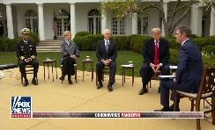







Live concerts featuring ‘living room performances’ replaced award shows and helped raise money for COVID relief while classic sports and gaming / esports have replaced live sports
Ad-Supported TV ‘Specials’ That Trended in the Twitter Top 10
(March 16th – April 8th)
3/16
3/22
3/26
3/29
3/30
4/1
4/2
4/2
4/3
4/3
4/5
(#4)
(#5)
(#2)
(#1)
(#1)
(#2)
(#1)
(#8)
(#5)
(#10)
(#6)
ABC’s 20/20 brought specialists on air to inform the public about the pandemic and take questions from viewers.
ESPN re-aired a classic WWE event, Wrestlemania 30, on Sunday night.
The CNN Town Hall reported on information and updates regarding the coronavirus pandemic.
Fox aired the iHeart Living Room Concert to help provide relief and support to combat the spread of the COVID-19.
CBS’ Homefest: James Corden’s Late Late Show Special, raised money for charity organizations including the CDC Foundation and Feeding America.
The Garth & Trisha Live! special included Garth Brooks and Trisha Yearwood performing a live concert for coronavirus relief.
The CNN Town Hall reported on information and updates regarding the coronavirus pandemic.
ESPN re-aired the 2006 Rose Bowl,
a classic national championship college football game between Texas & USC.
ESPN2 aired the NBA 2K20 Video Game Player Tournament featuring current NBA players competing against each other with the winner’s prize going to charity
ESPN aired the classic sports movie, Glory Road, on Friday night.
With the Academy of Country Music Awards pushed back due to the coronavirus pandemic, CBS held a concert special, ACM Presents: Our Country, where musicians performed from their own homes.
(#) = the highest ranking the trending topic achieved during the night
Source: VAB custom analysis of Top 10 trending Twitter Topics each night (9:30p & 11p) aggregated during the analysis time period (3/16/2020 – 4/8/2020). Results include both ‘direct’ and ‘related’ topics.
This information is exclusively provided to VAB members and qualified marketers. Further distribution is prohibited.
PAGE 28

Slide 29












TV networks stepped up their cultural presence by increasing the amount of ‘specials’ in support of COVID-19 relief efforts while providing fans with more sports content
Ad-Supported TV ‘Specials’ That Trended in the Twitter Top 10
(April 9th – April 26th)
4/11
4/12
4/12
4/16
4/17
4/18
4/19, 4/26
4/21
4/22
4/23-4/25
4/24
4/25
(#1)
(#3)
(#7)
(#1)
(#3)
(#2)
(#1) (#1)
(#2)
(#4)
(#1) (#1) (#2)
(#2)
(#2)
Lifetime premiered the original film, The Clark Sisters: First Ladies of Gospel.
ESPN televised an NBA HORSE Tournament -- a single-elimination shooting competition.
Jesus Christ Superstar Live, starring John Legend and Brandon Victor Dixon re-aired for Easter Sunday on NBC.
ABC’s Disney Family Singalong featured pop stars performing their favorite Disney numbers from their own homes.
The 2020 WNBA Draft was the league's draft for the 2020 season that was held virtually due to the pandemic.
Global Citizen and WHO broadcasted the One World: Together At Home global special in support of the fight against COVID-19.
ESPN aired a 10-part documentary, The Last Dance, follows Michael Jordan and the 1997-98 Chicago Bulls throughout their final championship together.
CBS aired a special tribute concert, Let’s Go Crazy: The GRAMMY Salute to Prince.
Saving Our Selves: A BET COVID-19 Relief Effort benefit aired to help communities of color impacted by COVID-19.
The 2020 NFL Draft was held via video conferencing to select players for the 2020 season.
RuPaul's Secret Celebrity Drag Race aired as a special spin-off of RuPaul's Drag Race.
Club MTV Presents: Dance Together With D-Nice brought live dance parties to living rooms across America while raising funds for the Save the Music foundation.
(#) = the highest ranking the trending topic achieved during the night
Source: VAB custom analysis of Top 10 trending Twitter Topics each night (9:30p & 11p) aggregated during the analysis time period (4/9/2020 – 4/26/2020). Results include both ‘direct’ and ‘related’ topics.
This information is exclusively provided to VAB members and qualified marketers. Further distribution is prohibited.
PAGE 29

Slide 30
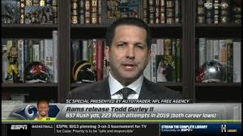
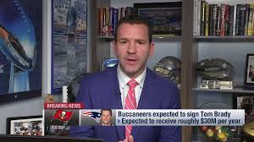

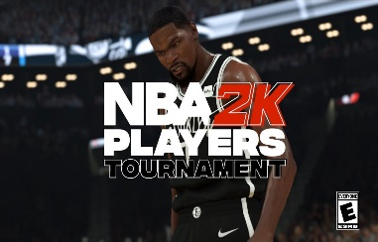




Just because there weren’t live sports being played, doesn’t mean there wasn’t sports to talk about throughout the lockdown
Even with the cancellation of almost all live events, nearly three-fourths of sports fans say they are watching more or the same amount of TV during the pandemic
1
1
2
Sampling of Sports Programming That Trended In The Top 10
(March 16th-April 26th)
1
3/16 -19, 3/24, 4/1,4/9, 4/21 (#1 on 3/16): NFL Free agency was buzzing on social media during w/o 3/16 and 3/23 fueled by continual breaking news from top NFL insiders – ESPN’s Adam Schefter & NFL Networks’ Ian Rapoport.
4/2-3 (#8 on 4/2): ESPN aired classic sporting events like the 2006 Rose Bowl and classic sports movies like Glory Road.
4/3 (#5): ESPN / ESPN2 aired the NBA 2K20 Player Tournament featuring current NBA players competing against each other remotely on the video game.
4/12 (#3): The NBA held a HORSE competition featuring past and present players from the NBA and WNBA filmed remotely at their homes.
4/17 (#3): The 2020 WNBA Draft was held remotely across teams.
4/19, 4/26 (#1): ESPN's 10-part documentary, "The Last Dance,“ chronicles Michael Jordan and the 1997-98 Chicago Bulls during their final championship together.
4/23-25 (#1): The 2020 NFL Draft was held remotely via video conferencing across teams.
2
3
3
4
3
4
5
6
7
5
6
7
(#) = the highest ranking the trending topic achieved during the night
Source: VAB’s 'As Time Goes By: How Media Consumption Is Helping America Cope’. VAB / Lucid ‘Media Usage In The Time of COVID-19 Survey,’ April 2020. Survey base: P18+, household subscribes to cable, telco, internet TV or satellite and viewers that previously watched live sports (n=797). Q12: Due to COVID-19 virtually all live sports have been pulled off the air. As a result, are you watching more, less or the same amount of TV? Excludes respondents who did not watch live sports. VAB custom analysis of Top 10 trending Twitter Topics each night (9:30p & 11p) aggregated during the analysis time period (3/15/2020 – 4/8/2020). Results include both ‘direct’ and ‘related’ topics.
This information is exclusively provided to VAB members and qualified marketers. Further distribution is prohibited.
PAGE 30

Slide 31







TV news network-hosted town halls and the daily telecasts of the Coronavirus task force briefings also made for popular conversations
Viewers are hungry for up-to-the-minute news to stay informed: 74% of consumers check the news multiple times a day for updates and 49% have at least one TV in their home set to a news channel at all times
1
2
Sampling of News Programming That Trended In The Top 10
(March 16th-April 26th)
1
3/16 (#4): David Muir and Dr. Jennifer Ashton host a live coronavirus special, ABC 20/20 COVID-19: Pandemic: What You Need to Know, in order to hear from and inform viewers.
3/19 (#3): Tucker Carlson Tonight featured opinions from different guests on whether lockdowns should continue.
3/24 (#1): During a Fox News Town Hall, President Trump and several advisors gave updates regarding the COVID-19 pandemic.
3/26 (#2): CNN’s Global Town Hall featured Dr. Anthony Fauci, Dr. Sanjay Gupta, and Anderson Cooper answering questions from the public regarding COVID-19.
3/27 (#10): On Trish Regan Primetime, Regan shared her thoughts on the coronavirus pandemic.
4/12 (#10): Fox News Sunday with Chris Wallace shares his opinion on Trump’s response to the COVID-19 pandemic.
4/22 (#6): The mayor of Las Vegas called for hotels and casinos to be reopened in an interview on Anderson Cooper 360.
2
3
4
3
4
5
5
6
7
6
7
(#) = the highest ranking the trending topic achieved during the night
Source: VAB custom analysis of Top 10 trending Twitter Topics each night (9:30p & 11p) aggregated during the analysis time period (3/15/2020 – 4/8/2020). Results include both ‘direct’ and ‘related’ topics. Percentages come from VAB’s 'As Time Goes By: How Media Consumption Is Helping America Cope’. VAB / Lucid ‘Media Usage In The Time of COVID-19 Survey,’ April 2020. Survey base: P18+ & household subscribes to cable, telco, internet TV or satellite TV (n=1,004). Q6: Thinking of your behavior during the COVID-19 Pandemic, please indicate below how much you agree or disagree with the following statements & Q7: Thinking of your behavior since the start of COVID-19, please indicate below how much you agree or disagree with the following statements. , top 2 box (agree completely or agree somewhat)
This information is exclusively provided to VAB members and qualified marketers. Further distribution is prohibited.
PAGE 31

Slide 32
Ad-supported TV’s ability to quickly adapt and produce fresh, timely, quality content resulted in the highest levels of engagement of any platform
Although Netflix shows like Tiger King and Ozark no doubt also entered the cultural zeitgeist during the early days of the lockdown, they didn’t garner the same level of concurrent conversations or ‘simultaneous community’ since people could view these series on their own time
Source: VAB custom analysis of Top 10 trending Twitter Topics each night (9:30p &11p) (3/16/2020 – 4/26/2020). Results include both ‘direct’ and ‘related’ topics. Various Video Platforms include Epic Games, and various concert streaming partners. Pay-TV: insecure (HBO), Westworld (HBO), Homeland (Showtime). Netflix - #BlackAF, Extraction, Homecoming: A Film by Beyonce. Disney – Onward. Amazon Prime Video – Happiness Continues: A Jonas Brothers Concert Film.
This information is exclusively provided to VAB members and qualified marketers. Further distribution is prohibited.
PAGE 32

Slide 33
Major Takeaways: Ad-Supported TV As The Cultural Cornerstone of Society
Many programs have become consistent ‘appointment TV’ and fresh content like specials, benefits and town halls rally us as a community
During the lockdown, entertainment programming has filled the social conversation void left by the absence of daily sports
However, despite the lack of live sports, sports-related programming (news, talk, retrospectives and other ancillary content) continues to inspire conversation and is a good opportunity to connect with passionate fans
News content also inspires online discussion and healthy debate
This information is exclusively provided to VAB members and qualified marketers. Further distribution is prohibited.
PAGE 33

Slide 34
Video & Beyond: A Deeper Dive Into Culture During COVID-19

Slide 35



Beyond ad-supported TV, three other major topics consistently spark conversation on Twitter
Music
Movies
Video Games
This information is exclusively provided to VAB members and qualified marketers. Further distribution is prohibited.
PAGE 35

Slide 36
24% of all trending topics on Twitter were music-related, driven by video content produced through Instagram and ad-supported TV
% of Top 10 ‘Music-Related’ Trending Topics by Platform
(March 16th – April 26th)
77% of total topics were video-based
Source: VAB custom analysis of Top 10 trending Twitter Topics each night (9:30p & 11p) aggregated during the analysis time period (3/16/2020 – 4/26/2020). Results include both ‘direct’ and ‘related’ topics. Other video platforms include Amazon Prime Video, Epic Games, Facebook Live, Netflix, PBS, Twitter, Twitch and various other streaming platforms.
This information is exclusively provided to VAB members and qualified marketers. Further distribution is prohibited.
PAGE 36

Slide 37





























Specials, live-streamed performances, DJ battles and the latest news on musicians and album releases has people continually chatting about music online
Music-Related Trends In The Top 10 By Platform
(March 16th – April 26th)
Ad-Supported TV Music Programs & Specials
Live-Streamed Performances
Instagram Live Music Battles
K-Pop News and
Album Releases
Source: VAB custom analysis of Top 10 trending Twitter Topics each night (9:30p & 11p) aggregated during the analysis time period (3/16/2020 – 4/26/2020). Results include both ‘direct’ and ‘related’ topics. Various Video Platforms include YouTube, and various concert streaming partners. Live-Streamed Performances include Tommy Torres, Saturday Night Seder, and Take Me To The World. Instagram Live music battles feature DJ Premier vs. RZA, Sean Garret vs. The Dream, Swizz vs. Timbaland, Tainy vs. Luny Tunes, Neyo vs. Johnta, Lil Jon vs. T-Pain, and Babyface vs.
Teddy Riley. Non-Video Music include Astro, Soobin and Bebe Rexha, Kid Cudi, BTS, IU and Suga, J Balvin, NCT Dream, Kim Taehyung, and Uzi
This information is exclusively provided to VAB members and qualified marketers. Further distribution is prohibited.
PAGE 37

Slide 38







Music-related ‘event’ video content that sparked online conversation ranged from musicians streaming virtual concerts to Broadway actors and celebrities performing live from their homes
Video Streaming ‘Special’ Content That Trended in the Twitter Top 10
(March 16th – April 26th)
3/17
3/18
3/22
3/26
4/9
4/11
4/17-4/18
4/24
4/25
4/26
(#3)
(#1)
(#7)
(#1)
(#2)
(#2)
(#1) (#6)
(#8)
(#6)
(#1)
Dropkick Murphy’s live streamed their annual St. Patrick’s Day concert across various platforms.
Beyoncé fans were encouraged to join a Twitter watch party for her 2019 Netflix documentary, Homecoming, conversation was further fueled when Beyoncé retweeted in support.
The Rosie O'Donnell Show came back for a one-night special return through Broadway.com and their YouTube channel with celebrities live streaming from their homes to benefit the Actors Fund to provide aid during the coronavirus outbreak.
Dave Matthews live streamed a concert on Twitter for Verizon's 'Pay It Forward Live’ weekly livestream event which features musicians performing from their living rooms to support small businesses.
DJs Kayzo and Insomniac performed Unleashed – Online via YouTube.
The Saturday Night Seder had Broadway stars, actors, and celebrities performing and supported the effort to combat the spread of the COVID-19 virus.
The BANGBANGCON streaming event provided fans with an at-home BTS concert experience.
The Jonas Brothers crashed Zoom calls hosting viewing parties for their new movie that premiered on Amazon Prime Video, Happiness Continues: A Jonas Brothers Concert Film.
The Room Service Music Festival raised money for Feeding America and Sweet Relief while bringing back the festival experience to music lovers.
Broadway.com and their YouTube channel hosted a virtual concert, Take Me To The World, to celebrate the 90th birthday of legendary composer Stephen Sondheim.
(#) = the highest ranking the trending topic achieved during the night
Source: VAB custom analysis of Top 10 trending Twitter Topics each night (9:30p & 11p) aggregated during the analysis time period (4/9/2020 – 4/26/2020). Results include both ‘direct’ and ‘related’ topics.
This information is exclusively provided to VAB members and qualified marketers. Further distribution is prohibited.
PAGE 38

Slide 39


















Instagram, fueled by regular real-time music battles between artists, was the second most popular video platform during this time period
With production and public performances at a halt, artists brought old school hip-hop ‘beat battles’ to Instagram Live featuring popular songs which garnered attention and engagement across social media platforms
Instagram Live Music / Verzuz* Battles In The Top 10 Trending Topics
(March 16th – April 26th)
3/22
3/24
3/27
Sean Garrett
vs. The Dream
Rory vs. Mal
Swizz vs. Timbaland
Boi-1da vs. Hit-Boy
3/28
(#3)
(#5)
(#10)
(#1)
*Verzuz = a real-time, virtual DJ battle on Instagram Live that pits R&B and hip-hop icons against each other in friendly competition and collaboration curated by Swizz and Timbaland.
4/4
4/11
Tainy vs.
Luny Tunes
4/18
4/17
Babyface vs.
Teddy Riley
4/26
4/11
Hezekiah Walker
vs. John P. Kee
3/29
4/1
Lil John vs.
T-Pain
DJ Premier vs.
RZA
Neyo vs. Johnta
Manny Fresh
vs. Scott Storch
(#1)
(#4)
(#7)
(#1)
(#10)
(#2)
(#7)
(#3)
(#) = the highest ranking the trending topic achieved during the night
Source: VAB custom analysis of Top 10 trending Twitter Topics each night (9:30p & 11p) aggregated during the analysis time period (3/16/2020 – 4/26/2020). Results include both ‘direct’ and ‘related’ topics. Sampling of Instagram live music battles from Vulture.
This information is exclusively provided to VAB members and qualified marketers. Further distribution is prohibited.
PAGE 39

Slide 40


















Anxious for an outlet to discuss films in the wake of cinema closures, movie fans used social media to host watch parties and bond over memories from their favorite movie franchises and actors
Movie-Related Trends In The Top 10 During Six-Week Time Period
(March 16th – April 26th)
Movie-Related Conversations Online
‘Stay At Home’ Watch Parties
Actor-Related Fan Engagement
(rankings, polls, etc)
Sam Rockwell
Natalie Portman
Gretta Gerwig
Andy Samberg
Jessica Chastain
Source: VAB custom analysis of Top 10 trending Twitter Topics each night (9:30p & 11p) aggregated during the analysis time period (3/16/2020 – 4/26/2020). Results include both ‘direct’ and ‘related’ topics.
This information is exclusively provided to VAB members and qualified marketers. Further distribution is prohibited.
PAGE 40

Slide 41








Video games are also a popular cultural genre as fans connect with each other through new games, share communal experiences and discuss upcoming releases
Video Game Trends In The Top 10 During Six-Week Analysis
(March 16th – April 26th)
3/19
3/21
3/28
3/31
4/7
4/11
4/15
4/23
(#2)
GameStop
(#2)
Zato
(#3)
#AnimalCrossingNewHorizons
(#1)
#SonicXbox
Sweepstakes
(#3)
Xbox Controller
(#9)
#RIPFortnite
(#6)
GTA 6
(#10)
Travis Scott
GameStop claims it is ‘essential retail’ in order to remain open amid coronavirus shutdowns
A new trailer for the upcoming video game Guilty Gear Strive reveals the addition of characters Millia Rage and Zato-1.
Due to people being confined to their homes, Animal Crossing: New Horizons saw a spike in users and hours played.
The Sonic Movie Xbox Console Sweepstakes is given away to a select number of fans.
Sony reveals the new PS5 'DualSense' controller.
Fortnite is challenged by the release of new yet similar games such as Valorant.
Reports surface that the long-awaited Grand Theft Auto VI is ‘early in development.’
Travis Scott and Fortnite collaborated to debut Astronomical, a ‘one of a kind musical journey.’
(#) = the highest ranking the trending topic achieved during the night
Source: VAB custom analysis of Top 10 trending Twitter Topics each night (9:30p & 11p) aggregated during the analysis time period (3/16/2020 – 4/26/2020). Results include both ‘direct’ and ‘related’ topics.
This information is exclusively provided to VAB members and qualified marketers. Further distribution is prohibited.
PAGE 41

Slide 42
Major Takeaways: Video & Beyond – A Deeper Dive Into Culture During COVID-19
Capitalizing on consumers’ thirst for content and their exploration of new media technology, streaming platforms have entered the cultural conversation by showcasing special performances and creating online watch parties
Music transcends platforms but is most popular through Instagram and ad-supported TV
Lacking the ability to go to a movie theater, people have been participating in online movie watch parties and discussing popular movie franchises
With more time to play, video gamers are actively discussing the latest games and sharing strategies
This information is exclusively provided to VAB members and qualified marketers. Further distribution is prohibited.
PAGE 42

Slide 43




What Marketers Need To Know
Tie into Virtual Communal Gatherings
Build connections via ritual TV
Diversity of conversation and trending topics
Video offers brands ‘safe spaces’ on social media
The rise of movies and TV watch parties, live music battles and performances and video game competitions mean communities of like-minded viewers are tuning into (virtually) together.
How can your brand find its audience and organically integrate into these gatherings?
As time at home settles into a new norm, “appointment TV” and talking about it on Twitter have become ritualized behaviors the viewers engage in week after week.
How can your brand naturally create second screen activations to build relationships with these engaged and attentive viewers?
With conversation sparked across a variety of platforms, networks, programs and genres, marketers can be assured of finding advertising opportunities to engage its viewers regardless of their demographic, lifestage or interests.
Video-related trending topics – whether based on TV shows, streaming programs or music – generally exist in fun, lighthearted environments which offers marketers ‘safe spaces’ to engage audiences - especially younger, multicultural adults - on social media platforms.
This information is exclusively provided to VAB members and qualified marketers. Further distribution is prohibited.
PAGE 43

Slide 44






Thank You
Creators
Jason Wiese
Reed Kiely
Karolina Guillen
SVP, Director of Strategic Insights
jasonw@thevab.com
Insights Manager
reedk@thevab.com
Senior Insights Analyst
karolinag@thevab.com
Interested in learning more? Check out this related content:
As Time Goes By
How Media Consumption Is Helping America Cope
Make Yourself at Home:
Video Viewing In The Time of COVID-19
#VideoIsSocial #Ep5 #HolidaySeason:
How Premium Video Leads Online Conversations
This information is exclusively provided to VAB members and qualified marketers. Further distribution is prohibited.
PAGE 44

Slide 45

Get immediate access to the VAB Insights library
We’ve answered hundreds of marketers’ questions.
Our guides, reports, webinars and videos provide actionable insights to help marketers navigate today’s video landscape and think differently about their strategy.
We are committed to your business growth and proud to offer brand marketers and agencies complimentary access to our continuously-growing Insights library.
Get Access at theVAB.com or visit us here
This information is exclusively provided to VAB members and qualified marketers. Further distribution is prohibited.
PAGE 45

