Slide 1


VIDEO ADVERTISING BUREAU - A MARKETER’S GUIDE - 2019
.................
The Age Of Opportunity
Understanding The Consumer Value Of Adults 50+

Slide 2
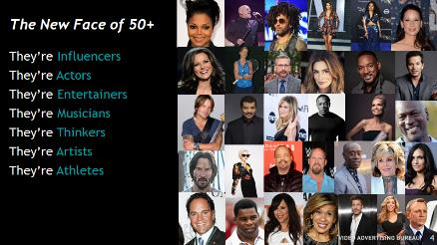



Contents
1
The New Face Of 50+
2
An Opportunity That’s Too Big To Miss
1
3
Working Longer = Increased Spending Power
2
4
Reaching The New Face Of 50+
3
5
Parting Wisdom
4
2

Slide 3



A New Investment Plan
The New Face of 50+
The face of Adults 50+ in America is changing. Enabled by extended employment and disposable income, older Americans lead vibrant, active lives. They are traveling and exploring, entertaining friends and family at home, and they are very involved in their communities. As such, Americans over 50 are a significant consumer group across a wide variety of goods and services.
However, 77% of older adults feel that their age group is being ignored by advertisers.
Are Marketers Missing A Huge Opportunity?
There are 114 Million Adults 50+ in the U.S., comprising over one-third of the U.S. population; a number that’s projected to grow more than the Adult 18-34 segment over the next several decades. This group is just too big to be ignored.
Why Are A50+ So Valuable To Marketers?
They are working longer into their careers and currently account for 34% of the U.S. workforce
They account for over $3.2 trillion in aggregate annual expenditures, or 41% of total U.S. consumer expenditures
They enjoy an active lifestyle, are heavy purchasers across product categories and, for many of them, their wallet is still up for grabs when it comes to many goods and services.
They’re huge viewers of video, enjoying a variety of programming across screens and devices. This represents a great opportunity to build, or reinforce, a relationship with these highly engaged viewers.
Join us, as we look at the Age of Opportunity for Adults 50+…and for marketers.
3

Slide 4
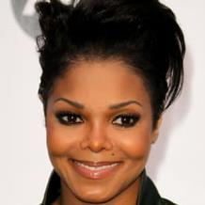
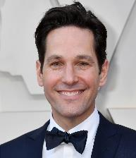


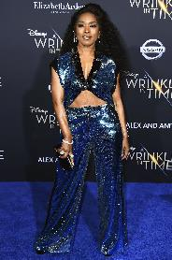

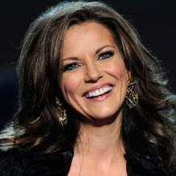




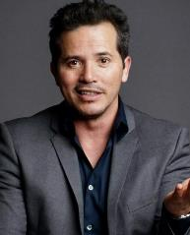
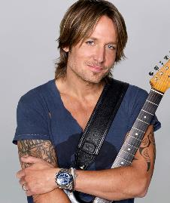
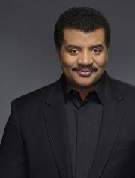


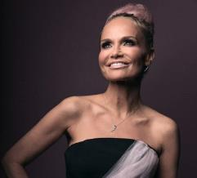
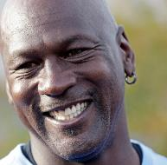

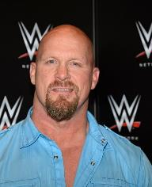






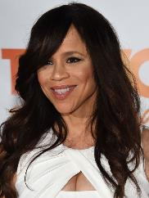
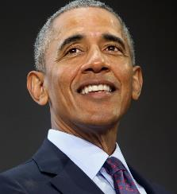

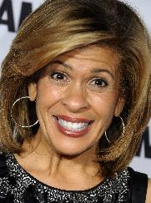

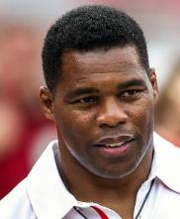
The New Face of 50+
They’re Influencers
They’re Actors
They’re Entertainers
They’re Musicians
They’re Thinkers
They’re Artists
They’re Athletes
4

Slide 5















They’re Also Carpenters
They’re Teachers
They’re Accountants
They’re Chefs
They’re Lawyers
They’re Retirees
They’re Doctors
They’re Architects
And More
5

Slide 6

Adults 50+ Often Feel They Are Underrepresented, Misrepresented Or Ignored By Advertisers
78%
Say That They Felt Their Age Group Was Underrepresented And Misrepresented In Advertising
77%
Of 50-59 Year-Olds Feel That Their Age Group Is Most Ignored By Advertisers
62%
Believe That They Are Ignored Because Advertisers Are Too Young To Understand Their Market
6
Source: Gransnet, Ageism in Advertising: Fighting Marketing’s Unconscious Bias, 2018.

Slide 7

49%
Avoid Brands Who Actively
Ignore Their Age Group
7
Source: Gransnet, Ageism in Advertising: Fighting Marketing’s Unconscious Bias, 2018.

Slide 8


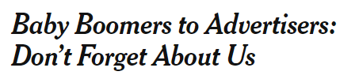


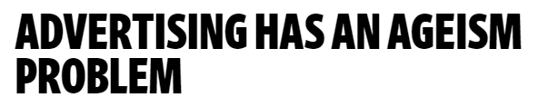
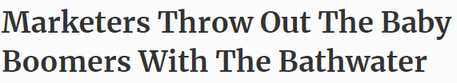


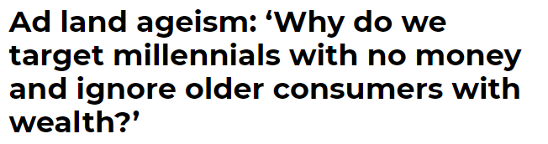
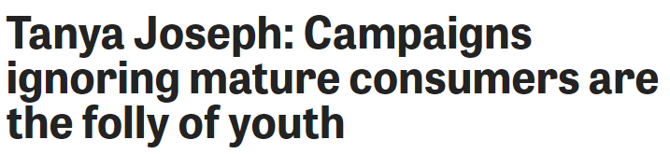
However The Industry Is Beginning To Realize That Marketers Are Missing
A Huge Opportunity By Not Realizing The Potential Of Older Americans
8

Slide 9

Why Exactly Is This Generation Such
A Missed Opportunity?
9

Slide 10

An Opportunity That’s Too Big To Miss

Slide 11

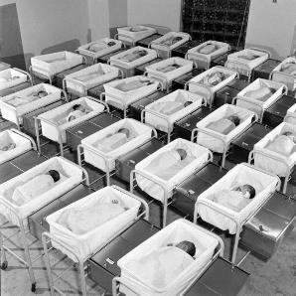


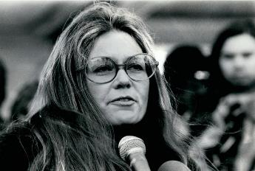
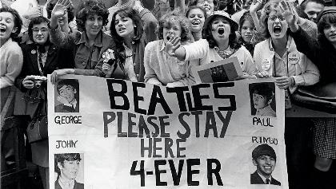



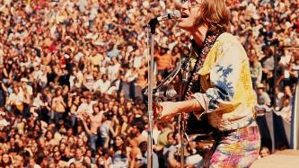
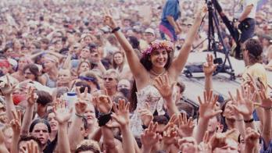
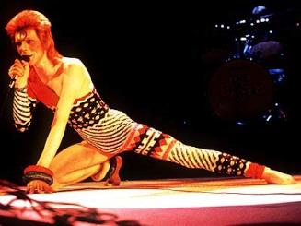
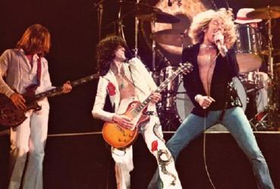
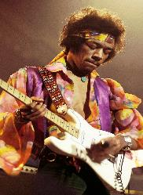
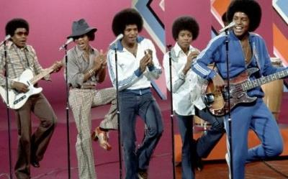
Fueled By The Aging Of Baby Boomers,
The Adult 50+ Segment Is Steadily Growing
Following the end of World War II, the U.S. experienced a sharp spike in births, the result of a strong post-war economy
By 1964, the 76.4 million babies born into the baby boom generation constituted a whopping 40% of the US population
As a result of their size & personality, the Baby Boomer generation heavily influenced the American economy, culture & social change – a significant parallel to the Millennials of today
Source: James T. Patterson, Grand Expectations: The United States, 1945-1974 (New York: Oxford University Press, 1996).
11

Slide 12
As A Result Of The Aging Of The Baby Boomer Generation, The Median Age Of Americans Is Increasing
The median age has increased nearly 20% over the last 30 years
Source: U.S. Census Bureau, Population Estimates for 1980, 1990, 2000, 2010; U.S Census Bureau,
Projected 5-Year Age Groups And Sex Composition of the Population, 2017 – 2060.
* = Projected Median Age.
12

Slide 13

There Are 114 Million Adults 50+ In The U.S. And They Account For 35% Of The Total Population
Under 18
A50+
A18-34
A35-49
They Also Account For 45% Of The Adult (18+) Population
Source: U.S. Census Bureau, 2013-2017 American Community Survey 5-Year Estimates.
13

Slide 14
By 2020, The Adult 50+ Population Will Have Doubled In Size Over The Last 40 Years, Reflecting An Increase Of 60 Million People
Adults 50+ will account for 46% of all adults 18+ by 2020 & 51% by 2030
% of Total Population
26%
26%
27%
32%
36%
37%
39%
40%
41%
1980
2000
2010
2020
2030
2040
2050
2060
Source: U.S. Census Bureau, Population Estimates for 1980, 1990, 2000, 2010; U.S. Census Bureau, Population Division: Washington, DC., Projected Age Groups and Sex Composition of the Population: Main Projections Series for the United States, 2017-2060.
14

Slide 15
While Marketers Often Focus On Younger Demos, The Adult 50+ Population Dwarfs Those Audiences…And The Gap Is Growing
By 2020, there will be over 42 million more A50+ than A18-34, and by 2030 that gap will increase to
over 55 million
Source: U.S. Census Bureau, Population Estimates for 1980, 1990, 2000, 2010; U.S. Census Bureau, Population Division: Washington, DC., Projected Age Groups and Sex Composition of the Population: Main Projections Series for the United States, 2017-2060.
15

Slide 16

Working Longer = Increased Spending Power

Slide 17















Adults 50+ Work Longer Now Than Ever Before
They’re “Influencers” In Their Professions
And They Have More Money To Spend
17

Slide 18
Nearly Half of Adults 50+ Are Working, Accounting for 34% Of Employed Individuals In The U.S.
The Number Of Employed People Over The Age Of 50 Has Also Increased 21% Over The Last 10 Years
+21%
Source: VAB analysis of U.S. Bureau of Labor Statistics data, Household Data Annual Averages, Employment status of the civilian noninstitutional population by age, sex, and race, 2018
18

Slide 19

Adults 50+ Are Leaders In The Workforce
Adults 55+ are 62% more likely than older Millennials to hold management positions
2018 Employment of Workers Ages 55 and Older, by Occupation Group
(Thousands)
Source: U.S. Bureau of Labor Statistics, Household Data Annual Averages, Employed Persons By Detailed Occupation and Age, 2018; Data represents adults 55+ due to data age group breakouts; Millennials = Adults 25-34 due to data age group breakouts.
19

Slide 20

4 in 10
Americans Expect To Work Until 70 Years Or Older
Many Americans Plan On Working Past Retirement Age As Their Job Fulfills Both Economic And Social Needs
Source: Northwestern Mutual, Planning & Progress Study 2018; The 2018 Planning & Progress Study seeks to provide unique insights into U.S. adults’ attitudes and behaviors toward money, financial decision-making, and the broader landscape issues impacting people’s long-term financial security. The study is based on an online survey of 2,003 U.S. adults age 18+ conducted from March 7-19, 2018. Data were weighted to be representative of the U.S. population (age 18+) based on Census targets for education, age/gender, race/ethnicity, region and household income.
20

Slide 21
With More Adults 50+ Working Later Into Life, Their Household Income Has Outpaced The National Average Increase Over The Past 20 Years
1998 vs. 2018
% Change
+58%
A45-54
+66%
National Average
% Change
+75%
A55-64
+91%
A65+
21
Source: Consumer Expenditure Survey, U.S. Bureau of Labor Statistics, 1998, 2008 & 2018; Reflects income after taxes.

Slide 22
They’re Choosing To Work Later Into Life Because They View Their Job As Being An Integral Part Of Who They Are
Why do you anticipate working past the traditional retirement age of 65?
I want additional disposable income
55%
I enjoy my job/career and would like to continue
54%
It is a social outlet that will help me stay active/prevent boredom
44%
18%
The number of entrepreneurs over age 50 has increased 50% since 2007
I want to do something that will let me give back to the community
It is my opportunity to try a new field
10%
I plan to start my own business
9%
I plan to pursue a passion that was too risky to commit to previously
9%
Source: Northwestern Mutual, 2018 Planning & Progress Study; BASE: THOSE NOT RETIRED PLANNING TO WORK PAST AGE 65 BY CHOICE -Gen Pop: (n=233); Q1546. Why do you anticipate working past the traditional retirement age of 65? Chart displays statements garnering 5% or more of the responses; AAPaychex, Small Business Research Report, May 2018, Report based on payroll data from Paychex startup clients & survey responses from 500+ business owners.
22

Slide 23

Their Aggregation Of Disposable Income Over The Years Means Adults 50+ Have Significant Spending Power, And They Use It
23

Slide 24

Adults 55+ Account For 41% Of Annual Total
U.S. Expenditures
This translates to $3.2 trillion in total yearly spend
Source: VAB Analysis of Consumer Expenditure Survey data, U.S. Bureau of Labor Statistics, September, 2018, Data represents adults 55+ due to data age group breakouts.
24

Slide 25

Their Spending Profile Is Virtually Identical To
Older Millennials
Adults 25-34
Adults 55+
Source: VAB Analysis of Consumer Expenditure Survey data, U.S. Bureau of Labor Statistics, September, 2018, Adults 55+ calculated based on a weighted average for Adults 55-64 and Adults 65 and older; Data represents adults 55+ due to data age group breakouts.
25

Slide 26




















With More Disposable Income, Adults 55+ Collectively Spend More On Consumer Goods & Services Than Any Other Demographic Segment
In fact, on average, adults 55+ are responsible for 40% of the spending across the top consumer categories
A55+ Total Annual Expenditures By Category
(% Share of Total Category Spend)
$581.5B
(38%)
$353.0B
(55%)
$235.7B
(42%)
$195.5B
(37%)
$159.1B
(36%)
$110.2B
(43%)
$92.6B
(36%)
Housing
Healthcare
Food at Home
Vehicle Purchases
Food Away
From Home
Household Furnishings
& Equipment
Gasoline / Fuel
$69.8B
(40%)
$57.3B
(45%)
$52.9B
(27%)
$48.6B
(50%)
$39.8B
(43%)
$39.7B
(40%)
$38.4B
(42%)
Phone Services
Audio & Visual
Equipment & Services
Education
Housekeeping Supplies
Pets
Personal Care
Products & Services
Transportation
$33.9B
(35%)
$32.8B
(36%)
$29.9B
(41%)
$17.9B
(31%)
$15.7B
(32%)
$7.6B
(53%)
Entertainment Fees / Admissions
Women & Girls
Apparel
Alcohol
Men & Boys Apparel
Footwear
Reading
Source: VAB Analysis of Consumer Expenditure Survey data, U.S. Bureau of Labor Statistics, September, 2018. Data represents adults 55+ due to data age group breakouts.
26

Slide 27
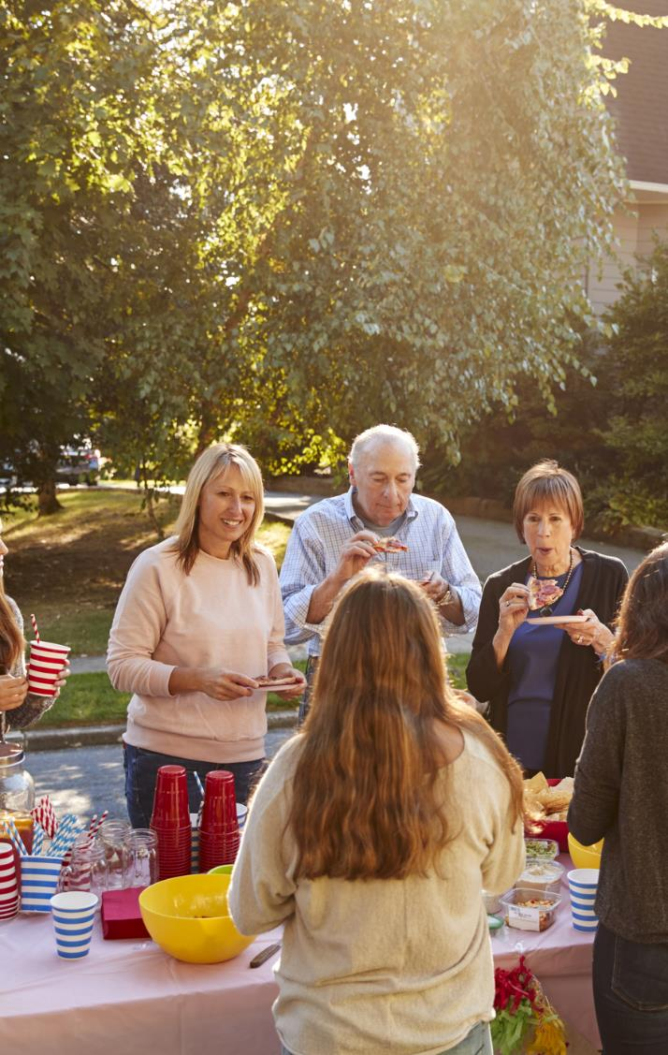
Because They Lead Such Socially Active Lifestyles, They Are Investing In Travel And Entertainment
A50+ Top Leisure Activities
(% Participated In Last 12 Months)
Source: GfK MRI, 2018 Doublebase; Leisure Activities - Personally Participated Last 12 Months,
All Domestic Travel Reason for Trip Past 12 Months/Any Trip or All Foreign Travel Reason for Each Trip Last 3 Years/Any Trip.
27

Slide 28







More Disposable Income, And Often Less Demanding Familial Responsibilities, Frees Older Adults To Indulge Their Interests
In many ways, they are more active than older millennials
A55+ Spend 11% More Time Than Older Millennials
Eating & Drinking
A55+ Spend 22% More Time Than Older Millennials
Shopping
A55+ Spend 56% More Time Than Older Millennials
Doing Leisure Activities & Sports
A55+ Spend 47% More Time Than Older Millennials
Doing Household Activities To Maintain Their Homes
Source: VAB analysis of Bureau of Labor Statistics data, American Time Use Survey, 2017, % Share Based on Average Hours Per Day Spent in Primary Activities;
Data represents A55+ due to data breakouts; Older Millennials = A25-34 due to data breakouts.
28

Slide 29
There are more Adults 50+ than Millennials actively in the market looking for new, relevant products to purchase
Most Importantly, Marketers Can Win Over Adults 50+ Since, For Many Of Them, Their Wallet Is Still Up For Grabs Across Goods & Services
= A18-34
= A50+
# of Consumers Who Are On The Lookout For New Products That Are Relevant To Them
44.8Million
56.0Million
# of Consumers Who Enjoy Variety In The Products They Purchase
28.1Million
28.6Million
Source: GfK MRI, 2018 Doublebase; Consumers Who Are Always On The Lookout For New Products That Are Relevant To Them = Any Agree [I enjoy wandering the store looking for new, interesting products], Consumers Who Enjoy Variety In The Products They Purchase = Any Agree [I like to change brands often for the sake of variety and novelty].
29
Source: GfK MRI, 2018 Doublebase.

Slide 30


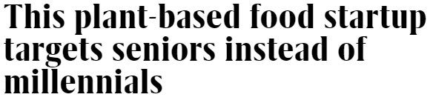


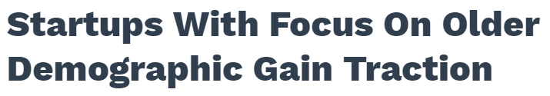
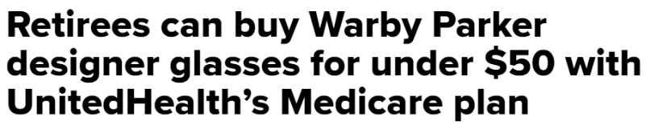


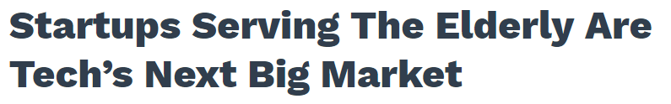

Age Doesn’t Matter To Data-Driven, Direct-To-Consumer Brands Who Are Capitalizing On The Value Of Adults 50+ With Custom Products & Services
30

Slide 31
And The Leaders Of These Companies Are Making Sure To Keep Older Consumers In Mind By Going Out Of Their Way To Be Inclusive And Accessible
“There’s no doubt that the baby boomer space is red hot….This demographic has significant purchasing power and it’s growing very, very fast.”
“When we do use technology, we work to build something advanced enough that a millennial would be impressed, without making marketing and design choices that alienate older consumers,”
“I think you’re starting to see in your baby boomers adults that have spent the last 10 to 20 years using technology, using the internet, and getting more and more comfortable with it through their children,”
Christian Gormsen, CEO, Eargo
Digiday, ‘We’re dealing with an issue that’s unsexy’: New DTC brands are targeting baby boomers, 3/21/19
Adam Karp, CEO, Lively
CrunchBase News, Startups With Focus On Older Demographic Gain Traction,
3/12/19
Jason Shuman, Principal, Primary Ventures
Digiday, ‘We’re dealing with an issue that’s unsexy’: New DTC brands are targeting baby boomers, 3/21/19
“Right now, younger baby boomers are paving the way to technology adoption….We believe that we [older users] have been adapting to technology and now it’s time technology adapts to us.”
“They’re active, healthy, they have money to spend, they’re interested, and they’re curious….I don’t think many businesses have tapped into exactly how different they are.”
"It's become a gold rush….Whether you're a hairbrush-maker or a technology company, you're thinking about how you can meet the needs of an aging population."
Dr. Doug Norris, SVP, Chief Demographer, Environics Analytics
Financial Post, Move over, millennials — baby boomers are the ultimate untapped market,
4/2/19
Ashish Mudgal, Founder, HeyHerbie
CrunchBase News, Startups With Focus On Older Demographic Gain Traction,
3/12/19
Danny Silverman, CMO, Clavis Insight
Telegram.com, ‘Retail's new niche: Aging baby boomers, 9/1/18
31

Slide 32

Reaching The New Face Of 50+

Slide 33

They’re Huge Consumers Of Video, Spending Twice As Much Time With It As Millennials
Daily Time Spent With Video
Based On Total U.S. Population, 3Q ‘18
(Hrs:Mins)
Source: VAB analysis of data from the Nielsen Total Audience Report, Q3 2018. Video includes: Live + Time-Shifted TV, TV-Connected Devices, Video on a Computer, Video on a Smartphone & Video on a Tablet. TV-Connected Device = DVD, game console, internet connected device; Internet Connected Device = devices connected to the TV that are used to stream content such as Apple TV, Roku, Google Chromecast, Amazon Fire TV, Smartphone, Computer/Laptops, etc. (inclusive of smart TV app usage).
33

Slide 34
More Specifically, They Can Be Found Consuming Ad-Supported TV
% Share Of Average Daily Time Spent On Video By Platform
Based On Total U.S. Population, 3Q ‘18
(Hrs:Mins)
7:22
6:18
3:39
TV (Live + Time-Shifted)
TV-Connected Devices
Video on a Computer
Video Focused App/Web on a Smartphone
Video Focused App/Web on a Tablet
Note: Keep in mind, TV content is viewed on connected devices, mobile and computer screens as well
Source: VAB analysis of data from the Nielsen Total Audience Report, Q3 2018. TV-Connected Device = DVD, game console, internet connected device; Internet Connected Device = devices connected to the TV that are used to stream content such as Apple TV, Roku, Google Chromecast, Amazon Fire TV, Smartphone, Computer/Laptops, etc. (inclusive of smart TV app usage).
34

Slide 35

They’re Also Just As Likely As Millennials To Watch TV Live
‘Live’ vs. ‘Time-Shifted’ TV Viewing
Average Weekly TV Time Spent, 3Q '18
Source: VAB analysis of Nielsen Total Audience Report 3Q 2018; based on U.S. population.
35

Slide 36

TV Is A Great Source Of Entertainment, Information & Inspiration For Them
% A50+ Who Agree That TV…
(Index vs. A18+)
83%
Is pure entertainment
(107)
65%
Relaxes me
(110)
73%
Is a good escape
(110)
70%
Keeps me informed /
up to date
(119)
56%
Puts me in a
good mood
(111)
62%
Is a good source
of learning
(118)
52%
Gives me good ideas
(114)
52%
Makes me think
(115)
Source: GfK MRI, 2018 Doublebase, Adults 50+; Index vs. A18+.
36

Slide 37
















































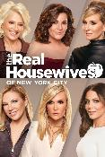






They Have An Eclectic Taste In TV Programs And Can Be Found Enjoying Programming Across A Variety Of Networks & Genres
Source: VAB analysis Nielsen R&F Program Report, ranked on top 250 regular pgms (regular 3 or more t/c) ad-supported cable+english bdcst; total day; P50+; 9/25/17-9/23/18.
37

Slide 38

They Enjoy TV Content So Much That They Consider Their Favorite TV Shows “Appointment Viewing”
75%
Try to watch every new episode of their favorite TV programs
60%
Say watching their favorite TV shows is their
'me-time’
58%
Regularly set aside time in their busy schedule to watch their favorite TV programs
Source: Source: VAB / Research Now “Program Engagement” Survey, April 2018. Q13: Please rate how much you agree or disagree with the following statements. % of Respondents who agree-Top 2 Box (net); Q15: Which of the following statements are true for you? Check any that apply. Total Respondents=1,001, A55+=307.
38

Slide 39
Because Of Their High Attention To TV, They Are Also Receptive To TV Advertising
% A50+ Who Agree
“Advertising on TV provides me with useful information about new products and services”
53%
(Index vs. A18+: 106)
“Advertising on TV provides me with useful information about bargains”
43%
(Index vs. A18+: 102)
42%
(Index vs. A18+: 105)
“For me, advertising on TV is amusing”
“Advertising on TV provides me with meaningful information about the product use of other consumers”
38%
(Index vs. A18+: 102)
“Advertising helps me keep up-to-date about products and services that I need or would like to have”*
36%
(Index vs. A18+: 108)
Source: GfK MRI, 2018 Doublebase, *Advertising helps me keep up-to-date about products and services that I need or would like to have [6 or 7 or 8 or 9 or 10 - Describes your attitude completely].
39

Slide 40









Their Increasing Adoption Of Technology And New Devices Means A Greater Opportunity To Reach Adults 50+ Across Screens
Device Adoption Among Adults 50+
% Who Own A Device
75%
+7% vs. 2017
65%
+5% vs. 2017
61%
+0% vs. 2017
49%
N/A vs. 2017
42%
-2% vs. 2017
Smartphone
Laptop
Desktop
Smart TV
Tablet
22%
+5% vs. 2017
14%
+8% vs. 2017
13%
+86% vs. 2017
6%
+600% vs. 2017
E-Reader
Wearables
Home Assistant
Smart Home Technology
Source: AARP, 2019 Tech and the 50+ Survey, January 2019, Base = Total Respondents, 2017 (n=1,520) Q. Tech 1: Which of the following items do you have?
40

Slide 41













In Fact, Almost 80% Of Adults 50+ Visit Ad-Supported TV-Branded Digital Platforms, Which Consists Of Some Of The Most Popular Content Across Major Genres Online
Ad-Supported TV Brands That Rank In The Top 5 Digital Platforms For A50+ By Major Content Genre
Sports
News
Business & Financial News
Kids
Weather
Food
Home
Comedy
Source: VAB analysis of comScore MediaMetrix multiplatform (desktop + mobile) data, Audience Duplication, December 2018. Unduplicated unique visitors based on a “TV-branded digital platforms” custom group list which includes ad-supported broadcast TV & cable TV brands and MVPDs. % are based on U.S. population per U.S. Census Bureau data 2017 Population Estimates, not digital universe. ; VAB analysis of comScore Media Metrix Key Measures multi-platform (desktop + mobile) data, December 2018, based on categories (top 5 rankings based on “Total Minutes Viewed”). Total Audience = (Desktop P2+, Mobile 18+).
41

Slide 42
Their Love Of Ad-Supported TV Extends Specifically To Mobile Platforms As Well
Where Total Time Spent Has Increased 35% In The Last Year Alone
Ad-Supported TV-Branded Digital Platforms (Mobile Activity)
+10%
+35%
+18%
+2%
2016
2017
2018
% Change
2016
2017
2018
Source: VAB analysis of comScore MediaMetrix mobile data, Audience Duplication, December 2016, 2017 & 2018. Unduplicated unique visitors based on a “Ad-Supported TV-branded digital platforms” custom group list which includes ad-supported broadcast TV & cable TV brands and MVPDs.
42

Slide 43

Beyond The Smaller Screens, Older Americans Are Also Cinema-Goers Who Rely On Advertising To Learn About New Movies
Motivation For Going To The Movies
How Do You Typically Hear About New Movies?
71%
Go To The Movies
22%
Go Once A Month Or More
~50%
Of Movie Goers Can Be Motivated To Go To Movies More Often In The Future
Source: AARP, What Boomers Want: Insights Into Cinema Experience Preferences and Behaviors, April 2018; Respondents = Adults 54 – 72 years old. Q4: What typically prompts your decision / desire to go to the movies? Base: Baby Boomers who have ever gone to see a movie (n=428); Q4b: How do you typically hear about new movies? Base: Baby Boomers (n=602); “Advertising (e.g. TV, online, outdoor)”, “Television Shows (e.g. Today Show, Tonight Show).
43

Slide 44

So, How Can Advertisers Effectively Engage Older Consumers?
Employ A Diverse Workforce
88%
Said Employing More Older People Can Help Advertisers To Understand The Audience Better
Ask Them What They Want
93%
Said Advertisers Should Ask Them What They Want And Not Make Assumptions
Acknowledge Their Spending Power
92%
Said Advertisers Should Acknowledge That They Have Spending Power And Focus Their Efforts Accordingly
44
Source: Gransnet, Ageism in Advertising: Fighting Marketing’s Unconscious Bias, 2018.

Slide 45

Parting Wisdom
Adults 50+ Comprise A Significant Consumer Group, Representing Nearly Half Of All Adults In The U.S., However They Are Often Overlooked By Marketers
They Are Working Longer, Which Provides Them With More Disposable Income To Indulge (And Fund) Their Interests
They Have Significant Spending Power, Much Greater Than That Of Any Other Major Demographic Segment Including Millennials
They Are Huge Consumers of Video Content, Offering Marketers A Strong Opportunity To Engage With Them Across Screens
45

Slide 46



Contact Us
Jason Wiese
SVP, Director of Strategic Insights
jasonw@thevab.com
Marianne Vita
VP, Strategic Insights
mariannev@thevab.com
Leah Montner-Dixon
Senior Multi-Platform Video Analyst leahm@thevab.com
VAB
@VideoAdBureau
Join Our Mailing List

