Slide 1
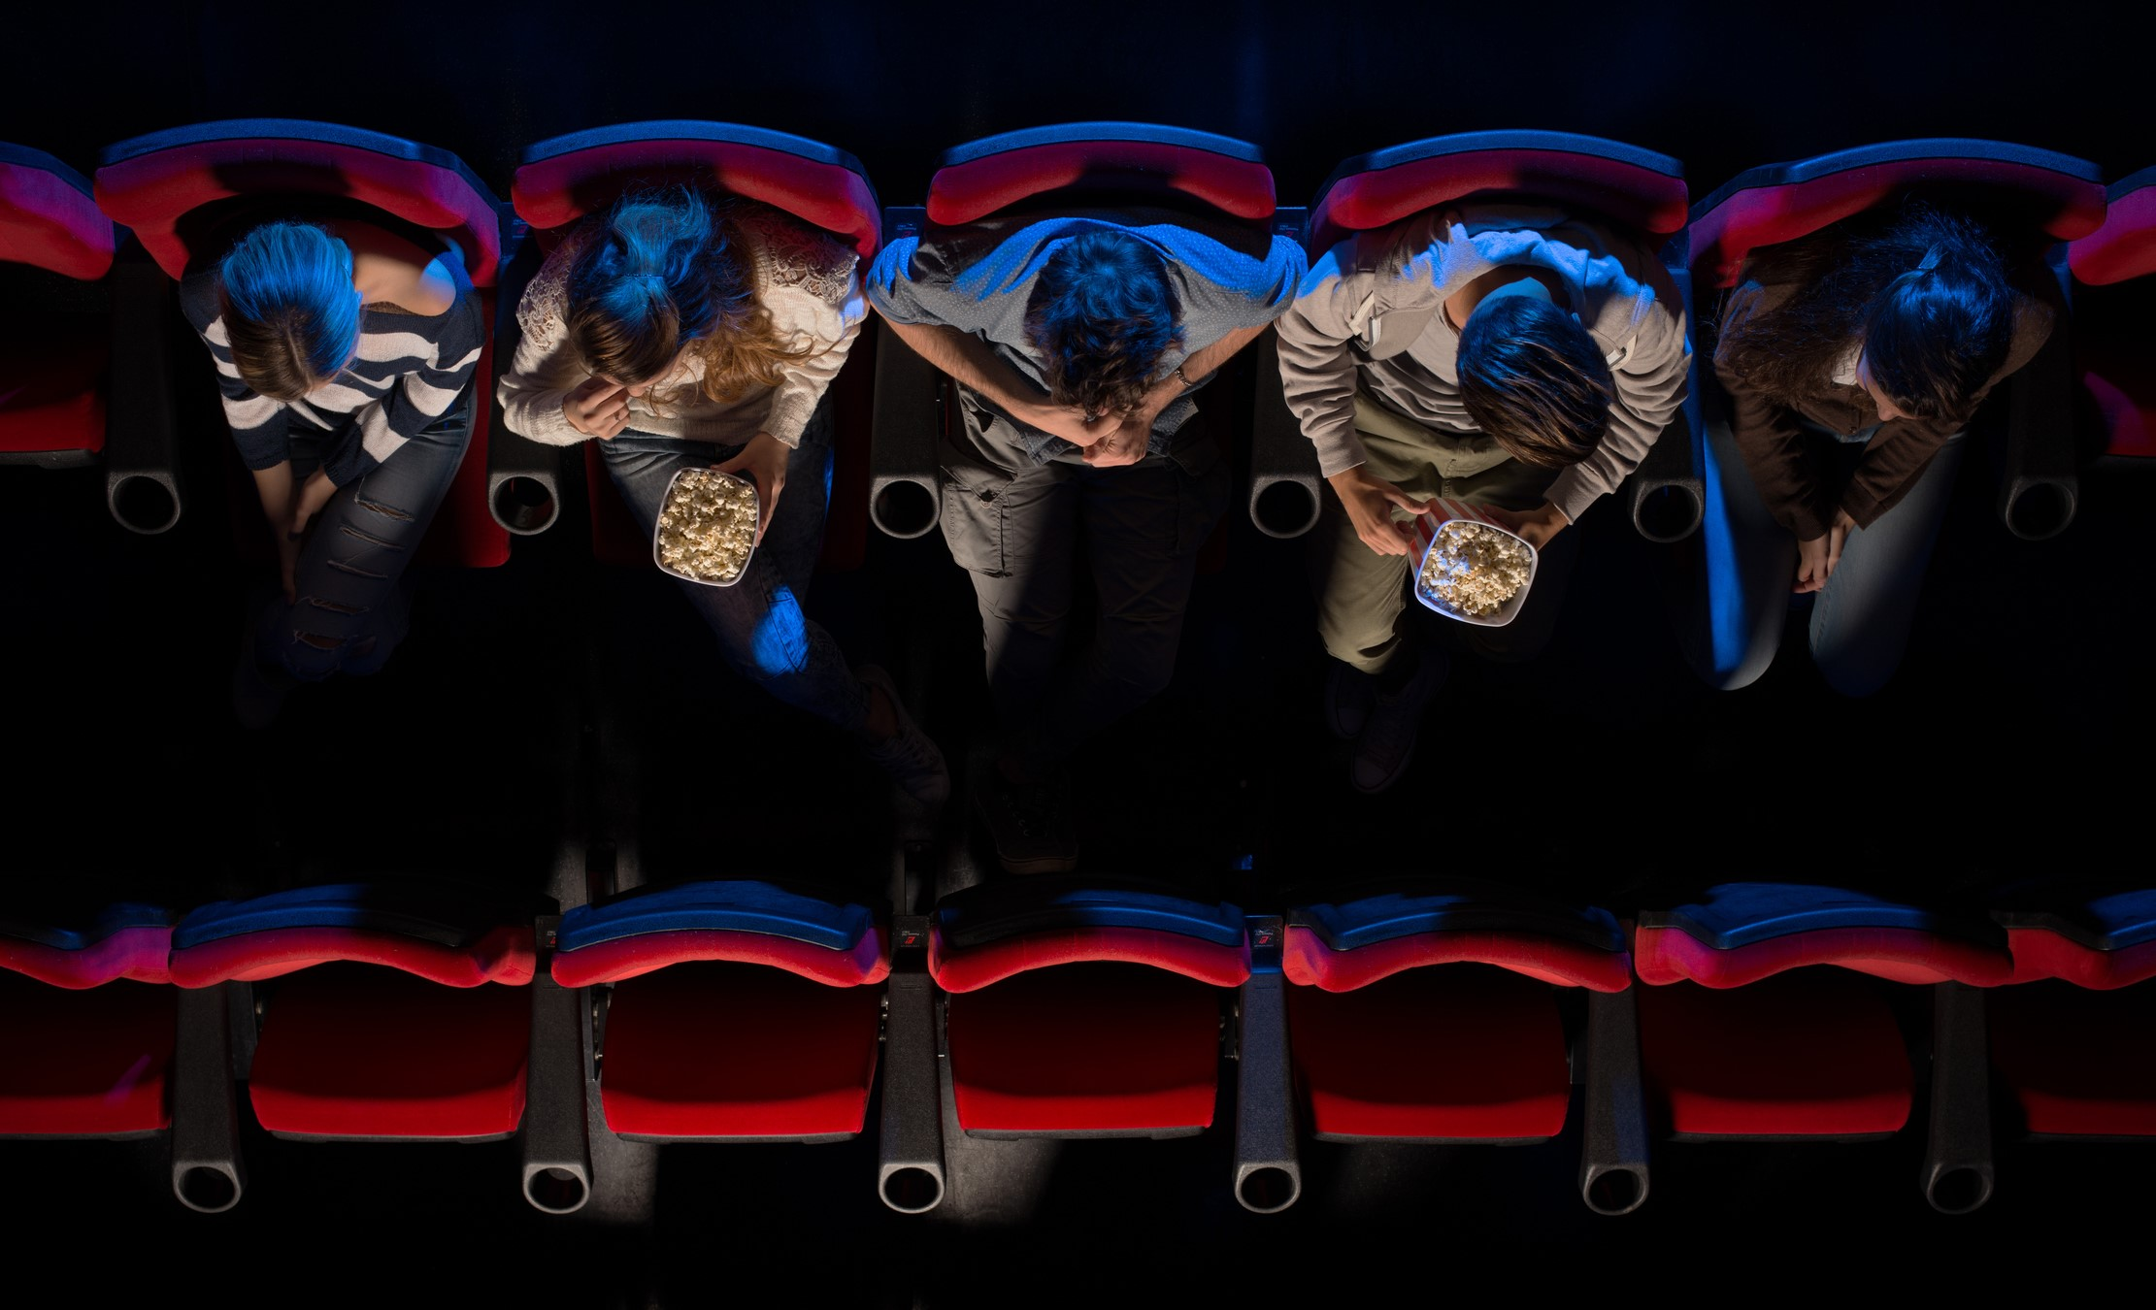

VIDEO ADVERTISING BUREAU- REPORT 2019
.................
Spotlight on Affluent Cinema Goers
Q4 2018

Slide 2
Affluent Adults Are Engaged Movie-Goers Who Value Premium Experiences And Are More Likely To Take An Action Based On Cinema Advertising
With greater disposable income, affluent movie-goers are much more likely than the average adult to seek out movie theaters that offer premium amenities like reclining seats, in-theater dining and alcoholic beverages.
Almost half are also likely to engage with advertisers either through pre-show content – such as interactive polling, games and trivia – or directly on a brand’s website through their mobile phone after seeing an advertisement.
This engagement turns into action powered by the strength of cinema advertising as over half of affluent adults are likely to shop, dine out or purchase a product they see advertised in a movie theater.
Their higher ‘rate of action’ is seen in the results of our custom questions included within the quarterly Nielsen Cinema Audience Report. For instance, while cinema advertisements are effective across the adult population, affluent adults are 36% more likely to purchase a product advertised in a movie theater.
2

Slide 3
Affluent Adults Are More Likely Than The Average Adult To Value Premium Experiences When They Go Out To The Movies
% Who ‘Agree’ That They Are More Likely To Choose a Movie Theater If The Theater Has…
110
Index
118
Index
119
Index
“Index” example: Affluent adults 21+ are 19% more likely to choose a movie theater that has alcoholic beverages than the average adult 21+ (top two box – agree).
Source: Nielsen National Cinema Audience Report, October-December 2018, VAB Custom Question: QM37Please indicate how much you agree or disagree with the following statement I am more likely to choose a movie theater if it has…(top two box – agree); P21+ Base: 4,126 respondents, P21+ & HHI $100K+ Base: 719 respondents.
3

Slide 4
In Fact, Affluent Adults Are Much More Likely To Actively Seek Out Movie Theaters That Offer Premium Options
% Who ‘Strongly Agree’ That They Are More Likely To Choose a Movie Theater If The Theater Has…
116
Index
108
Index
129
Index
“Index” example: Affluent adults 21+ are 29% more likely to choose a movie theater that has alcoholic beverages than the average adult 21+ (strongly agree).
Source: Nielsen National Cinema Audience Report, October-December 2018, VAB Custom Question: QM37Please indicate how much you agree or disagree with the following statement I am more likely to choose a movie theater if it has…(top box – strongly agree); P21+ Base: 4,126 respondents, P21+ & HHI $100K+ Base: 719 respondents.
4

Slide 5
Almost Half Of Affluent Adults Are Likely To Engage With Advertisers Through Pre-Show Content Or Their Website
% Who Are “Likely” or “Very Likely” To Take A Specific Action As A Result of Seeing A Cinema Advertisement
112
Index
114
Index
(interactive polling, games, trivia, etc.)
“Index” example: Affluent adults are 14% more likely than the average adult 18+ to say they’re likely or very likely to visit a brands website on their phone
Source: Nielsen National Cinema Audience Report, October-December 2018, VAB Custom Questions: QM39.1018V Likely to interact with cinema advertising through interactive polling, games, trivia, etc. (top 2 box – Likely & Very Likely) QM38.1018V. Likely to Visit Brand Website on Mobile Phone (top 2 box – Likely & Very Likely); P18+ Base: 3,953 respondents, P18+ & HHI $100K+ Base: 622 respondents.
5

Slide 6
One-Quarter Of Affluent Adults Are Very Likely To Engage With Advertisers Through Pre-Show Content Or Their Website
% Who Are “Very Likely” To Take A Specific Action As A Result of Seeing A Cinema Advertisement
Affluent Adults are 20% more likely to visit a brand’s website on their mobile phone
120
Index
122
Index
(interactive polling, games, trivia, etc.)
“Index” example: Affluent adults are 20% more likely than the average adult 18+ to say they’re very likely to visit a brands website on their phone
Source: Nielsen National Cinema Audience Report, October-December 2018, VAB Custom Questions: QM39.1018V Likely to interact with cinema advertising through interactive polling, games, trivia, etc. (top box – Very Likely) QM38.1018V. Likely to Visit Brand Website on Mobile Phone (top box – Very Likely); P18+ Base: 3,953 respondents, P18+ & HHI $100K+ Base: 622 respondents.
6

Slide 7
At Least Half Of Affluent Adults Are Also Likely To Shop, Dine Out Or Buy Products Due To Cinema Advertising
% Who Are “Likely” or “Very Likely” To Take A Specific Action As A Result of Seeing A Cinema Advertisement
124
Index
130
Index
136
Index
“Index” example: Affluent adults are 30% more likely than the average adult 18+ to say they’re very likely to go shopping as a result of seeing a cinema ad.
Source: Nielsen National Cinema Audience Report, October-December 2018, VAB Custom Question: QM35: Likelihood of … As Result of Seeing an Advertisement in Movie Theater/Theater Lobby (top 2 box – Likely & Very Likely); P18+ Base: 754 respondents, P18+ & HHI $100K+ Base: 149 respondents.
7

Slide 8
Affluent Adults Are Much More Likely To Be Very Influenced To Make A Purchase Because Of Cinema Advertising
% Who Are “Very Likely” To Take A Specific Action As A Result of Seeing A Cinema Advertisement
While cinema advertisements are effective across the adult population, Affluent Adults are 67% more likely to purchase a product advertised in a movie theater
171
Index
142
Index
167
Index
“Index” example: Affluent adults are 71% more likely than the average adult 18+ to say they’re very likely to go shopping as a result of seeing a cinema ad.
Source: Nielsen National Cinema Audience Report, October-December 2018, VAB Custom Question: QM35: Likelihood of … As Result of Seeing an Advertisement in Movie Theater/Theater Lobby (top box – Very Likely); P18+ Base: 754 respondents, P18+ & HHI $100K+ Base: 149 respondents.
8

Slide 9

Contact Us
Jason Wiese
SVP, Director of Strategic Insights
jasonw@thevab.com
Reed Kiely
Senior Multi-Platform Video Analyst reedk@thevab.com

