Slide 1





Advertising, Accelerated
An Update on 15 Streaming Trends That Are Impacting Marketing Plans
A follow-up companion to
‘Setting the Stage: 15 Streaming Trends That Will Impact Marketing Plans in 2023’ (Jan ’23)

Slide 2


Adoption of ad-supported streaming is accelerating.
In January 2023, VAB released ‘Setting the Stage’ which identified 15 trends in streaming that would impact marketing plans. What we didn’t realize is the impact that report would have on the marketplace, becoming our most popular report of all-time!
Due to its popularity, we thought we would revisit the trends we identified a year ago, determining which
are still relevant and which may have slowed in 2024.
Stocked with fresh data, this report clearly illustrates how many of our predictions not only remain true but have accelerated in the past year.
This information is exclusively provided to VAB members and qualified marketers.
PAGE 2

Slide 3
An Update on 15 Streaming Trends That Are Impacting Marketing Plans
As video consumption continues to evolve and advertising opportunities in video streaming accelerate, VAB revisited the 15 streaming trends that we identified last year in our ‘Setting the Stage’ report and updated them with the latest research and insights so marketers can continue to make informed decisions for their marketing plans.
1
2
3
4
5
Cord cutting among traditional pay-TV HHs continues
Over half of all adults are now ‘cordless’
More adults across
all ages are shifting towards streaming
Consumers’ wider definition of ‘TV’ has remained consistent
Streaming accounts
for over one-third
of total TV viewing
6
7
8
9
10
Audiences increasingly prefer ad-supported streaming options
More connected TV HHs watch ad-supported services than ad-free
Ad-supported streaming reaches eight out of every ten streamers
Multiscreen TV platforms have increased scale in ad-supported streaming
FAST has achieved meaningful scale as a streaming platform
11
12
13
14
15
Average time spent with ad-supported streaming has doubled
Multicultural audiences account for around half of key age demos
Marketers are increasingly adopting ‘audience-based buying’
Marketers continue to explore more modern measurement solutions
Many marketers focus on ‘outcomes’ metrics that drive growth
click through the appropriate box if you would like to be brought directly to the corresponding trend
This information is exclusively provided to VAB members and qualified marketers.
PAGE 3

Slide 4

1
Cord cutting continues among traditional pay-TV households as non-pay TV households are projected to grow to 80 million homes this year
Share of U.S. Pay TV vs. Non-Pay TV Households
53.5MM HHs
80.3MM HHs
(revised proj. – Sept.’23)
58.2MM HHs
74.4MM HHs
(original proj. – Sept.’22)*
62.8MM HHs
68.7MM HHs
Source: eMarketer, Pay TV Households & Viewers, US, 9/20/23, & *US Pay TV vs. Non-Pay-TV Households – 2018-2026, 9/22. Note: Pay TV households are those with a subscription to traditional pay TV services excludes IPTV and pure-play online video services (e.g., YouTube TV, Hulu Live TV, FuboTV, Sling TV, etc.). Non-Pay-TV households are those that have cancelled their subscription to or have never had pay TV services.
This information is exclusively provided to VAB members and qualified marketers.
PAGE 4

Slide 5



2
Over half of all adults are now ‘cordless,’ which makes video streaming a necessity for incremental reach within video campaigns
% of adults 18+ who are ‘Cord Cutters’ or ‘Cord Nevers’
November 2022
March 2024
49%
Total ‘Cordless’
54%
Total ‘Cordless’
29%
Cord Cutters
20%
Cord Nevers
31%
Cord Cutters
23%
Cord Nevers
Source: VAB analysis of MRI-Simmons Cord Evolution Study, November 2022 & March 2024, A18+. ‘Cord Cutters’: no pay-TV; cancelled it, ‘Cord Nevers’: no pay-TV; never had it.
This information is exclusively provided to VAB members and qualified marketers.
PAGE 5

Slide 6

3
More adults across all age groups are shifting towards streaming
as a replacement for accessing their favorite long-form programming
‘Streaming has replaced traditional TV for me’
% of video streamers who agree
Source: VAB analysis of MRI-Simmons November 2022 & March 2024 Cord Evolution Study, A18+. Base = ‘Streamed in the past 12 months’.
This information is exclusively provided to VAB members and qualified marketers.
PAGE 6

Slide 7


4
Consumers’ wider definition of TV – which includes streaming across devices - has remained consistent, while the TV set still dominates
How do you personally define TV?
% of video streamers who agree
‘Anything I can watch on my TV set whether it’s
via streaming or cable, satellite, fiber optic’
‘Anything I can watch on any device’
Source: VAB analysis of MRI-Simmons November 2022 & March 2024 Cord Evolution Study, A18+. Base = ‘Streamed in the past 12 months.’
This information is exclusively provided to VAB members and qualified marketers.
PAGE 7

Slide 8

5
Streaming accounts for over one-third of total time with TV as both exclusive and library content continues to shift to these platforms
Share of Monthly Time Spent With TV
Feb ‘24
Nov ‘23
Feb ‘23
Nov ‘22
Source: VAB analysis of Nielsen, ‘The Gauge’, November 2022, February 2023, November 2023 & February 2024, Total Day, P2+, ‘Other’ includes all other TV including all other tuning (unmeasured sources), unmeasured video on demand (VOD), audio streaming, gaming and other device (DVD playback) use. Note: Due to a methodical change, Gauge data for November 2022 has been updated compared to the VAB ‘Setting the Stage’ report released in 2023.
This information is exclusively provided to VAB members and qualified marketers.
PAGE 8

Slide 9
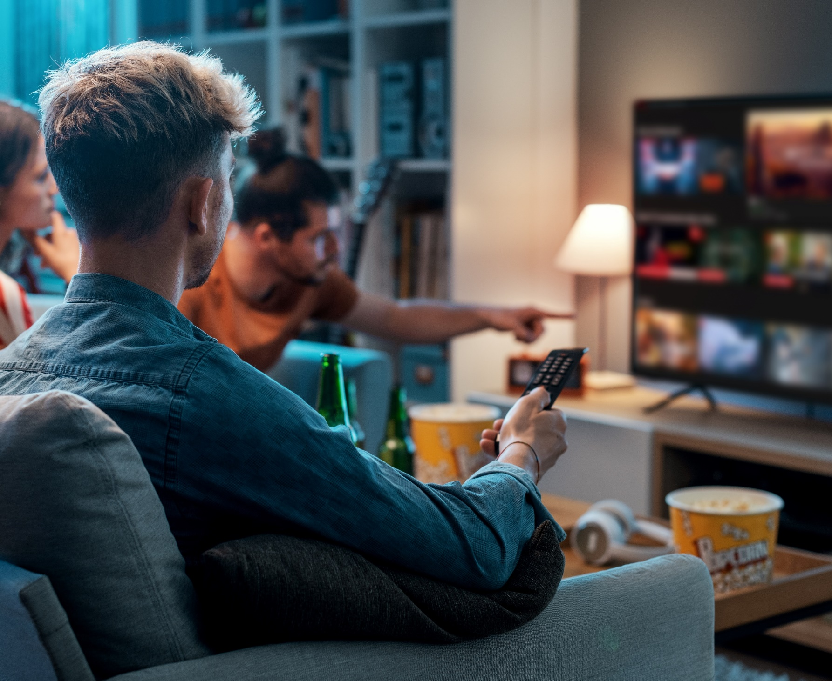
6
Two-thirds of audiences prefer ad-supported services and tiers due to the cost benefit and value exchange of ads in streaming
‘I prefer streaming free video content with ads / commercials instead of paying for a subscription without ads / commercials’
% of video streamers that agree
Source: VAB analysis of MRI-Simmons November 2022 & March 2024 Cord Evolution Study, A18+. ‘I prefer streaming free video content with ads/commercials instead of paying for a subscription without ads/commercials’ (strongly / somewhat agree). Base = ‘Streamed in the past 12 months’.
This information is exclusively provided to VAB members and qualified marketers.
PAGE 9

Slide 10
7
With increased options, there are now more CTV HHs that watch ad-supported streaming than those that subscribe to paid, ad-free services
Connected TV Households by Streaming Type
Households in millions
+27%
vs. 2021
+9%
vs. 2021
Source: Comscore, State of Streaming, 2023. Comscore CTV Intelligence, CTV devices, U.S.
This information is exclusively provided to VAB members and qualified marketers.
PAGE 10

Slide 11

8
Through organic platform growth and the launch of new ad tiers,
ad-supported streaming now reaches eight out of ten streaming adults
% of streamers who use at least one ad-supported streaming service
New Pic
Source: VAB analysis of MRI-Simmons November 2022 & March 2024 Cord Evolution Study, A18+. Base = ‘streamed in the past 12 months’. November ’22: reflects % of streamers who have used any of the following streaming services in the past 12 months: Crackle, Crunchyroll (limited commercial subscription), Discovery + (limited commercial subscription), Hulu (limited commercial subscription), PARAMOUNT + (LIMITED COMMERCIAL SUBSCRIPTION), Peacock (limited commercial subscription), IMDb TV, Local Now OR PARAMOUNT + (LIMITED COMMERCIAL SUBSCRIPTION), Peacock (limited commercial subscription), Pluto TV, redbox, Roku Channel, Samsung TV Plus, Tubi TV, Vudu, Xumo. March ’24: reflects % of streamers who have used any of the following streaming services in the past 12 months: Crackle, Crunchyroll (free), Tubi, Discovery+ (with ads/commercials), Disney+ (with ads/commercials), Freevee (formerly IMDb TV), Max (with ads/commercials), Hulu (with ads/commercials) NET, LG Channels, Local Now App, Paramount+ (with ads/commercials), Peacock (with ads/commercials), Pluto TV, redbox, Roku Channel, Samsung TV Plus, Vudu)
This information is exclusively provided to VAB members and qualified marketers.
PAGE 11

Slide 12

9
Multiscreen TV platforms have almost full penetration collectively within ad-supported streaming since all major services now have an ad tier
% of streamers who have used a network TV app or ad-supported streaming service owned by a multiscreen TV company*
Source: VAB analysis of MRI-Simmons November 2022 & March 2024 Cord Evolution Study, A18+. Base = ‘streamed in the past 12 months’. *March ‘24: Based on respondents who watched any of the following ad-supported streaming services in the last 12 months: ABC App, AMC App, Bravo App, CBS App, Discovery+ (with ads/commercials), ESPN+, Max (with ads/commercials), Hulu (with ads/commercials) NET, Paramount+ (with ads/commercials), Peacock (with ads/commercials), Pluto TV, Tubi, TVOne, VICE TV, Hallmark TV, Disney+ (with ads/commercials), FOX Sports, NBC App, NFL+ Nov 22: *Based on respondents who watched any of the following ad-supported streaming services in the last 12 months: ABC App, AMC App, Bravo App, CBS App, Discovery+ (Limited Commercial Subscription), ESPN+, HBO Max (Limited Commercial Subscription), Hulu (Limited Commercial Subscription), Paramount+ Essential (Limited Commercial Subscription), Peacock Premium (Limited Commercial Subscription), Pluto TV, Tubi TV, TV One, Vice TV, Hallmark TV.
This information is exclusively provided to VAB members and qualified marketers.
PAGE 12

Slide 13
10
FAST viewership has achieved meaningful scale as audiences grow and advertising opportunities increase
% of U.S. adult 18+ streamers that watch FAST
(Free Ad-supported Streaming TV) services
+38%
YOY
+22%
more FAST Channels available in the U.S. YoY*
(Feb ‘24: 1,959 vs. Dec ’22: 1,610)
Source: VAB analysis of MRI-Simmons November 2022 & March 2024 Cord Evolution Study, A18+. Base = ‘streamed in the past 12 months’. March ‘24: Used any FAST services in the past 12 months: (includes, but not limited to, services like Peacock, Roku Channel, Tubi, Freevee, Pluto TV, Samsung TV Plus, Xumo, Local Now, Bloomberg Originals, MotorTrend, NBC News Now, Plex, PopcornFlix). November ‘22: Used any FAST services in the past 12 months: (includes, but not limited to, services like Peacock, Roku Channel, Tubi, Freevee, Pluto TV, Samsung TV Plus, Xumo, Local Now). *VAB Analysis of The FASTMaster, ‘There are 1,959 FAST Channels in the U.S.’, 2/15/24 & ‘There Are Now 1,995 FAST Channels’, 12/22/23.
This information is exclusively provided to VAB members and qualified marketers.
PAGE 13

Slide 14
11
Time spent with ad-supported platforms has more than doubled in less than two years as consumers increasingly shift towards these services
Daily Time Spent With Streaming by Service Type
By % Share and Time Spent in HH:MM
SVOD
AVOD / FAST / vMVPD
Q4 2021
Q2 2022
Q2 2023
63%
(1:24)
37%
(0:49)
48%
(1:10)
52%
(1:15)
46%
(1:27)
54%
(1:41)
2:12
AVOD + SVOD
Total
2:24
AVOD + SVOD
Total
3:08
AVOD + SVOD
Total
+3 mins
vs. Q4 ‘21
+52 mins
vs. Q4 ‘21
Source: VAB analysis of TiVo Video Trends Report, Q2 2022 & Q2 2023. Base: P18+.
This information is exclusively provided to VAB members and qualified marketers.
PAGE 14

Slide 15
12
Approximately half of key age demos are comprised of multicultural consumers, underscoring their importance to streaming TV plans
Multicultural Audiences
% of U.S. TV Population by Age
Source: VAB analysis of Nielsen NPower, Universe Estimate, UE and Sample Information Report. “Reflects 2018-2019 & 2023-2024 Broadcast Seasons. Multicultural Audiences represent Hispanic, Non-Hispanic Black, Non-Hispanic Asian/Pacific Islander, Non-Hispanic American Indian/Alaska Native and Non-Hispanic Other.
This information is exclusively provided to VAB members and qualified marketers.
PAGE 15

Slide 16
13
Marketers are increasingly adopting ‘audience-based TV buying’ to optimize ad investment against their best customer prospects
% of Demographic TV Buying vs. Audience-Based TV Buying
Source: Advertiser Perceptions, TV Measurement Report, 2023. Q: What percentage of your [company’s/main client’s] TV buys are currently activated via audience-based buying versus traditional demographic/content buying? What do you anticipate those percentages will be in the next 2 years? Base: Total Respondents
This information is exclusively provided to VAB members and qualified marketers.
PAGE 16

Slide 17

14
Nearly two-thirds of marketers will use modern measurement solutions to more accurately count audiences reached across video platforms
62%
of advertisers are likely to use
alternative currencies in the next 12 months
Source: Advertiser Perceptions, TV Measurement Report, 2023. Q: Did your [company/main client] use alternative currencies, outside of Nielsen, for its TV buy transactions in the past 12 months? Base: Total Respondents. Likely = ‘very’ or ‘somewhat.’
This information is exclusively provided to VAB members and qualified marketers.
PAGE 17

Slide 18





15
Beyond audience counts, many marketers also continue to look at video campaign ‘outcomes’ metrics that drive business growth
According to publishers, the following metrics are most important to advertisers in measuring converged TV:
86%
57%
43%
29%
Online Outcomes
(sales, registrations, app downloads, etc.)
Offline Outcomes
(in-store traffic, sales, etc.)
Incremental Reach
Brand Lift
Source: Innovid, The Future of Converged TV, February 2023. Advertisers could pick ‘up to 3’ in determining the metrics that are most important to them.
This information is exclusively provided to VAB members and qualified marketers.
PAGE 18

Slide 19
An Update on 15 Streaming Trends That Are Impacting Marketing Plans
1
2
3
4
5
Cord cutting among traditional pay-TV HHs continues
Over half of all adults are now ‘cordless’
More adults across
all ages are shifting towards streaming
Consumers’ wider definition of ‘TV’ has remained consistent
Streaming accounts
for over one-third
of total TV viewing
6
7
8
9
10
Audiences increasingly prefer ad-supported streaming options
More connected TV HHs watch ad-supported services than ad-free
Ad-supported streaming reaches eight out of every ten streamers
Multiscreen TV platforms have increased scale in ad-supported streaming
FAST has achieved meaningful scale as a streaming platform
11
12
13
14
15
Average time spent with ad-supported streaming has doubled
Multicultural audiences account for around half of key age demos
Marketers are increasingly adopting ‘audience-based buying’
Marketers continue to explore more modern measurement solutions
Many marketers focus on ‘outcomes’ metrics that drive growth
click through the appropriate box if you would like to be brought directly to the corresponding trend
This information is exclusively provided to VAB members and qualified marketers.
PAGE 19

Slide 20
Adults over 50 account for 36% of the total population and nearly half of all adults
Ad-supported streaming is accelerating as more opportunities are created across platforms.
More audiences are migrating to ad-supported streaming
as exclusive, original and library content shifts over to these platforms and new services, FAST channels and advertising tiers continue to launch and build scale
Audiences increasingly prefer ad-supported streaming options compared to paid, ad-free platforms due to the
cost benefits and their acceptance of the value exchange
Ad-supported streaming now reaches eight out of every
ten streamers with multiscreen TV platforms collectively providing near complete coverage of this universe
Average daily time spent with ad-supported steaming by adults has more than doubled in less than two years
Marketers are increasingly adopting ‘audience-based TV buying’ and modern measurement solutions to optimize
ad investment towards their best customer prospects
Key Marketer Takeaways
This information is exclusively provided to VAB members and qualified marketers.
PAGE 20

Slide 21
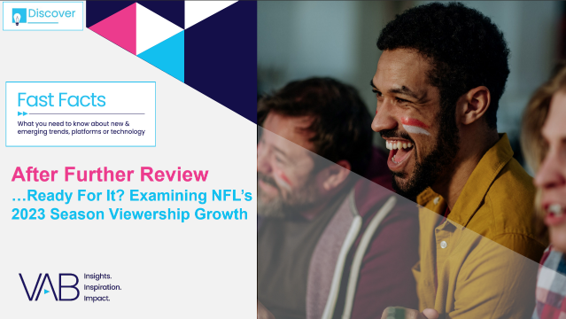




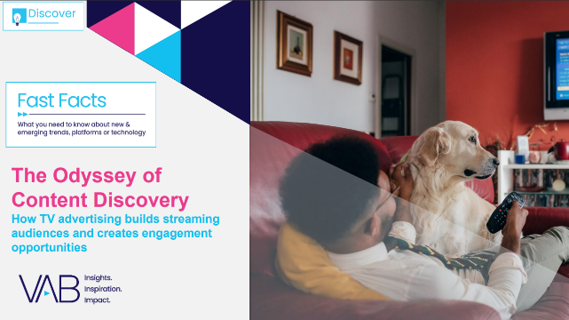
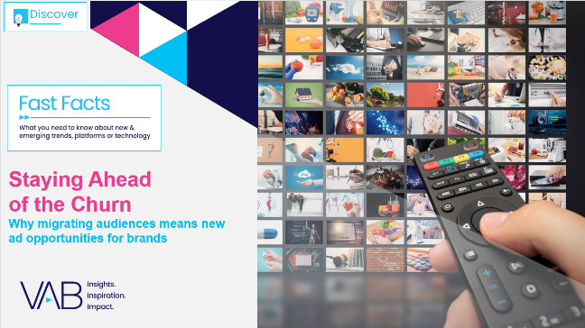

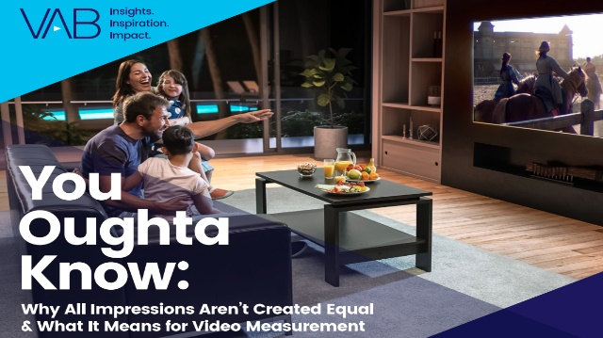
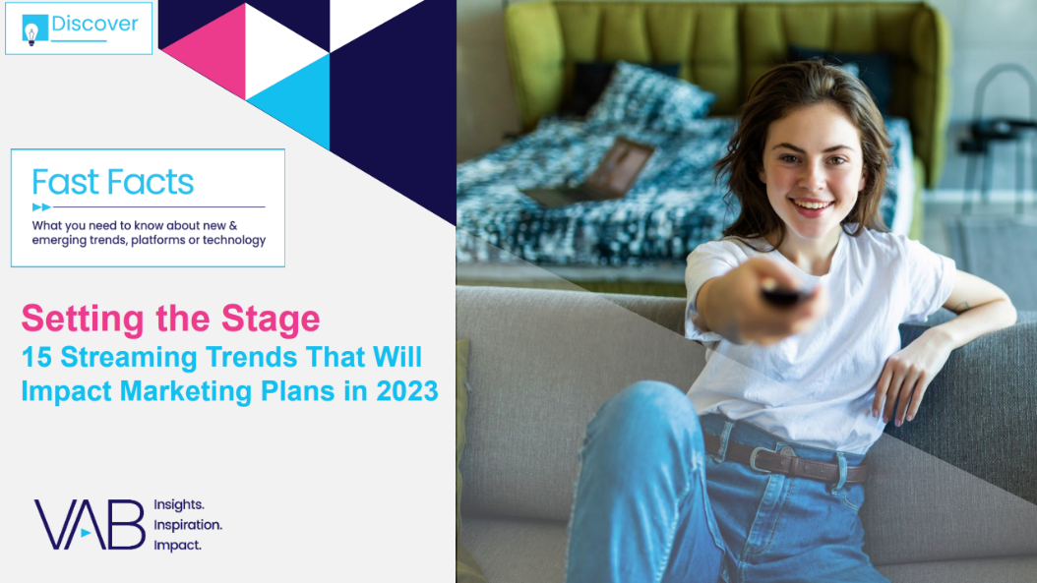

Creators
Jason Wiese
Reed Kiely
SVP, Director of Strategic Insights
jasonw@thevab.com
Director, Data Insights & Trends reedk@thevab.com
Leah Montner-Dixon
Karolina Guillen
Director, Audience & Behavioral Insights
leahm@thevab.com
Associate Director, Insights, Strategy & Analytics karolinag@thevab.com
Kaileen Cain
Insights Analyst
kaileenc@thevab.com
Discover more
Looking for more data, insights and takeaways? Check out this related VAB content
Download ‘Setting the Stage’ for additional trend data from prior years
VAB Members, brand marketers and agencies get free and immediate access to VAB’s content library. Get access at theVAB.com
This information is exclusively provided to VAB members and qualified marketers.
PAGE 21

Slide 22


About VAB
VAB plays a dual role in the video advertising industry. We are leading the change to bring about a more innovative and transparent marketplace. We also provide the insights and thought leadership that enables marketers to develop business-driving marketing strategies.
Drawing on our marketing expertise, we simplify the complexities in our industry and discover new insights that transform the way marketers look at their media strategy.
We are committed to your business growth and proud to offer VAB members, brand marketers and agencies complimentary access to our continuously-growing Insights library. Get immediate access at theVAB.com.
This information is exclusively provided to VAB members and qualified marketers.
PAGE 22

