Slide 1



Advanced Measurement Solutions Directory
Your guide to modern measurement solutions and their capabilities
January 2026

Slide 2






As the video ecosystem evolves, measurement solutions are innovating and scaling their capabilities to support a wide
range of marketer needs and goals.
With so much choice, many marketers, programmers and others in the video ecosystem are looking for streamlined and essential resources about a measurement platform or product.
The Advanced Measurement Solutions Directory has been
built with this in mind. This directory serves as a reference guide to simplify and provide clarity in measurement solutions so that you can keep informed.
Developed in partnership with the solutions themselves, the directory is a compilation of their topline capabilities and several applicable case studies.
We expect this directory to continue to grow and welcome all measurement solutions that would like to contribute.
`
The measurement solutions included in this directory play a role in at least one of the following measurement categories covered in the VAB’s “What's the Deal with Measurement” series
Viewership Data Collection
Identity
Engagement
Outcomes
Click to learn more!
PAGE 2

Slide 3











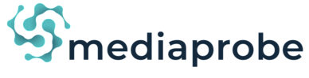





Advanced Measurement Solutions Directory
VAB is proud to share this directory
with our 19 partners including 3 new additions!
Click on the company logos to be brought to their capabilities page
New!
New!
New!
We invite all measurement solutions to submit their capabilities for inclusion.
If interested, please contact us at info@thevab.com
PAGE 3

Slide 4

What do you do?
Affinity Solutions is the leading consumer purchase insights company. We provide a complete view
of U.S. and U.K. consumer spending, across and between brands, via exclusive access to fully permissioned transaction data from over 100 million consumers. Our proprietary AI technology, Comet™, transforms these purchase signals into actionable insights for business and marketing leaders to drive optimal outcomes and build lasting customer relationships. Visit www.affinitysolutions.com to discover how we're shaping the future of consumer purchase insights.
What makes your product or platform unique?
Affinity’s proprietary platform, Comet™, offers exclusive access to the largest deterministic dataset
of consumer spending in the US and the U.K.. Affinity’s purchase insights are fully permissioned, privacy-safe and available in real-time. Comet™ not only enhances existing datasets but also integrates seamlessly into widely adopted platforms ensuring a smooth, hassle-free user experience. This unique blend of proprietary data, innovative technology and seamless integrations makes Affinity Solutions a crucial partner in outcomes measurement.
Which types of companies do you serve?
Affinity’s services cater to a wide array of industries including retail, QSR, travel, entertainment, and more. We provide indispensable value to marketers, agencies, platforms, publishers, consultancies and financial service companies through marketing and measurement solutions crafted to meet their diverse needs.
Which attribution model(s) do you utilize?
At Affinity, we use a sophisticated closed-loop attribution model that combines purchase lift metrics with media exposure data to unveil a new level of transparency in marketing measurement. This approach not only quantifies the direct incremental impact of marketing activities on revenue but also empowers marketers to fine-tune their strategies across various channels, ensuring optimal performance and efficiency.
Which video platforms do you measure or support?
We measure and support OTT, CTV, mobile video, and linear platforms, helping advertisers clearly understand how media exposure drives real consumer purchases. Our Consumer Purchase Lift (CPL) solution is used by leading media platforms to help advertisers connect campaigns directly to sales outcomes—tracking ROI with closed-loop measurement, incremental lift analysis, and robust attribution. CPL reveals what’s driving growth—whether it’s higher spend per customer, increased shopping frequency, or more buyers—enabling always-on optimization and true impact measurement at any point during the campaign based on the outcome that matters most: the purchase.
What are the core elements of a successful partnership?
We build partnerships with companies that believe in the power of high-quality, deterministic purchase metrics as a core driver of better marketing measurement and optimization. We value partners who prioritize privacy-first technology, ongoing innovation, and helping brands maximize every advertising dollar by proving real impact to the bottom line.
Website and contact information:
affinitysolutions.com | Dewi Paulino | info@affinitysolutions.com
PAGE 4

Slide 5
What do you do?
Ampersand is Moving TV Forward™. As the industry’s largest source of combined multiscreen TV inventory and viewership insights, we are changing the way TV is bought and measured. Powered by aggregated viewership insights and with a commitment to protecting personal information, Ampersand gives advertisers true audience first planning, scale in execution and advanced measurement of their TV investments. Ampersand represents 117M multiscreen households and over 75% of addressable households in the U.S. (64M households). Whether a local or national advertiser, we help clients reach their unique target audience and deliver their stories – anytime, anywhere and on whatever device. Ampersand is owned by Comcast Corporation, Charter Communications, Inc. and Cox Communications.
What makes your product or platform unique?
Ampersand’s value proposition sits at the intersection of our data insights and media inventory. The scale of both allows marketers to not only glean actionable insights on past, present and even future campaigns, but they can also then activate those insights across the largest multiscreen TV inventory in the industry.
Which types of companies do you serve?
Ampersand serves brands and agencies of all sizes, across all verticals (including political). We serve both the local and national marketplace and work with digital teams working on addressable and streaming media buys.
What is your footprint/scale?
Through its ownership and affiliate structure including Comcast, Charter, Cox, Verizon and Altice, Ampersand reaches 117M multiscreen households across 200+ DMAs
Ampersand represents 75% of the US addressable household footprint
Ampersand receives multiplatform viewership data insights from 64M households
Which video platforms do you measure or support?
Linear (STB)
VOD (STB)
Streaming (Live + VOD)
What are the core elements of a successful partnership?
We believe that an audience-first mindset, a willingness to think outside the box and the spirit of collaboration are paramount to successful partnerships. Within an industry that is so rapidly evolving, if marketers can’t embrace data and implement new test-and-learn strategies, brands and agencies will watch their competition fly right by them.
Website and contact information:
www.ampersand.tv | linkedin.com/company/meetampersand | marketing@ampersand.tv
PAGE 5

Slide 6
Product Category: Insurance
Measurement Category: Engagement
Addressable innovation to reach the elusive light and medium TV viewer
Incremental Reach Analysis
Suppressing the Heavy TV Viewer to Expand Reach
0%
10%
20%
30%
40%
50%
60%
National Linear TV
Broadcast & Cable
Ampersand Addressable TV
A1849 w/ Heavy TV Viewer Suppression
National + Ampersand
50%
+15% unique reach
Source: Campaign Dates 4/19/23 – 6/4/23 (MVPD Footprint: Comcast, Spectrum, Cox, Verizon, Altice)
`
Challenge
A national insurance brand sought to improve national campaign performance, specifically reach and frequency.
Measurement Solution
Ampersand created terciles of light, medium and heavy TV viewing HHs, in a privacy compliant manner and utilized addressable TV to deliver 100% campaign impressions to light and medium TV HHs.
Target Segment
Adults 18-49
Learnings
Overall, the addressable campaign resulted in 15 additional unique reach points. Specifically, the campaign reached 3 million additional unique households previously not reached with their brand message.
From an efficacy standpoint, the distribution of impressions delivered to light or medium TV households increased to 71% from 45% vs. national alone.
Viewing Source / Media Type
Ampersand addressable TV (with results compared to national campaign alone)
PAGE 6

Slide 7
What do you do?
Blockgraph is a technology company that is redefining how data is harnessed for privacy-safe multiscreen TV advertising. The company was formed to streamline data collaboration within the ever-evolving premium video ecosystem, enabling scaled first-party data use for multi-platform TV. The company is owned by Charter Communications Inc., Comcast NBCUniversal, and Paramount.
What makes your product or platform unique?
Blockgraph provides a platform that enables marketers and media companies to use their first-party data in a privacy-focused way, facilitating direct matching of data sets for multiscreen TV planning, targeting, and measurement. Our flexible platform offers simplicity, speed, and scale for companies looking to match audiences, form and share insights, and distribute segments to platform destinations. The platform is underpinned by a scaled, deterministic, universal household ID capable of unifying disparate data within the connected home.
Which types of companies do you serve?
Blockgraph has established a truly unique ecosystem of first-party data within the converged TV ecosystem consisting of multi-system distributors (MVPDs, ISPs), media companies and ad sellers, measurement providers, as well as advertisers, agencies, and ad platforms.
How do you validate the quality of your matches?
Blockgraph’s technology removes the guesswork of matching by enabling any two companies to directly match their data in a privacy compliant fashion without the use of a third party.
Given our unique focus on the converged TV ecosystem, Blockgraph’s universal household ID is directly connected to leading MSOs’ subscriber data – further enhancing the fidelity of being able to attribute outcomes and audiences across offline, digital, and linear platforms.
Using Blockgraph, Kantar achieved a 10X increase in cross platform match rates, empowering them to deliver far greater insight into their brand clients’ impact of multiscreen TV campaigns.
Which video platforms do you measure or support?
From linear addressable to programmatic, Blockgraph is platform agnostic, as data is utilized for multi-platform audience-based premium video advertising across devices in connected homes.
What are the core elements of a successful partnership?
Successful partnerships within the Blockgraph ecosystem involve direct, privacy-safe matching and activation of first-party data in near real-time, reducing the need for third-party intermediaries in audience-based advertising. This direct collaboration between partners, including media buyers and sellers, as well as measurement companies, ensures precision, speed, and control across all parties.
Website and contact information:
blockgraph.co | Aleck Schleider, Chief Revenue Officer (aschleider@blockgraph.co)
| Scott Collins, EVP Client Partnerships & Sales Strategy (scollins@blockgraph.co)
PAGE 7

Slide 8
What do you do?
BrightLine is the leading provider of interactive CTV advertising, empowering brands to engage streaming audiences through interactive formats like advergames and dynamic, performance-driven experiences. Trusted by major streamers including Disney, Warner Bros. Discovery, and NBCUniversal, BrightLine delivers thousands of campaigns for brands of all sizes — including
Fortune 100 advertisers like Progressive, Volvo, and State Farm.
What makes your product or platform unique?
BrightLine technology is deployed at scale enabling truly interactive, dynamic and shoppable CTV ad experiences that drive interaction via remote control. BrightLine’s tech is the de facto “standard” for such ad formats across all leading streamers, most exclusively, including Peacock, Hulu, Max, Samsung TVPlus, Vizio WatchFree, Sling and many others.
Which types of companies do you serve?
All leading OTT providers rely on BrightLine’s TV-first technology offering to engage their audiences with next generation content and ad experiences across broadcast and cable networks. Partners include A&E Networks, AMC Networks, NBC Universal, CBS Interactive, Fox Corp, Disney, Warner Bros. Discovery, Hulu, Sling and leading OTT platforms including Roku, Samsung, Apple, Amazon, Microsoft Xbox and Sony PlayStation.
Which engagement metrics do you report on?
Engagement rate (interaction with remote)
Video completion rates
Earned time*
Selection rate*
QR scan rate*
*for applicable ad formats
Which video platforms do you measure or support?
BrightLine has direct relationships with Disney,
NBCU, WBD, Roku, Samsung, Vizio, Sling, Fox
and a slew of other content providers and
platforms. BrightLine works with a variety of
measurement vendors to measure its campaign
in partnership with each streaming platform.
What are the core elements of a successful partnership?
The most successful partnerships are ones grounded in collaboration from an early start. When we work directly with brands to clearly identify their KPIs for advertising in CTV, we can then help create
a custom ad experience that best aligns with that KPI based on thousands of executions we have facilitated over the last several years. Once that concept is identified, it gains more strength when activated across multiple CTV platforms helping brands achieve the reach and frequency they need.
Website and contact information:
brightline.tv | Rob Aksman, President & Chief Strategy Officer (raksman@brightline.tv)
| Mike Bologna, Chief Accelerator Officer (mbologna@brightline.tv)
PAGE 8

Slide 9
What do you do?
datafuelX provides advanced analytics and optimization technology purpose-built for a multi-currency television marketplace. Its M3 SaaS platform enables planning, transaction support, and measurement across linear, streaming, and cross-platform TV/DAT using multiple audience currencies and datasets. The platform supports more precise reach, frequency, and performance management across fragmented supply. By normalizing disparate measurement providers, datafuelX enables optimization against advanced audiences in addition to age/sex demos. datafuelX helps buyers and sellers effectively operate in a multi-currency, demo and advanced audience marketplace.
What makes your product or platform unique?
datafuelX’s M3 platform is a data-agnostic, predictive and prescriptive analytics engine that combines advanced forecasting, holistic optimization, and real-time stewardship to help buyers and sellers plan, transact, and manage TV and cross-platform campaigns against multiple measurement currencies. Unlike traditional point solutions, M3’s forecasting uses machine learning-driven model selection for accuracy and a global optimization engine that balances goals and constraints across the full plan rather than piece by piece.
The platform’s architecture supports linear, addressable, and streaming environments and integrates seamlessly with leading measurement and outcomes providers, enabling planners to use multiple audience and behavior signals concurrently rather than forcing a single currency view. Proprietary modules such as precisionX and outcomeX extend reach and frequency modeling and outcome prediction, helping clients forecast exposure at the individual level to ensure cross-platform synergy and build optimizations targeted to forward-looking business outcomes. Coupled with deep publisher and measurement partnerships, this makes datafuelX uniquely positioned to operationalize true cross-currency, audience-centric decisioning at scale.
Which types of companies do you serve?
Television networks, streaming platforms, MVPDs, agencies, and brands. The platform supports both sell-side and buy-side stakeholders. Clients range from national broadcasters to digital-first video publishers and agencies managing cross-platform TV investment.
Which data sources and/or partners do you leverage?
datafuelX integrates with leading industry measurement and outcomes partners, including Nielsen, VideoAmp, TVision and EDO. The platform is data-agnostic and designed to incorporate multiple first- and third-party data sources to support forecasting, optimization, and measurement use cases.
How do you leverage AI?
datafuelX leverages AI and machine learning within the M3 platform to power forecasting, optimization, and audience modeling across linear, streaming, and cross-platform TV. These models help predict viewership, manage reach and frequency, and improve campaign efficiency across multiple measurement currencies and data sources. As part of our AI roadmap, we are actively developing explainability features into M3 that will allow users to understand why forecasts and recommendations change as new data and signals are introduced. We are also building AI-driven data validation and quality monitoring to better assess inputs from multiple measurement providers before they impact planning and stewardship. Together, these efforts are focused on increasing transparency, confidence, and trust in AI-assisted decisioning.
What are the core elements of a successful partnership?
Timely access to high-quality data, including first-party data where available, and early alignment on measurement objectives and currencies. Clear operating models matter just as much as data, including defined workflows for planning, forecasting, stewardship, and change management during a campaign. While M3 uses AI and machine learning to drive forecasting and optimization, human expertise remains critical, and our Partnership Success team plays an active role in planning, interpretation, and day-to-day execution. Transparency around assumptions, data limitations, and optimization logic is essential to building trust and avoiding downstream friction. The strongest partnerships treat measurement and optimization as a shared process, with joint planning, regular review, and a willingness to adapt as data, inventory, and market conditions evolve.
Website and contact information:
datafuelx.com | Howard Shimmel | howard@datafuelx.com
PAGE 9

Slide 10
What do you do?
EDO is the TV outcomes company. Our leading measurement platform connects Convergent TV airings to the ad-driven consumer behaviors most predictive of future sales. EDO empowers the advertising industry to maximize media impact, measure creative performance, and know the fair value of every impression — across linear and streaming for an increasingly programmatic world. By combining immediate engagement signals with world-class decision science and Vertical AI, EDO equips industry leaders with syndicated, investment-grade data that aligns media to business results — with detailed competitive, category, and historical insights. Leading brands, agencies, networks, streamers, and studios trust EDO’s TV intelligence to know what works.
What makes your product or platform unique?
EDO is the leader of predictive, real-time behavioral outcome measurement for Convergent TV. Our comprehensive outcomes data, which includes search engagement and site visitation information, serves
as a powerful signal of business results. Through our syndicated, competitive dataset and proprietary outcomes modeling, our clients can harness the power of granular, privacy-safe TV ad insights.
EDO delivers precise ad measurement that bridges the gap between planning metrics and offline sales. Powered by Vertical AI, EDO leverages proprietary propensity and efficacy algorithms to isolate the true causal impact of each ad exposure across linear and streaming TV. Our measurement captures incremental ad engagement not only for individual brands, but across all categories and advertisers. Built for interoperability, EDO seamlessly integrates with leading partners such as Nielsen, VideoAmp, DoubleVerify, Chalice, The Trade Desk, and Amazon, enabling marketers to drive efficiency and ROI by activating EDO’s insights within their existing measurement and optimization workflows.
How do you leverage AI?
EDO uses advanced AI across all aspects of our data, equipping marketers with a precise, outcomes-driven view of how linear and streaming TV ads influence consumer behavior. Through proprietary propensity and efficacy modeling built with Vertical AI, EDO isolates the true causal impact of each ad exposure across all brands and categories.
EDO’s proprietary solution parses every national ad airing, connecting them to billions of behavioral data points to connect ad exposure to real-world engagement such as search and site visits. EDO’s AI continuously refines attribution accuracy and even generates natural-language insights for clients. The result is an intelligent, interoperable product that integrates seamlessly with platforms and empowers marketers to activate EDO’s insights within their existing ecosystems for optimal reach, engagement, and ROI.
Which video platforms do you measure or support?
Linear TV Coverage Includes: Live National Linear TV, Live Local TV, Time-Shifted Linear TV, and Live Addressable Linear TV.
OTT/CTV Streaming Coverage Includes: Ad Supported Streaming VOD, Free Ad-Supported Streaming TV, Full Episode Players, TV Everywhere Apps, and CTV Ad Platforms.
What are the core elements of a successful partnership?
A successful partnership requires collaboration, innovation, and quality data. We work hand-in-hand with our clients to accomplish joint measurement goals — and we don’t accept the inefficiencies that come with measuring TV the way it’s always been done.
Website and contact information:
edo.com | hello@edo.com
PAGE 10

Slide 11
Product Category: Tune-in
Measurement Category: Outcomes
Major Publisher Measures Cross-Media Outcomes Through Ad EnGage Convergent
Engagement Rate by Media Type
1
CLIENT Streamer
2
CLIENT Premium Linear Tier 1 + Streamer
3
CLIENT Premium Linear Tier 1: Live Events & Holiday Tentpole
4
All Premium Streaming
5
CLIENT Network Group Premium Tiers 1-3 + Streamer
Streamer drove
23%
greater engagement than market average
(All Linear + All Premium Streaming)
6
YouTube
7
All Linear
100
All Linear + All Premium Streaming Average
Challenge
A publisher client with linear and streaming media properties wanted to run a PII-free analysis on how its various media types perform relative to competitors such as YouTube.
Measurement Solution
EDO measured engagement data for 30+ combinations of media environments such as premium streaming & primetime.
EDO also produced category-level reports by property and media type for categories such as auto, electronics, & insurance.
Target Segment
Client leveraged insights to demonstrate the effectiveness of its properties to buyers. All measurement is run against the footprint of campaigns and captures the impact of client targeting strategy.
Learnings
The client’s streaming media environment drives 23% greater engagement than market average (All Linear + Premium Streaming) and 16% greater engagement than YouTube.
The highest performing categories for the Streamer relative to the All Linear + Premium Streaming benchmarks were Internet and Telecommunications, Retail and Travel.
Viewing Source / Media Type
Convergent TV (Linear + OTT)
`
PAGE 11

Slide 12
What do you do?
Innovid’s InnovidXP provides linear, CTV and digital video measurement and attribution in one media-unbiased platform. With a universal view of converged TV, see every impression, every creative and every channel and tie it through to reach, frequency, incremental reach and outcomes. InnovidXP also empowers advertisers to make those insights actionable through real-time media and creative optimizations directly within the platform.
What makes your product or platform unique?
Innovid’s unique market position as a measurement provider built on top of an ad server offers an unparalleled data footprint consisting of 95M+ U.S. TV HHs, 1.2B+ MRC-accredited impressions processed daily, 1K+ publisher integrations and 210 DMAs. Innovid bridges the gap between understanding and action. InnovidXP serves as the vehicle to understand – delivering a unified view of converged TV advertising efforts with unmatched visibility into the streaming universe. But it’s Innovid’s foundation as an ad server that provides the technology to make these insights actionable, enabling advertisers to continuously uncover and activate a limitless loop of optimization opportunities instantly.
Which types of companies do you serve?
Innovid is the strategic measurement partner for advertisers across the buy- and sell-sides – from brands and agencies that leverage InnovidXP to prove the value of ad investments, drive new business and get a competitive edge; to networks and publishers that use it to prove the value of inventory and secure ad dollars.
Which attribution model(s) do you utilize?
Impression-based and probabilistic models are utilized across Innovid’s proprietary HH graph to measure reach, frequency, unique reach and immediate and longer-term outcomes like web visits, online/offline sales, app activity and more.
Which video platforms do you measure or support?
InnovidXP measures all forms of TV – linear, CTV and digital video. This is done globally, across publishers, networks, MVPDs and platforms, including walled gardens.
What are the core elements of a successful partnership?
Innovid designed its platform to meet the unique needs of every advertiser, no matter the vertical, geography, or campaign size/goal. Already certified to measure or serve across the top global TV publishers/networks, InnovidXP’s self-service platform allows for same-day onboarding and automated workflows to deliver real-time results.
Website information:
innovid.com
PAGE 12

Slide 13

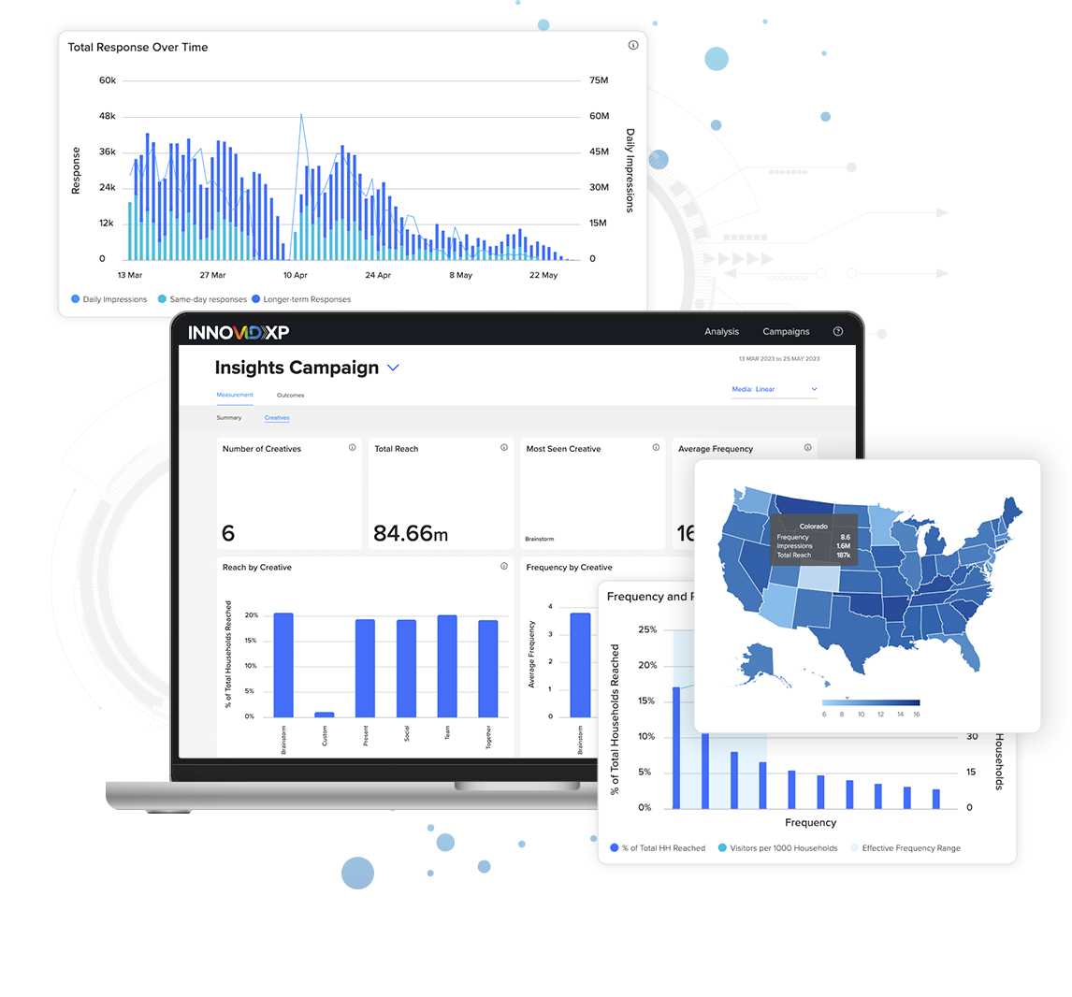
Product Category: Retail
Measurement Category: Outcomes
Haix Optimizes Converged TV with InnovidXP to Increase eCommerce Response
55%
Improvement in ROI
+37%
Increase in Immediate Visits
+24%
Increase in Longer-Term Visits
+78%
Increase in TV Inventory YoY
`
Challenge
As a global manufacturer of tactical footwear, Haix produces more than 1 million pairs of shoes and boots annually. While its footwear can be purchased in brick-and-mortar stores, Haix embarked on a converged TV campaign to drive response and direct ecommerce sales via its website.
Measurement Solution
InnovidXP
Target Segment
Haix footwear is designed for firefighters, EMTs, paramedics, law enforcement officers, foresters and safety workers.
Learnings
Leveraging InnovidXP, Haix measured its campaigns’ immediate and longer-term impact on site traffic.
The always-on analytics provided Haix with the ability to leverage granular performance data for campaign insights and media and creative optimizations.
Viewing Source / Media Type
CTV and linear
PAGE 13

Slide 14
What do you do?
IQVIA Digital is entrusted by healthcare marketers to plan, activate, and measure with precision across the healthcare marketing ecosystem.
We deliver personalization at scale through intelligent, transparent solutions built on unmatched clinical and behavioral data. Our real-world data infrastructure ensures privacy-optimized engagements that drive meaningful connections and better patient outcomes.
What makes your product or platform unique?
Our measurement solutions are built on the industry’s most comprehensive healthcare data; it measures real patient and HCP outcomes alongside campaign performance. Our solution delivers frequent, transparent updates on audience verification, media property effectiveness, and optimization, providing actionable insights that drive smarter decisions and better health outcomes.
IQVIA Digital Measurement gives pharmaceutical brands the confidence to evaluate ad-supported channels with clarity and trust.
Which types of companies do you serve?
Our measurement solutions are built for pharmaceutical marketers - including brands, their agencies, and cross-channel publisher ecosystem.
What type of measurement do you provide?
IQVIA Digital Measurement provides real-world, outcome-based insights that go beyond standard engagement metrics.
We start with audience quality verification and extend through patient and healthcare professionals journey timelines to reveal behavioral impact. This gives marketers the “so what” behind campaign activity—enabling optimization, uncovering market dynamics, and connecting media performance directly to impact metrics like NBRx. All delivered accurately, responsibly, and at scale.
What is your footprint/scale?
IQVIA Digital partners with leading privacy-first identity networks to deliver measurement across more than 318 million non-identified patients.
With over 150,000 data suppliers, IQVIA provides access to 1.3+ billion medical claims and insights from 2+ million U.S. prescribers—creating an unmatched foundation for accurate, privacy-compliant measurement and optimization.
Which video platforms do you measure or support?
Linear (STB/ACR)
OTV/CTV
Addressable
Digital Video
Programmatic Video
MVPDs
*Other Video assets are measurable through IQVIA's digital platform as well*
What are the core elements of a successful partnership?
A successful partnership with IQVIA Digital is built on collaboration and data-driven precision. Successful clients leverage IQVIA’s unparalleled healthcare data at every stage of the marketing cycle—planning, activation, measurement, and optimization—offering solutions that deliver measurable impact. IQVIA Digital works closely with clients to understand campaign objectives and define business rules that ensure accurate, meaningful measurement of advertising effectiveness. Each client is supported by a dedicated engagement team that guides implementation and helps interpret results, turning insights into actionable strategies.
Website and contact information:
iqviadigital.com | IQVIA Digital: Overview / LinkedIn | info@iqviadigital.com
PAGE 14

Slide 15
Product Category: Healthcare
Measurement Category: Engagement and Outcomes
Measurement of Linear TV Impact to Support Strategic Campaign Goals
CBS
ABC
Inspire
Fox News
TV Land
GSN
History
Weather
Oxygen
Fox
CW
Hallmark
Science
Channel
Fox
My
Network TV
MeTV
Weather
GSN
Newsmax
TV ONE
`
Challenge
Assess promotional impact of 2024 Linear TV buy in time to inform upfront buys for 2025.
Measurement Solution
IQVIA Digital's Linear TV platform provided comprehensive and timely updates on TV audience validity and promotional impact. Data updated through mid-year highlighted individual network performance and allowed for focus on those showing profitable acquisition.
Segment
Psoriasis Patients (de-identified) with and without prior prescription treatment.
Learnings
A combination of high reach broadcast networks and targeted niche cable networks proved successful. While large scaled broadcast networks contributed the highest volume of incremental new patients the highest relative promotional lift came from niche, entertainment channels like CW and Hallmark.
Viewing Source / Media Type
Linear TV Exposure reported via iSpot STB/ACR data.
PAGE 15

Slide 16
What do you do?
iSpot helps advertisers drive ad effectiveness with holistic TV and video measurement across the full ad lifecycle. Our fast, accurate and actionable measurement solutions enable advertisers to assess creative effectiveness, improve media plans and drive business outcomes from TV and video advertising.
What makes your product or platform unique?
iSpot gives marketers fast, actionable insights that inform how ad creatives and target audiences impact business and brand outcomes. Unlike legacy and ad-hoc offerings, iSpot solutions are purpose-built to measure the performance of every ad on TV with digital-like precision and granularity; and to provide a holistic view of video ad performance across linear, streaming, digital, and social media. Empowered with always-on cross-platform performance analytics, advertisers can take quick and confident action to drive greater ROI. With currency-grade measurement, large-scale verified insights, and deep competitive intelligence, iSpot gives advertisers control and confidence amid the fragmentation chaos.
Which types of companies do you serve?
iSpot has extensive experience supporting brands of all sizes and across all industries, including 85 of the top 100 advertisers. We also serve agencies, networks and publishers, giving them measurement, attribution and currency solutions that prove and maximize business impact.
Which attribution model(s) do you utilize?
Which video platforms do you measure or support?
iSpot believes there’s a better way to measure TV and video ad ROI. We support granular views of cross-screen ad performance in real-time across streaming, linear, digital and social video, including walled gardens.
iSpot’s attribution is a multi-touch fractional attribution model of media exposures to conversion events. The Fractional Linear and Fractional Weighted models provide fractional credit and look back in time from the point of exposure (impression on TV) to when conversion occurs.
What are the core elements of a successful partnership?
We work hard to provide solutions for all phases of TV and streaming advertising from creative testing to audience exposures and business outcomes. Offering the most comprehensive suite of measurement solutions, iSpot delivers transparency and accountability for TV and video ad investments.
Our incredible technology, talented people and expansive data sources are evidence of
our commitment to our customers, partners and a deeply held belief that trusted modern measurement will be critical for everyone in the marketplace.
Website and contact information:
iSpot.tv | iSpot.tv/contact-us
PAGE 16

Slide 17
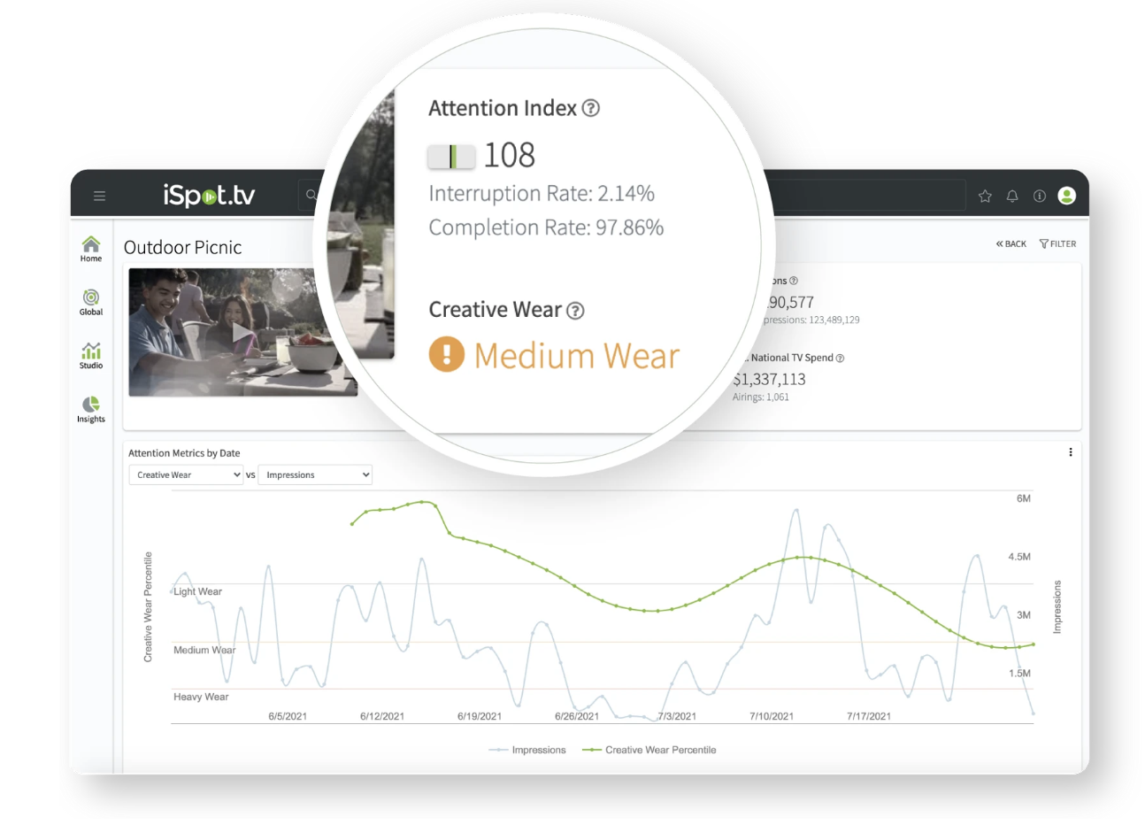
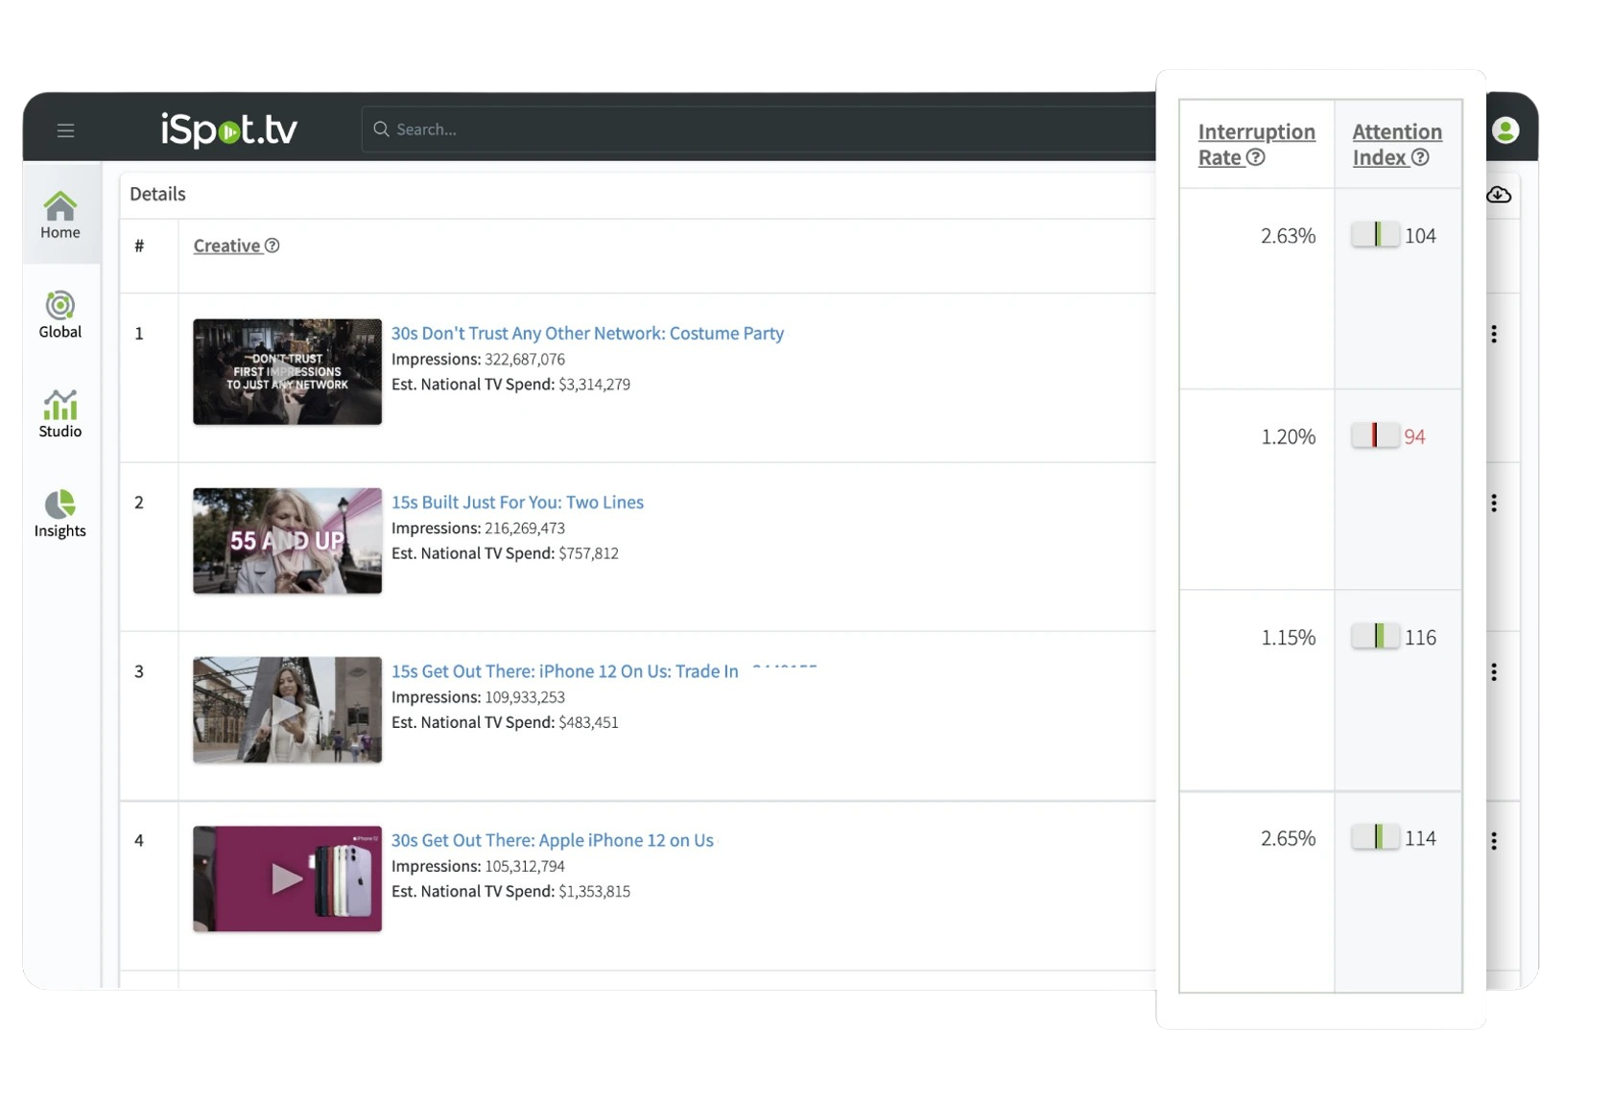
Product Category: Automotive
Measurement Category: Engagement and Outcomes
Automotive brand partners with iSpot to measure and identify campaign efficiencies
Attention Index and Interruption Rate Utilized to
Increase Savings and Boost Performance
$2M+
saved in wasted ad spend
7out of 29
linear networks were identified as being inefficient
8 out of 24
streaming publishers were identified as being inefficient
Attention Index: Compare your ad’s actual Interruption Rate against the expected rate for the specific media placement.
Interruption Rate: Understand when viewers are changing channels, fast forwarding, turning off the TV or otherwise interrupting your ad.
`
Challenge
Boost performance, increase ROAS and grow savings for an automotive brand’s upfront campaign by analyzing quarterly performance across linear and streaming platforms to identify and remove inefficient networks.
Measurement Solution
iSpot’s person-level measurement and Attention Analytics were used to gauge ad effectiveness through KPIs like Attention Index and Interruption Rate. By examining the campaign across Linear, Digital, and Streaming channels they were able to identify campaign efficiencies across key metrics including total reach, target audience reach, frequency and attention index.
Target Audience
Automotive Intenders
Learnings
Identified 7 of 29 linear networks and 8 of 24 streaming publishers as inefficient and removed from campaign
Drove $2M in savings through refining DSP selection, pinpointing high-performing partners, and reduced ad waste by optimizing for a more targeted media buy
Viewing Source / Media Type
iSpot.tv / Smart TV / Linear TV
PAGE 17

Slide 18
What do you do?
We are a Producer, Distributor and an Ad Marketplace for Long Form Brand Engagement.
What makes your product or platform unique?
Long Form Brand Engagement are half-hour TV shows that uniquely tell a brand story designed to drive measurable results. Leap produces and distributes the show and then executes a tune-in plan utilizing our Ad Marketplace platform to drive consideration and viewership.
Which types of companies do you serve?
We have successfully produced branded content for Travel, Home/Cooking, Education and Financial categories.
Which attribution model(s) do you utilize?
Incremental Reach
Website traffic lift
Subscription signups
Product sales lift
Which video platforms do you measure or support?
Traditional Linear
VOD
Streaming
What are the core elements of a successful partnership?
Focus on the client’s end result ROI. Then built a story, distribution plan and promotional plan to support the ROI. Therefore, a successful partnership consists of a half-hour TV Show which contains a call-to-action to the consumer that drives the
stated ROI.
Website and contact information:
leapmediagroup.net
PAGE 18

Slide 19


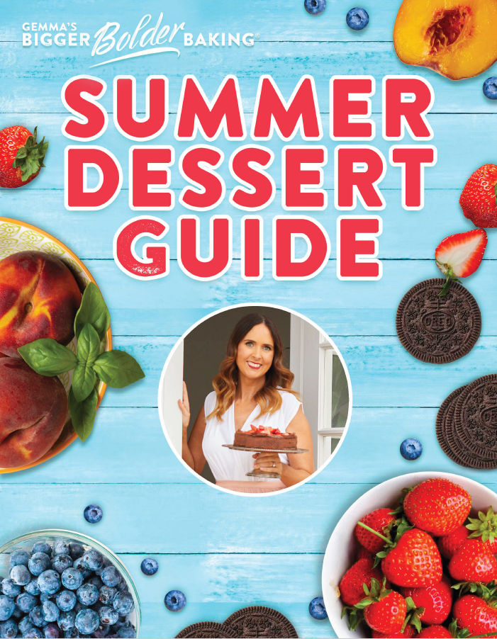


Product Category: Tune-In
Measurement Category: Engagement
Long Form Brand Engagement TV Shows Drive ROI
Social + TV Networks Draws Greatest Increase in ROI
Email Signups
`
Challenge
Increase email signups to the Bigger Bolder Baking community.
Measurement Solution
Produced Half-Hour Brand Engagement show, Gemma's Summer Desserts. The brand created a free Summer Dessert Guide featuring recipes from the show to incentivize email signups to the Bigger Bolder Baking community. The offer was promoted throughout the show via QR code and unique URL.
Target Segment
Baking enthusiasts
Learnings
Airing on weekend mornings on high reach TV networks in the category drove Guide downloads better than social alone and social plus general shopping channels.
Signups increased by 3,750% by adding a Brand Engagement TV show to the media mix.
Viewing Source / Media Type
Linear, FAST, VOD
PAGE 19

Slide 20
What do you do?
LG Ad Solutions is a global leader in Connected TV and cross-screen advertising, helping brands reach millions of viewers with engaging, data-driven campaigns on the largest screen in the home. Powered by LG’s award-winning Smart TVs and proprietary ACR data, LG Ad Solutions enables advertisers to target, measure, and optimize their efforts with precision, creativity, and scale.
What makes your product or platform unique?
LG Ad Solutions connects advertisers across the LG Universe, bringing together the world’s most awarded LG Smart TVs, deterministic viewership data, and captivated audiences.
What makes our platform unique in the marketplace is a combination of proprietary technology, exclusive access, and scaled reach:
    Leverage Proprietary 1P Data Signals through LG’s Automatic Content Recognition (ACR) technology, capturing granular viewership behaviors across linear, OTA, FAST, AVOD, SVOD, OTT, and HDMI-connected devices.
    Deliver Exclusive Home Screen and CTV Video Experiences that reach viewers at the moment of content discovery, enhanced with interactivity and creative innovation to drive deeper engagement.
    Activate Cross-Device Precision with a scaled network of 336M+ devices, enabling advertisers to extend frequency and retarget exposed viewers across screens for performance-driven campaigns.
    Partner for Innovation with leading measurement providers, creative innovators, and data partners to deliver measurable lift in awareness, favorability, and conversion outcomes.
This combination of exclusive OEM access, proprietary data signals, premium ad experiences, and scaled performance capabilities positions LG Ad Solutions as a trusted and differentiated partner in the global CTV marketplace.
Which video platforms do you measure or support?
LG Ad Solutions measures and supports viewership across the full spectrum of video platforms. Our proprietary ACR technology captures data directly from the glass, covering linear TV (broadcast and cable), streaming apps (SVOD, AVOD, FAST), and content accessed through connected HDMI devices such as game consoles.
In addition, we enable cross-device activation and measurement across mobile, tablet, and desktop, giving advertisers the ability to engage audiences across the entire connected household. This provides a truly holistic view of video consumption and viewer engagement across all screens.
What are the core elements of a successful partnership?
At LG Ad Solutions, we have found that the most successful partnerships are built on clear objectives, collaboration, and data-driven alignment. Key elements include:
  Defined Business Objectives: Establishing upfront goals tied to brand awareness, performance outcomes, or audience engagement.
  Audience & Data Alignment: Leveraging 1P advertiser data, LG proprietary viewership signals, and third-party data to inform precise targeting and measurement.
  Creative Collaboration: Partnering on innovative formats across Home Screen, CTV video, and cross-device activations to maximize impact.
  Operational Transparency: Clear processes for campaign setup, creative review, and ongoing optimizations to ensure smooth execution.
  Measurement Framework: Agreement on KPIs and integration with preferred measurement partners to validate performance and inform future strategies.
Website and contact information:
lgads.tv
PAGE 20

Slide 21
Product Category: Travel
Measurement Category: Engagement and Outcomes
‘Visit Myrtle Beach’ increased brand awareness and arrival lift through CTV Video ads and Household Extend​*
+102%
+34%
+4 PPs
Arrival Lift
Cost Per Arrival Efficiency
Brand Awareness
`
Challenge
‘Visit Myrtle Beach’ wanted to boost brand visibility and influence consideration and intention to travel (while showcasing the 60 miles of beaches in South Carolina).
Measurement Solution
Use CTV ads and Household Extend to broaden reach of customized creatives through seamless cross-device retargeting
Partner with Upwave for brand lift studies and Arrivalist to measure ad-driven visits, ensuring precise evaluation of campaign impact and ROI
Target Segment
Adults ages 25-74, in southeast US markets, with a strong interest in travel, family, food & health content
Learnings
Results demonstrated a 102% lift in arrivals, 34% lift in cost per arrival efficiency and 4-point increase in brand awareness
Viewing Source / Media Type
Household Extend/CTV
*Household Extend: Powered by our ACR technology and Identity Graph, advertisers can own the living room and surround the connected household, extending reach beyond the TV to secondary mobile, tablet and desktop devices within LG Households.
PAGE 21

Slide 22
What do you do?
MarketCast is a data and technology-driven research and insights firm serving CMOs and marketers at the world’s top brands, media companies, tech platforms and sports and video games organizations. The company brings together a unique mix of primary research, AI and big data to deliver full-funnel transparency for marketers. Our insights guide critical marketing decisions, in addition to developing, launching and measuring brand and advertising campaigns across media platforms.
What makes your product or platform unique?
MarketCast’s attribution solution uniquely focuses on the entire marketing funnel (not just the bottom half) to understand how ad campaigns impact audience awareness and consideration, as well as down funnel conversions – from web site visits and search queries to sales outcomes. This provides advertisers a richer, more detailed look at how their advertising creative and media plans influence customers to take action, from start to finish.
Which types of companies do you serve?
MarketCast counts more than 80% of Ad Age’s top advertising spenders (in 2023) as clients, from leading consumer brands to top media sellers and technology platforms.
Which attribution model(s) do you utilize?
We combine cross-platform MTA with Shapely Values (game theory).
Which video platforms do you measure or support?
All major video platforms including Linear, CTV and Social.
What are the core elements of a successful partnership?
A match between the measurable media and capabilities of the provider.
Common understanding of the business objectives.
Openness on the reality of what is actually effective and what has historically been done.
Website and contact information:
marketcast.com | kristin.klindt@marketcast.com
PAGE 22

Slide 23
What do you do?
Mediaprobe provides measurement data on the physiological activation of consumers as they are exposed to media. We are a panel-based solution that captures electrodermal activity and heart rate from participants in their homes. The signals are synchronized with the media content panelists are exposed to and are processed in an automated platform to deliver second-by-second (and aggregated) impact metrics. Mediaprobe provides Emotional Impact Scores (EIS) on every element of the broadcast (content and advertising) across demographics, via a dedicated platform, which are combined with declarative data, such as dial ratings or survey responses.
What makes your product or platform unique?
For the first time, media companies can go beyond who’s watching to measure the true value of media content to optimize both editorial and commercial decisions that lead them to sell more ads, increase commercial efficacy and amplify sponsorships.
Mediaprobe’s ability to understand the emotional impact of media and advertising is the missing piece for the industry. Powerful explorative data is collected in the viewers native environment, in-home and delivered in all-in-one platform that uniquely captures what people feel by measuring Galvanic Skin Response (GSR) via the Mediaprobe proprietary sensor in the palm of their hand, what they think (Dial) via the Mediaprobe mobile app and what they say (Survey) via the Mediaprobe mobile app.
Which types of companies do you serve?
Mediaprobe works with clients across media entertainment publishers, sports broadcasters and rights holders and advertisers as well as terrestrial radio and streaming audio providers.
Which engagement metrics do you report on?
Since attention is a construct, Mediaprobe uses GSR as proxy for attention to video. This metric is a valid and reliable indicator of perceived arousal in video stimuli. We have done meta-analysis around the psychophysiological correlation of emotion, which clearly shows the linear association between GSR and perceived emotion.
Which video platforms do you measure or support?
Mediaprobe measures media content and ads to support media, media planning and campaign measurement to companies providing linear TV, addressable TV, connected TV, AVOD/FAST and SVOD.
What are the core elements of a successful partnership?
Mediaprobe goes beyond eye-tracking and audience ratings to provide actionable second-by-second measurement to create more engaging content to sell ads, increase commercial efficacy and amplify brands.
Our Customer Success teams work with clients to access our second-by-second data via our proprietary dashboard, which is tagged (on a client-by-client basis) with key elements of the broadcast, as well as any other meta-data aggregated to the broadcast.
As audiences become more fragmented and the reach of individual channels diminishes, it’s becoming more and more important for media owners and brands to determine the true value of their content, inventory and investments.
Website and contact information:
Mediaprobe.com | Mediaprobe.com/contact
PAGE 23

Slide 24
What do you do?
PREMION is a 16x award-winning, industry-leading CTV/OTT advertising platform. With the scale to reach streaming TV viewers across all 210 U.S. DMAs, Premion’s platform is purpose-built with a local-first approach, delivering CTV and omnichannel advertising with tailored campaign performance that prioritizes premium content, brand safety, advanced targeting, and measurable outcomes. Backed by local experts covering every corner of the U.S., PREMION understands unique characteristics, viewer trends and the power of local relevance that drives outcomes for advertisers.
What makes your product or platform unique?
125+ Leading TV & Media Brands
Expansive Presence
Unparalleled Reach & Scale
Precision Targeting
Measurement & Attribution
Transparent Reporting
Experience & Expertise
Platinum TAG Certified
  (Ad Fraud, Brand Safety & Malware)
Which types of companies do you serve?
Regional and Local Agencies and Brands
Which attribution model(s) do you utilize?
Sales Conversion Attribution
Industry-Specific Attribution
Website Attribution
Brand Lift Studies
Linear Reach Extension
Which video platforms do you measure or support?
CTV/OTT
Linear Reach Extension
Omnichannel
What are the core elements of a successful partnership?
PREMION’s team of local experts simplify CTV/OTT and omnichannel advertising with a consultative, full-service approach for planning, buying and measuring campaigns. We prioritize premium content, brand safety, advanced targeting and attribution to drive measurable outcomes for our clients.
Website and contact information:
Premion.com | Premion.com/contact
PAGE 24

Slide 25








Product Category: Furniture Retail
Measurement Category: Engagement
PREMION Delivers Impressive Full Funnel Outcomes
For A Large Regional Furniture Retailer
BRAND LIFT PERFORMANCE:
+22%
+23%
+17%
Aided Awareness
Ad Recall
Purchase Intent
WEBSITE ATTRIBUTION RESULTS
(within 7 days
of exposure) :
37K
2.2K
Exposed Website Visits
Exposed Cart Page Visits
SALES CONVERSION RESULTS
(within 30 days
of exposure):
6.2K
$5M
$809
# of Transactions
(online +in-store)
Generated Sales
Revenue
Average Revenue
Per Sale
`
Challenge
Following the pandemic, consumer demand for new home furnishing has never been greater. A growing regional furniture retailer wanted to drive awareness of their brand and grow sales within multiple markets. They challenged PREMION to reach key furniture buyer audiences while proving the campaign generated measurable brand lift, drove both website and in-store sales and generated a positive return on ad spending.
Measurement Solution
Brand Lift
Sales Conversion and Website Attribution
Target Segment
Home Furnishing Intenders + Women 25-54
New Movers or Homeowners + Women 25-54
Spanish Speakers
Learnings
Results proved that PREMION drove roughly 20% brand lift across 3 KPIs, generated 37K website visits and 6.2K furniture transactions that resulted in $5M in sales revenue.
Viewing Source / Media Type
CTV/OTT
PAGE 25

Slide 26



What do you do?
RSLT TV resolves the complexity of measuring overlapping TV exposures. Using a unified, signal-based, privacy-first approach, we clarify true incremental lift. Measure all your Linear and Connected TV investments with confidence. No pixels or identity matching required.
What makes your product or platform unique?
Measurement Core | Designed to isolate incremental lift beyond baseline demand, helping advertisers better understand what TV contributes to real business outcomes.
Data / Privacy | Does not rely on pixels, IP addresses, or persistent identity graphs, making measurement more resilient to data loss and evolving privacy regulations.
Linear + CTV | Measures Linear TV and Connected TV within a single, unified framework, enabling consistent analysis and de-duplication across channels.
Attribution Integrity | Our system resolves overlap in response data across Linear & CTV to reduce attribution inflation & increase confidence in reported results.
Attribution Window | Automatically calibrates conversion windows based on observed response patterns, improving accuracy and removing manual guesswork.
Creative Fatigue | Estimates when creative will stop generating incremental lift, enabling timely creative refresh and budget protection.
Campaign Adaptability | Built to support national, local, always-on, and flighted campaigns across a wide range of advertiser strategies.
Which types of companies do you serve?
Brands, agencies and publishers. We serve a range of industries including retail, ecommerce, financial services, insurance, home and lifestyle, QSR and restaurants, legal services and non-profit organizations.
How do you leverage AI?
Which platforms do you measure?
AI and machine learning detect incremental online business outcomes from TV advertising. Signal-based models identify creative fatigue and avoid reliance on fragile identity matching.
Linear, Connected, and Streaming TV ads are analyzed using the same incremental methodology, providing consistent measurement and overlap resolution across every TV channel.
What are the core elements of a successful partnership?
Partnerships are built on transparency and trust. Advertisers retain control of their data while receiving clear, incremental insights designed to reduce attribution inflation and support confident decision-making.
Website and contact information:
rslt.io | contact@rslt.io
PAGE 26

Slide 27
What do you do?
Samba TV specializes in TV data and cross-screen measurement. We leverage viewership data to provide off-the-shelf and custom audience targeting solutions.
We can also measure TV and digital campaigns to provide insights into viewership habits, advertising effectiveness, and audience engagement.
What makes your product or platform unique?
At Samba TV, we have a full proprietary tech-stack that includes ACR, first party data, Identity Graph, and a panel which produces TV data and measurement insights that are the most representative in the industry compared to the U.S. census.
Which types of companies do you serve?
Samba TV provides solutions for a wide array of Brands, Agencies, Research Firms, Digital Publishers, Broadcasters, and TV OEMs. We provide value regardless of size, budgets, or industry, focusing on the diverse needs of these sectors with both standard and custom solutions.
What engagement metrics do you report on?
Samba TV can report on Ad Views / Impressions, Reach, Frequency, Incremental Lift, Page Views, Clicks, Unique Visitors, Tune-In, Box Office, Purchase, Location-based attribution and conversion metrics.
Which video platforms do you measure or support?
Samba TV can measure CTV, OTT, VOD, SVOD, AVOD, FAST, Digital Video, Social Video and any other digital media that can support third-party pixels or tagging for measurement.
What are the core elements of a successful partnership?
At Samba TV, we believe successful partnerships are built on trust. Wholly owning our own full tech-stack means that our partners can have trust in our first-party data, the
most diverse and representative in the industry, while maintaining the most stringent global privacy standard to provide trusted data you can rely on now and into the future.
Website and contact information:
samba.tv | info@samba.tv
PAGE 27

Slide 28
What do you do?
TVision provides an unparalleled lens into thousands of America's living rooms. We deliver person-level data on:
  What people are watching: Detailed insights into specific programs and ad creatives.
  How they are getting that content: Granular understanding of platform and device consumption (e.g., specific CTV app vs. linear channel).
  If and when those people are paying attention: Second-by-second measurement of true, human attention to the screen.
  Crucially, who they are watching with: Understanding co-viewing dynamics and household composition during viewing.
TVision’s holistic, multi-dimensional dataset goes far beyond anything available. It provides a level of scale and granularity for real-world, in-home viewing that was once confined to small-scale lab studies.
What makes your product or platform unique?
While traditional metrics focus on reach or impressions, TVision's core differentiation lies in its ability to measure and deliver Attention and Co-Viewing at a person-level:
  Attention: If a viewer does not pay attention to an ad, can it truly have an impact? TVision uniquely quantifies this elusive metric, allowing customers to understand viewing quality, not just quantity. This shifts the focus from simply counting eyeballs to understanding true engagement, revealing whether an audience is fully immersed or distracted.
  Co-Viewing: In a world where volume is often counted as digital impressions, understanding who
  is watching together is increasingly vital. Our data accounts for the complex dynamics of the living room, providing accurate insights into the size and composition of the actual viewing group, which profoundly impacts effective reach and engagement.
By combining "what," "how," "who," and "attention," TVision provides an always up-to-date, scaled look into the living room that allows customers to make the most out of the rest of their data products.
What types of companies do you serve?
TVision serves brands, agencies, publishers, streaming platforms, ad sales organizations, and advertising technology partners.
Which video platforms do you measure or support?
TVision measures Linear and CTV.
What is your footprint/scale?
TVision has one of the largest 1st party data sets for TV consumption and attention, covering over 15 billion viewing seconds, 14 million viewing sessions, 31,100 brands tracked, and over 350,000 unique creative assets .
What are the core elements of a successful partnership?
A critical piece of a successful partnership is a conversation with the TVision team to discuss the business case, goal of measurement, and any additional questions the partner is looking to answer with measurement. In this conversation, the TVision team can ask questions, discuss operational needs and set expectations on what is possible.
Website and contact information:
tvisioninsights.com | hello@tvisioninsights.com
PAGE 28

Slide 29
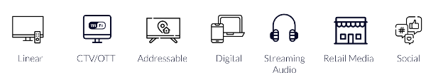
What do you do?
Upwave is the Brands Outcome Measurement Platform.
With Upwave, brands, agencies, and media partners can bring science to top-of-funnel-measuring Brand Lift, validating Brand Reach, and surfacing Brand Optimization opportunities in one, dynamic platform. With cross-channel capabilities, privacy-safe data, and the industry’s most advanced AI models, Upwave helps maximize brand investment.
What makes your product or platform unique?
Upwave is the only company entirely focused on measuring and optimizing the Brand Outcomes driven by advertising. Brand campaign measurement is our only line of business (not a side hustle), and we have measured over one trillion ad impressions for 1,000+ advertisers.
Which types of companies do you serve?
The Upwave platform is built for Publishers, Platforms, Brands and Advertisers.
How do you build privacy into your product?
Given the limitations of 1:1 identifiers, Upwave tracks at the micro-cohort level. Micro-cohorts are small groups of people, such as a household, that are measured as a privacy-safe surrogate for the underlying individuals.
Which video platforms do you measure or support?
Upwave is truly cross-channel, making it possible to measure across all video platforms.
What are the core elements of a successful partnership?
When we partner with customers–whether it be a publisher looking to prove their brand-building power, or a brand wanting to effectively reallocate their media–there is one simple goal in mind: maximize your brand objective. When looking for a brand measurement partner, ask yourself the following questions:
Do you have a brand you are advertising?
Does your advertising have brand objectives?
Do you want to measure those brand objectives with accuracy?
Do you want to elevate your on-target audience reach during a campaign?
Do you want to maximize the outcomes for those brand objectives in real time?
If you have a brand and brand objectives and you want to not only measure those objectives with accuracy, but maximize those outcomes, partner with Upwave–the first and only measurement platform to help you do that.
Website and contact information:
To learn more, or schedule a demo today, visit upwave.com/platform-demo
PAGE 29

Slide 30







Product Category: Pharmaceutical / Healthcare
Measurement Category: Outcomes
Upwave in Action: Optimize for Outcomes Among a Brand-Specific Target Audience
1.5X
2.5X
More likely to reach those in the Hospital Leadership sector
3X
More likely to reach those in the Government sector
5X
More likely to reach those in the Finance sector
More likely to reach VP-level audience via Linear TV
521MM
Total Digital Impressions
Lift in Awareness on Digital
Lift in Awareness on Linear TV
Lift in Awareness Cross-Channel (Digital & Linear)
Lift in Awareness among Affluent Audience (HHI $100k+)
4.2B
11.9MM
People Lifted (Awareness)
Total TV Impressions
`
Challenge
A leading pharmaceutical & health care company invested in an 8-month Digital (Display, Mobile and Desktop) and TV campaign, measuring and optimizing their brand spend. Increasing Brand KPIs, specifically brand awareness and brand reputation, with an end-goal of becoming a household name and measuring overall and on-target reach.
Measurement Solution
Upwave’s analytics solution is powered by exposed/control respondent data and includes reach capabilities that allow brands to measure against a broad, national audience, but also niche demographics, beyond age and gender.
Target Segment
Broad National Audience
HHI $100k+, High-Level Job Title/Industry in Healthcare, Finance, Government.
Learnings
Messaging on TV took time to gain momentum and the brand should utilize programmatic to hyper-target better performing audiences on TV.
The ability to refine their messaging throughout the campaign - optimizing creatives based on Outperformance indicators among the target audiences–led to spikes in key KPIs in the final month of the campaign.
In general, the campaign drove higher lift (comparing Control vs. Exposed) across all Brand Outcomes KPIs over time, based on the utilization of Brand Optimization and Brand Reach tools.
Viewing Source / Media Type
Linear TV, Streaming (CTV, OTT) and Digital Platforms (Display, Mobile and Desktop)
PAGE 30

Slide 31
What do you do?
VideoAmp is a media measurement company transforming advertising. By leveraging the power of currency-grade big data, VideoAmp’s solutions provide clients with access to advanced audiences and the ability to precisely plan, optimize and measure media investments across platforms to achieve better outcomes. With these solutions, media sellers can increase the value of their inventory, while advertisers can benefit from increased return on investment. VideoAmp has seen incredible adoption for its measurement and currency solutions with 880% YoY growth, 98% coverage of the TV publisher ecosystem, 11 agency groups and more than 1,000+ advertisers.
What makes your product or platform unique?
Stable, cross-platform measurement you can confidently act on: Measures linear, streaming, and digital together with consistent methodology—delivering reliable reach, frequency, and performance insights without volatility or blind spots.
VALID™: Big data–led foundation for greater accuracy and precision: A decade of commingled datasets underpins our viewership footprint (40M households, 65M devices) and multi-sourced ID graph, delivering up to 3× more targetable IDs and 200% higher match rates than traditional approaches (WBD study, 2025).
Privacy-forward, census-level streaming and cross-platform visibility: Patented clean room and ML technologies, combined with direct 1P integrations with Disney, FOX, Meta, Snap, and more, deliver a complete, privacy-forward view of streaming and cross-screen audiences.
Unified full-funnel measurement across any audience and outcome: Measure reach, frequency, mid-funnel behaviors, and sales outcomes for any first or third-party advanced or demo audience, using consistent, currency-grade data and identity.
Flexible integration paths to fit your workflows: API-first architecture scales with your business and reduces operational effort, with an intuitive UI for teams that prefer visual tools.
Which types of companies do you serve?
Publishers: Networks, Streamers, Social / Digipubs
Agencies: Holdcos, Independent Agencies
Advertisers: Brands and Marketers
Which video platforms do you measure or support?
Linear TV
Streaming (CTV, OTT)
Digital platforms
What is your footprint / scale?
40MM Homes
65MM Devices
Please briefly explain the essentials of what service your platform of product provides?
Audience R/F Measurement: Understand historical and mid-campaign performance of linear TV, digital or cross screen media's reach and frequency against an age, gender, demographic, or advanced audience target by matching linear, streaming, and digital household exposure data to a single VideoAmp household ID.
Outcome Measurement: Understand impact of linear TV, digital or cross screen advertising campaigns on driving business outcomes (e.g., offline purchase, online purchase, website action) by assigning credit to media events using first-touch, last-touch, even-touch, conversion participation and fractional attribution models.
Content Measurement: Measures viewership of linear programming on national broadcast and cable networks, and other programming types upon availability, via aggregate ratings by telecast.
What are the core elements of a successful partnership?
Proper Scoping of Business and Measurement Goals: A successful partnership begins by ensuring the scope of solutions and support directly aligns with the client's strategic objectives.
Secure Data Integration and Onboarding: Clients achieve maximum value by securely and efficiently integrating their first-party data.
Engagement in Structured Onboarding: New clients are guided through a structured and comprehensive onboarding process.
Website and contact information:
videoamp.com | solutions@videoamp.com
PAGE 31

Slide 32




Product Category: Identity Solution
Measurement Category: Identity
VideoAmp’s Industry-Leading Commingled Identity Solution Delivers
Significant Match Rate Improvements Throughout the Advertising Life Cycle
Enabling advertisers and content owners to more effectively reach their intended audience
79%
average increase in match rate with pixel-based measurement
60%
average increase in match rate with clean room-based measurement
30%
average increase in scale for digital activation
+90%
accuracy of market assignment on local campaigns
Challenge
Traditional single provider identity solutions inhibit advertisers’ ability to resolve impressions to the right audience consistently across platforms; leading to lower accuracy and hurting advertising ROI as audiences are planned, measured and activated throughout the advertising lifecycle.
Measurement Solution
VideoAmp’s industry-leading identity solution commingles identity assets from multiple providers into a complete view of an audience, minimizing audience loss from translation and delivering more accurate targeting and measurement of ads across platforms.
Target Segment
This solution supports Brands, Agencies and Content Owners, enabling each of these segments to increase the efficacy of their ad targeting and measurement to ensure they reach their intended audiences across platforms.
Learnings
VideoAmp’s Commingled Identity Solution has shown significant improvement in match rates throughout the entire advertising cycle compared to single provider identity solutions.
Viewing Source / Media Type
Linear TV, Streaming (CTV, OTT) and Digital Platforms
`
PAGE 32

Slide 33




Best Practices for Marketers
TV is data driven. Leverage advancements in viewership data collection to drive customer targeting, acquisition, engagement and outcomes
Integrate identity into your marketing strategy throughout planning, activation and measurement
Determine how you want consumers to engage with your brand and measure accordingly
Leverage cutting edge technologies and methodologies to drive and measure engagement and outcomes
When it comes to campaign measurement, go beyond audience count to measuring impact and outcomes
PAGE 33

Slide 34
What do we do?
VAB plays a dual role in the video advertising industry. We are leading the change to bring about a more innovative and transparent marketplace. We also provide insights and thought leadership that enables marketers to develop business-driving marketing strategies. We keep you up to date on what's impacting our industry and prepare you for what's ahead.
What makes us unique?
Drawing on our marketing expertise, we simplify the complexities in our industry and discover new insights that transform the way marketers look at their media strategy. With a marketer first perspective, we answer your toughest media questions with innovative thinking, supporting facts and actionable, real-world takeaways.
Which types of companies do we serve?
Our membership represents a varied and dynamic cross section of the ad-supported premium video ecosystem. VAB members are the leaders in the video industry: programmers, content platforms, MVPDs, cinema advertising companies, place-based out-of-home media, data & analytics companies, cross-platform solutions, DSPs, SSPs, advanced measurement companies, consumer insights and more.
What’s on our website?
VAB hosts 390+ custom pieces of insights and measurement content (marketer’s guides, reports, ‘fast facts', educational pieces, FAQs, and more). In addition,
you can find on-demand webinars, panel appearances, op-eds and other thought pieces. Keep up to date with important news, valuable discussions and key events.
How do we support marketers?
As the unified voice of the multiscreen TV industry, VAB is shaping the narrative and leading the conversation on topics such as cross-platform measurement, advanced TV, video streaming,
ad fraud and brand safety. We equip marketers with the insights they need to create inspiring and well-informed marketing strategies that grow their business.
What are the core elements of a successful partnership?
VAB highly values the partnership of our members and the broader advertising and
video marketing community. When cultivating relationships with other organizations,
we look for the same traits we see in ourselves: tenacious, collaborative, trustworthy
and curious. We know that progress best comes about when we work together.
Website information:
thevab.com | info@vab.com
PAGE 34

Slide 35







Thank you for reading the VAB’s Advanced Measurement Solutions Directory.
We invite all measurement solutions to submit their capabilities for inclusion.
If interested, please contact us at info@thevab.com
Want to learn more?
Click on the images below for the content
Looking for industry glossaries and overviews?
VAB’s Advertising Essentials Insights Hub hosts content on a wide range of topics including addressable TV, audience-based buying, brand safety, data privacy & security, programmatic TV, streaming, video measurement and more.
PAGE 35

