Slide 1



The Opportunities to Engage Adults 50+ in Streaming Video

Slide 2


During COVID, adults 50+ invested heavily to modernize their video devices and enhance their ‘at-home’ connectivity. These upgrades further accelerated this segment’s adoption of video streaming which had already begun pre-pandemic.
As adults 50+ embraced the discovery of new shows and streaming platforms that offer library and exclusive content beyond their MVPD subscription, the growth of ad-based services is providing marketers with greater opportunities to reach a broader range of consumers in premium programming across video platforms.
This information is exclusively provided to VAB members and qualified marketers. Further distribution is prohibited.
PAGE 2

Slide 3

Tech Adoption and Video Streaming Has Accelerated for Adults over 50

Slide 4
In order to modernize, update or create better online experiences for themselves during the pandemic, older adults almost tripled their annual spending on technology in 2020
YoY Spending on Technology Products
Adults 50+
+194%
Source: AARP, 2021 Tech Trends and the 50-Plus: Top 10 Biggest Trends, April 2021. Survey was conducted between September 25 – October 20, 2020 (n=2,271 adults 50+). Technology products include smartphones, smart TVs, Bluetooth headsets/ear buds, laptop computers or netbooks, tablets, wearable devices, home assistant devices, smart home technology / security, desktop computers, home audio equipment, digital cameras, gaming systems, e-readers, GPS trackers designed to monitor/share location, home health & safety devices, virtual reality devices and others.
This information is exclusively provided to VAB members and qualified marketers. Further distribution is prohibited.
PAGE 4

Slide 5

Driven by the desire to upgrade their video devices, Smart TVs became the second most popular tech purchase against adults 50+ and are now owned by two-thirds (64%) of the demographic
% of adults 50+ who own a smart TV
+31%
vs. 2019
+31%
vs. 2019
+28%
vs. 2019
64%
of adults 50+ owned a Smart TV by the end of 2020
compared to 49% in 2019
Source: AARP, 2021 Tech Trends and the 50-Plus: Top 10 Biggest Trends, April 2021. Survey was conducted between September 25 – October 20, 2020 (n=2,271 adults 50+). 2019 respondents were broken out into the following age groups: 50-59 (n=972), 60-69 (n=848), 70+ (n=778). 2020 respondents were broken out into the following age groups: 50-59 (n=808), 60-69 (n=798), 70+ (n=650). Note: Smartphones were the most popular tech purchase during the pandemic according to AARP 2021 Tech Trends report.
This information is exclusively provided to VAB members and qualified marketers. Further distribution is prohibited.
PAGE 5

Slide 6



This newfound connectivity enabled adults 50+ to discover new shows and new streaming services, a curiosity that will continue post-pandemic
COVID-related streaming behaviors among adults 50+
62%
Discovered new shows they didn’t even know existed
34%
Started using a new streaming service as a result of COVID-19
94%
Are likely to continue using the new streaming service they added as a result of COVID-19*
Source: VAB analysis of MRI-Simmons Cord Evolution Study, April 2021. *Base = ‘started using new streaming service as a result of COVID’.
This information is exclusively provided to VAB members and qualified marketers. Further distribution is prohibited.
PAGE 6

Slide 7

With greater access to connected video devices and an openness for discovery, streaming among adults 50+ has been steadily increasing over the last few years and almost one-third are streaming daily
% of adults 50+ that have ‘streamed in the past 12 months’
3 in 10
of adults 50+ stream entertainment daily
(up from 18% in 2019)
Source: AARP, 2021 Tech Trends and the 50-Plus: Top 10 Biggest Trends, April 2021. Survey was conducted between September 25 – October 20, 2020 (n=2,271 adults 50+). VAB analysis of MRI-Simmons Cord Evolution Study, October 2016, October 2017, November 2018, November 2019, November 2020, July 2020 & April 2021.
This information is exclusively provided to VAB members and qualified marketers. Further distribution is prohibited.
PAGE 7

Slide 8
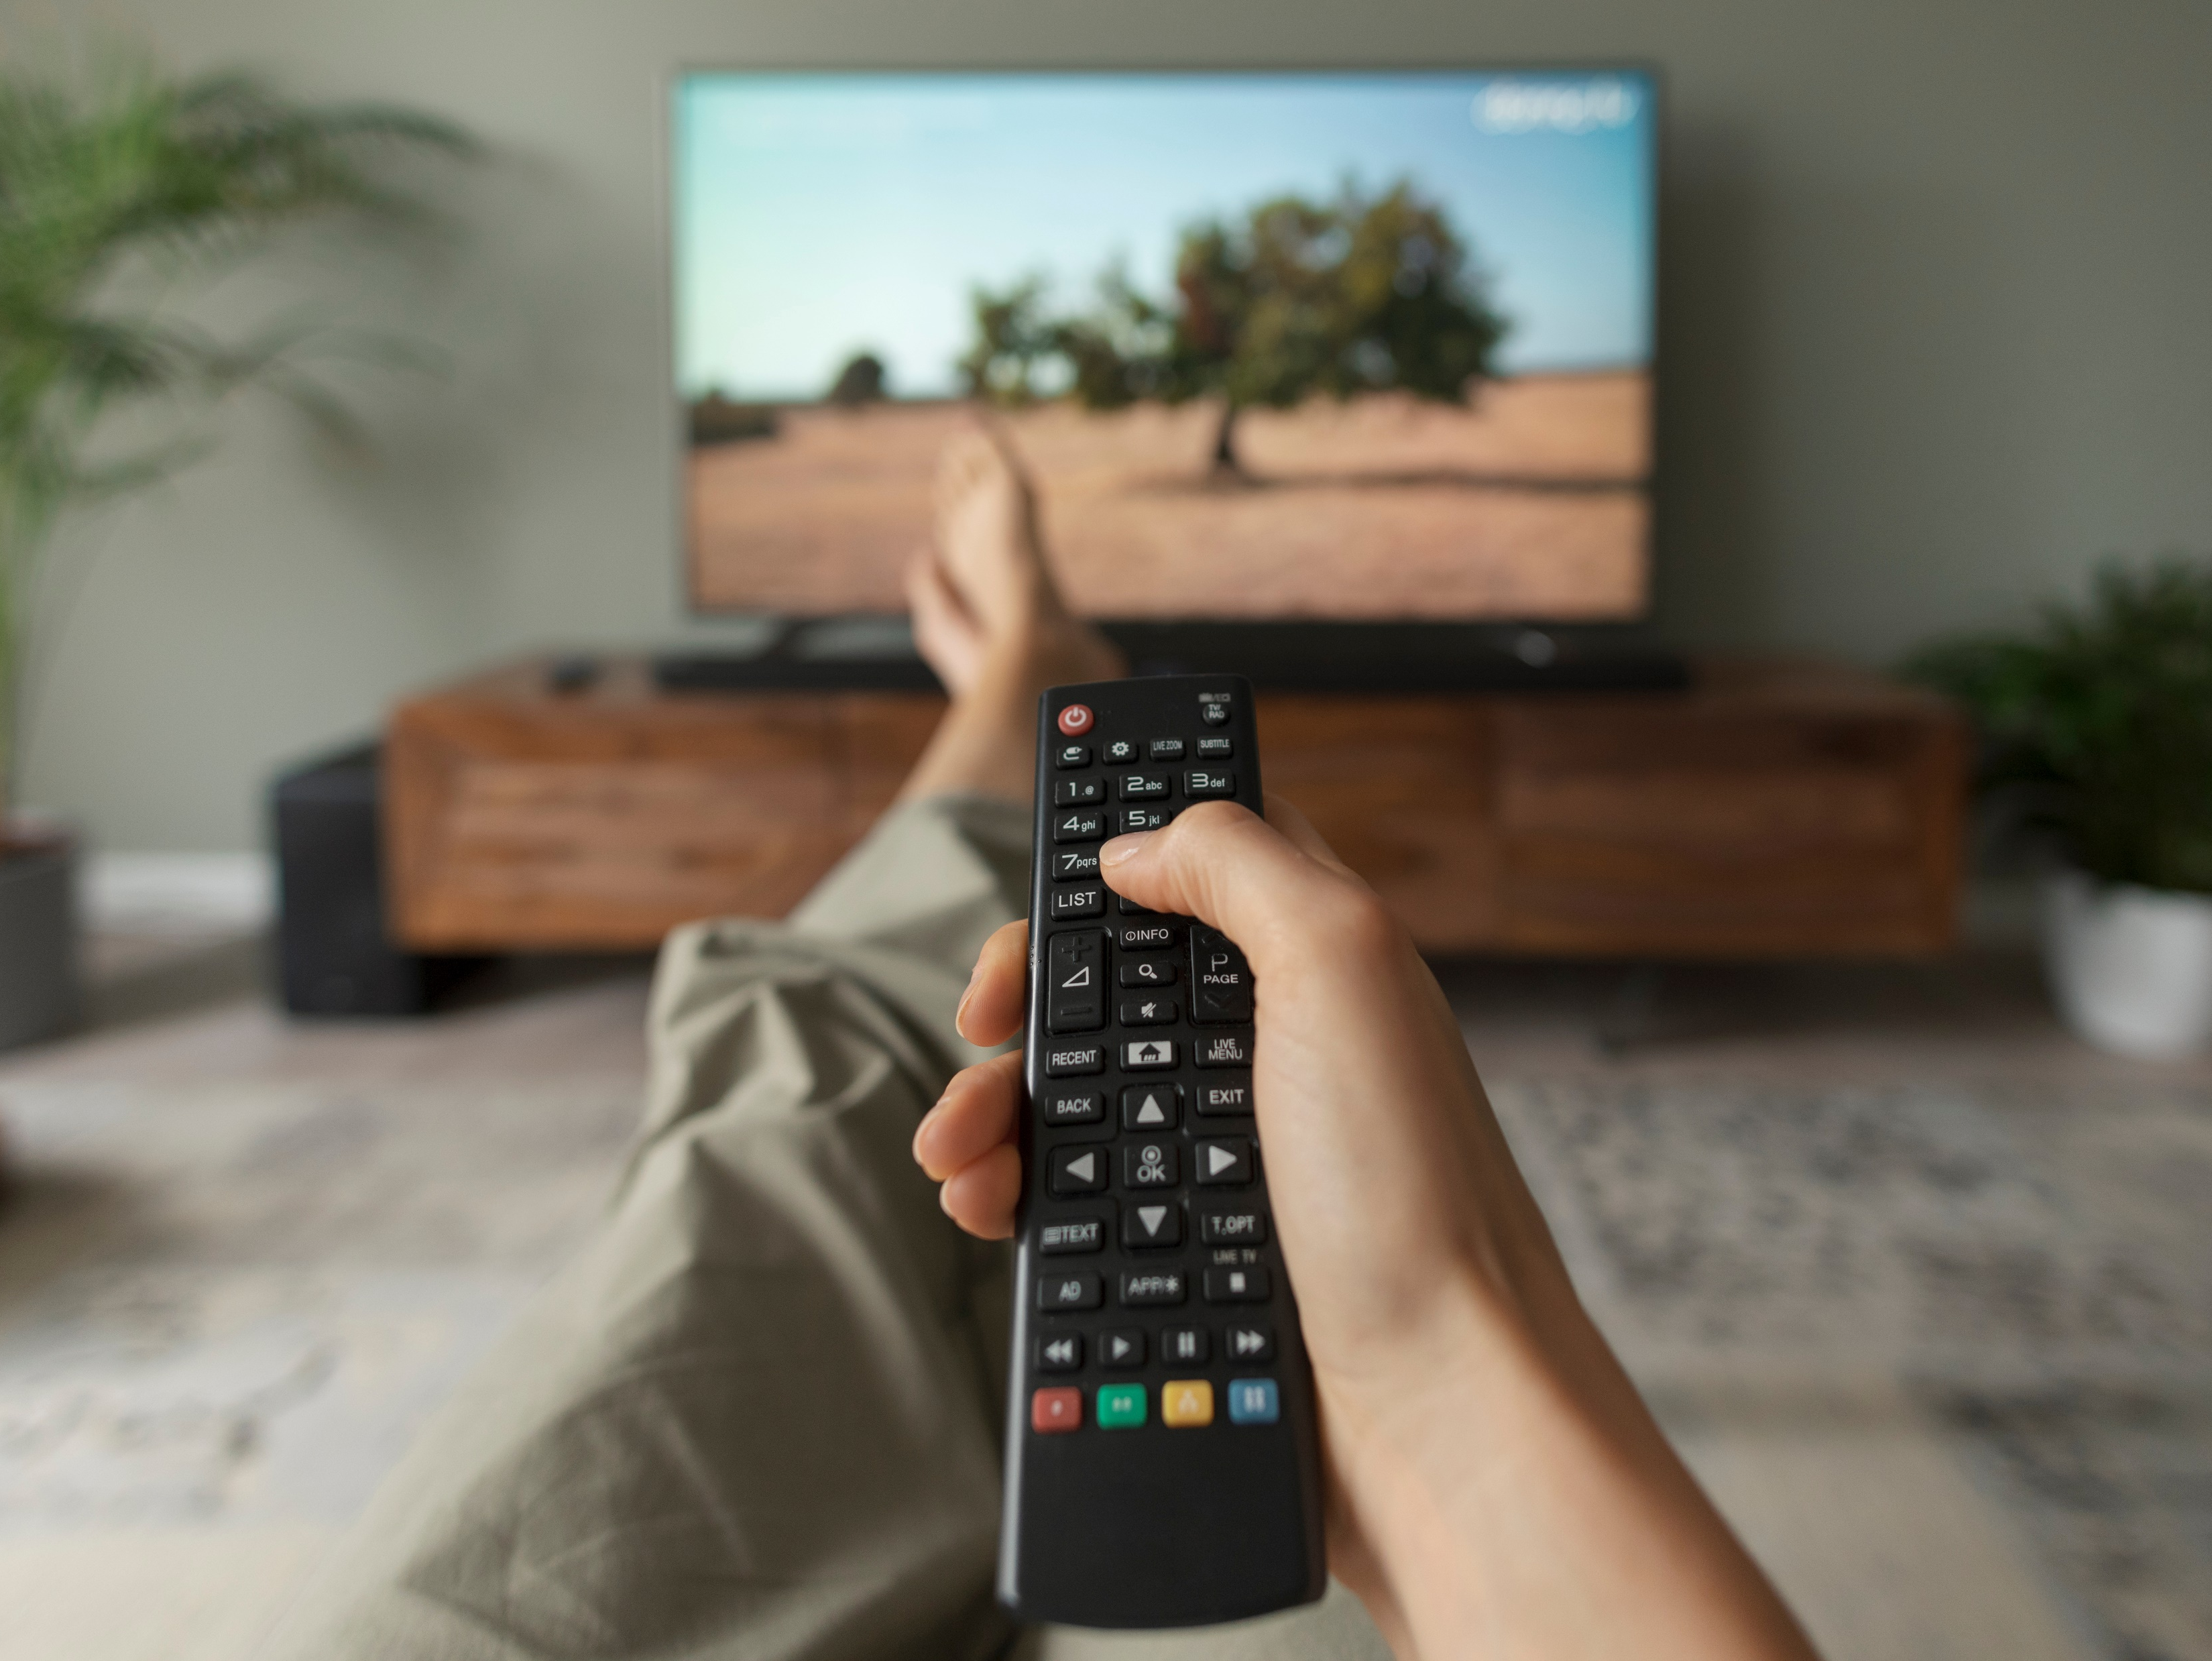
As streaming increases, adults 50+ are more likely to view it as a complement to linear TV because of the value they gain from additional entertainment content
‘I think of streaming as an addition to watching traditional TV, not a replacement’
% of adults 50+ who agree
Source: VAB analysis of MRI-Simmons Cord Evolution Study, October 2017, November 2019 & April 2021.
This information is exclusively provided to VAB members and qualified marketers. Further distribution is prohibited.
PAGE 8

Slide 9






Adults 50+ view streaming as a complement to linear TV because they turn to these services specifically for access to library and exclusive, original content not typically available elsewhere
What drives you to want to use / subscribe to a new streaming service?
% of adults 50+ who agree with the following
Library content
Original content
Library content
41%
32%
25%
Access to movies (old & new releases)
Access to original series exclusive to service
Access to series that no longer air on traditional TV networks
(e.g., Friends, How I Met Your Mother, Friday Night Lights, etc.)
Live content
Live content
Live content
20%
14%
11%
Access to series that are currently airing on traditional TV networks
(e.g., The Walking Dead, The Good Place, This Is Us, etc.)
Access to sports events the service streams
Access to news content the service streams
Source: VAB analysis of MRI-Simmons Cord Evolution Study, April 2021.
This information is exclusively provided to VAB members and qualified marketers. Further distribution is prohibited.
PAGE 9
This information is exclusively provided to VAB members and qualified marketers. Further distribution is prohibited.

Slide 10
Nearly two-thirds of adult 50+ MVPD subscribers are also streaming as this segment stacks video services in search of more exclusive content
% of adults 50+ MVPD subscribers who have ‘streamed in the past 12 months’
72%
of adults 50+ are MVPD subscribers
Source: VAB analysis of MRI-Simmons Cord Evolution Study, October 2016, October 2017, November 2018, November 2019, November 2020 & April 2021.
This information is exclusively provided to VAB members and qualified marketers. Further distribution is prohibited.
PAGE 10

Slide 11
With the growth in smart TV penetration, OTT usage and population size, adults 55+ now collectively spend more time streaming than adults 18-34
% of Total Streaming Minutes by Demo
Source: Nielsen CES 2021. Nielsen, Streaming Meter Homes: Average Weekly Streaming Minutes (Weighted), P2+, Total Day.
This information is exclusively provided to VAB members and qualified marketers. Further distribution is prohibited.
PAGE 11

Slide 12
The Ad Opportunity
for Advertisers

Slide 13
Motivated by the pandemic and a desire for more content, older audiences are expanding into new platforms, especially free streaming services, providing marketers more avenues to reach a broader range of consumers
% change in A50+ streamers who have access to a…
Nov ‘18 vs. Apr ‘21
% of adults 50+ streamers that have access to a…
+47%
+9%
Free / Ad-Based
streaming service
Subscription streaming service
Source: VAB analysis of MRI-Simmons Cord Evolution Study, November 2018, November 2019, February 2020 & April 2021. Base = ‘Streamed in the past 12 months’. Free Streaming services (e.g., Pluto TV, YouTube, Tubi, etc.). Subscription services may include ads or limited ad load tiers.
This information is exclusively provided to VAB members and qualified marketers. Further distribution is prohibited.
PAGE 13

Slide 14

Older audiences are also increasing their usage of ‘TV Everywhere’ apps, TV network apps and vMVPDs
Nearly one-third (30%) of adult 50+ MVPD subscribers have used a ‘TV Everywhere’ or TV network app*
% of adults 50+ that have used a TV Everywhere app in the past 12 months*
% of adults 50+ that have used a TV network app in the past 12 months**
% of adults 50+ that have used vMVPDs in the past 12 months**
+10%
vs. 2019
+32%
vs. 2019
+40%
vs. 2019
Source: VAB analysis of MRI-Simmons Cord Evolution Study, November 2019, February 2020 & April 2021, Adults 50+. TV network apps include ‘through free TV network apps’ and ‘through paid TV network apps’. *Base: Households that subscribe to a cable / satellite / fiber optic service. **Base: Streamed in the past 12 months.
This information is exclusively provided to VAB members and qualified marketers. Further distribution is prohibited.
PAGE 14

Slide 15
On average, adults 50+ spend nine hours with video streaming per week, over five of which are through services with at least limited ad loads
Average % of time spent with streaming in a typical week by platform
A50+
On average, adults 50+ spend nearly
38% of their time streaming on subscription services without ads in a typical week
On average, adults 50+ spend
62% of their time streaming on services with ads in a typical week
Source: VAB analysis of MRI-Simmons Cord Evolution Study, April 2021. Percentage breakout represents average time spent in a typical week with various sources used to watch content. Average hours represents ‘hours of time-shifted streaming in typical week’ and ‘hours of live streaming in typical week’. ‘Paid Subscription Streaming w/out Ads’ includes pure paid subscription services (e.g., Netflix, Prime Video, HBO Max, Commercial-free Hulu, etc). ‘Streaming Services w/ Ads (Paid/Free)’ includes Paid Subscription Streaming w/ Ads (e.g., versions of Hulu, Discovery+, Peacock, etc. with ads/commercials), Free Streaming services (e.g., Pluto TV, YouTube, Tubi, etc.), Streaming Cable TV network apps (e.g., A&E app, Bravo app, E! app, etc.) and Streaming Broadcast TV network apps (e.g., ABC app, NBC app, CBS app, FOX app, etc.).
This information is exclusively provided to VAB members and qualified marketers. Further distribution is prohibited.
PAGE 15

Slide 16




While two-thirds of adults 50+ prefer streaming free content with ads, they are much less likely to see ads that are relevant to them which creates a strategic opportunity for savvy marketers to engage with this audience
% of adults 50+ streamers who agree with the following statements
63%
‘I prefer streaming free video content with ads/commercials instead of paying for a subscription without ads / commercials’
89%
‘I like that streaming services have
less ads / commercials’
32%
‘The ads / commercials I see on streaming services I use are relevant to me’
(vs. 44% of A18-34)
Source: VAB analysis of MRI-Simmons Cord Evolution Study, April 2021. Base = ‘Streamed in the past 12 months.’
This information is exclusively provided to VAB members and qualified marketers. Further distribution is prohibited.
PAGE 16

Slide 17
Over two-thirds of all adults 50+ have streamed content in the last year while they modernized their video devices and discovered ‘new’ content across additional platforms
Adults 50+ view streaming as a complement to linear TV and their existing MVPD subscription as they turn to these services for access to library content and exclusive programming
As the adult 50+ audience grows among ad-based streaming services, this provides marketers more viable cross-platform opportunities to reach a broader range of consumers and underscores the importance of an audience-based (vs. demo-based) multiscreen TV buying approach
Key Marketer Takeaways
This information is exclusively provided to VAB members and qualified marketers. Further distribution is prohibited.
PAGE 17

Slide 18



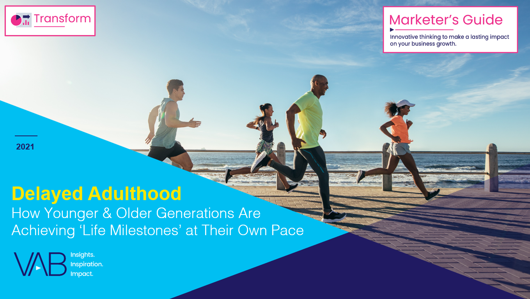
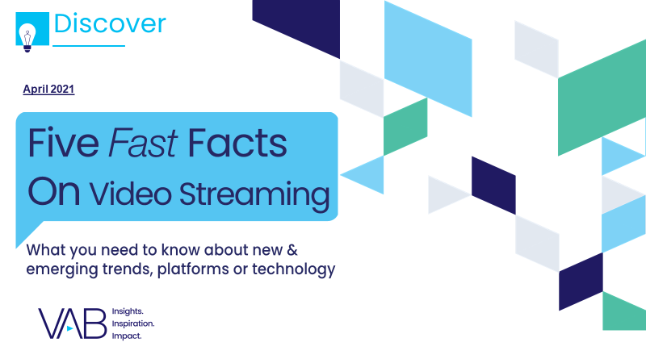
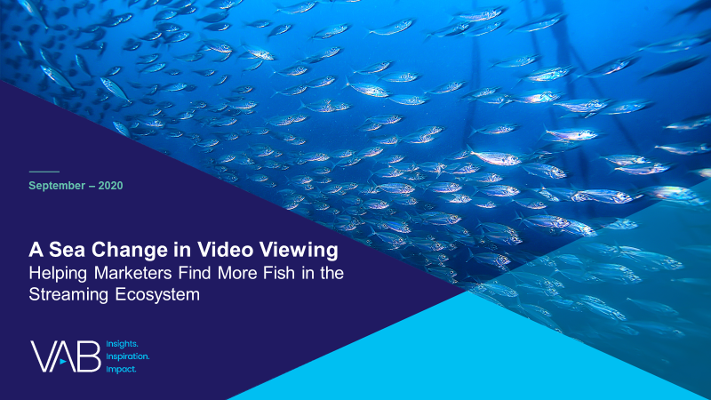
Creators
Leah Montner-Dixon
Karolina Guillen
Associate Insights Director
leahm@thevab.com
Insights Manager
karolinag@thevab.com
Discover more
Looking for more data, insights and takeaways? Check out this related VAB content
The VAB Top 10
A top-line view of how the industry
is adopting audience-based buying
An Insider’s Look
Why brands and agencies are shifting to audience-based buying
Audience Migration in Context
Leveraging Population Shifts To Unlock $4 Trillion in Buying Power
Delayed Adulthood
How younger & older generations are achieving ‘life milestones’ at their own pace
Five Fast Facts on
Video Streaming
A Sea Change in Video Viewing
Helping Marketers Find More Fish in the Streaming Ecosystem
VAB Members, brand marketers and agencies get free and immediate access to VAB’s content library. Get access at theVAB.com
This information is exclusively provided to VAB members and qualified marketers. Further distribution is prohibited.
PAGE 18

Slide 19

About VAB
VAB is an insights-driven organization that inspires marketers to reimagine their media strategies resulting in fully informed decisions.
Drawing on our marketing expertise, we simplify the complexities in our industry and discover new insights that transform the way marketers look at their media strategy.
Discover
We keep you one step ahead with the latest thinking so you can create innovative, forward-looking strategies.
Simplify
We save you time by bringing you the latest data & actionable takeaways you can use to inform your marketing plans.
Transform
We help you build your brand by focusing on core marketing principles that will help drive tangible business outcomes.
We are committed to your business growth and proud to offer VAB members, brand marketers and agencies complimentary access to our continuously-growing Insights library. Get immediate access at theVAB.com.
This information is exclusively provided to VAB members and qualified marketers. Further distribution is prohibited.
PAGE 19

