Slide 1


VIDEO ADVERTISING BUREAU – A MARKETER’S GUIDE - 2019
.................
Address For Success
How Addressable TV Delivers Full-Funnel Outcomes

Slide 2
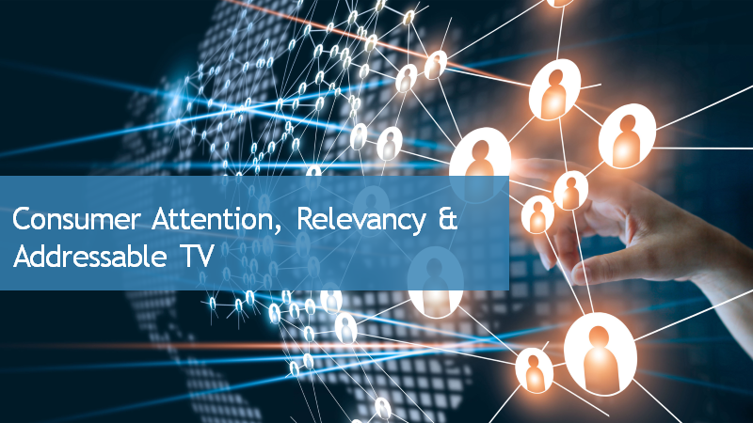





Contents
1
Consumer Attention, Relevancy & Addressable TV
2
Precision Targeting & Advanced Data Capabilities
1
2
3
Delivering Business Outcomes Across The Purchase Funnel
4
Addressable TV’s Increasing Scale
3
4
5
Growing Awareness & Implementation
5
6
6
The Future of Addressable TV

Slide 3
Focus: Addressable TV Through MVPDs
As of 2018, there were 64MM Addressable TV HHs across all DMAs, representing more than 54% of TV HHs
For the purposes of this report, the term ‘Addressable TV’ will refer specifically to the platform & technologies available through multichannel video programming distributors (MVPDs) only
Definition:
Addressable TV is the use of technologies to enable advertisers to selectively deliver ads to individual households via cable, satellite, and Internet Protocol television (IPTV) delivery systems and set-top boxes (STBs).
Addressable TV
Xandr
DISH
Charter*
Altice
Comcast
Cox*
Verizon
*VOD / TV Everywhere app only
Source: FreeWheel, A Buyer’s Guide to the New Living Room, October 2018; eMarketer, July 2018. Note: includes targeted TV ads delivered on a home-by-home basis via cable and satellite boxes; includes video-on-demand (VOD); excludes connected TV, smart TV and over-the-top (OTT).

Slide 4
People have a deep emotional commitment to the premium multiscreen TV content that they watch and enjoy. However, 66% wish the advertisements they see were more relevant to their interests & lifestyles. Additionally, relevant ads are more likely to engage viewers and elicit emotional responses, which help increase sales volume.
As a solution, advertisers can further enhance their relevancy by harnessing the power of Addressable TV through MVPDs. The precision targeting of Addressable TV delivers a deeper level of personalization that enriches the consumer experience and builds greater attention for advertisers.
This personalization leads to positive business outcomes which we showcase in this report via
full-funnel Addressable TV case studies across several categories including automotive, retail, CPG, travel and financial.
It’s Linear TV’s ‘scale of attention’ & emotional engagement combined with Addressable TV’s precision targeting, advanced data capabilities, scale and transparency that drives consumer awareness, interest & action through the purchase funnel.
The success stories are real which explains why agency & marketing professionals who invest in Addressable TV are planning to increase their spend significantly.
With precision targeting driving relevancy & results, one can understand why Addressable TV is experiencing consistent double-digit growth.
Addressable TV’s Premium
‘One-To-One’ Precision Targeting Drives Business Outcomes Across
The Purchase Funnel
Addressable TV Fast Fact:
At approximately 64MM households, covering more than 54% of TV HHs, Addressable TV’s footprint is larger than Netflix, Amazon Prime Video or Hulu in the U.S.
MVPD = multichannel video programming distributor

Slide 5

Consumer Attention, Relevancy & Addressable TV

Slide 6

The Key To Consumer Attention Beyond The TV Program Is Relevant Advertising
And While 82% Of Consumers Understand That Ads Need To Exist As Part Of The “Contract” They Have With Professionally-Produced, Premium Content….
Source: 2018 Relevance Report; Xandr partnered with Insight Strategy Group and Advertiser Perceptions to conduct the Xandr Relevance Report. Insight Strategy Group conducted research among Consumers; Nationally Representative Consumer Online Survey fielded between June 18-June 25, 2018 (N=3,022); In-home Ethnographies from July 16-July 20, 2018 (N=8); and Virtual Attention Diaries from May 31-June 6, 2018 (N=16). Advertiser Perceptions conducted research among Advertising and Marketing Professionals; Online Survey fielded between June 4-June 19, 2018 (N=500); Phone Interviews fielded July 12-July 23, 2018 (N=6).
6

Slide 7

66%
of consumers wish advertisements were more relevant to their interests & lifestyle
Source: 2018 Relevance Report; Xandr partnered with Insight Strategy Group and Advertiser Perceptions to conduct the Xandr Relevance Report. Insight Strategy Group conducted research among Consumers; Nationally Representative Consumer Online Survey fielded between June 18-June 25, 2018 (N=3,022); In-home Ethnographies from July 16-July 20, 2018 (N=8); and Virtual Attention Diaries from May 31-June 6, 2018 (N=16). Advertiser Perceptions conducted research among Advertising and Marketing Professionals; Online Survey fielded between June 4-June 19, 2018 (N=500); Phone Interviews fielded July 12-July 23, 2018 (N=6).
7

Slide 8
Relevant Ads Are More Likely To Engage Viewers And Elicit An Emotional Response Which Help Increase Sales Volume
Brands with ads that generated above-average scores for emotional response are associated with a 23% lift in sales volume
Below Average Ads
Average Ads
Above Average Ads
Source: Nielsen 2016, Emotions Give A Lift To Advertising; Nielsen Consumer Neuroscience Internal Study – FMCG Brands – 2015 (most recent landmark neuroscience study to be completed on this topic). Based on 100 ads across 25 fast-moving consumer goods (FMCG) industry. “Below Average”, “Average” and “Above Average” ads quantified based on people’s electroencephalogram activity (EEG) while viewing the ad. Each ad’s contribution to sales volume computed against the average ad for that brand. Electroencephalography (EEG) is a very precise technology that uses electrodes placed in contact with participants’ scalps to track and record patterns of brain wave activity.

Slide 9

Meet Consumer Needs:
79% say it’s a great feeling when a brand helps them find a product they didn’t know they wanted
So What Does It Take For An Ad To Be Relevant?
Meet A Moment In Time:
70% like when an ad fits in with what they are watching / listening to/ reading
It’s simple: ads need to be helpful, relatable, and emotionally engaging.
They should also fit seamlessly into the programming.
Evoke An Emotion:
71% like when ads make them feel something
Source: 2018 Relevance Report; Xandr partnered with Insight Strategy Group and Advertiser Perceptions to conduct the Xandr Relevance Report. Insight Strategy Group conducted research among Consumers; Nationally Representative Consumer Online Survey fielded between June 18-June 25, 2018 (N=3,022); In-home Ethnographies from July 16-July 20, 2018 (N=8); and Virtual Attention Diaries from May 31-June 6, 2018 (N=16). Advertiser Perceptions conducted research among Advertising and Marketing Professionals; Online Survey fielded between June 4-June 19, 2018 (N=500); Phone Interviews fielded July 12-July 23, 2018 (N=6).

Slide 10

How Can Advertisers Further Enhance
Their Relevancy?
Advertisers Can Harness The Power Of
Addressable TV:
Precision Targeting That Delivers Relevancy & Personalization Which Benefits Both Advertisers & Consumers
10

Slide 11

What Is Addressable TV Advertising?
The use of technologies to enable advertisers to selectively deliver ads to individual households via cable, satellite, and Internet Protocol television (IPTV) delivery systems and set-top boxes (STBs).
Delivery is based on a defined audience-target developed through first-, second-, and/or third-party data. Segmentation can occur at geographic, demographic, behavioral and data-matched household levels.
Under this method, the advertiser buys a specific audience, not individual networks or programs, and ads can be delivered in either live, linear TV or VOD environments.
In summary, Addressable TV is a means of delivering the right ad to the right person by combining the scale of Television with the targeting precision and measurement capabilities of “one-to-one” marketing.
For the purposes of this report, “Addressable TV” refers only to the
multichannel video programming distributor (MVPD) offering / platform
11

Slide 12

A Few Additional Points On Addressable TV
Addressable TV is…
An ad that’s delivered only to households when the television is on and only to the audience that satisfies the advertiser’s target criteria
Inventory where the linear Addressable is allocated from the approximately two minutes of local advertising time an hour that is made available to the cable or satellite operator by each insertable cable network
Addressable ads can also be inserted in Video-On-Demand (VOD) as pre-roll, mid-roll or post-roll
Based on buying audiences, not networks or programs…therefore viewers don’t find the ads, the ads find the viewer. The ad targets a specific audience regardless of what they’re watching instead of projecting upfront what programs they’ll be watching
Impressions / audience-based vs. GRPs / ratings-based
Fully transparent in reporting, measurement and back-end reporting
12

Slide 13
When Implementing Addressable TV, Buying Audiences That Exist Across A Wider Range Of Cable Networks and Programming Increases Reach
49% of total time spent with ad-supported cable TV now happens outside of the top 20 networks as Television viewing fragments across more channels
With this “one-to-one” targeting, value can be found in any program, on any network, at any time
Top 20
58%
Top 20
51%
13
Source: Nielsen NPower Reach & Frequency Program Report. Live, Total Day, P18+, Ad-supported cable TV networks only.

Slide 14




































































































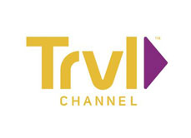









With That Said, Addressable TV is Available Across Virtually Every Cable Network…
Addressable ads are slotted within the approximately two minutes of local advertising time each hour made available to cable or satellite operators
14

Slide 15








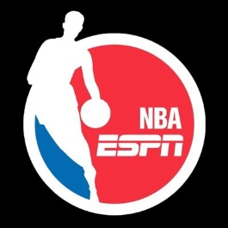






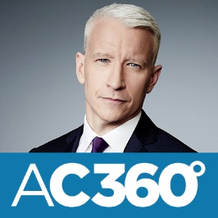
























…Within Premium, Iconic Programming
For transparency, many post-campaign reports include detailed delivery information like impressions by daypart and network
15

Slide 16

…And Across All Devices & Screens
Ads can be served to the same audience on their TV and through their digital devices. By reaching the same consumers across channels, advertisers can gain insights into how media can influence sales lifts and tune-in conversions
1
Identify Addressable households that meet advertiser’s target criteria
2
Identify digital devices associated with target Addressable homes
3
Serve ads to target audience across TV and digital devices
4
Provide cross-screen measurement across the purchase funnel
Source: 2018 Xandr Intellectual Property. Xandr℠, the Kite logo, Xandr, the Globe logo and other marks are trademarks and service marks of Xandr Intellectual Property and/or Xandr affiliated companies. All other marks contained herein are the property of their respective owners.
16

Slide 17

Precision Targeting &
Advanced Data Capabilities

Slide 18






Addressable TV Delivers The Right Ad To The Right Audience At The Household Level
As an example, imagine a street in Providence, Rhode Island all tuned into a New England Patriots game on ESPN’s Monday Night Football through their local cable or satellite provider…
…the program content is all the same, but the local commercials can be tailored to each household’s specific consumption patterns and behavioral data
18

Slide 19
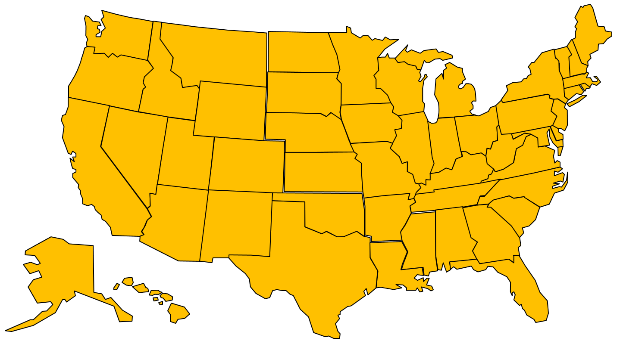

How Does Addressable TV Work?
Addressable TV is not as complex as you might think; sophistication doesn’t have to mean difficult
5
BRAND
1
Nielsen Catalina
CPG
Analyze
Brand Data
Kantar Shopcom
CPG
Results:
-Brand Lift
-Consideration
-Response
-Conversion
-Sales Lift
-ROI
-Frequency /
Creative
Impact
Polk (IHS)
Auto
4
Experian
various
Acxiom
various
Your Ad
Served
Crossix
Healthcare
IXI Services
Finance
3
Mastercard
Retail
Target
Households
2
Media Partner Viewership Data
Data Providers
1
Brand works with media partner on the objectives of campaign and provides relevant first-party data if available.
4
The brand’s ad is delivered with precision only to the households in the target segment.
2
The brand information is matched with the relevant third-party data provider who offer anonymized in-depth, vertical-specific knowledge in a privacy compliant manner.
5
After the Addressable campaign is complete, the media partner / data provider analyzes the results of the campaign and provides the brand with post-buy media details and insights such as impact on brand awareness, purchase consideration and even sales conversion.
3
Based on the matching data, the data provider / media partner finds the specific households the brand wants to reach. Then they pinpoint and identify those households within the Addressable TV footprint.
19

Slide 20



An Addressable Advertiser Can Mine Data From Different Sources To Determine Their Target Audience & Best Prospects
A precise, desired audience can be developed through first-, second- or third-party data
First-Party Data
Advertiser’s data about their own customers, prospects and website users
Potentially made up of purchase history, registered profiles, email subscribers
Can be completed and enriched by Third-Party data
Second-Party Data
Data elements from partners or affiliates that a brand works with
Advertiser may share a customer who they would like to co-market to
Example: credit card company wants to target individuals who frequently travel on a specific airline
Third-Party Data
Data an advertiser acquires from other companies such as Experian or Acxiom
Important to vet that Third-Party data has both scale and accuracy
Can be used on its own, or with first- and second-party data to enrich targeting and segmentation
20
Source: internal VAB information and Experian Addressable TV Whitepaper

Slide 21




















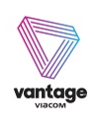








































Advertisers Now Have Numerous Resources Available To Them Through
A Growing Ecosystem Of Data Providers & Measurement Companies
Data Providers
Data Management & Measurement
Demand-Side Media Facilitation
Supply-Side Media Facilitation
Addressable Linear TV
21
Source: LUMA Partners LLC 2018. Note: these are examples of companies and not meant to be an exhaustive list.

Slide 22
Addressable TV Provides Marketers With A Variety Of Benefits
More precise targeting means greater relevance for the audience and increased ROI for advertisers
Source: Xandr Ahead of the Curve: Addressable TV Insights; Advertiser Perceptions Addressable TV State of the Industry, March/April 2017. Q: Please rank the top 5 benefits of Addressable TV advertising. Base: Total Respondents.
22

Slide 23
With Precision Targeting, Every Dollar Spent Goes To The Right Consumer
When compared on a standard CPM basis, Addressable can seem expensive. However, it comes at a premium for a reason.
Based on the availability of advanced data, Addressable ensures lower overall ad spend by guaranteeing an efficient buy that only targets a specific audience.
This means advertisers have fewer wasted impressions against non-prospects, yielding an improved “effective CPM” (eCPM).
A lower “cost-of-entry” also means that an Addressable buy can create a path to TV advertising for smaller businesses who couldn’t previously afford TV.
Source: Xandr Ahead of the Curve: Addressable TV Insights; Advertiser Perceptions Addressable TV State of the Industry, March/April 2017. Q: What are the advantages of using an eCPM to measure efficiency? Base: Total Respondents.
23

Slide 24

Delivering Business Outcomes Across The Purchase Funnel

Slide 25
The Benefits Of Linear TV With The Enhancements Of Addressable TV Delivers Full-Funnel Business Outcomes For Advertisers
“Scale of Attention”
+
Emotional Engagement
Linear TV
Awareness
Intent
Sales
Consideration
Upper Funnel
Combined With Addressable TV’s
Enhanced Ad Relevancy
+
Precision Targeting
+
Advanced Data Capabilities
+
Growing Penetration
+
Superior Visibility, Trust & Transparency
Within The Digital Ecosystem
Mid Funnel
Addressable TV
Lower Funnel
Drives Consumer Awareness, Interest & Action Through the Purchase Funnel
25

Slide 26
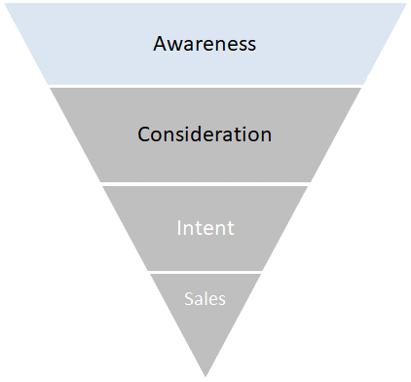

“Awareness” Case Study: A Cruise Line Makes Waves Utilizing 1st Party Data
Results
The Addressable campaign turned the tide for the cruise line, elevating the brand’s position in awareness and recall metrics. When comparing the target group vs. the control group, the campaign generated:
200% surge in Unaided TV Ad Awareness
87% lift in Aided TV Ad Awareness
25% growth in Aided Ad Recall
8% uptick in Aided Brand Awareness
Category:
Travel & Tourism (Cruise Line)
The Challenge:
A widely recognizable cruise company wanted to ensure their brand stood out among consumers, opting to use their ad spend to increase awareness and recall
Brand Metrics
+8% Lift
Flight Duration:
4-week campaign
+25% Lift
Execution: Addressable
The Cruise Line utilized Xandr’s Addressable technology to reach the right audience with the right ad. The brand’s message was delivered to target consumers within premium content.
Ad Metrics
Control
Target
+87% Lift
Target Segment:
Members of client’s loyalty program
Consumers who have sailed three or more times in the last 3 years
+200% Lift
Source: Xandr, Campaign Flight: Q1 2018. Case study results are based on individual campaign factors. Xandr makes no performance warranties. Control represents 10% of DTV HHs within the target that did not receive exposure to the Addressable ad. Source: Kantar Millward Brown.
26

Slide 27
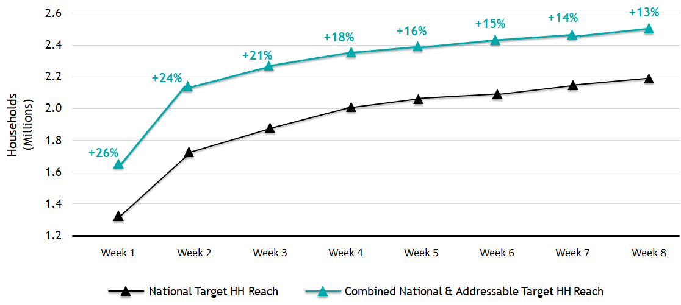
“Awareness” Case Study: Auto Advertiser Drives Increased Reach By
Re-Purposing A Portion Of Their Linear TV Dollars To Addressable
Category:
Auto
Results
Compared to the Advertiser’s National campaign, the Addressable campaign drove an increase in target reach of over 13%
The Challenge:
A leading auto manufacturer wanted to increase their reach against their audience target
Incremental Target Reach With Addressable
Reach Build Over 8-Week National Campaign
Flight Duration:
8-week campaign
Execution: Addressable
The advertiser utilized Xandr’s Addressable technology and deep data insights to serve ads only to the households within their precise target, at the same time as their national campaign flight
Target Segment:
In-market car shoppers
Visitors of auto advertiser’s website
Source: Xandr 2018; Viewership data based on DIRECTV Universe; National Ad Schedule: Comscore Advertising Occurrence Data © 2019 KANTAR Media / Intelligence. Addressable Target from Data Vendor IXI.
27

Slide 28
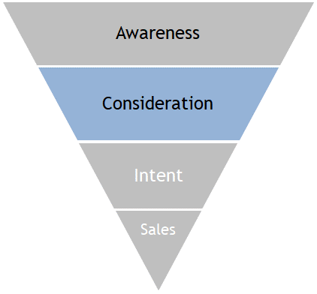

“Consideration” Case Study: Travel Advertiser’s Key Brand Metrics & Attributes Take Flight With Addressable TV
Target:
Relevant Travel Propensity & Demos
Flight Duration:
5-week campaign
Results:
Household Addressable TV campaign achieved significant lifts in both upper and lower-funnel measures and brand attributes, driving a positive impact at 4+ frequency
+13%
+25%
+8% - +23%
Lift in Favorability
Lift in Likelihood to Seek Info
Lift in Key Brand Attributes
Exposure to the campaign generated a higher opinion of the brand
After exposure, there was increased likelihood to learn more about the brand
More likely to associate the brand with relaxation, among other key perceptions
28
Source: Verizon Media, HHA Case Studies, December 2018; Campaign Flight: 2Q’18 – 3Q’18, Reporting based on 4+ Frequency.

Slide 29
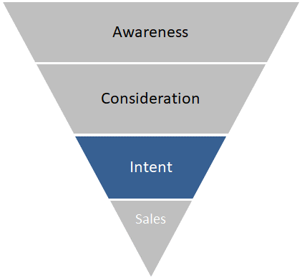


“Intent” Case Study: Turning Audiences Into “Tune-In” Viewers Via Set-Top-Box Data
Targeting:
Tune-in campaigns utilized set-top box data to leverage a highly targeted custom audience based on prior viewing. (Set-top box targets can be made available for activation within approximately one week)
Flight Duration:
2-week campaign
Measurement:
100% set-top-box reporting was leveraged to conduct a third-party analysis measuring the impact on tune-in as a result of ad exposure, with no modeling needed.
Results:
Across a variety of campaigns, advanced targeting drives significantly higher tune-in rates to the programs among HHs exposed to the Addressable campaign. For example:
+14%
+31%
Up to +14% Lift in Tune-In Rate for New Series Premieres
Up to +31% Lift in Tune-In Rate for Returning Series Premieres
Source: Verizon Media, HHA Case Studies, December 2018; Campaign Flight: 3Q’18 – 4Q’18, Tune-In qualifier 6+ Minutes; Control comprised of HHs within target withheld from Addressable campaign exposure. Includes overall lift for tune-in rate across multiple episodes where applicable to campaign.
29

Slide 30
“Intent” Case Study: This Isn’t A Rerun, It’s Another Episode Of Turning Viewers Into “Tune-In” Fans Via Set-Top-Box Data
Category:
Tune-In: Hispanic TV
Results
The Addressable campaign generated significant increases in both ratings and tune-in conversions.
The Challenge:
Drive tune-in to a specific Hispanic network
Flight Duration:
11-week campaign
Execution: Addressable
Addressable TV media campaign and conversion measurement using AT&T Viewership Data
Target Segment:
Subscribers of a DIRECTV’s Spanish-language package and viewers of Hispanic TV networks
Target vs. Control
Target vs. All Hispanic Homes
30
Source: Xandr 2018; Campaign flight: Q3 – Q4 2018. Case study result are based on individual campaign factors. Xandr makes no performance warranties. All Homes: Hispanic DTV HHs. Control: Represents 10% of DTV HHs within target that did not receive ad and therefore were not exposed to Addressable spot.

Slide 31


“Intent” Case Study: Cross-Screen Addressable Is Commandeered By Local State Police To Increase Sign-Ups
Case Study: Multi-Screen Becomes Most Wanted
Goal: Increase Sign-Ups Among Females and Minorities Ages 18-35 for the State Police Exam
Solution:
Local TV: Commercials aired on target networks
a4 Digital:
  Online banners and pre-roll videos were placed on relevant sites, like Facebook’s Newsfeed and MundoLatino.com
  Geo-fencing of gyms, colleges, and popular venues within urban areas
Results
+240% Increase in Click-Through Rates vs. National Average
Sign-Up Rates Surged
Additional Test Date Created To Meet Demand
31
Source: a4 media, Local Advertising Case Studies.

Slide 32
“Intent” Case Study: Making A Smart Investment In Cross-Screen Addressable To Boost Financial Account Sign-Ups
Category:
Financial
Results
Households exposed to both TV and digital ads generated a +102% lift in account sign-ups vs. the control, and a 16% lift over households that just saw a TV ad.
Households exposed to only a TV ad generated a +73% lift over the control.
The Challenge:
An online financial planning company was looking to increase account sign-ups through strategic marketing tactics
HH Account Sign-Ups
Flight Duration:
6-week campaign
+102% vs. Control
Execution: Cross-Screen Addressable
Personalized ads were delivered via Addressable TV to targeted consumers within premium TV content at the household level.
Simultaneously, digital ads were served to the same consumers by mapping digital devices to the target households.
+73% vs. Control
Control
Target: TV
Target: TV & Digital
Target Segment:
$100K+ investible assets & tech enthusiasts
Source: Xandr, Xandr 2018; Campaign flight: Q4 2016 – Q1 2017. Case study results are based on individual campaign factors. Xandr makes no performance warranties. Control: Represents 10% of DTV HHs within the target that did not receive exposure to the Addressable ad. Source: Internal Business Analytics and secondary data provider for targeting.
32

Slide 33
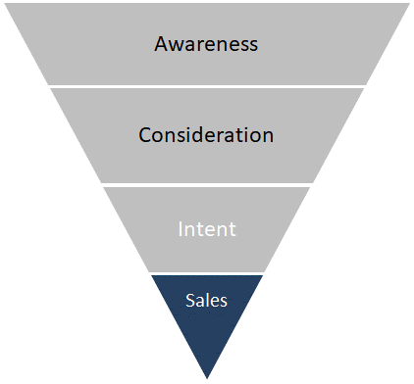
“Sales” Case Study: Retailer Moving On Up Among “Recent Movers” & “Recently Married”
Results
For the “Recently Married” segment, target households gained a 100% lift over the national rate, with an 11.94% lift compared to the control group.
The “Recently Married” target segment was more influenced by the Addressable campaign than “Recent Movers”. This insight helped the retail brand inform their marketing strategy going forward.
Additionally, the campaign drove purchases both in store and online, with in-person sales generating more than twice as many purchases.
Category:
Retail - Furniture
The Challenge:
A major furniture chain was looking to increase sales by driving traffic to both its brick-and-mortar locations as well as its website.
Online & In-Store Purchasers
Total Orders by Sales Channel
Flight Duration:
13-week campaign
+285.33% Lift vs. National
+1.40% Lift vs. Control
29%
Execution: Addressable
Addressable campaign that targeted those who had recently moved or were recently married. The brand’s commercials were delivered to the target audience at the household level, regardless of what networks or dayparts they were watching.
+100% Lift vs. National
+11.94% Lift vs. Control
71%
Target Segment:
Recent Mover Or Recently Married
In Store
Online
National
Control
Target
Source: Xandr, Xandr 2018; * Lifts are based on a subset of the target HHs for which Xandr gets return path data. Campaign flight: Q4 2017. Case Study Results are based on individual campaign factors. Xandr makes no performance warranties. Control: Represents 10% of DTV HHs within the target that did not receive exposure to the Addressable ad. National: Third-Party Data Provider’s proxy for national sales rate. HHs sourced from Third-Party Data Provider’s database. Source: Third-Party data provider.
33

Slide 34
“Sales” Case Study: Addressable TV Delivers Positive Sales Outcomes For A Leading Home Appliances Brand
Execution: Addressable
The home appliances brand reached key audiences on TV through an Addressable campaign using advanced data targeting
Target:
Various Homeowner Audience Segments
Flight Duration: 6-week campaign
Results:
Exposure to the Addressable campaign successfully generated significant lifts in purchase metrics, compared to an unexposed group with similar pre-campaign shopping behavior
+66%
+39%
+19%
Lift in Sales Rate
Lift in Penetration
Lift in Buying Rate
Overall, Households exposed to the campaign spent more on the brand
There was a higher share of households buying the advertised brand after exposure
Purchasing households spent more on the brand after exposure
34
Source: Verizon Media, HHA Case Studies, December 2018; Campaign Flight: 3Q’17 – 4Q’17.

Slide 35
“Sales” Case Study: Auto Manufacturer Revs Up Sales Utilizing 3rd Party Data
Category:
Auto
Results
Xandr partnered with trusted automotive insights provider, IHS Markit, to measure sales of the SUV using the Polk Audience Measurement solution. These sales were then compared against a control group (10% of HHs within the target segment that were NOT exposed to the Addressable ad) to determine ad impact.
  Target group outperformed the national buy rate by 518%, indicating the effectiveness & accuracy of Addressable in reaching & influencing audiences
  In the 30-day measurement period, the campaign garnered a 36% sales lift in sales against the control
  In the 90-day period, sales lift rose even higher to a staggering 48%
The Challenge:
A leading auto manufacturer saw a decline in sales for their full-size luxury SUV, with research showing that many consumers were instead purchasing competing luxury SUVs
Flight Duration:
5-week campaign
Buy Rate
Execution: Addressable
Utilizing household-level Addressable targeting technology & delivery, the auto advertiser’s media was sent directly to target households within premium cable TV content across a national footprint.
Xandr also collaborated closely with the client to define post-campaign measurement strategies and success metrics, such as sales lift.
+36% Lift
vs. Control
+518% Lift
vs. National
+48% Lift
+355% Lift
vs. National
National
Target Segment:
Auto Enthusiast
Competitive Set
Luxury Lifestyles
Look-alike Model
Control
Target
Source: Xandr, Xandr 2018; Campaign flight: Q2 2017 – Q3 2017. Case study results are based on individual campaign factors. Xandr makes no performance warranties. Source: IHS Polk
35

Slide 36

“Sales” Case Study: Auto Brand Shifts Sales Into A Higher Gear With Cross-Screen Addressable
Category:
Auto (Tier 1)
The Challenge:
Increase sales by reaching auto-intenders watching premium content on Ads Everywhere platforms (Spectrum TV App & STB VOD)
Flight Duration:
Q3 2017 campaign
Execution: Cross-Screen Addressable
Built upon target audience profiles that were created using an automotive data provider’s purchase predictors¹ to identify intenders.
Then created deeper targets using a privacy compliant 3rd party data provider to identify households with a high propensity to meet client’s auto-intender target.
Target Segment:
Households with a high propensity to be a auto intender across 4 segments:
HHs likely to buy Brand Model X
HHs likely to buy Brand Model Y
HHs likely in-market for vehicle
HHs likely to upgrade vehicle
Results
Addressable targeting led to an incremental sales lift of $730K²
Exposed audiences had 15% lift in buy-rate vs. the control group (those in target buy not exposed to campaign)
Achieved 95% average ad completion rate³
Source: Charter Spectrum Reach, 2018; Campaign period: 7/3/17 – 9/24/17; 1. Purchase predictor flags are a value from 1 (most likely) to 100 (least likely); 2. Incremental Sales ($) = sum of (MSRP * number of Incremental Sales by model); 3. Defined as percentage of total impressions that were viewed continuously for 100% of the length of the ad. Completion rate data is not available for months earlier than June ’17.
36

Slide 37
“Sales” Case Study: Cross-Screen Addressable Accentuates Sales For Beauty Retailer
Category:
Retail / CPG
The Challenge:
Reach current, lapsed and prospective customers of beauty retailer watching premium cable content on Ads Everywhere platforms (Spectrum TV App and STB VOD)
Flight Duration:
4-week campaign
Execution: Cross-Screen Addressable
Combined client’s first-party CRM data with a privacy compliant 3rd party data provider’s insights to create custom audience segments and lookalike models¹ based on objective.
Post-campaign results were analyzed based on customer purchases online and in-store using client’s CRM data for households that were exposed to ad.
Target Segment:
Current Customers
Lapsed Customers
New Customers
Lookalike Models Using 3rd Party Data Provider Segmentation
Results
Spectrum’s penetration in client’s markets was key to success: Incremental ROAS² based on sales and spend for exposed households was over $157K, or 1.93x client’s budget (nearly 2x return on investment)
Source: Charter Spectrum Reach, 2018; Campaign period: October 2018; 1. Audience segments included three targets using client’s CRM database (current, lapsed, and new),
and one privacy compliant 3rd party data provider lookalike model segment; 2. Incremental ROI = incremental sales X Total average dollars (exposed); 3. Comingled less Spectrum.
37

Slide 38

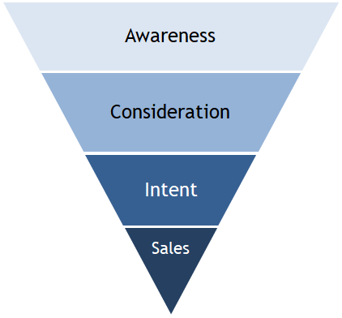


“Full-Funnel” Case Study: How Addressable TV
Lifts Campaign Metrics Through The Purchase Funnel
Category:
Travel Credit Card
Unaided Awareness
+67%¹
Research Intent
+100%¹
Application
Intent
+105%
Travel Card Awareness
+47%
Aided Ad Recall
+230%¹
Favorability
+74%¹
Upper Funnel
Mid Funnel
Lower Funnel
38
Source: Kantar Millward Brown, Travel Card: Comcast Addressable TV Brand Lift Advertising Research, January 2018. Sample Size for Addressable Audience: Addressable Control – n=101, Addressable Exposed – n=141; Flight dates: 10/2/2017 – 11/19/2017; Control respondents were weighted to match the exposed sample; ¹Significant increase at 90% confidence.

Slide 39

“Full-Funnel” Case Study: Travel Credit Card’s KPIs Take Off With TV / VOD Addressable
Category:
Travel Credit Card
Key Takeaways
After consumer exposure to Addressable TV content, the brand saw a lift in awareness & intent to research and apply for the credit card.
Commercials successfully reinforced the card’s key attributes among those exposed to the brand’s messaging.
Low exposures (1-4x) positively influenced subscribers, however frequencies of 5x+ proved to be the optimal amount for memorability, metric gains, and attribute reinforcement.
Flight Duration:
6-week campaign
Execution: Addressable
Addressable campaign for a Travel Card brand ran on Xfinity TV / VOD.
Addressable exposed and control cells were recruited following the campaign to collect survey-based attitudinal data.
Target Segment:
Active and inactive travel card members & Experian lookalike models for the brand’s frequent fliers.
Source: Kantar Millward Brown, Travel Card: Comcast Addressable TV Brand Lift Advertising Research, January 2018. Sample Size for Addressable Audience: Addressable Control – n=101, Addressable Exposed – n=141; Flight dates: 10/2/2017 – 11/19/2017; Control respondents were weighted to match the exposed sample.
39

Slide 40
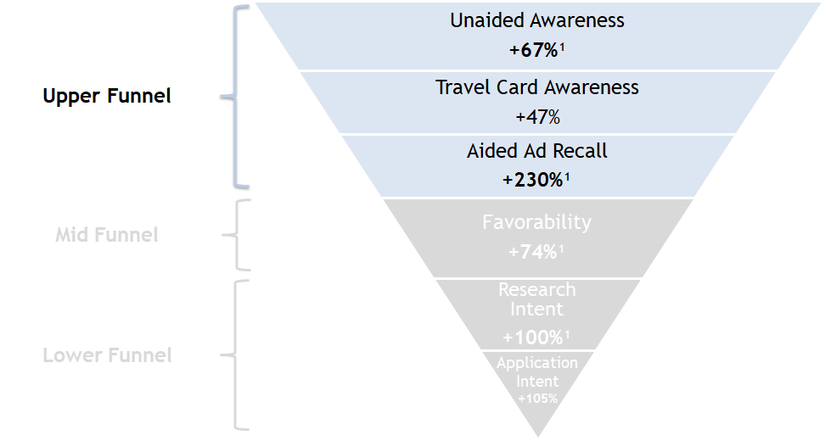
“Full-Funnel” Case Study: Positive Upper Funnel Outcomes For Awareness & Recall
Category:
Travel Credit Card
Upper Funnel Results
Viewers who were exposed to the targeted Addressable TV ads were more likely to exhibit increased brand and ad awareness and ad recall, significantly more so in the case of Travel Card Awareness and Aided Ad Recall.
+17.6
+27.3
+4.2
+4.6
+1.2
Significant Increase at 90% Confidence
Source: Kantar Millward Brown, Travel Card: Comcast Addressable TV Brand Lift Advertising Research, January 2018. Sample Size for Addressable Audience: Addressable Control – n=101, Addressable Exposed = n=141; Flight dates: 10/2/2017 – 11/19/2017; Control respondents were weighted to match the exposed sample. Unaided Brand Awareness Q: When thinking of brands of Travel/Airline Credit Cards, which brands come to mind? ; Unaided TV Brand Awareness Q: Which brands of Travel/Airline Credit Cards, if any, do you remember seeing any TV advertisements for in the past 30 days?; Aided Awareness Q: Have you heard of the following brands of Credit Cards?; Ad Awareness Q: Have you seen the following brand(s) of Credit Cards advertised on TV in the past 30 days?
40

Slide 41
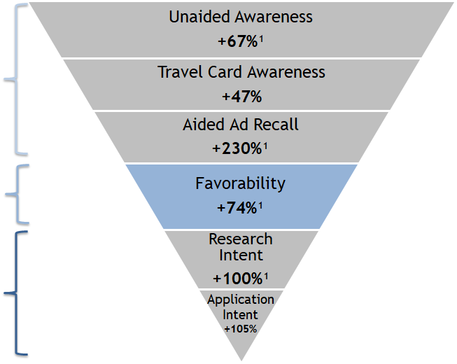
“Full-Funnel” Case Study: Positive Middle Funnel Outcomes For Consideration / Favorability
Overall Brand Metric Results:
Favorability
Middle Funnel Results
Addressable exposed viewers showed increased favorability towards the brand following the campaign as well.
By targeting consumers with ads that are more tailored to their needs, brands can develop a more positive relationship with current and prospective customers.
+13.8
33%
19%
Upper Funnel
Mid Funnel
Control
Exposed
Lower Funnel
Significant Increase at 90% Confidence
Category:
Travel Credit Card
Source: Kantar Millward Brown, Travel Card: Comcast Addressable TV Brand Lift Advertising Research, January 2018. Sample Size for Addressable Audience: Addressable Control – n=101, Addressable Exposed – n=141; Flight dates: 10/2/2017 – 11/19/2017; Control respondents were weighted to match the exposed sample. Brand Favorability Q: How would you describe your overall opinion of the following brand(s) of Credit Cards?
41

Slide 42
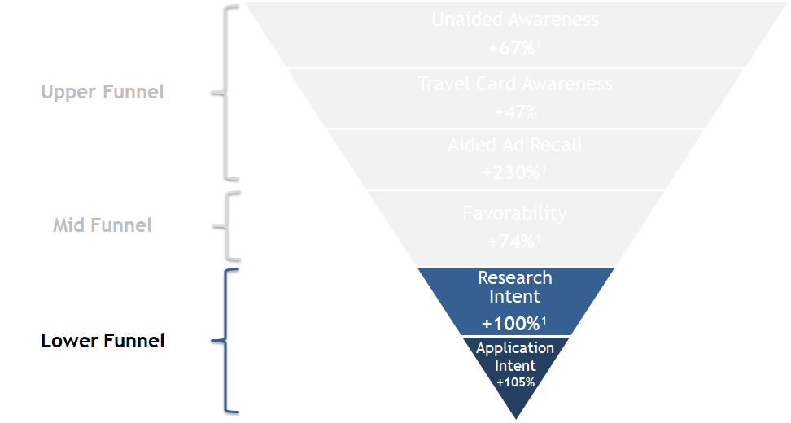

“Full-Funnel” Case Study: Positive Lower Funnel Outcomes For Intent
Lower Funnel Results
Category:
Travel Credit Card
Exposed viewers were not only educated about the Travel Card, but were also driven to research it more and ultimately apply for it.
An Addressable TV campaign can help build awareness and favorability for brands. By being present throughout the process, brands can stay at the top of mind for consumers and lead to more conversions.
+20.1
+19.8
Significant Increase at 90% Confidence
Source: Kantar Millward Brown, Travel Card: Comcast Addressable TV Brand Lift Advertising Research, January 2018. Sample Size for Addressable Audience: Addressable Control – n=101, Addressable Exposed – n-141; Flight dates: 10/2/2017 – 11/19/2017; Control respondents were weighted to match the exposed sample. Research Intent Q: If you were thinking of applying for a credit card, to take advantage of mileage points/travel benefits, how likely would you be to research each of the following brand(s) of Credit Cards?; Application Intent Q: Again, if you were thinking of applying for a new credit card, to take advantage of mileage points/travel benefits, how likely are you to consider the following brand(s) of Credit Cards?
42

Slide 43

Creative Messaging Is Also Important Throughout The Funnel And Addressable TV Can Help Inform Advertisers Which Ads Do Best To Inspire Action By Consumers
Ad Impact on Action Intent
Aided Ad Recall
(Exposed n = 139)
25%
“Creative B”
32%
“Creative A”
Case Study: Travel Credit Card
Source: Kantar Millward Brown, Travel Card: Comcast Addressable TV Brand Lift Advertising Research, January 2018. Sample Size for Addressable Audience: Addressable Control – n=101, Addressable Exposed – n-141; Flight dates: 10/2/2017 – 11/19/2017; Control respondents were weighted to match the exposed sample. Aided Ad Recall Q: Have you seen this ad before viewing it in the survey?; Ad Impact on Action Intent Q: Please select any of the following actions you would take as a result of seeing this ad.
43

Slide 44

Addressable TV’s Increasing Scale

Slide 45

Approximately 64 Million U.S. Households Now Have Addressable TV Capabilities
An estimated $2.1 billion was spent on Addressable TV in 2018,
on par with projected expenditures in ad-supported OTT during the same time period
As of 2018, there were 64MM Addressable TV HHs across all DMAs within the U.S., representing more than 54% of TV HHs
Addressable TV
Xandr
DISH
Charter*
Altice
Comcast
Cox*
Verizon
$
$
$
$
$
$
$
$
$
$
$
$
$
$
$
$
$
$
$
$
$
$
$
$
$
$
$
$
$
$
$
$
$
$
$
$
$
$
$
$
$
$
$
$
$
$
$
$
$
$
$
$
$
$
$
$
$
$
$
$
$
$
$
$
*VOD / TV Everywhere app only
Source: FreeWheel, A Buyer’s Guide to the New Living Room, October 2018; eMarketer, July 2018. Note: includes targeted TV ads delivered on a home-by-home basis via cable and satellite boxes; includes video-on-demand (VOD); excludes connected TV, smart TV and over-the-top (OTT). Ad-supported OTT estimate (approx. $2.0B) based on MAGNA US Ad Revenue Forecasts, September 2018.
45

Slide 46
The Number Of Addressable TV Households Has Grown Rapidly,
Increasing 30% In Just Two Years
Estimated Addressable TV Households
(in millions)
64.0
49.8
+30%
2016
2018
46
Source: 2018 Households - FreeWheel, A Buyer’s Guide to the New Living Room, October 2018; 2016 Households - Starcom MediaVest Group, May 17th 2016.

Slide 47
How Big is Addressable TV?
U.S. Only (in millions)
At 64MM HHs, Addressable TV Has A Larger Footprint Than Netflix, Amazon Prime Video, Hulu & Other Popular Subscription Platforms
Source: Addressable TV HHs FreeWheel, A Buyer’s Guide to the New Living Room, October 2018. Netflix – company financial reports for Q4 2018. Amazon Prime – Q4 ‘17 data from SNL Kagan published April ’18. HBO – AT&T company financial reports for Q4 2018; includes HBO NOW. Roku – January ‘19 from Roku Blog (Roku defines active accounts as the number of distinct user accounts that have streamed content on the platform in the last 30 days). Hulu - company financial reports for FY 2018 published January ‘19. Sling TV – Q3 ‘18 data from SNL Kagan published December ’18. YouTube TV – Estimated July 2018, Fast Company & CNBC. Playstation Vue – Estimated December 2017, Fast Company & Ben Bajarin. fuboTV – MoffettNathanson, MEDIA REDEF, 2018.
47

Slide 48
When Projected Out Across The 64 Million Household Footprint, Addressable TV’s Audience Universe Is Estimated To Be Approximately 162.2MM Persons 2+
Estimated Addressable TV P2+ Audience
(in millions)
162.2
127.7
+27%
2016
2018
Source: Addressable TV’s total P2+ audience is estimated based on 64.0MM Addressable HHs multiplied by 2.535 for 2018; 49.8MM Addressable HHs multiplied by 2.565 for 2016 (the ratio of P2+ / HHs in “cable and/or ADS” households from Nielsen 2016-2017 & 2018-2019 universe estimates).
48

Slide 49
The Addressable TV Audience Is Larger Than Many Other Popular Digital Platforms
Digital Platforms’ Monthly Unique Visitors vs. Estimated Addressable TV Audience
(in millions)
Source: VAB analysis of comScore MediaMetrix Key Measures multiplatform (desktop, P2+; mobile, P18+) data, December 2018, P2+; Addressable TV’s total P2+ audience is estimated based on 64.0MM Addressable HHs multiplied by 2.535 (the ratio of P2+ / HHs in “cable and/or ADS” households from 2018-2019 universe estimates).
49

Slide 50

Growing Awareness & Implementation

Slide 51
Addressable TV Has Been Gaining Traction In The Industry As Scale & Knowledge Of Its Benefits Has Increased And Current Advertisers See Positive Results
Not At All Aware
Regularly Include Addressable In TV Plans
15% of surveyed advertisers are including Addressable in their buys on a regular basis, while 35% have experimented with it.
Aware Of, But Don’t know Enough To Use It
Experimented But Need To Learn More
Knowledgeable But Haven’t Bought Addressable Ads Yet
51
Source: ANA/Forrester Q1 2018 US State Of TV And Online Video Advertising Online Survey. Base = 88 Association of National Advertisers members.

Slide 52

There’s Been A Recent Influx Of New Advertisers Who Have Integrated Addressable TV Into Their Media Plans
71% Of Advertisers Surveyed At The Time Had Only Recently Begun Buying Addressable TV
Source: Xandr Ahead of the Curve: Addressable TV Insights; Advertiser Perceptions Addressable TV State of the Industry, March/April 2017. Q: Which of the following best describes your current approach to Addressable TV advertising?
52

Slide 53
38%
Currently Testing Addressable TV
The Value Of Addressable TV Is Already Clear Among Those Who Are Using It
62%
of Advertisers Using It Already Believe Addressable Is A Valuable Part Of Their Media Buy
62%
Addressable TV is Valuable
Source: Xandr Ahead of the Curve: Addressable TV Insights; Advertiser Perceptions Addressable TV State of the Industry, March/April 2017. Q: Which of the following best describes your current approach to Addressable TV advertising?
53

Slide 54

Addressable TV Advertisers Are Planning To Increase Their Investment Based On The Value They See
40% of U.S. Addressable TV agency & marketing professionals say they are now making a significant investment in the platform
55% of Addressable TV advertisers are planning on increasing their spend on Addressable
Ultimately, these advertisers would like to be able to allocate 10% more of their budgets to Addressable TV
Source: Xandr Ahead of the Curve: Addressable TV Insights; Advertiser Perceptions Addressable TV State of the Industry, March/April 2017.
54

Slide 55
Top Decision-Makers In The Industry Are Actively Voicing Their Support
For Addressable TV
“The actual functionality of what Addressable can do is more fully appreciated today…It’s in a brand-safe environment, with transparent delivery, third-party validation and without the concern of fraud.”
“Less waste, better segmentation & targeting”
“With Addressable, we can be a lot more specific than we had been with broader audiences. We will identify the households that match what the advertisers are looking for and we will deliver the right message to them.”
Anna Papadopoulos, VP of Integrated Media Services, Prudential Financial
Xandr, Ahead of the Curve: Addressable TV Insights, March/April 2017
Rick Welday, President of Media Sales & Operations, Xandr Advertising & Analytics
MediaVillage, Xandr's Rick Welday on Addressable TV’s Powerful Present, 8/9/2018
Adam Gaynor, VP of Advertising & Data Solutions, AMC
AdExchanger, AMC Networks To Offer Addressable TV Inventory, 7/27/18
"As audiences shift to OTT platforms and as advanced technologies accelerate the reach potential of Addressable media, television will have a new communications and commerce application across the consumer journey,"
“It’s really the relevancy that we’re looking for – to matter more to the consumer. And with relevancy comes efficiency & effectiveness”
“With Google & Facebook, you have the ability to place the ads, but you don’t have the same kind of content where users will spend 30 [minutes] to an hour undisturbed”
Tracey Scheppach, CEO & Co-Founder, Matter More Media
Xandr, Ahead of the Curve: Addressable TV Insights, March/April 2017
Jack Myers, Media Ecologist & Founder, MediaVillage
MediaVillage, Where Are We in Addressable TV?
MediaVillage Polls Agencies and Marketers, 10/22/2018
“It’s becoming a key part of [the] media mix for a number of autos and a number of other players who have adopted it.”
“In many ways it’s the best of both the traditional TV and digital worlds.”
Raghu Kodige, Chief Product Officer & Co-Founder, Alphonso
CNBC, Xandr's Recent Acquisition Spree Is Part Of A Plan To Dominate Advertising On Connected TVs And Devices, 8/10/2018
Jim D’Antoni, Director of National Media Sales, Dish Network
Beet.TV, DISH Seeing Addressable TV Buys Becoming Part Of Overall Planning, 8/5/2018
Andy Fisher, Chief Analytics Officer, Merkle
CNBC, 8/10/2018
55

Slide 56

The Future Of Addressable TV

Slide 57
Barriers Will Continue To Be Knocked Down By Advertisers As Addressable TV
Grows In Scale And Advanced Data Measurement Capabilities Increase
Providers and early adopters of Addressable TV can help educate the industry on the “full-funnel” value the platform offers to ignite further growth
Source: Xandr Ahead of the Curve: Addressable TV Insights; Advertiser Perceptions Addressable TV State of the Industry, March/April 2017. Q: You indicated that Addressable TV is second-tier buy. What would persuade you to move it to a must buy? Base: Total Respondents.
57

Slide 58

U.S. Addressable TV Ad Spending Projections
2016 – 2021 (in millions)
Ad Spend Is Growing Significantly As The Number Of Addressable Households Increase & Positive Outcomes Are Seen By Brands
+359%
vs. 2016
By The End of 2021, Addressable Is Expected To Grow To Over A
$3 Billion Segment Of TV Advertising
That’s a 359% increase over a five-year period
Source: eMarketer, July 2019. Note: includes targeted TV ads delivered on a home-by-home basis via cable and satellite boxes; includes video-on-demand (VOD); excludes connected TV, smart TV and over-the-top (OTT).
58

Slide 59

Addressable Is Also Projected To Account For A Larger Part Of Overall Video Advertising Minutes Viewed Over The Next Few Years
+25% pp vs. 2016
59
Source: FreeWheel, A Buyer’s Guide to the New Living Room, October 2018; Mindshare, via comScore and Broadcasters Audience Research Board.

Slide 60

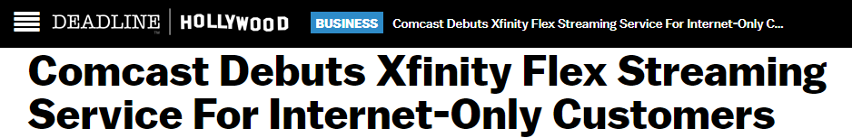

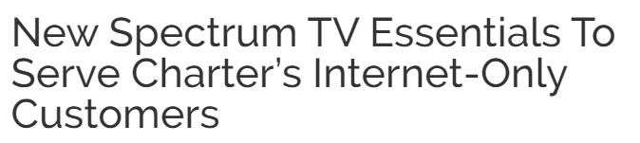

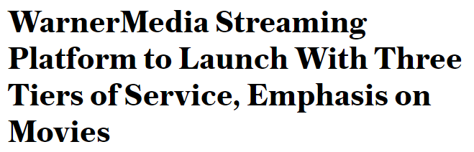

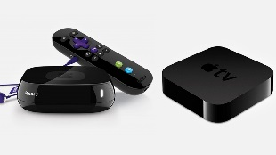
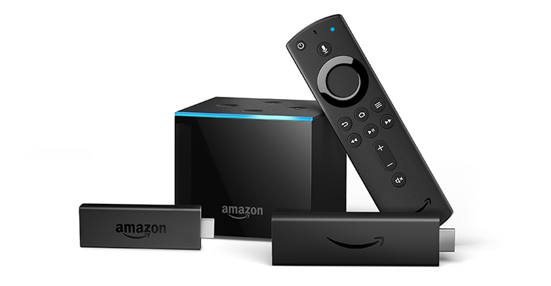

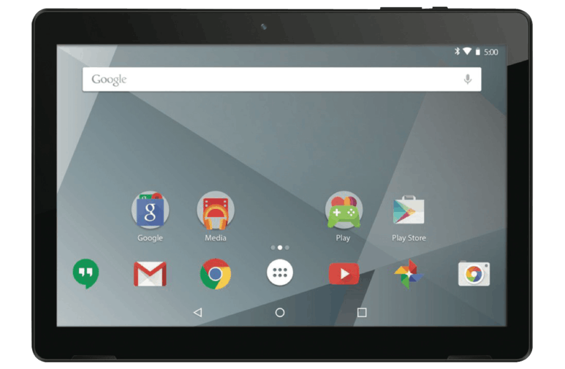

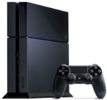
The Future Of Addressable TV Is Not Tethered To The Set-Top-Box And Will Follow The Consumer
As MVPDs move into internet-direct video services across devices beyond the set-top-box, addressable TV will move with them
60

Slide 61

Parting Thoughts
Addressable TV enhances ad relevancy for advertisers who are striving to keep consumers’ attention in a world of media fragmentation
Addressable TV delivers advanced targeting in a fully visible, brand-safe, trusted and transparent premium ‘one-to-one’ video environment
TV’s ‘scale of attention’ & emotional engagement enhanced by Addressable TV’s precise targeting & advanced data capabilities drives consumer awareness, interest & action through the purchase funnel
Ad spending is growing significantly as Addressable penetration increases and knowledge of the positive outcomes that the platform delivers becomes more prevalent
61

Slide 62




Contact Us
Jason Wiese
SVP, Director of Strategic Insights
jasonw@thevab.com
Leah Montner-Dixon
Senior Multi-Platform Video Analyst leahm@thevab.com
VAB
@VideoAdBureau
Join Our Mailing List

