Slide 1


Diversity, Inclusion and Belonging
Actionable Takeaways from the Summit

Slide 2



The VAB IMPACT Diversity Leadership Summit offered candid conversations, fresh insights and the unique personal experiences that prompt us to think differently about what inclusivity really means.
Our goal in this summit was to help bring about real, lasting change in how diversity and inclusion are embraced across the industry and within society.
It’s our hope that these takeaways, and the conversations they were drawn from, inspire you to become an agent of change in your own communities.
This information is exclusively provided to VAB members and qualified marketers. Further distribution is prohibited.
PAGE 2

Slide 3
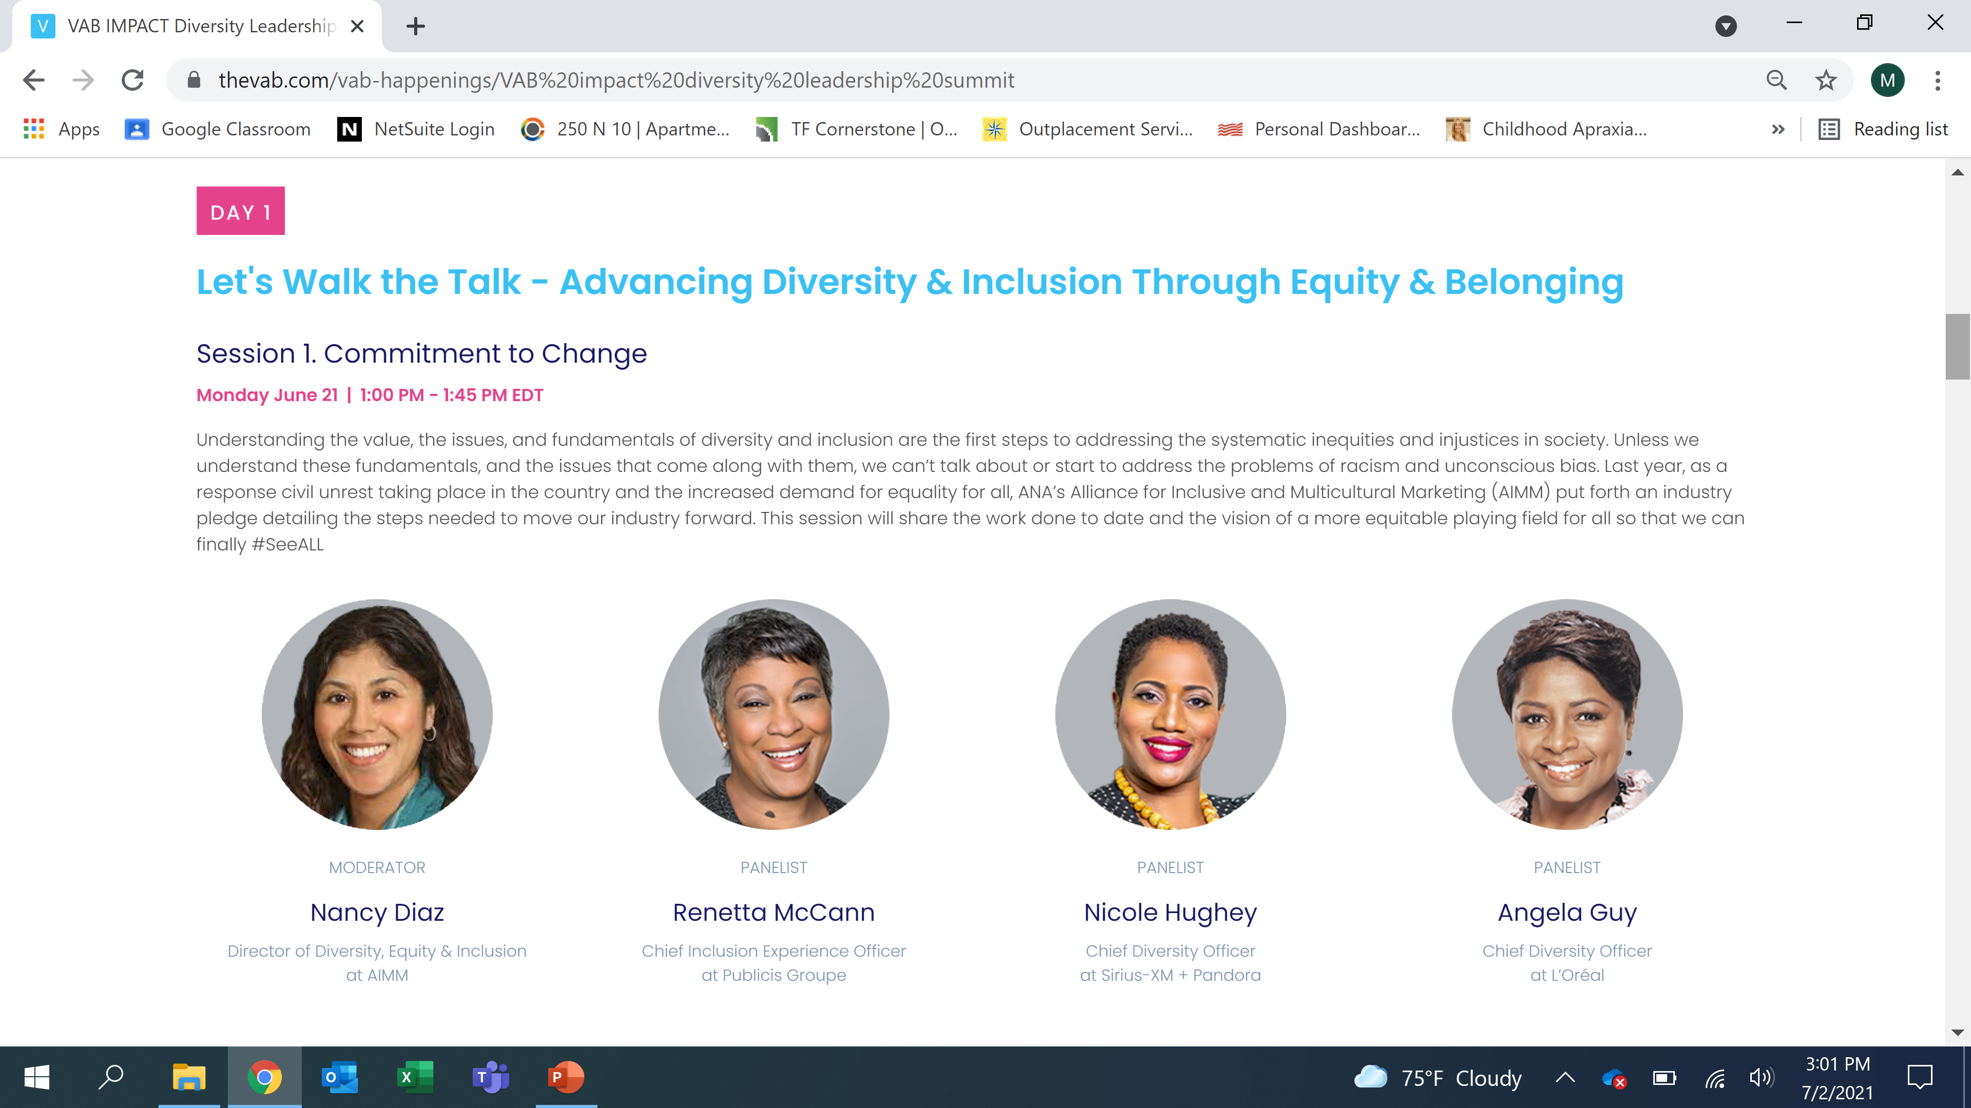
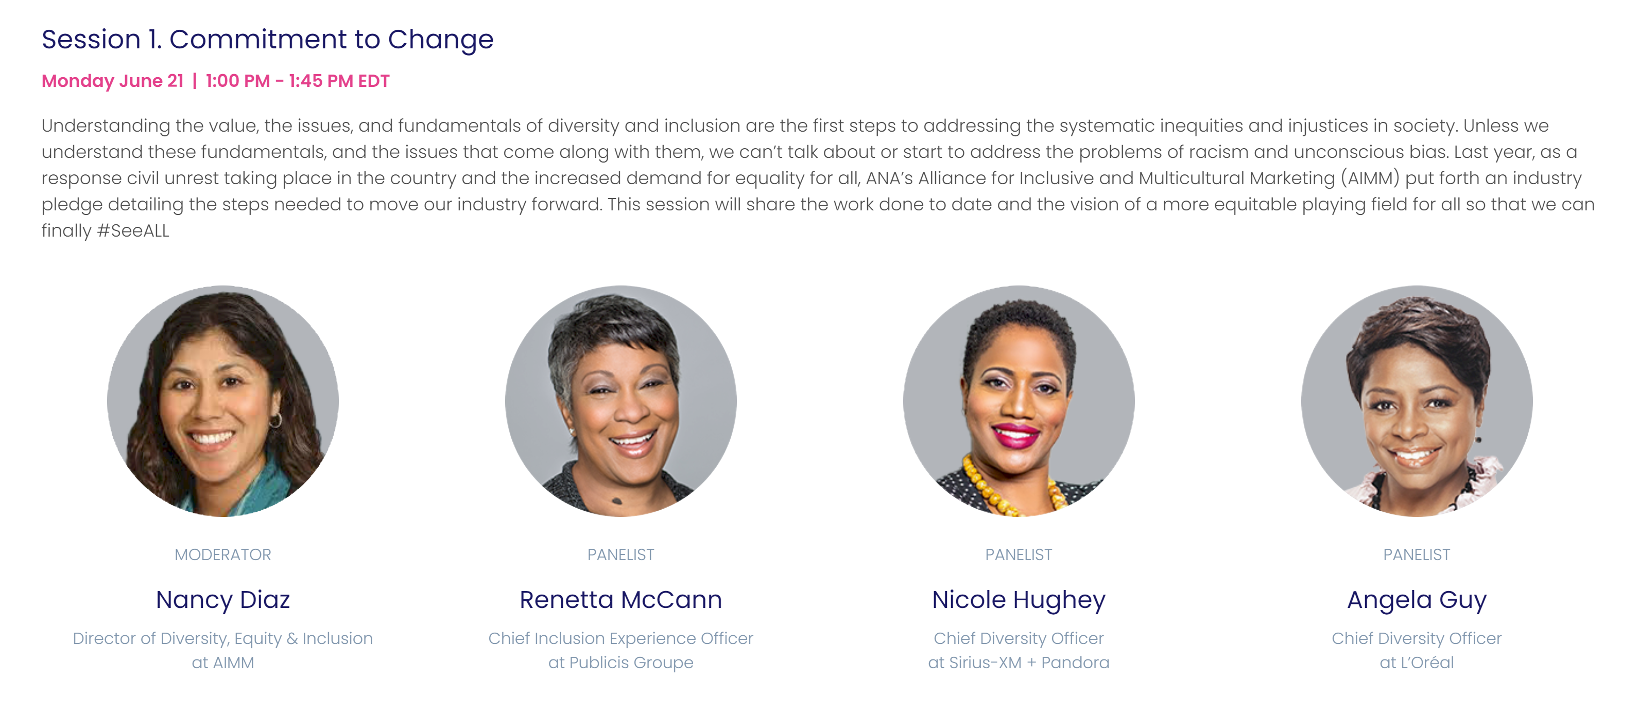
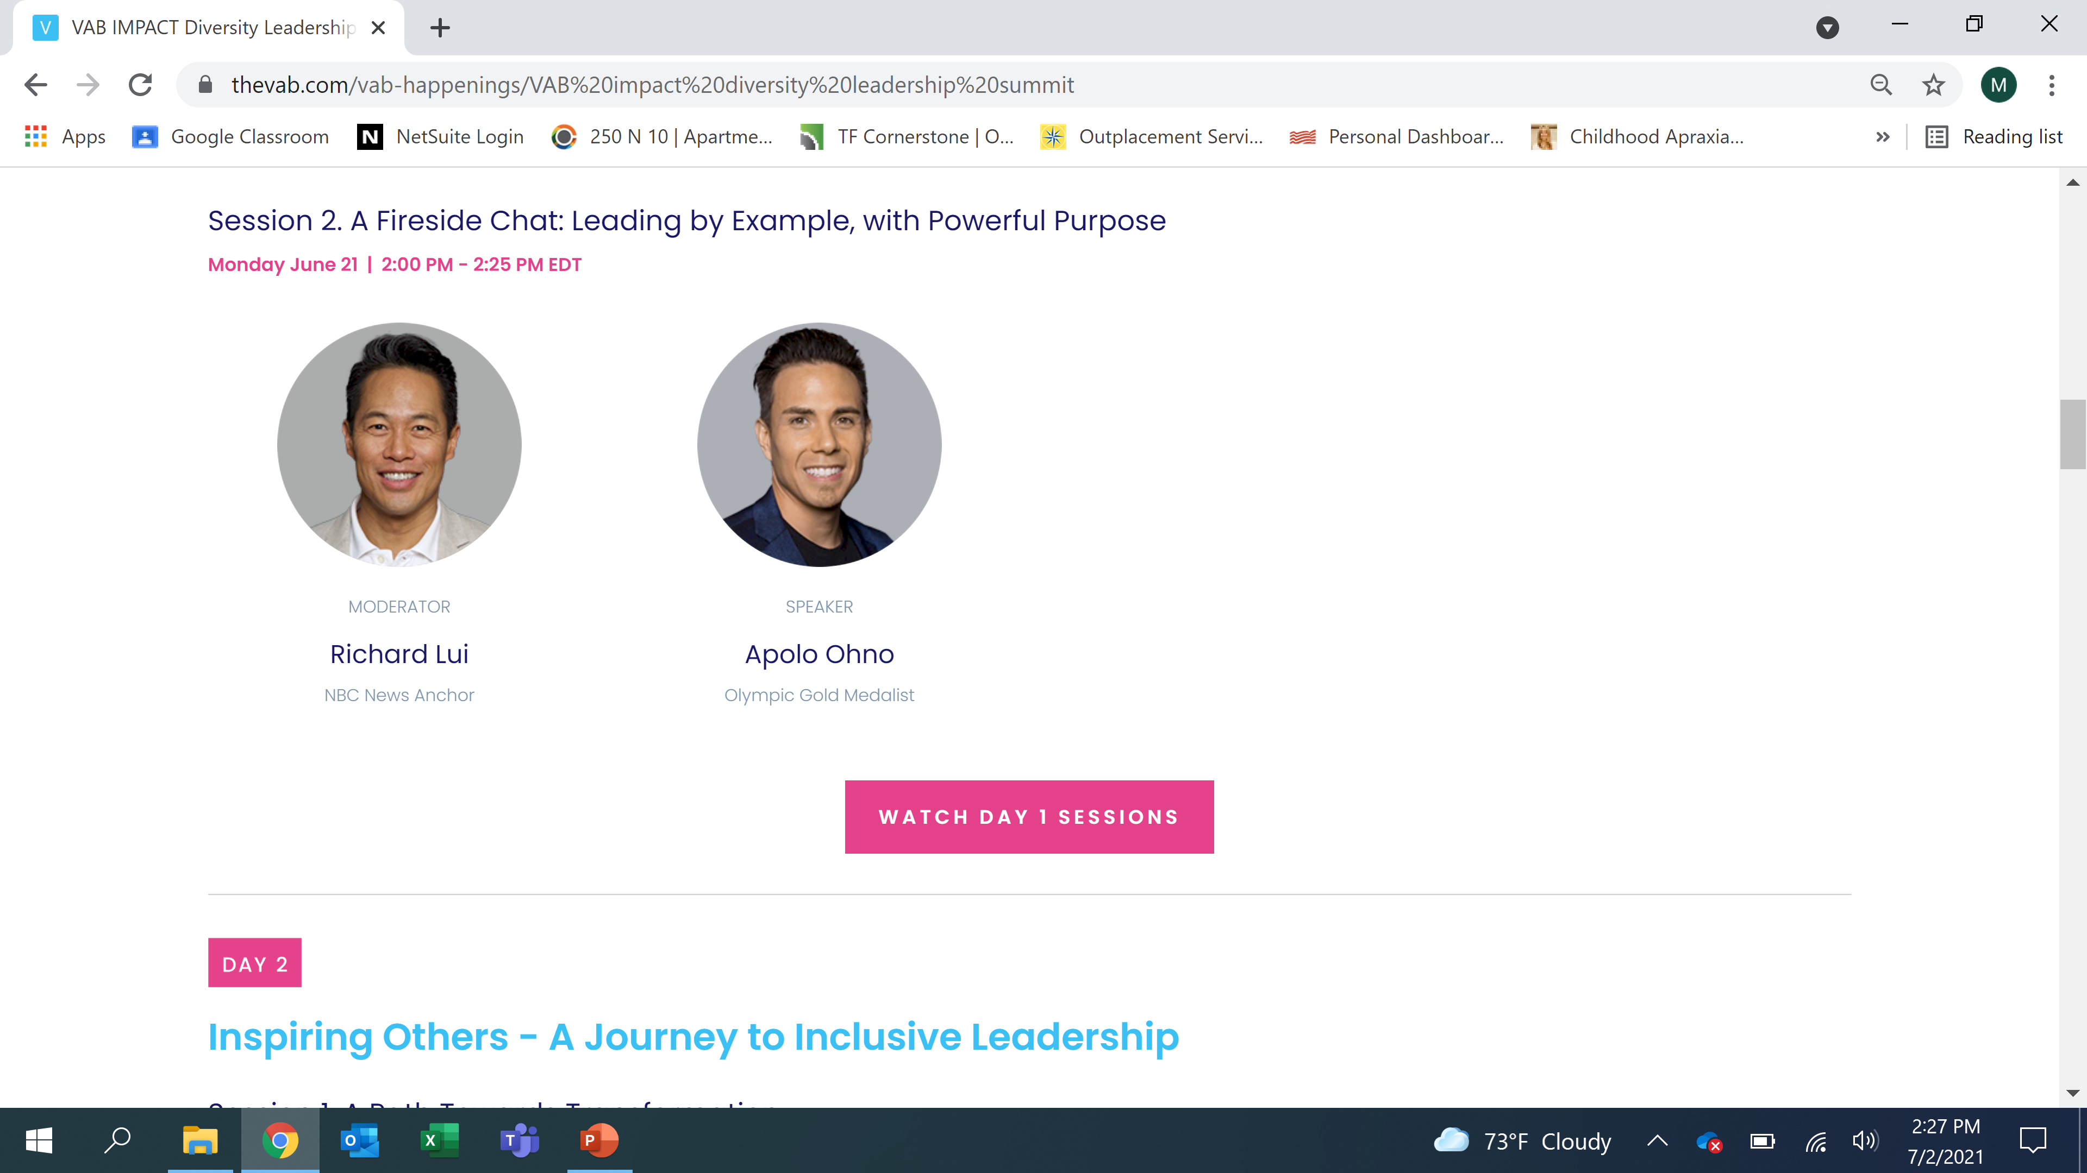
Click to view session
Click to view session
This information is exclusively provided to VAB members and qualified marketers. Further distribution is prohibited.
PAGE 3

Slide 4
Have the tough conversations, sometimes it means troughing through the mud
Sometimes we need to look at our own self insecurities, traumas, limiting beliefs and self- doubts. Begin having deeper conversations and in that process, you as an organization will become better.
Accept that you don’t have to have all the answers.
Allow yourself to start with a beginner’s mindset to allow ourselves to listen, have openness, empathy and gratitude of understanding.
Understand that marketers hold the narrative.
Marketers hold the pen and the pad and the script to change what the narrative looks like. You are more powerful beyond your own realization. Go deeper. The deeper you go, the more authentic that voice is to the consumer.
This information is exclusively provided to VAB members and qualified marketers. Further distribution is prohibited.
PAGE 4

Slide 5
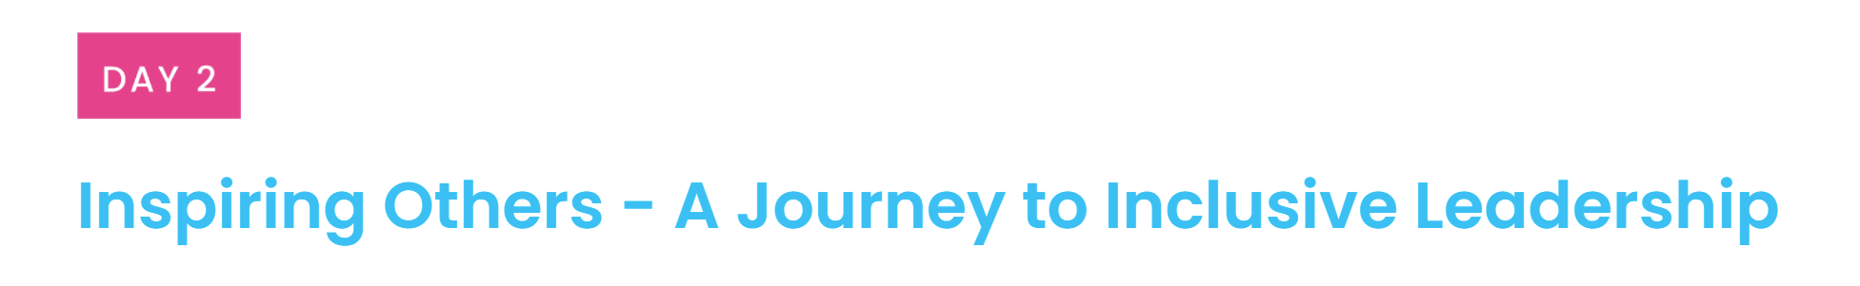
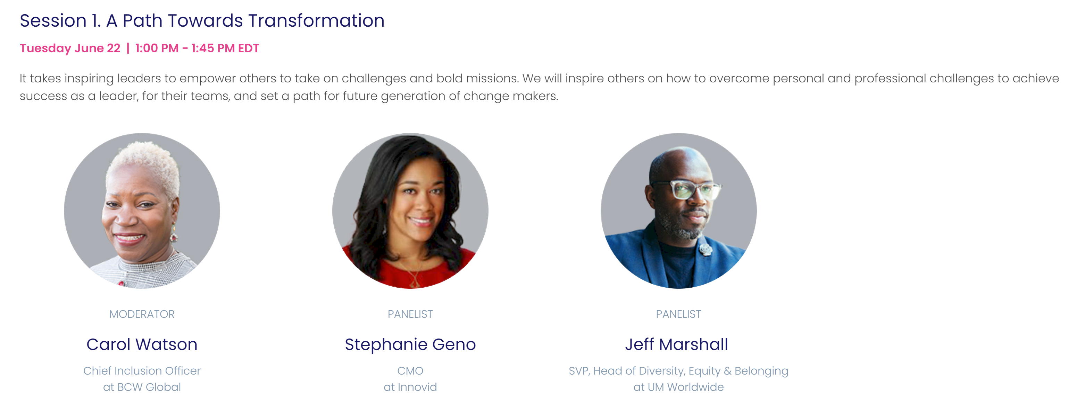
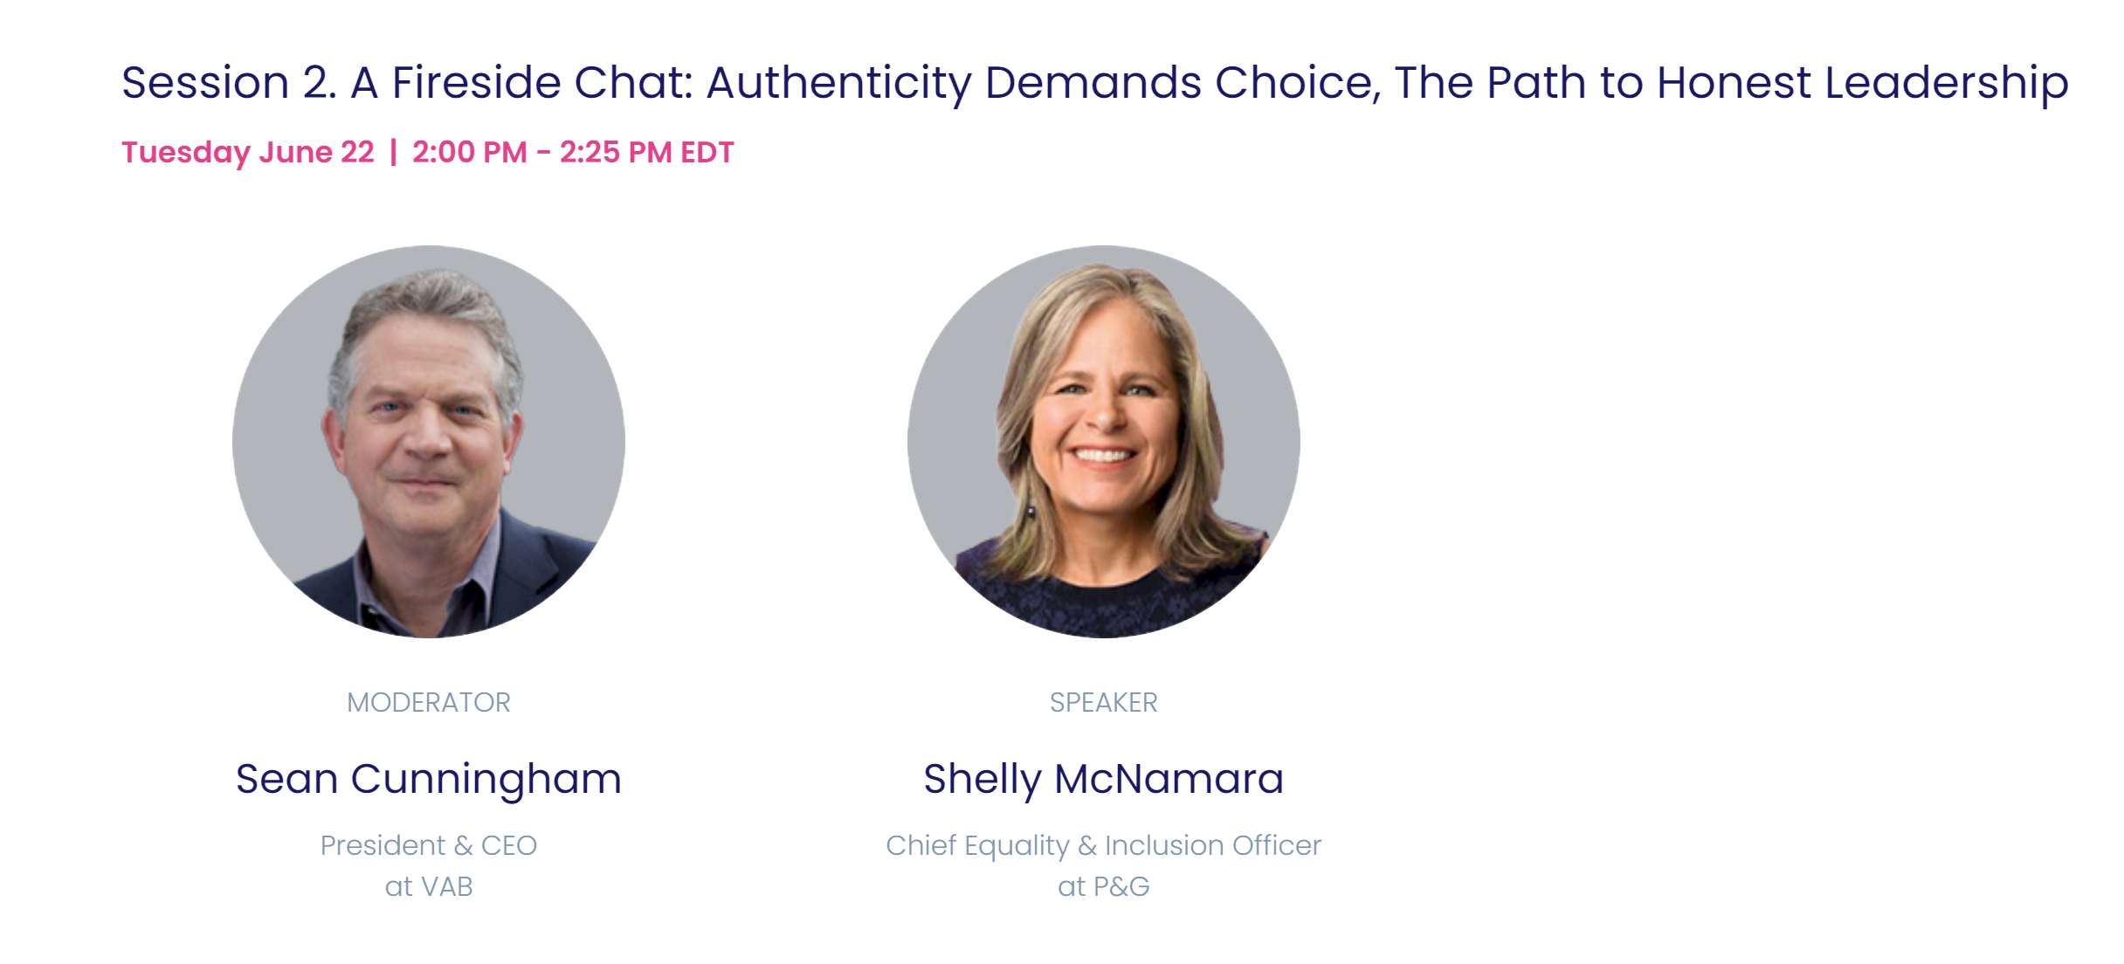
Day 2:
Click to view session
Click to view session
This information is exclusively provided to VAB members and qualified marketers. Further distribution is prohibited.
PAGE 5

Slide 6
Senior leaders play an important role in setting the tone and influencing the company culture.
Ongoing formal and informal conversations between leadership and employees are important to fostering an inclusive and open working environment.
Invest in your employees.
Consider talent the valuable resource that it is. Invest in external and internal resources to provide coaching and mentorship, as needed. Empower employees to be part the change by establishing ambassadorship programs or other support networks.
Understand that great leaders don't allow people to be treated "less than."
They understand the need and power of "level setting." They work hard to set a company culture of acceptance.
This information is exclusively provided to VAB members and qualified marketers. Further distribution is prohibited.
PAGE 6

Slide 7
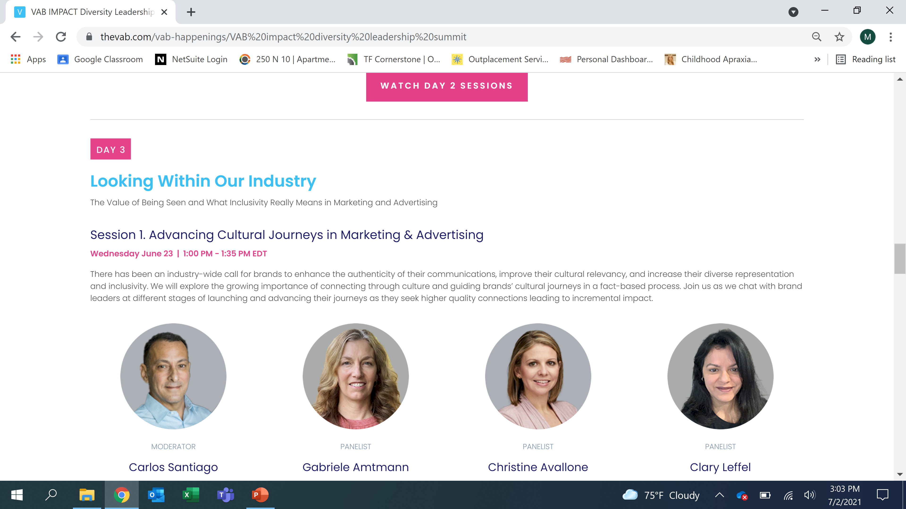
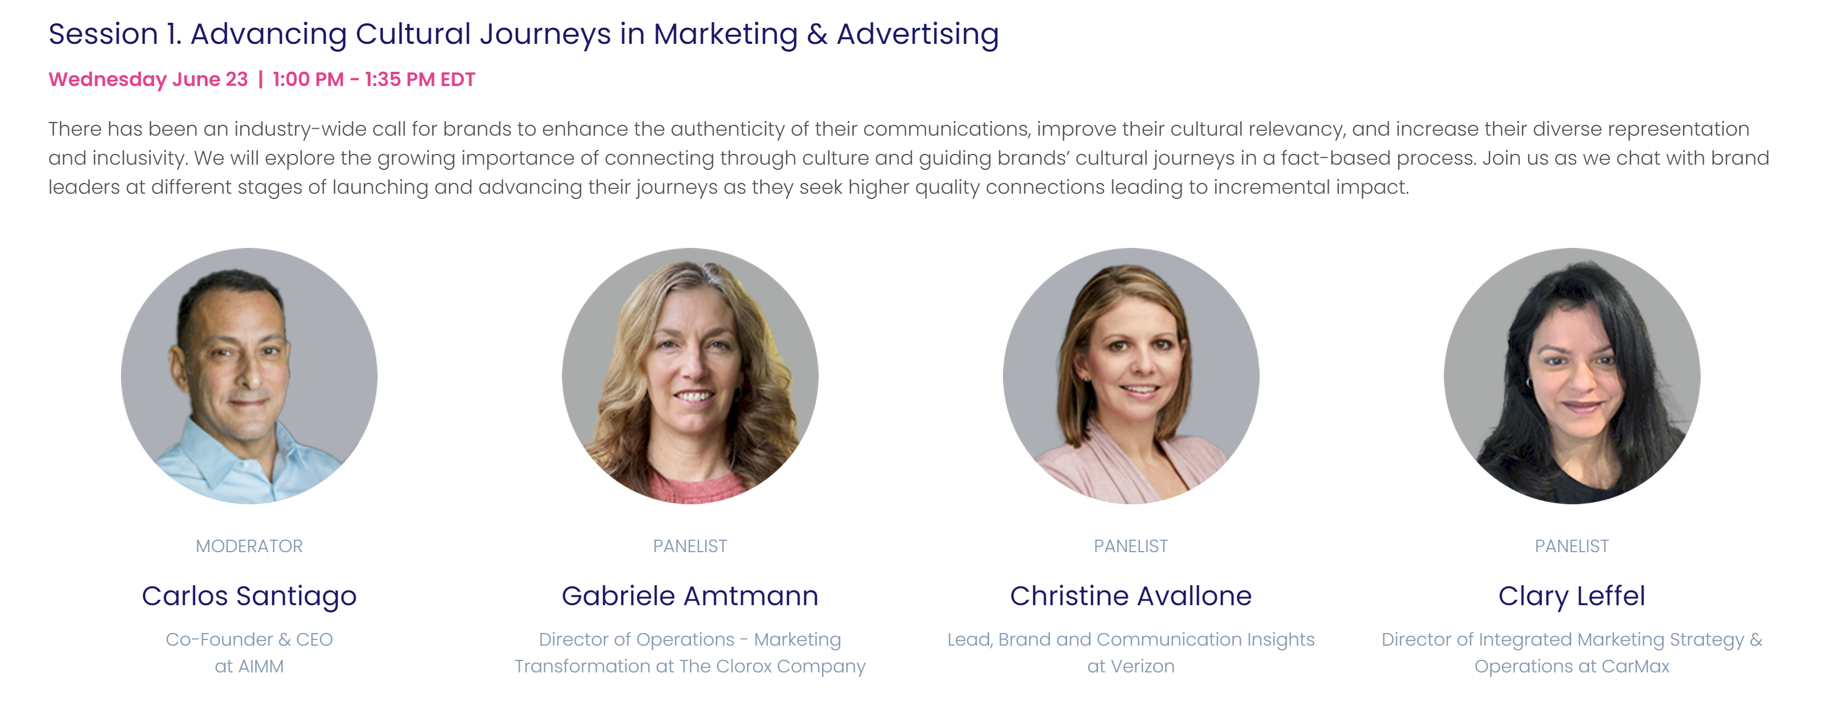
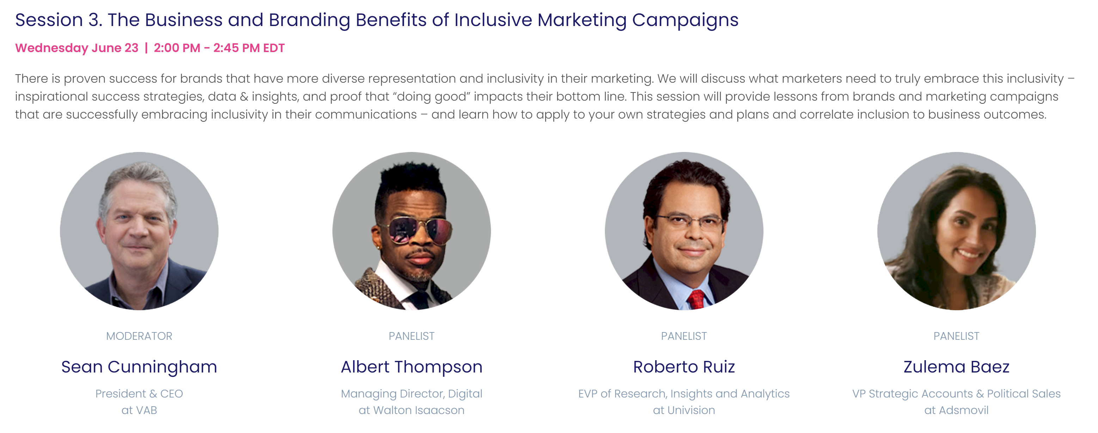
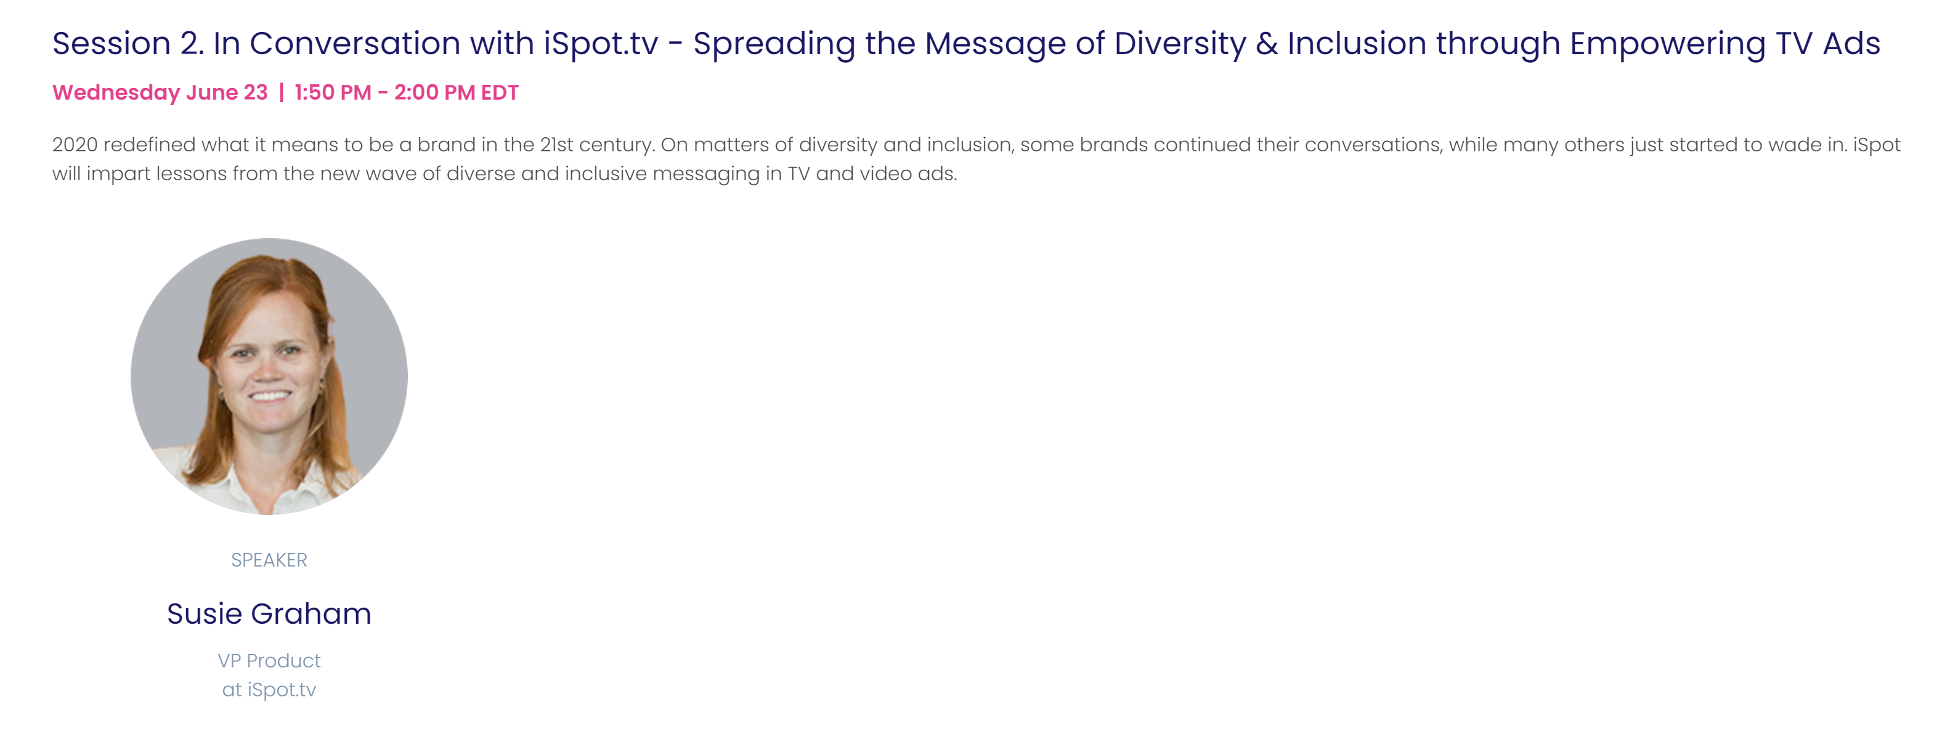
Click to view session
Click to view session
Click to view session
This information is exclusively provided to VAB members and qualified marketers. Further distribution is prohibited.
PAGE 7

Slide 8
Prioritize representation.
Have diverse voices at the table. It makes a big difference to developing marketing that is culturally authentic .
Acknowledge that representation requires authenticity.
How people, cultures and communities needs to be done in an authentic way.
Know that inclusive marketing grows brands.
In engaging diverse consumers through media, brands are winning and they're also doing the right thing from a societal perspective.
Be consistent.
An on-going commitment to engaging multicultural groups is needed. Consistency in spending, creative development, and other elements of outreach.
This information is exclusively provided to VAB members and qualified marketers. Further distribution is prohibited.
PAGE 8

Slide 9
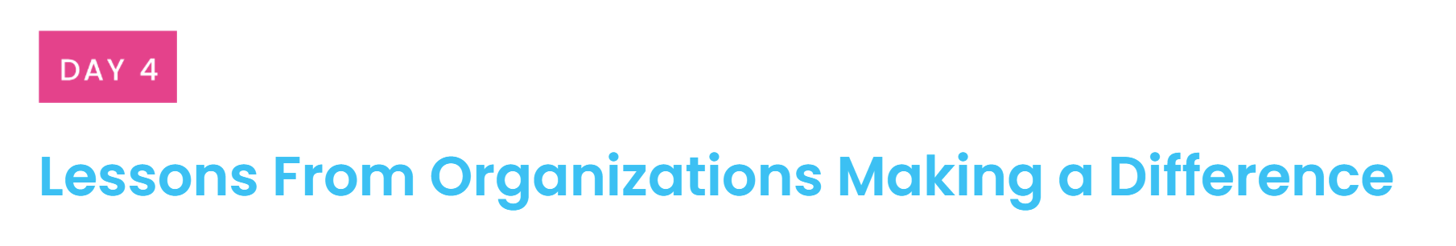

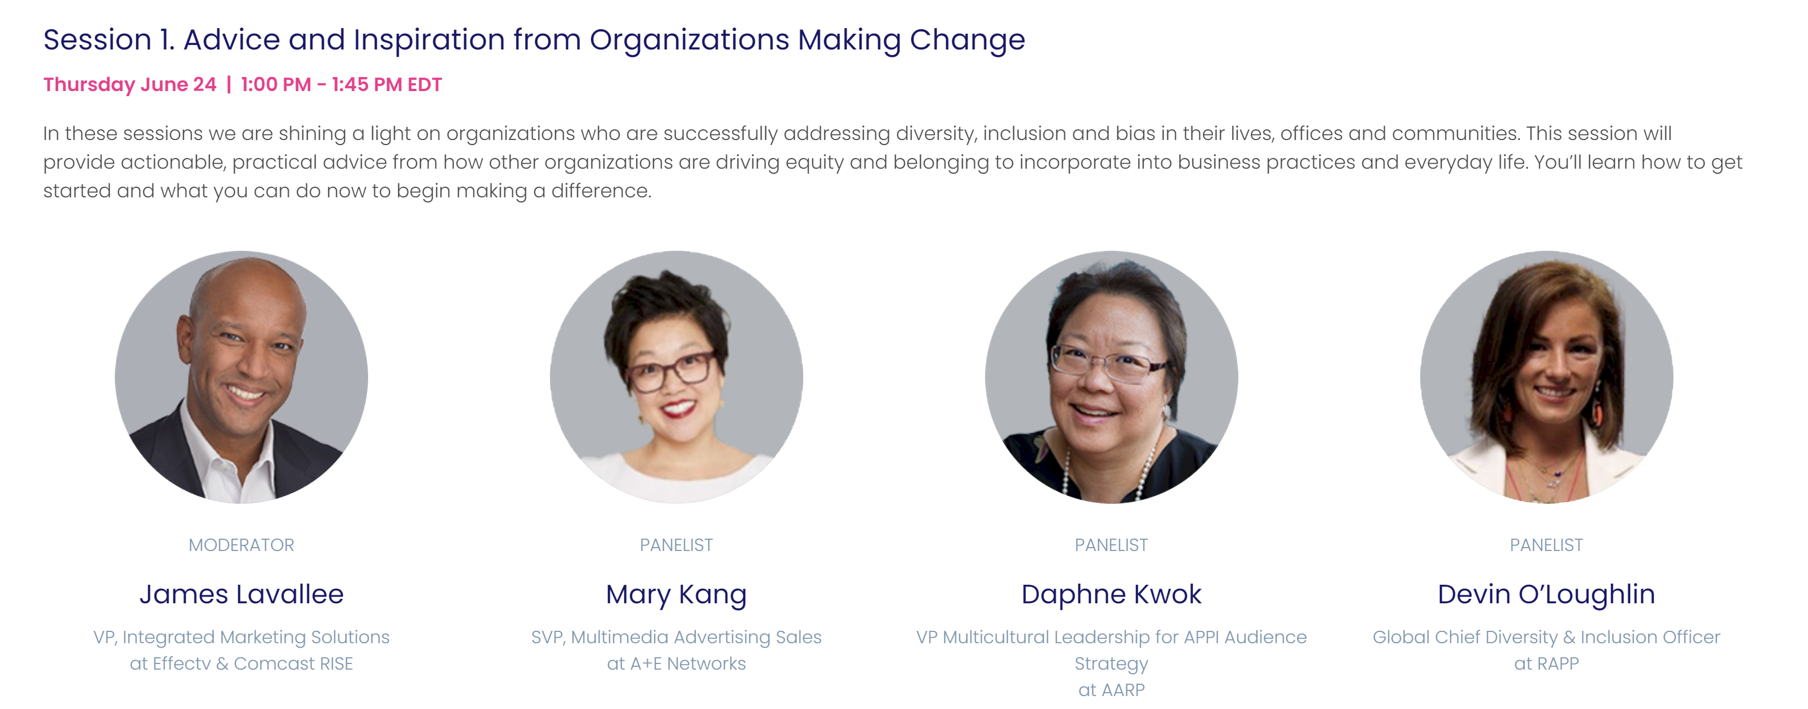
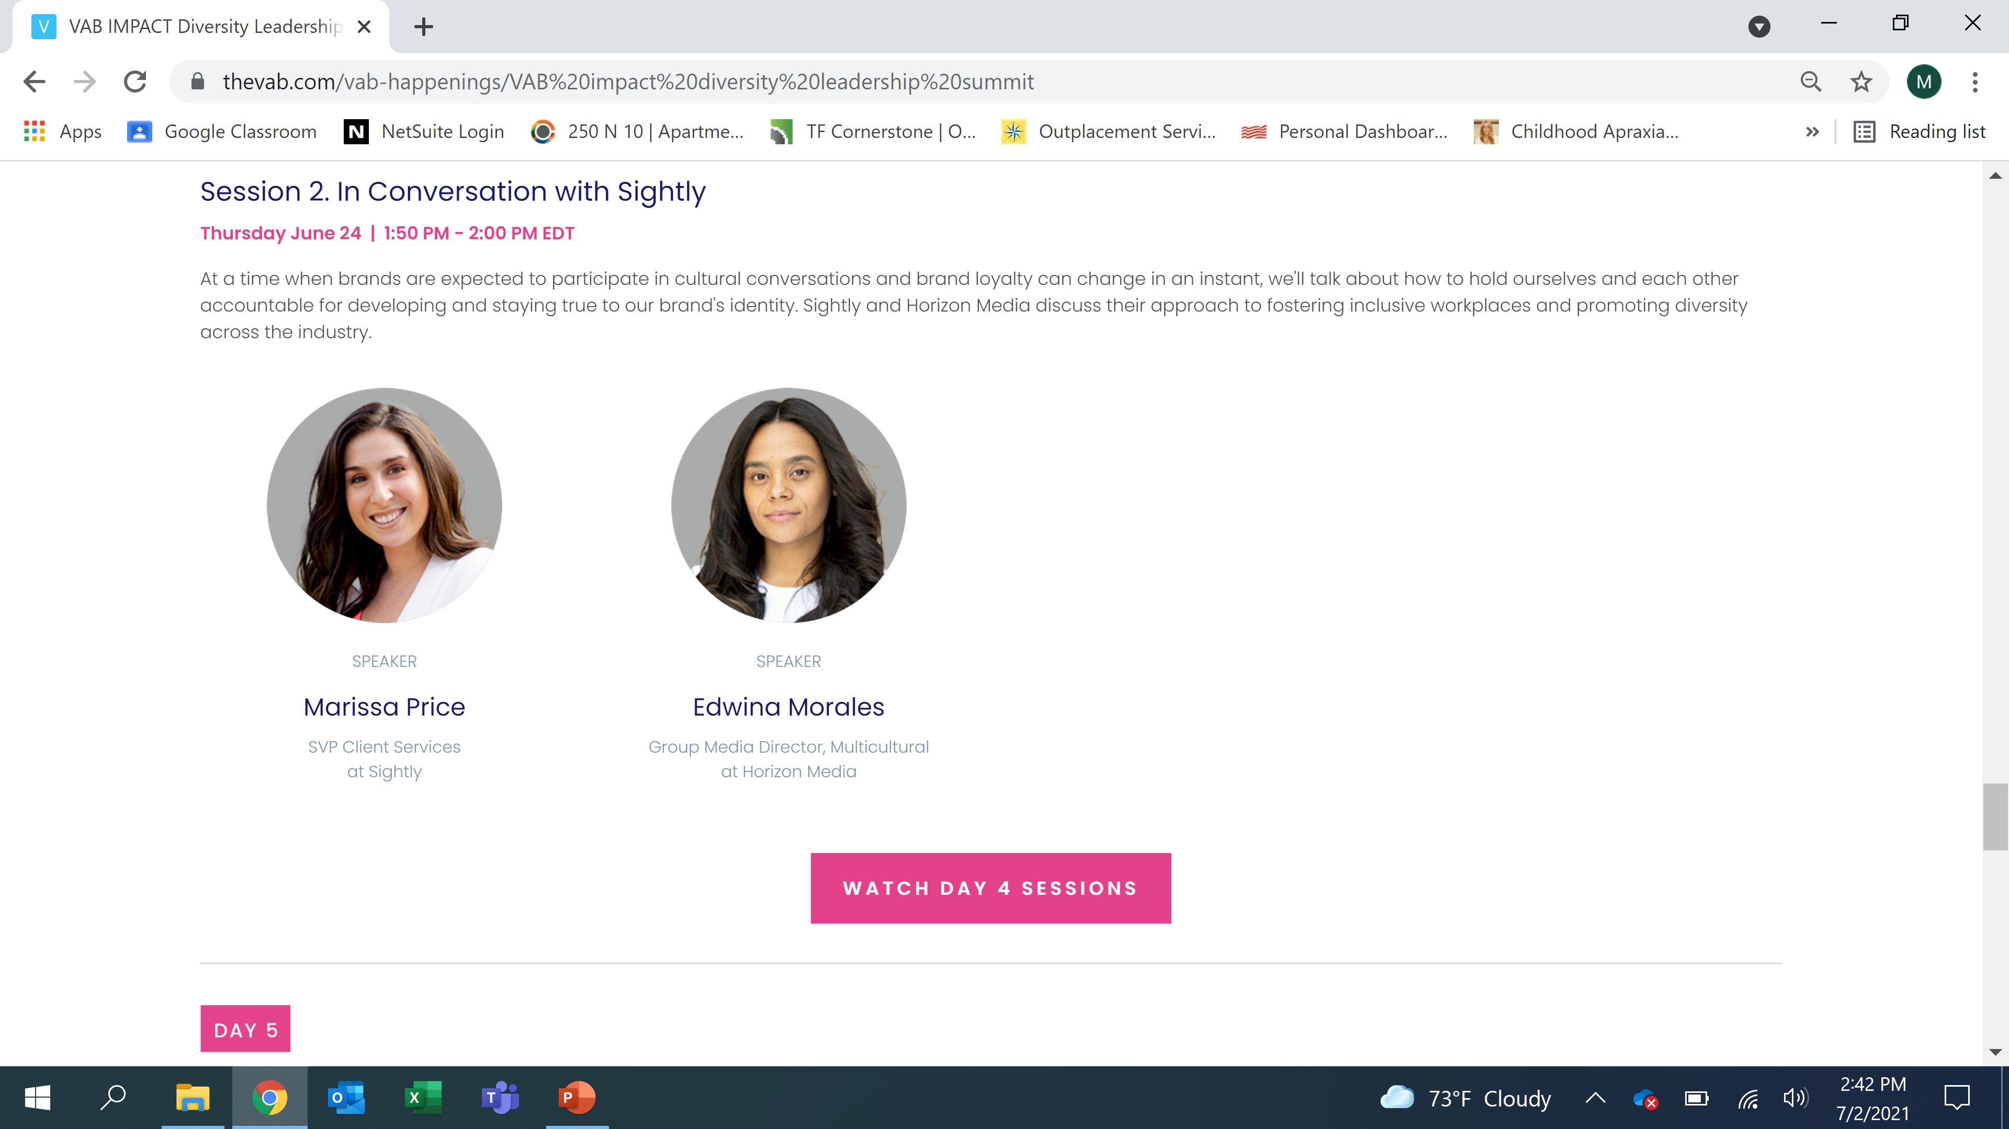
Day 4 sponsor
Click to view session
Click to view session
This information is exclusively provided to VAB members and qualified marketers. Further distribution is prohibited.
PAGE 9

Slide 10
Know that everyone can make a difference.
Take a step back and analyze what are you doing well, where there are areas of opportunity, and where there’s white space in your industry to position your company as a diversity market leader. Take personal accountability, every single person can make a difference.
Empower diverse voices to speak up.
Make sure that you’re not only putting a diverse mix of people in the decision-making room, but that you’re also empowering them to share their voice – good or bad. This starts with the culture in the organization and helps ensure that what you’re producing is truly inclusive.
Seek out the feedback loop.
As we target and message multicultural audiences, we can also learn from them. That feedback loop makes for more informed campaigns in the future—a better brand interaction for both marketers and consumers.
Ensure DE&I is a key consideration at the outset of everything you do.
It’s more efficient, inclusive, budget-effective and accessible to think about it right at the start of a project, than to wait and try to force-fit it.
This information is exclusively provided to VAB members and qualified marketers. Further distribution is prohibited.
PAGE 10

Slide 11
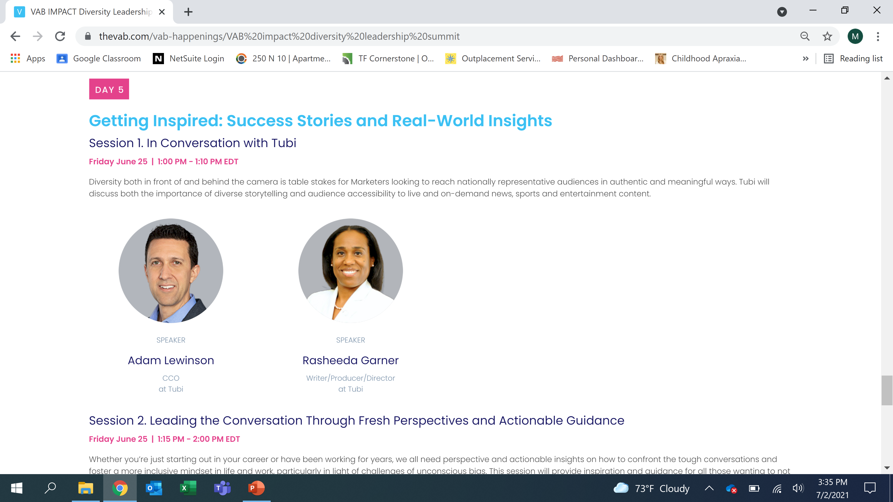
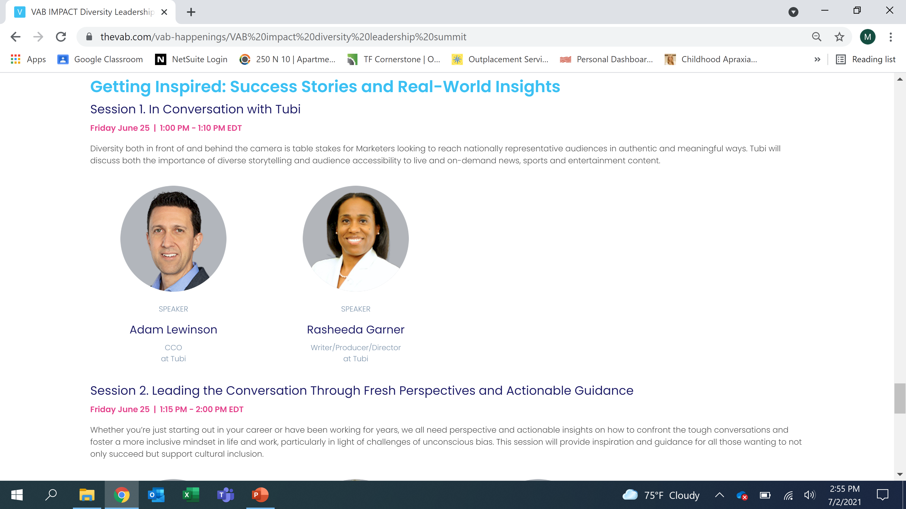
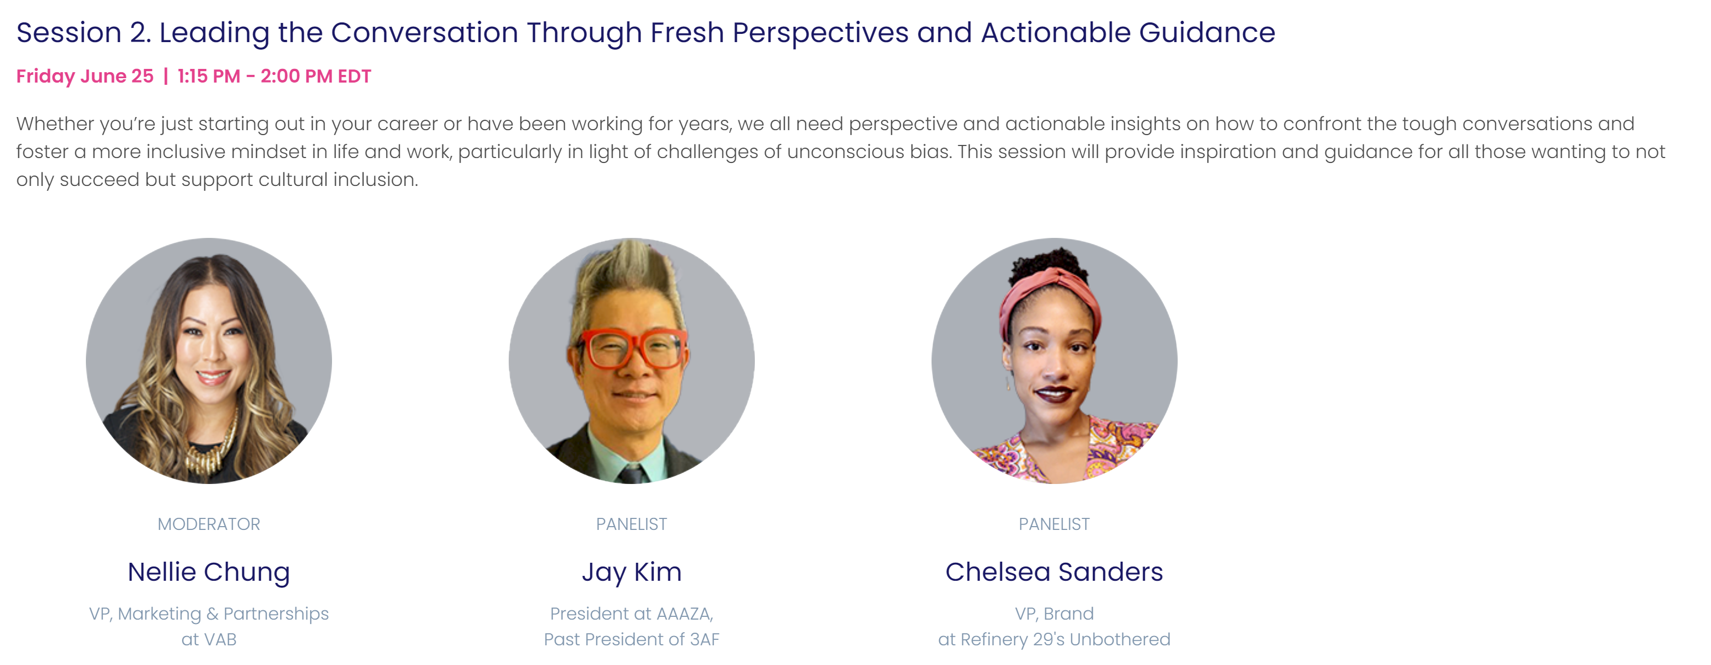
Click to view session
Click to view session
This information is exclusively provided to VAB members and qualified marketers. Further distribution is prohibited.
PAGE 11

Slide 12
Approach unconscious bias with openness.
Start by admitting it, unraveling it and figuring out why and how those biases formed. The more you know, the more empowered you’ll feel and become open to diverse and multi-cultures.
Bring people together.
Have a potluck lunch! Every food and dish has a story which will lead to a lot of sharing of cultural backgrounds. It can break down barriers and be more accepting around something we are very familiar with.
Get comfortable with being uncomfortable.
In the spirit of deepening understanding, ask the awkward questions and learn from others’ experiences. Companies need to not be afraid of talking about D&I.
Reognize there’s a lot of unlearning to do.
Always ask questions, be curious. Do not assume. Communicate, have conversations. Seek out other experiences in order to have empathy. Corporations should have mandatory learning sessions like African American 101, Latin X 101, Asian American 101 and LGBTQ 101 so that employees can be better educated, starting with data, insights and culture.
This information is exclusively provided to VAB members and qualified marketers. Further distribution is prohibited.
PAGE 12

Slide 13
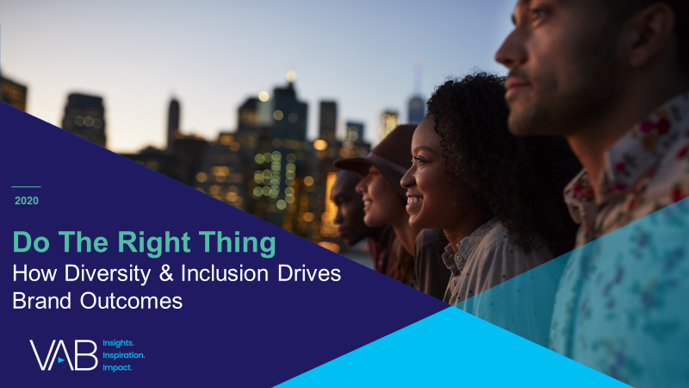
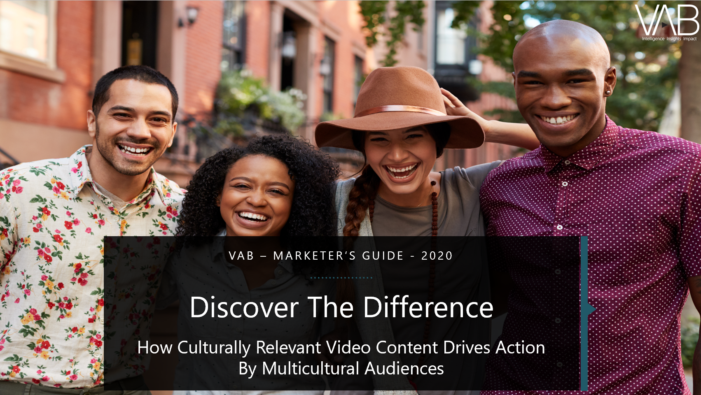
Discover more
Looking for more data, insights and takeaways? Check out this related VAB content
Do The Right Thing
How Diversity & Inclusion Drives Brand Outcomes
Discover The Difference
How Culturally Relevant Video Content Drives Action By Multicultural Audiences
We are committed to providing marketers with the data and insights they need to develop thoughtful, inclusive campaigns & strategies. To find out more on the unique media consumption behaviors and cultural trends of multicultural consumers, visit our Multicultural Marketing Resource Center.
VAB Members, brand marketers and agencies get free and immediate access to VAB’s content library.
Get access at theVAB.com
This information is exclusively provided to VAB members and qualified marketers. Further distribution is prohibited.
PAGE 13

Slide 14

About VAB
VAB is an insights-driven organization that inspires marketers to reimagine their media strategies resulting in fully informed decisions.
Drawing on our marketing expertise, we simplify the complexities in our industry and discover new insights that transform the way marketers look at their media strategy.
Discover
We keep you one step ahead with the latest thinking so you can create innovative, forward-looking strategies.
Simplify
We save you time by bringing you the latest data & actionable takeaways you can use to inform your marketing plans.
Transform
We help you build your brand by focusing on core marketing principles that will help drive tangible business outcomes.
We are committed to your business growth and proud to offer VAB members, brand marketers and agencies complimentary access to our continuously-growing Insights library. Get immediate access at theVAB.com.
This information is exclusively provided to VAB members and qualified marketers. Further distribution is prohibited.
PAGE 14

