Slide 1



The Impression Gap
What works harder for marketers on CTV - Premium Video or YouTube?

Slide 2


Premium Video impressions deliver
quality, engagement and reliability
As advertising investments in CTV continue to grow, its critical marketers understand that not all CTV inventory delivers the same value. Audiences can access both Premium Video Platforms and YouTube on CTV, but the attention they generate differs meaningfully.
This matters because higher attention on CTV correlates with lifts in brand awareness, consideration and purchase intent. In other words, attention is a cornerstone of a successful campaign.
Attention enables marketers to go deeper in their understanding of video
ad effectiveness, and if viewers' eyes aren’t on screen, impressions can lose value. Marketers are increasingly expected to do more with less and
it is vital that every impression works as hard as possible.
We found that the hardest working impressions on CTV live within Premium Video Platforms.
Continue reading to learn how Premium Video Platforms and YouTube measure up across a variety of attention and engagement factors critical
to advertising success.
This information is exclusively provided to VAB members and qualified marketers.
PAGE 2

Slide 3




VAB Custom Study Methodology
+
VAB commissioned TVision to provide custom research data
to help us understand the differences between how audiences consume CTV content on Premium Video Platforms vs. YouTube.
This research is intended to address key audience and behavioral questions on co-viewing, attention and session length.
Key Metrics:
  Co-viewing: Measuring how often multiple viewers are watching together
  Attention: Quantifying the amount of time viewers are present, attentive and engaged
  Session Length: How long viewers are watching and engaging with content
Study Timeframe:
  July 2024 to June 2025
This information is exclusively provided to VAB members and qualified marketers.
PAGE 3

Slide 4














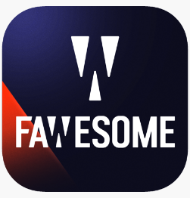


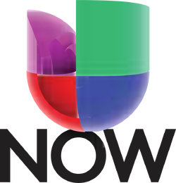




We analyzed the CTV viewership of 21 Premium Video Platforms and YouTube to determine which impressions work harder for marketers
Premium Video Platforms Across App Types
Hybrid (AVOD/SVOD)
vMVPD
FAST
vs.
Premium Video Platforms included in VAB + TVision Custom Study
App types included in study: AVOD = Ad Supported Video On Demand, SVOD = Subscription Video on Demand, Hybrid = AVOD & SVOD, vMVPD = virtual Multichannel Video Programming Distributor, FAST = Free Ad-Supported Streaming TV
Notes: YouTube TV is a live streaming TV service and is a separate CTV app from YouTube, which includes user-uploaded videos, creators, music, and some movies/shows. | Spanish Language Apps are grouped together for the analysis.
This information is exclusively provided to VAB members and qualified marketers.
PAGE 4

Slide 5



Premium Video Platforms deliver consistent, captivating content to drive audience engagement and increase brand outcomes for marketers
Household Value Lives on Premium Video Platforms
Premium Video Platforms Drive Consistent Attention
Brand Impact Thrives Across Premium Video Platform Session Lengths
This information is exclusively provided to VAB members and qualified marketers.
PAGE 5

Slide 6


Premium Video Platforms are where collective viewership creates household value for marketers through multi-viewer engagement
Household Value Lives on Premium Video Platforms
Premium Video Platforms Drive Consistent Attention
Brand Impact Thrives Across Premium Video Platform Session Lengths
This information is exclusively provided to VAB members and qualified marketers.
PAGE 6

Slide 7

Co-viewing creates unique opportunities for audience engagement and Premium Video Platforms are where that's most likely to happen
What is
‘Co-viewing’?
“Co-viewing leads to deeper engagement with ads and, as a result, higher performance...ultimately, when family members are in a room watching together, it increases their attention, not just for programming, but for advertising, as well.”
The proportion of viewing where 2 or more viewers have overlapping *active viewing sessions for at least 5 minutes.
A 100 Co-viewing factor indicates 2 or more viewers are watching together for the full viewing session.
Vikrant Mathur
Co-Founder, Future Today
*Note: A singular viewing session is defined for each individual viewer and CTV app over the course of a single day. Co-viewing requires 5 minutes of overlapped viewing. Weighted based on share of impressions.
This information is exclusively provided to VAB members and qualified marketers.
PAGE 7

Slide 8

Co-viewing sparks engagement and conversations that amplify ads beyond the screen
Shared viewing experiences turn into shared moments
43%
of consumers say they are likely to discuss ads with others when co-viewing
Source: Magnite, Streaming Together: Why Co-viewing Matters for Advertisers, November 2025.
This information is exclusively provided to VAB members and qualified marketers.
PAGE 8

Slide 9
More shared viewing on Premium Video Platforms demonstrates that each impression carries greater value than YouTube on CTV
Co-viewing by Platform on CTV
YouTube ranks 18th
YouTube
Source: VAB + TVision Custom Study. June 2024-July 2025. P2+. Co-viewing indicates the % of total impressions that occur with another viewer in the room. Weighted based on share of impressions. Spanish language apps comprised of 4 individual apps.
This information is exclusively provided to VAB members and qualified marketers.
PAGE 9

Slide 10

Premium Video Platforms consistently bring multiple viewers into the room delivering more ad exposures and more efficient impressions for brands
Average ‘Co-viewing’
% of total impressions
‘Co-viewing’ is
+33%
stronger on Premium Video Platforms than YouTube
Source: VAB + TVision Custom Study. July 2024-June 2025. P2+. ‘Co-viewing’ indicates the % of total impressions that occur with another viewer in the room. Weighted based on share of impressions. Premium Video Platforms represent an average of the 21 Premium Video Platforms analyzed.
This information is exclusively provided to VAB members and qualified marketers.
PAGE 10

Slide 11
Premium Video Platforms bring viewers together across all demographics creating richer household experiences and amplifying exposure
‘Co-viewing’ by Age Demographics
% of total impressions
+29%
+35%
+33%
+49%
Source: VAB + TVision Custom Study. July 2024-June 2025. ‘Co-viewing’ indicates the % of total impressions that occur with another viewer in the room. Premium Video Platforms represent an average of the 21 Premium Video Platforms analyzed. Weighted based on share of impressions.
Source: VAB / TVision Custom Study. July 2024-June 2025. Attention to Visible Index is defined as : The proportion of time spent with eyes on screen while the viewer in in the room with the content tuned indexed to TV viewing norm.
This information is exclusively provided to VAB members and qualified marketers.
PAGE 11

Slide 12


Watching TV with others creates unforgettable moments, making the ads more memorable than solitary viewing
+23%
Increase in ad recall when watching with others in the
living room vs. watching alone
Source: Thinkbox UK, Context Effects, Map The Territory & Tapestry Research, 2024. Source: A18. Do you remember seeing any advertising when you watched [occasion]? A10. Who, if anyone, were you watching [occasions] with? Base: 4,005 viewing occasions with ads answered by 2,017 online respondents aged 18-75 who watched any type of video content via any source the previous day. Sample matched to Barb.
This information is exclusively provided to VAB members and qualified marketers.
PAGE 12

Slide 13

Premium Video Platforms provide stable, consistent attention creating a reliable environment for brand storytelling
Household Value Lives on Premium Video Platforms
Premium Video Platforms Drive Consistent Attention
Brand Impact Thrives Across Premium Video Platform Session Lengths
This information is exclusively provided to VAB members and qualified marketers.
PAGE 13

Slide 14




Attention provides a reliable signal to advertising effectiveness, linking audience engagement to predictable outcomes
Eyes on Screen
Presence of Viewer
Eyes
Stay on Screen
Why Does ‘Attention’ Matter?
Platforms that provide Attention Stability produce predictable results, making it easier for marketers to ensure that their ad placements will reach attentive audiences.
This information is exclusively provided to VAB members and qualified marketers.
PAGE 14

Slide 15
To understand how CTV captivates viewers, we explored the
‘presence to active’ index across different platforms
What is ‘Presence
to Active’?
“Attention gives us a unifier across the different channels that we operate in…which will help us from the planning phases all the way through to our optimization on an ongoing basis.”
“
The percentage of time a viewer is in the room out of the total active viewing session indexed to CTV viewing norm.
A 100 ‘presence to active’ index represents an average level of time a viewer was in the room out of the total viewing session.
Jason Jutla
Head of Practice, EMEA & UK, WPP Media
*Note: A singular viewing session is defined for each individual viewer and CTV app over the course of a single day. Weighted based on duration of session.
This information is exclusively provided to VAB members and qualified marketers.
PAGE 15

Slide 16

Higher levels of attention can be used to predict performance and drive more effective advertising
Attention metrics improve ROI campaign forecasting by
+38%
compared to viewability
Source: Dentsu, What is the Attention Economy, January 2024.
This information is exclusively provided to VAB members and qualified marketers.
PAGE 16

Slide 17
Premium Video Platforms keep audiences present for more of the viewing session, driving higher engagement
‘Presence to Active’ Index by Platform on CTV
YouTube ranks 14th
YouTube
Source: VAB + TVision Custom Study. July 2024 – June 2025. P2+. ‘Presence to Active’ indicates the percentage of time a viewer was in the room out of the total active viewing session indexed to TV viewing norm. Weighted based on duration of session. Spanish language apps comprised of 4 individual apps.
This information is exclusively provided to VAB members and qualified marketers.
PAGE 17

Slide 18
Premium Video Platforms and YouTube deliver similar levels of viewer presence for CTV viewing sessions
Average ‘Presence to Active’ Index
'Presence to Active’ is
+5%
higher on Premium Video Platforms than YouTube
Source: VAB + TVision Custom Study. July 2024-June 2025. P2+. ‘Presence to Active’ indicates the percentage of time a viewer was in the room out of the total active viewing session indexed to CTV viewing norm. Premium Video Platforms represent an average of the 21 Premium Video Platforms analyzed. Weighted based on duration of session.
This information is exclusively provided to VAB members and qualified marketers.
PAGE 18

Slide 19
Audience presence across Premium Video remains slightly higher than YouTube across all demographics
‘Presence to Active’ Index Across Age Demographics
+2%
+>1%
+5%
+4%
Source: VAB + TVision Custom Study. July 2024-June 2025. ‘Presence to Active’ indicates the percentage of time a viewer was in the room out of the total active viewing session indexed to CTV viewing norm. Premium Video Platforms represent an average of the 21 Premium Video Platforms analyzed. Weighted based on duration of session.
This information is exclusively provided to VAB members and qualified marketers.
PAGE 19

Slide 20
To understand how CTV captivates viewers, we explored the
‘attention to presence’ index across different platforms
What is ‘Attention
to Presence’?
“
“
“What people look at is strongly linked to what they buy.
Attention is the missing
link between exposure
and effectiveness.”
The proportion of time spent with eyes on screen while the viewer is in the room with the CTV on indexed to CTV viewing norm.
A 100 ‘attention to presence’ index represents an average level of time spent with eyes on the screen.
Mike Follett
CEO, Lumen Research
*Note: A singular viewing session is defined for each individual viewer and CTV app over the course of a single day. Weighted based on duration of session.
This information is exclusively provided to VAB members and qualified marketers.
PAGE 20

Slide 21
Attention commanding media is a critical driver for effectiveness, outperforming non attention optimized approaches
Attention optimized media lift vs non attention optimized media
+30%
+10%
Higher sales lift when optimized
for attention
Increase in ROI when optimized for attention
Source: WARC, The WARC Guide to Attention, July 2024. Data from Mars Essence Mediacom Study.
This information is exclusively provided to VAB members and qualified marketers.
PAGE 21

Slide 22
On CTV, YouTube ranks below the top 10 Premium Video Platforms for eyes on screen
‘Attention to Presence’ by Platform on CTV
YouTube ranks 17th
YouTube
Source: VAB + TVision Custom Study. July 2024-June 2025. P2+. ‘Attention’ to Presence Index is defined as: The proportion of time spent with eyes on screen while the viewer in in the room with the content tuned indexed to TV viewing norm. Weighted based on duration of session. Spanish language apps comprised of 4 individual apps. Weighted based on duration of session.
This information is exclusively provided to VAB members and qualified marketers.
PAGE 22

Slide 23
Premium Video Platforms deliver attentive audiences by getting eyes on screen and maximizing every impression
Average ‘Attention to Presence’ Index
‘Attention to Presence’ is
+14%
Stronger on Premium Video Platforms than YouTube
Source: VAB + TVision Custom Study. July 2024-June 2025. P2+ . Premium Video Platforms represent an average of the 21 Premium Video Platforms analyzed. ‘Attention to Presence’ Index is defined as: The proportion of time spent with eyes on screen while the viewer in in the room with the content tuned indexed to CTV viewing norm. Weighted based on duration of session.
This information is exclusively provided to VAB members and qualified marketers.
PAGE 23

Slide 24
Premium Video Platforms are more likely to attract audiences’ eyes to their TV than YouTube, giving marketers stronger, more reliable attention
‘Attention to Presence’ Index Across Demographics
+16%
+6%
+10%
+10%
Source: VAB + TVision Custom Study. July 2024-June 2025. P2+. Premium Video Platforms represent an average of the 21 Premium Video Platforms analyzed. ‘Attention to Presence’ Index is defined as the proportion of time spent with eyes on screen while the viewer in in the room with the content tuned indexed to CTV viewing norm. Weighted based on duration of session.
Source: VAB / TVision Custom Study. July 2024-June 2025. Attention to Visible Index is defined as : The proportion of time spent with eyes on screen while the viewer in in the room with the content tuned indexed to TV viewing norm.
This information is exclusively provided to VAB members and qualified marketers.
PAGE 24

Slide 25
To understand how CTV continually captivates viewers, we explored the
‘attention to duration’ index across different platforms
What is ‘Attention
to Duration’?
“
“
“The more seconds of active attention an ad receives,
the more days it can stay in the memory, and the longer
it can work.”
The proportion of time spent that eyes stay on screen relative to the duration of the app viewing session indexed to CTV viewing norm.
Window of attention captured requires a minimum of 30 seconds of consistent viewing.
A 100 ‘attention to duration’ index represents an average level of time spent with eyes on the screen relative to the duration of content.
Dr. Karen Nelson-Field
CEO, Amplified Intelligence
*Note: A singular viewing session is defined for each individual viewer and CTV app over the course of a single day. Weighted based on duration of session.
This information is exclusively provided to VAB members and qualified marketers.
PAGE 25

Slide 26
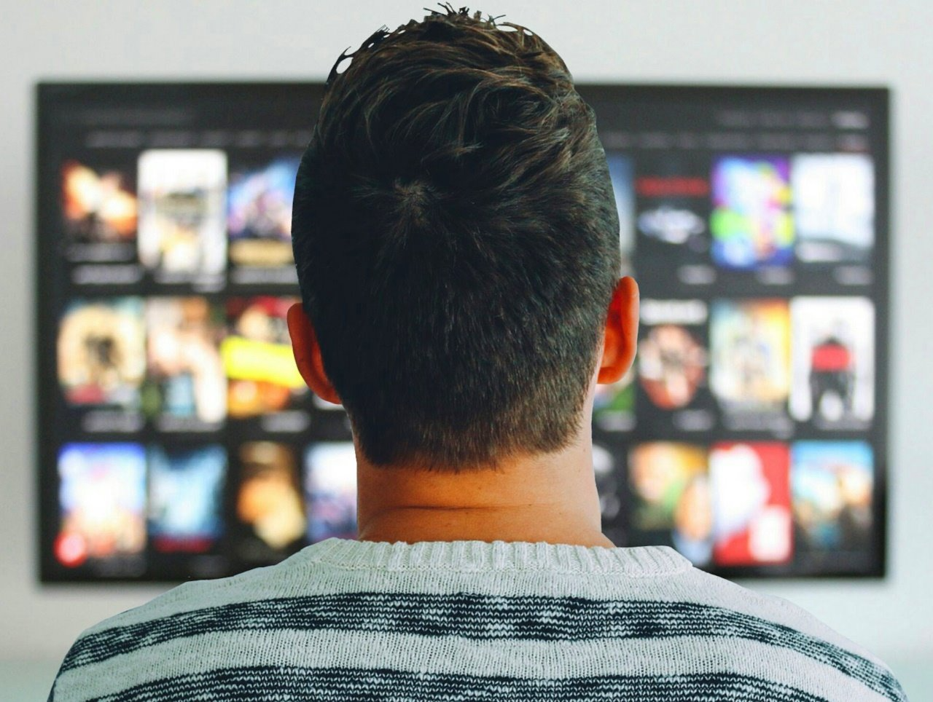
Attention optimized campaigns drive stronger brand impact, turning viewing into impact
+41%
higher brand lift from campaigns leveraging attention metrics
Source: Adelaide, 2025 Outcomes Guide, January 2025.
This information is exclusively provided to VAB members and qualified marketers.
PAGE 26

Slide 27
Premium Video drives greater consistent attention across content duration than YouTube, illustrating that not all viewing minutes are equal
‘Attention to Duration’ by Platform on CTV
YouTube ranks 14th
YouTube
Source: VAB + TVision Custom Study. July 2024 – June 2025. P2+. ‘Attention to Duration’ refers to: The proportion of time spent with eyes on screen relative to the duration of the app viewing session indexed to TV viewing norm. Spanish language apps comprised of 4 individual apps. Weighted based on duration of session.
This information is exclusively provided to VAB members and qualified marketers.
PAGE 27

Slide 28
Premium Video Platforms are 18% more likely to convert viewing time into meaningful attentive minutes across CTV viewership
Average ‘Attention to Duration’ Index
‘Attention to Duration’ is
+18%
stronger on Premium Video Platforms than YouTube
Source: VAB + TVision Custom Study. July 2024 – June 2025. P2+. Premium Video Platforms represent an average of the 21 Premium Video Platforms analyzed. ’Attention to Duration’ refers to: The proportion of time spent with eyes on screen relative to the duration of the app viewing session indexed to CTV viewing norm. Weighted based on duration of session.
This information is exclusively provided to VAB members and qualified marketers.
PAGE 28

Slide 29
Premium Video Platforms capture and sustain more attention across all demographics on CTV than YouTube
‘Attention to Duration’ Index Across Demographics
+14%
+8%
+13%
+13%
Source: VAB + TVision Custom Study. July 2024 – June 2025. P2+. Premium Video Platforms represent an average of the 21 Premium Video Platforms analyzed. ‘Attention to Duration’ refers to the proportion of time spent with eyes on screen relative to the duration of the app viewing session indexed to CTV viewing norm. Weighted based on duration of session.
Source: VAB / TVision Custom Study. July 2024-June 2025. Attention to Visible Index is defined as : The proportion of time spent with eyes on screen while the viewer in in the room with the content tuned indexed to TV viewing norm.
This information is exclusively provided to VAB members and qualified marketers.
PAGE 29

Slide 30
Premium Video Platforms deliver stronger and more reliable attention enabling advertisers to maximize the impact of each impression
Average Attention Metrics
Presence of Viewer
Eyes on Screen
Eyes Stay on Screen
Source: VAB + TVision Custom Study. July 2024-June 2025. P2+. Average attention metrics span all session durations. Premium video platforms represent an average of the 21 premium video platforms analyzed Weighted based on duration of session.
This information is exclusively provided to VAB members and qualified marketers.
PAGE 30

Slide 31
Seemingly small advertising decisions can lead to big impact, emphasizing that platform matters for compounding attention growth
Average Premium Video Platform Lift vs YouTube on CTV
+5%
+14%
+18%
more likely to be in the
room when the TV is on
more likely to have their eyes on screen
more likely to keep
their eyes on screen
*Max PVP vs YT : +20%
*Max PVP vs YT : +33%
*Max PVP vs YT : +88%
Source: VAB + TVision Custom Study. July 2024 – June 2025. P2+. Premium Video Platforms represent an average of the 21 Premium Video Platforms. Weighted based on duration of session. | *PVP refers to Premium Video Platforms. Max PVP means the Premium Video Platform with the highest index.
This information is exclusively provided to VAB members and qualified marketers.
PAGE 31

Slide 32
Premium Video Platforms dominate long-form content, driving higher attention and consistent engagement on CTV
Household Value lives on Premium Video Platforms
Premium Video Platforms Drive More Consistent Attention
Brand Impact Thrives Across Premium Video Platform
Session Lengths
This information is exclusively provided to VAB members and qualified marketers.
PAGE 32

Slide 33

Premium Video Platforms drive longer, more engaging viewing sessions, offering advertisers more reliable opportunities to connect with viewers
What is
‘Session Length’?
“Ads viewed in the long-form, lean-back TV environment have greater unaided recall and purchase intent”
Average viewing sessions grouped into four buckets based on length:
Super Short: 0 - 20 minutes
Short: 20 - 84 minutes
Medium: 84 minutes - 3 hours
Long: 3+ hours
James Rooke
President, Comcast Advertising
*Note: A singular viewing session is defined for each individual viewer and CTV app over the course of a single day. Weighted based on duration of session.
This information is exclusively provided to VAB members and qualified marketers.
PAGE 33

Slide 34

Premium Video environments deliver high quality ad exposure where higher attention and completion drive stronger engagement
94%
Average ad completion rate for long-form premium video content
Source: FreeWheel, The Delicate Art of Balancing Ad Load, September 2023.
This information is exclusively provided to VAB members and qualified marketers
PAGE 34

Slide 35
Shorter viewing sessions on YouTube limit impressions opportunities, compared with longer form content across Premium Video Platforms
Average Session Length by Platform on CTV
In Hours
YouTube ranks last
Source: VAB + TVision Custom Study. July 2024 – June 2025. P2+. Spanish language apps comprised of 4 individual apps. Weighted based on duration of session.
This information is exclusively provided to VAB members and qualified marketers.
PAGE 35

Slide 36
Shorter viewing sessions on YouTube limit opportunities for marketers to connect with audiences
Average Session Length by App Type on CTV
hours, minutes across a 12-month time period
YouTube ranks last
YouTube
Source: VAB + TVision Custom Study. July 2024 – June 2025. P2+. Weighted based on duration of session.
This information is exclusively provided to VAB members and qualified marketers.
PAGE 36

Slide 37
Premium Video Platforms have 49% longer viewing sessions than YouTube, maximizing the marketer opportunity for meaningful impressions
Average Session Length
hours, minutes
Average Session Length is
+26
minutes longer on Premium Video Platforms than YouTube
Source: VAB + TVision Custom Study. July 2024 – June 2025. P2+. Premium Video Platforms represent an average of the 21 Premium Video Platforms analyzed. Weighted based on duration of session.
This information is exclusively provided to VAB members and qualified marketers.
PAGE 37

Slide 38
The bulk of YouTube impressions live solely in super short or short viewing sessions, minimizing brand opportunities to drive attention
Share of YouTube Impressions Across Session Duration
75%
of YouTube impressions fall within super short and short viewing sessions
Source: VAB + TVision Custom Study. July 2024-June 2025. P2+. Super Short Session 0 minutes to 20 minutes; Short Session 20 minutes to 84 minutes; Medium Session 84 minutes to 3 hours; Long Session 3+ hours
This information is exclusively provided to VAB members and qualified marketers.
PAGE 38

Slide 39
Regardless of session length, consumers who access Premium Video Platforms on CTV are more likely to have their eyes on screen than YouTube
‘Attention to Presence’ Index by Session Length
+19%
+13%
+15%
+13%
Source: VAB + TVision Custom Study. July 2024-June 2025. P2+. Super Short Session 0 minutes to 20 minutes; Short Session 20 minutes to 84 minutes; Medium Session 84 minutes to 3 hours; Long Session 3+ hours. ‘Attention to Presence’ Index is defined as the proportion of time spent with eyes on screen while the viewer in in the room with the content tuned indexed to CTV viewing norm. Premium Video Platforms represent an average of the 21 Premium Video Platforms analyzed. Weighted based on duration of session.
This information is exclusively provided to VAB members and qualified marketers.
PAGE 39

Slide 40
YouTube’s attention environment is below average for eyes on screen, undermining the reliability advertisers need for brand impact
‘Attention to Presence’ Across Session Durations
108
Premium Video Average
YouTube
Source: VAB + TVision Custom Study. July 2024-June 2025. P2+. ‘Attention to Visible’ Index is defined as the proportion of time spent with eyes on screen while the viewer in in the room with the content tuned indexed to CTV viewing norm. Spanish language apps are comprised of 4 individual apps. Super Short Session 0 minutes to 20 minutes; Short Session 20 minutes to 84 minutes; Medium Session 84 minutes to 3 hours; Long Session 3+ hours. Weighted based on duration of session. Absence of data point reflects lack of required sample size for reporting.
This information is exclusively provided to VAB members and qualified marketers.
PAGE 40

Slide 41
YouTube struggles to retain eyes on screen with nearly all session durations under-indexing compared to Premium Video Platforms
‘Attention to Duration’ Across Session Durations
110
Premium Video Average
YouTube
Source: VAB + TVision Custom Study. July 2024-June 2025. P2+. analyzed ‘Attention to Duration’ refers to the proportion of time spent with eyes on screen relative to the duration of app viewing session indexed to CTV viewing norm. Spanish language apps are comprised of 4 individual apps. Super Short Session 0 minutes to 20 minutes; Short Session 20 minutes to 84 minutes; Medium Session 84 minutes to 3 hours; Long Session 3+ hours . Weighted based on duration of session. Absence of data point reflects lack of required sample size for reporting.
This information is exclusively provided to VAB members and qualified marketers.
PAGE 41

Slide 42
Premium Video Platforms outperform YouTube on CTV across key attention and engagement metrics, which creates outsized value for marketers
Household Value Lives on Premium Video Platforms
Premium Video Platforms Drive Consistent Attention
Brand Impact Thrives Across Premium Video Platform Session Lengths
This information is exclusively provided to VAB members and qualified marketers.
PAGE 42

Slide 43
CTV impressions on Premium Video Platforms
work harder for marketers than impressions on YouTube
Average Premium Video Platform Lift vs YouTube on CTV
‘Presence to Active’
‘Attention to Presence’
‘Attention to Duration’
+5%
+14%
+18%
more likely to be in the
room when the TV is on
more likely to have their eyes on screen
more likely to keep
their eyes on screen
‘Co-viewing’
‘Session Length’
+33%
+49%
stronger co-viewing
longer viewing sessions
Source: VAB + TVision Custom Study. July 2024 – June 2025. P2+.
This information is exclusively provided to VAB members and qualified marketers.
PAGE 43

Slide 44

Adults over 50 account for 36% of the total population and nearly half of all adults
Premium Video Platforms on CTV are much more likely to generate shared audiences, enabling advertisers to get greater efficiency out of every
CTV impression they buy
Attention on YouTube underperforms, whereas marketers can rely on the consistency and predictability of attention on Premium Video Platforms to help achieve their desired business outcomes
Higher attention across session lengths in Premium Video Platforms drive deeper engagement and facilitates greater brand storytelling opportunities
for marketers
Not all CTV impressions are created equal. Impressions delivered on Premium Video Platforms work harder for marketers than impressions on YouTube
Key Marketer Takeaways
This information is exclusively provided to VAB members and qualified marketers
PAGE 44

Slide 45

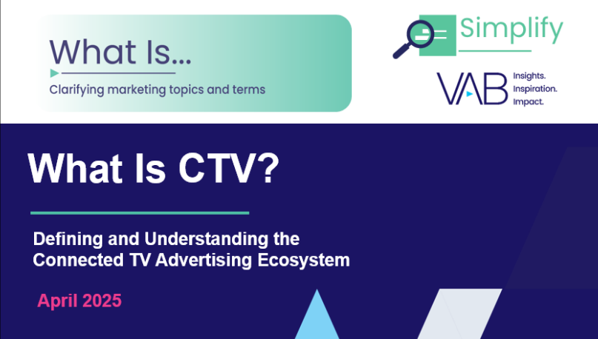
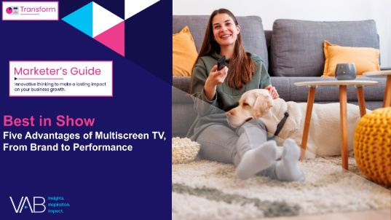

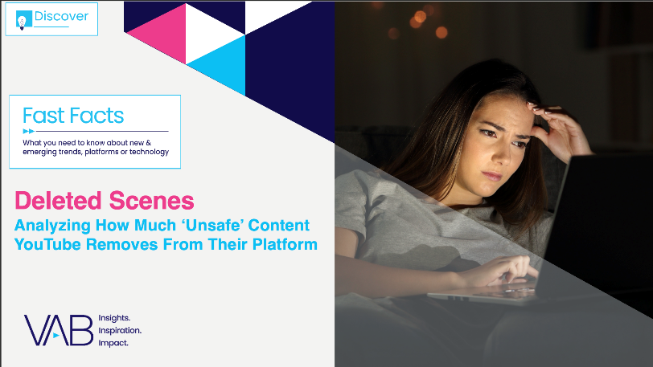



Creators
Jason Wiese
Benjamin Vandegrift
EVP, Strategic Insights & Measurement
jasonw@thevab.com
SVP, Measurement Strategy & Innovation benjaminv@thevab.com
The Power of Premium Video
What It Means for Multiscreen TV
and Why It Matters to Marketers
What Is CTV?
Defining and Understanding the Connected TV Advertising Ecosystem
Reed Kiely
Rohan Gosalia
VP, Data Insights & Trends
reedk@thevab.com
Associate Director, Measurement Intelligence
rohang@thevab.com
Best in Show
Five Advantages of Multiscreen TV, From Brand to Performance
The Big Picture
12 Key Charts on the Impact of TV & Streaming vs. Social Media Platforms
Discover more
Looking for more data, insights and takeaways? Check out this related VAB content
Deleted Scenes
Analyzing How Much ‘Unsafe’ Content
YouTube Removes From Their Platform
“Where do ad dollars go when they’re spent with Google?”
VAB Members, brand marketers and agencies get free and immediate access to VAB’s content library. Get access at theVAB.com
This information is exclusively provided to VAB members and qualified marketers.
PAGE 45

Slide 46


About VAB
VAB plays a dual role in the video advertising industry. We are leading the change to bring about a more innovative and transparent marketplace. We also provide the insights and thought leadership that enables marketers to develop business-driving marketing strategies.
Drawing on our marketing expertise, we simplify the complexities in our industry and discover new insights that transform the way marketers look at their media strategy.
We are committed to your business growth and proud to offer VAB members, brand marketers and agencies complimentary access to our continuously-growing Insights library. Get immediate access at theVAB.com.
This information is exclusively provided to VAB members and qualified marketers.
PAGE 46

Slide 47

TVision Methodology & Glossary

Slide 48
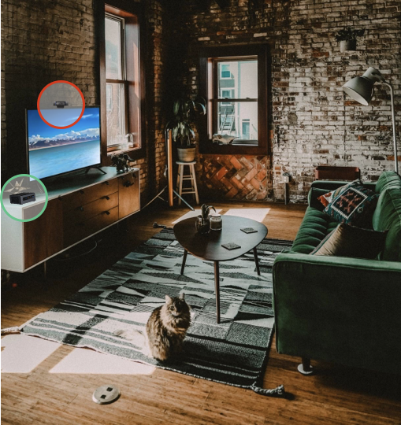

TVision’s Technology Stack
Cutting edge and proprietary technology was used to measure who, how and what audiences are watching on their CTV devices
TVision Sensor
Person & Facial Recognition (Who is in the room, and if they’re paying attention)
ACR Fingerprinting (What is on TV)
TVision Digital Meter
Device Detection (If a digital device is in use)
App Detection (If a streaming service is in use)
Flexibility to add additional digital traffic analysis
TVision Measurement Engine
Remote Device Management to manage and service thousands of in-home devices
ACR Engine to identify linear and time-shifted TV content and ad units, over the air TV and on CTV
Click here to access more TVision content.
This information is exclusively provided to VAB members and qualified marketers.
PAGE 48

Slide 49



TVision’s Data Approach: Streaming
TVision Device Meter:
TVision's device detection capabilities measure how people are watching TV, identifying if the viewer is watching CTV, and what device and application are currently in use.
ACR Fingerprinting:
TVision’s ACR data measures what people are watching, identifying program and ad airings using ACR technology in conjunction with our ingested library content.
Computer Vision:
TVision’s Computer Vision technology detects who is in the room, identifies the person(s), and matches them back to their demographic information. It also detects whether the person is actively looking at the TV or not, which provides us with Attention information.
This information is exclusively provided to VAB members and qualified marketers.
PAGE 49

Slide 50
Study Definitions
Term | Definition
Timeframe | July 1, 2024 - June 30, 2025
Demo | P2+, P2-17, P18-34, P35-54, P55+
Session | A singular viewing session is defined for each individual viewer and application title over the course of a single day. For a session to be included, it requires a 30 second minimum session duration on YouTube and 5 minutes on Premium Video Platforms. For a given viewer and application, a new session begins whenever there is a gap of more than 10 minutes in viewing that specific application. Each session captures continuous viewing of that application within the day.
Session Length Group | These are created by grouping sessions into four buckets based on length: super short – 0 minutes to 20 minutes; short - 20 minutes to 84 minutes; medium - 84 minutes to 3 hours; long - 3+ hours.
This information is exclusively provided to VAB members and qualified marketers.
PAGE 50

Slide 51
Data Cuts – Metric Guide
Metric | Definition | Weighting
Co-viewing % | The proportion of viewing where 2 or more viewers have overlapping *active viewing sessions for at least 5 minutes. | Share of impressions
‘Presence to Active’ Index | The percentage of time a viewer was in the room out of the total active viewing session indexed to CTV viewing norm. | Duration of session
‘Attention to Presence’ Index | The proportion of time spent with eyes on screen while the viewer in in the room with the content tuned indexed to CTV viewing norm. | Duration of session
‘Attention to Duration’ Index | The proportion of time spent with eyes on screen relative to the duration of the content indexed to CTV viewing norm. Window of attention captured requires 30 seconds of consistent viewing. | Duration of session
Session Length | Average viewing session grouped into 4 buckets based on length: super short – 0 minutes to 20 minutes; short - 20 minutes to 84 minutes; medium - 84 minutes to 3 hours; long - 3+ hours. | Duration of session
This information is exclusively provided to VAB members and qualified marketers.
PAGE 51

