Slide 1

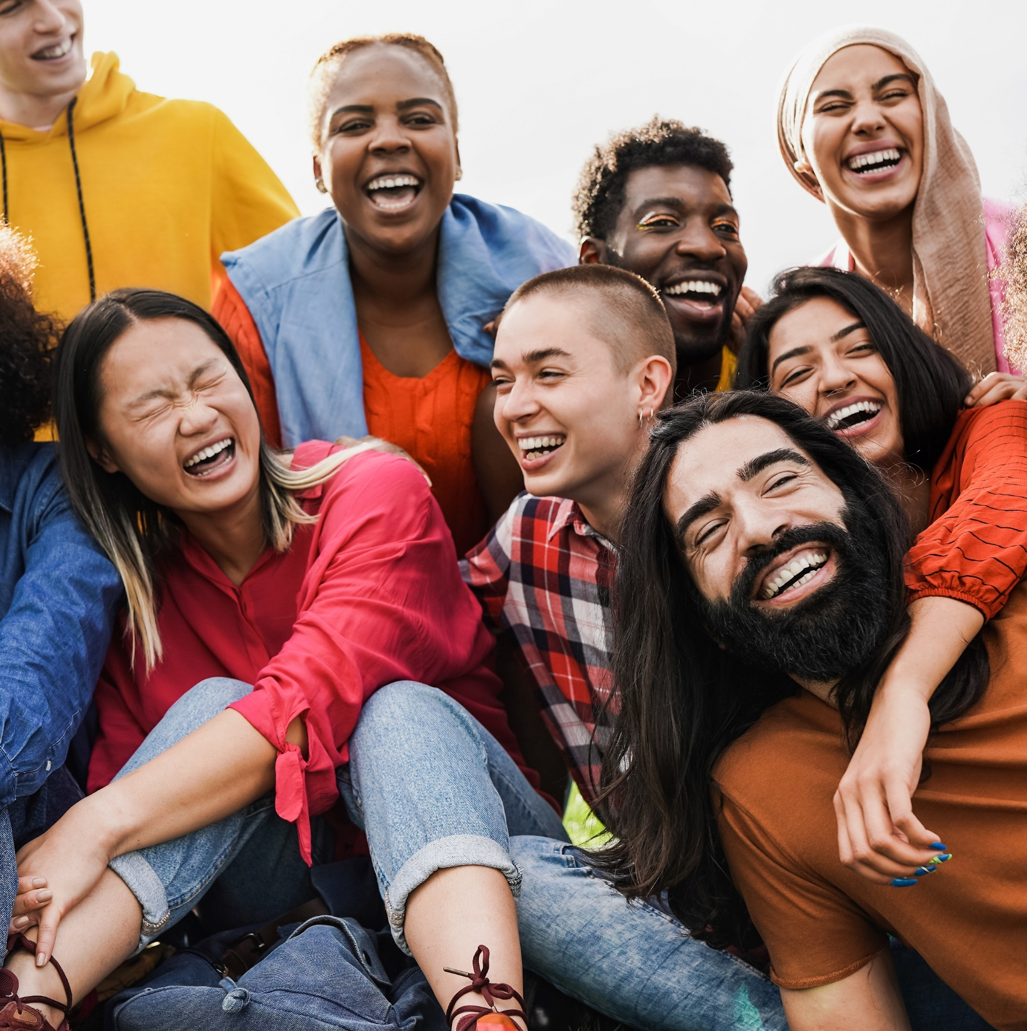



7 Ways for Brands to Successfully Engage
Diverse Audiences

Slide 2
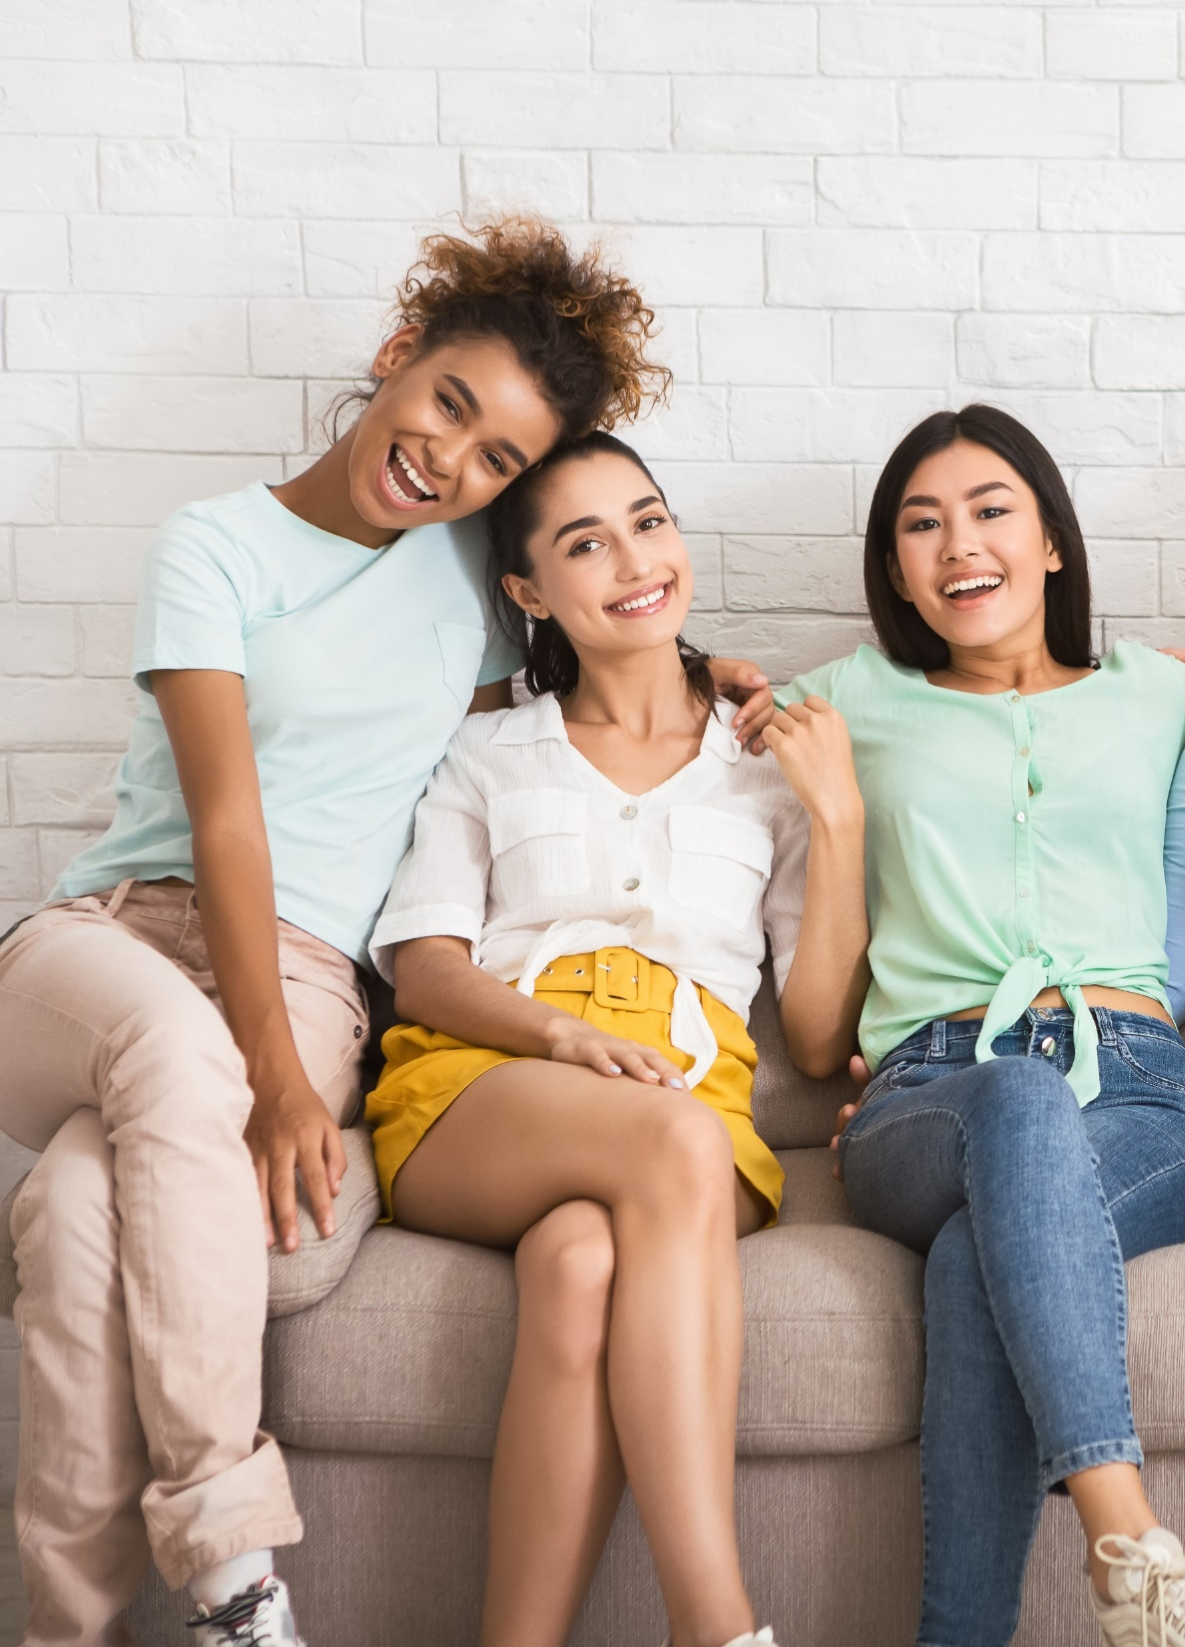

Accurate representation matters.
Diverse and multicultural audiences are drawn to content that represents their identity, their culture
and their community accurately.
Marketers can build deep connections with these highly-engaged audiences through programming that authentically reflects inclusivity.
As the population becomes more diverse, marketers can invest in multicultural-targeted and minority-owned media platforms to engage their audiences while showing a commitment to support more inclusive voices within the marketplace.
This information is exclusively provided to VAB members and qualified marketers. Further distribution is prohibited.
PAGE 2

Slide 3
7 Ways for Brands to Successfully Engage Diverse Audiences
1
2
3
4
Attract multicultural and diverse audiences with stories and characters
that are relatable to their
own lives
Understand how their cultural identity strongly influences what content they engage with
Prioritize reflecting identity and culture accurately and authentically to connect with diverse audiences
Build your brand’s presence on video platforms where multicultural audiences are most likely to be spending their time
5
6
7
Reach multicultural audiences within the types of content and environments that resonate best with them
Leverage multicultural viewers’ passion for engaging with their favorite content on social media to grow brand consideration and sentiment
Accelerate investment in multicultural-targeted, owned and operated media
to show a real commitment to improving diversity and inclusion
This information is exclusively provided to VAB members and qualified marketers. Further distribution is prohibited.
PAGE 3

Slide 4
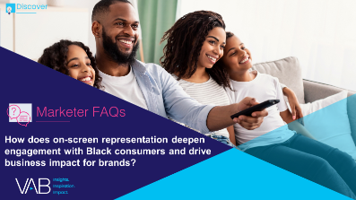
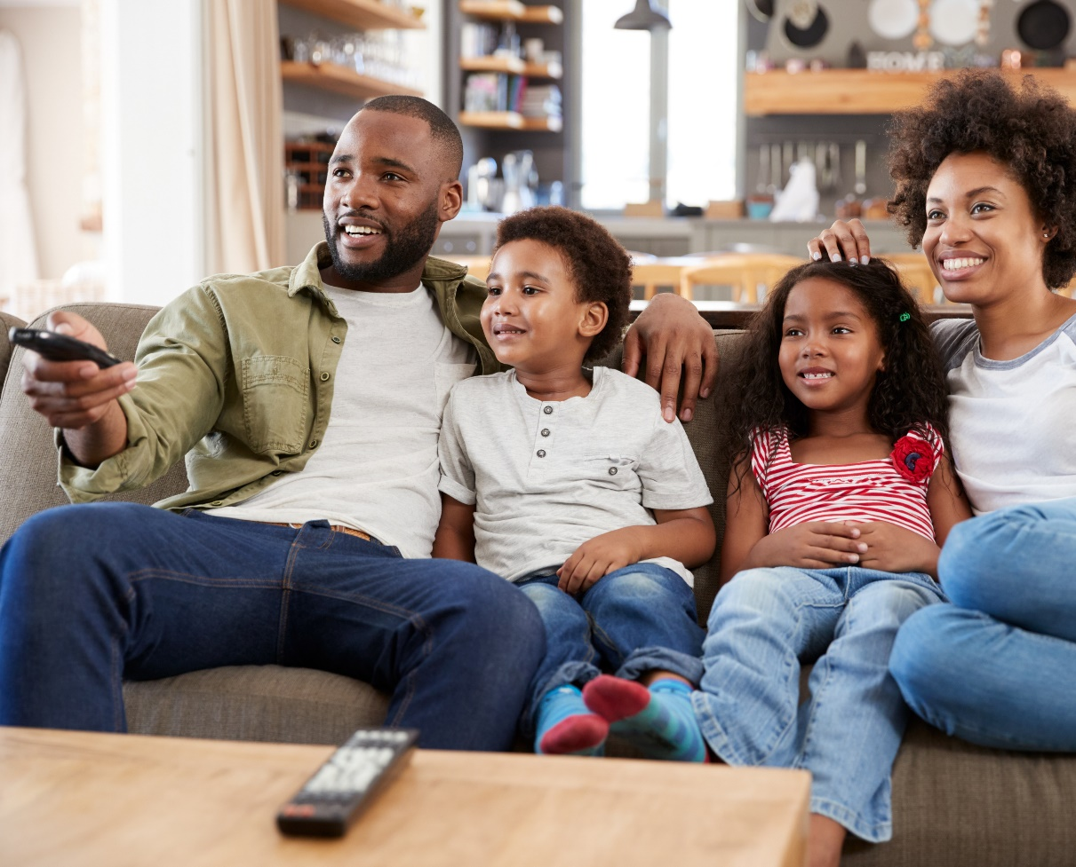
Attract multicultural and diverse audiences with stories and characters that are relatable to their own lives
1
By building campaigns around TV content that not only promotes inclusivity but accurately portrays identities, marketers can further engage diverse audiences who are more likely to prioritize viewing this content
Click here for the full report
% that are more likely to start watching a television show or movie because characters with similar (racial, ethnic, religious, etc.) identities
as you are represented?
% of respondents who answered very/somewhat likely
81%
68%
67%
Black
Hispanic
Asian
71%
52%
LGBTQ
Non-Hispanic White
Source: VAB analysis of Morning Consult, Media Representation, September 2021.
This information is exclusively provided to VAB members and qualified marketers. Further distribution is prohibited.
PAGE 4

Slide 5
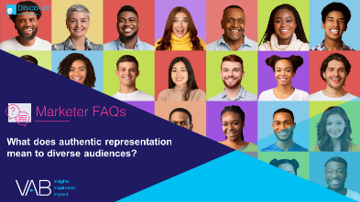
Understand how their cultural identity strongly influences what content they engage with
2
The opportunity to deeply connect with multicultural consumers can be achieved by shaping storylines, characters and experiences that accurately represent and resonate with these audiences
Click here for the full report
‘My cultural / ethnic heritage is an important part of who I am’
% of respondents who answered agree completely or agree somewhat
“Across streaming, cable and broadcast platforms, viewership among adults age[s] 18 to 49 peaked in many cases when a show had a majority-minority cast.
People basically want to see the TV shows that look like America, that have characters they can relate to and have experiences that resonate with them.”
83%
78%
82%
Black
Hispanic
Asian
75%
52%
American Indian
or Alaska Native
Non-Hispanic White
Darnell Hunt
Dean of the Social Sciences at UCLA
Source: VAB analysis of MRI-Simmons USA Study, Fall 2021; ‘My cultural / ethnic heritage is an important part of who I am (any agree)’. For more information, download: How does on-screen representation deepen engagement with Black consumers and drive business impact for brands?
This information is exclusively provided to VAB members and qualified marketers. Further distribution is prohibited.
PAGE 5

Slide 6

Prioritize reflecting identity and culture accurately and authentically to connect with diverse audiences
3
Marketers can further engage diverse audiences by building campaigns around video programming that promotes inclusivity
Click here for the full report
% that agree that it is important for television shows and movies
accurately represent their identities
% of respondents who answered very/somewhat important
77%
64%
78%
Black
Hispanic
Asian
71%
61%
LGBTQ
Non-Hispanic White
Source: VAB analysis of Morning Consult, Media Representation, September 2021.
This information is exclusively provided to VAB members and qualified marketers. Further distribution is prohibited.
PAGE 6

Slide 7
Build your brand’s presence on video platforms where multicultural audiences are most likely to be spending their time
4
Multicultural audiences are more likely to watch professionally-produced, long-form TV programming across devices which should be an important consideration when marketers are crafting their multiplatform video campaigns
% of weekly time spent watching TV Shows
Share of Time | Live / DVR / VOD on TV | Live TV Streaming / Streaming on TV | TV Total | VOD / Downloaded on Other Devices | Live TV Streaming / Streaming on Other Devices | Other Devices Total
Black / African American | 39% | 28% | 67% | 12% | 21% | 33%
Hispanic | 32% | 35% | 67% | 10% | 21% | 31%
American Indian / Alaska Native | 38% | 34% | 72% | 11% | 19% | 30%
Asian | 32% | 33% | 65% | 9% | 23% | 32%
Other | 30% | 35% | 65% | 16% | 20% | 36%
Non-Hispanic White | 44% | 31% | 75% | 11% | 16% | 27%
Source: VAB analysis of MRI-Simmons August 2022 Cord Evolution Study, A18+. Q40b: Ways Watching TV Shows - Time Spent In Typical Week: Volume (% of Time Spent). Live on TV: Live, when it is broadcast, on a TV set; DVR on TV: DVR, on a TV set; VOD on TV: TV provider's Video On-Demand service on a TV; Live TV Streaming on TV: Streaming live, at the same time it airs on TV, on a TV; Streaming on TV: Streaming, on my schedule, on a TV set; VOD on other devices: TV provider's Video On-Demand service on any other device; Streaming on other devices: Streaming, on my schedule, on any other device; Live TV Streaming on other devices: Streaming live, at the same time it airs on TV, on any other device; Streaming on other devices: Streaming, on my schedule, on any other device; Downloaded content on any device: Watching downloaded content on any device. Note: %s may not add to 100% due to rounding.
This information is exclusively provided to VAB members and qualified marketers. Further distribution is prohibited.
PAGE 7

Slide 8
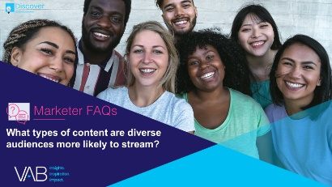





Reach multicultural audiences within the types of content and environments that resonate best with them
5
Many multicultural audiences stream content that is inherently communal, with a gravitation towards in-language, sports and family-friendly programming that is often watched together
Click here for the full report
Type of TV content streamed
% more likely to watch (index by segment vs. non-Hispanic White A18+ respondents)
Foreign language programming
Sports talk / debate shows
(e.g., First Take, Undisputed, The Herd)
Kids programming
Series that are currently airing on linear TV networks
(e.g., The Walking Dead, The Good Place, etc.)
Documentary / informational TV shows
Hispanic
+76%
Hispanic
+57%
American Indian
or Alaska Native
+51%
LGBTQ
+17%
American Indian
or Alaska Native
+7%
Asian
+60%
Black
+46%
Hispanic
+29%
Black
+5%
Asian
+6%
How to read: Hispanic streamers are 76% more likely to watch foreign language programming than non-Hispanic White streamers
Source: VAB analysis of MRI-Simmons Cord Evolution Study, November 2021; P18+. Base = ‘Used any streaming services in the past 12 months.’
This information is exclusively provided to VAB members and qualified marketers. Further distribution is prohibited.
PAGE 8

Slide 9


Leverage multicultural viewers’ passion for engaging with their favorite content on social media to grow brand consideration and sentiment
6
The communal nature of multicultural consumers extends online as well, with diverse audiences much more likely to talk about TV shows on social media
% who agree with the following statements
‘I am more likely to watch a TV show that is active on social media’
‘I use social media to talk about shows I watch’
Black
Hispanic
Asian
Black
Hispanic
Asian
28%
29%
28%
28%
24%
20%
(206 Index)
(210 Index)
(204 Index)
(227 Index)
(194 Index)
(165 Index)
American Indian
or Alaska Native
Non-Hispanic
White
American Indian
or Alaska Native
Non-Hispanic
White
19%
14%
19%
12%
(137 Index)
(155 Index)
How to read index: Black adults are 106% more likely to watch a TV show that is active on social media than non-Hispanic White adults (Black: 28% vs 14% NH White).
Source: VAB analysis of MRI-Simmons Spring 2022 Doublebase.
This information is exclusively provided to VAB members and qualified marketers. Further distribution is prohibited.
PAGE 9

Slide 10
Accelerate investment in multicultural-targeted, owned and operated media to show a real commitment to improving diversity and inclusion
7
Marketers can foster greater connection with multicultural audiences and create a stronger marketplace of diverse voices by partnering with, and investing in, minority-owned media entities
Comprising nearly 7% of all media entities,* minority-owned media platforms are a growing component for advertising spend
“It's time the industry invests in engaging multicultural and diverse audiences who are key
to business growth.
That effort cannot be maximized without investing in both diverse-owned AND targeted media.”
Share of Minority Owned Media
Lisette Arsuaga
Co-Founder, AIMM &
Co-President, DMI Consulting
Source: AIMM, ‘MINORITY-OWNED MEDIA’, 2021 including data from MAVEN Diversity, September 2021 Media Framework LLC. *Includes entities across: TV, radio and digital platforms. HBCU = Historically Black Colleges and Universities.
This information is exclusively provided to VAB members and qualified marketers. Further distribution is prohibited.
PAGE 10

Slide 11
7 Ways for Brands to Successfully Engage Diverse Audiences
1
2
3
4
Attract multicultural and diverse audiences with stories and characters
that are relatable to their
own lives
Understand how their cultural identity strongly influences what content they engage with
Prioritize reflecting identity and culture accurately and authentically to connect with diverse audiences
Build your brand’s presence on video platforms where multicultural audiences are most likely to be spending their time
5
6
7
Reach multicultural audiences within the types of content and environments that resonate best with them
Leverage multicultural viewers’ passion for engaging with their favorite content on social media to grow brand consideration and sentiment
Accelerate investment in multicultural-targeted, owned and operated media
to show a real commitment to improving diversity and inclusion
This information is exclusively provided to VAB members and qualified marketers. Further distribution is prohibited.
PAGE 11

Slide 12
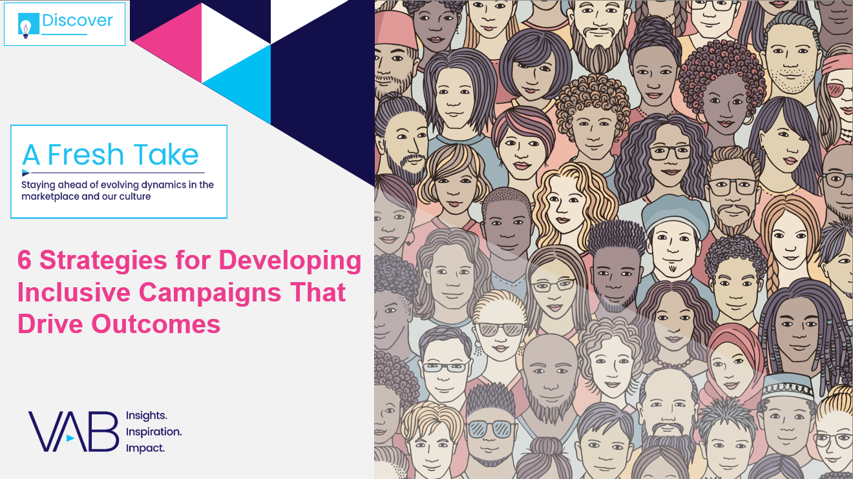
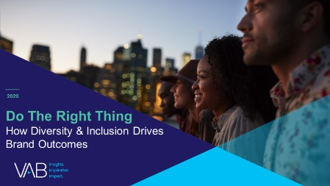
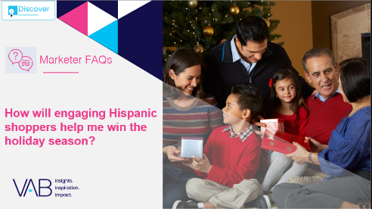
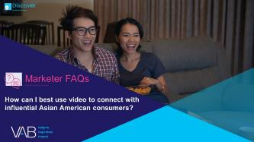


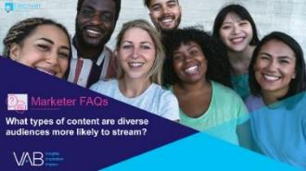
Creators
Jason Wiese
Reed Kiely
SVP, Director of Strategic Insights
jasonw@thevab.com
Associate Insights Director
reedk@thevab.com
6 Strategies for Developing Inclusive Campaigns That Drive Outcomes
Do The Right Thing
How Diversity & Inclusion Drives
Brand Outcomes
Discover more
Looking for more data, insights and takeaways? Check out this related VAB content
How will engaging Hispanic shoppers help me win the
holiday season?
How can I best use video to connect with influential Asian American consumers?
We are committed to providing marketers with the data and insights they need to develop thoughtful, inclusive campaigns & strategies. To find out more on the unique media consumption behaviors and cultural trends of multicultural consumers, visit the VAB’s Multicultural Marketing Resource Center.
What is the market opportunity
for the LGBTQ+ community?
What types of content are diverse audiences more likely to stream?
VAB Members, brand marketers and agencies get free and immediate access to VAB’s content library. Get access at theVAB.com
This information is exclusively provided to VAB members and qualified marketers. Further distribution is prohibited.
PAGE 12

Slide 13


About VAB
VAB is an insights-driven organization that inspires marketers to reimagine their media strategies resulting in fully informed decisions.
Drawing on our marketing expertise, we simplify the complexities in our industry and discover new insights that transform the way marketers look at their media strategy.
We are committed to your business growth and proud to offer VAB members, brand marketers and agencies complimentary access to our continuously-growing Insights library. Get immediate access at theVAB.com.
Curious to learn more about VAB? Check out this quick video to see what we do and how we can help you develop business-driving marketing strategies.
This information is exclusively provided to VAB members and qualified marketers. Further distribution is prohibited.
PAGE 13

