Slide 1





6 Strategies for Developing Inclusive Campaigns That Drive Outcomes

Slide 2


Inclusive messaging is the key to resonating with all audiences today.
When brands create campaigns that showcase diverse lives and stories, it grabs consumers’ attention.
Inclusive messaging that specifically resonates among diverse segments can often reverberate across a wider audience of allies and advocates and increase positive sentiment around a brand.
This piece provides guidance on six strategies
for inclusive campaigns that drive engagement, attention and sales for brands across audiences.
This information is exclusively provided to VAB members and qualified marketers. Further distribution is prohibited.
PAGE 2

Slide 3

“We need to break with a habitual mindset that there is a general market. We live in a totally diverse country with many cultures, we are not homogeneous,
there is no average consumer.”
Marc Pritchard
Chief Brand Officer, Proctor & Gamble
ANA Masters of Marketing, keynote address, 10/27/22
This information is exclusively provided to VAB members and qualified marketers. Further distribution is prohibited.
PAGE 3

Slide 4
6 Strategies for Developing Inclusive Campaigns That Drive Outcomes
1
2
3
Recognize the importance of creating culturally diverse advertising to heighten relevancy across all audiences
Understand the nuance of diverse consumers to create campaigns that are truly relevant to them, whether through relatable stories or in-language messaging
Customize creative messaging with personalized and authentic stories to drive attention
4
5
6
Empathize with consumers
by providing relevant products
and services tailored to their specific needs
Expand inclusivity messaging beyond individual segments
to create deeper connections across audiences by engaging ‘allies’
and ‘advocates’ as well
Act by establishing your brand’s position as an ally and advocate through purposeful partnerships
This information is exclusively provided to VAB members and qualified marketers. Further distribution is prohibited.
PAGE 4

Slide 5
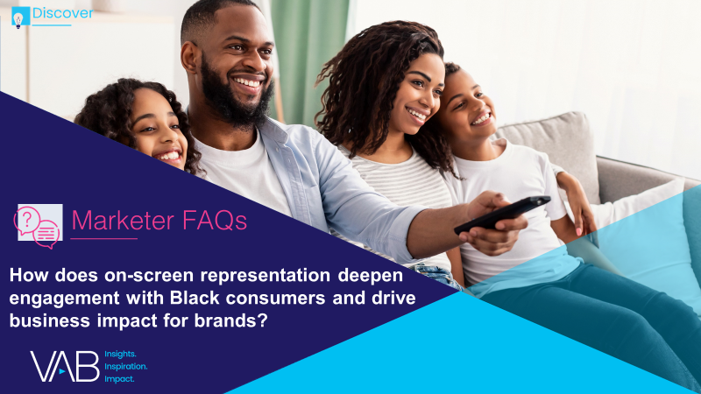
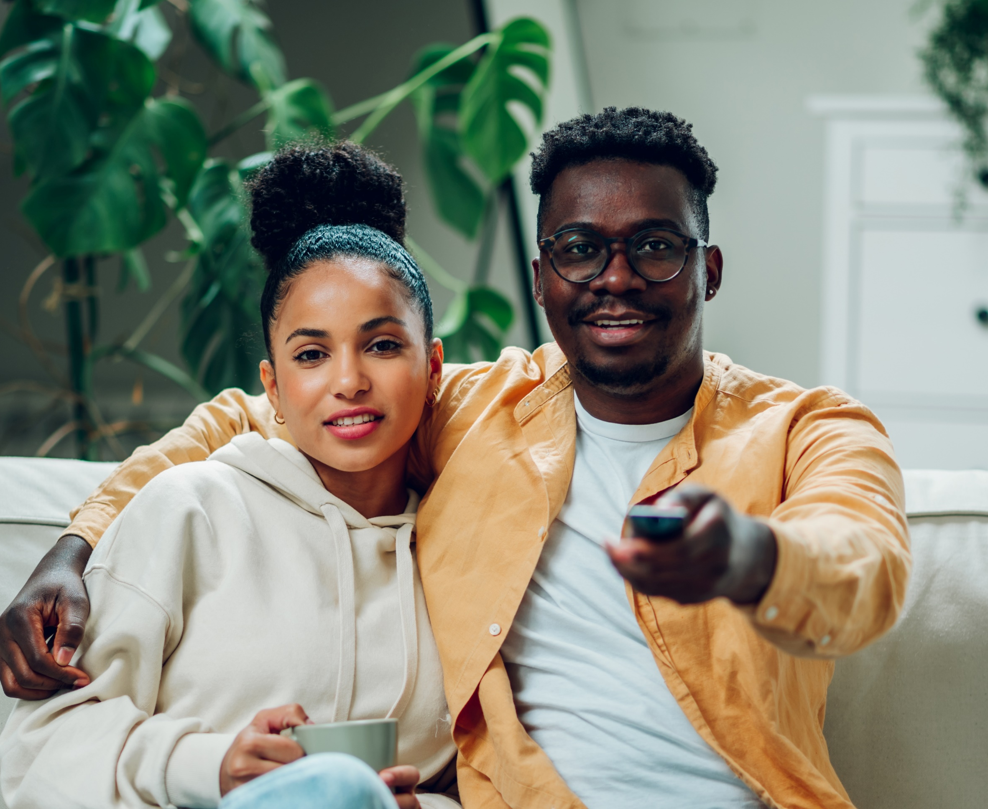
Recognize the importance of creating culturally diverse advertising to heighten relevancy across all audiences
1
Regardless of their identity, more than half of all audiences believe advertisers should have inclusive messaging in order to effectively resonate with the evolving demographics of today’s consumers
Click here for the full report
‘It is important for companies to create advertising that is culturally diverse
in order to stay relevant’
% of respondents who agree
81%
74%
74%
Black
Hispanic
LGBTQ
73%
65%
61%
Asian
Native American
non-Hispanic White
Source: VAB analysis of MRI-Simmons USA Study, Fall 2021; A18+.
This information is exclusively provided to VAB members and qualified marketers. Further distribution is prohibited.
PAGE 5

Slide 6
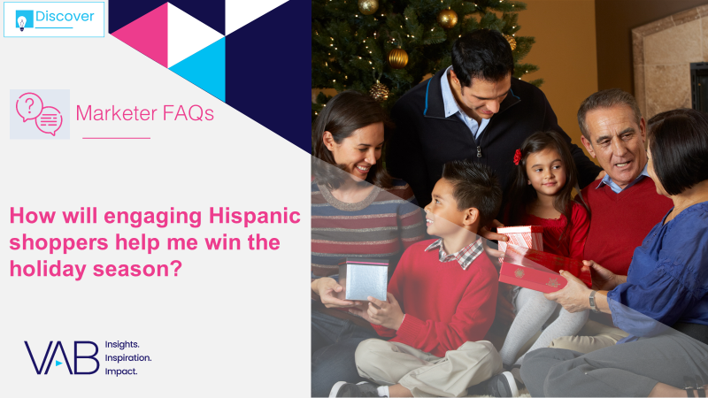
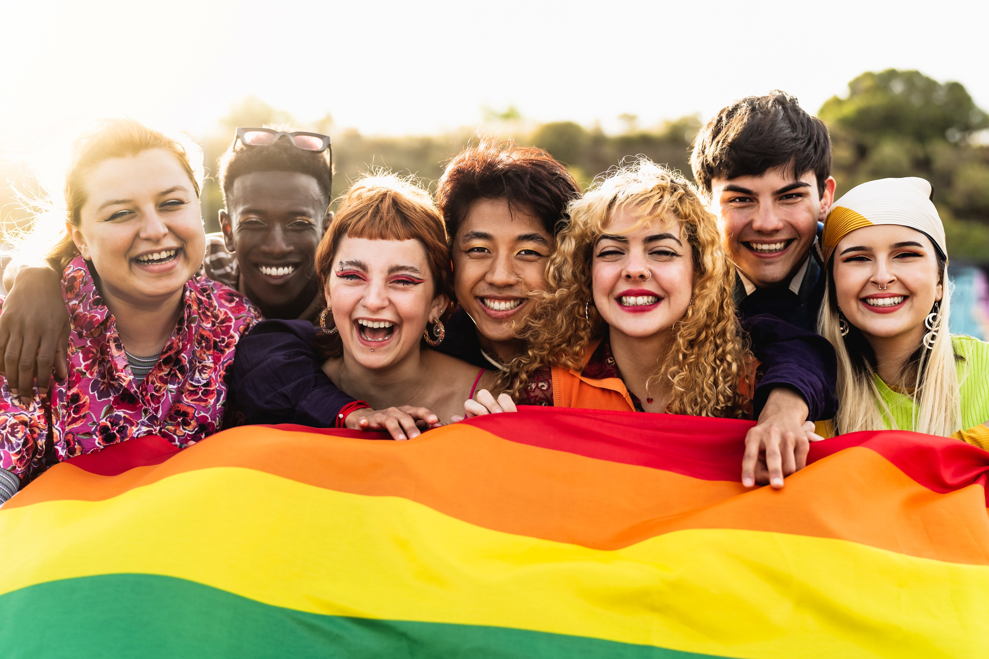

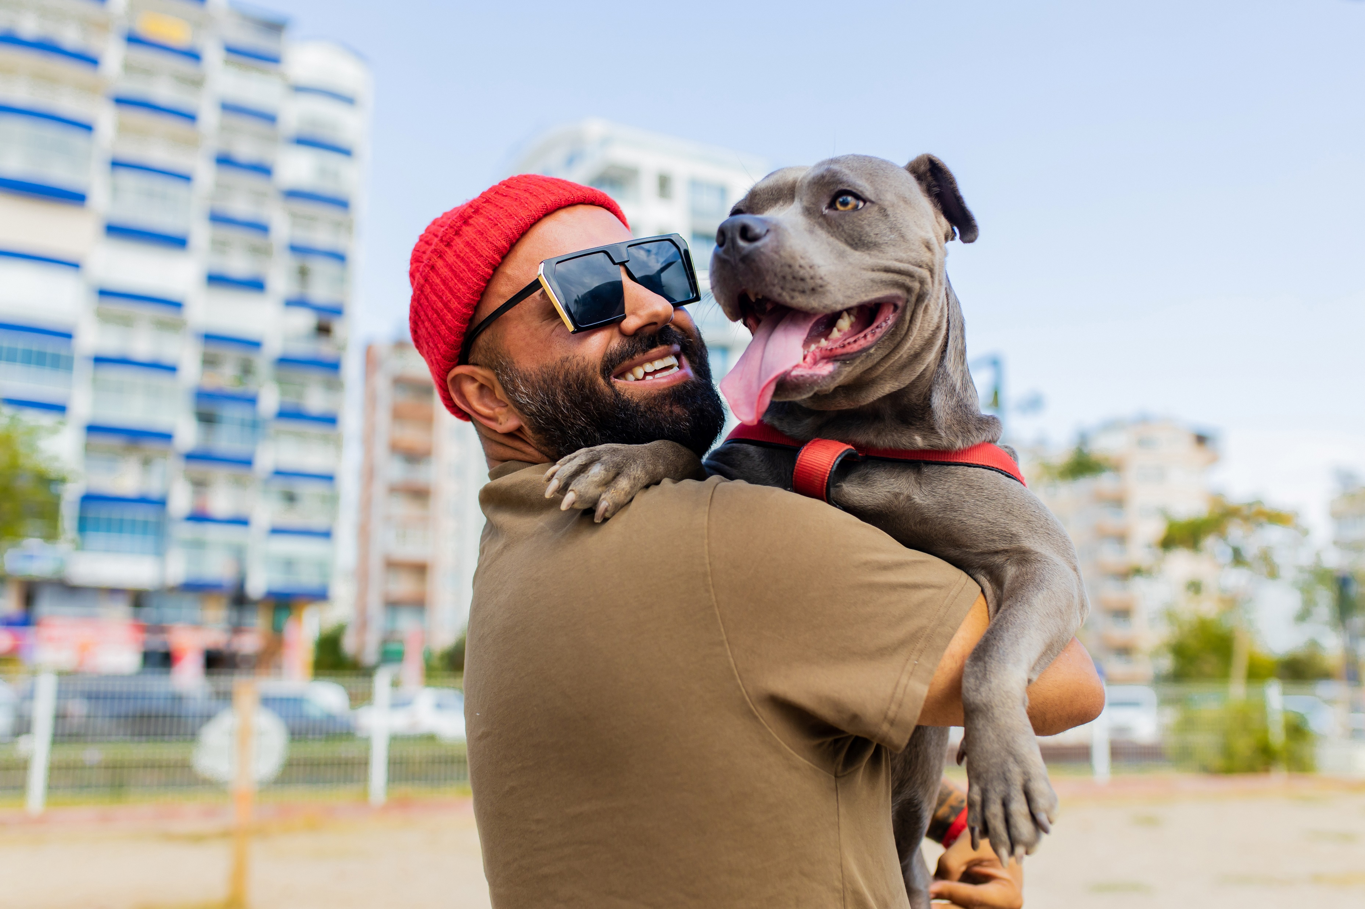
Understand the nuance of diverse consumers to create campaigns that are truly relevant to them, whether through relatable stories or in-language messaging
2
Marketers can drive engagement and sales by creating authentic campaigns that are inclusive of different cultures, identities and languages
Click here for the full report
% of respondents who agree with the following statements
71%
‘I am more likely to start watching a television show or movie because characters with similar identities are represented’*
(Among LGBTQ A18+)
69%
‘I feel really good about seeing celebrities in the media that share my ethnic background’
(Among Black A18+)
65%
‘I believe that companies who advertise in Spanish respect my culture and want my business’**
(Among Hispanic A18+)
Source: MRI-Simmons, Spring 2022 Doublebase Study, A18+. *MRI-Simmons, LGBTQ and Gender Identity Study, October 2021. **Based only on respondents of Spanish or Hispanic origin which represents 17% of A18+ population.
This information is exclusively provided to VAB members and qualified marketers. Further distribution is prohibited.
PAGE 6

Slide 7






Customize creative messaging with personalized and authentic stories to drive attention
3
The success of campaigns that highlight different identities and cultures shows how brands who tailor their messaging with personalized, authentic stories can better engage diverse audiences
Click here for the full report
Holiday-related campaigns with Spanish-language messaging and authentic Hispanic stories
Ad Attention Index against total P18+
‘Ven por ingredientes’ TV Spot
(Flight duration: 11/7/2021-12/21/2021)
‘Navidea y come de todo’ TV Spot
(Flight duration: 11/8/2021-12/24/2021)
‘The Recipe’ TV Spot
(Flight duration: 11/1/2021-12/31/2021)
119
Ad Attention Index
110
Ad Attention Index
108
Ad Attention Index
How to read: ‘Ven por ingredientes’ (119 index) had 19% less interruptions than other ads in the context of the media placement with a 100 score being average.
Source: Creative from iSpot.tv, time period of airing 11/1/21 – 12/31/21, Ad Attention Index within iSpot.tv’s Attention Analytics. Index scale is 0-200 with an 100 index seeing ad performance as expected. Note: Ad Attention Index is based on total viewers, not specifically Hispanic or Spanish-language consumers. Click above images to watch TV spots.
This information is exclusively provided to VAB members and qualified marketers. Further distribution is prohibited.
PAGE 7

Slide 8
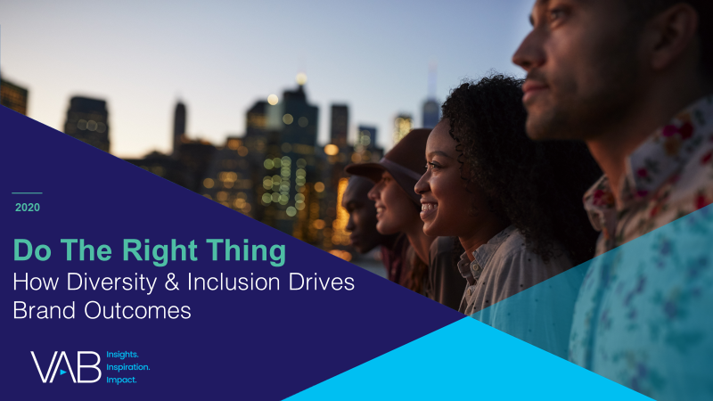




Empathize with consumers by providing relevant products
and services tailored to their specific needs
4
Delivering on the unique desires of a specific segment can result in deeper engagement across all audiences
Click here for the full report
Microsoft aired a :60 ad during Super Bowl LIII showcasing their latest Xbox Adaptive Controller. Entitled ‘We Will Win,’ the spot featured a handful of children with physical disabilities who talked about their love of video games and how these games allow them to bond with their friends.
The message was one of inclusion and empowerment for young people with disabilities and the ad ended with the inspirational line, ‘when everybody plays, we all win.’
Results: Microsoft invested over $10 million to air this one-minute spot once during the Super Bowl and with such a large, captive audience its no surprise this garnered the highest viewer attention for an Xbox ad during our measurement period.
Business Outcomes
Ad Attention Score: 98.8
On average, the ad was viewed for 99% of its duration before interruption.
Brand Attention Index: 188
88% fewer interruptions than the average Xbox ad during the measured time period.
Attention Ranking: #1
Ad ranked #1 in viewer attention among 116 Xbox ads that aired between 1/1/16 – 6/30/20.
‘We All Win’ TV spot - $10.4 MM
1 Airing (Super Bowl LIII): 2/3/19
95.5 MM HH IMPs
click banner above images to watch spot
Source: VAB analysis of iSpot.tv TV occurrence data and attention analytics, time period: 1/1/16 – 6/30/20, estimated media spend. Impressions represent US TV HHs and include activity within measured national broadcast and cable TV linear, national time-shifted, local, VOD and OTT. Attention scoring is based on national aired impressions viewed live/same day and played from the beginning. Interruptions = changing the channel, skipping the ad (via DVR), turning off the TV device or pulling up the programming guide.
This information is exclusively provided to VAB members and qualified marketers. Further distribution is prohibited.
PAGE 8

Slide 9
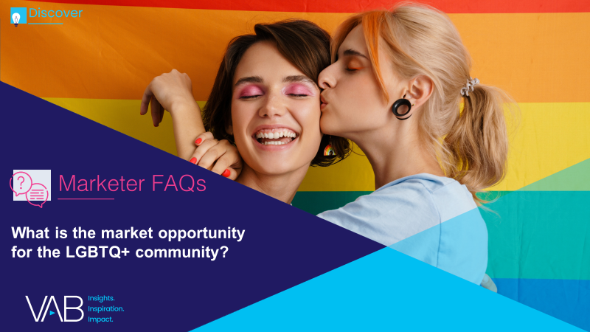
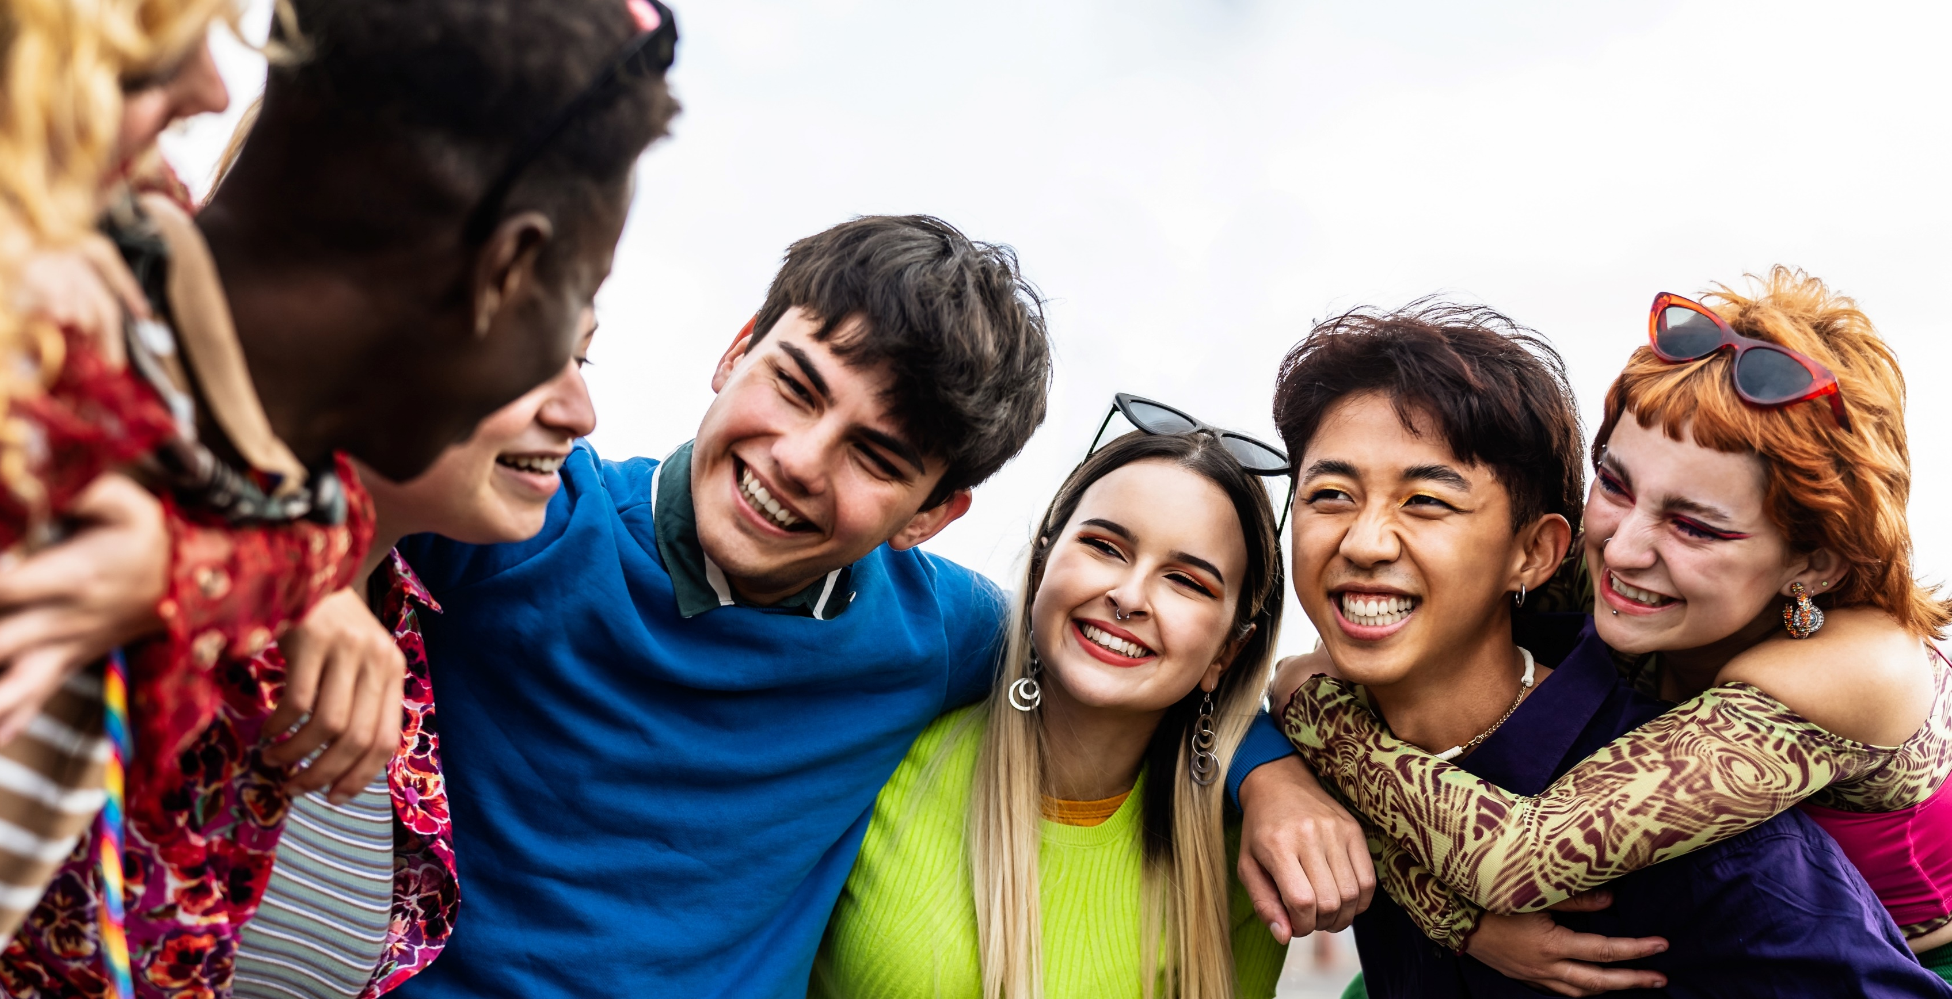
Expand inclusivity messaging beyond individual segments
to create deeper connections across audiences by engaging ‘allies’ and ‘advocates’ as well
5
Click here for the full report
Supporting a specific segment of the population can generate ripple effects well beyond that one group and resonate with a wider circle of allies and advocates who want to see others acknowledged and celebrated
5.3%
% of the U.S. A18+ population
that identifies as LGBTQ+
% of A18+ who agree with the following statements*
61%
‘I believe brands should support the LGBTQ community all year, not just during gay pride month’
60%
‘Today, I think most companies / brands should support the LGBTQ community’
% of that are supportive of the LGBTQ community*
68%
(A18+)
80%
(A18-24)
72%
(A25-44)
46%
‘I am more likely to purchase a product / service from a company / brand that supports the LGBTQ community’
64%
(A45-64)
59%
(A65+)
Source: Source: VAB analysis of MRI-Simmons Winter 2022 Study. LGBTQ represents A18+ that identify as LGBTQ. *MRI-Simmons, LGBTQ and Gender Identity Study, October 2021. Based on respondents who ‘strongly agree’ or ‘somewhat agree.’
This information is exclusively provided to VAB members and qualified marketers. Further distribution is prohibited.
PAGE 9

Slide 10

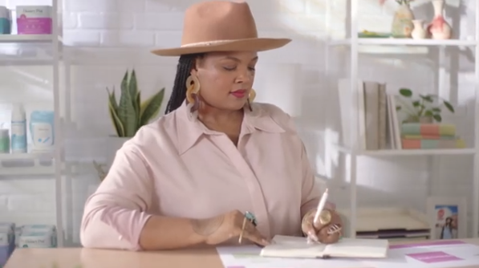
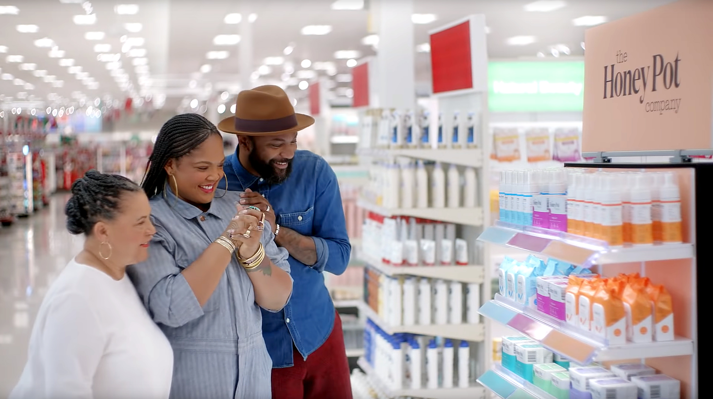

Act by establishing your brand’s position as an ally and advocate through purposeful partnerships
6
Consumers engage more with brands that strive to empower, and stand in solidarity with, them and their community
Click here for the full report
Target released an ad entitled ‘Entrepreneur: The Honey Pot’ as part of their ‘Founders We Believe In’ series. The spot featured Beatrice Dixon, owner of The Honey Pot, who talked about how difficult it was for her to start her own company, while expressing gratitude to Target for helping her overcome obstacles and paving the way for her to get shelf space in other retailers.
Results: One of the highest attention scores of all Target ads, Honey Pot sales increased 20-30% across its retailers a month after the campaign launched.
Business Outcomes
Ad Attention Score: 96.8
On average, the ad was viewed for 97% of its duration before interruption.
Brand Attention Index: 170
70% fewer interruptions than the average Target ad during the measured time period.
Brand Attention Ranking: #8
Ad ranked #8 in viewer attention among 296 Target ads that aired between 1/1/16 – 6/30/20.
‘Entrepreneur: The Honey Pot’ TV spot - $15.3 MM
6-Week Flight: 2/1/20 – 3/16/20
4,473 Airings / 1,244.8 MM HH IMPs
click banner above images to watch spot
Source: VAB analysis of iSpot.tv TV occurrence data and attention analytics, time period: 1/1/16 – 6/30/20, estimated media spend. Impressions represent US TV HHs and include activity within measured national broadcast and cable TV linear, national time-shifted, local, VOD and OTT. Attention scoring is based on national aired impressions viewed live/same day and played from the beginning. Interruptions = changing the channel, skipping the ad (via DVR), turning off the TV device or pulling up the programming guide.
This information is exclusively provided to VAB members and qualified marketers. Further distribution is prohibited.
PAGE 10

Slide 11
6 Strategies for Developing Inclusive Campaigns That Drive Outcomes
1
2
3
Recognize the importance of creating culturally diverse advertising to heighten relevancy across all audiences
Understand the nuance of diverse consumers to create campaigns that are truly relevant to them, whether through relatable stories or in-language messaging
Customize creative messaging with personalized and authentic stories to drive attention
4
5
6
Empathize with consumers
by providing relevant products
and services tailored to their specific needs
Expand inclusivity messaging beyond individual segments
to create deeper connections across audiences by engaging ‘allies’
and ‘advocates’ as well
Act by establishing your brand’s position as an ally and advocate through purposeful partnerships
This information is exclusively provided to VAB members and qualified marketers. Further distribution is prohibited.
PAGE 11

Slide 12

Authentic inclusivity messaging can resonate well beyond individual groups as people from all audiences want to see advertising that accurately reflects the evolving demographics of today’s consumers across races, cultures, identities and abilities.
Brands that establish themselves as an advocate for diverse audiences can build deeper connections with all consumers and generate stronger engagement and outcomes.
Key Marketer Takeaways
This information is exclusively provided to VAB members and qualified marketers. Further distribution is prohibited.
PAGE 12

Slide 13
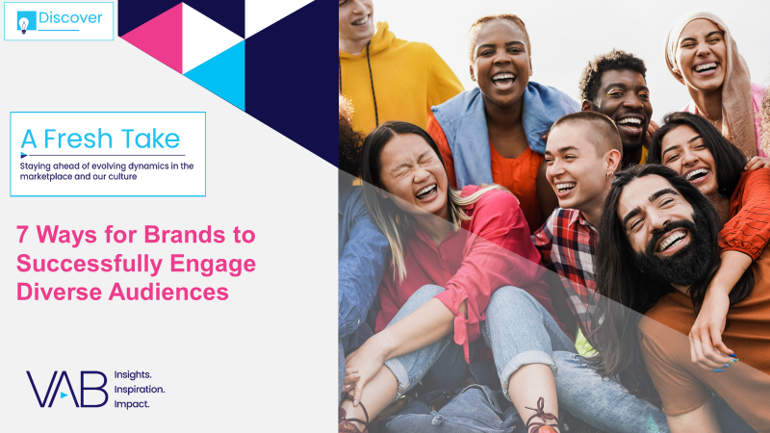
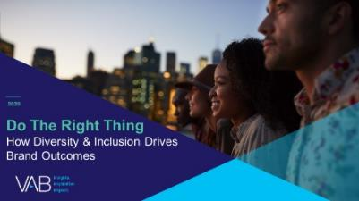
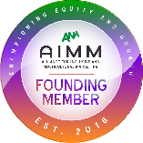
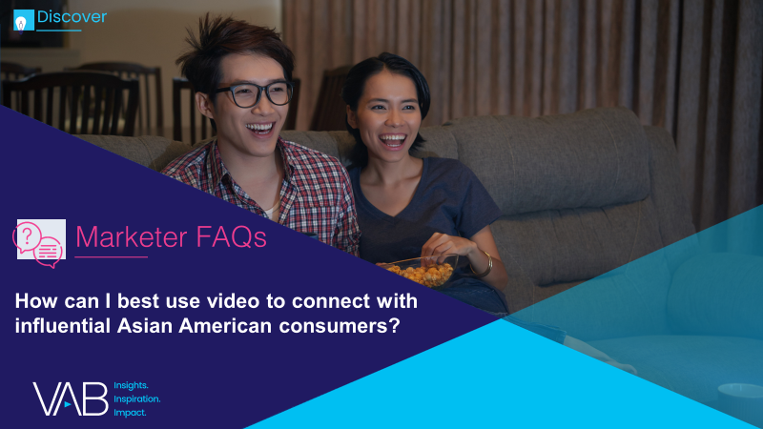
Creators
Jason Wiese
Leah Montner-Dixon
SVP, Director of Strategic Insights
jasonw@thevab.com
Associate Insights Director
leahm@thevab.com
7 Ways for Brands to Successfully Engage Diverse Audiences
How will engaging Hispanic shoppers help me win the holiday season?
Discover more
Looking for more data, insights and takeaways? Check out this related VAB content
How does on-screen representation deepen engagement with Black consumers and drive business impact for brands?
Do The Right Thing
How Diversity & Inclusion Drives Brand Outcomes
We are committed to providing marketers with the data and insights they need to develop thoughtful, inclusive campaigns & strategies. To find out more on the unique media consumption behaviors and cultural trends of multicultural consumers, visit the VAB’s Multicultural Marketing Resource Center.
How can I best use video to connect with influential Asian American consumers?
What is the market opportunity for the LGBTQ+ community?
VAB Members, brand marketers and agencies get free and immediate access to VAB’s content library. Get access at theVAB.com
This information is exclusively provided to VAB members and qualified marketers. Further distribution is prohibited.

Slide 14


About VAB
VAB is an insights-driven organization that inspires marketers to reimagine their media strategies resulting in fully informed decisions.
Drawing on our marketing expertise, we simplify the complexities in our industry and discover new insights that transform the way marketers look at their media strategy.
We are committed to your business growth and proud to offer VAB members, brand marketers and agencies complimentary access to our continuously-growing Insights library. Get immediate access at theVAB.com.
Curious to learn more about VAB? Check out this quick video to see what we do and how we can help you develop business-driving marketing strategies.
This information is exclusively provided to VAB members and qualified marketers. Further distribution is prohibited.
PAGE 14

