Slide 1





Recipe for Success
Six Key Ingredients For Stirring Growth in Streaming

Slide 2


The secret ingredients for streaming success.
In highly competitive categories, building a successful business
can be quite complex but those with trade secrets have a distinct competitive advantage.
Much like restaurants that build success through a ‘secret recipe,’ we created a recipe for success in streaming backed by supporting data compiled from a year-long custom research partnership with Hub Entertainment Research.
Based on our insights, this recipe is made up of several ingredients which all do their part in successfully scaling streaming services across audiences that can also attract meaningful marketers’ advertising investments.
Continue reading as we delve into six key ingredients for
streaming success.
This information is exclusively provided to VAB members and qualified marketers.
PAGE 2

Slide 3
The List: Marketers and platforms can each leverage six key ingredients, and their components, to find success in streaming
2
3
4
5
6
1
Engagement
Diversified Content Offerings
Loyalty
&
Retention
Cross-Platform Content Discovery
Innovative Ad Experiences
High-Quality Content
TV is Premium
Appointment Viewing
FAST
Customer Acquisition
Social Video Influencer
Innovative Ad Formats
Streaming is TV
Optionality
Live Sports
Customer Retention
Shoppable Ads
Consumer Choice
Women’s Sports
Branded Integrations
Habitual Viewing
Binge Viewing
Content Preference
This information is exclusively provided to VAB members and qualified marketers.
PAGE 3

Slide 4
Ingredient #1: Streaming delivers high-quality content across all platforms and devices
As we’ve illustrated recently in ‘Prioritize Quality’ and ‘The Consumer Connection,’ marketers that invest in high-quality content for their video ad campaigns can enhance their brand perception and drive higher engagement, increased business outcomes and greater long-term brand value.
High-Quality Content
Engagement
Diversified Content Offerings
Loyalty
&
Retention
Cross-Platform Content Discovery
Innovative Ad Experiences
1
2
3
4
5
6
This information is exclusively provided to VAB members and qualified marketers.
PAGE 4

Slide 5




TV is Premium
Consumers equate ‘TV’ to high-quality content that features compelling stories with complex characters played by professionals
Which of the following statements are how you would define ‘TV’?
% of total respondents
33%
31%
28%
27%
Professionally produced, high budget, high production value
Professional actors and actresses featured
Emotionally compelling stories and narratives
Complex character and story development
Source: VAB custom research fielded by Hub Entertainment Research as part of the 2023 Best Bundle report. Data sourced from Hub’s survey of 1,603 TV consumers, ages 16-74 who meet the following criteria: watch at least one hour of TV / week, have broadband access. U.S. census balanced. Data collected March 2023. Q: Which of the following statements are how you would define ‘TV’?
This information is exclusively provided to VAB members and qualified marketers.
PAGE 5

Slide 6



Streaming is TV
Long-form streaming content is now central to what people view as ‘TV,’ regardless of the platform or device they watch it on
Which of the following statements are how you would define ‘TV’?
% of total respondents
43%
30%
24%
Video content I watch on my TV set, regardless of how I access it
Long-form content
Video content I can watch on any device
Source: VAB custom research fielded by Hub Entertainment Research as part of the 2023 Best Bundle report. Data sourced from Hub’s survey of 1,603 TV consumers, ages 16-74 who meet the following criteria: watch at least one hour of TV / week, have broadband access. U.S. census balanced. Data collected March 2023. Q: Which of the following statements are how you would define ‘TV’? Note: Long-form content = longer than 10 minutes
This information is exclusively provided to VAB members and qualified marketers.
PAGE 6

Slide 7
Ingredient #2: Successful services are engaging consumers through a variety of ‘viewer-first’ streaming experiences
As highlighted in our comprehensive guide, ‘You Oughta Know,’ engagement heightens a brands’ memorability, increasing the likelihood that a consumer will notice, recognize and think about your brand in buying situations.
High-Quality Content
Engagement
Diversified Content Offerings
Loyalty
&
Retention
Cross-Platform Content Discovery
Innovative Ad Experiences
1
2
3
4
5
6
This information is exclusively provided to VAB members and qualified marketers.
PAGE 7

Slide 8


Appointment Viewing
Streaming reaches highly-attentive viewers who prioritize watching their favorite programs when relaxing at home
Which of the following statements apply to you when you watch something on streaming / TV platforms?
% of respondents, by age
Regularly set aside time in my schedule to
watch my favorite content
Regard watching content on these platforms
as my ‘me time’
37% / 34% / 43% / 56%
38% / 34% / 36% / 37%
Source: VAB custom research fielded by Hub Entertainment Research as part of the 2023 Video Redefined report. Data sourced from Hub’s survey of 1,900 consumers, ages 13-74. Data collected December 2023. Q: Which of the following statements apply to you when you watch something on the following platforms? Note: P13+ for ‘Regularly set aside time in my schedule to watch my favorite content = 43% and ‘Regard watching content on these platforms as my ‘me time’’ = 36%
This information is exclusively provided to VAB members and qualified marketers.
PAGE 8

Slide 9

Optionality
Since ‘free time’ can be fluid, viewers - especially busy young pros - like having the ability to stream programs when they want
% of respondents who agree with the following statements regarding
how you like to watch your favorite streaming / TV shows
% of respondents, by age
I like to watch on-demand so I can watch on my schedule
I like to watch TV shows at the time of their broadcast, or streaming shows as soon as they are available, rather than waiting
Source: VAB custom research fielded by Hub Entertainment Research as part of the 2023 Evolution of Video Branding report. Data sourced from Hub’s survey of 2,400 TV consumers, ages 16-74 who meet the following criteria: watch at least one hour of TV / week, have broadband access. U.S. census balanced. Data collected early February 2023. Q: How much do you agree with the following statements regarding how you like to watch your favorite streaming / TV shows?
This information is exclusively provided to VAB members and qualified marketers.
PAGE 9

Slide 10


Consumer Choice
Choice is important to viewers who appreciate the ability to either access all episodes on their own time or follow a weekly release ritual
What cadence of episode releases for your favorite shows do you prefer from streaming services?
% total respondents
73%
‘I like when streaming services
release all episodes at once’
52%
‘I like when streaming services release episodes weekly, rather than a whole season all at once,
similar to traditional TV schedules’
Source: VAB custom research fielded by Hub Entertainment Research as part of the 2023 Evolution of Video Branding report. Data sourced from Hub’s survey of 2,400 TV consumers, ages 16-74 who meet the following criteria: watch at least one hour of TV / week, have broadband access. U.S. census balanced. Data collected early February 2023. Q: How much do you agree with the following statements regarding how you prefer to watch your favorite streaming / TV shows?
This information is exclusively provided to VAB members and qualified marketers.
PAGE 10

Slide 11


Consumer Choice
Diverse audiences are more likely to enjoy weekly episode releases as it creates more of a ‘social event’ among their friends and family
What cadence of episode releases for your favorite shows do you prefer from streaming services?
% of total respondents, by race / ethnicity
‘I like when streaming services
release all episodes at once’
‘I like when streaming services release episodes weekly, rather than a whole season all at once,
similar to traditional TV schedules’
78% / 72% / 71%
57% / 67% / 47%
Hispanic
NH Black
NH White
Hispanic
NH Black
NH White
Source: VAB custom research fielded by Hub Entertainment Research as part of the 2023 Evolution of Video Branding report. Data sourced from Hub’s survey of 2,400 TV consumers, ages 16-74 who meet the following criteria: watch at least one hour of TV / week, have broadband access. U.S. census balanced. Data collected early February 2023. Q: How much do you agree with the following statements regarding how you prefer to watch your favorite streaming / TV shows? Note: NH Black represents Non-Hispanic Black and NH White represents Non-Hispanic White.
This information is exclusively provided to VAB members and qualified marketers.
PAGE 11

Slide 12

Habitual Viewing
As a highlight of their ‘me time’ with others, diverse audiences are also more likely to appreciate the anticipation of weekly episodic releases
“I like when streaming services release episodes weekly because
it gives me something to look forward to”
% of total respondents, by race / ethnicity
NH Black
Hispanic
74%
65%
NH White
58%
Source: VAB custom research fielded by Hub Entertainment Research as part of the 2023 Evolution of Video Branding report. Data sourced from Hub’s survey of 2,400 TV consumers, ages 16-74 who meet the following criteria: watch at least one hour of TV / week, have broadband access. U.S. census balanced. Data collected early February 2023. Q: How much do you agree with the following statements regarding how you prefer to watch your favorite streaming / TV shows? Note: NH Black represents Non-Hispanic Black and NH White represents Non-Hispanic White.
This information is exclusively provided to VAB members and qualified marketers.
PAGE 12

Slide 13


Binge Viewing
Although many adults binge shows, young professionals especially enjoy the social currency that ‘being the first to watch’ provides
% of respondents who agree with the following statements regarding binge watching
% of respondents, by age
‘I like watching on-demand so I can
binge multiple episodes in one sitting’
‘I like to binge-watch when a streaming service releases all episodes at once so I can be the first one among my friends to know what happens during an entire series’
77% / 85% / 77% / 53%
69% / 82% / 66% / 40%
Source: VAB custom research fielded by Hub Entertainment Research as part of the 2023 Evolution of Video Branding report. Data sourced from Hub’s survey of 2,400 TV consumers, ages 16-74 who meet the following criteria: watch at least one hour of TV / week, have broadband access. U.S. census balanced. Data collected early February 2023. Q: How much do you agree with the following statements regarding how you prefer to watch your favorite streaming / TV shows?
This information is exclusively provided to VAB members and qualified marketers.
PAGE 13

Slide 14


Content Preference
While young audiences enjoy social videos, over two-thirds of P16-34 spend more time, and are more engaged, with long-form programming
How much do you agree or disagree with the following statements regarding short-form content?
% P16-24 / P25-34 respondents
65% / 75%
‘I spend more time watching professionally
produced long-form programming through streaming and TV than short-form video content
on social media platforms’
66% / 71%
‘Watching professionally produced, long-form programming through streaming and TV is
more engaging to me than short-form,
user-generated videos on social media platforms’
of P16-24 agree that…
of P25-34 agree that…
of P16-24 agree that…
of P25-34 agree that…
Source: VAB custom research fielded by Hub Entertainment Research as part of the 2023 Evolution of Video Branding report. Data sourced from Hub’s survey of 2,400 TV consumers, ages 16-24 & P25-34 who meet the following criteria: watch at least one hour of TV / week, have broadband access. U.S. census balanced. Data collected early February 2023. Q: How much do you agree with the following statements?
This information is exclusively provided to VAB members and qualified marketers.
PAGE 14

Slide 15
Ingredient #3: Successful streaming services are diversifying their content offerings to increase their user base and optimize platform reach
Also highlighted in our comprehensive guide, ‘You Oughta Know,’ is the need for platforms to have scale to garner attention for their advertisers which drives greater ad recall and message association that enables brands to form relationships with consumers and move them closer to consideration.
High-Quality Content
Engagement
Diversified Content Offerings
Loyalty
&
Retention
Cross-Platform Content Discovery
Innovative Ad Experiences
1
2
3
4
5
6
This information is exclusively provided to VAB members and qualified marketers.
PAGE 15

Slide 16
FAST
Consumers’ appetite for high-quality video content have drawn many to FAST services which offer a wide array of programming at no cost
Which of the following are the reasons for why you have
watched / signed up for a free ad-supported streaming TV service?
% of total respondents
The ability to access free content I want to see in exchange for watching ads
A specific TV program or movie I wanted to see
Easy access to a large library of 'classic’ programming at any time
The wide variety of content offered which complements my other video subscriptions
Source: VAB custom research fielded by Hub Entertainment Research as part of the 2023 Evolution of Video Branding report. Data sourced from Hub’s survey of 2,400 TV consumers, ages 16-74 who meet the following criteria: watch at least one hour of TV / week, have broadband access. U.S. census balanced. Data collected early February 2023. Q: Which of the following are reasons for why you have watched / signed up for a free ad-supported streaming TV service?
This information is exclusively provided to VAB members and qualified marketers.
PAGE 16

Slide 17




FAST
As cord-cutting continues, consumers – especially older ones – like FAST because of its’ cable-like experience without the commitment
Which of the following are the reasons for why you have
watched / signed up for a free ad-supported streaming TV service?
% of respondents, by age
The ability to access free content I want to see in exchange for watching ads
A specific TV program
or movie I wanted to see
Easy access to a large library
of 'classic’ programming
at any time
The nostalgia of being able
to see TV shows again that I grew up watching
41% / 36% / 43% / 47%
40% / 35% /
43% / 49%
34% / 28% /
35% / 46%
30% / 26% / 31% / 37%
Source: VAB custom research fielded by Hub Entertainment Research as part of the 2023 Evolution of Video Branding report. Data sourced from Hub’s survey of 2,400 TV consumers, ages 16-74 who meet the following criteria: watch at least one hour of TV / week, have broadband access. U.S. census balanced. Data collected early February 2023. Q: Which of the following are reasons for why you have watched / signed up for a free ad-supported streaming TV service?
This information is exclusively provided to VAB members and qualified marketers.
PAGE 17

Slide 18
Live Sports
More than half of all viewers have streamed live sports as access grows and the number of events available across services proliferate
Have you streamed sports in the last 12 months?
% of demos that have streamed sports in the last 12 months
P16-24
P25-34
65%
65%
P35-54
P55-74
59%
37%
Source: VAB custom research fielded by Hub Entertainment Research as part of the 2023 Decoding the Default report. Data sourced from Hub’s survey of 1,601 TV consumers, ages 16-74 who meet the following criteria: watch at least one hour of TV / week, have broadband access. U.S. census balanced. Data collected August 2023. Q: Have you streamed a live sporting event using any of the following methods in the last 12 months?
This information is exclusively provided to VAB members and qualified marketers.
PAGE 18

Slide 19
Live Sports
Multiscreen TV platforms hold key broadcast rights with many sports leagues, making them a premier destination for live sports streaming
What methods have you used to stream a live sporting event in the last 12 months?
% of sports streamers, select all that apply
Streaming TV*
(MVPD, vMVPD and TV Networks)
Subscription streaming service
(e.g., Peacock, Paramount+, ESPN+, Apple TV+, Amazon Prime)
Sports-league specific streaming service
(e.g., NFL+, MLB.TV, NBA League Pass)
Free streaming service
(e.g., Tubi, Pluto TV)
Source: VAB custom research fielded by Hub Entertainment Research as part of the 2023 Decoding the Default report. Data sourced from Hub’s survey of 1,601 TV consumers, ages 16-74 who meet the following criteria: watch at least one hour of TV / week, have broadband access. U.S. census balanced. Data collected August 2023. Q: Have you streamed a live sporting event using any of the following methods in the last 12 months? Base: Sports Streamers (Have streamed sports in the last 12 months). *Streaming TV represents an unduplicated response of: Cable provider’s authenticated app, TV network app authenticated using cable subscription, TV network broadcast app and vMVPD subscription
This information is exclusively provided to VAB members and qualified marketers.
PAGE 19

Slide 20
Women’s Sports
Women’s sports is a significant growth engine as representation has increased dramatically along with year-round interest and viewership
% of those who watch the following women’s sports events on streaming or TV
% of sports viewers, by age
Summer Olympics
(gymnastics, track & field, softball, etc.)
42%
Winter Olympics
(alpine skiing, figure skating, curling, etc.)
FIFA Women’s World Cup
Women's NCAA March Madness
Women's Tennis Grand Slam
(Wimbledon, French Open)
of females (16+) have streamed sports
in the last 12 months
WNBA Playoffs
NCAA Softball Women’s College World Series
Women's MMA
Other NCAA Women's Sports Championships
(volleyball, field hockey, soccer etc.)
Women's LPGA Majors
(U.S. Women's Open, Women's PGA Championship)
Source: VAB custom research fielded by Hub Entertainment Research as part of the 2023 Monetizing Video report. Data sourced from Hub’s survey of 1,602 consumers, self-identified active sports viewers (TV or streaming) ages 18-54 who meet the following criteria: watch at least one hour of TV / week, have broadband access. U.S. census balanced. Data collected June 2023. Q: Do you watch the following women’s sport events on streaming or TV?
Source: XX
XX
XX
This information is exclusively provided to VAB members and qualified marketers.
PAGE 20

Slide 21
Ingredient #4: Successful streaming services are building deep libraries and creative bundling options to foster customer loyalty and retention
As we laid out the challenges last year in ‘Staying Ahead of the Churn,’ streaming services need to have strong customer acquisition, loyalty and retention strategies to mitigate churn and create stable audience scale for marketers’ ad investments in this competitive landscape.
High-Quality Content
Engagement
Diversified Content Offerings
Loyalty
&
Retention
Cross-Platform Content Discovery
Innovative Ad Experiences
1
2
3
4
5
6
This information is exclusively provided to VAB members and qualified marketers.
PAGE 21

Slide 22
Customer Acquisition
Consumers are looking for value through an abundance of content, new and acquired, and ‘getting a deal’ when subscribing to a service
How much would each of the following impact the likelihood of you subscribing to a streaming service?
% of respondents, sorted by top 2 box
Major Impact | Moderate Impact
Exclusive original content
Access to other streaming services at a discount
Free trials
Older content that originally aired on other TV networks or streaming services
Ability to share passwords with friends / family
for no extra cost
Source: VAB custom research fielded by Hub Entertainment Research as part of the 2023 Best Bundle report. Data sourced from Hub’s survey of 1,603 TV consumers, ages 16-74 who meet the following criteria: watch at least one hour of TV / week, have broadband access. U.S. census balanced Data collected March 2023. Q: How much would each of the following items impact the likelihood of you subscribing to a streaming service? Respondents who answered ‘major impact’ or ‘moderate impact’. ‘Major impact’ and ‘moderate impact’ might not add up to top 2 box total due to rounding.
This information is exclusively provided to VAB members and qualified marketers.
PAGE 22

Slide 23




Customer Retention
Bundling of retail or other streaming service subscriptions along with the flexibility to shift across tiers can mitigate streaming churn
Which of the following incentives, if any, would motivate you to continue subscribing to a streaming service?
% of total respondents
Free access to other, non-TV benefits
(e.g., Walmart+, Amazon Prime)
Access to other streaming services
at a discount
Ability to switch to a lower-priced ad-supported tier or see even more ads for a lower cost
37%
33%
26%
Exclusive benefits for premium subscribers or frequent users of a service
Ability to watch live sporting events
25%
25%
Source: VAB custom research fielded by Hub Entertainment Research as part of the 2023 Best Bundle report. Data sourced from Hub’s survey of 1,603 TV consumers, ages 16-74 who meet the following criteria: watch at least one hour of TV / week, have broadband access. Data collected early February 2023. Q: Which of the following incentives, if any, would motivate you to continue subscribing to a streaming service?
This information is exclusively provided to VAB members and qualified marketers.
PAGE 23

Slide 24
Ingredient #5: Social video has been a successful tool in driving content discovery across audiences for streaming shows and services
As we explored last year in ‘The Odyssey of Content Discovery,’ finding ‘what to watch’ has never been more challenging than it is today, but cross-platform strategies - like the use of social video – aid in creating awareness and building audiences especially among young, diverse segments.
High-Quality Content
Engagement
Diversified Content Offerings
Loyalty
&
Retention
Cross-Platform Content Discovery
Innovative Ad Experiences
1
2
3
4
5
6
This information is exclusively provided to VAB members and qualified marketers.
PAGE 24

Slide 25

Social Video Influencers
Social video and influencers are popular with young audiences which creates opportunities to drive fans to discover shows on streaming
Have you ever tuned into a show on a streaming service or TV network because of watching a short video or influencer on a social media platform?
% total respondents, by age
P16+
28%
P16-24
P25-34
43%
42%
Source: VAB custom research fielded by Hub Entertainment Research as part of the 2023 Decoding the Default report. Data sourced from Hub’s survey of 1,601 TV consumers, ages 16-74 who meet the following criteria: watch at least one hour of TV / week, have broadband access. U.S. census balanced. Data collected August 2023. Q: Have you ever tuned into a show on a streaming service or TV network as a result of watching a short video or influencer on a social media platform?
This information is exclusively provided to VAB members and qualified marketers.
PAGE 25

Slide 26
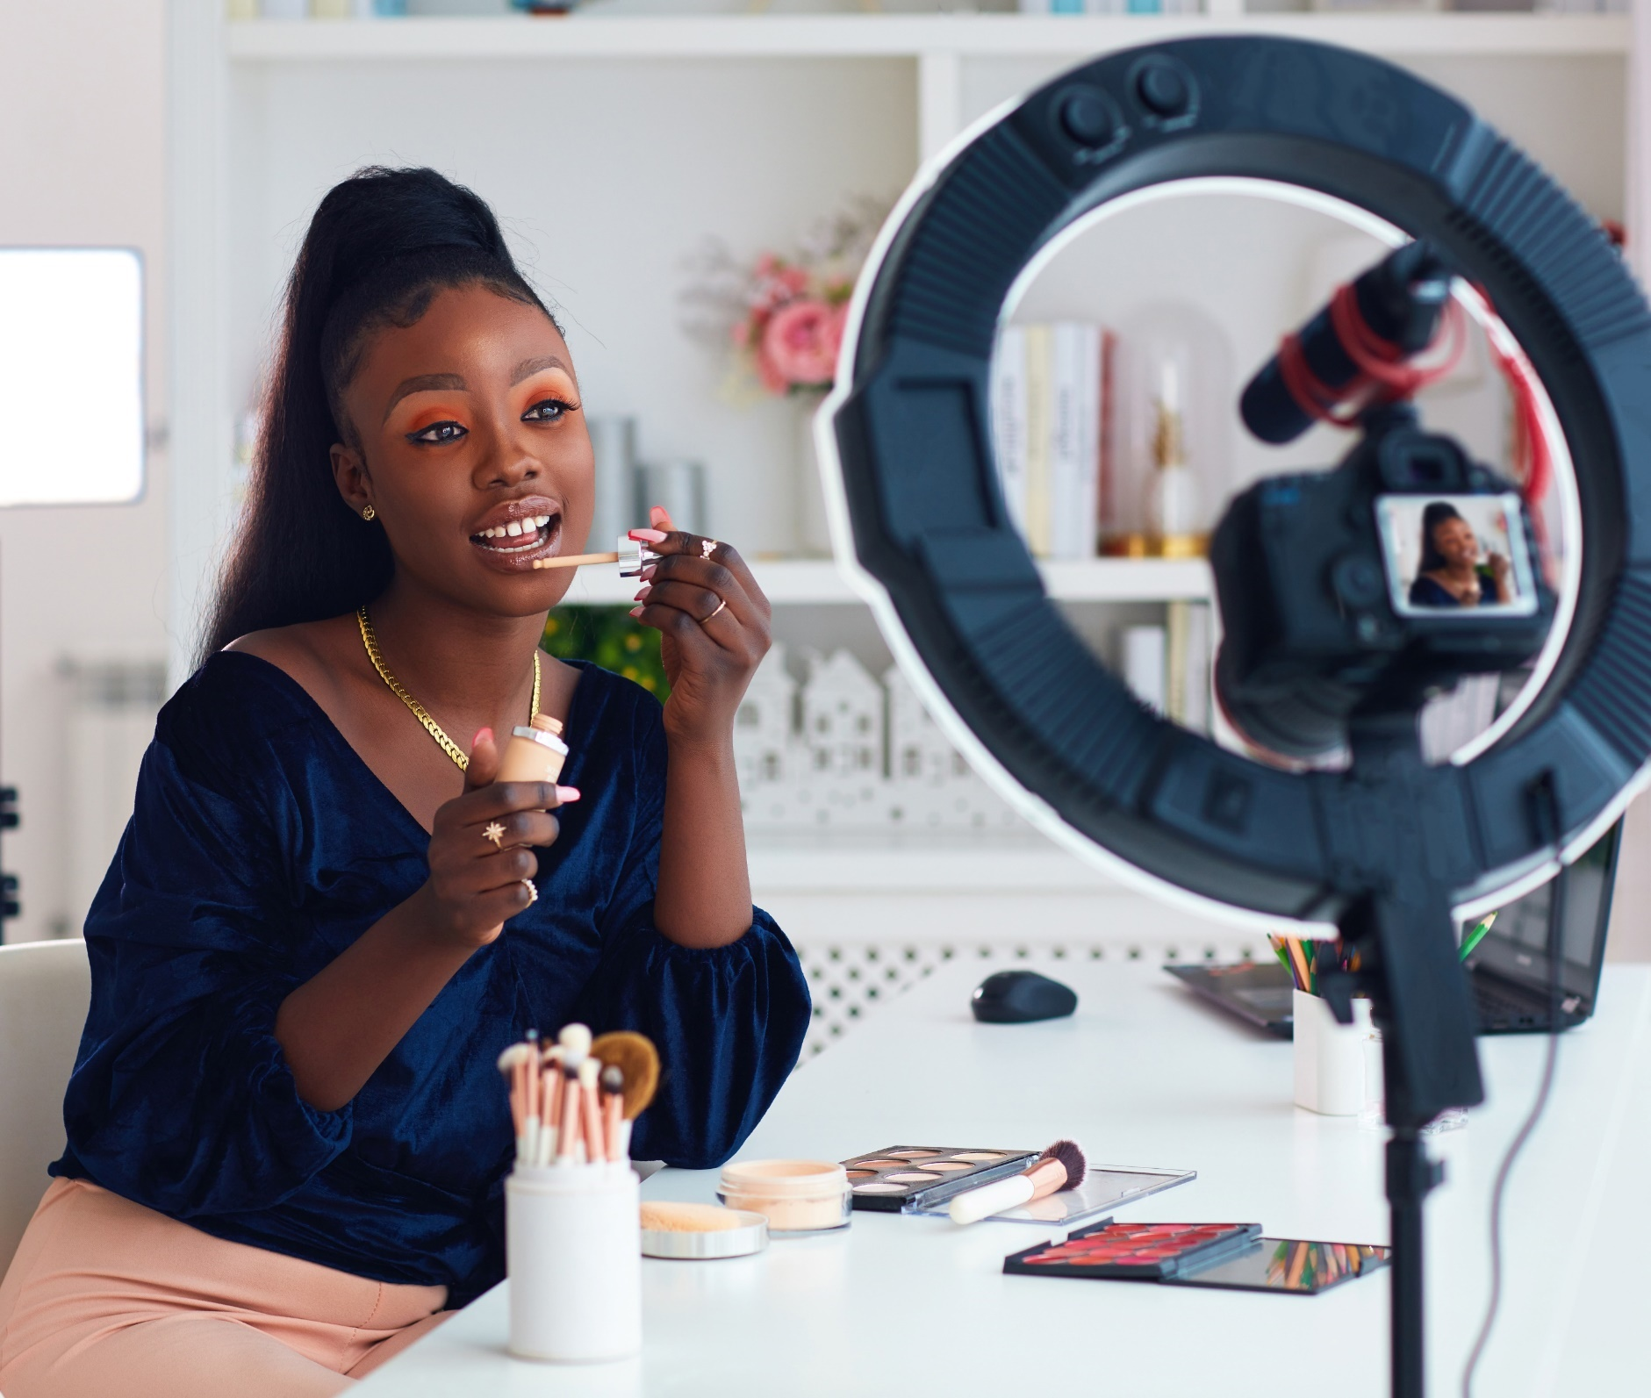
Social Video Influencers
Diverse audiences are heavy social media users who are much more likely to discover streaming shows through social video or influencers
Have you ever tuned into a show on a streaming service or TV network because of watching a short video or influencer on a social media platform?
% total respondents, by race / ethnicity
Hispanic
NH Black
+58%
more likely than
NH White respondents
(38% vs. 24%)
+38%
more likely than
NH White respondents
(33% vs. 24%)
Source: VAB custom research fielded by Hub Entertainment Research as part of the 2023 Decoding the Default report. Data sourced from Hub’s survey of 1,601 TV consumers, ages 16-74 who meet the following criteria: watch at least one hour of TV / week, have broadband access. U.S. census balanced. Data collected August 2023. Q: Have you ever tuned into a show on a streaming service or TV network as a result of watching a short video or influencer on a social media platform? Note: NH Black = Non-Hispanic Black and NH White = Non-Hispanic White.
This information is exclusively provided to VAB members and qualified marketers.
PAGE 26

Slide 27
Ingredient #6: Streaming services are creating a selection of innovative ad experiences to actively engage viewers and drive consumer action
As we’ve recently highlighted in ‘Embrace Innovation’ and ‘Shortening the Path to Purchase,’
innovative ad experiences enhance streaming as a high-performance channel that ignites full-funnel outcomes while also providing marketers with inventive ways to increase engagement with customers.
High-Quality Content
Engagement
Diversified Content Offerings
Loyalty
&
Retention
Cross-Platform Content Discovery
Innovative Ad Experiences
1
2
3
4
5
6
This information is exclusively provided to VAB members and qualified marketers.
PAGE 27

Slide 28

Innovative Ad Formats
Streaming ad units beyond ‘traditional’ :15s & :30s such as ‘pause’ ads drive consumer engagement and action
Which of the following actions have you taken after seeing a pause ad
% of total respondents
Used a search engine to look up more information on a product or service I saw advertised
51%
Talked to friends/family about a product or service I saw advertised
Saved information about a product or service I saw advertised for future reference
of viewers have taken some sort of action after seeing a pause ad
Visited a brand's social media page to learn more
(19% of respondents recall seeing an ad that appears on the screen when a program is paused)
Source: VAB custom research fielded by Hub Entertainment Research as part of the 2023 Monetizing Video report. Data sourced from Hub’s survey of 1,602 consumers, ages 16-74 who meet the following criteria: watch at least one hour of TV / week, have broadband access. U.S. census balanced. Data collected June 2023. Q: Which of the following types of ad formats do you recall seeing when watching TV (including: TV and streaming)? Q: [Ads that appear on the screen when a program is paused (pause ads)] (Have seen) Which of the following actions have you taken after seeing the following types of ads?
This information is exclusively provided to VAB members and qualified marketers.
PAGE 28

Slide 29




Interactive Shoppable Ads
Consumers are inherently curious and willing to interact and learn more about products through shoppable ads on their TV sets
% of P16+ who have taken the following actions after seeing a specific type of interactive shoppable ad
% of respondents Total (rank 1-3)
Click to Receive Info to Your Email / Device
Explorable Ads*
‘Click to Buy’ Ads
QR Codes
67%
Have interacted
62%
Have interacted
58%
Have interacted
36%
Have interacted
27%
Used a search engine to look up more information
28%
Used a search engine to look up more information
18%
Used a search engine to look up more information
13%
Visited a website for a product/service to learn more
24%
Visited a website for a product/service to learn more
26%
Saved information for future reference
17%
Purchased a product they
saw advertised
13%
Downloaded an app they
saw on screen
23%
Used a coupon or offer they received from the ad
22%
Visited a website for a product/service to learn more
17%
Visited a brands social media page to learn more
12%
Used a search engine to look up more information
Source: VAB custom research fielded by Hub Entertainment Research as part of the 2023 Monetization of Video report. Data sourced from Hub’s survey of 1,602 TV consumers, ages 16-74 who meet the following criteria: watch at least one hour of TV / week, have broadband access. U.S. census balanced. Data collected June 2023. Q: Which of the following actions have you taken after seeing the following types of ads? *Ads that let you browse different video clips, product types, or information screens.
This information is exclusively provided to VAB members and qualified marketers.
PAGE 29

Slide 30
Interactive Shoppable Ads
Shoppable ads can be tailored to best resonate with engaged audiences like younger adults, HHs with kids and diverse segments
% of P16+ who have taken the following actions after seeing a specific type of interactive shoppable ad
% of respondents Total (rank 1-3)
Click to Receive Info to Your Email / Device
Explorable Ads
‘Click to Buy’ Ads
QR Codes
P16+
67%
Have interacted
62%
Have interacted
58%
Have interacted
36%
Have interacted
HH w/ Kids
NH Black
NH Black
P25-34
+22%
More Likely*
+37%
More Likely
+24%
More Likely
+53%
More Likely
P25-34
HH w/ Kids
Hispanic
P16-24
+9%
More Likely
+26%
More Likely
+12%
More Likely
+33%
More Likely
*How to read: HH w/ Kids are 22% more likely to have interacted with a ‘click to receive info to your email/device ad’ than P16+
Source: VAB custom research fielded by Hub Entertainment Research as part of the 2023 Monetization of Video report. Data sourced from Hub’s survey of 1,602 TV consumers, ages 16-74 who meet the following criteria: watch at least one hour of TV / week, have broadband access. U.S. census balanced. Data collected June 2023. Q: Which of the following actions have you taken after seeing the following types of ads? *Ads that let you browse different video clips, product types, or information screens.
This information is exclusively provided to VAB members and qualified marketers.
PAGE 30

Slide 31

Branded Integrations
Viewers are comfortable with the blending of content and advertising together since they are willing to engage with branded integrations
Which of the following actions have you taken
after seeing promos with an ‘add to watch list’ button?
% of respondents, by age
58%
of viewers have taken some sort of brand action after seeing an ‘add to watch list’ button
(14% of respondents recall seeing promos with an
‘add to watch list’ button)
Source: VAB custom research fielded by Hub Entertainment Research as part of the 2023 Monetizing Video report. Data sourced from Hub’s survey of 1,602 consumers, ages 16-74 who meet the following criteria: watch at least one hour of TV / week, have broadband access. U.S. census balanced. Data collected June 2023. Q: Which of the following types of ad formats do you recall seeing when watching TV (including: TV and streaming)? Q: [Promos with an 'add to watch list' button ] (Have seen) Which of the following actions have you taken after seeing the following types of ads?
This information is exclusively provided to VAB members and qualified marketers.
PAGE 31

Slide 32
The List: Marketers and platforms can each leverage six key ingredients, and their components, to find success in streaming
2
3
4
5
6
1
Engagement
Diversified Content Offerings
Loyalty
&
Retention
Cross-Platform Content Discovery
Innovative Ad Experiences
High-Quality Content
TV is Premium
Appointment Viewing
FAST
Customer Acquisition
Social Video Influencer
Innovative Ad Formats
Streaming is TV
Optionality
Live Sports
Customer Retention
Shoppable Ads
Consumer Choice
Women’s Sports
Branded Integrations
Habitual Viewing
Binge Viewing
Content Preference
This information is exclusively provided to VAB members and qualified marketers.
PAGE 32

Slide 33
Adults over 50 account for 36% of the total population and nearly half of all adults
Six Ingredients Stirring Streaming Successs.
Prioritizing high-quality content within ad campaigns enhances brand perception and drives higher ad engagement, increased business outcomes and greater long-term brand value
Greater engagement heightens a brands’ memorability, increasing the likelihood that a consumer will notice, recognize and think about your brand in buying situations
Platforms with scale will garner more attention for their advertisers which drives greater ad recall and message association that enables brands to form relationships with consumers and move them closer to consideration
Strong customer acquisition, loyalty and retention strategies
can mitigate churn and create stable audience scale
Social videos aids in creating awareness and building audiences especially among young, diverse segments
Innovative ads enhance streaming as a high-performance channel that ignites full-funnel outcomes while also providing marketers with inventive ways to increase engagement
Key Takeaways For Marketers & Streaming Platforms
This information is exclusively provided to VAB members and qualified marketers.
PAGE 33

Slide 34






Want More Data?
Through our custom research, we can cut statements on several demographics for VAB members, just ask!
VAB Member Exclusive
Additional Custom Study Segments Available
Demos
Gender
Kids in Household
P16-24 / P25-34 / P16-34 / P18-34 / P35-54 / P35-74 /
P55-74 / P55-64 / P65-74
Female 16-24 / 25-34 / 16-34 / 35-74
Male 16-24 / 25-34 /
16-34 / 35-74
Kids in HH / No Kids in HH
Kids 0-5 in HH / Kids 6-12 in HH / Kids 13-17 in HH
Ethnicity
Household Income
Non-Hispanic White
Non-Hispanic Black
Hispanic
<$75K+ / $75K+
<$50K / $50K-$74K / $75K - $99K / $100K+
And More Cuts Involving Viewing Behaviors
For additional demo data, please contact info@thevab.com with the desired segments & requested slides
This information is exclusively provided to VAB members and qualified marketers.
PAGE 34

Slide 35

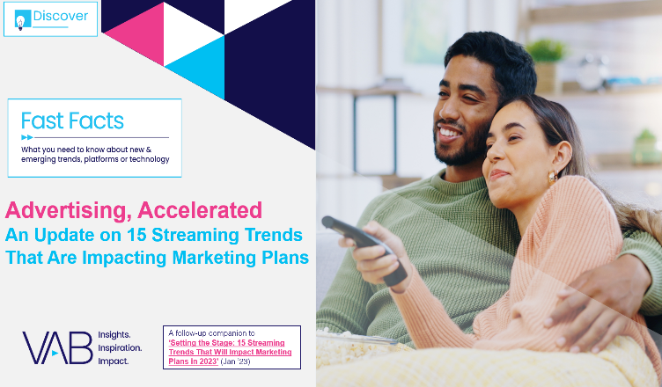
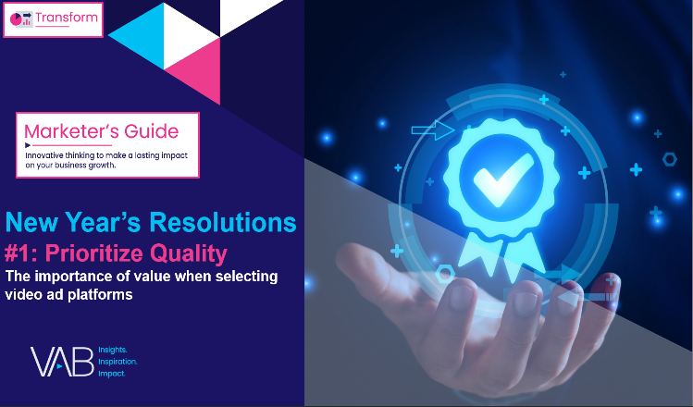
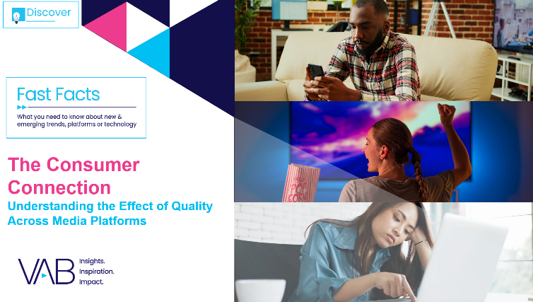
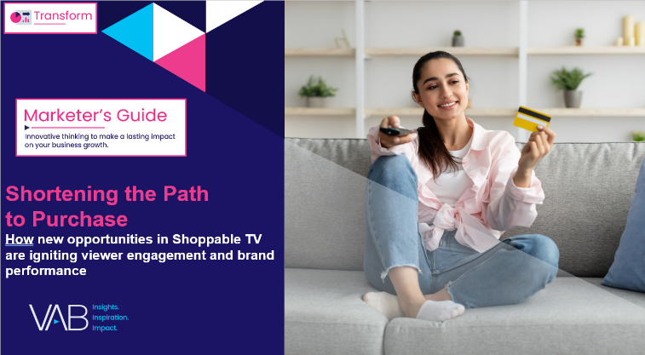
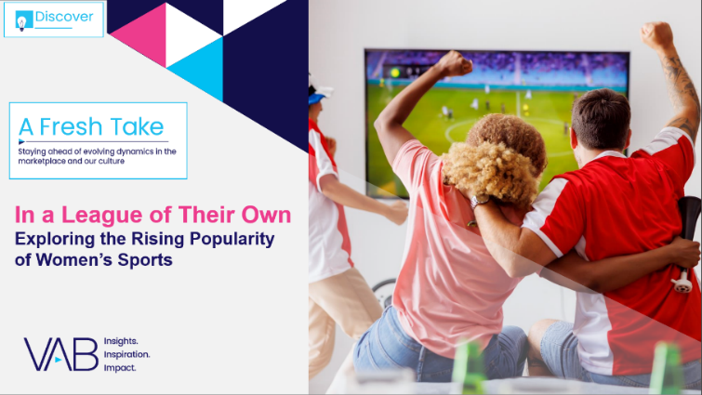
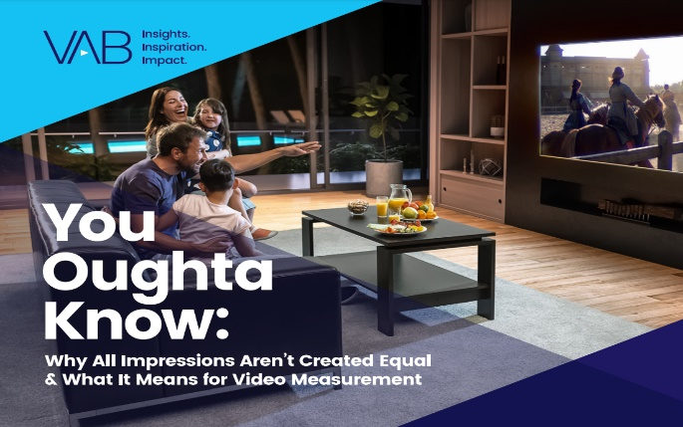

Creators
Jason Wiese
Reed Kiely
SVP, Director of Strategic Insights
jasonw@thevab.com
Director, Data Insights & Trends
reedk@thevab.com
Leah Montner Dixon
Kaileen Cain
Advertising, Accelerated
An Update on 15 Streaming Trends
That Are Impacting Marketing Plans
Prioritize Quality
The Importance of Value When
Selecting Video Platforms
Director, Audience & Behavioral Insights
leahm@thevab.com
Insights Analyst
kaileenc@thevab.com
Discover more
Looking for more data, insights and takeaways? Check out this related VAB content
The Consumer Connection
Understanding the Effect of Quality
Across Media Platforms
Shortening the Path to Purchase
How New Opportunities in Shoppable TV are Igniting Viewer Engagement & Brand Performance
Want to learn more about streaming?
Let us be your guide.
Visit the VAB’s Streaming Video Resources
to get clarity on streaming terms, understand the latest trends and behaviors, learn about streaming outcomes and more.
A League of Their Own
Exploring the Rising Popularity
of Women’s Sports
You Oughta Know
Why All Impressions Aren’t Created Equal
& What It Means for Video Measurement
VAB Members, brand marketers and agencies get free and immediate
access to VAB’s content library. Get access at theVAB.com
This information is exclusively provided to VAB members and qualified marketers.
PAGE 35

Slide 36


About VAB
VAB plays a dual role in the video advertising industry. We are leading the change to bring about a more innovative and transparent marketplace. We also provide the insights and thought leadership that enables marketers to develop business-driving marketing strategies.
Drawing on our marketing expertise, we simplify the complexities in our industry and discover new insights that transform the way marketers look at their media strategy.
We are committed to your business growth and proud to offer VAB members, brand marketers and agencies complimentary access to our continuously-growing Insights library. Get immediate access at theVAB.com.
This information is exclusively provided to VAB members and qualified marketers.
PAGE 36

