Slide 1





Unwrapping the Holidays
5 Ways Multiscreen TV Brings Festive Cheer to Retailers

Slide 2

Multiscreen TV creates opportunities to connect with consumers during the holidays
The upcoming holiday season presents both uncertainties and opportunities for marketers, as consumers navigate economic pressures while still seeking connection, celebration and memorable experiences.
Consumers are deeply committed to traditions, gift giving and special moments, reinforcing the holidays as a key buying period. Their planning habits, shopping preferences and spending motivations provide actionable insights for brands seeking to capture attention in meaningful ways.
At the same time, multiscreen TV drives inspiration while mobile delivers instant purchasing, underscoring the importance of cross-screen strategies in meeting holiday demand.
This report dives into shifting holiday habits and spotlights
five distinct ways that multiscreen TV enables brands to
shine bright and stand out, even in uncertain times.
This information is exclusively provided to VAB members and qualified marketers
PAGE 2

Slide 3

1
Holiday outlook remains hopeful, though policy shifts and potential tariffs add uncertainty for consumers

Slide 4
Economic uncertainty remains a key factor, with two-thirds of consumers cautious as ongoing tariffs continue to cloud confidence in the future
Rolling 3-month avg: How consumers feel about the ‘shape’ of the economy
August 2025
65%
63%
61%
63%
Source: Dentsu, Consumer Navigator – American Mindset, August 2025.
This information is exclusively provided to VAB members and qualified marketers
PAGE 4

Slide 5

Although demand is healthy, marketers should focus on building brand value and trust in cautious consumers
“Overall, the economy has shown continued momentum so far in 2025 — bolstered by low unemployment and real wage gains — however, significant policy uncertainty is weighing on consumer and business confidence.”
Matthew Shay, President and CEO, National Retail Federation
NRF Press Release, 4/2/2025
This information is exclusively provided to VAB members and qualified marketers
PAGE 5

Slide 6
Policy pressures are slowing overall retail sales growth, making it even more important for brands to compete on value and differentiation
U.S. Holiday Season Retail Sales
In trillions
% change
+14.4%
+4.2%
+3.2%
+4.3%
+1.2%
Source: EMARKETER, Holiday Shopping 2025, May 2025. Note: sales are for Nov and Dec of each year; excludes travel and event tickets, payments such as bill pay, taxes or money transfers, food services and drinking place sales, gambling and other vice goods sales.
This information is exclusively provided to VAB members and qualified marketers
PAGE 6

Slide 7
2
Consumers are committed to holiday traditions, creating reliable opportunities for brands despite economic uncertainty

Slide 8

Amidst uncertainty, consumers continue to prioritize holiday traditions, making seasonal moments a reliable driver of engagement
Which of the following holidays do you think you’ll celebrate / observe this year?
% who are planning to celebrate
Source: Numerator, 2025 U.S. Annual Holiday Preview, January 2025.
This information is exclusively provided to VAB members and qualified marketers
PAGE 8

Slide 9
While consumers start planning for most holidays just two weeks ahead,
more than a third begin preparing for Christmas three months or earlier
‘How far in advance do you typically start planning/preparing for [holiday]?’
Source: Numerator, 2025 U.S. Annual Holiday Preview, January 2025.
This information is exclusively provided to VAB members and qualified marketers
PAGE 9

Slide 10
In fact, nearly half of all consumers begin Christmas shopping before November, making it important for marketers to reach audiences early
‘When did you start, or plan to start, winter holiday shopping?’
49%
Source: Bankrate, 2025 Holiday Spending Report, September 2025.
This information is exclusively provided to VAB members and qualified marketers
PAGE 10

Slide 11




Cautious consumers are shifting their habits and choosing to shop locally, in bulk and in a timely manner to avoid price increases
How Economic Conditions Will Affect Consumers During The Holidays
% who agree with the following
65%
‘Tariffs are encouraging me to support local businesses more’
55%
‘I’ve started buying in bulk to avoid future price increases’
50%
‘I'm rushing to buy certain items simply because I'm worried about future price increases’
34%
‘Tariffs haven’t affected how or when I buy gifts’*
Source: VAB analysis of MRI-Simmons Q3 2025 Trending Topics Study. Based on A18+. Reflects % of respondents who answered ‘somewhat agree’ or ‘strongly agree’. *CivicScience, The State of Holiday Shopping Today Amid Tariff-Driven Uncertainty, August 2025.
This information is exclusively provided to VAB members and qualified marketers
PAGE 11

Slide 12
Consumers prioritize spending on meaningful holiday traditions, underscoring the importance of staying resilient even with tight budgets
'Non-Negotiable’ Categories Consumers Will Preserve Spending For
% of respondents
Source: Inmar Intelligence, 2025 Holiday Commerce Forecast, July 2025.
This information is exclusively provided to VAB members and qualified marketers
PAGE 12

Slide 13

Holiday shoppers focus spending on priority categories like apparel and toys, creating opportunities for brands tied to lifestyle and gifts
In which category will you buy the most gifts this holiday season?
% of respondents
24%
of consumers will spend
$1,000+
on holiday gifts this year**
Source: CivicScience, The State of Holiday Shopping Today Amid Tariff-Driven Uncertainty, August 2025. *Note: Entertainment includes books, games, movies, gaming, etc.; Experiences include tickets, money for travel, etc.; Home & outdoor includes décor, kitchen items, furniture, etc.. **Inmar Intelligence, 2025 Holiday Commerce Forecast, July 2025.
This information is exclusively provided to VAB members and qualified marketers
PAGE 13

Slide 14
3
Holiday shopping trends show that consumers are increasingly mobile, experience-driven and savvy

Slide 15
Online shopping continues increasing, giving marketers more ways to engage consumers and drive holiday sales
U.S. Holiday Retail Sales: Physical and e-commerce
In billions
$1,343.3
$1,359.5
$1,248.8
$1,288.2
+4%
YOY
$1,198.8
+9%
YOY
+9%
YOY
+9%
YOY
+6%
YOY
+2%
YOY
+3%
YOY
+0.5%
YOY
+16%
YOY
+4%
YOY
Source: EMARKETER, Holiday Shopping 2025, May 2025. Note: sales are for Nov and Dec of each year; excludes travel and event tickets, payments such as bill pay, taxes or money transfers, food services and drinking place sales, gambling and other vice goods sales; includes products or services ordered using the internet, regardless of the method of payment or fulfilment.
This information is exclusively provided to VAB members and qualified marketers
PAGE 15

Slide 16
Mobile is a key driver of ecommerce sales, now accounting for nearly 60% of all online shopping sales
U.S. m-commerce (Mobile) Holiday Retail Sales
In billions
+7%
YOY
+17%
YOY
+15%
YOY
+11%
YOY
+14%
YOY
% of total retail
e-commerce holiday season sales
46%
48%
51%
55%
57%
Source: EMARKETER, Holiday Shopping 2025, May 2025. Note: sales are for Nov and Dec of each year; excludes travel and event tickets, payments such as bill pay, taxes or money transfers, food services and drinking place sales, gambling and other vice goods sales; includes products or services ordered using the internet, regardless of the method of payment or fulfilment.
This information is exclusively provided to VAB members and qualified marketers
PAGE 16

Slide 17

Online ‘deal days’ are gaining even more momentum, making them key moments for marketers to capture heightened shopper attention
U.S. e-commerce Retail Estimated 2025 Sales:
Across the Five-Day Holiday Cyber Shopping Period
In billions
16%
of total e-commerce holiday retail sales will come from ‘Cyber Five’ deal days
% change YOY
4%
5%
4%
4%
5%
$45.3B total Cyber Five sales
(+9% YOY*)
% share of total
e-commerce holiday retail sales
2%
4%
2%
2%
5%
Source: EMARKETER, Holiday Shopping 2025, May 2025. Note: sales are for the five-day span between Thanksgiving Day and Cyber Monday of each year; includes products or services ordered using the internet, regardless of the method of payment or fulfillment; excludes travel and event tickets, payments such as bill pay, taxes or money transfers, food services and drinking place sales, gambling and other vice goods sales. *EMARKETER, Guide to holiday retail: Trends and 2024 outlook, November 2024.
This information is exclusively provided to VAB members and qualified marketers
PAGE 17

Slide 18
4
Five ways Multiscreen TV is creating opportunities for brands to connect with consumers during the holidays

Slide 19





Multiscreen TV engages holiday shoppers at every stage of the customer journey, from attention and engagement to driving sales
How Multiscreen TV supports the holiday shopping journey
C
C
C
C
C
Gift
Inspiration
Brand Favorability
Co-Viewing
Interactivity
Sales
Families and friends watching multiscreen TV together create deeper connections leading to more impactful brand exposures during the holidays.
Ads viewed in co-viewing moments on multiscreen TV inspire holiday gift ideas.
Ads on multiscreen TV channels like FAST strengthen brand perception as holiday shoppers connect emotionally with campaigns.
Shoppable and connected devices give consumers simple, seamless ways to look for more information and move closer to purchase.
From co-viewing to inspiration to perception and easy accessibility, multiscreen TV converts holiday shoppers to buyers.
This information is exclusively provided to VAB members and qualified marketers
PAGE 19

Slide 20

The holidays unite friends and families around shared viewing, giving marketers a chance to connect with engaged audiences
Prevalence of Co-Viewing During the Holiday Season
57%
+23%
of TV viewing during the
holiday season happens with
two or more people
Increase in ad recall when watching with others in the living room vs. watching alone*
Source: Comcast Advertising, ‘Tis the Season to Reach Your Audience, April 2025. *Thinkbox US, Context Effects, Map The Territory & Tapestry Research, 2024. Source A18. Do you remember seeing any advertising when you watched [occasion]? A10. Who, if anyone, were you watching [occasions] with? Base: 4,005 viewing occasions with ads answered by 2,017 online respondents aged 18-75 who watched any type of video content via any source the previous day. Sample matched to Barb.
This information is exclusively provided to VAB members and qualified marketers
PAGE 20

Slide 21


TV is a primary driver of seasonal inspiration and purchase intent, with nearly 60% of shoppers getting holiday gift ideas from the TV ads they see
Sources for Helpful / Useful Information About Possible Holiday Gifts
(streaming, traditional
or TV home screen ads)
36%
of CTV viewers get holiday gift inspiration from TV ads*
Source: LG Ad Solutions, Season’s Streaming, June 2025. Note: Aided choices. *Streaming & traditional TV ads.
This information is exclusively provided to VAB members and qualified marketers
PAGE 21

Slide 22



Free ad-supported streaming (FAST) is favored among holiday shoppers, which creates brand opportunities to directly access engaged audiences
64%
of CTV viewers agree that streaming TV ads are relevant to them for
holiday shopping information
81%
of holiday shoppers watch
free ad-supported streaming services
And of those holiday shoppers…
59%
feel more favorable towards
brands that advertise on free,
ad-supported streaming TV
Source: LG Ad Solutions, Season’s Streaming, June 2025.
This information is exclusively provided to VAB members and qualified marketers
PAGE 22

Slide 23






Consumers are very open to interacting with brands on TV through multiple devices including their remotes, mobile phones and smart speakers
% of viewers who are open to using the following methods for purchasing products or services via TV
70%
Saving products to a wish list directly on the TV
67%
Sending a text for more information or discount code
62%
Scanning a QR code to checkout on a mobile device
62%
Using a voice to add to cart
via home smart speaker or TV
60%
Saving shipping / payment details for quick checkout on TV
54%
AI assistant contacting them via email, text or social media
Source: LG Ad Solutions, Shoppable TV Report 2025, March 2025.
Click here to download VAB’s full report, ‘The Rise of Shoppable TV: Bringing Commerce and Premium Video Content Together’
This information is exclusively provided to VAB members and qualified marketers
PAGE 23

Slide 24







Connected TVs and mobile work together during the holidays as multitasking shoppers turn ‘second-screening’ into sales
CTV Viewer Behavior Trends During the Holidays
93%
77%
19%
of CTV viewers shop
on other devices while watching TV
of CTV viewers plan to purchase holiday gifts via mobile
are always shopping while watching TV
+17%
YOY
Source: LG Ad Solutions, Season’s Streaming, June 2025.
This information is exclusively provided to VAB members and qualified marketers
PAGE 24

Slide 25

Even with continued economic uncertainty leading to tighter budgets, consumers are committed to celebrating the holidays as they prioritize gift gifting and related experiences – they are planning earlier, shopping more locally and capitalizing on cyber deal days
Holiday retail sales are set to top $1.3T by 2025, with e-commerce continuing to climb alongside the enduring strength of physical stores, highlighting the importance of reaching consumers through both digital and in-store touchpoints
With TV driving inspiration and interactivity which enables instant purchases from remotes, mobile phones and other connected devices, multiscreen TV engages holiday shoppers at every stage of the consumer journey from attention and engagement to sales
Key Marketer Takeaways
This information is exclusively provided to VAB members and qualified marketers
PAGE 25

Slide 26
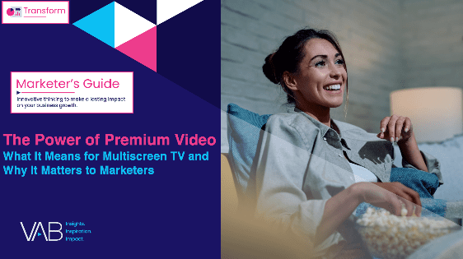


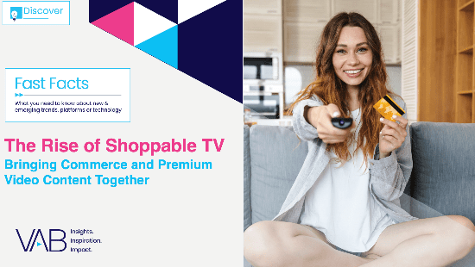


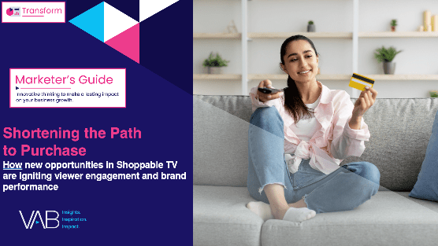
Creators
Jason Wiese
Leah Montner-Dixon
EVP, Strategic Insights & Measurement
jasonw@thevab.com
Director, Audience & Behavioral Insights
leahm@thevab.com
Karolina Guillen
The Power of Premium Video
What It Means for Multiscreen TV
and Why It Matters to Marketers
Best in Show
Five Advantages of Multiscreen TV, From Brand to Performance
Associate Director, Insights, Strategy & Analytics
karolinag@thevab.com
Discover more
Looking for more data, insights and takeaways? Check out this related VAB content
“How should I think about my advertising
in the wake of economic uncertainty
caused by tariffs?”
The Rise of Shoppable TV
Bringing Commerce and Premium Video Together
We are committed to providing marketers with the data and insights they need to develop thoughtful, inclusive campaigns & strategies. To find out more on the unique media consumption behaviors and cultural trends of diverse audiences, visit the VAB’s DEIB Marketing Resources.
It’s the Most Opportune Time
of the Year
Why consumers’ holiday spirit triumphs over economic uncertainty
Shortening the Path to Purchase
How new opportunities in Shoppable TV are igniting viewer engagement and brand performance
This information is exclusively provided to VAB members and qualified marketers
PAGE 26

Slide 27


About VAB
VAB plays a dual role in the video advertising industry. We are leading the change to bring about a more innovative and transparent marketplace. We also provide the insights and thought leadership that enables marketers to develop business-driving marketing strategies.
Drawing on our marketing expertise, we simplify the complexities in our industry and discover new insights that transform the way marketers look at their media strategy.
We are committed to your business growth and proud to offer VAB members, brand marketers and agencies complimentary access to our continuously-growing Insights library. Get immediate access at theVAB.com.
This information is exclusively provided to VAB members and qualified marketers
PAGE 27

