Slide 1


December 16th 2025
4Q Currency Chasm:
Instability & Unpredictability Decimate the Demos

Slide 2
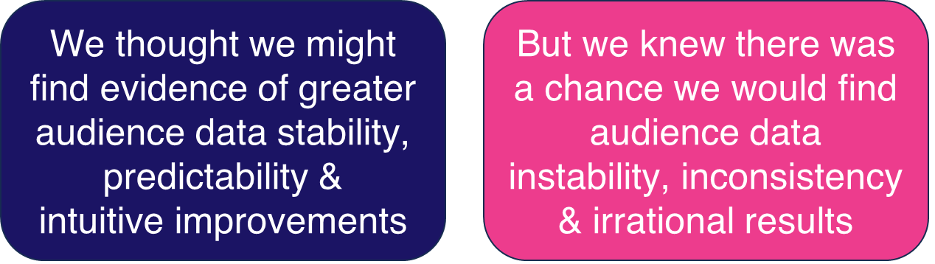
This analytics-rich report dives deep into
“the first quarter” of actual audience results
(4Q 2025)
as measured by Nielsen’s new
“Big Data +Panel” national currency product
The process we used to best sort through this possible range of results is a “variability / stability analysis” of BD+P actual audience data
This information is exclusively provided to VAB members and qualified marketers
PAGE 2

Slide 3
Report Origin & Background:
The VAB spent most of October and November meeting with Agency investment leads and their audience research leads on predictable 4Q 2025 topics - currency data trends and currency data quality.
The “currency data” topic coming to the forefront of the 2025 video advertising conversation is not surprising given:
The Spring 2025 National Upfront market saw the first widespread use of Nielsen’s Big Data product (“Big Data + Panel” or “BD+P”) as currency in a high-volume buy/sell marketplace
Also, widespread last Spring were buyer & seller concerns over the “state of readiness” with Nielsen’s BD+P’s audience data for currency use…
… As multiple BD+P data defects posed significant challenges for buyers & sellers in their foundational processes of estimating & forecasting audiences…and then negotiating audience guarantees.
This information is exclusively provided to VAB members and qualified marketers
PAGE 3

Slide 4
Report Background & Origins:
With a number of uncertainties as to how BD+P would perform as currency data, there was a very high desire to get an early read on “how stable” BD+P audience data was and “what early trends” were emerging since mid-September
Early on in 4Q, both buyers & sellers were citing “a lot of instability” on a program level across a number of networks - with unexplained or “illogical” high and low swings in BD+P audience data
The “big question” quickly became: How much variability was/is there between Nielsen’s 4Q BD+P audience data vs. their 4Q Panel-Only audience data on a wider level?
A lot of Upfront audience guarantees were informed by ratios of projected differences between BD+P & PO
Roughly 80% of any BD+P audience count is driven by the Panel-Only audience count for that same entity,
so double-digit variations of BD+P over/under PO could signal departures of significance - to be checked into
Looking on a “more stable” basis - at the Network level and combined Networks level - should “smooth out” a lot of the program-level peaks & valleys of audience variance
Note: BD+P = Big Data + Panel; PO = Panel Only
This information is exclusively provided to VAB members and qualified marketers
PAGE 4

Slide 5

Methodology:
To answer the “big question”: How much variability was/is there between Nielsen’s 4Q BD+P audience data vs. their 4Q Panel-Only audience data on a wider level:
Timing: Four weeks of data (Sept. 15th - Oct. 12th) where we analyzed hour-by-hour differences between BD+P & PO
Demos: Six audiences - HH, P2+, P18-34, P18-49, P25-54, P55+
Networks: 33 networks across a mix of broadcast networks, Spanish language networks, cable entertainment, cable networks with major live sports, cable sports networks and cable news networks
Variance Levels: We flagged the hourly occurrences where the difference between BD+P vs. PO was +/-20%, +/- 50% or +100% / - 75%
Note: BD+P = Big Data + Panel; PO = Panel Only
This information is exclusively provided to VAB members and qualified marketers
PAGE 5

Slide 6
We started with a very-wide view of BD+P audience variability:
(A full month of audience data for 33 Networks combined)
5
2
16
3
3
4
Broadcast networks
Spanish Broadcast Language networks
Cable
Entertainment networks
Cable networks w/ Major Live Sports
Cable
Sports
networks
Cable
News
networks
We first quantified variances of BD+P vs. PO
at the +/- 20% level
to see if there were “systemic” variability issues:
Note: BD+P = Big Data + Panel; PO = Panel Only
This information is exclusively provided to VAB members and qualified marketers
PAGE 6

Slide 7
33 Network Total: Between 45% to 58% of total hours had over a 20% audience variance on BD+P vs. PO among key buying demos
Differences in Average Audience (AA) by % of Hours
Big Data + Panel (BD+P) vs. Panel Only (PO)
4-week period (w/o 9/15 – w/o 10/6)
33 Network Total
+/- 20% AA Difference | HH | P2+ | P18-34 | P18-49 | P25-54 | P55+
% of Hours More Than +20% diff: | 12% | 15% | 31% | 24% | 19% | 20%
% of Hours More Than -20% diff: | 7% | 9% | 27% | 27% | 27% | 8%
+/- 20% Diff Total (% of Hours): | 18% | 24% | 58% | 51% | 45% | 28%
How to read: BD+P average audience was more than 20% higher than PO average audience on Households for 12% of the total measured hours in the 4-week period and more than 20% lower on P18-34 for 27% of total measured hours across the 33 networks.
Source: VAB analysis of Nielsen NPower Ratings Analysis Time Period Report data (as of 10/28/25). Live. 4-week period (672 total measured hours): w/o 9/15 – w/o 10/6 (9/15/25 – 10/12/25). Total Day (6a – 6a). Average Audience % Diff: Updated Big Data + Panel (BD+P) vs. National Panel (PO). Not all networks are measured across all 672 hours within a four-week period (see appendix for more detail), so the percentages in the above chart are based on only the measured hours across each of the 33 networks. Note: only hours with a reported audience for both BD+P & PO are included in the percentages by demo.
This information is exclusively provided to VAB members and qualified marketers
PAGE 7

Slide 8
33 Network Total: This equates to either close to, or over, ten thousand hours where there is a 20% audience variance among key buying demos
Differences in Average Audience (AA) by # of Hours
Big Data + Panel (BD+P) vs. Panel Only (PO)
4-week period (w/o 9/15 – w/o 10/6)
33 Network Total
+/- 20% AA Difference | HH | P2+ | P18-34 | P18-49 | P25-54 | P55+
# of Hours More Than +20% diff: | 2,423 | 3,097 | 6,377 | 4,969 | 3,879 | 4,107
# of Hours More Than -20% diff: | 1,364 | 1,832 | 5,546 | 5,672 | 5,515 | 1,610
+/- 20% Diff Total (# of Hours): | 3,787 | 4,929 | 11,923 | 10,641 | 9,394 | 5,717
How to read: BD+P average audience was more than 20% higher than PO average audience on Households for 2,423 of the total measured hours in the 4-week period and more than 20% lower on P18-34 for 5,546 of total measured hours collectively across the 33 networks.
Source: VAB analysis of Nielsen NPower Ratings Analysis Time Period Report data (as of 10/28/25). Live. 4-week period (672 total measured hours): w/o 9/15 – w/o 10/6 (9/15/25 – 10/12/25). Total Day (6a – 6a). Average Audience % Diff: Updated Big Data + Panel (BD+P) vs. National Panel (PO). Not all networks are measured across all 672 hours within a four-week period (see appendix for more detail), so the numbers of hours in the above chart are based on only the measured hours across each of the 33 networks. Note: only hours with a reported audience for both BD+P & PO are included in the number of hours by demo.
This information is exclusively provided to VAB members and qualified marketers
PAGE 8

Slide 9
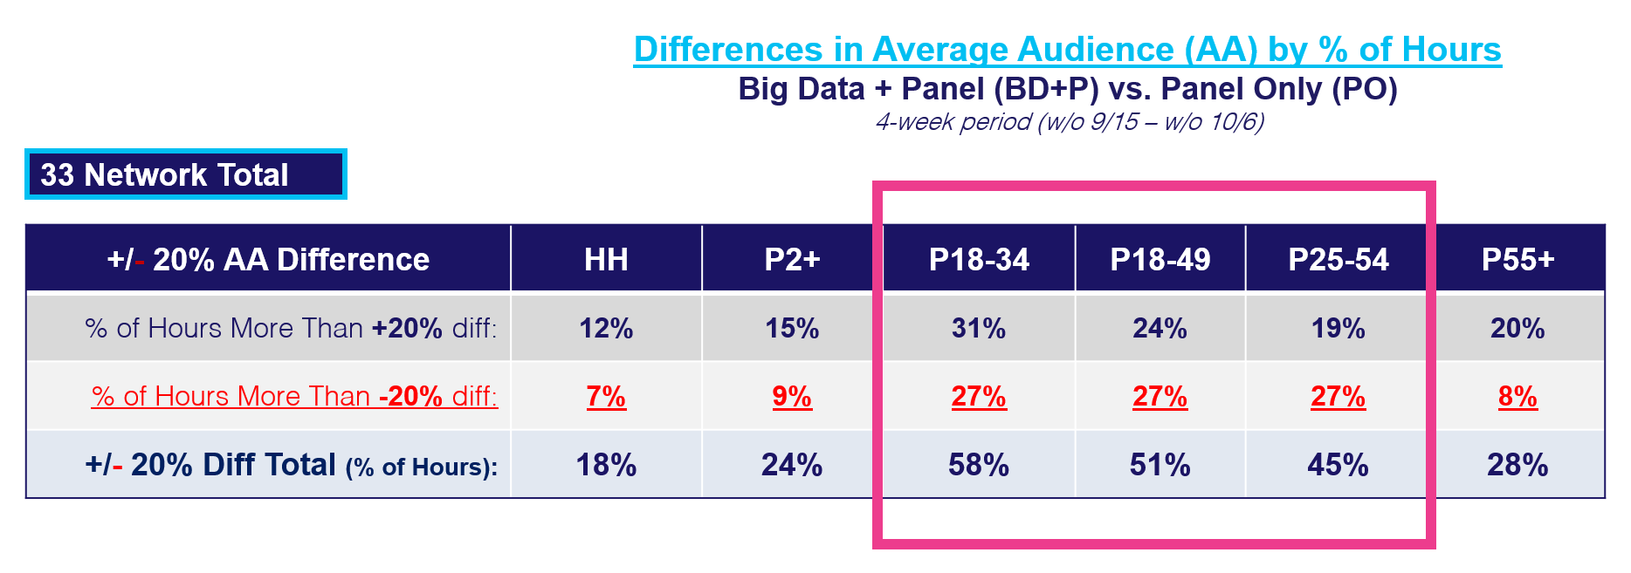
The level of variability on trading demos with audience guarantees
is certainly EXCESSIVE … and destabilizing from a currency perspective
(These 33-network cumulative “scores” have a tremendous amount of “smoothing out” of the highs
& lows of individual programs (and networks)….many of which have severe variability/instability)
How to read: BD+P average audience was more than 20% higher than PO average audience on Households for 12% of the total measured hours in the 4-week period and more than 20% lower on P18-34 for 27% of total measured hours across the 33 networks.
Source: VAB analysis of Nielsen NPower Ratings Analysis Time Period Report data (as of 10/28/25). Live. 4-week period (672 total measured hours): w/o 9/15 – w/o 10/6 (9/15/25 – 10/12/25). Total Day (6a – 6a). Average Audience % Diff: Updated Big Data + Panel (BD+P) vs. National Panel (PO). Not all networks are measured across all 672 hours within a four-week period (see appendix for more detail), so the percentages in the above chart are based on only the measured hours across each of the 33 networks. Note: only hours with a reported audience for both BD+P & PO are included in the percentages by demo.
This information is exclusively provided to VAB members and qualified marketers
PAGE 9

Slide 10
33 Network Total: A significant percentage of hours had over a 50% audience variance on BD+P vs. PO among key buying demos
Differences in Average Audience (AA) by % of Hours
Big Data + Panel (BD+P) vs. Panel Only (PO)
4-week period (w/o 9/15 – w/o 10/6)
33 Network Total
+/- 50% AA Difference | HH | P2+ | P18-34 | P18-49 | P25-54 | P55+
% of Hours More Than +50% diff: | 2% | 3% | 18% | 11% | 7% | 5%
% of Hours More Than -50% diff: | 0% | 0% | 11% | 6% | 5% | 0%
+/- 50% Diff Total (% of Hours): | 2% | 3% | 29% | 17% | 12% | 5%
How to read: BD+P average audience was more than 50% higher than PO average audience on Households for 2% of the total measured hours in the 4-week period and more than 50% lower on P18-34 for 11% of total measured hours across the 33 networks.
Source: VAB analysis of Nielsen NPower Ratings Analysis Time Period Report data (as of 10/28/25). Live. 4-week period (672 total measured hours): w/o 9/15 – w/o 10/6 (9/15/25 – 10/12/25). Total Day (6a – 6a). Average Audience % Diff: Updated Big Data + Panel (BD+P) vs. National Panel (PO). Not all networks are measured across all 672 hours within a four-week period (see appendix for more detail), so the percentages in the above chart are based on only the measured hours across each of the 33 networks. Note: only hours with a reported audience for both BD+P & PO are included in the percentages by demo.
This information is exclusively provided to VAB members and qualified marketers
PAGE 10

Slide 11
33 Network Total: This equates to thousands of hours where there is a 50% audience variance on BD+P vs. PO among key buying demos
Differences in Average Audience (AA) by # of Hours
Big Data + Panel (BD+P) vs. Panel Only (PO)
4-week period (w/o 9/15 – w/o 10/6)
33 Network Total
+/- 50% AA Difference | HH | P2+ | P18-34 | P18-49 | P25-54 | P55+
# of Hours More Than +50% diff: | 420 | 570 | 3,792 | 2,209 | 1,477 | 1,044
# of Hours More Than -50% diff: | 33 | 50 | 2,180 | 1,257 | 978 | 47
+/- 50% Diff Total (# of Hours): | 453 | 620 | 5,972 | 3,466 | 2,455 | 1,091
How to read: BD+P average audience was more than 50% higher than PO average audience on Households for 420 of the total measured hours in the 4-week period and more than 50% lower on P18-34 for 2,180 of total measured hours collectively across the 33 networks.
Source: VAB analysis of Nielsen NPower Ratings Analysis Time Period Report data (as of 10/28/25). Live. 4-week period (672 total measured hours): w/o 9/15 – w/o 10/6 (9/15/25 – 10/12/25). Total Day (6a – 6a). Average Audience % Diff: Updated Big Data + Panel (BD+P) vs. National Panel (PO). Not all networks are measured across all 672 hours within a four-week period (see appendix for more detail), so the numbers of hours in the above chart are based on only the measured hours across each of the 33 networks. Note: only hours with a reported audience for both BD+P & PO are included in the number of hours by demo.
This information is exclusively provided to VAB members and qualified marketers
PAGE 11

Slide 12
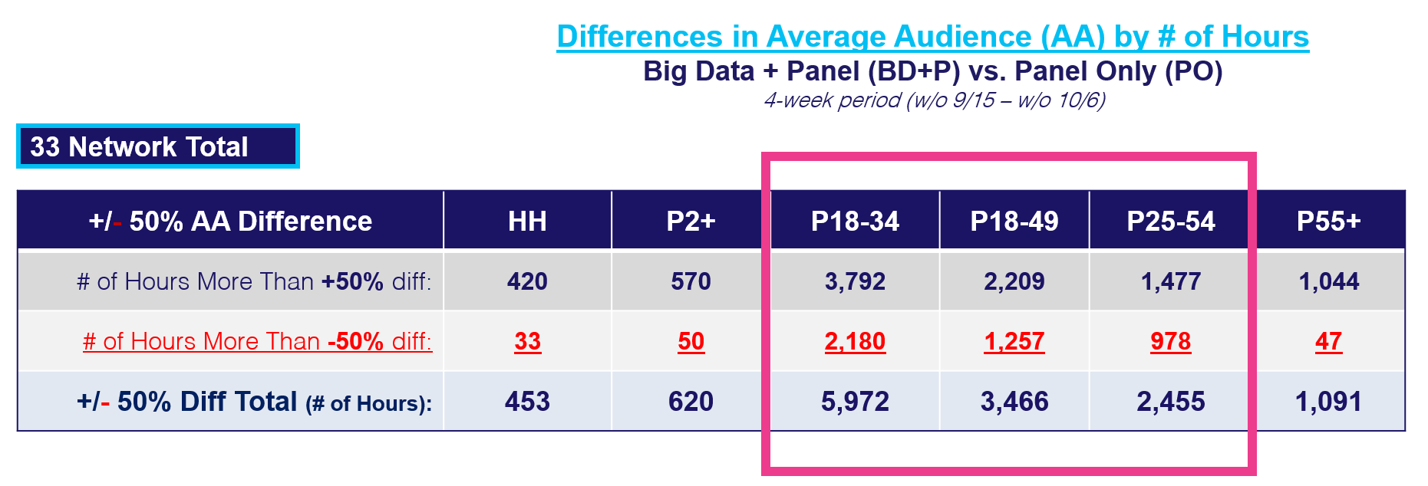
The +/- 50% variance level on trading demos with audience guarantees
is certainly EXCESSIVE … and destabilizing from a currency perspective
(It’s reasonable that no buyers or sellers calculated their audience estimates assuming a
+/- 50% variance/instability factor on a scale of thousands of hours of programming)
How to read: BD+P average audience was more than 50% higher than PO average audience on Households for 420 of the total measured hours in the 4-week period and more than 50% lower on P18-34 for 2,180 of total measured hours collectively across the 33 networks.
Source: VAB analysis of Nielsen NPower Ratings Analysis Time Period Report data (as of 10/28/25). Live. 4-week period (672 total measured hours): w/o 9/15 – w/o 10/6 (9/15/25 – 10/12/25). Total Day (6a – 6a). Average Audience % Diff: Updated Big Data + Panel (BD+P) vs. National Panel (PO). Not all networks are measured across all 672 hours within a four-week period (see appendix for more detail), so the percentages in the above chart are based on only the measured hours across each of the 33 networks. Note: only hours with a reported audience for both BD+P & PO are included in the percentages by demo.
This information is exclusively provided to VAB members and qualified marketers
PAGE 12

Slide 13
33 Network Total: One in every ten hours had severe variances between BD+P vs. PO on the younger P18-34 demo
Differences in Average Audience (AA) by % of Hours
Big Data + Panel (BD+P) vs. Panel Only (PO)
4-week period (w/o 9/15 – w/o 10/6)
33 Network Total
+100% / -75% AA Difference | HH | P2+ | P18-34 | P18-49 | P25-54 | P55+
% of Hours More Than +100% diff: | 0% | 1% | 7% | 3% | 2% | 1%
% of Hours More Than -75% diff: | 0% | 0% | 3% | 1% | 0% | 0%
+100% / -75% AA Diff Total: | 0% | 1% | 10% | 4% | 2% | 1%
How to read: BD+P average audience was more than 100% higher than PO average audience on P18-34 for 7% of the total measured hours in the 4-week period and more than 75% lower on P18-34 for 3% of total measured hours across the 33 networks.
Source: VAB analysis of Nielsen NPower Ratings Analysis Time Period Report data (as of 10/28/25). Live. 4-week period (672 total measured hours): w/o 9/15 – w/o 10/6 (9/15/25 – 10/12/25). Total Day (6a – 6a). Average Audience % Diff: Updated Big Data + Panel (BD+P) vs. National Panel (PO). Not all networks are measured across all 672 hours within a four-week period (see appendix for more detail), so the percentages in the above chart are based on only the measured hours across each of the 33 networks. Note: only hours with a reported audience for both BD+P & PO are included in the percentages by demo.
This information is exclusively provided to VAB members and qualified marketers
PAGE 13

Slide 14
33 Network Total: This equates to over two thousand hours where there are severe audience variances between BD+P vs. PO on P18-34
Differences in Average Audience (AA) by # of Hours
Big Data + Panel (BD+P) vs. Panel Only (PO)
4-week period (w/o 9/15 – w/o 10/6)
33 Network Total
+100% / -75% AA Difference | HH | P2+ | P18-34 | P18-49 | P25-54 | P55+
# of Hours More Than +100% diff: | 66 | 113 | 1,525 | 698 | 423 | 210
# of Hours More Than -75% diff: | 2 | 1 | 649 | 132 | 85 | 1
+100% / -75% AA Diff Total: | 68 | 114 | 2,174 | 830 | 508 | 211
How to read: BD+P average audience was more than 100% higher than PO average audience on P18-34 for 1,525 of the total measured hours in the 4-week period and more than 75% lower on P18-34 for 649 of total measured hours collectively across the 33 networks.
Source: VAB analysis of Nielsen NPower Ratings Analysis Time Period Report data (as of 10/28/25). Live. 4-week period (672 total measured hours): w/o 9/15 – w/o 10/6 (9/15/25 – 10/12/25). Total Day (6a – 6a). Average Audience % Diff: Updated Big Data + Panel (BD+P) vs. National Panel (PO). Not all networks are measured across all 672 hours within a four-week period (see appendix for more detail), so the numbers of hours in the above chart are based on only the measured hours across each of the 33 networks. Note: only hours with a reported audience for both BD+P & PO are included in the number of hours by demo.
This information is exclusively provided to VAB members and qualified marketers
PAGE 14

Slide 15
At a program / programming level we focused on
30 NFL games played during the month of data we analyzed
NFL Football accounted for 48 of the 50 top-rated programs during our 4-week analysis period (Sept. 15th – Oct. 12th)
NFL Football games’ audience counts should be very stable:
While spread across seven networks - it is essentially the same programming
NFL games consistently have among the largest & most loyal audiences
We looked at three types of BD+P vs. PO stability:
Note: BD+P = Big Data + Panel; PO = Panel Only
This information is exclusively provided to VAB members and qualified marketers
PAGE 15

Slide 16

Methodology:
How much variability was/is there between Nielsen’s 4Q BD+P audience data vs. their 4Q Panel-Only audience data on an NFL Game level:
Timing: Four weeks of data (Sept. 15th - Oct. 12th) where we analyzed hour-by-hour differences between BD+P & PO during live NFL games (30 games across 115 total hour occurrences)
Demos: Six audiences - HH, P2+, P18-34, P18-49, P25-54, P55+
Networks: 7 networks across broadcast and cable airing live NFL games
Variance Levels: We flagged the hourly occurrences where the difference between BD+P
vs. PO was was +/-10% or +/- 15%
Note: BD+P = Big Data + Panel; PO = Panel Only
This information is exclusively provided to VAB members and qualified marketers
PAGE 16

Slide 17
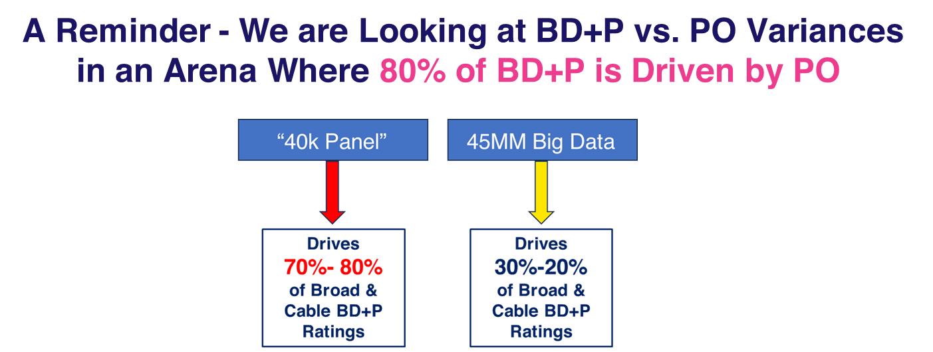
We Studied the 30 Games Very Closely - Expecting to Find More Stability, Less Negative Variances in BD+P vs. PO
This information is exclusively provided to VAB members and qualified marketers
PAGE 17

Slide 18
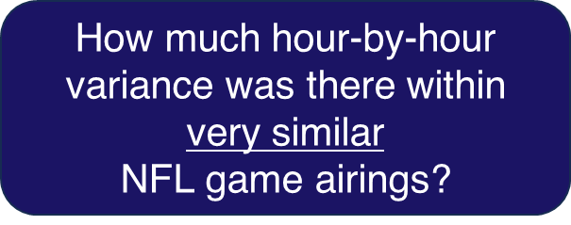
We Studied the 30 Games Very Closely - Expecting to Find More Stability, Less Negative Variances in BD+P vs. PO
This information is exclusively provided to VAB members and qualified marketers
PAGE 18

Slide 19
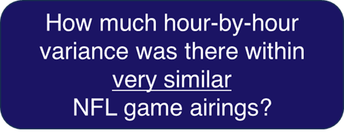
At the most-basic level: same broadcast network, same 1pm start time, same game duration (3 hours)
We found odd/irrational contradictions in BD+P vs. PO audience differences hour-by-hour:
Same Broadcast Network w/ NFL:
% Range of Differences in Average Audience (AA)
Big Data + Panel (BD+P) vs. Panel Only (PO)
Across three full hours of live NFL game broadcasts
Date | Game | HH | P2+ | P18-34 | P18-49 | P25-54 | P55+
9/28/25 | Afternoon (1p) | +16% to +13% | +17% to +13% | +19% to +14% | +15% to +11% | +13% to +18% | +22% to +16%
10/12/25 | Afternoon (1p) | +3% to (-10%) | +2% to (-12%) | (-10%) to (-27%) | (-6%) to (-17%) | (-6%) to (-14%) | +7% to (-10%)
How to read: BD+P average audience was 16% to 13% higher than PO average audience on Households across the three hours of the 9/28/25 1p live NFL game broadcast. For instance, 1p-2p was +13%, 2p-3p was +15% and 3p-4p was +16%.
Source: VAB analysis of Nielsen NPower Ratings Analysis Time Period Report data (as of 10/28/25). Live (6 total measured hours). Average Audience % Diff: Updated Big Data + Panel (BD+P) vs. National Panel (PO).
This information is exclusively provided to VAB members and qualified marketers
PAGE 19

Slide 20
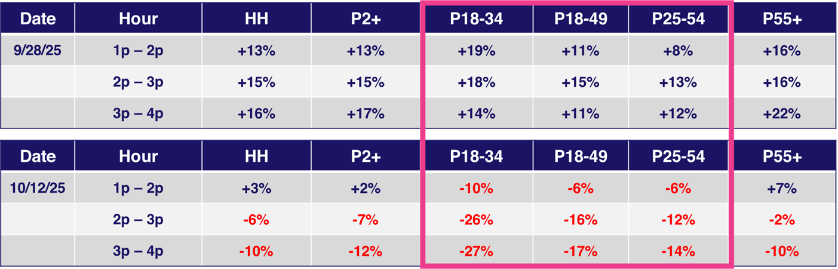
At the most-basic level: same broadcast network, same 1pm start time, same game duration (3 hours)
We found odd/irrational contradictions in BD+P vs. PO audience differences hour-by-hour:
Same Broadcast Network w/ NFL:
Differences in Average Audience (AA)
Big Data + Panel (BD+P) vs. Panel Only (PO)
Across three full hours of live NFL game broadcasts
How to read: BD+P average audience was 19% higher than PO average audience on P18-34 for the 1p – 2p hour of the 9/28/25 live NFL game broadcast and 10% lower on P18-34 for the 1p – 2p hour of the 10/12/25 live NFL game broadcast.
Source: VAB analysis of Nielsen NPower Ratings Analysis Time Period Report data (as of 10/28/25). Live (6 total measured hours). Average Audience % Diff: Updated Big Data + Panel (BD+P) vs. National Panel (PO).
This information is exclusively provided to VAB members and qualified marketers
PAGE 20

Slide 21

At the most-basic level: same broadcast network, same 1pm start time, same game duration (3 hours)
We found odd/irrational contradictions in BD+P vs. PO audience differences hour-by-hour:
Same Broadcast Network w/ NFL:
Differences in Average Audience (000)
Big Data + Panel (BD+P) vs. Panel Only (PO)
Across three full hours of live NFL game broadcasts
How to read: BD+P average audience was 339K lower than PO on P18-34 for the 3p – 4p hour of the 10/12/25 live NFL game broadcast.
Source: VAB analysis of Nielsen NPower Ratings Analysis Time Period Report data (as of 10/28/25). Live (6 total measured hours). Average Audience # Diff: Updated Big Data + Panel (BD+P) vs. National Panel (PO).
This information is exclusively provided to VAB members and qualified marketers
PAGE 21

Slide 22
This was also true on the NFL Network games
We found odd/irrational contradictions in BD+P vs. PO audience differences hour-by-hour
NFL Network :
% Range of Differences in Average Audience (AA)
Big Data + Panel (BD+P) vs. Panel Only (PO)
Across three full hours of live NFL game broadcasts
Date | Game | HH | P2+ | P18-34 | P18-49 | P25-54 | P55+
9/28/25 | Sunday | +7% to +4% | +11% to +6% | +22% to (-2%) | +17% to +4% | +16% to +2% | +14% to +3%
10/5/25 | Sunday | +2% to (-1%) | +4% to 0% | (-3%) to (-15%) | (-2%) to (-7%) | +5% to 0% | +5% to (-1%)
10/12/25 | Sunday | 0% to (-4%) | (-1%) to (-3%) | (-10%) to (-18%) | (-6%) to (-11%) | (-3%) to (-11%) | +5% to 0%
How to read: BD+P average audience was 7% to 4% higher than PO average audience on Households across the three hours of the 9/28/25 live NFL game broadcast. For instance, 1st hour was +7%, 2nd hour was +4% and 3rd hour was +4%.
Source: VAB analysis of Nielsen NPower Ratings Analysis Time Period Report data (as of 10/28/25). Live (9 total measured hours). Average Audience % Diff: Updated Big Data + Panel (BD+P) vs. National Panel (PO).
This information is exclusively provided to VAB members and qualified marketers
PAGE 22

Slide 23
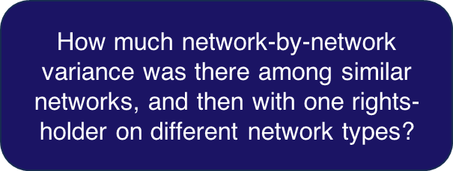
We Studied the 30 Games Very Closely - Expecting to Find More Stability, Less Negative Variances in BD+P vs. PO
This information is exclusively provided to VAB members and qualified marketers
PAGE 23

Slide 24
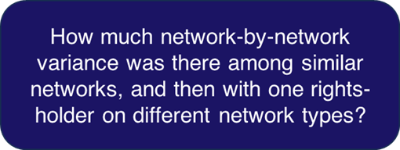
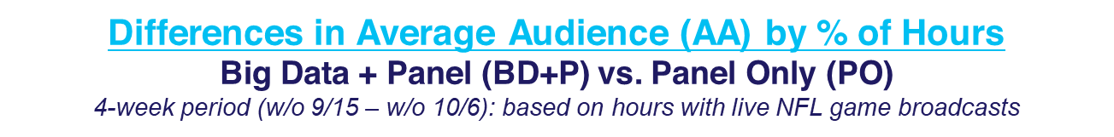
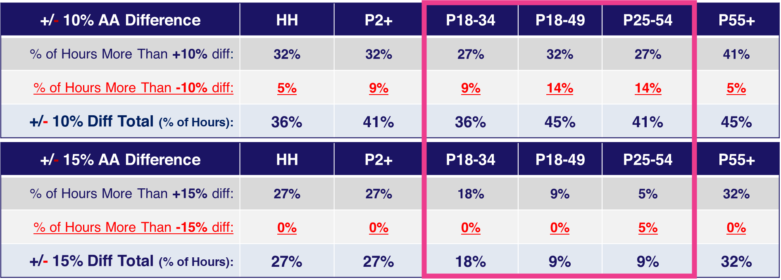
We did not find consistent audience variability patterns across the Broadcast networks…
Example: two very different patterns on two very similar NFL Broadcasters….
NFL Broadcast Network #1:
More positive variances than negative
Widest range of variance on 18-49 & 55+
How to read: BD+P average audience was more than 10% higher than PO average audience on Households for 32% of the total measured hours in the 4-week period and more than 10% lower on P18-34 for 9% of total measured hours.
Source: VAB analysis of Nielsen NPower Ratings Analysis Time Period Report data (as of 10/28/25). Live. 4-week period (22 total measured hours): w/o 9/15 – w/o 10/6 (9/15/25 – 10/12/25). Based on hours airing live NFL games. Average Audience % Diff: Updated Big Data + Panel (BD+P) vs. National Panel (PO).
This information is exclusively provided to VAB members and qualified marketers
PAGE 24

Slide 25
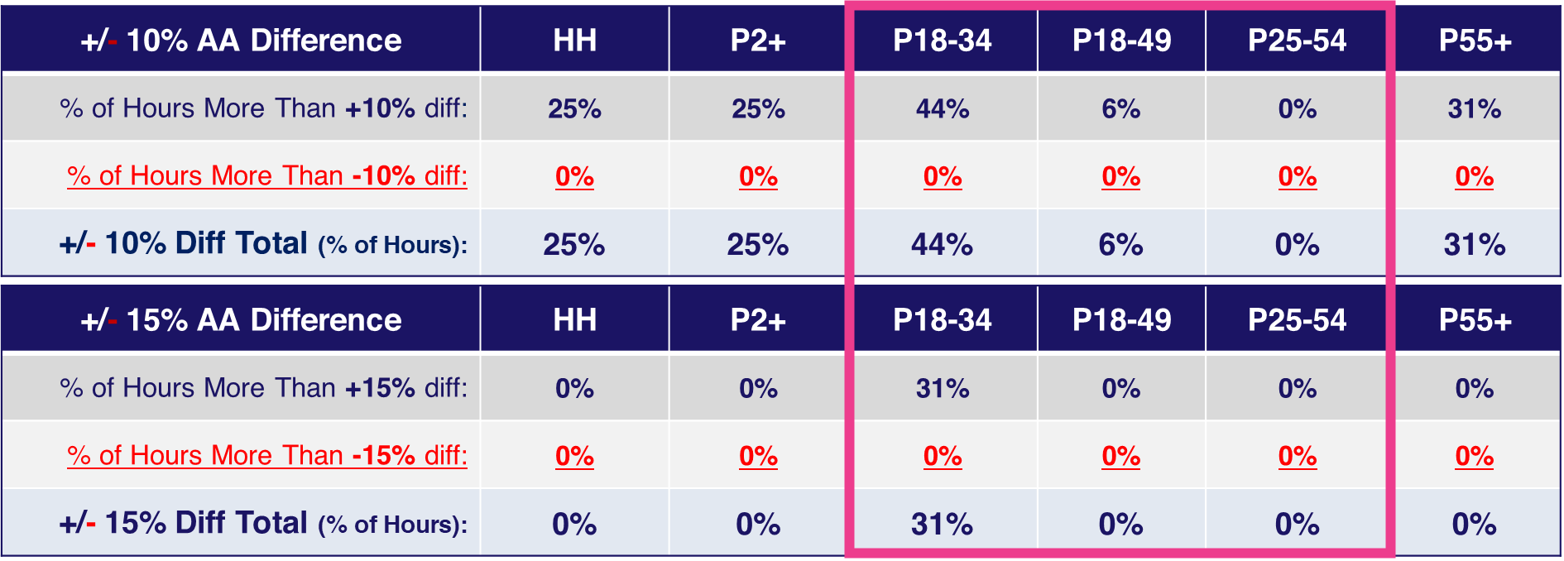
We did not find consistent audience variability patterns across the Broadcast networks…
Example: two very different patterns on two very similar NFL Broadcasters….
NFL Broadcast Network #3:
No Negative variances at all
Highest positive variance (+44% on 18-34) of any NFL Broadcaster
How to read: BD+P average audience was more than 10% higher than PO average audience on Households for 25% of the total measured hours in the 4-week period and 44% of the total measured hours for P18-34..
Source: VAB analysis of Nielsen NPower Ratings Analysis Time Period Report data (as of 10/28/25). Live. 4-week period (16 total measured hours): w/o 9/15 – w/o 10/6 (9/15/25 – 10/12/25). Based on hours airing live NFL games. Average Audience % Diff: Updated Big Data + Panel (BD+P) vs. National Panel (PO).
This information is exclusively provided to VAB members and qualified marketers
PAGE 25

Slide 26
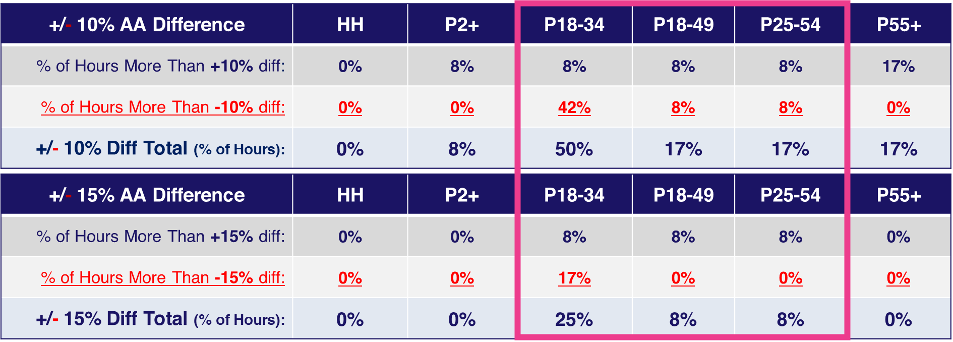
One of the most irrational NFL audience dynamics we found was within the varying types of telecasts from the same NFL rights-holder - very opposite variability profiles between their Broadcast network and their Cable network…
The Same NFL Rights-Holder:
NFL on their Broadcast Network:
NFL on their Cable Network:
How to read: BD+P average audience was more than 10% higher than PO average audience on Households for 25% of the total measured hours in the 4-week period and 44% of the total measured hours for P18-34.
Source: VAB analysis of Nielsen NPower Ratings Analysis Time Period Report data (as of 10/28/25). Live. 4-week period (broadcast network represents 16 total measured hours; cable network represents 12 total measured hours): w/o 9/15 – w/o 10/6 (9/15/25 – 10/12/25). Based on hours airing live NFL games. Average Audience % Diff: Updated Big Data + Panel (BD+P) vs. National Panel (PO).
This information is exclusively provided to VAB members and qualified marketers
PAGE 26

Slide 27
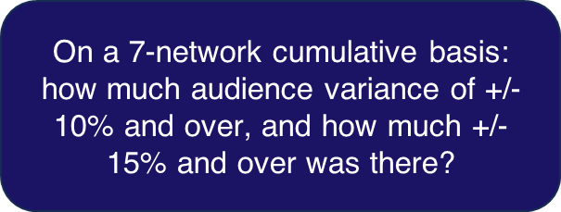
We Studied the 30 Games Very Closely - Expecting to Find More Stability, Less Negative Variances in BD+P vs. PO
This information is exclusively provided to VAB members and qualified marketers
PAGE 27

Slide 28
7 Nets w/ NFL Games Total: Between 16% to 40% of hours with NFL games had double-digit BD+P vs. PO audience variances among key demos
Differences in Average Audience (AA) by % of Hours
Big Data + Panel (BD+P) vs. Panel Only (PO)
4-week period (w/o 9/15 – w/o 10/6): based on hours with live NFL game broadcasts
7 Network Total
+/- 10% AA Difference | HH | P2+ | P18-34 | P18-49 | P25-54 | P55+
% of Hours More Than +10% diff: | 15% | 17% | 29% | 12% | 8% | 22%
% of Hours More Than -10% diff: | 2% | 3% | 11% | 6% | 8% | 1%
+/- 10% Diff Total (% of Hours): | 17% | 19% | 40% | 18% | 16% | 23%
+/- 15% AA Difference | HH | P2+ | P18-34 | P18-49 | P25-54 | P55+
% of Hours More Than +15% diff: | 7% | 7% | 15% | 3% | 2% | 10%
% of Hours More Than -15% diff: | 0% | 0% | 5% | 2% | 2% | 0%
+/- 15% Diff Total (% of Hours): | 7% | 7% | 20% | 4% | 3% | 10%
How to read: BD+P average audience was more than 10% higher than PO average audience on Households for 15% of the total measured hours in the 4-week period and more than 10% lower on P18-34 for 11% of total measured hours.
Source: VAB analysis of Nielsen NPower Ratings Analysis Time Period Report data (as of 10/28/25). Live. 4-week period (115 measured total hours): w/o 9/15 – w/o 10/6 (9/15/25 – 10/12/25). Based on hours airing live NFL games. Average Audience % Diff: Updated Big Data + Panel (BD+P) vs. National Panel (PO).
This information is exclusively provided to VAB members and qualified marketers
PAGE 28

Slide 29
7 Nets w/ NFL Games Total: A double-digit variance can mean the ‘loss’ of hundreds of thousands of viewers in key demos within higher rated games
Differences in Average Audience (AA) Based on Hours w/ 10% Variance
Big Data + Panel (BD+P) vs. Panel Only (PO)
4-week period (w/o 9/15 – w/o 10/6): based on hours with live NFL game broadcasts
7 Network Total
+10% AA Difference | HH | P2+ | P18-34 | P18-49 | P25-54 | P55+
Big Data + Panel: AA (000) | 7,090 | 9,652 | 1,111 | 3,050 | 3,432 | 5,277
Panel Only: AA (000) | 6,204 | 8,455 | 967 | 2,711 | 3,032 | 4,580
BD+P vs. PO AA (000): | +886 | +1,196 | +144 | +340 | +400 | +697
-10% AA Difference | HH | P2+ | P18-34 | P18-49 | P25-54 | P55+
Big Data + Panel: AA (000) | 10,154 | 12,376 | 1,037 | 2,917 | 2,773 | 8,105
Panel Only: AA (000) | 11,376 | 14,054 | 1,234 | 3,377 | 3,207 | 9,027
BD+P vs. PO AA (000): | -1,222 | -1,679 | -197 | -460 | -433 | -923
How to read: BD+P average audience was 10,154 and PO was 11,376 on Households in hours with a -10% AA variance between BD+P vs. PO; therefore, the BD+P average audience was -1,222 lower in those hours.
Source: VAB analysis of Nielsen NPower Ratings Analysis Time Period Report data (as of 10/28/25). Live. 4-week period (115 measured total hours): w/o 9/15 – w/o 10/6 (9/15/25 – 10/12/25). Based on hours airing live NFL games. Average Audience % Diff: Updated Big Data + Panel (BD+P) vs. National Panel (PO).
This information is exclusively provided to VAB members and qualified marketers
PAGE 29

Slide 30
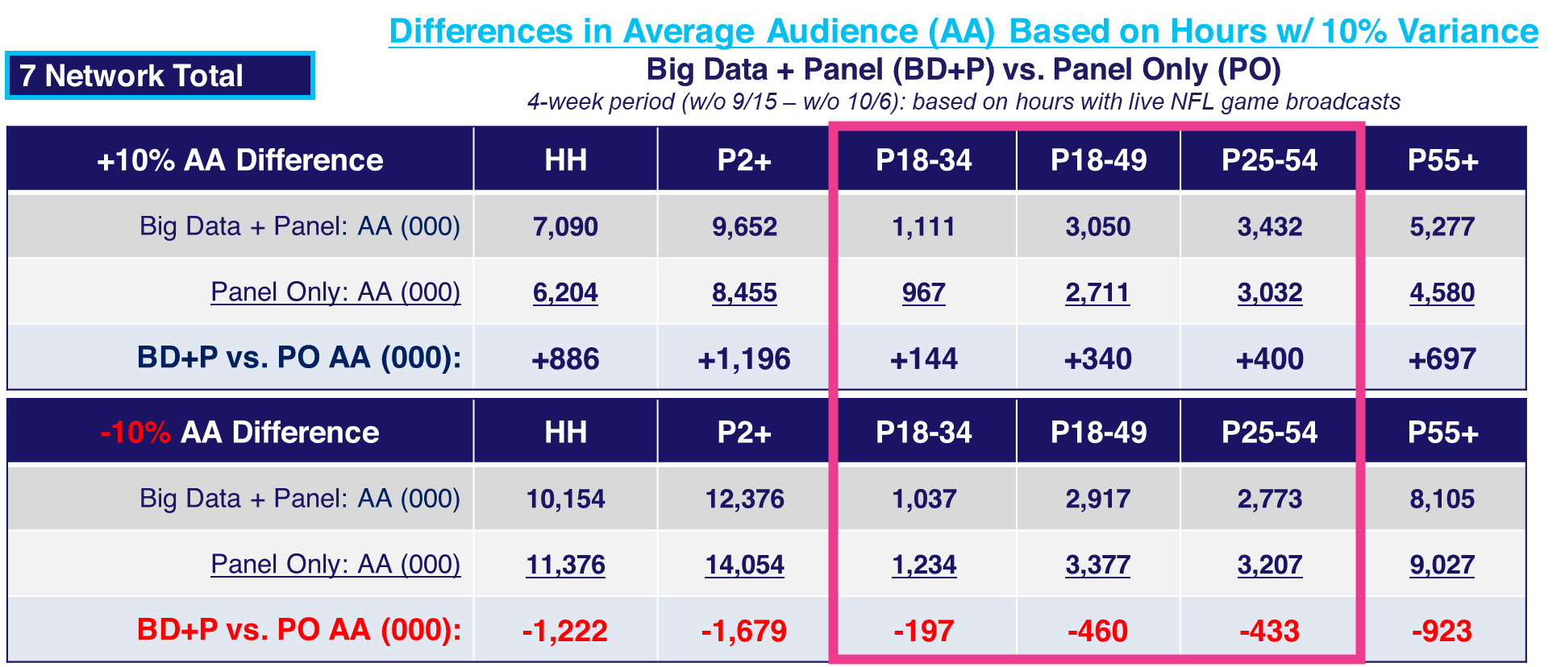
Another one of the most unique NFL audience dynamics we found was:
It was within the higher-rated games that the most negative variances were concentrated… …in quantifying the actual audience gains/losses (vs. %’s) - we saw “more loss than gain”
How to read: BD+P average audience was 10,154 and PO was 11,376 on Households in hours with a -10% AA variance between BD+P vs. PO; therefore, the BD+P average audience was -1,222 lower in those hours.
Source: VAB analysis of Nielsen NPower Ratings Analysis Time Period Report data (as of 10/28/25). Live. 4-week period (115 measured total hours): w/o 9/15 – w/o 10/6 (9/15/25 – 10/12/25). Based on hours airing live NFL games. Average Audience % Diff: Updated Big Data + Panel (BD+P) vs. National Panel (PO).
This information is exclusively provided to VAB members and qualified marketers
PAGE 30

Slide 31
We expected the NFL games to display a much “better” variability dynamic
NFL Football accounted for 48 of the 50 top-rated programs during our analytics period (Sept 15 – Oct 12)
NFL Football games’ audience counts should be very stable
Instead:
We Found Both High Variability and Irrational Variability in Every Way That We Analyzed a 4Q Month of 30 NFL Games
This information is exclusively provided to VAB members and qualified marketers
PAGE 31

Slide 32
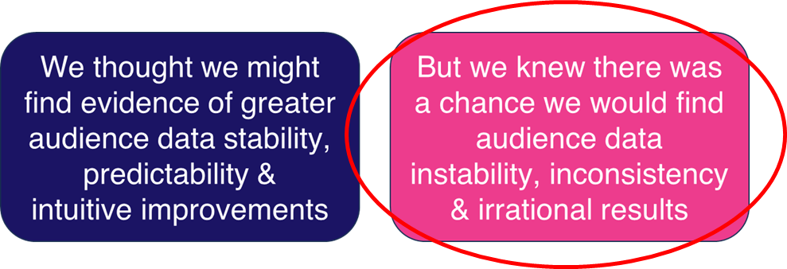
Quick Summary Conclusions:
The instability & unpredictability of BD+P in 4Q 2025 was far worse than we expected
The thousands of collective demo audience hours (25-54,18-49,18-34) that were compromised by BD+P instability might easily transform guarantees into liabilities…and take herculean efforts to “correct” in real time
This level of currency instability is not what buyers & sellers “signed up for” to say the least… everyone eventually loses with decimated demos
Note: BD+P = Big Data + Panel; PO = Panel Only
This information is exclusively provided to VAB members and qualified marketers
PAGE 32

Slide 33
Click here to download the full appendix
of all 33 Anonymized Networks Detailed on BD+P vs. PO
5
2
16
3
3
4
Broadcast networks
Spanish Broadcast Language networks
Cable
Entertainment networks
Cable networks w/ Major Live Sports
Cable
Sports
networks
Cable
News
networks
Variance Levels: We flagged the hourly occurrences where the difference between BD+P vs. PO was +/-20%, +/-50% or +100% / -75%
Note: BD+P = Big Data + Panel; PO = Panel Only
This information is exclusively provided to VAB members and qualified marketers
PAGE 33

Slide 34

Click here for an anonymized analysis
on how three ‘Big Data’ currency vendors see crucial audiences
This information is exclusively provided to VAB members and qualified marketers
PAGE 34

Slide 35

Abridged Appendix:
Examples of Anonymized Networks Detailed on BD+P vs. PO (+/-20% or +/-50%)
Click here to download the full appendix
Note: BD+P = Big Data + Panel; PO = Panel Only

Slide 36
Broadcast Network #1: Analyzed Hour-by-Hour Average Audience Variations (BD+P vs. PO) Over 4 Weeks in September & October 2025
Differences in Average Audience (AA) by % of Hours
Big Data + Panel (BD+P) vs. Panel Only (PO)
4-week period (w/o 9/15 – w/o 10/6)
+/- 20% AA Difference | HH | P2+ | P18-34 | P18-49 | P25-54 | P55+
% of Hours More Than +20% diff: | 2% | 3% | 15% | 6% | 3% | 5%
% of Hours More Than -20% diff: | 0% | 0% | 36% | 13% | 11% | 0%
+/- 20% Diff Total (% of Hours): | 2% | 3% | 51% | 19% | 14% | 5%
+/- 50% AA Difference | HH | P2+ | P18-34 | P18-49 | P25-54 | P55+
% of Hours More Than +50% diff: | 0% | 0% | 5% | 1% | 0% | 1%
% of Hours More Than -50% diff: | 0% | 0% | 6% | 0% | 0% | 0%
+/- 50% Diff Total (% of Hours): | 0% | 0% | 11% | 1% | 0% | 1%
How to read: BD+P average audience was more than 20% higher than PO average audience on Households for 2% of the total measured hours in the 4-week period and more than 20% lower on P18-34 for 36% of total measured hours.
Source: VAB analysis of Nielsen NPower Ratings Analysis Time Period Report data (as of 10/28/25). Live. 4-week period (672 total measured hours): w/o 9/15 – w/o 10/6 (9/15/25 – 10/12/25). Total Day (6a – 6a). Average Audience % Diff: Updated Big Data + Panel (BD+P) vs. National Panel (PO).
This information is exclusively provided to VAB members and qualified marketers
PAGE 36

Slide 37
Broadcast Network #2: Analyzed Hour-by-Hour Average Audience Variations (BD+P vs. PO) Over 4 Weeks in September & October 2025
Differences in Average Audience (AA) by % of Hours
Big Data + Panel (BD+P) vs. Panel Only (PO)
4-week period (w/o 9/15 – w/o 10/6)
+/- 20% AA Difference | HH | P2+ | P18-34 | P18-49 | P25-54 | P55+
% of Hours More Than +20% diff: | 2% | 2% | 21% | 5% | 3% | 3%
% of Hours More Than -20% diff: | 0% | 0% | 36% | 29% | 26% | 0%
+/- 20% Diff Total (% of Hours): | 2% | 3% | 56% | 35% | 29% | 3%
+/- 50% AA Difference | HH | P2+ | P18-34 | P18-49 | P25-54 | P55+
% of Hours More Than +50% diff: | 1% | 1% | 9% | 2% | 1% | 1%
% of Hours More Than -50% diff: | 0% | 0% | 9% | 3% | 1% | 0%
+/- 50% Diff Total (% of Hours): | 1% | 1% | 18% | 5% | 3% | 1%
How to read: BD+P average audience was more than 20% higher than PO average audience on Households for 2% of the total measured hours in the 4-week period and more than 20% lower on P18-34 for 36% of total measured hours.
Source: VAB analysis of Nielsen NPower Ratings Analysis Time Period Report data (as of 10/28/25). Live. 4-week period (672 total measured hours): w/o 9/15 – w/o 10/6 (9/15/25 – 10/12/25). Total Day (6a – 6a). Average Audience % Diff: Updated Big Data + Panel (BD+P) vs. National Panel (PO).
This information is exclusively provided to VAB members and qualified marketers
PAGE 37

Slide 38
Cable Entertainment Network #1: Analyzed Hour-by-Hour Average Audience Variations (BD+P vs. PO) Over 4 Weeks in September & October 2025
Differences in Average Audience (AA) by % of Hours
Big Data + Panel (BD+P) vs. Panel Only (PO)
4-week period (w/o 9/15 – w/o 10/6)
+/- 20% AA Difference | HH | P2+ | P18-34 | P18-49 | P25-54 | P55+
% of Hours More Than +20% diff: | 0% | 1% | 15% | 4% | 3% | 3%
% of Hours More Than -20% diff: | 60% | 68% | 41% | 56% | 58% | 62%
+/- 20% Diff Total (% of Hours): | 60% | 69% | 56% | 60% | 61% | 65%
+/- 50% AA Difference | HH | P2+ | P18-34 | P18-49 | P25-54 | P55+
% of Hours More Than +50% diff: | 0% | 0% | 4% | 1% | 1% | 1%
% of Hours More Than -50% diff: | 1% | 6% | 10% | 7% | 4% | 4%
+/- 50% Diff Total (% of Hours): | 1% | 6% | 14% | 9% | 5% | 5%
How to read: BD+P average audience was more than 20% higher than PO average audience on Households for 0% of the total measured hours in the 4-week period and more than 20% lower on P18-34 for 41% of total measured hours.
Source: VAB analysis of Nielsen NPower Ratings Analysis Time Period Report data (as of 10/28/25). Live. 4-week period (364 total measured hours): w/o 9/15 – w/o 10/6 (9/15/25 – 10/12/25). Total Day (6a – 6a). Average Audience % Diff: Updated Big Data + Panel (BD+P) vs. National Panel (PO).
This information is exclusively provided to VAB members and qualified marketers
PAGE 38

Slide 39
Cable Entertainment Network #2: Analyzed Hour-by-Hour Average Audience Variations (BD+P vs. PO) Over 4 Weeks in September & October 2025
Differences in Average Audience (AA) by % of Hours
Big Data + Panel (BD+P) vs. Panel Only (PO)
4-week period (w/o 9/15 – w/o 10/6)
+/- 20% AA Difference | HH | P2+ | P18-34 | P18-49 | P25-54 | P55+
% of Hours More Than +20% diff: | 6% | 7% | 24% | 20% | 9% | 14%
% of Hours More Than -20% diff: | 5% | 10% | 30% | 35% | 45% | 4%
+/- 20% Diff Total (% of Hours): | 11% | 17% | 54% | 55% | 54% | 18%
+/- 50% AA Difference | HH | P2+ | P18-34 | P18-49 | P25-54 | P55+
% of Hours More Than +50% diff: | 1% | 2% | 17% | 9% | 1% | 3%
% of Hours More Than -50% diff: | 0% | 0% | 11% | 10% | 9% | 0%
+/- 50% Diff Total (% of Hours): | 1% | 2% | 28% | 19% | 10% | 3%
How to read: BD+P average audience was more than 20% higher than PO average audience on Households for 6% of the total measured hours in the 4-week period and more than 20% lower on P18-34 for 30% of total measured hours.
Source: VAB analysis of Nielsen NPower Ratings Analysis Time Period Report data (as of 10/28/25). Live. 4-week period (568 total measured hours): w/o 9/15 – w/o 10/6 (9/15/25 – 10/12/25). Total Day (6a – 6a). Average Audience % Diff: Updated Big Data + Panel (BD+P) vs. National Panel (PO).
This information is exclusively provided to VAB members and qualified marketers
PAGE 39

Slide 40


About VAB
VAB plays a dual role in the video advertising industry. We are leading the change to bring about a more innovative and transparent marketplace. We also provide the insights and thought leadership that enables marketers to develop business-driving marketing strategies.
Drawing on our marketing expertise, we simplify the complexities in our industry and discover new insights that transform the way marketers look at their media strategy.
We are committed to your business growth and proud to offer VAB members, brand marketers and agencies complimentary access to our continuously-growing Insights library. Get immediate access at theVAB.com.
This information is exclusively provided to VAB members and qualified marketers.
PAGE 40

