Slide 1





25 Ways TV Grows Brands
Powering Performance Through Full-Funnel Business Outcomes

Slide 2
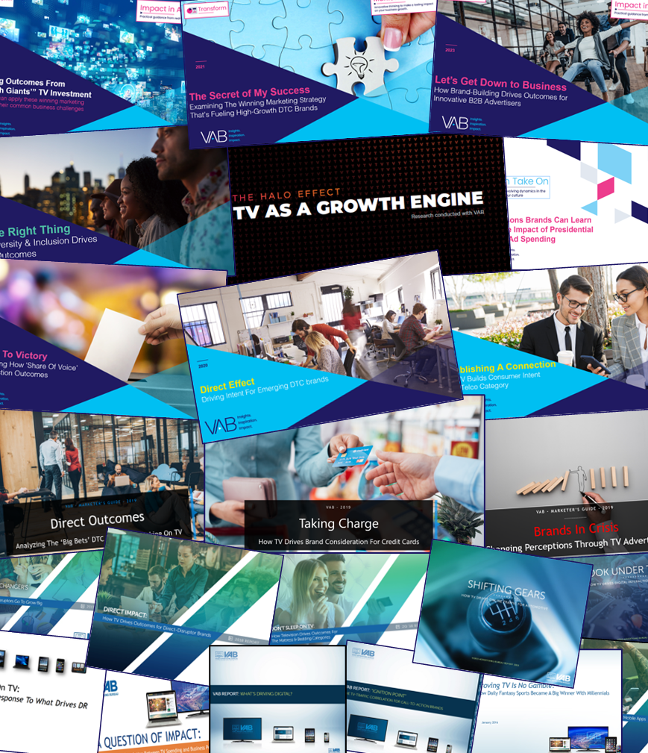

TV is a performance channel that drives full-funnel outcomes.
VAB has long studied the effects of TV investment on driving business outcomes:
  10 years of analysis
  23 TV attribution reports
    612 pages in total
  1,000+ brands
  80+ categories
  30+ metrics analyzed
What’s clear? TV delivers full-funnel results for brands, whether it’s increasing awareness, fostering greater brand consideration, driving more consumer intent or converting action into sales.
This guide distills a decade of analysis into the 25 ways TV grows brands at each stage of the purchase funnel.
This information is exclusively provided to VAB members and qualified marketers. Further distribution is prohibited.
PAGE 2

Slide 3
TV consistently drives brand growth and value creation through each stage of the consumer journey, delivering on both upper and lower funnel metrics
Purchase Funnel
Awareness
Consideration
Sales
Intent
“Every interaction with a company
is a point of branding, and every interaction with a company is a
point of potential conversion into transaction… you can really test
TV and make it work over time”
Arjun Kapur
Managing Partner & Founder of Forecast Labs
AdExchanger Talks 2/28/23, ‘Can TV Be A Performance Channel?’
Value Creation
This information is exclusively provided to VAB members and qualified marketers. Further distribution is prohibited.
PAGE 3

Slide 4
25 Ways TV Grows Brands:
Powering Performance Through Full-Funnel Business Outcomes
Awareness
Consideration
Intent
Sales
Value Creation
1
2
3
4
5
Legitimizes brands
Turns brands into household names
(Re)Builds brand perception
Enables brands to breakthrough
Provokes search queries
6
7
8
9
10
Piques curiosity for ubiquitous brands
Sparks social conversations
Delivers new
customer prospects
Drives people to branded
digital storefronts
Creates a halo effect
for digital actions
11
12
13
14
15
Boosts app downloads
Generates greater intent at all investment levels
Lifts website traffic for brands at all life stages
Converts best prospects
for niche brands
Motivates younger audiences to act
16
17
18
19
20
Grows customer acquisition
Ignites short-term business performance
Increases long-term
sales
Successfully launches
new products
Transforms challengers into market leaders
21
22
23
24
25
Strengthens
share of market
Inspires multicultural audiences to purchase
Stimulates capital investment
Stokes company valuations
Spurs acquisitions
PAGE 4
click through the appropriate box if you would like to be brought directly to the corresponding slide

Slide 5




















Legitimizes brands
1
Brands invest in TV early in their life stage to legitimize their product
by associating with premium video programming
Total TV Investment in First 3 Years from Product Launch
($10.5MM)
($4.8MM)
($31.2MM)
($1.1MM)
($18.2MM)
($19.3MM)
($29.3MM)
($77.0MM)
($15.4MM)
($18.8MM)
($6.8MM)
($22.9MM)
($140.4MM)
($7.3MM)
($24.0MM)
($10.4MM)
($90.4MM)
($10.9MM)
($11.2MM)
($18.6MM)
Source: VAB analysis of Nielsen Ad Intel data, calendar years 2013-2018. TV spend includes national cable TV, broadcast TV, Spanish language cable TV, Spanish language broadcast TV, spot TV, syndication TV. Reflects the cume of the first 3 years of each brand’s TV spend. *Manscaped data reflects Jun ‘16 – Jun ’20 (calendar months) analysis.
Want to learn more? Click here to download ‘Direct Outcomes’
PAGE 5

Slide 6

Turns brands into household names
2
Continued TV re-investment over multiple years has turned many disruptor brands into household names
30 ‘Direct-to-Consumer’ Brands: Total Rolling Cume TV Spend
($ in millions, spending aggregated across years within time period)
Annual TV Spend (MM):
$28
$36
$158
$337
$395
$554
$495
$803
$1,040
$811
$141
Sources: VAB analysis of Nielsen Ad Intel data, CY 2010 – Q1 2021. TV spend includes national broadcast TV, cable TV, Spanish language broadcast TV, Spanish language cable TV, spot TV, syndication TV. Reflects the total annual TV spend across the 30 brands analyzed. Cume TV spend = the rolling totals aggregated across each year. Recent TV spend reflects a 31% compound annual growth rate (CAGR) of cume TV spend between calendar years 2016 – 2020 (i.e., mean annual growth of TV spend across the time period). Impact on advertising figures based on data from Ebiquity, ‘Advertising Through a Recession,’ April 2020.
Want to learn more? Click here to download ‘The Secret of My Success’
PAGE 6

Slide 7


(Re)Builds brand perception
Uber’s ‘Moving Forward’ TV campaign successfully re-built their reputation after a series of company crises
3
After a quarter of low growth with active users (+3%) and total trips taken (+4%), Uber’s “Moving Forward” campaign and the branding campaign that immediately followed, helped spur an average +10% growth in both users and trips over the next three quarters
Uber
(in millions)
Crisis
“Moving Forward” & “Post-Response” TV Branding Campaigns
*Note: Represents global figures since U.S. breakout is not available within Uber 10-Q filings, however U.S. accounts for 89% of Uber’s revenue growth per 10-Q (8/9/19) so a similar trend line would be expected between Global & U.S.
Source: Uber 10-Q filings via SEC.gov (EDGAR)
Want to learn more? Click here to download ‘Brands In Crisis’
PAGE 7

Slide 8






Enables brands to breakthrough
4
Within the heavily competitive mattress category, awareness skyrocketed for brands that launched TV campaigns
Sampling of Brands: Monthly Website Unique Visitors Comparison
Based Over a Three-Year Time Period: May ‘15 – Apr ‘18
Brand | Monthly Average: Prior to TV Launch | Monthly Average: TV Launch – Apr ‘18 | % Difference
 | N/A | 136K
 | 207K | 608K | +194%
 | N/A | 153K
 | 109K | 1,446K | +1,227%
 | 213K | 363K | +70%
 | N/A | 163K
Source: VAB analysis of comScore mediametrix multiplatform media trend data; total audience (Desktop P2+. Mobile 18+), May ‘15 – April ’18 (calendar months). VAB analysis of Nielsen Ad Intel data, TV spend (national cable TV, national broadcast TV, Spanish language broadcast TV, Spanish language cable TV, spot TV, syndication TV), May ’15 – Apr ’18 (calendar months). N/A = not enough traffic for comScore to measure. Averages are based on months with measured and reported unique visitor (000) data.
Want to learn more? Click here to download ‘Don’t Sleep on TV’
PAGE 8

Slide 9









Provokes search queries
5
Brands that increase their TV investment see comparatively significant lifts in search results
Sampling of Brands: TV Spend vs. Search Queries
YOY % Increase: 2017 vs. 2018
Brand | TV Spend | Search Queries
 | +38% | +99%
 | +149% | +119%
 | +682% | +1,125%
 | +173% | +119%
 | +1,637% | +1,456%
 | +8,426% | +6,929%
 | +105% | +197%
 | +337% | +160%
 | +3,874% | +3,398%
 | +783% | +762%
Source: TV spending based on VAB analysis of Nielsen Ad Intel data, TV spend (national cable TV, national broadcast TV, Spanish language broadcast TV, Spanish language cable TV, spot TV, syndication TV), calendar years 2017 & 2018. Search Queries based on VAB analysis of iSpot.tv data and reflects TV commercial-related searches (Google, Bing, Yahoo!). Digital actions are correlated to TV ad airing data.
Want to learn more? Click here to download ‘Direct Outcomes’
PAGE 9

Slide 10

Piques curiosity for ubiquitous brands
Meta’s Oculus Quest 2 TV launch campaign drove search queries, dominating VR category SOV
6
Meta’s Oculus Quest 2 led category search queries with their share of voice (SOV) advantage in the VR category: $67 MM in 4Q ’20 TV spend vs. no spending by its competitors
Weekly Google Search Trend Indices & Total U.S. TV Spend
2020
Oct 13
Release Date
Source: VAB analysis of Nielsen AdIntel, 10/4/20-1/1/21, TV spend includes cable TV, broadcast TV, Spanish language cable TV, Spanish language broadcast TV, spot TV, and syndicated TV. U.S. TV spend only; VAB analysis of Google Trends, United States only, All Categories, Web Search, 10/4/20-1/1/21, SOV = Share of voice. *Google Search Index represents search interest relative to the highest point on the chart for the given region and time period, a value of 100 is the peak popularity for the term, a value of 50 means that the term is half as popular.
Want to learn more? Click here to download ‘Analyzing Outcomes From The Tech Giants’ TV Investment’
PAGE 10

Slide 11









Sparks social conversations
Increased TV investment leads to a significant lift in online social conversations
7
The impact of TV ads on social conversations is sizeable, driving a +206% growth in social actions from a +93% growth in TV spend across the 22 measured “emerging” direct brands
Sampling of Brands: TV Spend vs. ‘Social Actions’ YOY % Increase
Brand | TV Spend | Social Actions
 | +121% | +558%
 | +150% | +174%
 | +5,815% | +77,000%
 | +801% | +109%
 | +141% | +232%
 | +155% | +25,120%
 | +2,246% | +475%
 | +216% | +73%
 | +845% | +26,300%
 | +69% | +764%
Source: TV spending based on VAB analysis of Nielsen Ad Intel data, TV spend (national cable TV, national broadcast TV, Spanish language broadcast TV, Spanish language cable TV, spot TV, syndication TV), CY 2016 & 2017. Social actions based on VAB analysis of iSpot.tv data and reflects TV commercial-related social actions (posts, likes, shares and comments related to TV ads on Facebook, Twitter, YouTube, iSpot.tv)
Want to learn more? Click here to download ‘Direct Impact’
PAGE 11

Slide 12


Delivers new customer prospects
8
TV campaigns expose brands to new audiences which delivers an influx of fresh, high-valued customers with more spending power
Unique Website Visitors Composition Shift
30 Direct-to-Consumer Brand Average
1Q ‘21 vs. 1Q ’17 (Monthly Avg)
30 DTC Brands Analyzed
Median Age
P50+ Comp %
+6.7
years
+14.1
percentage points
49.9 vs 43.2
1Q ’21 vs 1Q ’17* monthly average
51.7% vs 37.6%
1Q ’21 vs 1Q ’17* monthly average
30-Brand Cume TV spend between 2010-2016: $1.5B
30-Brand Cume TV spend between 2010-1Q 2021: $4.8B
Source: VAB analysis of Comscore mediametrix multiplatform media trend data, P18+. 1Q ’17: January – March ‘17, 1Q ‘21: January – March ‘21 (calendar months), monthly average within each quarter, P50+ comp% is based on monthly unique visitors; figures are based on monthly averages for each 3-month time period across the 30 brands analyzed. *1Q ‘17 (Jan-Mar ‘ 17) is reflective of the first 3-month measurement period available and is inclusive of a few brands that were first measured after this time period, based on their first 3-month measurement period. Note: Comscore did not begin measuring ‘median age’ as a reported metric until February ‘17, therefore the first time period reflects Feb-Apr ‘17.
Want to learn more? Click here to download ‘The Secret of My Success’
PAGE 12

Slide 13
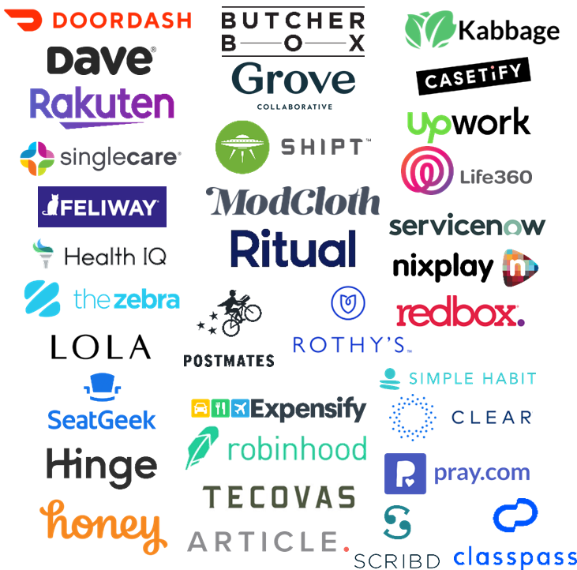
Drives people to branded digital storefronts
9
After TV launches, digital-native brands see a surge of new customers to their online storefronts, with continued lifts through their campaign
36 ‘Emerging’ Direct-to-Consumer (DTC) Brands*
Average Monthly Website Unique Visitors (000)
Based Over a Four-Year Time Period: Jan ‘16 – Jan ‘20
TV Campaign Duration
36 DTC Brands Analyzed
+85%
(+1.6MM monthly uniques)
+56%
(+1.0MM monthly uniques)
vs. monthly average prior to TV launch
vs. monthly average prior to TV launch
(monthly average)
(TV launch – January 2020)
Source: VAB analysis of Nielsen Ad Intel data, TV spend (national cable TV, national broadcast TV, Spanish language broadcast TV, Spanish language cable TV, spot TV, syndication TV), Feb ‘18 – Jan ‘20 (calendar months). VAB analysis of Comscore mediametrix multiplatform media trend data, total audience (Desktop P2+, Mobile 18+), Jan ‘16 – Jan ‘20 (calendar months). ‘Prior to TV Launch’ reflects the average monthly unique visitors based on when each brand’s website began being measured by Comscore, or starting from January 2016 if measurement began before that month. *Reflects the 36 brands that are measured in Comscore and had reported monthly unique visitors in at least one month prior to their campaign launch.
Want to learn more? Click here to download ‘Direct Effect’
PAGE 13

Slide 14

























Creates a halo effect for digital actions
10
TV campaigns create a ‘halo effect’ for brands, driving more people
to their website even in months when they are not on TV
25 Business-to-Business (B2B) Brands Analysis
Monthly Website Unique Visitors (000) Comparison
Based Over a Four-Year Time Period: Apr ‘18 – Apr ‘22
25 B2B Brands Analyzed
TV Campaign Duration
+26%
+226K monthly uniques
vs. three months average prior to TV launch
Monthly Average ‘When On TV’
(monthly average)
(TV launch – April 2022)
(TV launch – April 2022)
Source: VAB analysis of Comscore mediametrix multiplatform media trend data, P18+. April 2018 – April 2022 (calendar months), figures are based on monthly averages for the 25 brands analyzed. ‘When On TV’ represents the monthly average for brands in months where they spend on national TV as measured through Nielsen AdIntel across the April 2018 – April 2022 (calendar months) time period across the 25 brands analyzed. ‘When Not On Air’ represents the monthly average for brands in months where they don’t spend on national TV, after their first month of TV spend, as measured through Nielsen AdIntel across the April 2018 – April 2022 (calendar months) time period across the 25 brands analyzed.
Want to learn more? Click here to download ‘Let’s Get Down to Business’
PAGE 14

Slide 15














































Boosts app downloads
11
When app brands advertise on TV, they see significant increases in visits to their digital platforms, including mobile
46 Mobile App Advertisers: Unique Visitors vs. TV Spend
“When Off” & “When On” TV During 15 Month Analysis Time Period
‘When On’ TV Months
+25% more Unique Visitors
+$2.0MM TV Spend
(on average)
Sources: Nielsen AdIntel, (web-based app game product category), TV spend (cable TV, broadcast TV, Spanish language cable TV, Spanish language broadcast TV, syndication TV, spot TV); October 2014 – December 2015. comScore mobile metrix media trend (application access only), unique visitors (P2+), October 2014 – December 2015. Analysis is based on comparison of average monthly unique visitors for “When TV Off” vs. “When TV On” months of activity.
Want to learn more? Click here to download ‘What’s APP’ning!!’
PAGE 15

Slide 16

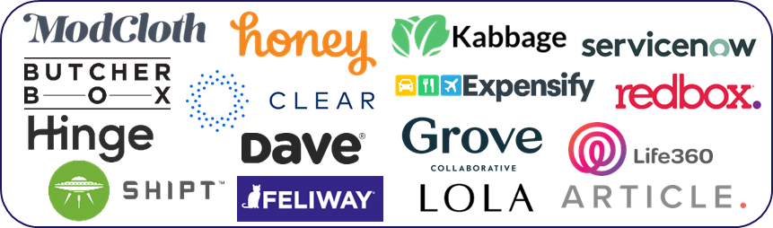

Generates greater intent at all investment levels
12
Brands across all investment levels see substantial and sustained
lifts in website traffic
36 ‘Emerging’ Direct-to-Consumer (DTC) Brands*
Average Monthly Website Unique Visitors (000)
Based Over a Four-Year Time Period: Jan ‘16 – Jan ‘20
$500K - $2MM TV Spend: 12 Brands Analysis
$2MM - $10MM TV Spend: 16 Brands Analysis
$10MM+ TV Spend: 8 Brands Analysis
+205%
(+5.3MM)
+126%
(+3.3MM)
+18%
(+376K)
+34%
(+693K)
+31%
(+338K)
+22%
(+236K)
(monthly average)
(TV launch – Jan ‘20)
(monthly average)
(TV launch – Jan ‘20)
(monthly average)
(TV launch – Jan ‘20)
(% & MM) vs. monthly average prior to TV launch
(% & MM) vs. monthly average prior to TV launch
(% & MM) vs. monthly average prior to TV launch
Source: VAB analysis of Nielsen Ad Intel data, TV spend (national cable TV, national broadcast TV, Spanish language broadcast TV, Spanish language cable TV, spot TV, syndication TV), Feb ‘18 – Jan ‘20 (calendar months). VAB analysis of Comscore mediametrix multiplatform media trend data, total audience (Desktop P2+, Mobile 18+), Jan ‘16 – Jan ‘20 (calendar months). ‘Prior to TV Launch’ reflects the average monthly unique visitors based on when each brand’s website began being measured by Comscore, or starting from January 2016 if measurement began before that month. *Reflects the 36 brands that are measured in Comscore and had reported monthly unique visitors in at least one month prior to their campaign launch.
Want to learn more? Click here to download ‘Direct Effect’
PAGE 16

Slide 17
Lifts website traffic for brands at all life stages
13
No brand is too ‘young’ for TV as advertisers across all life stages see
a wave of new customers to their digital platforms after launching on TV
“When On TV” Monthly Average vs. Three-Month Average Prior To TV
Average Website Unique Visitors
Direct-to-Consumer (DTC) Brands
140 brands across 25+ categories
Non-DTC Brands
50 brands across 15+ categories
Three Years Old or Younger
(40 brands)
Between Four – Seven Years Old
(60 brands)
Eight Years or Older
(40 brands)
Under Twenty Years Old
(25 brands)
Over Twenty Years Old
(25 brands)
+138%
+72%
+23%
+50%
+21%
Unique Visitors % increase:
Unique Visitors increase:
+811K
+1,383K
+803K
+2,302K
+315K
Source: VAB analysis of Nielsen Ad Intel data, TV spend (national cable TV, national broadcast TV, Spanish language broadcast TV, Spanish language cable TV, spot TV, syndicated TV), Jun ‘16 – Jun ’20 (calendar months). VAB analysis of Comscore mediametrix multiplatform (desktop + mobile) media trend data; P18+, Jun ’16 – Jun ‘20 (calendar months).
Want to learn more? Click here to download ‘The Halo Effect’
PAGE 17

Slide 18








Converts best prospects for niche brands
14
Brands with niche targets are using audience-based buying to reach their best customer prospects and drive them to their digital platforms
Sampling of Business-to-Business Brands: Monthly Website Unique Visitors (000) Comparison
Based Over a Four-Year Time Period: Apr ‘18 – Apr ‘22
Brand | B2B Category | Three-Month Average: Prior to TV Launch | Monthly Average: ‘When On TV’ | # Diff (000) | % Diff
 | Software | 71 | 153 | +82 | +115%
 | Graphic Design | 5,281 | 9,480 | +4,199 | +80%
 | Security | 217 | 644 | +427 | +197%
 | Expense Mgmt. | 240 | 477 | +237 | +99%
 | Banking/Finance | 118 | 241 | +123 | +105%
 | Software | 142 | 306 | +164 | +116%
 | Staffing | 118 | 163 | +45 | +38%
 | Software | 1,288 | 1,723 | +434 | +34%
 | Comm. Real Estate | 144 | 419 | +275 | +191%
 | Freelancing | 1,542 | 1,759 | +216 | +14%
 | Software | 387 | 698 | +312 | +81%
 | Human Resources | 15 | 156 | +141 | +929%
Source: VAB analysis of Comscore mediametrix multiplatform media trend data, P18+. April 2018 – April 2022 (calendar months), figures are based on monthly averages for the 25 brands analyzed. ‘When On TV’ represents the monthly average for brands in months where they spend on national TV as measured through Nielsen AdIntel across the April 2018 – April 2022 (calendar months) time period across the 25 brands analyzed.
Want to learn more? Click here to download ‘Let’s Get Down to Business’
PAGE 18

Slide 19







Motivates younger audiences to act
15
TV campaigns for younger-targeted, disruptor brands inspire engagement and online conversion
Sampling of Younger-Skewing Disruptor Brands
Monthly Website Unique Visitors (000) Comparison
Based Over a Four-Year Time Period: Jan ‘16 – Jan ‘20
Based Over a Four-Year Time Period: Mar ‘16 – Feb ’19
Brand | Monthly Average: Prior to TV Launch | Monthly Average: TV Launch – Jan ‘20 | # Diff | % Diff
 | 5,467 | 22,020 | +16,553 | +303%
 | 2,920 | 3,923 | +1,003 | +34%
 | 765 | 1,662 | +897 | +117%
 | 549 | 1,081 | +532 | +97%
 | 286 | 474 | +188 | +66%
Brand | Monthly Average: Prior to TV Launch | Monthly Average: TV Launch – Feb ‘19 | # Diff | % Diff
 | 2,471 | 10,549 | +8,078 | +327%
 | 5,978 | 13,812 | +7,833 | +131%
 | 1,309 | 1,630 | +321 | +25%
 | 1,584 | 3,008 | +1,424 | +90%
 | 254 | 1,324 | +1,070 | +422%
Source: Direct Effect - VAB analysis of Nielsen Ad Intel data, TV spend (national cable TV, national broadcast TV, Spanish language broadcast TV, Spanish language cable TV, spot TV, syndication TV), Feb ‘18 – Jan ‘20 (calendar months). VAB analysis of Comscore mediametrix multiplatform media trend data, total audience (Desktop P2+, Mobile 18+), Jan ‘16 – Jan ‘20 (calendar months). ‘Prior to TV Launch’ reflects the average monthly unique visitors based on when each brand’s website began being measured by Comscore, or starting from January 2016 if measurement began before that month. Direct Outcomes - Source: VAB analysis of Nielsen Ad Intel data, TV spend (national cable TV, national broadcast TV, Spanish language broadcast TV, Spanish language cable TV, spot TV, syndication TV), March ‘15 – February ‘19 (calendar months). VAB analysis of Comscore mediametrix multiplatform media trend data, total audience (Desktop P2+, Mobile 18+), March ’15 – February ’19 (calendar months). ‘Prior to TV Launch’ reflects the average monthly unique visitors based on when each brand’s website began being measured by Comscore, or starting from March 2015 if measurement began before that month.
Want to learn more? Click here to download ‘Direct Effect’ and ‘Direct Outcomes’
PAGE 19

Slide 20



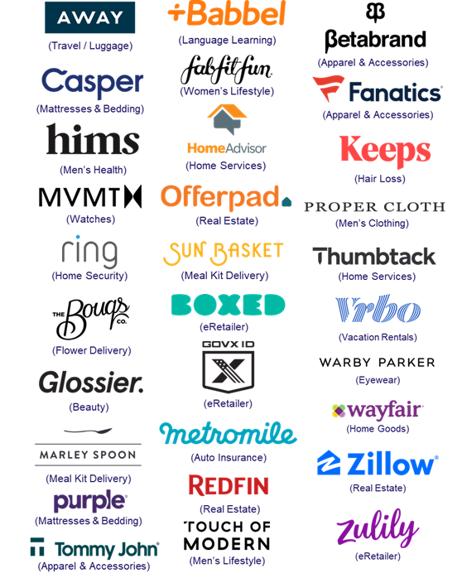
Grows customer acquisition
16
TV campaigns drive increased digital platform engagement with
high-value customers who are more likely to become repeat visitors
Key Website Metrics: 30 Direct-to-Consumer Brand Average
1Q ‘21 vs. 1Q ‘17*: Monthly Avg Comparison
30 DTC Brands Analyzed
Unique Visitors (000)
Total Visits (000)
Total Minutes (MM)
# Difference
+3,156
+22,184
+95
% Difference
+63%
+135%
+89%
Total U.S. Internet Avg
% Difference
+10%
+26%
+34%
Source: VAB analysis of Comscore mediametrix multiplatform media trend data, P18+. 1Q ’17: January – March ’17, 1Q ’21: January – March ‘21 (calendar months), figures are based on monthly averages for each 3-month time period across the 30 brands analyzed. *1Q ’17 (Jan-Mar ’17) is reflective of the first 3-month measurement period available and is inclusive of a few brands that were first measured after this time period, based on their first 3-month measurement period. 30 brands total TV spend (between 1Q ‘17 – 1Q’21): $3.3B.
Want to learn more? Click here to download ‘The Secret of My Success’
PAGE 20

Slide 21



Ignites short-term business performance
17
TV is the catalyst for short-term business results, igniting revenue growth for brands during the launch year of their first TV campaign
Company
Year Prior to TV
TV Launch Year
YoY Diff
%
=revenue increase after launching TV
(TV launch: 2018)
TV Spend (000):
---
$7,662
+$7,662
Revenue (000):
$317,755
$425,841
+$108,086
+34%
Founded in 2005
(TV launch: 2018)
TV Spend (000):
---
$10,548
+$10,548
Revenue (000):
$48,000
$150,000
+$102,000
+213%
Founded in 2013
(TV launch: 2017)
TV Spend (000):
---
$3,438
+$3,438
Founded in 2012
Revenue (000):
$100,000
$150,000
+$50,000
+50%
(TV launch: 2017)
TV Spend (000):
---
$535
+$535
Founded in 2011
Revenue (000):
$50,000
$100,000
+$50,000
+100%
(TV launch: 2017)
TV Spend (000):
---
$2,670
+$2,670
Revenue (000):
$60,000
$80,000
+$20,000
+33%
Founded in 2013
Source: Revenues reflect estimated revenue data from Pivotal Research. TV spend based on VAB analysis of Nielsen Ad Intel data, TV spend (national cable TV, national broadcast TV, Spanish language broadcast TV, Spanish language cable TV, spot TV, syndication TV), CY 2016 & 2017 &TV spend based on VAB analysis of Nielsen Ad Intel data, TV spend (national cable TV, national broadcast TV, Spanish language broadcast TV, Spanish language cable TV, spot TV, syndication TV), CY 2016-2018. Revenues for public companies are based on company filings (10-K) for U.S. revenue via SEC.gov (EDGAR). Revenues for private companies are based on reports/projections/guidance provided publicly by company founders/representatives, or analyst estimates/forecasts, and reported within business/technology news outlets such as Bloomberg, CNBC, Digiday, Forbes, Inc., Recode, TechCrunch, WSJ, etc.
Want to learn more? Click here to download ‘Direct Impact’ and ‘Direct Outcomes’
PAGE 21

Slide 22





Increases long-term sales
18
Brands see a correlation between increases in their TV investment
and growth in annual revenues
Time Period
CAGR*
Brand
2017
2020
U.S. Revenue (000)
$230,106
$485,028
+28%
Rolling Cume TV Spend (000)
$18,777
$119,923
+86%
U.S. Revenue (000)
€18,838
€127,220
+89%
Rolling Cume TV Spend (000)
$364
$2,937
+101%
U.S. Revenue (000)
$370,036
$886,093
+34%
Rolling Cume TV Spend (000)
$10,080
$72,878
+93%
U.S. Revenue (000)
$4,153,057
$11,900,658
+42%
Rolling Cume TV Spend (000)
$105,794
$450,889
+62%
U.S. Revenue (000)
$1,076,794
$3,339,817
+46%
Rolling Cume TV Spend (000)
$44,180
$155,449
+52%
Sources: Revenues are based on company filings (10-K) via sources such as SEC.gov (EDGAR) and S&P Global Market Intelligence. TV spend based on VAB analysis of Nielsen Ad Intel data (national cable TV, national broadcast TV, Spanish language broadcast TV, Spanish language cable TV, spot TV, syndication TV). For comparison purposes, rolling cume TV spend based only on the time period between CY 2017-2020, with 2020 cume TV spend based on aggregated spending across the time period beginning in CY 2017. Casper revenues are based on North America. Marley Spoon U.S. revenues were reported in euros. *CAGR = compound annual growth rate (i.e., mean annual growth across the time period).
Want to learn more? Click here to download ‘The Secret of My Success’
PAGE 22

Slide 23

Successfully launches new products
AppleTV+’s consistent TV presence drove adoption and engagement of their new streaming service as total time spent on the platform grew in line with their TV investment
19
Apple TV+ - Cumulative Monthly U.S. Total TV Spend & Time Spent
Nov ’19 – Dec ‘20
Cume TV spend:
$174.7 MM
(Nov ‘19 launch – Dec ’20)
How to read - example: Dec ‘20 represents total measured time spent & TV spend from Nov ‘19 – Dec ’20 for Apple TV+
Source: VAB analysis of Nielsen AdIntel, Nov ‘19 – Dec ‘20 (calendar months). TV spend includes cable TV, broadcast TV, Spanish language cable TV, Spanish language broadcast TV, spot TV, and syndicated TV. U.S. TV spend only. VAB analysis of Comscore mediametrix multiplatform media trend data, total audience (Desktop P2+, Mobile 18+), Nov ‘19 – Dec ‘20 (calendar months), data represents Apple TV (mobile app).
Want to learn more? Click here to download ‘Analyzing Outcomes From The Tech Giants’ TV Investment’
PAGE 23

Slide 24
Transforms challengers into market leaders
Joe Biden found the path to victory for the 2020 Presidential Election by heavying up on his TV investment as election night drew closer
20
For Biden, a continuous advertising presence built ‘brand salience’ – top of mind awareness that creates a propensity of a brand to be thought of in ‘buying’ situations (or, in this case, when ready to vote)
2020 Presidential General Election: Weekly TV Spend
(Candidate, Party & Issue-Based)
$ in Millions, 6/16/20 – 11/2/20
(Biden)
(Trump)
Source: VAB analysis of Kantar CMAG Political Competitive Data Gathering, 2020 Presidential Election data measured from 6/16/20 to 11/2/20 across general election ‘heavy-up period’ spend. Political weeks begin Tuesdays and end Mondays. TV Platforms: Cable TV, Broadcast TV (including Spanish Language Broadcast TV), Spanish Language Broadcast TV and Satellite TV. Candidate represents spend from only the candidates. Party represents spend from the political party and candidate/party co-op. Issue-Based represents spend from election-affiliated third-party sources (e.g. PACs, The Lincoln Project, NRA Victory Fund, Republican Voters Against Trump). Note: Biden invested over $15MM in TV during 12 separate weeks vs. 7 for Trump.
Want to learn more? Click here to download ‘Lessons Brands Can Learn From the Impact of Presidential Election Ad Spending’
PAGE 24

Slide 25


Strengthens share of market
Microsoft Teams utilized TV to increase their SOV which enabled
them to take significant ‘share of market’ from a major competitor
21
By quickly pivoting to recognize a new consumer demand and driving share of voice (SOV) behind its relevant product, Microsoft Teams established itself as the leading business communications platform through $172 MM in TV investment
10-Month COVID Time Period vs. Previous 10-Months
May ’19 - Feb ‘20
Mar ’20 - Dec ‘20
% Change
Total U.S. TV Spend
$20.0 MM
$152.4 MM
+661%
Avg. Monthly Unique Visitors
11.8 MM
32.3 MM
+173%
Time Period Cume Total Hours Spent
68.5 MM
379.1 MM
+453%
May ’19 - Feb ‘20
Mar ’20 - Dec ‘20
% Change
Total U.S. TV Spend
N/A
$0.5 MM
N/A
Avg. Monthly Unique Visitors
5.1 MM
4.9 MM
-6%
Time Period Cume Total Hours Spent
101.1 MM
49.3 MM
-51%
Source: VAB analysis of Nielsen AdIntel, calendar months of May 2019 - December 2020. TV spend includes cable TV, broadcast TV, Spanish language cable TV, Spanish language broadcast TV, spot TV, and syndicated TV. U.S. TV spend only. VAB analysis of Comscore mediametrix multiplatform media trend data, total audience (Desktop P2+, Mobile 18+), May ‘19 – Dec ‘20 (calendar months)
Want to learn more? Click here to download ‘Analyzing Outcomes From The Tech Giants’ TV Investment’
PAGE 25

Slide 26
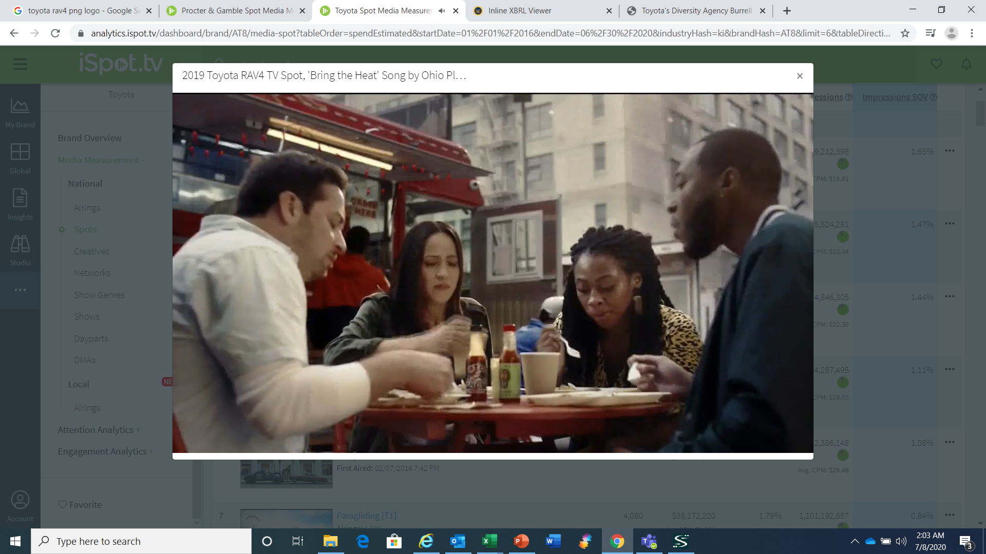
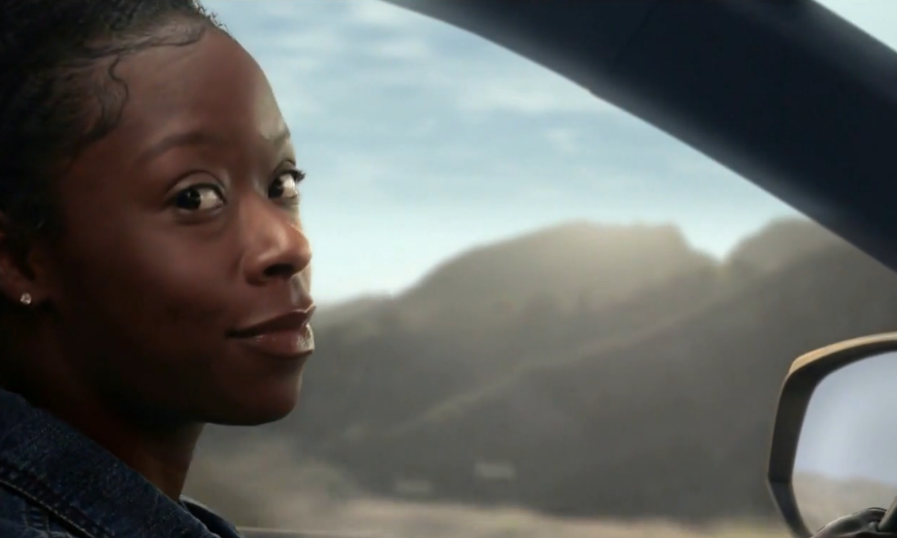
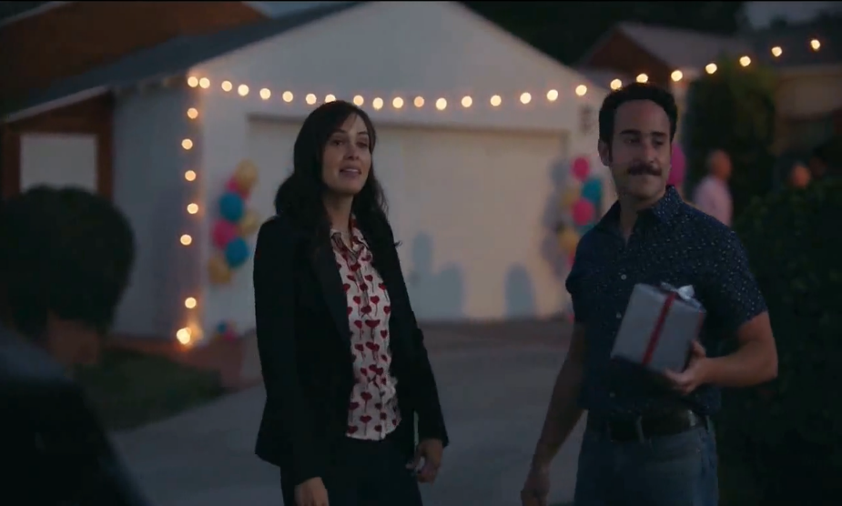
Inspires multicultural audiences to purchase
22
TV campaigns that feature strong diversity, inclusivity and empowering messaging increase sales among multicultural audiences
Toyota’s RAV4 authentically connects with diverse audiences through TV campaigns that feature inclusivity and female empowerment messaging which has aided the brand in becoming the best-selling SUV in America.
Rav4 casts people of all ethnicities within their advertising campaigns and have created a host of Spanish-language ads. Additionally, the brand also created a Super Bowl ad with a female empowerment message about shattering perceptions.
Results: 2019 was Toyota RAV4’s highest annual unit sales ever and marked their eighth straight year of successive unit growth. In fact, RAV4 sold 130K+ units more than they did five years ago in 2015. Their Hybrid model is doing particularly well, posting a 92% increase YoY.
‘Bring The Heat’ TV spot - $42.0 MM
12-Month Campaign:
2/4/19 – 2/2/20
4,865 Airings / 1,874.8 MM HH IMPs
‘Toni’ TV spot - $21.6 MM
10-Month Campaign:
1/29/19 – 11/24/19
284 Airings / 330.5 MM HH IMPs
13 Spanish-Language TV spots - $22.6 MM
Various Flights: 1/12/16 – 3/29/20
7,018 Airings / 933.8 MM HH IMPs
Business Outcomes
Annual U.S. Unit Sales: +42% increase
in RAV4 vehicles sold annually in the U.S. over the last five years between 2015 and 2019 (315,142 vs. 448,071).
click image above to watch spot
click image above to watch spot
click image above to watch spot
Source: VAB analysis of iSpot.tv TV occurrence data, time period: 1/1/16 – 6/30/20, estimated media spend. Impressions represent US TV HHs and include activity within measured national broadcast and cable TV linear, national time-shifted, local, VOD and OTT. Revenues are based on Toyota Motor North America’s U.S. Sales Annual Summaries available through their online news pressroom portal.
Want to learn more? Click here to download ‘Do the Right Thing’
PAGE 26

Slide 27










Stimulates capital investment
The excitement, exposure and increased customer base that is
created from new TV campaigns often fuels more investor funding
23
72% of the overall $5 billion in investor funded raised across these 10 private companies during the time period analysis occurred when these brands were ramping up their TV investments to broaden their customer bases
Brand
Year Founded
Total Funding $$$
btwn 2010 – 1Q ‘21
% of Total Funding
btwn 2017 – Aug ’21
Cume TV Spend $$$
(btwn 2010 – 1Q ‘21)
% of Cume TV Spend
btwn 2017 – 1Q ‘21
1995
$2.7 B
74%
$826.4 MM
54%
2008
$698.2 MM
61%
$126.3 MM
58%
2010
$535.5 MM
60%
$298.0 MM
95%
2010
$266.4 MM
87%
$846.0 K
100%
2013
$245.9 MM
45%
$36.2 MM
25%
2015
$155.0 MM
100%
$37.9 MM
100%
2015
$181.0 MM
94%
$40.3 MM
100%
2012
$88.1 MM
78%
$9.1 MM
62%
2010
$83.5 MM
96%
$14.4 MM
100%
2017
$69.8 MM
100%
$72.9 MM
100%
Sources: Funding figures based on VAB analysis of crunchbase.com, as of August 2021. TV spend based on VAB analysis of Nielsen Ad Intel data (national cable TV, national broadcast TV, Spanish language broadcast TV, Spanish language cable TV, spot TV, syndication TV), CY 2010-1Q 2021. Cume TV spend reflects the aggregated spending between CY 2010 – 1Q 2021. Collectively across the 10 private companies, 67% of the cume TV spend was invested between 2017 – 1Q 2021.
Want to learn more? Click here to download ‘The Secret of My Success’
PAGE 27

Slide 28



Stokes company valuations
24
Brands that have expanded their customer base through strong TV launches have become ‘unicorns,’ with valuations over $1 billion
‘Unicorn’ Brands
$1+ Billion Valuations
(as of 1Q ’21)
(Apparel & Accessories)
(Home Services)
(Eyewear)
$12.8 B valuation
$3.2 B valuation
$3.0 B valuation
(cume TV spend*: $895MM)
(cume TV spend:* $126MM)
(cume TV spend*: $283MM)
(Real Estate)
(Beauty)
$3.0 B valuation
(Travel / Luggage)
$1.8 B valuation
(Language Learning)
$1.54 B valuation
(Auto Insurance)
(Hair Loss)
(cume TV spend*: $38MM)
(cume TV spend*: $1MM)
$1.19 B valuation
$1.3 B valuation
(cume TV spend*: $40MM)
$1.0+ B valuation
(cume TV spend*: $26MM)
(cume TV spend*: $91MM)
(cume TV spend*: $79MM)
Sources: based on latest funding and valuation data publicly available through sources including TechCrunch, PitchBook, Bloomberg, Wall Street Journal, Fortune, CNN Money. “Unicorn” = private companies valued at $1 billion+. Keeps valuation is based on parent company, Thirty Madison. “B” = billions. TV spend based on VAB analysis of Nielsen Ad Intel data (national cable TV, national broadcast TV, Spanish language broadcast TV, Spanish language cable TV, spot TV, syndication TV), *cume TV spend based on aggregated spend from CY 2000 - 1Q 2021.
Want to learn more? Click here to download ‘The Secret of My Success’
PAGE 28

Slide 29
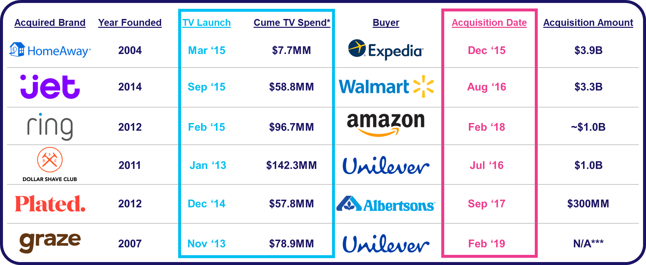
Spurs acquisitions
25
TV drives financial success and often leads to disruptor brands becoming attractive acquisition targets by larger category incumbents
Sources: VAB analysis of Nielsen Ad Intel data, TV spend (national cable TV, national broadcast TV, Spanish language broadcast TV, Spanish language cable TV, spot TV, syndication TV); March ‘15 – February ‘19 (calendar months). Acquisition price based on publicly-released reports. *Cume TV spend reflects the measured TV spend between a brand’s TV launch date and their acquisition month. ** Cume TV spend only goes through February 2019. ***Terms of the acquisition were not disclosed as of April 2019.
Want to learn more? Click here to download ‘Direct Outcomes’
PAGE 29

Slide 30
25 Ways TV Grows Brands:
Powering Performance Through Full-Funnel Business Outcomes
Awareness
Consideration
Intent
Sales
Value Creation
1
2
3
4
5
Legitimizes brands
Turns brands into household names
(Re)Builds brand perception
Enables brands to breakthrough
Provokes search queries
6
7
8
9
10
Piques curiosity for ubiquitous brands
Sparks social conversations
Delivers new
customer prospects
Drives people to branded
digital storefronts
Creates a halo effect
for digital actions
11
12
13
14
15
Boosts app downloads
Generates greater intent at all investment levels
Lifts website traffic for brands at all life stages
Converts best prospects
for niche brands
Motivates younger audiences to act
16
17
18
19
20
Grows customer acquisition
Ignites short-term business performance
Increases long-term
sales
Successfully launches
new products
Transforms challengers into market leaders
21
22
23
24
25
Strengthens
share of market
Inspires multicultural audiences to purchase
Stimulates capital investment
Stokes company valuations
Spurs acquisitions
PAGE 30
click through the appropriate box if you would like to be brought directly to the corresponding slide

Slide 31
Adults over 50 account for 36% of the total population and nearly half of all adults
A few major themes emerge when exploring
the 25 ways TV grows brands:
TV is a performance-driven medium that delivers both
short-term sales and long-term results
TV is brand inclusive and accessible and drives full funnel
outcomes for all types of advertisers - regardless or life stage, size of target audience or budget level
TV’s halo effect increases the efficacy of other marketing efforts resulting in increased search, social, website visitation and app downloads
TV lifts financial impact for brands - stimulating capital investment, stoking company valuations and attracting acquisitions
Key Implications for Marketers
This information is exclusively provided to VAB members and qualified marketers. Further distribution is prohibited.
PAGE 31

Slide 32




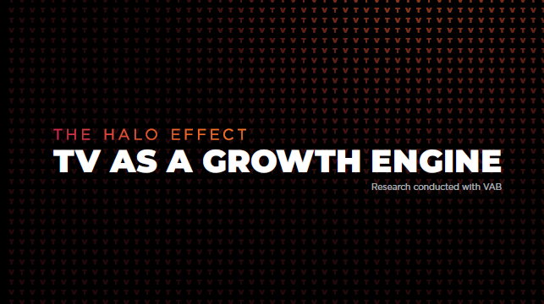
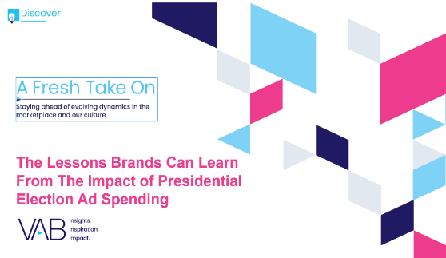



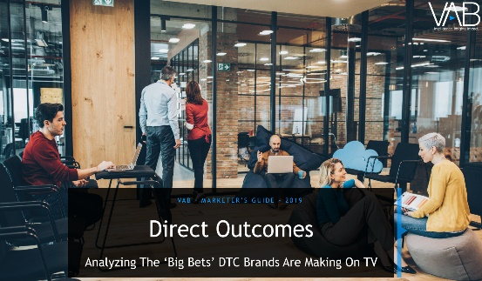

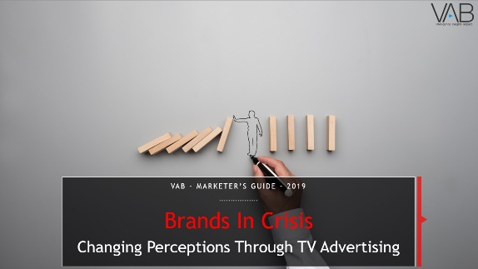



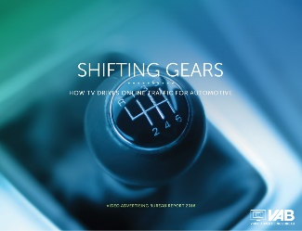

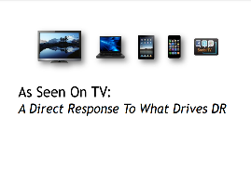
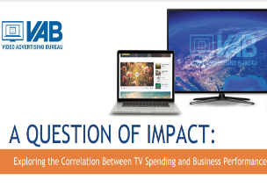





Creators
Jason Wiese
SVP, Director of Strategic Insights
jasonw@thevab.com
Reed Kiely
Leah Montner-Dixon
Karolina Guillen
Associate Insights Director
reedk@thevab.com
Associate Insights Director
leahm@thevab.com
Insights Manager
karolinag@thevab.com
Discover more
Looking for more data, insights and takeaways? Check out this related VAB content
VAB Members, brand marketers and agencies get free and immediate access to VAB’s content library. Get access at theVAB.com
This information is exclusively provided to VAB members and qualified marketers. Further distribution is prohibited.
PAGE 32

Slide 33


About VAB
VAB is an insights-driven organization that inspires marketers to reimagine their media strategies resulting in fully informed decisions.
Drawing on our marketing expertise, we simplify the complexities in our industry and discover new insights that transform the way marketers look at their media strategy.
We are committed to your business growth and proud to offer VAB members, brand marketers and agencies complimentary access to our continuously-growing Insights library. Get immediate access at theVAB.com.
Curious to learn more about VAB? Check out this quick video to see what we do and how we can help you develop business-driving marketing strategies.
This information is exclusively provided to VAB members and qualified marketers. Further distribution is prohibited.
PAGE 33

