Slide 1





Bigger, Bolder & More
Ad-Supported
25 Streaming Trends That Are Impacting Marketing Plans in 2025
March 2025

Slide 2


The ‘mainstreaming’ of ad-supported streaming is ushering in more opportunities
Welcome to our third annual streaming trends report, now bigger and bolder than ever with an emphasis on 25 trends that are shaping the streaming landscape!
As a follow-up to our previous reports, Advertising Accelerated and Setting the Stage, we’re providing the latest updates on streaming behaviors and diving deeper into device and platform usage, the importance of quality content and the continued growth of ad-supported options.
The mainstreaming of ad-supported streaming has cemented its role as a cornerstone of multiscreen TV and premium video strategies and is driving innovation across live sports, retail media and interactive formats which creates new opportunities for brands to connect with engaged audiences.
As streaming claims a larger share of viewership, cross-platform strategies are more important than ever. Dive in to find out more!
This information is exclusively provided to VAB members and qualified marketers.
PAGE 2

Slide 3

25 Streaming Trends That Are Impacting Marketing Plans in 2025
Streaming Audience Behaviors & Attitudes
Devices, Platforms & Services, Oh My!
Ad-Supported Streaming in Focus
Quality Content Counts
1
2
3
4
5
Younger adults have a broader definition of what ‘TV’ means
Non-pay TV HHs are projected to overtake
total pay-TV HHs (w/vMVPD)
Nearly six in 10 adults
are now cordless
Based on age, streaming is either a replacement or complement to traditional TV
Multicultural adults make up 48% of the 18-34 streaming audience
6
7
8
9
10
Streaming now accounts for more than 40% of total time with TV
Convergent TV ad dollars are following the audiences to CTV
More consumers are streaming directly on
smart TVs
Smart TV apps are viewers’ go-to
Majority of smart TV households are ‘streaming only’
11
12
13
14
15
The number of streaming apps used on smart TV has leveled off recently
Viewers are becoming more selective with using streaming services
Multiscreen TV streaming services, in all their forms,
are ubiquitous
Ad-supported streaming
now reaches nine out of 10 streaming adults
Most streamers that watch ads use at least one multiscreen TV platform
16
17
18
19
20
Two-thirds of streaming audiences prefer
ad-supported services
The gap between ad-free and ad-supported subscriptions is closing
Ad tiers are now driving new subscription sign-ups
FAST has increased its
scale as viewership becomes more habitual
Commercial time on FAST has maintained a steady
ad load
21
22
23
24
25
Retail media spending
on CTV platforms is expanding
Audiences enjoy a mix of network-produced shows, movies & streaming originals
As share of time spent increases so does share
of content spend
Live sports drive engagement on streaming platforms
Proliferation of services has driven viewers’ interest in bundling
PAGE 3
click through the appropriate box if you would like to be brought directly to the corresponding slide

Slide 4

1
Streaming Audience Behaviors
& Attitudes

Slide 5


1
Younger adults have a broader definition of what ‘TV’ means to them even as the prominence of the TV set increases within their criteria
How do you personally define TV?
% of video streamers who agree
‘Anything I can watch on my TV set whether it’s
via streaming or cable, satellite, fiber optic’
‘Anything I can watch on any device’
Source: VAB analysis of MRI-Simmons November 2022, November 2023 & November 2024 Cord Evolution Study, A18+. Base = ‘Streamed in the past 12 months.’
This information is exclusively provided to VAB members and qualified marketers.
PAGE 5

Slide 6

2
Non-pay TV HHs are projected to overtake total pay-TV HHs (including vMVPDs) during 2025 with nearly 70 million homes
Share of U.S. Pay TV vs. Non-Pay TV Households
Pay-TV HH universe include vMVPDs
projected*
65.0MM HHs
69.9MM HHs
69.5MM HHs
64.3MM HHs
75.2MM HHs
57.4MM HHs
Source: EMARKETER, Pay TV Households & Viewers, US.. Based on EMARKETER Forecast, October 2024. Note: Pay TV households are those with a subscription to a traditional or digital (vMVPD) pay TV service. Non-Pay-TV households are those without a subscription to a traditional or digital (vMVPD) pay TV service. Additional Note: Traditional pay TV services include cable, satellite, telecom and fiber operators, multiple system operators (MSOs), multichannel video programming distributors (MVPDs), and major TV broadcast and cable networks. Virtual multichannel video programming distributors (vMVPDs) are internet-delivered live TV services (e.g., Hulu + Live TV, Sling TV, YouTube TV). *2025 data based on EMARKETER Forecast projection.
This information is exclusively provided to VAB members and qualified marketers.
PAGE 6

Slide 7



3
Nearly six in 10 adults are now cordless, making video streaming essential for optimizing reach in multiscreen TV campaigns
% of adults 18+ who are ‘Cord Cutters’ or ‘Cord Nevers’
November 2022
November 2024
49%
Total ‘Cordless’
57%
Total ‘Cordless’
29%
Cord Cutters
20%
Cord Nevers
33%
Cord Cutters
24%
Cord Nevers
Source: VAB analysis of MRI-Simmons Cord Evolution Study, November 2022 & November 2024, A18+. ‘Cord Cutters’: no pay-TV; cancelled it, ‘Cord Nevers’: no pay-TV; never had it.
This information is exclusively provided to VAB members and qualified marketers.
PAGE 7

Slide 8

4
Most adults under 50 continue to see streaming as a replacement for traditional TV while older adults are more likely to see it as a complement
‘Streaming has replaced traditional TV for me’
% of video streamers who agree
Source: VAB analysis of MRI-Simmons November 2022, November 2023 & November 2024 Cord Evolution Study, A18+. Base = ‘Streamed in the past 12 months’.
This information is exclusively provided to VAB members and qualified marketers.
PAGE 8

Slide 9
5
Multicultural adults make up a significant share of streaming audiences, underscoring their importance to multiscreen TV campaigns
Multicultural Audiences
% of U.S. A18+ Streaming Population by Age
vs. 37%
of A18+ pop
(103 Index)
vs. 27%
of A50+ pop
(107 Index)
Source: VAB analysis of MRI-Simmons November 2022, November 2023 & November 2024 Cord Evolution Study, A18+. Base = ‘Streamed in the past 12 months.’ ‘Multicultural Audiences’ includes respondents who are of Spanish or Hispanic origin, non-Hispanic Black / African American, non-Hispanic Asian, non-Hispanic American Indian or Alaska Native and non-Hispanic other.
This information is exclusively provided to VAB members and qualified marketers.
PAGE 9

Slide 10
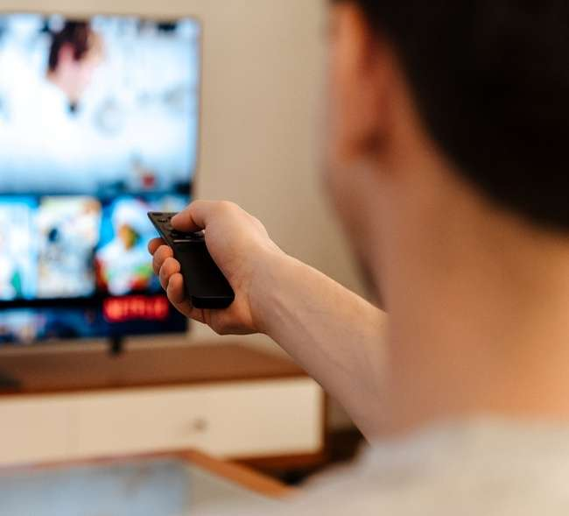
6
Streaming now accounts for more than 40% of total time with TV as the shift in viewership has increased over the last year
Share of Monthly Time Spent With TV
Jan ‘25
Jan ‘24
Feb ‘23
Source: VAB analysis of Nielsen, ‘The Gauge’, February 2023, January 2024 & January 2025, Total Day, P2+, ‘Other’ includes all other TV including all other tuning (unmeasured sources), unmeasured video on demand (VOD), audio streaming, gaming and other device (DVD playback) use. Nielsen implemented some methodological changes to The Gauge in February 2023 which is why we’ve included Feb ’23 and not Jan ’23.
This information is exclusively provided to VAB members and qualified marketers.
PAGE 10

Slide 11

7
Overall TV ad spend growth is being driven by CTV as marketers look to further engage with the platform’s rapidly expanding audiences
U.S. TV and Connected TV (CTV) Ad Spend
in billions
$88.2
$87.0
$92.0
$82.4
$82.0
$84.9
Source: EMARKETER Forecast, November 2024. Note: CTV includes digital advertising that appears on CTV devices, includes display ads that appear on home screens and in-stream video ads that appear on CTVs from platforms like Hulu, Roku and YouTube, and excludes network-sold inventory from traditional linear TV and addressable TV advertising; traditional TV includes broadcast TV (network, syndication and spot) and cable TV, and excludes digital.
This information is exclusively provided to VAB members and qualified marketers.
PAGE 11

Slide 12

2
Devices, Platforms & Services,
Oh My!

Slide 13
8
Consumers are shifting more towards streaming directly through their smart TV, as they move away from sticks and boxes
Share of Total Hours by Device Type
August 2020
August 2024
Source: Comscore at ARF OTT 2024, Comscore Annual State of Streaming Report 2024, 10/23/2024. Note: ‘Other’ consists primarily of video game consoles.
This information is exclusively provided to VAB members and qualified marketers.
PAGE 13

Slide 14
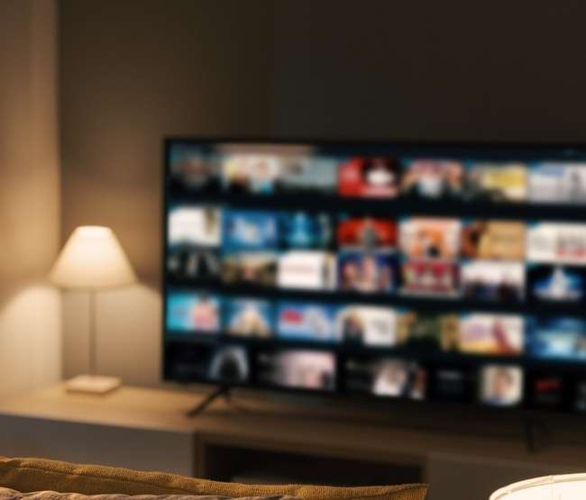
9
Among smart TV homes, built-in apps have become the default access point for TV viewing over any other device
Default Devices for Watching TV
Source: Hub Entertainment, Decoding The Default, August 2024. Note: Smart TV built-in apps refer to both pre-installed apps and those that the owner installs. *TV: Streaming media player (net), e.g., Roku, Fire TV, Apple TV.
This information is exclusively provided to VAB members and qualified marketers.
PAGE 14

Slide 15
10
Smart TV HHs are now primarily accessing content through streaming, making it essential for marketers to prioritize CTV strategies
% of Smart TVs: Streaming vs. Cable / Satellite / OTA
Source: Inscape, TV Market Trends Report, Q2 2024. Inscape TV Panel. Base: Opted-In Inscape TVs with at least one minute of app viewing. Streaming includes viewership on vMVPDs and 3P streaming devices. Gaming console viewing is not included in these calculations. Results do not add up to 100% due to rounding.
This information is exclusively provided to VAB members and qualified marketers.
PAGE 15

Slide 16
11
The number of native apps used quarterly on smart TVs has leveled off as consumers take an intentional approach with their consumption
Average Number of Native Apps Used by Smart TVs that Streamed
Source: Inscape, TV Market Trends Report, Q2 2024. Base: Opted-in Inscape TVs with at least one minute of app viewing. Streaming includes viewership on vMVPDs. Gaming console viewing is not included in these calculations.
This information is exclusively provided to VAB members and qualified marketers.
PAGE 16

Slide 17
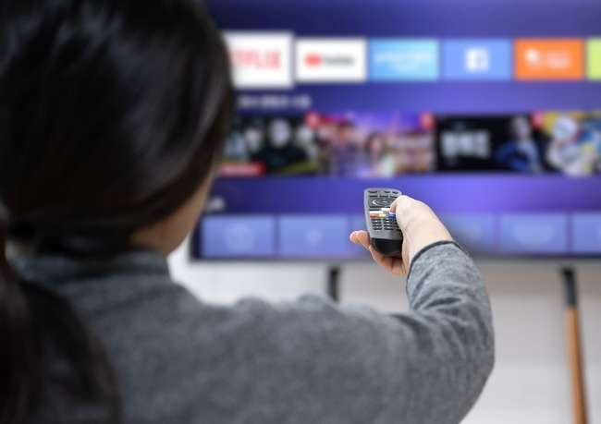

12
Audiences are streamlining how they access content and being more selective with which streaming services they use
11
Average # of streaming services used in the past 12 months
(Down from 13 in 2023)
Source: MRI-Simmons, From Cable to Clicks: The Evolution of American TV Habits, 2025. Audience insights from MRI-Simmons’ 2024 Cord Evolution Study. Streaming services Includes a mix of ad-supported, ad-free, paid subscriptions, free services and TV network apps. Ad-supported includes YouTube, Prime Video, Tubi, Hulu, Roku, Netflix, Disney+, Pluto TV, Peacock, YouTube Music, ESPN+, Paramount+, ESPN, Fox Sports, Paramount, Max, YouTube Kids, Hallmark TV and Samsung TV Plus;
non-ad supported includes Netflix, AppleTV+, Disney+, Prime Video, YouTube Premium, Max, Hulu, Starz, Paramount+, AMC+.
This information is exclusively provided to VAB members and qualified marketers.
PAGE 17

Slide 18

13
Multiscreen TV streaming platforms are ubiquitous and collectively now have over 90% penetration of streamers across all key age demos
% of streamers who have used a network TV app or streaming service owned by a multiscreen TV company
Last 30 days*
Source: VAB analysis of MRI-Simmons November 2022 & November 2024 Cord Evolution Study, A18+. *Q: Non ad-supported and ad-supported streaming services used in the past 30 days. Base = ‘streamed in the past 12 months’. Note: To be considered a multiscreen TV app you must be a TV network, or an associated streaming app (e.g., Adult Swim, NBC) or an MVPD app (e.g., Spectrum, Xfinity) or a service owned by one of the major multiscreen TV companies (e.g., Disney+, Max, Paramount+).
This information is exclusively provided to VAB members and qualified marketers.
PAGE 18

Slide 19
3
Ad-Supported Streaming in Focus

Slide 20

14
Through organic platform growth and the launch of new ad tiers,
ad-supported streaming now reaches nine out of 10 streaming adults
% of streamers who used at least one ad-supported streaming service
Last 30 Days
Source: VAB analysis of MRI-Simmons November 2022 & November 2024 Cord Evolution Study, A18+. Base = ‘streamed in the past 12 months’. November ’22: reflects % of streamers who have used any ad-supported streaming service in the past 30 days. November ’24: reflects % of streamers who have used any ad-supported streaming services in the past 30 days.
This information is exclusively provided to VAB members and qualified marketers.
PAGE 20

Slide 21

15
Most people that are watching ads on streaming services are specifically using at least one ad-supported multiscreen TV platform
Within multiscreen TV platform streamers, % who use an ad-supported service or tier: A18+: 83%; A18-34: 85%; A35-49: 84%; A50+: 81%
% of streamers who have used a network TV app or ad-supported streaming service owned by a multiscreen TV company*
Last 30 Days
Source: VAB analysis of MRI-Simmons November 2022 & November 2024 Cord Evolution Study, A18+. Q: Ad-supported streaming services used in the past 30 days. Base = ‘streamed in the past 12 months’. Note: To be considered a multiscreen TV app you must be a TV network, or an associated streaming app (e.g., Adult Swim, NBC) or an MVPD app (e.g., Spectrum, Xfinity) or a service owned by one of the major multiscreen TV companies (e.g., Disney+, Max, Paramount+)
This information is exclusively provided to VAB members and qualified marketers.
PAGE 21

Slide 22

16
Two-thirds of streaming audiences have consistently preferred ad-supported services and tiers for the cost benefit and value exchange
‘I prefer streaming free video content with ads / commercials instead of paying for a subscription without ads / commercials’
% of video streamers that agree
Source: VAB analysis of MRI-Simmons November 2022, November 2023 & November 2024 Cord Evolution Study, A18+. ‘I prefer streaming free video content with ads/commercials instead of paying for a subscription without ads/commercials’ (strongly / somewhat agree). Base = ‘Streamed in the past 12 months’.
This information is exclusively provided to VAB members and qualified marketers.
PAGE 22

Slide 23
17
While total streaming subscriptions still skew towards ad-free, the gap with ad-supported subscriptions is steadily closing
Share of Total Quarterly Subscriptions
Source: Antenna, A Closer Look at the Growth in Ad-Supported Streaming, 2024. Note: US only. Services measured are AMC+, BET+, Discovery+, Disney+, Hulu, Max, Netflix, Paramount+ and Peacock.
This information is exclusively provided to VAB members and qualified marketers.
PAGE 23

Slide 24
18
Ad tiers are now driving new streaming subscription sign-ups, which signals a shift in preference toward lower-cost, ad-supported options
Share of Quarterly Gross Subscriptions
Source: Antenna, A Closer Look at the Growth in Ad-Supported Streaming, 2024. Note: US only. Services measured are AMC+, BET+, Discovery+, Disney+, Hulu, Max, Netflix, Paramount+ and Peacock.
This information is exclusively provided to VAB members and qualified marketers.
PAGE 24

Slide 25

19
FAST services are achieving meaningful scale as viewership becomes more habitual and advertising opportunities increase
% of U.S. adult 18+ streamers that watch FAST
(Free Ad-supported Streaming TV) services
Last 30 Days
Source: VAB analysis of MRI-Simmons November 2022 & November 2024 Cord Evolution Study, A18+. Base = ‘streamed in the past 12 months’. November ‘24: Used any of these FAST services in the past 30 days: (includes Freevee, Local Now App, Plex, Pluto TV, Roku Channel, Samsung TV Plus, Tubi, Xumo Play). November ‘22: Used any of these FAST services in the past 30 days: (includes Freevee, Local Now, Roku Channel, Peacock Free, Pluto TV, Samsung TV Plus, Xumo, Bloomberg, Plex).
This information is exclusively provided to VAB members and qualified marketers.
PAGE 25

Slide 26

20
Commercial time on FAST has maintained a stable nine-minute ad load, striking a balance between monetization and viewer experience
Average Commercial Minutes Per Hour on FAST
Source: Wurl Analytics, The CTV Trends Report 2024. Note: Based on data across Wurl’s partnerships with more than 4,000 FAST channels and streaming services.
This information is exclusively provided to VAB members and qualified marketers.
PAGE 26

Slide 27





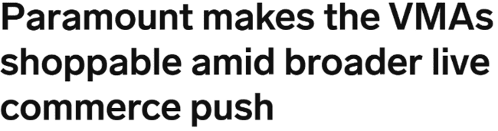

21
Retail media through connected TV is expanding data partnerships and shoppable advertising opportunities on streaming platforms
U.S. Retail Media Connected TV Ad Spending
In billions
Sampling of Recent News about Retail Media
1/30/25
11/26/24
Walmart and NBCU bring shoppable ads, outcomes measurement to live sports
5/9/24
9/12/24
5/8/24
Source: EMARKETER Forecast, November 2024. Note: Digital advertising that appears on websites or apps that are primarily engaged in retail ecommerce or is bought through a retailer's media network or demand-side platform (DSP); examples of websites or apps primarily engaged in retail ecommerce include Amazon, Walmart, and eBay; examples of retail media networks include Amazon's DSP and Etsy's Offsite Ads; includes ads purchased through retail media networks that may not appear on ecommerce sites or apps. Additional Note: Includes advertising that appears on desktop and laptop computers as well as mobile phones, tablets, and other internet-connected devices, and includes all the various formats of advertising on those platforms.
This information is exclusively provided to VAB members and qualified marketers.
PAGE 27

Slide 28
4
Quality Content Counts

Slide 29
22
Audiences enjoy a mix of network-produced shows, blockbuster movies and streaming originals, appreciating familiarity and variety
Top Drivers to Use / Subscribe to a Streaming Service*
% of streamers
Source: The Ankler, Streaming Libraries: Next War in the Retention Economy, 1/23/25. *VAB analysis of MRI-Simmons November 2022 & November 2024 Cord Evolution Study, A18+. Base = ‘streamed in the past 12 months’. **e.g., Stranger Things, Handmaids Tale, The Crown, etc. ***Old and new releases. ****Reflects respondents who selected ‘Series that no longer air on traditional TV networks (e.g., Friends, How I Met Your Mother, Friday Night Lights, etc.’ OR ‘Series that are currently airing on traditional TV networks (e.g., The Walking Dead, The Good Place, This Is Us, etc.)’
This information is exclusively provided to VAB members and qualified marketers.
PAGE 29

Slide 30
23
As share of time spent increases, so does share of content spend as streaming platforms look to increase engagement across more viewers
Global Content Spend by Company Type
% Share
Source: Ampere Analysis, February 2025.’All Others’ include commercial broadcasters, public broadcasters, theatrical studios and Pay-TV networks.
This information is exclusively provided to VAB members and qualified marketers.
PAGE 30

Slide 31



24
Live sports streaming has seen significant viewership growth as leagues, such as the NFL, expand their digital presence
P2+ Average Audience (Weekly Average, Per Min)
2024 Exclusive Streaming Games vs. 2023 Comparable Games
Peacock Exclusive
9/6 Packers @ Eagles
Black Friday
11/29 Raiders @ Chiefs
Christmas
Chiefs @ Steelers
Ravens @ Texans
14.0 MM
13.5 MM
24.3 MM
+91%
vs. 2023
12/23 Bills @ Chargers (Peacock)
+41%
vs. 2023
11/24 Dolphins @ Jets (Amazon Prime)
-16%
vs. 2023
Raiders @ Chiefs (CBS)
Giants @ Eagles (Fox)
Click here to download VAB’s full report to learn more, ‘Huddle Up! A Look Inside the NFL’s 2024 Season Viewership Evolution’
Source: VAB analysis of Nielsen Ratings Analysis Program Report, Peacock Exclusive (Peacock Streaming Data), Black Friday (Amazon Prime (incl local broadcast for in-game markets only)), Christmas (Exclusive game on Netflix). Live+SD, P2+, Panel data. CBS and Fox reflects linear TV audience only and does not include audiences gained from their digital / app streaming. The comparable games reflect the same event or streaming service that aired NFL primetime games in 2023. The Christmas two games on Netflix is compared to the Christmas games that aired on linear TV in 2023 at the same daypart (afternoon games).
This information is exclusively provided to VAB members and qualified marketers.
PAGE 31

Slide 32


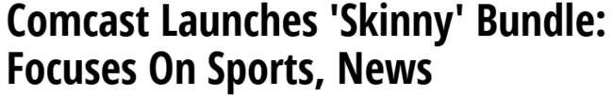

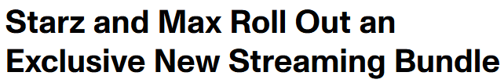


25
As services have proliferated, viewers are increasingly drawn to bundling to get access to more content with streamlined payment
Sampling of Recent News about Streaming Bundles
1/23/25
67%
of U.S. adults 18+ are interested in a service that bundles multiple streaming platforms with a single payment
1/22/25
12/4/24
+5% vs. August 2023
Source: Ipsos as cited in company blog, October 18, 2024. Note: ages 18+. Based on August 2023 vs. August 2024. Reflects respondents who answered ‘somewhat interested’ or ‘very interested’.
This information is exclusively provided to VAB members and qualified marketers.
PAGE 32

Slide 33
25 Streaming Trends That Are Impacting Marketing Plans in 2025
Streaming Audience Behaviors & Attitudes
Devices, Platforms & Services, Oh My!
Ad-Supported Streaming in Focus
Quality Content Counts
1
2
3
4
5
Younger adults have a broader definition of what ‘TV’ means
Non-pay TV HHs are projected to overtake
total pay-TV HHs (w/vMVPD)
Nearly six in 10 adults
are now cordless
Based on age, streaming is either a replacement or complement to traditional TV
Multicultural adults make up 48% of the 18-34 streaming audience
6
7
8
9
10
Streaming now accounts for more than 40% of total time with TV
Convergent TV ad dollars are following the audiences to CTV
More consumers are streaming directly on
smart TVs
Smart TV apps are viewers’ go-to
Majority of smart TV households are ‘streaming only’
11
12
13
14
15
The number of streaming apps used on smart TV has leveled off recently
Viewers are becoming more selective with using streaming services
Multiscreen TV streaming services, in all their forms,
are ubiquitous
Ad-supported streaming
now reaches nine out of 10 streaming adults
Most streamers that watch ads use at least one multiscreen TV platform
16
17
18
19
20
Two-thirds of streaming audiences prefer
ad-supported services
The gap between ad-free and ad-supported subscriptions is closing
Ad tiers are now driving new subscription sign-ups
FAST has increased its
scale as viewership becomes more habitual
Commercial time on FAST has maintained a steady
ad load
21
22
23
24
25
Retail media spending
on CTV platforms is expanding
Audiences enjoy a mix of network-produced shows, movies & streaming originals
As share of time spent increases so does share
of content spend
Live sports drive engagement on streaming platforms
Proliferation of services has driven viewers’ interest in bundling
PAGE 33
click through the appropriate box if you would like to be brought directly to the corresponding slide

Slide 34
Adults over 50 account for 36% of the total population and nearly half of all adults
The ‘mainstreaming’ of streaming is creating more opportunities for investment in premium video
As streaming reshapes consumer perceptions of TV, more marketers are shifting ad spend across premium video platforms to follow evolving viewer behaviors
While audiences are streamlining their streaming services
and becoming more intentional with how they consume content, multiscreen TV platforms have collectively reached near-ubiquity across key demos which creates many cross-platform opportunities for brands
The pendulum for new streaming subscriptions has swung towards ad-supported tiers which creates greater scale for brands to reach highly engaged audiences, especially through innovative ad executions
Viewers gravitate towards services that provide, and invest in, high quality content - such as acquired libraries, originals and live sports – which highlights the need for marketers to partner with premium video platforms to ensure this pipeline continues
Key Marketer Takeaways
This information is exclusively provided to VAB members and qualified marketers.
PAGE 34

Slide 35

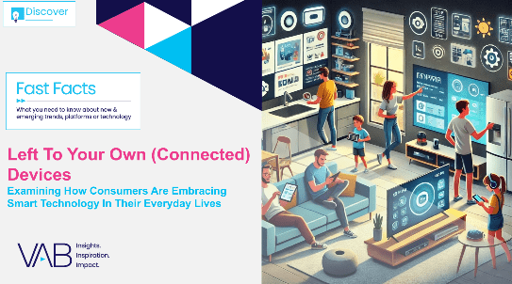
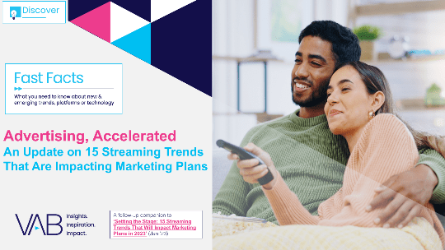





Creators
Jason Wiese
Leah Montner Dixon
SVP, Director of Strategic Insights
jasonw@thevab.com
Director, Audience & Behavioral Insights
leahm@thevab.com
Reed Kiely
Karolina Guillen
Left To Your Own (Connected) Devices
Examining How Consumers Are Embracing Smart Technology In Their Everyday Lives
Advertising, Accelerated
An Update on 15 Streaming Trends That Are Impacting Marketing Plans
Director, Data Insights & Trends
reedk@thevab.com
Associate Director, Insights, Strategy & Analytics
karolinag@thevab.com
Kaileen Cain
Senior Insights Analyst
kaileenc@thevab.com
Discover more
Looking for more data, insights and takeaways? Check out this related VAB content
Visit our Streaming Video Resources Hub
for the latest consumption stats, trends and advertising opportunities.
Recipe for Success
Six Key Ingredients for
Stirring Growth in Streaming
Staying Current on Streaming
The Latest on Connected TV
Consumer Behaviors
Shortening the Path to Purchase
How New Opportunities in Shoppable TV Are Igniting Viewer Engagement and Brand Performance
The Power of Premium Video
What it Means for Multiscreen TV and Why it Matters to Marketers
VAB Members, brand marketers and agencies get free and immediate access to VAB’s content library. Get access at theVAB.com
This information is exclusively provided to VAB members and qualified marketers.
PAGE 35

Slide 36


About VAB
VAB is an insights-driven organization that inspires marketers to reimagine their media strategies resulting in fully informed decisions.
Drawing on our marketing expertise, we simplify the complexities in our industry and discover new insights that transform the way marketers look at their media strategy.
We are committed to your business growth and proud to offer VAB members, brand marketers and agencies complimentary access to our continuously-growing Insights library. Get immediate access at theVAB.com.
This information is exclusively provided to VAB members and qualified marketers.
PAGE 36

