Slide 1


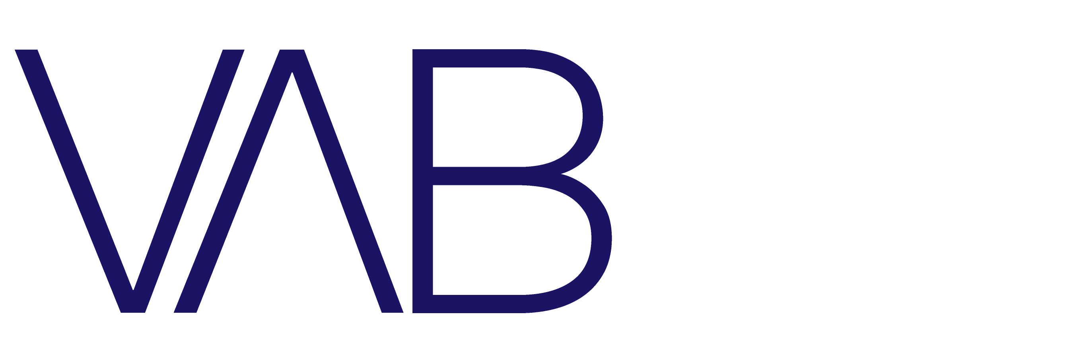
2020 – Year End Review
20/20 Vision
2020 Trends That Will Continue to Shape 2021

Slide 2


About VAB
VAB is an insights-driven organization that inspires marketers to reimagine their media strategies resulting in fully informed decisions.
Drawing on our marketing expertise, we simplify the complexities in our industry and discover new insights that transform the way marketers look at their media strategy.
Simplify
We save you time by bringing you the latest data & actionable takeaways you can use to inform your marketing plans.
Discover
We keep you one step ahead with the latest thinking so you can create innovative, forward-looking strategies.
Transform
We help you build your brand by focusing on core marketing principles that will help drive tangible business outcomes.
This information is exclusively provided to VAB members and qualified marketers. Further distribution is prohibited.
PAGE 2

Slide 3





2020 Trends that Will Continue into 2021
Social reform and the on-going pandemic, which drastically changed the daily lives of most people and triggered a recession, have accelerated already evolving media habits and consumer behavioral trends. These events have also solidified the value of core marketing principles in ways that will continue to shape the foreseeable future.
1
2
3
4
+
Diversity & inclusion leads the conversation
Video consumption is evolving and expanding across audiences
Consumer adoption
of e-commerce accelerates
Advertisers are going back to basics as economic uncertainty persists
This information is exclusively provided to VAB members and qualified marketers. Further distribution is prohibited.
PAGE 3

Slide 4

Diversity & Inclusion Leads
the Conversation

Slide 5
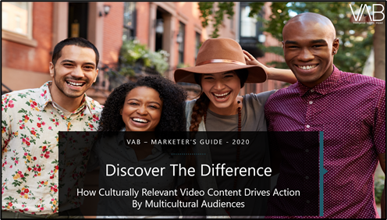
Multicultural audiences represent significant buying power and they have a high affinity for their favorite TV programs and personalities which is much more likely to drive product purchases
Click here for the full report
% vs. Non-Hispanic White 18+
Black A18+
Hispanic A18+
Asian A18+
‘I have purchased a product I saw while watching a TV program or endorsed by a favorite TV personality / actor’
+65%
+59%
+52%
68%
66%
63%
XX%
= % of Respondents
Source: VAB / Dynata ‘Multicultural Video Engagement Survey,’ August 2019. Q10: Please indicate how often you do the following. Respondents Answer = Always, Frequently or Occasionally. African American/Black/Caribbean American = 302 Respondents, Hispanic = 300 Respondents, Asian American/Pacific Islander = 100 Respondents, Non-Hispanic White = 300 Respondents.
This information is exclusively provided to VAB members and qualified marketers. Further distribution is prohibited.
PAGE 5

Slide 6



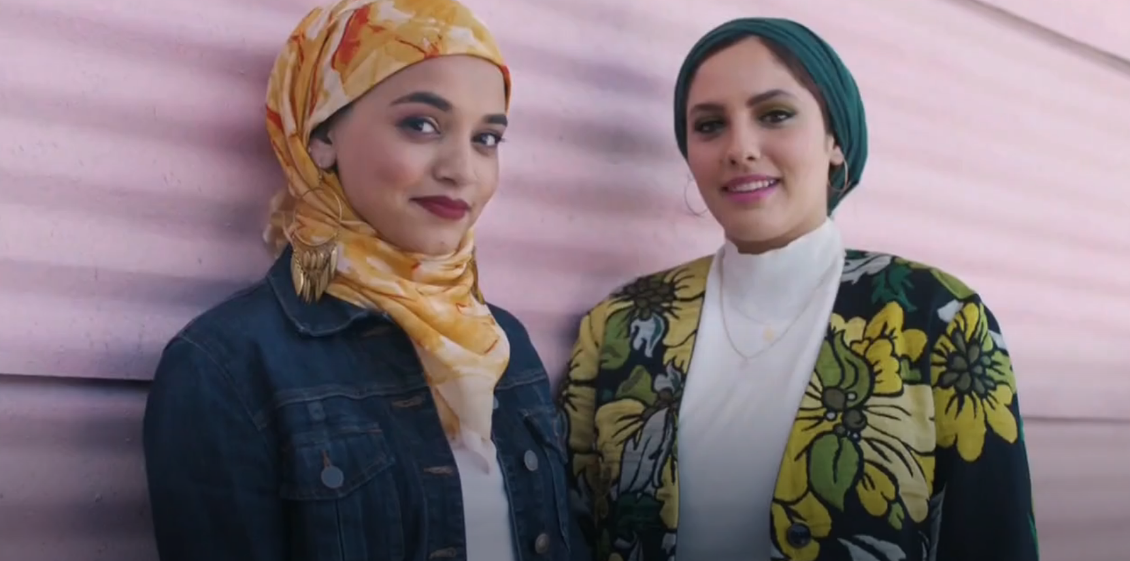

Ad campaigns with a core message of diversity and inclusion resonate more with consumers and drive greater business outcomes for brands
Click here for the full report
Ulta case study: In September 2018, Ulta Beauty launched their ‘The Possibilities are Beautiful’ campaign with a positive message of inclusiveness through both an English-language and Spanish-language spot. The ads featured people from a spectrum of age groups, ethnicities, body types and gender identities, illustrating the brand’s belief that nothing is more beautiful than possibility.
Results: Ulta Beauty maintained strong, steady growth in their monthly female website visitors through the duration of their inclusivity campaign with average visitation up over one-quarter vs. the 18-month average before the campaign launch (during which time other campaigns were periodically active, totaling 80% of TV spend as ‘The Possibilities are Beautiful‘).
‘The Possibilities are Beautiful’ TV spot (two creatives) - $47.5 MM
20-Month Campaign: 9/2/18 – 4/5/20
14,814 Airings / 3,670.0 MM HH IMPs
Business Outcomes
Women 18+ Website Traffic: +28% increase
in Ulta Beauty’s average monthly unique W18+ website visitors during the first 18 months of the campaign vs. the
18-month pre-campaign average (Mar ’17–Aug ’18).
Black Women 18+ Website Traffic: +21% increase
during the same 18-month time period as above for Women 18+.
click either image above to watch English-language spot
click image above to watch Spanish-language spot
Source: VAB analysis of iSpot.tv TV occurrence data, time period: 1/1/17 – 2/29/20, estimated media spend. Impressions represent US TV HHs and include activity within measured national broadcast and cable TV linear, national time-shifted, local, VOD and OTT. VAB analysis of Comscore mediametrix multiplatform media trend data (desktop and mobile), Women 18+, Black Women 18+. Comparisons reflect March ‘17 – August ‘18 (18 months) vs. September ‘18 – February ’20 (18 months).
This information is exclusively provided to VAB members and qualified marketers. Further distribution is prohibited.
PAGE 6

Slide 7

Population growth, even among adults 50+, will be driven almost exclusively by multicultural segments
By 2030, 10 million more multicultural people will have aged into the adult 50+ population and future growth will be driven primarily by these segments
Coming Soon!
167.0
156.7
145.2
132.4
119.3
41%
45%
37%
32%
27%
Source: VAB analysis of U.S. Census Bureau data, Population Division: Washington, DC., Projected Age Groups and Sex Composition of the Population: Main Projections Series for the United States, 2017-2060. NH = Non-Hispanic. Other – includes Non-Hispanic American Indian, Alaska Native, Native Hawaiian and Other Pacific Islander.
This information is exclusively provided to VAB members and qualified marketers. Further distribution is prohibited.
PAGE 7
Notes:
Add NH-White

Slide 8
Speaking of adults 50+, many brands continue to fixate on adults 18-34 while ignoring the fast-growing older audience
By the end of 2020, there will be over 42 million more A50+ than A18-34, and by 2030 that gap will increase
to over 55 million
Coming Soon!
Source: VAB analysis of U.S. Census Bureau data, Population Estimates for 1980, 1990, 2000, 2010; U.S. Census Bureau, Population Division: Washington, DC., Projected Age Groups and Sex Composition of the Population: Main Projections Series for the United States, 2017-2060.
This information is exclusively provided to VAB members and qualified marketers. Further distribution is prohibited.
PAGE 8

Slide 9
Summary: Diversity & Inclusion Leads
the Conversation
Culturally relevant programming and diversity among personalities are more likely to drive product purchases by multicultural audiences
Ad campaigns that tie diversity and inclusion into their brand messaging are not only necessary in today’s social and economic climate, but have proven to deliver outcomes across crucial brand metrics from awareness to sales
Marketers should not ignore the purchasing power of adults 50+, particularly multicultural segments which will be the driving force of future growth
This information is exclusively provided to VAB members and qualified marketers. Further distribution is prohibited.
PAGE 9

Slide 10
Video Consumption Is Evolving and Expanding Across Audiences

Slide 11
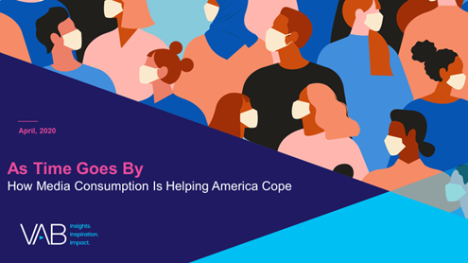

Overall media usage has increased as a direct result
of the COVID-19 pandemic
Click here for the full report
Media Usage Since COVID-19 Outbreak
P18+
Source: VAB’s 'As Time Goes By: How Media Consumption Is Helping America Cope’. VAB / Lucid ‘Media Usage In The Time of COVID-19 Survey,’ April 2020. Survey base: P18+ & household subscribes to cable, telco, internet TV or satellite TV (n=1,004). Q1: Overall, please choose the statement below that best describes your media usage since the outbreak of the COVID-19 Pandemic.
This information is exclusively provided to VAB members and qualified marketers. Further distribution is prohibited.
PAGE 11
Notes:
Media usage overall up due to COVID

Slide 12




TV has become the centerpiece of the household, with 8 out of 10 people saying they couldn’t imagine not having a television right now
Click here for the full report
% of respondents who agree with the statement
P18+
83%
72%
70%
67%
“I couldn't imagine not having a television set right now”
“Watching TV or movies together as a family has become more common”
“I binge watch more TV shows or movies”
“TV has become the central focus of our home”
Source: VAB / Lucid ‘Media Usage In The Time of COVID-19 Survey,’ April 2020. Survey base: P18+ & household subscribes to cable, telco, internet TV or satellite TV (n=1,004). Q7: Thinking of your behavior since the start of COVID-19, please indicate below how much you agree or disagree with the following statements & Q9: Thinking of your behavior during the COVID-19 Pandemic, please indicate below how much you agree or disagree with the following statements
This information is exclusively provided to VAB members and qualified marketers. Further distribution is prohibited.
PAGE 12

Slide 13




With sports back but in-person attendance severely limited, fans are maximizing their at-home viewing experience
Click here for the full report
% of Sports Fans Who Agree
All
Avid
Male
Female
Black
Hispanic
I bought a bigger TV screen just so I could have a better viewing experience for sports
63%
76%
66%
59%
68%
76%
I watch sports on a high definition TV so I can see the action clearer
60%
66%
60%
61%
52%
61%
Whenever possible I watch sports on the largest screen available in my home
48%
54%
49%
47%
41%
46%
Source: VAB / Dynata ‘Sports Viewing Experience Survey,’ September 2019. Survey base = self-identified sports fans, P18+. Q17: Please rate how much you agree or disagree with the following statement (Top 2 Box: Somewhat Agree & Strongly Agree), Q20: Which of the following statements do you believe are true for you? Avid Fans Respondents (habitually watch sports on TV, intensely follow teams / players, etc), All Sports Fans based on P18+.
This information is exclusively provided to VAB members and qualified marketers. Further distribution is prohibited.
PAGE 13

Slide 14
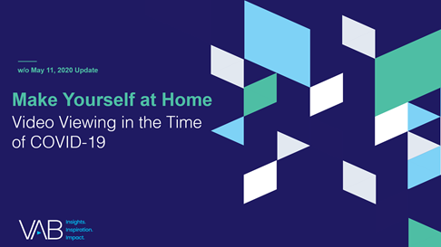



With more time in their day during the pandemic, people of all ages utilized new platforms and discovered the full functionality of their existing and new video devices
Click here for the full report
% of respondents who agree with the statement
P18+
84%
66%
54%
“I have more time to watch/listen/read media”
“I am more open to trying new types of media”
(e.g. new streaming services, podcasts, social media platforms, etc)
“I have learned how to use more features on my smart TV or a TV related device/platform”
Source: VAB’s 'As Time Goes By: How Media Consumption Is Helping America Cope’. VAB / Lucid ‘Media Usage In The Time of COVID-19 Survey,’ April 2020. Survey base: P18+ & household subscribes to cable, telco, internet TV or satellite TV (n=1,004). Q9: Thinking of your behavior during the COVID-19 Pandemic, please indicate below how much you agree or disagree with the following statements
This information is exclusively provided to VAB members and qualified marketers. Further distribution is prohibited.
PAGE 14

Slide 15
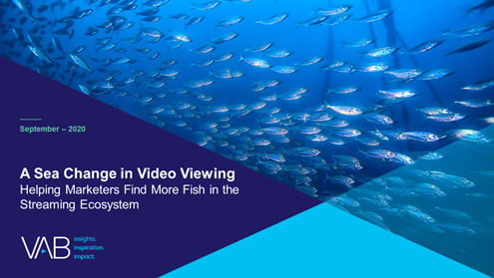

Time, comfort, technology adoption and more choices have all combined to establish video streaming as a habitual, daily activity for many viewers
Click here for the full report
On average, how many times per week do you watch a video streaming service?
Source: VAB / Lucid ‘COVID-19 Streaming Behavior Survey,’ June 2020. Survey base: A18+ in households with access to streaming services and have viewed content on streaming services (n=1,000). S3. On average, how many times per week do you watch a video streaming service? (e.g., Netflix, Disney +, Tubi, Hulu, CBS All Access, etc.)
This information is exclusively provided to VAB members and qualified marketers. Further distribution is prohibited.
PAGE 15
PAGE 1

Slide 16




Increased streaming usage has driven higher engagement among both paid and free ad-supported services
Click here for the full report
Since the COVID-19 Pandemic, have you done any of the following?
P18+
37%
36%
9%
Watched a free streaming service
Added a new streaming service
Unsubscribed from a streaming service
(e.g. Roku, Pluto or Tubi)
(i.e., Apple TV+, Disney+, Netflix, etc.)
(i.e., Apple TV+, Netflix, etc.)
Source: VAB / Lucid ‘Media Usage In The Time of COVID-19 Survey,’ April 2020. Survey base: P18+ & household subscribes to cable, telco, internet TV or satellite TV (n=1,004). Q10: Since the COVID-19 Pandemic, have you done any of the following? Note: Percentages don’t add to 100% because it excludes “none of the above” response. Digital TV Research via Cynopsis Media (North American AVOD Revenues), May 19, 2020.
This information is exclusively provided to VAB members and qualified marketers. Further distribution is prohibited.
PAGE 16

Slide 17
Trial and adoption of AVOD has accelerated as viewers stack free services on top of their paid subscriptions because of their large appetite for streaming content
Click here for the full report
27%
67%
38%
53%
of SVOD users
also subscribe to AVOD services
of AVOD users
like having access to every show, past or present, through a streaming service
of AVOD users
wish there were more free streaming services available
of AVOD users
appreciate the fact that ads make a streaming service cheaper for them
Source: VAB / Lucid ‘COVID-19 Streaming Behavior Survey,’ June 2020. Survey base: A18+ in households with access to streaming services and have viewed content on streaming services (n=1,000). AVOD Users = respondents who regularly watch free subscription streaming services with commercials (e.g., Crackle, Pluto TV, Tubi TV) (n= 298).
This information is exclusively provided to VAB members and qualified marketers. Further distribution is prohibited.
PAGE 17

Slide 18
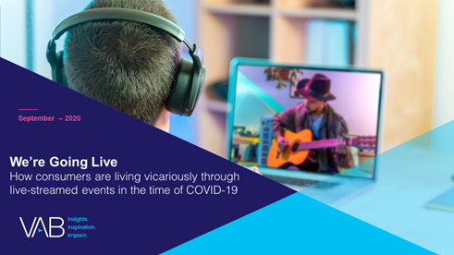


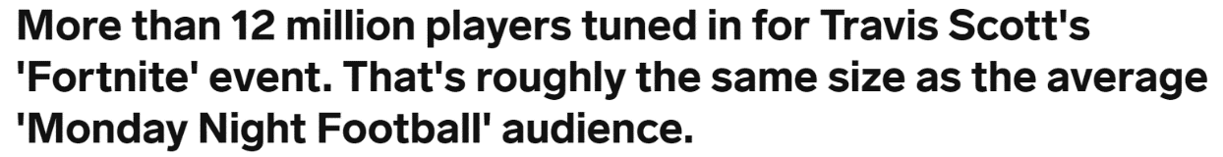

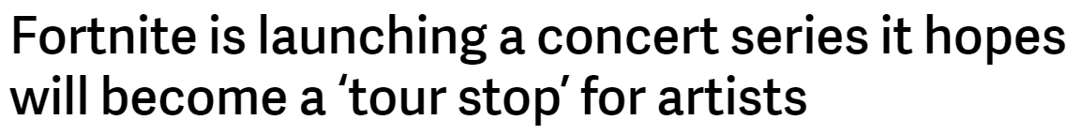
In the absence of large gatherings, livestreaming has grown in popularity and is creating more ad opportunities
The format is poised for even greater growth as more events become virtual and, in a post-pandemic world, more virtual experiences are created to complement live, in-person events
Click here for the full report
“I have livestreamed concerts and / or events
while in quarantine”
% who agree
April 24th, 2020
September 8th, 2020
Source: VAB / Lucid ‘COVID-19 Streaming Behavior Survey,’ June 2020. Survey base: P18+ in households with access to streaming services and have viewed content on streaming services within the past seven days (n=1,000). Q14.When thinking about livestreaming, by which we mean: streaming a program online live as it happens (e.g., Concert - One World: Together at Home, Sporting Event – Virtual NFL Draft) - which of the following statements do you feel apply to you?
This information is exclusively provided to VAB members and qualified marketers. Further distribution is prohibited.
PAGE 18
Notes:
Actual reach

Slide 19
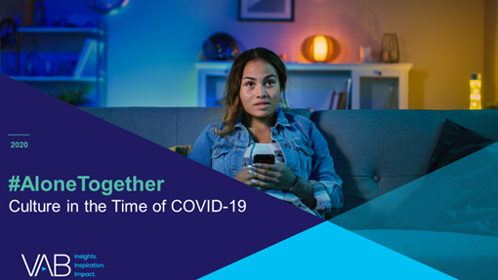
Social engagement around video content is huge and
ad-supported TV is the leading platform among the
‘most talked about’ trending topics
Click here for the full report
# of Unique Top 10 Trending Programs / Content by Video Platform
(March 16th – April 26th)
Source: VAB custom analysis of Top 10 trending Twitter Topics each night (9:30p &11p) (3/16/2020 – 4/26/2020). Results include both ‘direct’ and ‘related’ topics. Various Video Platforms include Epic Games, and various concert streaming partners. Pay-TV: insecure (HBO), Westworld (HBO), Homeland (Showtime). Netflix - #BlackAF, Extraction, Homecoming: A Film by Beyonce. Disney – Onward. Amazon Prime Video – Happiness Continues: A Jonas Brothers Concert Film.
This information is exclusively provided to VAB members and qualified marketers. Further distribution is prohibited.
PAGE 19

Slide 20
Summary: Video Consumption Is Evolving & Expanding Across Audiences
TV is the focal point of the household as people’s daily lives changed during the pandemic and more people consume more media
As live sports return with limited attendance, fans are maximizing their at-home viewing experience through bigger and better TV screens
Increased free-time during the pandemic allowed people of all ages to discover the full functionality of their video devices and utilize new platforms
As many viewers become habitual daily streamers, marketers should investigate ad opportunities in growing video segments
  Streamers are stacking free, ad-supported services in addition to their paid streaming service subscriptions
  Live streaming events have grown in popularity in the absence of large, in-person gatherings
Video content sparks social conversation and engagement with ad-supported TV as the leading platform
This information is exclusively provided to VAB members and qualified marketers. Further distribution is prohibited.
PAGE 20

Slide 21
Consumer Adoption
of E-commerce Accelerates

Slide 22









DTC brands deliver many benefits to consumers over traditional retailers and were well-positioned for growth at the onset of the pandemic
Click here for the full report
Primary Reasons For Purchasing DTC Over Traditional Retailers
48%
Cheaper Cost
43%
Fast, Free Shipping & Easy Returns
26%
Positive Media Coverage Or Reviews
26%
Superior Customer Service
22%
Better Product Design
16%
Better Company & Brand Design
15%
Company Donates To People In Need With A Product Purchase
12%
Ability To Subscribe To Automatic Refills Of Product
Source: Diffusion, 2020 Direct-To-Consumer Purchase Intent Index, 2019; respondents able to select multiple options.
This information is exclusively provided to VAB members and qualified marketers. Further distribution is prohibited.
PAGE 22

Slide 23










The median age of many DTC brand platforms is rising as they attract a new, broader customer base and older adults become more comfortable with technology
Coming Soon!
Median age by digital platform
September 2020
43.1
44.9
45.3
48.9
34.8
48.4
58.2
53.8
52.2
45.0
Source: VAB analysis of Comscore MediaMetrix Media Trend multiplatform (desktop + mobile) data, September 2020. Base: P18+, total digital population, median adult age.
This information is exclusively provided to VAB members and qualified marketers. Further distribution is prohibited.
PAGE 23

Slide 24

DTC brands who are new advertisers on TV are seeing quantifiable business outcomes at all levels of investment
Click here for the full report
36 ‘Emerging’ DTC Brands*
Average Monthly Website Unique Visitors (000)
Based Over a Four-Year Time Period: Jan ‘16 – Jan ‘20
8 Brands: $500K - $2MM TV Spend
16 Brands: $2MM - $10MM TV Spend
8 Brands: $10MM+ TV Spend
+205%
(+5.3MM)
+126%
(+3.3MM)
+31%
(+338K)
+18%
(+376K)
+34%
(+693K)
+22%
(+236K)
(monthly average)
(TV launch – Jan ‘20)
(monthly average)
(TV launch – Jan ‘20)
(monthly average)
(TV launch – Jan ‘20)
(% & MM) vs. monthly average prior to TV launch
(% & MM) vs. monthly average prior to TV launch
(% & MM) vs. monthly average prior to TV launch
Source: VAB analysis of Nielsen Ad Intel data, TV spend (national cable TV, national broadcast TV, Spanish language broadcast TV, Spanish language cable TV, spot TV, syndication TV), Feb ‘18 – Jan ‘20 (calendar months). VAB analysis of Comscore mediametrix multiplatform media trend data, total audience (Desktop P2+, Mobile 18+), Jan ‘16 – Jan ‘20 (calendar months). ‘Prior to TV Launch’ reflects the average monthly unique visitors based on when each brand’s website began being measured by Comscore, or starting from January 2016 if measurement began before that month. *Reflects the 36 brands that are measured in Comscore and had reported monthly unique visitors in at least one month prior to their campaign launch.
This information is exclusively provided to VAB members and qualified marketers. Further distribution is prohibited.
PAGE 24

Slide 25

Many DTC and non-DTC brands are launching their first TV campaigns earlier in their life stage and seeing greater impact
to their digital performance because of it
Click here for the full report
“When On TV” Monthly Average vs. Three-Month Average Prior To TV
Average Website Unique Visitors
Three Years Old or Younger
Between Four – Seven Years Old
Eight Years or Older
+138%
+72%
+23%
Unique Visitors % increase:
Unique Visitors increase:
+811K
+1,383K
+803K
Source: VAB analysis of Nielsen Ad Intel data, TV spend (national cable TV, national broadcast TV, Spanish language broadcast TV, Spanish language cable TV, spot TV, syndicated TV), Jun ‘16 – Jun ’20 (calendar months). VAB analysis of Comscore mediametrix multiplatform (desktop + mobile) media trend data; P18+, Jun ’16 – Jun ‘20 (calendar months).
This information is exclusively provided to VAB members and qualified marketers. Further distribution is prohibited.
PAGE 25

Slide 26
Summary: Consumer Adoption of E-commerce Accelerates
DTC brands’ e-commerce business model and core principles gave them an edge when demand for online delivery surged during the pandemic
DTC brands have been attracting a broader base, particularly among older shoppers, as consumers of all ages grow more comfortable with ordering online
This broader base has also been aided by DTC brands’ investment in TV which has driven quantifiable business outcomes at all budget levels
Brands at all stages of their life cycle are also seeing results from TV, but younger brands who invest earlier see the greatest impact on their digital performance
This information is exclusively provided to VAB members and qualified marketers. Further distribution is prohibited.
PAGE 26

Slide 27
Advertisers are Going Back to Basics as Economic Uncertainty Persists

Slide 28









Like in past recessions, after some initial cuts, many brands are now seeking to maintain or increase their advertising share of voice to grow market share during and after this pandemic
Click here for the full report
Business outcome examples of brands who increased their TV spend during the last recession (2008-2009)
Ecommerce
Retail
Telecommunications
Restaurants
Amazon launched its first TV campaign in the middle of the recession in 2008 and saw a compound annual growth rate of 34% between 2008-2012
Walmart significantly increased their TV investment in both 2008 & 2009 and saw high single digit sales increases
in each year with continued growth after the recession
T-Mobile had a moderate increase in their TV investment in both 2008 & 2009 and saw a compound annual growth rate of 21% between 2008-2011
Darden increased their TV investment in both 2008 & 2009 and increased their sales by an average of 14%
over those two years
Source: U.S. TV spend based on VAB analysis of Nielsen Ad Intel data, national TV spend (national cable TV, national broadcast TV, Spanish language broadcast TV, Spanish language cable TV), CY 2007-2012. U.S. revenues are based on company filings (10-K) for U.S. revenue via SEC.gov (EDGAR). Darden’s was for Olive Garden.
This information is exclusively provided to VAB members and qualified marketers. Further distribution is prohibited.
PAGE 28
Notes:
Advertising during a recession will deliver results

Slide 29




























Many new TV advertisers saw an opportunity to gain market share this year as other advertisers pulled back spending
In the first half of 2020, 110 first-time TV advertisers across 59 categories invested nearly $460 MM in the national TV marketplace; 70% of these dollars were invested during 2Q, the heart of the pandemic
Click here for the full report
2020 New Nat’l TV Advertisers Monthly Spend
Millions
Sampling of Q1’20 brand entrants
Sampling of Q2’20 brand entrants
Source: VAB analysis of Nielsen Ad Intel data, Q1’20-Q2’20. TV spend includes national cable TV, broadcast TV, Spanish language cable TV, Spanish language broadcast TV. Brands reflect those with national TV spend over $100k.
This information is exclusively provided to VAB members and qualified marketers. Further distribution is prohibited.
PAGE 29

Slide 30

As strategies are reassessed, more brands are leaning
into proven marketing principles during this time of economic uncertainty
Click here for the full report
PRINCIPLE NO. 1
PRINCIPLE NO. 2
PRINCIPLE NO. 3
Awareness
Balance Broad-Based Reach With Hyper-Targeting to Grow Market Share, a Key Driver of Profit
Virality Tactics Should Be a Part of an Integrated Campaign, Not the Sole Focus
Protect Your Brand by Investing in Only Premium, Viewable Content
PRINCIPLE NO. 4
PRINCIPLE NO. 5
PRINCIPLE NO. 6
PRINCIPLE NO. 7
Consideration
In an Information-Heavy, Opinion-Saturated Environment, Brand Building Is Essential to Support Brand Perception and Foster the Loyalty That Protects Pricing and Profits
Content Environment Matters Everywhere
Brand Building Leads to Increased Long-Term Profitability
Brand Building Media, Such As Premium Video, Fosters a Deep Emotional Connection
PRINCIPLE NO. 8
PRINCIPLE NO. 9
PRINCIPLE NO. 10
Purchase
Success Should Be Measured and Evaluated Against Both Short- and Long-Term KPIs
Brand Leaders Need to Equip Themselves With the Data to Defend Decisions Based on Core Marketing Trends
The Balance of Brand Building and Short-Term Tactics Drives Both Immediate Demand and Long-Term Equity
This information is exclusively provided to VAB members and qualified marketers. Further distribution is prohibited.
PAGE 30

Slide 31
Summary: Advertisers are Going Back to Basics as Economic Uncertainty Persists
Past recessions have shown that brands who maintain or increase ad presence in the face of economic uncertainty recover quickly and see more positive long-term business outcomes
By entering the national TV marketplace during a time of economic uncertainty, a new class of brands are seizing the opportunity to grow their market share while other brands may have pulled back spending
Brands reassessing their strategy in an unprecedented time are relying more than ever on core marketing principles to lead them to success
This information is exclusively provided to VAB members and qualified marketers. Further distribution is prohibited.
PAGE 31

Slide 32




Key Takeaways For Marketing Plans
Consumer behaviors and media habits continue to evolve but, by keeping important trends top of mind and staying principled, marketers can understand what to expect heading into 2021
Make diversity & inclusion a core part of your messaging
Identify opportunities within evolving video consumption
Brands across categories and stages can benefit from thinking like DTC
Rely on core marketing principles in times of uncertainty
Future growth will come from multicultural segments and older consumers so broadening your brand’s messaging to include audiences of all backgrounds will resonate more and deliver greater outcomes.
The pandemic has had a huge impact on media consumption and is shaping the future of video viewing behaviors.
As viewers grow more comfortable testing out ad-supported streaming services and livestreamed events, opportunities for marketers will continue to expand.
Digital-native brands with an e-commerce model were poised to succeed when demand for delivery surged during the pandemic. Now is a pivotal moment for brands, young and old, to broaden their own capabilities and grow their customer base by investing in multiscreen TV advertising.
Growth brands are relying on key marketing principles and maintaining, or increasing, their presence even amid economic and societal uncertainties.
This information is exclusively provided to VAB members and qualified marketers. Further distribution is prohibited.
PAGE 32

Slide 33



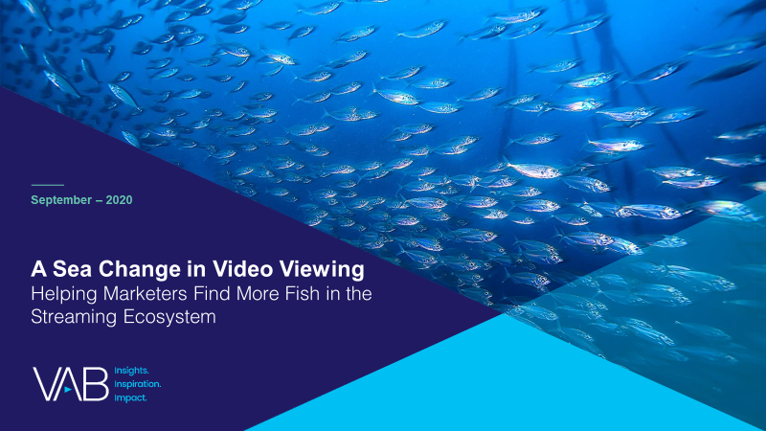




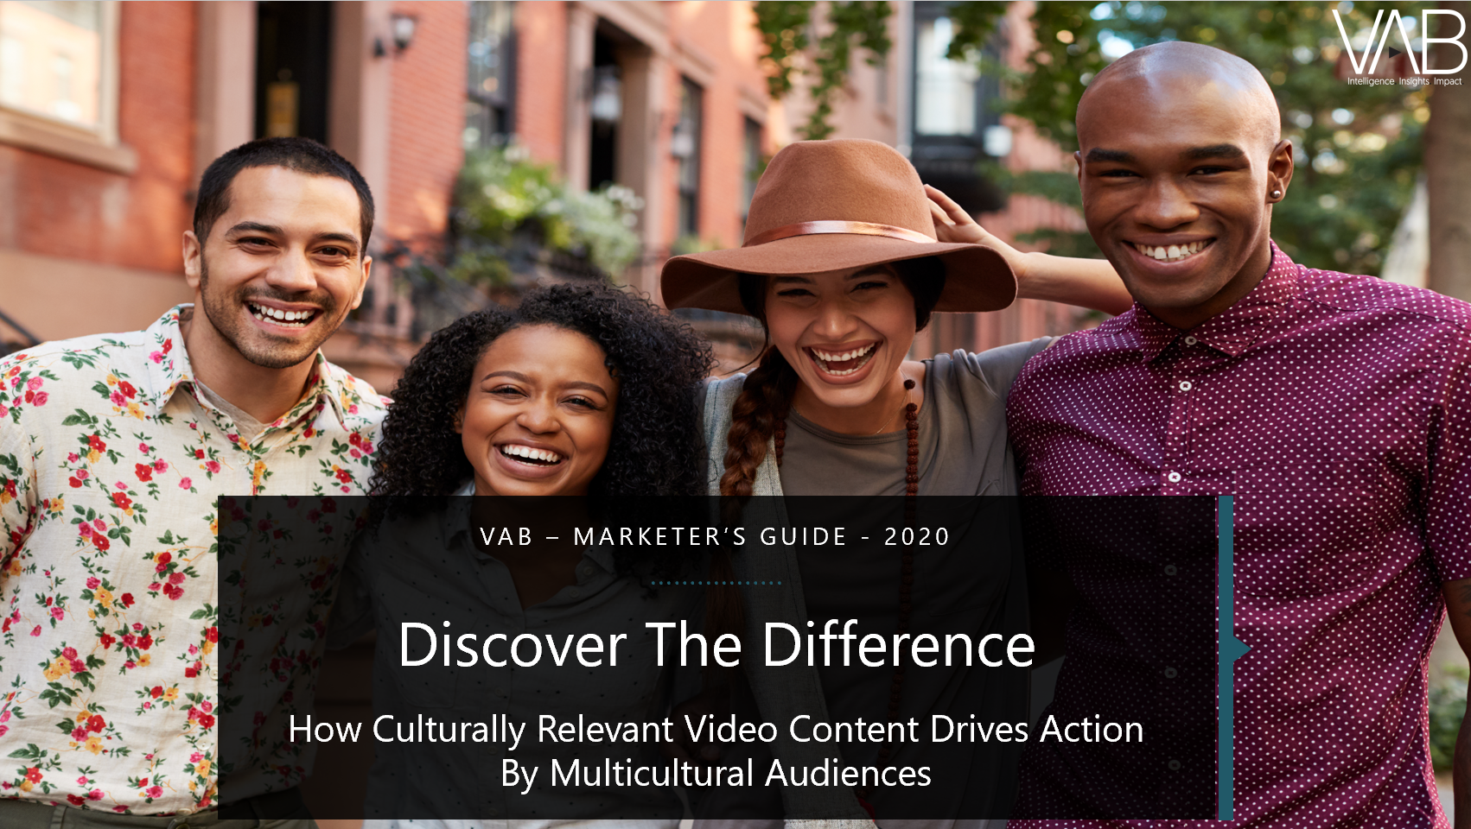





Interested in learning more?
Click the covers to download our full reports
…and more at
www.thevab.com
This information is exclusively provided to VAB members and qualified marketers. Further distribution is prohibited.
PAGE 33

Slide 34

Creators
Jason Wiese
SVP, Director of Strategic Insights
jasonw@thevab.com
Leah Montner-Dixon
Reed Kiely
Karolina Guillen
Insights Manager
leahm@thevab.com
Insights Manager
reedk@thevab.com
Senior Insights Analyst
karolinag@thevab.com
This information is exclusively provided to VAB members and qualified marketers. Further distribution is prohibited.
PAGE 34

Slide 35

Get immediate access to the VAB Insights library
We’ve answered hundreds of marketers’ questions.
Our guides, reports, webinars and videos provide actionable insights to help marketers navigate today’s video landscape and think differently about their strategy.
We are committed to your business growth and proud to offer brand marketers and agencies complimentary access to our continuously-growing Insights library.
Get Access at theVAB.com or visit us here
This information is exclusively provided to VAB members and qualified marketers. Further distribution is prohibited.
PAGE 35

