Slide 1


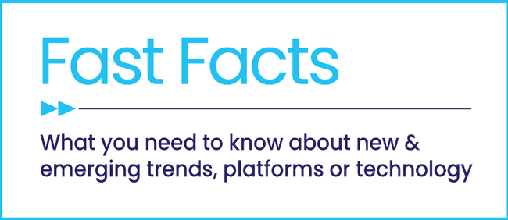


Fast Break
20 Facts on Sports Fandom, Viewership & Advertising Impact

Slide 2


Passionate fandom and scale of sports delivers full-funnel outcomes for brands
Sports fandom runs deep with emotion and engagement, with hundreds of millions of fans gathering to watch events with friends and family while participating in gameday rituals and superstitions.
Live sporting events is the ultimate appointment viewing for fans across platforms, as they tune in ‘real time’ and stay connected to their favorite teams and leagues.
Passionate fandom extends beyond the game, as they’re also attentive to the advertising that surrounds their favorite teams and sports. Sports, and their passionate fans, drive outcomes for brands across each stage of the customer journey.
Get your head in the game and dive in to find out more!
This information is exclusively provided to VAB members and qualified marketers
PAGE 2

Slide 3



In this report, we will focus on three critical aspects of sports – fandom, viewership and advertising impact
1
2
3
Fandom
The Intersection of Emotion & Engagement
Viewership
The Growing Importance
of Sports
Advertising Impact
The Path Through the Customer Journey
This information is exclusively provided to VAB members and qualified marketers.
PAGE 3

Slide 4

20 Fast Facts on Sports Today
Fandom
The Intersection of Emotion & Engagement
Viewership
The Growing Importance of Sports
Advertising Impact
The Path Through the Customer Journey
1
2
3
4
5
84% of U.S. adults identify themselves as a sport fan
Fandom encourages obsessive emotion and high, habitual engagement
Fandom creates touchpoints across multiscreen content, well beyond the game
Women’s sports is not just a moment, it’s a movement
The average sports fan follows multiple sports throughout the year
6
7
8
9
10
Sports is a popular content hub on connected TVs, which helps further fandom
Live sports telecasts on TV have increased by 14% over the last five years
Sports’ share of TV imps have more than doubled among adults 18-34
Sports is the ultimate appointment viewing as they’re watched in ‘real time’
Nearly nine out of ten sports fans prefer watching live sports on TV
11
12
13
14
15
64% of CTV viewers watch sports through both traditional TV & streaming
Live digital sports viewers continue to grow as leagues expand across platforms
CTV app access points are growing, while further opportunities exist with FAST
Sports streaming audiences are growing by double-digits
Out-of-home viewing gives a sizeable boost to sports ratings
16
17
18
19
20
Sports creates relevancy for advertisers, especially SMBs and local businesses
Live sports is proven to drive brand consideration for advertisers
Many fans are very likely to try products from official league sponsors
Almost half of avid fans have purchased products they’ve seen advertised
Measurement innovations are better quantifying the value of sports content
PAGE 4
click through the appropriate box if you would like to be brought directly to the corresponding slide

Slide 5

1
Sports Fandom
The Intersection of Emotion & Engagement

Slide 6


1
84% of U.S. adults identify themselves as a sports fan, a group that is representative of the U.S. population across both gender and age
U.S. Adult Sports Fans by Demo
Gender
Age Group
217 million
U.S. adults are
sports fans
which accounts for
84% of U.S. adults
Source: VAB analysis of MRI-Simmons Winter 2025 Study, A18+, Men 18+, Women 18+, A18-34, A35-49 & A50+. Base = ‘Sports Fan’ - Interest in Sports (Any), interest levels 1-10.’ Index vs. U.S. population.
This information is exclusively provided to VAB members and qualified marketers
PAGE 6

Slide 7





2
Sports fandom encourages obsessive emotion and creates high, habitual engagement
% of sports fans that…
Nearly 60%
say rituals (like wearing their lucky jersey) and superstitions play some role in their fandom
56%
watch some type of sporting event at
least once a week
51%
reported that their
favorite team or athlete’s performance affects their overall mood at least moderately
46%
say they show off their fandom by getting together with friends
and family
(Sports fans spend 3.2 hours watching sports content weekly on average)*
Source: PMG, State of Sports Report - Beyond the Game: Connecting with the Modern Sports Fan, May 2025. *Comcast Advertising, Behind the Remote: A Deep Dive into Sports Viewership & Fandom, October 2024. Base: Watched sports content (game, highlights, talk show, etc.) in the past six months.
This information is exclusively provided to VAB members and qualified marketers
PAGE 7

Slide 8




3
While live sports action is the centerpiece, fandom goes well beyond the game creating additional touchpoints across multiscreen content
69%
of Americans engage with sports content outside of the game
(talk shows, social media, etc.)
Source: Comcast Advertising, Behind the Remote: A Deep Dive into Sports Viewership & Fandom, October 2024. Base: Watched sports content (game, highlights, talk show, etc.) in the past six months.
This information is exclusively provided to VAB members and qualified marketers
PAGE 8

Slide 9
4
With mainstream audience interest and a desire for even more content, women’s sports is not just a moment, it’s a movement
185MM
60MM
“What really sets sports apart from everything else is that it’s truly appointment viewing, and I think this is what makes it so appealing to advertisers.”
Michelle Auguste, Global Media Insights Team, NBA
Advertising Week New York 2024
Adults 18+ are interested
in women’s sports*
Adults 18+ are more interested in women’s sports than last year**
108MM
67%
Fans wish there was more media coverage of women’s sports***
of women sports fans make it a point to support brands that invest in women’s sports***
Source: VAB analysis of 2024 Fall MRI-Simmons USA Study, A18+. *Reflects respondents who are ‘very interested’, ‘somewhat interested’ or ‘a little bit interested’ in the following women’s sports. **VAB analysis of MRI-Simmons 2024 Q4 Trending Topics Study, A18+. ***SBJ, Horizon Sports & Experiences releases study on women's sports growth, 2/4/2024. To learn more,
click here to download our Question of the Week -‘How can I capitalize on the growing interest in women’s sports?’
This information is exclusively provided to VAB members and qualified marketers
PAGE 9

Slide 10
The average sports fan typically follows multiple sports, which allows brands to reach highly engaged sports audiences throughout the year
5
According to Comcast data, the average sports fan watches 3 different leagues*
Which of the following sports have you watched on TV/online in the last 12 months?
% of Live Sports Viewers
Source: VAB analysis of MRI-Simmons, Winter 2025 study, Base: ’Live Sports Viewers’ - Has watched live sports on TV/online in the last 12 months. *Comcast Advertising, Behind the Remote: A Deep Dive into Sports Viewership & Fandom, October 2024. Base: Watched sports content (game, highlights, talk show, etc.) in the past six months.
This information is exclusively provided to VAB members and qualified marketers
PAGE 10

Slide 11


6
Sports is the second most popular content hub on connected TVs, which curates content and helps viewers further fuel their fandom
TV’s Built-In Content Hubs Most Likely to Use
40%
of CTV viewers rely on
the TV Home Screen for
content recommendation
Source: LG Ad Solutions, The Big Shift 2025: U.S. Edition, April 2025. Note: Aided choices.
This information is exclusively provided to VAB members and qualified marketers
PAGE 11

Slide 12

2
Viewership
The Growing Importance of Sports

Slide 13
7
Live sports telecasts on broadcast TV and ad-supported cable TV have increased by 14% over the last five years
# of National TV Live Sports Telecasts
January 1, 2019 – December 31, 2019
January 1, 2024 – December 31, 2024
14,109
16,065
+14%
(+1,956)
Source: VAB analysis of Nielsen NPower Ratings Analysis Program Report, Total Day, January 1, 2019 – December 31, 2019; January 1, 2024 – December 31, 2024; includes Spanish language networks; excludes regional sports networks, local broadcast airings and digital airings of sports through MVPD / network TV apps. Reflects live sporting events only. Telecast count Includes simulcasts of sports events across multiple networks, Spanish language networks, etc.
This information is exclusively provided to VAB members and qualified marketers
PAGE 13

Slide 14
8
The share of sports within total TV impressions has more than doubled among adults 18-34 in both total day and prime over the last five years
National TV Equivalized Ad IMPs by Program Genre: Adults 18-34
Broadcast TV + ad-supported cable TV
2019
2022
2024
Total Day
Prime
Source: VAB analysis of Nielsen Ad Intel, as of 5/23/25. National TV: broadcast & cable TV including Spanish-Language TV networks, excludes PSAs and promos. 1/1/19 – 12/31/19; 1/1/22 – 12/31/22; 1/1/24 – 12/31/24. Nielsen program genres were rolled up into four groups. Entertainment - comedy, drama, film, kids, music, specials, variety / game shows; news – news, news documentaries, political; sports – live events, commentary shows, anthologies; other – instructional, devotional, varied format, unclassified.
This information is exclusively provided to VAB members and qualified marketers
PAGE 14

Slide 15

9
Sports is the ultimate appointment viewing as live events are watched almost entirely in ‘real time’ on broadcast and cable TV
National TV Telecasts: Viewership By Stream
% of Total Viewing Hours, May 2025
P2+
P18-34
Source: VAB analysis of Nielsen NPower R&F Program Report, Total Day, P2+ & P18-34, ad-supported cable TV & broadcast TV, May 1, 2025 – May 31, 2025; includes Spanish language networks; excludes regional sports networks, local broadcast airings and digital airings of sports through MVPD / network TV apps. Reflects live sporting events only. Totals may not equal 100% due to rounding.
This information is exclusively provided to VAB members and qualified marketers
PAGE 15

Slide 16
Nearly nine out of ten sports fans prefer watching live sports on TV whether it’s at home, at someone else’s place or at their ‘third place’
10
85% of fans prefer watching live sports on TV rather than in-person
Where Sports Fan Watch Live Sports
Source: Comcast Advertising, Behind the Remote: A Deep Dive into Sports Viewership & Fandom, October 2024. Base: Watched sports content (game, highlights, talk show, etc.) in the past six months.
This information is exclusively provided to VAB members and qualified marketers
PAGE 16

Slide 17

11
64% of CTV viewers watch sports through a combination of traditional TV and streaming which shows the strength of multiplatform access
How US Connected Sports Viewers Watch Live Sporting Events
Source: LG Ad Solutions, Stadium to Screen: Streaming Live Sports in 2025, February 2025
This information is exclusively provided to VAB members and qualified marketers
PAGE 17

Slide 18
12
Live digital sports viewers are steadily growing at an average annual rate of 9% as leagues and events continue to expand across platforms
U.S. Live Digital Sports Viewers
In Millions
+52% vs. 2022
Source: EMARKETER, Live Sports Viewers Increasingly Embrace Digital, September 2024. Sports viewers are individuals who watch live sports content at least once per month over the course of the season of at least one sport via referenced distribution methods; excludes highlight viewing and viewing of non-live content; excludes esports & Olympic content. Digital includes platforms such as OTT, TV Everywhere and vMVPDs.
This information is exclusively provided to VAB members and qualified marketers
PAGE 18

Slide 19
13
All CTV app distribution methods continue to grow while a major opportunity exists to expand sports exposure on FAST services
CTV Apps Used to Stream Sports
Source: LG Ad Solutions, Stadium to Screen: Streaming Live Sports in 2025, February 2025
This information is exclusively provided to VAB members and qualified marketers
PAGE 19

Slide 20

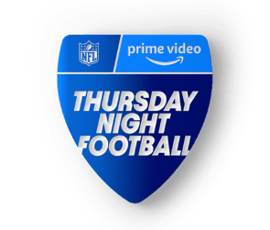

14
Sports streaming audiences are growing by double-digits, however comparative viewership is still not as large as broadcast TV yet
P2+ Average Audience (Weekly Average, Per Min)
2024 Exclusive Streaming Games vs. 2023 Comparable Games
Peacock Exclusive
9/6 Packers @ Eagles
Black Friday
11/29 Raiders @ Chiefs
Christmas
Chiefs @ Steelers
Ravens @ Texans
14.0 MM
13.5 MM
24.3 MM
+91%
vs. 2023
12/23 Bills @ Chargers (Peacock)
+41%
vs. 2023
11/24 Dolphins @ Jets (Amazon Prime)
-16%
vs. 2023
Raiders @ Chiefs (CBS)
Giants @ Eagles (Fox)
Source: VAB analysis of Nielsen Ratings Analysis Program Report, Peacock Exclusive (Peacock Streaming Data), Black Friday (Amazon Prime (incl local broadcast for in-game markets only)), Christmas (Exclusive game on Netflix). Live+SD, P2+, Panel data. CBS and Fox reflects linear TV audience only and does not include audiences gained from their digital / app streaming. The comparable games reflect the same event or streaming service that aired NFL primetime games in 2023. The Christmas two games on Netflix is compared to the Christmas games that aired on linear TV in 2023 at the same daypart (afternoon games). To learn more about the 2024 NFL Season Viewership Trends, click here to download VAB’s ‘Huddle Up’ report.
This information is exclusively provided to VAB members and qualified marketers
PAGE 20

Slide 21
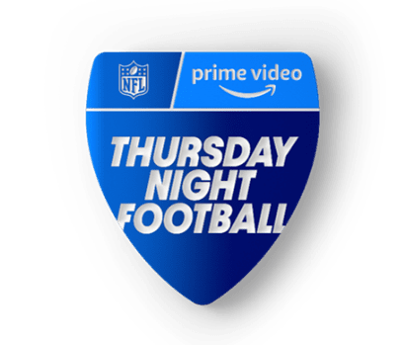

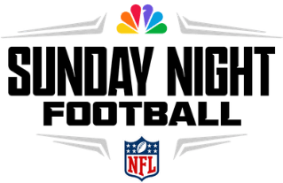









15
Out-of-home viewing gives a sizeable boost to sports, especially during holidays, which maximizes brand impact during key periods
73% of fans watch regular season games in groups of 3+ people, which is even higher for playoffs or championships*
Out-of-Home Contribution to P2+ Average NFL Audience
2024 Full Season ‘NFL Primetime’ Games (Weekly Average)
+10.0%
Average Viewership Contribution
+9.8%
Average Viewership Contribution
+6.5%
Average Viewership Contribution
Halloween
+10.6%
Black Friday
+20.4%
Day After Christmas +13.9%
Peacock Exclusive (9/6)
+16.3%
Thanksgiving
+27.6%
w/o Christmas +10.7%
Doubleheader (9/23) +7.4%
w/o Christmas +9.7%
New Years Eve
+8.5%
Source: VAB analysis of Nielsen Ratings Analysis Program Report, Sunday Night Football (NBC, Universo, Telemundo), Monday Night Football (ESPN, ESPN2, ESPN Deportes, ABC) and Thursday Night Football (Amazon (incl. local broadcast for in-game markets only)), excludes pre- & post-game shows, Live+SD, P2+, Panel data. NBC, Universo, Telemundo, ESPN, ESPN2, ESPN Deportes and ABC reflects linear TV audience only and does not include audiences gained from their digital / app streaming. The full season comparison reflect all weeks in the regular season (9/12-12/26 for TNF; 9/5 – 12/29 for SNF; 9/9 – 12/30 for MNF). NBC Sunday Night Football includes Universo and Telemundo simulcast viewership and exclusive viewership on Peacock on 9/6). ESPN Monday Night Football includes ESPN2 and ESPN Deportes simulcast viewership. Note: ESPN MNF data also includes ABC simulcast data. MNF weeks 3, 4 and 15 include two matchups on broadcast (ABC) and Cable (ESPN, ESPN2, ESPN Deportes); MNF week 7 includes exclusive game streamed on ESPN+. See appendix for schedule and single game details. *Comcast Advertising, Behind the Remote: A Deep Dive into Sports Viewership & Fandom, October 2024. Base: Watched sports content (game, highlights, talk show, etc.) in the past six months. To learn more about the 2024 NFL Season Viewership Trends, click here to download ‘Huddle Up’.
This information is exclusively provided to VAB members and qualified marketers.
PAGE 21

Slide 22

3
Advertising Impact
The Path Through the Customer Journey

Slide 23




Awareness
16
Live sports creates relevant and related opportunities to connect with fans, especially for small and localized businesses
Sports Fans’ Perceptions of Ads During Live Games
57%
prefer when ads are related to / compliment
the sport they’re watching
52%
like to see ads for
small businesses
when watching live sports
50%
can relate to the
ads shown during
live sports
48%
agree there are just the right amount of ads shown during games
Source: Comcast Advertising, Behind the Remote: A Deep Dive into Sports Viewership & Fandom, October 2024. Base: Watched sports content (game, highlights, talk show, etc.) in the past six months.
This information is exclusively provided to VAB members and qualified marketers
PAGE 23

Slide 24


Consideration
17
Live sports is proven to drive mid-funnel results like online branded search for advertisers looking to expand their customer base
Search increased 10x on Super Bowl night vs. week prior and was almost 6x higher than the second highest week over the last 12 months
10x
SB LIX Advertiser – Liquid Death: Weekly Google Trends Index
12-month trend leading up to Superbowl LIX (Weeks of 2/4/2024 – 2/9/2025)
vs. prior week
Super Bowl
(100 index)
“While we have a massive audience of loyal fans,
the Super Bowl is a great opportunity to introduce ourselves to new people and educate everyone about our entire line of healthy beverages.”
Andy Pearson
VP of Creative, Liquid Death
(Muse by Clios, 2/9/25)
Second Highest Week
(17 index)
Week Before Super Bowl
(10 index)
“[There is] no cheaper way to reach over
100 million unique people who want to pay attention to the commercials.”
Download our full report to see search results the 15 Super Bowl advertisers we analyzed
Mike Cessario
CEO, Liquid Death
(Adweek, 2/9/25)
Source: VAB analysis of Google Trends, United States only, All Categories, Web Search, Weeks of 2/4/24 – 2/9/25. Google Search Index represents search interest relative to the highest point on the chart for the given region and time period, a value of 100 is the peak popularity for the term, a value of 50 means that the term is half as popular. Note: Light blue line marks the date of Super Bowl LIX. Click here to view Liquid Death’s Super Bowl commercial (via iSpot.tv).
This information is exclusively provided to VAB members and qualified marketers
PAGE 24

Slide 25

Intent
18
Fandom extends beyond the screen as league fans are very likely
to try official sponsors’ products, especially among women’s sports
Fan’s Likelihood to Try the Products of an Official League Sponsor
2024 Season
Source: Marketcast, Women’s History Month: Sports Fandom Study, March 2025
This information is exclusively provided to VAB members and qualified marketers
PAGE 25

Slide 26

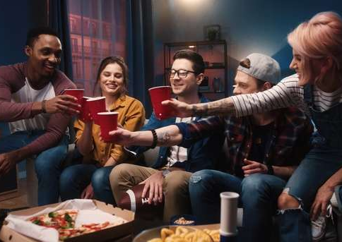
Sales
19
Almost half of all avid sports fans have purchased a product they’ve seen advertised while watching live sports
39% / 46%
of average / avid sports fans
purchased a product that they
saw while watching live sports
Source: Comcast Advertising, Behind the Remote: A Deep Dive into Sports Viewership & Fandom, October 2024. Base: Watched sports content (game, highlights, talk show, etc.) in the past six months. 47% of sports fans who purchased a product did so because it would enhance their game day viewing experience
This information is exclusively provided to VAB members and qualified marketers
PAGE 26

Slide 27


















Measures of Success
20
Marketers can leverage data and tech innovations from measurement providers to better quantify the impact and value of sports content
Three Innovations in Sports Measurement
Out-of-Home (OOH) / Location-Based
Measurement
Big Data Usage
AI & Computer Vision
The integration of big data in modern measurement solutions provides more accurate measurement of sports viewership and advertising
Robust identity solutions that tie location data to out of home viewing are increasing marketers' ability to quantify the full picture of sports viewership
The innovative use of technologies like AI & computer vision is enabling brands to analyze the impact of logo placements and sponsorships
in live sports broadcasts and beyond
Example Companies
Example Companies
Example Companies
This information is exclusively provided to VAB members and qualified marketers
PAGE 27

Slide 28
20 Fast Facts on Sports Today
Fandom
The Intersection of Emotion & Engagement
Viewership
The Growing Importance of Sports
Advertising Impact
The Path Through the Customer Journey
1
2
3
4
5
84% of U.S. adults identify themselves as a sport fan
Fandom encourages obsessive emotion and high, habitual engagement
Fandom creates touchpoints across multiscreen content, well beyond the game
Women’s sports is not just a moment, it’s a movement
The average sports fan follows multiple sports throughout the year
6
7
8
9
10
Sports is a popular content hub on connected TVs, which helps further fandom
Live sports telecasts on TV have increased by 14% over the last five years
Sports’ share of TV imps have more than doubled among adults 18-34
Sports is the ultimate appointment viewing as they’re watched in ‘real time’
Nearly nine out of ten sports fans prefer watching live sports on TV
11
12
13
14
15
64% of CTV viewers watch sports through both traditional TV & streaming
Live digital sports viewers continue to grow as leagues expand across platforms
CTV app access points are growing, while further opportunities exist with FAST
Sports streaming audiences are growing by double-digits
Out-of-home viewing gives a sizeable boost to sports ratings
16
17
18
19
20
Sports creates relevancy for advertisers, especially SMBs and local businesses
Live sports is proven to drive brand consideration for advertisers
Many fans are very likely to try products from official league sponsors
Almost half of avid fans have purchased products they’ve seen advertised
Measurement innovations are better quantifying the value of sports content
PAGE 28
click through the appropriate box if you would like to be brought directly to the corresponding slide

Slide 29
There are 217 million sports fans in the U.S.
and fandom runs deep within many of them - they’re emotionally invested, highly engaged and loyal
Sports continues to grow in importance across the video ecosystem and live events are the ultimate appointment viewing which gives brands the opportunity to reach ‘leaned in’ audiences at scale and in real time
With fans attentive and responsive, sports offers a high-performing environment for brands to lead audiences down the path to purchase, especially for relevant and relatable advertisers including SMBs and local businesses
Key Marketer Takeaways
PAGE 29
This information is exclusively provided to VAB members and qualified marketers.

Slide 30
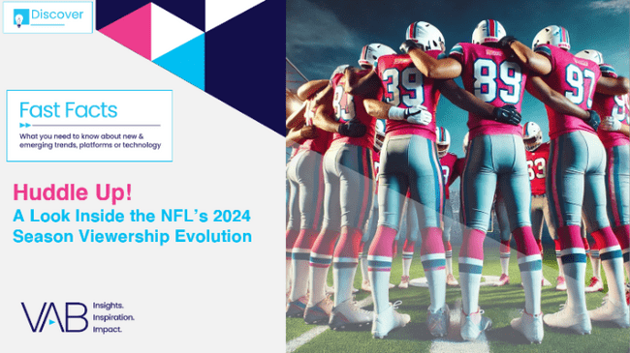
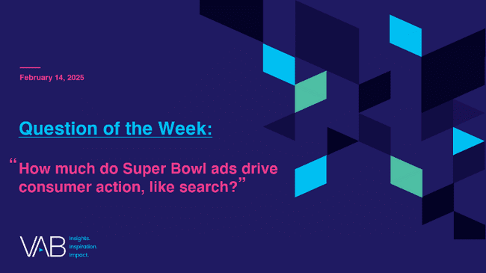
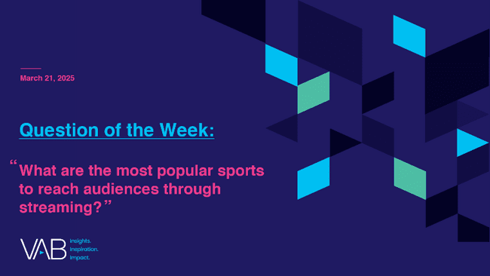






Creators
Jason Wiese
Reed Kiely
EVP, Strategic Insights & Measurement
jasonw@thevab.com
Director, Data Insights & Trends
reedk@thevab.com
Huddle Up!
A Look Inside the NFL’s 2024 Season Viewership Evolution
How much do Super Bowl ads drive consumer action, like search?
Discover more
Looking for more data, insights and takeaways? Check out this related VAB content
What are the most popular sports to reach audiences through streaming?
In a League of Their Own
Exploring the Rising Popularity of Women’s Sports
Visit our Multiscreen TV Attribution Resources
to learn from the winning marketing strategies of brands who utilize premium video platforms to achieve full-funnel outcomes, ranging from incremental reach to favorability to website visits and sales.
The Best Seats In The House
Recreating The Gameday Sports Experience At Home
How can I capitalize on the growing interest in women’s sports?
Bigger, Bolder, More Ad-Supported
25 Streaming Trends That Are Impacting
Marketing Plans in 2025
The Power of Premium Video
What It Means for Multiscreen TV
and Why It Matters to Marketers
This information is exclusively provided to VAB members and qualified marketers.
PAGE 30

Slide 31


About VAB
VAB plays a dual role in the video advertising industry. We are leading the change to bring about a more innovative and transparent marketplace. We also provide the insights and thought leadership that enables marketers to develop business-driving marketing strategies.
Drawing on our marketing expertise, we simplify the complexities in our industry and discover new insights that transform the way marketers look at their media strategy.
We are committed to your business growth and proud to offer VAB members, brand marketers and agencies complimentary access to our continuously-growing Insights library. Get immediate access at theVAB.com.
This information is exclusively provided to VAB members and qualified marketers.
PAGE 31

