Slide 1

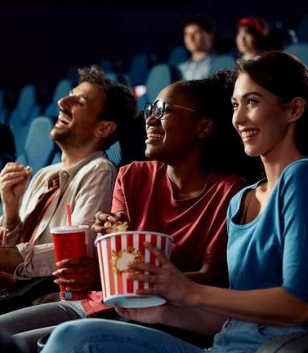



Reel Talk
20 Trends Exploring the Resurgence & Heightened Value of Cinema

Slide 2
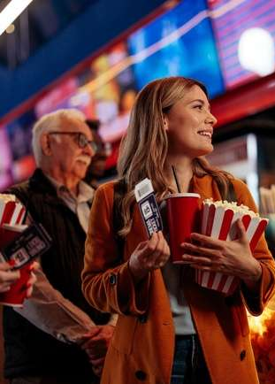

Quality content, elevated experiences and desirable audiences are key to cinema’s resurgence and heightened value to brands
With the pandemic and the ‘double’ Hollywood strikes of both writers and screen actors firmly in the past, cinema is once again charting a path for growth led by a consistent slate of upcoming films and a strong value proposition for advertisers.
Cinema endures as the most popular form of ‘away from the home’ entertainment, providing scale and engagement in a brand-safe environment for advertisers.
Theaters also continue to elevate the cinematic experience for audiences through upgraded screens, technologies and services to further increase engagement among moviegoers that are highly-valued by marketers.
Keep reading as we explore 20 trends that are key to cinema’s resurgence and its heightened value to brands…
This information is exclusively provided to VAB members and qualified marketers.
PAGE 2

Slide 3



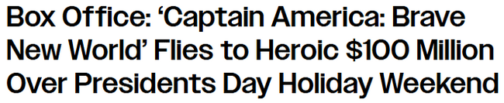


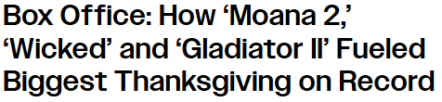

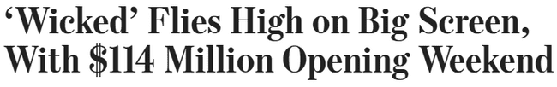

Several recent theatrical releases have achieved box office records,
with notable successes among family-friendly and specialty films
4/7/25
3/30/25
2/16/25
‘A Minecraft Movie’ smashes box office expectations with nearly $163 million opening weekend
‘The Chosen’ Pulls Off Major Surprise
in Debut Box Office Weekend, Pushing Franchise Toward $100 Million
1/12/25
12/2/25
12/1/24
‘A Complete Unknown’ Box Office Passes Major Milestone, Breaking Record For Star Timothée Chalamet
Box Office: ‘Moana 2’ Tops Best Thanksgiving Ever, Opens to Record $225M in U.S. and $389M Globally
11/17/24
11/2/24
10/24/24
Terrifier 3 Box Office Hits Massive Domestic Milestone After Unrated Horror Movie Breaks All-Time Record
Gladiator 2 smashes box office record for Ridley Scott as critics label it ‘thrilling’
This information is exclusively provided to VAB members and qualified marketers.
PAGE 3

Slide 4



In this trends report, we will focus on three distinct sectors within cinema – the content, the experience and the consumer
1
2
3
Highlights From
the Movie Theater
Elevating the Cinematic Experience
The Increasing Value of Moviegoers
This information is exclusively provided to VAB members and qualified marketers.
PAGE 4

Slide 5

20 Trends in Cinema
Highlights from the Movie Theater
Elevating the Cinematic Experience
The Increasing Value of Moviegoers
1
2
3
4
5
Movies continue to be the most popular ‘away from home’ entertainment activity
The number of films with big box office opening weekends are increasing
Family-friendly movies now account for over one-third of the box office
Theatrical releases continue to generate more buzz than Netflix movies
‘Wide’ theatrical releases will average more than two per week in 2025
6
7
8
9
10
Box office revenues are projected to rise steadily over the next few years
People are increasingly going to the movies for escapism and relaxation
‘Going to the movies’ continues to be the most affordable entertainment
There are now almost
120 million theater loyalty program members
Over half of all moviegoers buy their tickets online in advance of showtime
11
12
13
14
15
Immersive, large-format screens are increasing by double-digits
Over three-quarters have watched a movie in a ‘premium format’
Recall and engagement with cinema ads are exceeding pre-pandemic levels
Theaters are investing massive capital to elevate the cinematic experience
Cinema delivers much
sought-after but elusive younger age groups
16
17
18
19
20
Median household income is much higher among moviegoers
Hispanic audiences are much more likely to be habitual moviegoers
People in highly populated areas are more likely to be frequent moviegoers
Moviegoers are
the clear drivers of the
‘going out’ economy
The overall spending gap
between moviegoers and
non-moviegoers is widening
PAGE 5
click through the appropriate box if you would like to be brought directly to the corresponding slide

Slide 6

1
Highlights From the Movie Theater

Slide 7
1
Movies are the most popular ‘away from home’ entertainment activity,
drawing larger audiences than concerts, live sports and theme parks
Entertainment/Leisure Activities Participated In The Last 12 Months
% of A18+
Source: VAB analysis of MRI-Simmons Winter Study, 2023-2025. Base: A18+
This information is exclusively provided to VAB members and qualified marketers.
PAGE 7

Slide 8
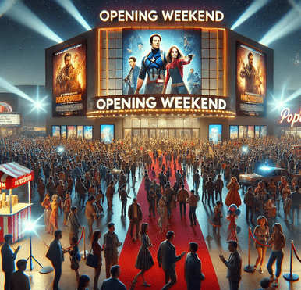
2
The number of films with big box office opening weekends have been steadily increasing since the pandemic
# of Films With $50M+ Domestic Box Office Opening Weekend
Source: VAB analysis of S&P Global Market Intelligence, ‘Box Office Averages, 2021-2024’, February 2025
This information is exclusively provided to VAB members and qualified marketers.
PAGE 8

Slide 9
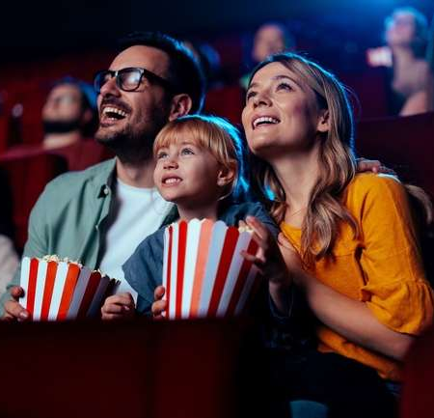
3
Family-friendly movies now make up over one-third of the box office, which creates more opportunities for brands looking to reach all ages
PG/G Movies Share of Total Annual Box Office Trend*
PG/G Box Office Revenue
48%
of moviegoers go to the movies with children in 2025
vs. 35% in 2023
$3.3B
$2.2B
$0.8B
$1.2B
Source: Fandango, ‘Theater Bound Media Trends & Insights Study’, Spring 2025; *VAB analysis of S&P Global Market Intelligence, ‘Box Office Averages, 2021-2024’, February 2025
This information is exclusively provided to VAB members and qualified marketers.
PAGE 9

Slide 10
4
Theatrical releases continue to drive significantly more buzz and online interest than the top movies on the largest streaming platform, Netflix
Theatrical Releases (Cinema) vs. Netflix Movies: Google Trends Index*
reflects a selection of three top theatrical releases vs. five top Netflix movies in 2nd Half 2024
Wicked
11/24 Index: 100
Beetlejuice Beetlejuice
9/7 Index: 75
It Ends With Us
8/11 Index: 45
Moana 2
11/24 Index: 39
Venom: The Last Dance
10/26 Index: 27
The Deliverance
9/1 Index: 13
The Menendez Brothers
9/22 Index: 12
Women of the Hour
10/20 Index: 10
Carry On
12/15 Index: 6
The Six Triple Eight
12/21 Index: 3
Source: VAB analysis of Google Trends, United States only, All Categories, Web Search, 7/1/24-12/31/24. *Google Trends Index represents search interest relative to the highest point on the chart for the given region and time period, a value of 100 is the peak popularity for the term, a value of 50 means that the term is half as popular. The date for each content represents the highest relative trend index achieved during the measurement period.
This information is exclusively provided to VAB members and qualified marketers.
PAGE 10

Slide 11
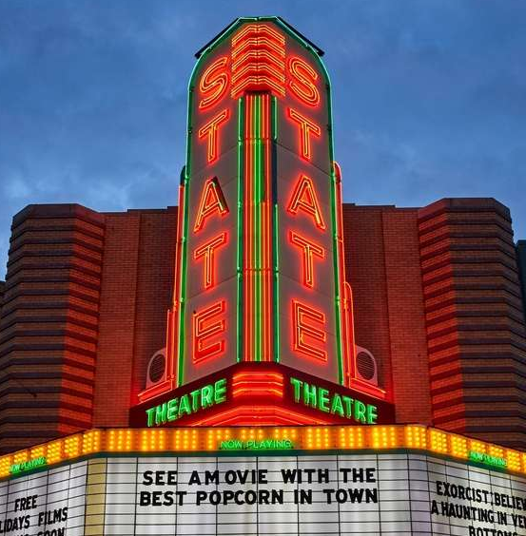
5
110 films are planned to be released across more than 2,000 theaters
in 2025, providing the marketplace with a steady pipeline of new content
Theatrical Wide Releases*
2021 - 2025
+16%
vs 2024
Source: National Association of Theatre Owners, ‘The Strength of Theatrical Exhibition’, projected as of 12/18/24. *Wide releases represent movies at 2,000+ locations.
This information is exclusively provided to VAB members and qualified marketers.
PAGE 11

Slide 12
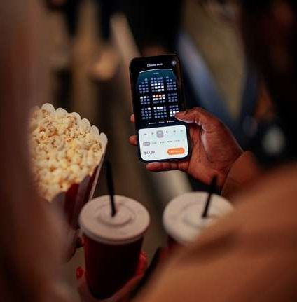
6
Box office revenues are projected to rise steadily over the next few years as more theatrical movies receive ‘wide’ releases
Annual Domestic Box Office Revenue
$ in Billions
+57%
vs 2022
(proj.)*
(proj.)*
(proj.)*
Source: Box Office Mojo, ‘Domestic Yearly Box Office’ for 2022-2024. *S&P Global Market Intelligence, ‘Exhibition Market Projections’ for 2025-2027 projections, July 2024.
This information is exclusively provided to VAB members and qualified marketers.
PAGE 12

Slide 13

2
Elevating the Cinematic Experience

Slide 14




7
People are now more likely to go to the movies as a form of escapism and relaxation from their daily routine
Top Reasons for Going to the Movies
2023
2024
2025
Movie needed to be seen
on the big screen
Big screen and
surround sound
Escape from daily routine
1.
1.
1.
Love going to the movies
Love going to the movies
Form of relaxation
2.
2.
2.
Big screen and
surround sound
Movie needed to be seen
on the big screen
Big screen and
surround sound
3.
3.
3.
Source: Source: Fandango, ‘Theater Bound Media Trends & Insights Study’, Spring 2025; ‘The Magic of the Theatrical Experience’, Spring 2024; ‘It’s Showtime’, Spring 2023. Note: 2023 respondents featured Fandango ticket buyers only.
This information is exclusively provided to VAB members and qualified marketers.
PAGE 14

Slide 15






8
A trip to the movie theater continues to be the most affordable local entertainment activity by far across all markets, both large and small
Since 2023, the average cost increase of non-theatrical activities (+25% on average) has outpaced cinema (+16%)
Entertainment Costs Across Different Market Sizes
vs
2023
2025
Activity
New York City
(County ‘A’)
Cleveland, OH
(County ‘B’)
Des Moines, IA
(County ‘C’)
Bakersfield, CA
(County ‘D’)
Movie Tickets
From Fandango
1 Adult Ticket
$19.65
$20.99
$10.25
$11.75
$11.24
$13.64
$13.75
$17.19
(Regal E-Walk)
(Capitol Theatre)
(Flix Brewhouse)
(Maya Bakersfield 16 & MPX)
Bowling
1 lane for 2 hours (Group of 6)
Price Per Person
$41.43
$63.82
$20.16
$20.16
$13.50
$15.32
$26.00
$35.98
(Bowlero)
(The Corner Alley)
(Air Lanes)
(Bowlero)
Mini Golf
2 rounds of mini golf
(estimated 50 – 90 mins) Price Per Person
$43.98
$43.98
$25.98
$23.98
$30.00
$30.00
$20.00
$22.00
(Shipwrecked)
(Swing n Things)
(Slideway Center)
(MB2 Entertainment*)
Laser Tag
Price Per Person for 1-1.5 hours
$39.99
$39.99
$22.50
$22.50
$32.00
$36.00
$20.00
$22.00
(Area 53 NYC)
(Area 51 Laser Tag)
(Spare Time Entertainment)
(The BLVD!)
Axe Throwing
Price Per Person for 2 hours
$42.00
$76.00
$28.99
$55.46
$40.00
$53.50
$30.00
$70.00
(Bury the Hatchet)
(Class Axe)
(Ironside Axe Club)
(Brainy Actz)
Archery
Price Per Person
$40.00
$45.00
$60.00
$60.00
$20.00
$20.00
$30.00
$30.00
(Gotham Archery)
(Crooked River Archers)
(Archery Field & Sports)
(Brainy Actz)
Source: VAB analysis of pricing available on the specific venues’ websites for the cost of activities based on the appropriate location as of 3/21/2025. Markets were selected from ABCD counties as categorized by Nielsen based on U.S. Census Bureau population data and metro areas. *MB2 Entertainment was used only in 2025 comparison since 2023 location closed.
This information is exclusively provided to VAB members and qualified marketers.
PAGE 15

Slide 16

9
Near 120 million people are theater loyalty members which represents a growing, highly engaged audience for brands to connect with
Movie Theater Loyalty Program Members
in Millions
Most Important Benefits of a Free Movie Loyalty Program*
Loyal & Casual Movie Fans
+12%
vs 2023
76%
Rewards & discounts on tickets
75%
Rewards on concessions
74%
Ability to track rewards easily
Source: National Association of Theatre Owners, ‘The Strength Of Theatrical Exhibition’, December 2024. *Fandango, ‘Theater Bound’, Spring 2025.
This information is exclusively provided to VAB members and qualified marketers.
PAGE 16

Slide 17
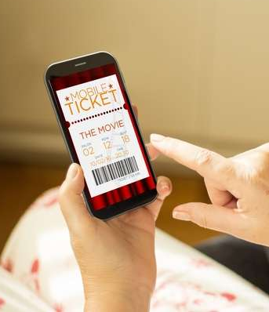
10
Moviegoers are expressing a greater commitment towards a trip to the theater as over half are now buying their tickets online in advance
% of Moviegoers Who Purchased a Movie Ticket Online in the Last 12 Months
+96%
vs 2022
Source: VAB analysis of MRI-Simmons Winter Study, 2022-2025. Base: A18+. ‘Moviegoer’ = Attended a movie in the last 12 months
This information is exclusively provided to VAB members and qualified marketers.
PAGE 17

Slide 18
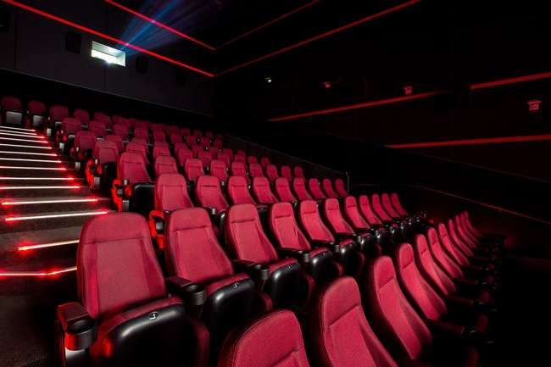

11
Immersive, large-format screens have grown by one-third over the
last five years as theaters compete with home entertainment systems
+37%
Increase in Large-Format Screens
across North America
over the past 5 years
(950 Large Format Screens in 2024)
Source: National Association of Theatre Owners, ‘The Strength Of Theatrical Exhibition’, December 2024. Note: Large screen format auditoriums are screens that are larger than standard screens and can include advanced projection technology and immersive sounds. Large format examples are IMAX, Dolby Cinema, Cinemark XD & Regal RPX.
This information is exclusively provided to VAB members and qualified marketers.
PAGE 18

Slide 19


12
Over three-quarters have watched a movie in a ‘premium format’ as more moviegoers seek to elevate their viewing experience vs. home
% of Moviegoers Who Have Seen A Movie in Premium Format*
In the last year
+15%
vs 2023
74%
of premium format moviegoers said that it
makes the moviegoing experience more enjoyable**
Source: Fandango, ‘Theater Bound’, Spring 2025; **‘The Magic of the Theatrical Experience’, Spring 2024; ‘It’s Showtime’, Spring 2023 Media Trends & Insights Studies. Note: 2023 respondents featured Fandango ticket buyers only. *Premium formats include IMAX, Dolby, RealD 3D, 4D, and more. Note: Large screen format auditoriums are screens that are larger than standard screens and can include advanced projection technology and immersive sounds.
This information is exclusively provided to VAB members and qualified marketers.
PAGE 19

Slide 20
13
Ad recall and engagement with cinema advertising, both on-screen and in lobbies, are exceeding pre-pandemic levels
Types of Cinema Advertising Seen in Last 30 Days by Frequent Moviegoers*
+19%
+35%
+8%
+33%
Ads shown on-screen
before the start of a movie
Product placement
in movies
Ads on posters at movie theaters
Video ads in movie theater lobbies
Source: VAB analysis of MRI-Simmons Doublebase 2019 & Winter 2025 Study. Base: A18+. *‘Frequent moviegoer’ reflects people who have gone to the movies at least once in the last month.
This information is exclusively provided to VAB members and qualified marketers.
PAGE 20

Slide 21



Theater owners have committed to massive capital investments to further modernize and elevate the cinematic experience
14
64% of moviegoers say the whole experience is why they go to the movies**
Capital Expenditures of Major Theatrical Exhibitors*
$ in MM
9/19/2024
Theater Owners Plan to Spend $2.2 Billion to
Modernize and Upgrade Moviegoing Experience
+111%
vs 2021
2/26/2025
How the world’s largest theaters are
Investing in modern moviegoers
AMC, Cinemark to spend nearly $500 million this year on high-end upgrades
11/6/2024
AMC Entertainment Plans To “Go On Offense” With Major Upgrades To Movie Theaters Amid Box Office Recovery
2/19/2025
Cinemark bounces back with new real estate plans after development hiatus
Cinema company to open its first family entertainment concept in Texas, with bowling and rock climbing
Source: VAB analysis of SEC 10-K filings of *The Marcus Corporation, AMC Entertainment Holdings, Inc. & Cinemark Holdings Inc. for fiscal years 2021-2024. AMC capital expenditures include US and international markets premium sight and sound, other upgrades to auditoriums, and beverage enhancements. Cinemark capital expenditures include US and International markets related to the development, remodel and enhancements of theaters. The Marcus Group capital expenditures includes theater upgrades including DreamLounger seating, SuperScreen DLX and ScreenX upgrades, excludes capital expenditures on the hotels and resorts division. **Screenvision, Screen Engine Data, March 2024. Base: Total Respondents (18+), ‘What are some of the reasons why you go to see movies in theater?’ *Major Theatrical Exhibitors represents: The Marcus Corporation, AMC Entertainment Holdings, Inc.& Cinemark Holdings Inc.
This information is exclusively provided to VAB members and qualified marketers.
PAGE 21

Slide 22
3
The Increasing Value of Moviegoers

Slide 23
15
Cinema delivers targeted audiences, especially among the more elusive, younger age groups that are sought after by marketers
2025 Population Composition by Age Group
109
Index*
108
Index*
105
Index*
115
Index*
Source: VAB analysis of MRI-Simmons Winter Study 2025 & Doublebase Study 2019. Base: A18+. ‘Moviegoer’ = Attended a movie in the last 12 months; VAB analysis of U.S. Census Bureau, ‘Projected Population by Single Year of Age, Sex, Race, and Hispanic Origin for the United States: 2022 to 2100’, November 2023. *% difference of moviegoers against U.S. population.
This information is exclusively provided to VAB members and qualified marketers.
PAGE 23

Slide 24

16
The median household income of moviegoers is nearly one-third higher than non-moviegoers, which has grown over recent years
Median Household Income (HHI) Trend
$ in Thousands
+29%
vs Non-Moviegoers
+23%
vs Non-Moviegoers
Source: VAB analysis of MRI-Simmons Winter Study, 2023 & 2025. Base: A18+. ‘Moviegoer’ = Attended a movie in the last 12 months. ‘Non-Moviegoer’ = Has not gone to the movies in the last 12 months
This information is exclusively provided to VAB members and qualified marketers.
PAGE 24

Slide 25
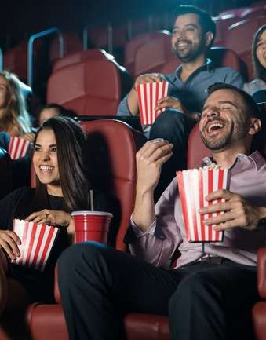
17
Hispanics are much more likely to be habitual moviegoers, which enables brands to connect with this valuable and growing audience
Hispanic A18+ Population Composition by Year
144
Index vs U.S. Pop*
128
Index vs U.S. Pop*
*How to read index: In 2025, Hispanics accounted for 26% of frequent moviegoers, which is 44% higher than their share of the U.S. pop
Source: VAB analysis of MRI-Simmons Winter 2025 Study and Doublebase 2019 Study. Base: A18+. ‘Frequent moviegoer’ reflects people who have gone to the movies at least once in the last month; VAB analysis of U.S. Census Bureau, ‘Annual Estimates of the Resident Population by Sex, Age, Race, and Hispanic Origin for the United States: April 1, 2010 to July 1, 2019, June 2020 & 2022 to 2100’, June 2020 & November 2023, A18+.
This information is exclusively provided to VAB members and qualified marketers.
PAGE 25

Slide 26
18
People in highly populated areas are more likely to be frequent moviegoers who seek escapism and relaxation from their daily lives
2025 Population Composition by County Size
113
Index vs A18+*
104
Index vs A18+*
*How to read index: Frequent Moviegoers are for 13% more likely to live in ‘County A’ than A18+
Source: VAB analysis of MRI-Simmons Winter Study, 2025. ‘Frequent moviegoer’ reflects people who have gone to the movies at least once in the last month. Markets were selected from ABCD counties as categorized by Nielsen based on U.S. Census Bureau population data and metro areas. County Sizes are categorized as: County A (~40% of U.S. HHs)- The 25 largest cities; County B (~30% of U.S. HHs)– Excl. A counties, and has a population of 150k+ and 85k+ HHs; County C (~15% of U.S. HHs) – Excl. A&B counties, and has a population of 40k+ and 20k+ HHs; County D (~15% of U.S. HHs) – Excl. A,B&C counties, with no limits on population of HHs.
This information is exclusively provided to VAB members and qualified marketers.
PAGE 26

Slide 27






19
Moviegoers are the drivers of the ‘going out’ economy and a vital target for brands across dining, sports and entertainment
Leisure Activities Participated in the Last 12 Months
+36%*
+100%
+86%*
+85%*
+180%*
+55%*
Attend Musical Performance
Source: VAB analysis of MRI-Simmons Winter Study, 2025. ‘Non-Moviegoer’ = Has not gone to the movies in the last 12 months, ‘Moviegoer’ reflects people who have gone to the movies at least once in the last year. Musical performances include rock, country, classical music/opera, R&B/Hip-Hop/Rap, and other. *% difference of moviegoers against non-moviegoers. **Using rideshare apps is based on usage in the last 30 days.
This information is exclusively provided to VAB members and qualified marketers
PAGE 27

Slide 28

20
Overall, moviegoers are highly desirable consumers whose gap in annual spending vs. non-moviegoers is only widening
Annual Credit Card & Debit Card Expenditure Per Person Trend
$ in Thousands
Interested in seeing the average moviegoer’s spending across twenty categories?
+19%*
+24%*
+28%*
+16%*
Click here to download
‘Show Me the Money’
Source: VAB analysis of MRI-Simmons – Winter 2025 & Fall Doublebase, 2022-2024, A18+. ‘Non-Moviegoer’ = Has not gone to the movies in the last 12 months; ‘Moviegoer’ = Attended a movie in the last 12 months *% difference of moviegoers against non-moviegoers.
This information is exclusively provided to VAB members and qualified marketers.
PAGE 28

Slide 29

Exciting, highly engaging releases coming soon to a movie theater near you

Slide 30
















The theatrical pipeline is filled with high-profile movies and specialty film releases this summer and beyond
5/23/25
5/23/25
5/30/25
6/6/25
6/6/25
6/13/25
6/20/25
6/20/25
7/2/25
7/11/25
7/25/25
8/1/25
8/1/25
8/8/25
8/25/25
8/29/25
Source: IMDb, Upcoming Releases, 2024/2025. Note: Release dates planned as of 3/27/2025 and subject to change.
This information is exclusively provided to VAB members and qualified marketers.
PAGE 30

Slide 31
20 Trends in Cinema
Highlights from the Movie Theater
Elevating the Cinematic Experience
The Increasing Value of Moviegoers
1
2
3
4
5
Movies continue to be the most popular ‘away from home’ entertainment activity
The number of films with big box office opening weekends are increasing
Family-friendly movies now account for over one-third of the box office
Theatrical releases continue to generate more buzz than Netflix movies
‘Wide’ theatrical releases will average more than two per week in 2025
6
7
8
9
10
Box office revenues are projected to rise steadily over the next few years
People are increasingly going to the movies for escapism and relaxation
‘Going to the movies’ continues to be the most affordable entertainment
There are now almost
120 million theater loyalty program members
Over half of all moviegoers buy their tickets online in advance of showtime
11
12
13
14
15
Immersive, large-format screens are increasing by double-digits
Over three-quarters have watched a movie in a ‘premium format’
Recall and engagement with cinema ads are exceeding pre-pandemic levels
Theaters are investing massive capital to elevate the cinematic experience
Cinema delivers much
sought-after but elusive younger age groups
16
17
18
19
20
Median household income is much higher among moviegoers
Hispanic audiences are much more likely to be habitual moviegoers
People in highly populated areas are more likely to be frequent moviegoers
Moviegoers are
the clear drivers of the
‘going out’ economy
The overall spending gap
between moviegoers and
non-moviegoers is widening
PAGE 31
click through the appropriate box if you would like to be brought directly to the corresponding slide

Slide 32

The cinema is the most popular ‘away from home’ entertainment by far – it provides scale, brand-safe environments, buzz and superior engagement
The affordable cinematic experience provides moviegoers with escapism and relaxation in an elevated viewing setting that will only continue to evolve with enhanced technology, features and services, which creates an ideal advertising environment for brands
Cinema delivers audiences that are of high value to brands - diverse segments across ages with higher household incomes who are active and are spenders
Key Marketer Takeaways
This information is exclusively provided to VAB members and qualified marketers.
PAGE 32

Slide 33

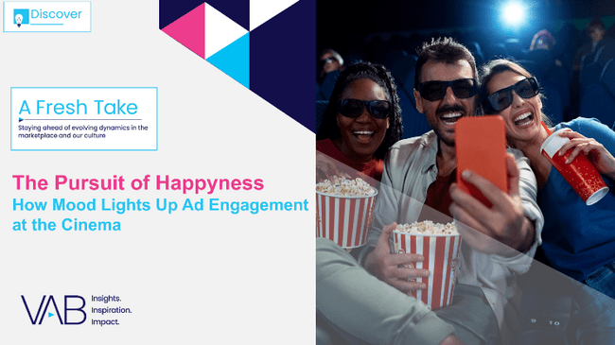
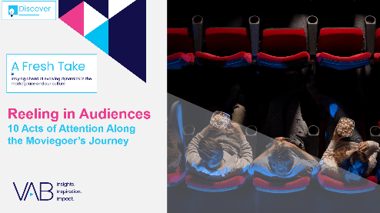

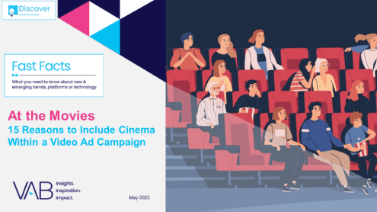

Creators
Jason Wiese
Reed Kiely
EVP, Strategic Insights & Measurement
jasonw@thevab.com
Director, Data Insights & Trends
reedk@thevab.com
Show Me the Money
Highlighting the Value of Moviegoers Across 20 Major Categories
The Pursuit of Happyness
How Mood Lights Up
Ad Engagement at the Cinema
Karolina Guillen
Kaileen Cain
Associate Director, Insights, Strategy & Analytics karolinag@thevab.com
Senior Insights Analyst
kaileenc@thevab.com
Discover more
Looking for more data, insights and takeaways? Check out this related VAB content
Reeling in Audiences
10 Acts of Attention Along
the Moviegoer’s Journey
The Passion of the Cinema
Tapping into people’s excitement
for quality, premium video content
At the Movies
15 Reasons to Include Cinema Within
a Video Campaign
How can cinema deliver desirable audiences for my brand?
VAB Members, brand marketers and agencies get free and immediate access to VAB’s content library. Get access at theVAB.com
This information is exclusively provided to VAB members and qualified marketers.
PAGE 33

Slide 34


About VAB
VAB is an insights-driven organization that inspires marketers to reimagine their media strategies resulting in fully informed decisions.
Drawing on our marketing expertise, we simplify the complexities in our industry and discover new insights that transform the way marketers look at their media strategy.
We are committed to your business growth and proud to offer VAB members, brand marketers and agencies complimentary access to our continuously-growing Insights library. Get immediate access at theVAB.com.
This information is exclusively provided to VAB members and qualified marketers.
PAGE 34

