Slide 1


January 24, 2025
Question of the Week:
“
Why is it important to demand transparency from my media partners?
”

Slide 2

12 key reasons why transparency needs to matter for marketers: The risks associated with opaque ad placements
Transparency is a cornerstone for effective marketing campaigns, yet it remains a persistent challenge. Despite industry discussions, the lack of transparency often leaves marketers exposed to risks that can undermine their efforts and investments
1
2
3
4
Significant amount
of wasted media spend
Brands may appear in poor advertising environments
Low-quality ad experiences can negatively impact brand perception
Potential for metric inflation and misrepresented
ad placements
5
6
7
8
Possibility of paying premium pricing for
non-premium placements
Misaligned incentives which could lead to poor advertising decisions
Brand safety issues including alignment with objectionable content
Ad fraud, which accounts for a significant share
of digital ad spending
9
10
11
12
Lack of accountability may occur which could lead to
a loss of campaign control
Appearing alongside misinformation can affect consumer sentiment
Fines have been levied for breaking privacy laws and misusing children’s data
Unknowingly funding organized crime and
other illicit activities
By aligning with trusted, transparent media partners, marketers can strengthen their strategies, build trust, and drive long-term success.
This information is exclusively provided to VAB members and qualified marketers.
PAGE 2

Slide 3





Transparency is widely discussed in the industry, but addressing the challenges remains difficult despite associated risks
Financial Risk
Brand Reputational & Corporate Risk
Legal Risk

Slide 4
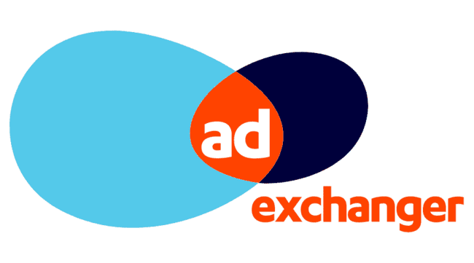
1
Lack of transparency can lead to a significant amount of wasted media spend in many cases
Roadblocks are often attributed to differing interpretations of what 'transparency' truly entails or a focus on short-term efficiencies over quality
12/5/2024
The ANA Releases Its Second Transparency Report – Hits The Open Web As 25% Waste
“Everyone says they are supporters of transparency, until they’re the ones asked to be transparent,” the ANA Programmatic Media Supply Chain Transparency Report cites, attributing the quote to a statement overheard at an ANA conference.
The ANA estimates that the open web programmatic market is about $88 billion this year – 25% of which is straight-up waste.
Of that wasted $22 billion, $10 billion accrues to made-for-advertising websites and $12 billion represents ad tech margin efficiencies. Which explains recommendations from the ANA like reducing vendors, resetting contracts, establishing direct lines to media sellers and switching to inclusion lists.
Programmatic media suppliers in particular tend to skate by some brand marketers, according to ANA EVP Bill Duggan. Other channels are well understood or just less complicated, but he said marketers get “embarrassed to ask questions that could make them be perceived as being stupid” when the programmatic pros are explaining themselves.
This information is exclusively provided to VAB members and qualified marketers.
PAGE 4

Slide 5









2
Lack of transparency can result in brands appearing in poor advertising environments
Examples of video ads running in subpar placements
In a small corner or side of a page
In a fully muted video player
With little to no video content between consecutive ads
‘Auto-plays’ without any user interaction or initiation
Ad plays continuously on a loop
Multiple video ads playing simultaneously on the same page
The ‘skip’ button on a video ad is hidden or obscured
Runs out of sight while the audio plays
Ads served “stacked” on top of another ad
This information is exclusively provided to VAB members and qualified marketers.
PAGE 5

Slide 6



3
A low-quality advertising experience, because of a lack of transparency, can negatively impact consumer perception of a brand
% of respondents that agree with the following on digital ads
86%
72%
66%
Too many ads on a webpage makes them feel overwhelmed and
more likely to ignore
the advertisement
Annoying or intrusive ad experiences have negatively affected their perception of a brand
Annoying or intrusive ad experiences make them less likely to purchase from that brand in future
Source: YouGov / Picnic, Ad UX Survey, 2023.
This information is exclusively provided to VAB members and qualified marketers.
PAGE 6

Slide 7


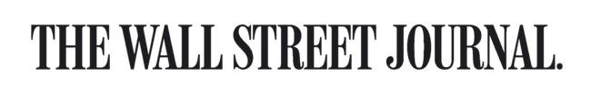

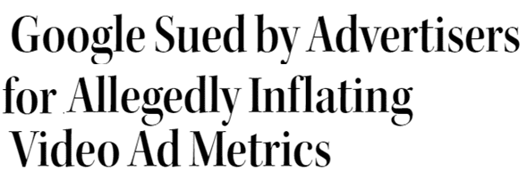
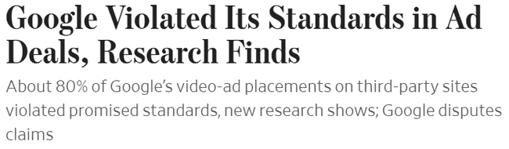

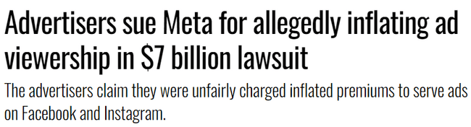


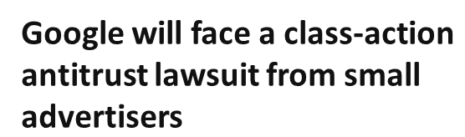
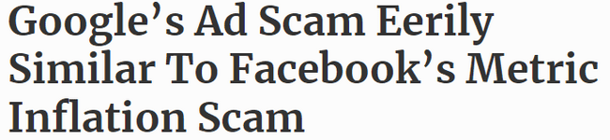





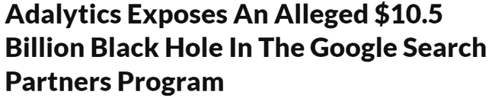
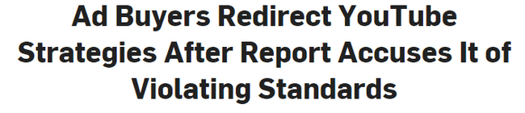
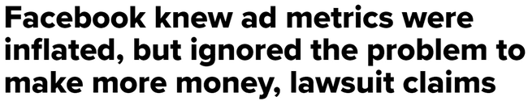
4
Lack of transparency can result in issues like metric inflation and misrepresented ad placements
April 2, 2024
July 26, 2023
June 27, 2023
March 29, 2024
June 28, 2023
December 15, 2023
August 20, 2018
November 28, 2023
July 11, 2023
February 19, 2021
This information is exclusively provided to VAB members and qualified marketers.
PAGE 7

Slide 8
5
Ad placement misrepresentation may include marketers potentially paying premium pricing for non-premium inventory
A study by Adalytics claimed a significant share of advertisers’ spend on Google’s ad network went to lower-quality placements
Distribution for YouTube TrueView In-stream Ad Campaign Budget Spend
on YouTube vs. Google Video Partner (GVP) Network
Major Infrastructure Brand
GVP Mobile App
Valid TrueView
Valid Placements
27% of YouTube buy spend were ‘valid TrueView, skippable,
in-stream video ads’
GVP Webpage
Valid TrueView
YouTube Channel
Valid TrueView
GVP Webpage
Invalid TrueView
Invalid Placements
73% of YouTube buy spend was misrepresented as ‘valid TrueView, skippable, in-stream video ads’ when they were not
GVP Mobile Application
Invalid TrueView
Source: Adalytics Research LLC, ‘Did Google Mislead Advertisers About TrueView Skippable In-Stream Ads for the Past Three Years?’ report, June 2023. Note: after the Adalytics report was released, YouTube changed the name of their ‘in-stream ads’ format to ‘skippable ads’ throughout Google Display and Video 360, according to a ‘What’s New: July 2023’ Google Blog Post and reported by Adweek on 8/7/23.
This information is exclusively provided to VAB members and qualified marketers.
PAGE 8

Slide 9
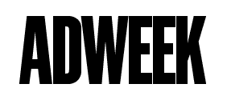
6
Lack of transparency can create misaligned incentives which could lead to poor ad decisions, especially among small and medium businesses
8/26/24
9/3/24
Google Sought to Pay Agencies Hundreds
of Millions to Sway Media Buys
Antitrust documents detail how Google planned to incentivize agencies in 2018
Agencies Continue to Receive Perks From Media Owners That Aren't Disclosed to Clients
Misaligned incentives can lead to wasted media spend
Arielle Garcia, director of intelligence at industry watchdog Check My Ads, who formerly worked at ad-buying giant UM, described the program as benefitting Google. Garcia has first-hand knowledge of Google’s program, she said.
“[Google] tends to recommend things that benefit themselves more so than advertisers,” Garcia said.
Incentive programs between large media companies and agencies continue to lead to poor advertising decisions and less transparency for smaller clients, 10 sources from agencies, brands, and publishers told ADWEEK.
Small and medium-sized clients were less likely to have stipulations in their contracts with agencies to ensure incentive programs are disclosed, the first buyer source said.
Medium-sized buyers would spend more with Google, “and then the rebates would come and they would typically go back to the agency or go back to the bigger clients,” the first buyer said.
What makes Google completely different “to another publisher or media vendor that participates in upfront negotiations is that the universe that you can transact through Google’s platform is endless,” the media auditor source said.
For instance, to fulfill a minimum spend commitment under an incentive program with a TV company, there are a finite number of shows in which agencies can buy airtime. But with Google, much more inventory is on the table, making it more likely brands don’t know which exact Google media their agency is buying, the source continued.
This information is exclusively provided to VAB members and qualified marketers.
PAGE 9

Slide 10

7
Lack of transparency can lead to brand safety issues like ad fraud and alignment with objectionable content and misinformation
% of respondents who are concerned about the following
For Their Business / Client’s Businesses
Click fraud*
Lack of transparency on campaign details and placements
Unknowingly appearing on websites with objectionable, offensive content
Unknowingly appearing on websites that deliberately serve disinformation / misinformation
Targeted/tracked ads running alongside children's content
Unknowingly appearing on 'Made for Advertising' (MFA) websites
Source: VAB / Advertiser Perceptions ‘Marketer Sentiment on Ad Fraud’ Survey, November 2023. Survey base: Marketer and agency contacts from the Advertiser Perceptions ‘Senior Marketer’ and ‘Streaming Video’ online communities.
Q3A. What are your top 3 concerns surrounding digital ad fraud regarding [your business/your clients' businesses]? Base = Total Respondents. *‘Click fraud’ refers to bots, click farms, etc. that generate fake clicks on an ad or website.
This information is exclusively provided to VAB members and qualified marketers.
PAGE 10

Slide 11


8
Ad fraud accounts for a significant share of digital ad spending and almost $1 out of every $3 dollars being spent in mobile is fraudulent
% of Global Digital Ad Spend Lost to Ad Fraud
by platform
22%
of digital ad spend
30%
of mobile ad spend
Source: Juniper Research, Quantifying the Cost of Ad Fraud: 2023-2028, 9/26/2023. Based on 2023 estimates.
This information is exclusively provided to VAB members and qualified marketers.
PAGE 11

Slide 12






9
There is a need for greater accountability as many marketers often defer to media partners to address ad fraud
% of brand marketer respondents who believe the following are responsible for preventing digital ad fraud
Trade Associations
Only 22% hold
agencies or advertisers accountable
(i.e., those most directly responsible
for the brand’s business)
Agencies
Digital supply chain vendors
Advertisers
Ad verification companies
Publishers
Source: VAB / Advertiser Perceptions ‘Marketer Sentiment on Ad Fraud’ Survey, November 2023. Survey base: Marketer and agency contacts from the Advertiser Perceptions ‘Senior Marketer’ and ‘Streaming Video’ online communities. Q10. Please rank the following based on who you believe is most responsible for preventing digital ad fraud? Base = Brand Marketer Respondents.
This information is exclusively provided to VAB members and qualified marketers.
PAGE 12

Slide 13


10
Appearing alongside misinformation can unfavorably influence consumer sentiment and have a drastic negative impact on brands
73%
65%
of consumers agree that they would feel unfavorably towards brands that have been associated with misinformation*
of consumers say that they are
likely to stop buying from a brand that advertises next to misinformation**
Source: Integral Ad Science, Advertising in the Age of Misinformation, 2022. Based on survey of 1,189 U.S. adults in July 2022. *Reflects respondents who answered ‘agree’ or ‘strongly agree’. **Reflects respondents who answered ‘likely’ or ‘very likely’.
This information is exclusively provided to VAB members and qualified marketers.
PAGE 13

Slide 14
11
Lack of transparency has led to digital platforms and brands being fined for breaking data privacy laws and misusing data from children
Instagram
$402MM
in EU for allegedly mishandling children’s data
TikTok
$367MM
fine by Irish Data Protection Commission for allegedly mishandling children's data
Google
$155MM
in settlements over
location tracking
Twitter (now ‘X’)
$150MM
fine for allegedly breaking privacy promises
Epic Games (‘Fortnite’)
$520MM
to settle charges of children’s privacy violations and deceptive practices
Microsoft
$20MM
for collecting and
retaining personal information from children
British Airways
£20MM
over breached data, some of which was shared with Google and Facebook
TikTok
$16MM
UK fine for misusing
children’s data
BetterHelp
$8MM
to online therapy users for alleged data misuse, including sharing metadata with Facebook and Google
GoodRx
$2MM
for sharing user’s health data with Google and Facebook
This information is exclusively provided to VAB members and qualified marketers.
PAGE 14

Slide 15



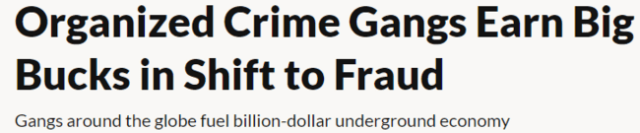
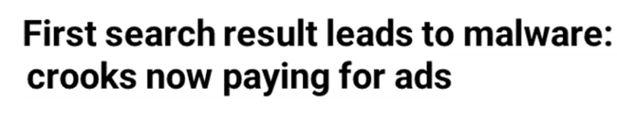
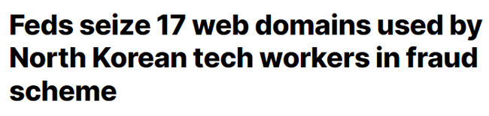


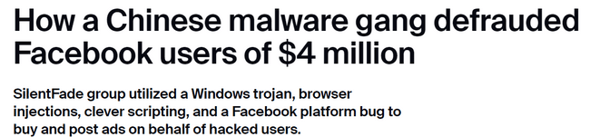
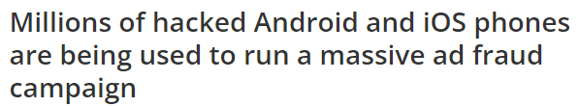
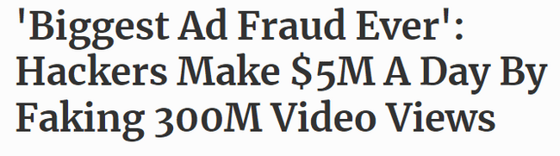



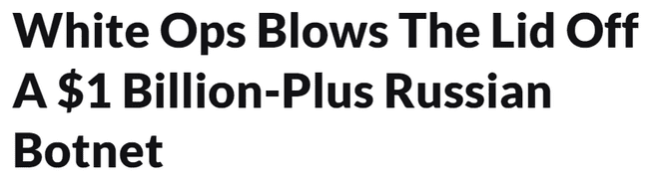

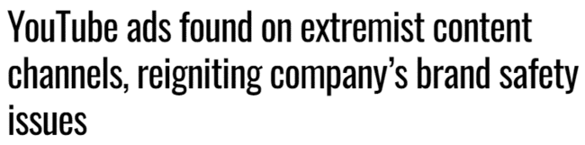


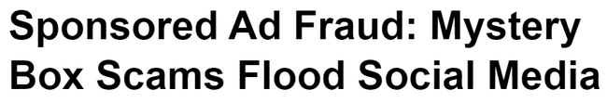

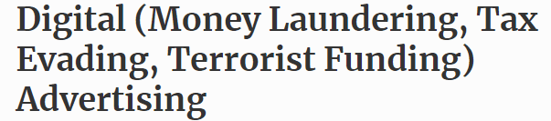
12
Lack of transparency in digital advertising has also caused brands to unknowingly fund organized crime and other illicit activities
April 20, 2022
November 15, 2023
October 19, 2023
October 1, 2020
October 10, 2023
November 10, 2021
December 20, 2016
April 20, 2022
April 20, 2018
PAGE 15
February 29, 2024
November 10, 2021
January 1, 2021
This information is exclusively provided to VAB members and qualified marketers.
PAGE 15

Slide 16






True transparency ensures full visibility into ad placements and the quality of data used to inform and measure campaign success
Transparency refers to the amount of information shared throughout the campaign lifecycle, enabling clear communication between the sell-side and the buy-side.
Marketers should demand complete transparency on…
True verification
The full lifecycle of all video ad units within your campaign by
media partner
All calculations
of video ad impressions by media partner
The granular details of exact ad placements, by type and inventory source, across each media partner
The composition of ad placement types and inventory sources in audience metrics such as reach calculations by media partner
Have media partners bring in a truly independent third party to provide transparency on
a now-permanent basis
Also, the FreeWheel Council for Premium Video and VAB have partnered to advocate for the value of premium standards. Click below to download and learn more!
Buying Premium Video: A Definitive Checklist
This information is exclusively provided to VAB members and qualified marketers.
PAGE 16

Slide 17




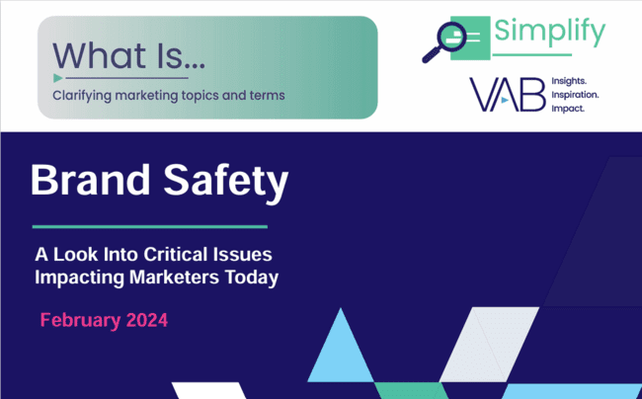


Download these other VAB resources to understand more about the importance of transparency, brand safety and quality within ad campaigns
41 pages
43 pages
28 pages
The Power of Premium Video
What It Means for Multiscreen TV
and Why It Matters to Marketers
Best in Show
Five Advantages of Multiscreen TV,
From Brand to Performance
The Consumer Connection
Understanding the Effect of Quality
Across Media Platforms
24 pages
11 pages
49 pages
The Credibility Crisis
How People Find Trusted News Amidst
a Wave of Misinformation
What is Brand Safety?
A Look Into Critical Issues
Impacting Marketers Today
Hidden Costs
Three Critical Business Ramifications
of Digital Ad Fraud
This information is exclusively provided to VAB members and qualified marketers.
PAGE 17

Slide 18
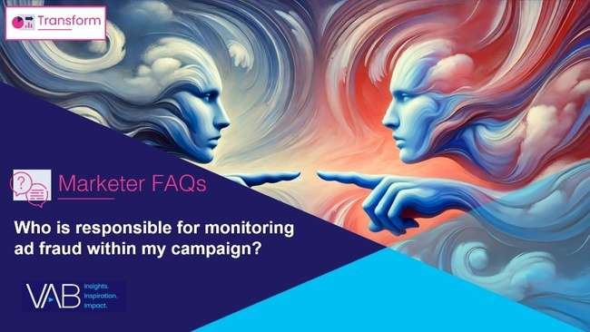

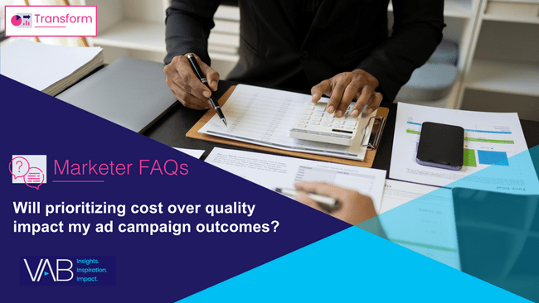
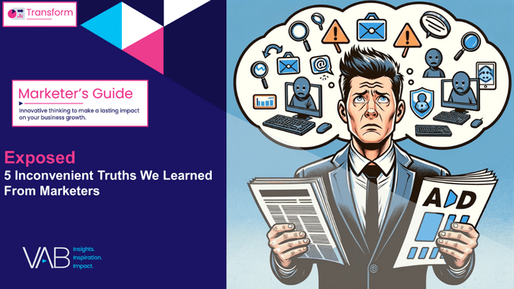
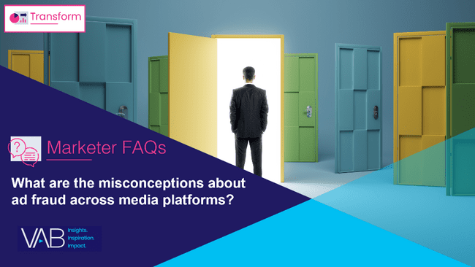
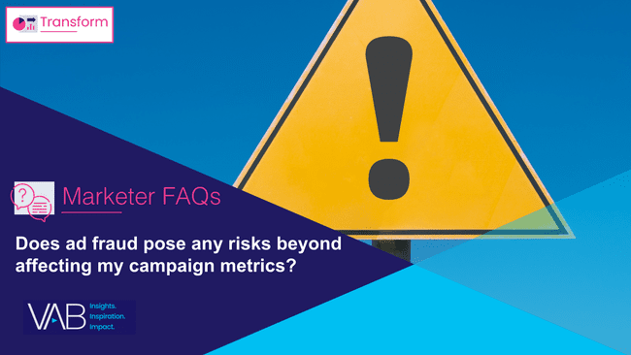
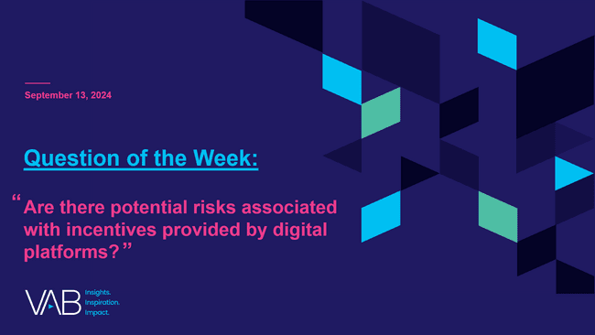
Download our full ‘Exposed’ marketer’s guide and ‘snackable’ FAQs to understand marketers’ views on transparency and brand safety in media
Other ‘Exposed’ Marketer FAQs
Full 51-page custom survey of marketers and agency professionals on the common misconceptions and misunderstandings around transparency, ad fraud and brand safety
Who is responsible for monitoring ad fraud within my campaign?
How can I effectively address
ad fraud within my campaign?
Will prioritizing cost over quality impact my ad campaign outcomes?
Click to Download
What are the misconceptions about ad fraud across media platforms?
Does ad fraud pose any risks beyond affecting my campaign metrics?
Are there potential risks associated with incentives provided by digital platforms?
This information is exclusively provided to VAB members and qualified marketers.
PAGE 18

Slide 19


About VAB
VAB plays a dual role in the video advertising industry. We are leading the change to bring about a more innovative and transparent marketplace. We also provide the insights and thought leadership that enables marketers to develop business-driving marketing strategies.
Drawing on our marketing expertise, we simplify the complexities in our industry and discover new insights that transform the way marketers look at their media strategy.
We are committed to your business growth and proud to offer VAB members, brand marketers and agencies complimentary access to our continuously-growing Insights library. Get immediate access at theVAB.com.
This information is exclusively provided to VAB members and qualified marketers.
PAGE 19

