Slide 1

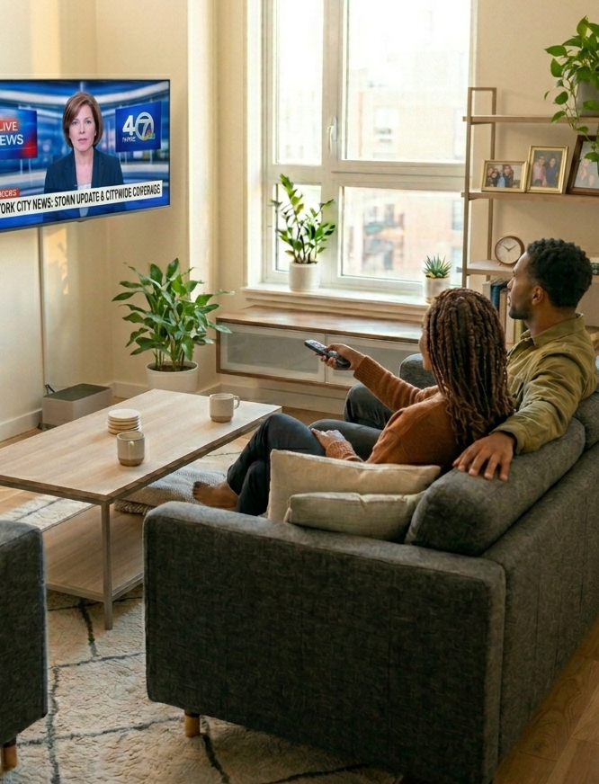


Community Connection
10 ways TV news creates trust and impact among diverse audiences

Slide 2


Trusted TV news strengthens community connections across diverse audiences
TV news is a central source of information for Black, Hispanic and Asian audiences as they navigate an increasingly fragmented media landscape. In moments that matter most, they turn to TV news for its accuracy, familiarity and unbiased perspectives, helping them stay informed and connected.
Local TV news particularly stands out by deepening personal relevance and trust through localized storytelling, trusted personalities and coverage that connects national issues to their communities.
In the third part of our custom study series, VAB partnered with Dynata to explore how TV news, especially local news, drives engagement and action among Black, Hispanic and Asian audiences.
Building on findings from The Lead Story and And That’s the Way It Is, this latest installment examines how advertising within TV news environments strengthens brand connection and influences consumer behavior.
See slide 19 for details on the custom study methodology of the survey fielded in December 2025.
This information is exclusively provided to VAB members and qualified marketers.
PAGE 2

Slide 3

Diverse audiences are more likely to be increasingly turning to TV news, especially in moments that matter

Slide 4
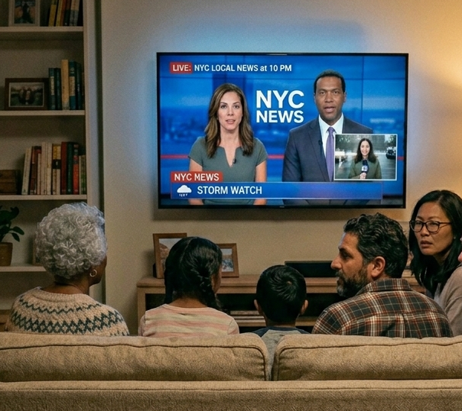
Diverse audiences are more likely to be increasingly turning to TV news, highlighting its growing importance as an outlet of community connection
% of respondents who are watching more TV news now than last year
Black
Hispanic
57%
57%
Asian
White
52%
47%
Source: Dynata, Media Consumption and Political Sentiment survey, fielded December 2025 (n=2,319). Survey base: A18+ U.S. respondents. Q9. Please rate your agreement with the following statements - ‘I am watching more TV news now than I did last year.’ Based on respondents who selected ‘strongly agree’ or ‘agree’ [Top 2 Box]. Base = All News Respondents. Black respondents (n=168), Hispanic respondents (n=143), Asian respondents (n=85), White respondents (n=941).
This information is exclusively provided to VAB members and qualified marketers.
PAGE 4

Slide 5

Staying informed on current events is the top reason why diverse audiences tune in, speaking to their interest and engagement with TV news
% of respondents who say the main reason they watch news on TV is to stay informed on current events
Black
45%
Hispanic
36%
Asian
55%
White
44%
Source: Dynata, Media Consumption and Political Sentiment survey, fielded December 2025 (n=2,319). Survey base: A18+ U.S. respondents. Q5. What is the main reason you watch news on TV? – ‘To stay informed about current events.’ Base = All News Respondents. Black respondents (n=168), Hispanic respondents (n=143), Asian respondents (n=85), White respondents (n=941).
This information is exclusively provided to VAB members and qualified marketers.
PAGE 5

Slide 6
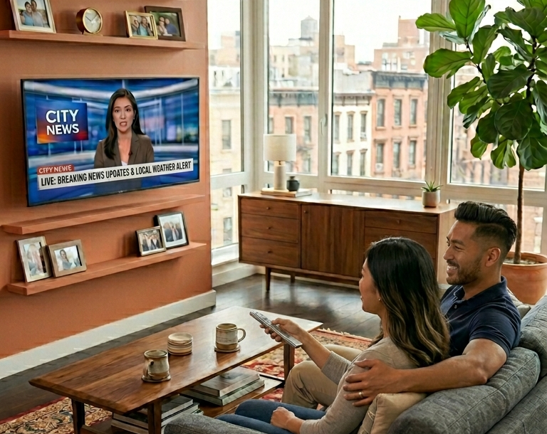
In moments of major importance, diverse audiences turn to TV first, reinforcing its role as a primary news destination
% of respondents who go to local or national TV news
first for breaking news
Black
Hispanic
83%
80%
Asian
White
87%
86%
Source: Dynata, Media Consumption and Political Sentiment survey, fielded December 2025 (n=2,319). Survey base: A18+ U.S. respondents. Q8. Where do you go first for breaking news? – ‘Local TV news’ or ‘National TV news.’ Base = All News Respondents. Black respondents (n=168), Hispanic respondents (n=143), Asian respondents (n=85), White respondents (n=941).
This information is exclusively provided to VAB members and qualified marketers.
PAGE 6

Slide 7





Diverse audiences are more likely to appreciate the honest, unbiased and straightforward perspective that TV news offers
% of respondents who are satisfied / unsatisfied with the unbiased perspective in TV news reports
3.5x
times more likely
2.6x
times more likely
4.5x
times more likely
1.9x
times more likely
Source: Dynata, Media Consumption and Political Sentiment survey, fielded December 2025 (n=2,319). Survey base: A18+ U.S. respondents. Q10. Indicate your overall level of satisfaction with the following. - ‘Unbiased perspective in TV news reports.’ Base = All News Respondents. Based on respondents who answered ‘satisfied’ or ‘very satisfied’ [Top 2 Box]. Black respondents (n=168), Hispanic respondents (n=143), Asian respondents (n=85), White respondents (n=941).
This information is exclusively provided to VAB members and qualified marketers.
PAGE 7

Slide 8





Conversely, social media is often perceived as a source of misinformation across most audiences, underscoring the trust and credibility in TV news
% of respondents who believe the following platforms are the most likely to provide
fake or misleading information
Social Media vs. Traditional TV
Key Groups
Social Media
Traditional TV
Social Media
vs. Traditional TV
x times more likely
Black
38%
14%
2.8x
Hispanic
44%
17%
2.6x
Asian
48%
13%
3.6x
White
52%
19%
2.7x
Source: Dynata, Media Consumption and Political Sentiment survey, fielded December 2025 (n=2,319). Survey base: A18+ U.S. respondents. Q30. Which source do you believe is the most likely to provide fake or misleading information. – ‘Social Media’ (e.g. Instagram, TikTok) vs. ‘Traditional TV’ (cable or satellite). Base = Total Respondents. Black respondents (n=318), Hispanic respondents (n=298), Asian respondents (n=160), White respondents (n=1650).
This information is exclusively provided to VAB members and qualified marketers.
PAGE 8

Slide 9
Local TV news strengthens trust among diverse audiences through positive personalities and community-focused content

Slide 10

Local news personalities have a positive impact on their community, strengthening engagement and trust among diverse audiences
‘Local TV news anchors have a positive impact on the community’
% of respondents that agree
Source: Dynata, Media Consumption and Political Sentiment survey, fielded December 2025 (n=2,319). Survey base: A18+ U.S. respondents. Q9. Please rate your agreement with the following statements - ‘Local TV news anchors have a positive impact on the community.’ Base = All News Respondents. Based on respondents who selected ‘strongly agree’ or ‘agree’ [Top 2 Box]. Black respondents (n=168), Hispanic respondents (n=143), Asian respondents (n=85), White respondents (n=941).
This information is exclusively provided to VAB members and qualified marketers.
PAGE 10

Slide 11
Diverse audiences value local TV news because it offers personal relevancy like local perspectives on national issues and community-centered stories
‘I appreciate the local perspective on national issues’
% of respondents that agree
‘Local TV news stories are more relevant
to me than national news’
% of respondents that agree
Black
Hispanic
Black
Hispanic
70%
67%
55%
53%
Asian
White
Asian
White
77%
65%
52%
49%
Source: Dynata, Media Consumption and Political Sentiment survey, fielded December 2025 (n=2,319). Survey base: A18+ U.S. respondents. Q9. Please rate your agreement with the following statements - ‘I appreciate the local perspective on national issues’, ‘Local TV news stories are more relevant to me than national news.’ Base = All News Respondents. Based on respondents who selected ‘strongly agree’ or ‘agree’ [Top 2 Box]. Black respondents (n=168), Hispanic respondents (n=143), Asian respondents (n=85), White respondents (n=941).
This information is exclusively provided to VAB members and qualified marketers.
PAGE 11

Slide 12





Diverse audiences are more likely to view local TV news as a more accurate source of information, due to the credibility it continually provides
% of respondents who find local TV news information more accurate than other sources
Source: Dynata, Media Consumption and Political Sentiment survey, fielded December 2025 (n=2,319). Survey base: A18+ U.S. respondents. Q9. Please rate your agreement with the following statements - ‘Information during local TV news is more accurate than other sources.’ Base = All News Respondents. Based on respondents who selected ‘strongly agree’ or ‘agree’ [Top 2 Box]. Black respondents (n=168), Hispanic respondents (n=143), Asian respondents (n=85), White respondents (n=941).
This information is exclusively provided to VAB members and qualified marketers.
PAGE 12

Slide 13
TV news enhances brand perception and motivates purchase among diverse audiences

Slide 14
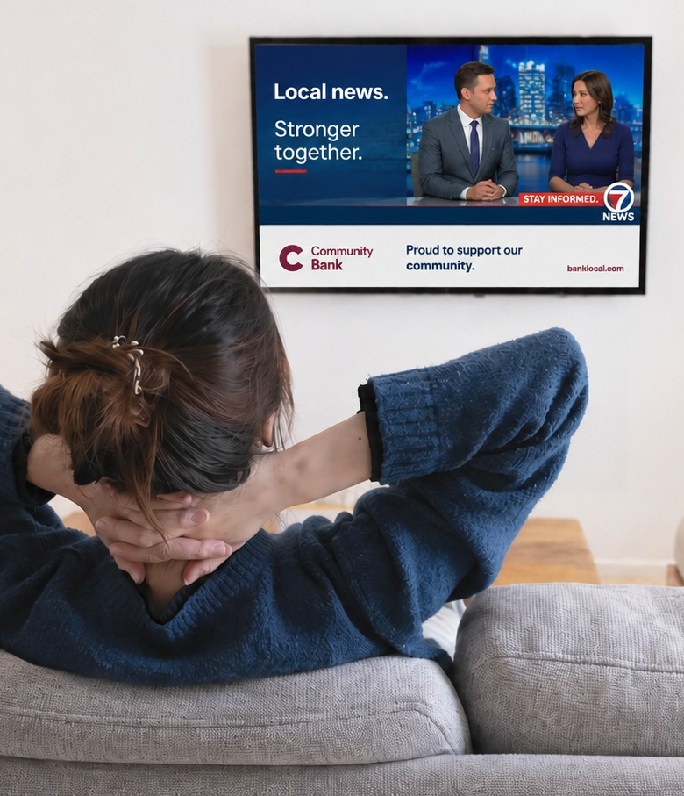
Advertising in local TV news strengthens brand perception among diverse audiences, highlighting the impact of messaging alongside trusted content
% of respondents who have a better opinion of brands that advertise during local TV news
Source: Dynata, Media Consumption and Political Sentiment survey, fielded December 2025 (n=2,319). Survey base: A18+ U.S. respondents. Q9. Please rate your agreement with the following statements - ‘I have a better opinion of brands that advertise during local TV news.’ Base = All News Respondents. Based on respondents who selected ‘strongly agree’ or ‘agree’ [Top 2 Box]. Black respondents (n=168), Hispanic respondents (n=143), Asian respondents (n=85), White respondents (n=941).
This information is exclusively provided to VAB members and qualified marketers.
PAGE 14

Slide 15
Engagement, trust and relevance translates into action for diverse audiences who are more likely to buy from TV news advertisers
% who say ads shown in the following would make them either ‘more likely’ or ‘less likely’ to purchase
Following a breaking news story on a local TV news channel
During national TV news
Source: Dynata, Media Consumption and Political Sentiment survey, fielded December 2025 (n=2,319). Survey base: A18+ U.S. respondents. Q35. Would any of the following impact your willingness to purchase a product or service after seeing an ad? – ‘Ad shown following a breaking news story on my local TV news channel’, ‘Ad shown during national TV news.’ Base = Ad Exposed Respondents. Based on respondents who answered ‘more likely to purchase’ or ‘less likely to purchase.’ Black respondents (n=199), Hispanic respondents (n=181), Asian respondents (n=98), White respondents (n=1,058).
This information is exclusively provided to VAB members and qualified marketers.
PAGE 15

Slide 16

Adults over 50 account for 36% of the total population and nearly half of all adults
Growing viewership, habitual engagement and credibility during key moments position TV news as an important outlet for community connection among diverse audiences
Local TV news is a highly trusted resource for relevant perspectives and community-focused stories provided
by positive personalities that makes content feel more relatable across diverse audiences
Advertising alongside TV news, especially local, enhances brand perception and motivates purchase
by diverse viewers
Key Marketer Takeaways
This information is exclusively provided to VAB members and qualified marketers.
PAGE 16

Slide 17








Creators
Jason Wiese
Leah Pujalte
EVP, Strategic Insights & Measurement
jasonw@thevab.com
VP, Audience & Behavioral Insights
leahm@thevab.com
Karolina Guillen
Amanda Cashman
The Lead Story
How Multiscreen TV Drives Cross-Partisan Engagement for Political Ad Campaigns
And That’s the Way It Is
How TV News Provides Scale, Attention Engagement for High-Value Audiences
Associate Director, Insights, Strategy & Analytics karolinag@thevab.com
Insights Analyst
amandac@thevab.com
Discover more
Looking for more data, insights and takeaways? Check out this related VAB content
The Credibility Crisis
How People Find Trusted News Amidst a Wave of Misinformation
Why banning Pharma TV ads would disproportionately affect minority groups
We are committed to providing marketers with the data and insights they need to develop thoughtful, inclusive campaigns & strategies. To find out more on the unique media consumption behaviors and cultural trends of multicultural consumers, visit the VAB’s DEIB Marketing Resource Center.
Holidays with Heart
How Marketers Can Authentically Connect with Hispanic Shoppers
What does authentic representation mean to diverse audiences?
VAB Members, brand marketers and agencies get free and immediate access to VAB’s content library. Get access at theVAB.com
This information is exclusively provided to VAB members and qualified marketers.
PAGE 17

Slide 18


About VAB
VAB plays a dual role in the video advertising industry. We are leading the change to bring about a more innovative and transparent marketplace. We also provide the insights and thought leadership that enables marketers to develop business-driving marketing strategies.
Drawing on our marketing expertise, we simplify the complexities in our industry and discover new insights that transform the way marketers look at their media strategy.
We are committed to your business growth and proud to offer VAB members, brand marketers and agencies complimentary access to our continuously-growing Insights library. Get immediate access at theVAB.com.
This information is exclusively provided to VAB members and qualified marketers.
PAGE 18

Slide 19
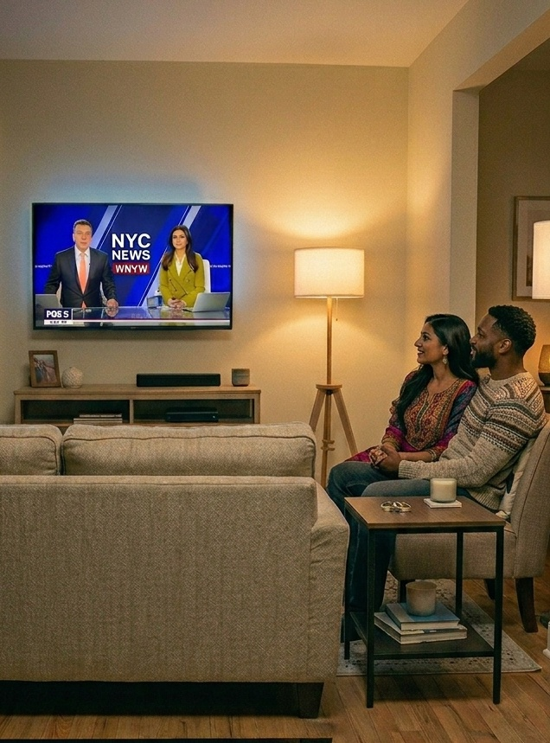
Custom Study Methodology
In December 2025, VAB conducted a survey with Dynata to understand how Americans engage with political and news content across today’s fragmented media landscape.
The results are based on 2,319 U.S. adults 18+. This study examines how diverse audiences engage with TV news, both local and national, and why this matters for marketers.
The analysis explores how TV news, particularly local TV news, serves as a trusted and engaging source of information for diverse audiences and how the strong credibility and personal relevance of these environments help brands build deeper connections and drive consumer action.
This information is exclusively provided to VAB members and qualified marketers.
PAGE 19

