Slide 1





Direct Momentum
10 Case Studies on How Multiscreen TV Drives Mid-Funnel Outcomes for DTC Brands

Slide 2

Increased multiscreen TV investment by DTC brands is fueled by mid-funnel results
Earlier this year we released our annual update on multiscreen TV investment by direct-to-consumer (DTC) brands. The results of our analysis showed that 2024 featured the highest number of DTC brands collectively investing the most amount of dollars into TV ever.
These digital-native, data-driven, performance-obsessed brands are investing more into multiscreen TV because they know that integration within premium video content works.
As a complement to our ‘Direct-to-Consumer’ Historical TV Spend Advertiser List, we created 10 real-world case studies that quantify the measurable impact of multiscreen TV on mid-funnel outcomes such as branded online search and brands’ website traffic.
There are many reasons for increased investment but all tie back to the ability of multiscreen TV’s ability to drive outcomes including brands that:
Increased their TV investment after seeing initial success
Made a ‘big bet’ in premium, signature programming that drove brand curiosity
Achieved incremental growth through a sustained presence
Saw success through a short campaign burst
Turned ‘test-and-learn’ results into ‘heavy-up’ investments
Came back to TV after a hiatus and achieved immediate traffic spikes
This information is exclusively provided to VAB members and qualified marketers.
PAGE 2

Slide 3
2024 featured the highest number of digital-native, direct-to-consumer brands investing in multiscreen TV platforms ever
# of Active Digital-Native, Direct-to-Consumer (DTC) Brands on Multiscreen TV
+6%
2024 vs. 2023
Source: VAB analysis of Nielsen AdIntel as of 7/14/25 (*includes all six measured TV media: nat'l cable TV, nat'l broadcast TV, Spanish language broadcast TV, Spanish Language cable TV, spot TV, syndication TV; and streaming as of 2022-2024); excludes promos and PSAs.
Direct to Consumer – a company that sells their product or service online directly to end customers without involving third-party retailers, wholesalers or other parts of the traditional consumer supply chain. Number of DTC brands reflect active on U.S. TV each year.
This information is exclusively provided to VAB members and qualified marketers.
PAGE 3

Slide 4
2024 also featured the highest total investment ever on multiscreen TV by performance-obsessed, data-driven, digital-native DTC brands
Digital-Native, Direct-to-Consumer (DTC) Brands U.S. Total TV* Spend
$ in millions
+9%
2024 vs. 2023
Source: VAB analysis of Nielsen AdIntel as of 7/14/25 (*includes all six measured TV media: nat'l cable TV, nat'l broadcast TV, Spanish language broadcast TV, Spanish Language cable TV, spot TV, syndication TV; and streaming as of 2022-2024); excludes promos and PSAs.
Direct to Consumer – a company that sells their product or service online directly to end customers without involving third-party retailers, wholesalers or other parts of the traditional consumer supply chain.
This information is exclusively provided to VAB members and qualified marketers.
PAGE 4

Slide 5

Why are more DTC brands investing more dollars into multiscreen TV?
Because it works.

Slide 6

We created 10 real-world case studies that quantify the measurable impact of multiscreen TV on branded online search and brands’ website traffic
Outcomes Metrics by Purchase Funnel Stage
Analysis Methodology
Awareness
Online Searches
Using Google Trends we compared the relative volume, quantified by the search index, of searches for DTC brands before and after their TV launch.
Website Visitors
We analyzed website traffic data between January 2023 - August 2025 through Comscore to compare monthly unique visitors for each brands’ measured website before and after their TV campaign.
Consideration
Online Searches
Intent
Website Visitors
Sales
This information is exclusively provided to VAB members and qualified marketers.
PAGE 6

Slide 7
Five real-world case studies based on the impact of multiscreen TV campaign investment on branded online search activity
Outcomes Metrics by Purchase Funnel Stage
Analysis Methodology
Awareness
Online Searches
Using Google Trends we compared the relative volume, quantified by the search index, of searches for DTC brands before and after their TV launch.
Consideration
Online Searches
Intent
Sales
This information is exclusively provided to VAB members and qualified marketers.
PAGE 7

Slide 8

‘Investment Spend’
Brand Case Studies:
Spikes in branded search activity achieved
by first-time TV advertisers in 2023 led to increased TV investment in 2024
How to read the charts in this section:
Google Search Index = represents search interest relative to the highest point during a specific time period for a given region (i.e., U.S.), a value of 100 is the peak popularity for the term, a value of 50 means that the term is half as popular.

Slide 9

Category: Apparel & Accessories
Mott & Bow: Saw a 3.5x spike in online branded search activity by the end the second month of their first TV campaign which launched in late-2023
Mott and Bow: Weekly Google Search Trends Index
Weeks of 10/30/22 – 11/19/23
3.5x
+45%
vs. prior week
vs. week before TV launch
w/o 11/19/23
(100 index)
TV Launch Week
(42 index)
Heavy Up:
$202K Weekly Avg
Week Before TV Launch
(29 index)
2-Month TV Campaign
TV Launch: 9/10/23
Source: VAB analysis of Google Trends, United States only, All Categories, Web Search, weeks of 10/30/22 – 11/19/23. Google Search Index represents search interest relative to the highest point on the chart for the given region and time period, a value of 100 is the peak popularity for the term, a value of 50 means that the term is half as popular. VAB analysis of Nielsen Ad Intel, TV launch month is based on the first activity reported across national cable TV, national broadcast TV, Spanish language broadcast TV, Spanish language cable TV, spot TV, syndication TV, streaming TV. Spend is based on reported national cable TV, national broadcast TV, Spanish language broadcast TV, Spanish language cable TV, spot TV, syndication TV, streaming TV spend. $1.7MM reflects TV investment for the weeks of 9/10/23-11/19/23. Note: Light blue line marks the first week of TV spending for each brand.
This information is exclusively provided to VAB members and qualified marketers.
PAGE 9

Slide 10

Category: Apparel & Accessories
Mugsy: Saw its online search activity quadruple when it ‘heavy-upped’ its TV investment spend within it’s first TV campaign towards the end of 2023
Mugsy: Weekly Google Search Trends Index
Weeks of 8/28/22 – 11/19/23
4x
+16%
vs. week before TV launch
w/o 11/19/23
(100 index)
vs. prior week
TV Launch Week
(29 index)
Week Before TV Launch
(25 index)
Heavy Up:
$249K Weekly Avg
5-Month TV Campaign
TV Launch: 7/9/23
Source: VAB analysis of Google Trends, United States only, All Categories, Web Search, weeks of 8/28/22 – 11/19/23. Google Search Index represents search interest relative to the highest point on the chart for the given region and time period, a value of 100 is the peak popularity for the term, a value of 50 means that the term is half as popular. VAB analysis of Nielsen Ad Intel, TV launch month is based on the first activity reported across national cable TV, national broadcast TV, Spanish language broadcast TV, Spanish language cable TV, spot TV, syndication TV, streaming TV. Spend is based on reported national cable TV, national broadcast TV, Spanish language broadcast TV, Spanish language cable TV, spot TV, syndication TV, streaming TV spend. $1.9MM reflects TV investment for the weeks of 7/9/23-11/19/23. Note: Light blue line marks the first week of TV spending for each brand.
This information is exclusively provided to VAB members and qualified marketers.
PAGE 10

Slide 11

Category: Skincare
Laura Geller: A sustained presence on TV for this first-time TV advertiser in 2023 culminated in a 4.5x increase in branded search by the end of the year
Laura Geller: Weekly Google Search Trends Index
Weeks of 3/27/22 – 12/24/23
4.5x
+5%
vs. week before TV launch
w/o 12/24/23
(100 index)
vs. prior week
TV Launch Week
(23 index)
Heavy Up:
$525K Weekly Avg
Week Before TV Launch
(22 index)
9-Month TV Campaign
TV Launch: 4/2/23
Source: VAB analysis of Google Trends, United States only, All Categories, Web Search, weeks of 3/27/22 – 12/24/23. Google Search Index represents search interest relative to the highest point on the chart for the given region and time period, a value of 100 is the peak popularity for the term, a value of 50 means that the term is half as popular. VAB analysis of Nielsen Ad Intel, TV launch month is based on the first activity reported across national cable TV, national broadcast TV, Spanish language broadcast TV, Spanish language cable TV, spot TV, syndication TV, streaming TV. Spend is based on reported national cable TV, national broadcast TV, Spanish language broadcast TV, Spanish language cable TV, spot TV, syndication TV, streaming TV spend. $9.5MM reflects TV investment for the weeks of 4/2/23-12/24/23. Note: Light blue line marks the first week of TV spending for each brand.
This information is exclusively provided to VAB members and qualified marketers.
PAGE 11

Slide 12
Those three brands launched TV for the first time in 2023 and significantly increased TV spend in 2024 after seeing major spikes in branded search
3 DTC Brands - U.S. Total TV* Spend
$ in millions
3 DTC Brands Analyzed
2024 vs. 2023
+2.3x
$43.7
+1.8x
+2.2x
$19.3
+3.4x
Source: VAB analysis of Nielsen AdIntel as of 7/14/25 (*includes all six measured TV media: nat'l cable TV, nat'l broadcast TV, Spanish language broadcast TV, Spanish Language cable TV, spot TV, syndication TV; and streaming as of 2022-2024); excludes promos and PSAs. *3 Brands: Mugsy, Mott & Bow and Laura Geller. DTC/Direct to Consumer – a company that sells their product or service online directly to end customers without involving third-party retailers, wholesalers or other parts of the traditional consumer supply chain.
This information is exclusively provided to VAB members and qualified marketers.
PAGE 12

Slide 13
‘Big Bet’
Brand Case Study:
A first-time TV advertiser in 2023 saw initial success leading them to make a ‘big bet’ TV investment in 2024 which drove significantly more branded online search activity

Slide 14

Category: Beverages
Poppi: After launching their first TV campaign in late-2023 the brand made a big bet with a 2024 Super Bowl ad which delivered a 3x increase in search
Poppi: Weekly Google Search Trends Index
Weeks of 2/12/23 – 2/11/24
2.9x
+17%
vs. week before TV launch
2024 Super Bowl ad
w/o 2/11/24 (100 index)
vs. prior week
Heavy Up: Super Bowl Spot
TV Launch Week
(14 index)
Week Before TV Launch
(12 index)
4-Month TV Campaign
TV Launch: 11/5/23
Source: VAB analysis of Google Trends, United States only, All Categories, Web Search, weeks of 2/12/23 – 2/11/24. Google Search Index represents search interest relative to the highest point on the chart for the given region and time period, a value of 100 is the peak popularity for the term, a value of 50 means that the term is half as popular. VAB analysis of Nielsen Ad Intel, TV launch month is based on the first activity reported across national cable TV, national broadcast TV, Spanish language broadcast TV, Spanish language cable TV, spot TV, syndication TV, streaming TV. Spend is based on reported national cable TV, national broadcast TV, Spanish language broadcast TV, Spanish language cable TV, spot TV, syndication TV, streaming TV spend. $29.0MM reflects TV investment for the weeks of 11/5/23-2/11/24. Note: Light blue line marks the first week of TV spending for each brand.
This information is exclusively provided to VAB members and qualified marketers.
PAGE 14

Slide 15
‘Sustaining Presence’
Brand Case Study:
The DTC brand with the largest first-time investment in 2024 achieved steady lifts in their branded online search throughout a sustained presence on TV

Slide 16
Category: Apparel & Accessories
Honeylove: After their TV launch at the beginning of 2024, a sustaining presence delivered a 5.6x increase in branded search after five months
Honeylove: Weekly Google Search Trends Index
Weeks of 1/1/23 – 5/26/24
5.6x
+17%
vs. week before TV launch
w/o 5/26/24
(100 index)
vs. prior week
Heavy Up:
$1.8MM Weekly Avg
TV Launch Week
(21 index)
Week Before TV Launch
(18 index)
5-Month TV Campaign
TV Launch: 12/31/23
Source: VAB analysis of Google Trends, United States only, All Categories, Web Search, weeks of 1/1/23 – 5/6/24. Google Search Index represents search interest relative to the highest point on the chart for the given region and time period, a value of 100 is the peak popularity for the term, a value of 50 means that the term is half as popular. VAB analysis of Nielsen Ad Intel, TV launch month is based on the first activity reported across national cable TV, national broadcast TV, Spanish language broadcast TV, Spanish language cable TV, spot TV, syndication TV, streaming TV. Spend is based on reported national cable TV, national broadcast TV, Spanish language broadcast TV, Spanish language cable TV, spot TV, syndication TV, streaming TV spend. $19.8MM reflects TV investment for the weeks of 12/31/23-5/26/24. Note: Light blue line marks the first week of TV spending for each brand.
This information is exclusively provided to VAB members and qualified marketers.
PAGE 16

Slide 17
Five real-world case studies based on the impact of multiscreen TV campaign investment on brands’ website traffic
Outcomes Metrics by Purchase Funnel Stage
Analysis Methodology
Awareness
Consideration
Website Visitors
We analyzed website traffic data between January 2023 - August 2025 through Comscore to compare monthly unique visitors for each brands’ measured website before and after their TV campaign.
Intent
Website Visitors
Sales
This information is exclusively provided to VAB members and qualified marketers.
PAGE 17

Slide 18
‘Incremental Results’
Brand Case Study:
A DTC brand launched TV in 2023 and continued with campaigns through 2024 and 2025 which drove incremental website traffic growth

Slide 19

Category: Meal Delivery Service
Factor: After launching TV in July 2023, the brand saw continued double-digit website traffic growth ‘when on’ throughout 2024 and beyond
Brand Website Traffic Analysis: Unique Website Visitors
Monthly Website Unique Visitors (000) Comparison
Time Period Analysis: Jan ’23 – Aug ‘25
A meal delivery service offering prepared, ready-to-eat meals (also known as Factor75)
+59%
+32%
+1.8MM monthly uniques
+973K monthly uniques
vs. six-month average prior to TV launch
vs. six-month average prior to TV launch
(monthly average)
(TV launch – August 2025)
Source: VAB analysis of Comscore mediametrix multiplatform media trend data, P18+. January 2023 – August 2025 (calendar months). VAB analysis of Nielsen Ad Intel, TV launch month is based on the first activity reported across national cable TV, national broadcast TV, Spanish language broadcast TV, Spanish language cable TV, spot TV, syndication TV, streaming TV. Spend is based on reported national cable TV, national broadcast TV, Spanish language broadcast TV, Spanish language cable TV, spot TV, syndication TV, streaming TV spend. ‘When on TV’ represents the monthly average for brands in months where they spent in TV as measured through Nielsen Ad Intel between January 2023 – August 2025 (10 months ‘when on TV’). $31.4MM spend reflects TV investment between July 2023 – August 2025. Factor brand launched in 2013.
This information is exclusively provided to VAB members and qualified marketers.
PAGE 19

Slide 20
‘Short Campaign Burst’
Brand Case Study:
A first-time TV advertiser achieved millions
of more unique website visitors during their targeted TV campaign launch in 2024

Slide 21

Category: Ecommerce
AliExpress: An increase of 3.5MM unique website visitors each month was seen during their TV launch, a 2-month campaign between June-July 2024
Brand Website Traffic Analysis: Unique Website Visitors
Monthly Website Unique Visitors (000) Comparison
Time Period Analysis: Dec ’23 – Jul ‘24
An online retail service based in China and owned by the Alibaba Group
Two-month TV campaign launch vs.
six-month average prior to TV launch
+20%
+3.5MM monthly uniques
(monthly average)
(monthly average)
Source: VAB analysis of Comscore mediametrix multiplatform media trend data, P18+. December 2023 – July 2024 (calendar months). VAB analysis of Nielsen Ad Intel, TV launch month is based on the first activity reported across national cable TV, national broadcast TV, Spanish language broadcast TV, Spanish language cable TV, spot TV, syndication TV, streaming TV. Spend is based on reported national cable TV, national broadcast TV, Spanish language broadcast TV, Spanish language cable TV, spot TV, syndication TV, streaming TV spend. $6.2MM reflects TV investment between June – July 2024. AliExpress brand launched in 2010.
This information is exclusively provided to VAB members and qualified marketers.
PAGE 21

Slide 22
‘Test-and-Learn’
Brand Case Study:
After testing TV in 2023, a DTC brand ‘heavy-upped’ their investment and continued with a sustaining presence through 2024 which drove huge spikes in their website traffic

Slide 23
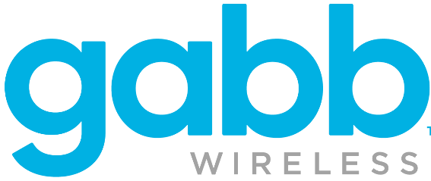
Category: Telco
Gabb: After two months of testing, the brand ‘heavy-upped’ TV investment in 4Q ’23 through 2024 which drove triple-digit increases in website traffic
Brand Website Traffic Analysis: Unique Website Visitors
Monthly Website Unique Visitors (000) Comparison
Time Period Analysis: May ‘23 – Aug ‘25
TV launch month vs.
six-month average prior to TV ‘heavy-up’
Kid-safe smartphones that have texting and music but
no social media or internet
+150%
+231K
monthly uniques
In the TV ‘heavy-up’ month vs. prior month:
+3.7x in spend
+4.6x in traffic
(monthly average;
beginning with ‘heavy up’ TV month)
(monthly average)
Source: VAB analysis of Comscore mediametrix multiplatform media trend data, P18+. May 2023 – August 2025 (calendar months). VAB analysis of Nielsen Ad Intel, TV launch month is based on the first activity reported across national cable TV, national broadcast TV, Spanish language broadcast TV, Spanish language cable TV, spot TV, syndication TV, streaming TV. Spend is based on reported national cable TV, national broadcast TV, Spanish language broadcast TV, Spanish language cable TV, spot TV, syndication TV, streaming TV spend. ‘When on TV’ represents the monthly average for brands in months where they spent in TV beginning with the ‘heavy up’ TV month as measured through Nielsen Ad Intel between May 2023 – August 2025 (21 months ‘when on TV’). $22.2MM spend reflects TV investment between September 2023 – August 2025. Gabb brand launched in 2018.
This information is exclusively provided to VAB members and qualified marketers.
PAGE 23

Slide 24
‘Welcome Back to TV’
Brand Case Studies:
After a prolonged hiatus from TV, DTC brands launched new TV campaigns which drove significant increases in website and app traffic

Slide 25

Category: Petcare
Tractive: After an 8-month national TV hiatus, the brand came back strong in Jan 2024 and saw an immediate +70% lift to their website traffic
Brand Website Traffic Analysis: Unique Website Visitors
Monthly Website Unique Visitors (000) Comparison
Time Period Analysis: Jul ’23 – Jan ‘24
TV launch month vs.
six-month average prior to TV launch
Smart GPS & Health trackers for Cats & Dogs
+70%
+75K monthly uniques
(monthly average)
Source: VAB analysis of Comscore mediametrix multiplatform media trend data, P18+. July 2023 – January 2024 (calendar months). VAB analysis of Nielsen Ad Intel, TV launch month is based on the first activity reported across national cable TV, national broadcast TV, Spanish language broadcast TV, Spanish language cable TV, spot TV, syndication TV, streaming TV. Spend is based on reported national cable TV, national broadcast TV, Spanish language broadcast TV, Spanish language cable TV, spot TV, syndication TV, streaming TV spend. $461K reflects TV investment in January 2024. Tractive brand launched in 2012.
This information is exclusively provided to VAB members and qualified marketers.
PAGE 25

Slide 26

Category: Online Tickets
TickPick: After a year hiatus, the brand launched TV again in summer 2023, airing continuously through 2024 which drove double-digit traffic increases
Online ticket marketplace for sports, concerts, and theater events
Unique Website Visitors
Monthly Website Unique Visitors (000) Comparison
Time Period Analysis: Feb ’23 – Aug ‘25
Unique Mobile App Visitors
Monthly Website Mobile App Visitors (000) Comparison
Time Period Analysis: Feb ’23 – Aug ‘25
+31%
+56%
+389K monthly uniques
+395K monthly uniques
(TV launch – August 2025)
(TV launch – August 2025)
(monthly average)
(monthly average)
Source: VAB analysis of Comscore mediametrix multiplatform media trend data, P18+. February 2023 – August 2025 (calendar months). VAB analysis of Nielsen Ad Intel, TV launch month is based on the first activity reported across national cable TV, national broadcast TV, Spanish language broadcast TV, Spanish language cable TV, spot TV, syndication TV, streaming TV. Spend is based on reported national cable TV, national broadcast TV, Spanish language broadcast TV, Spanish language cable TV, spot TV, syndication TV, streaming TV spend. ‘When on TV’ represents the monthly average for brands in months where they spent in TV as measured through Nielsen Ad Intel between February 2023 – August 2025 (25 months ‘when on TV’). $22.2MM spend reflects TV investment between August 2023 – August 2025. TickPick brand launched in 2011.
This information is exclusively provided to VAB members and qualified marketers.
PAGE 26

Slide 27
Increased multiscreen TV investment by DTC brands is fueled by mid-funnel results
More digital-native, data-driven, performance-obsessed direct-to-consumers brands are investing in multiscreen TV because of its’ ability to drive mid-funnel outcomes like branded online search and brands’ website traffic and, because these brands have so much access to their own data, they know that advertising in premium content works
DTC brands are seeing greater mid-funnel outcomes through a variety of multiscreen TV strategies:
  ‘Heavy-up’ investment spend
  ‘Big bets’ on highly social, highly buzzed about, marquee premium programming
  Sustained presence with advertising continuity
  Short campaign bursts aligning with business objectives, key selling periods and seasonality
  ‘Test-and-learn’ campaigns to understand what works and what can be optimized
  A fresh campaign restart after a TV advertising hiatus
Key Marketer Takeaways
This information is exclusively provided to VAB members and qualified marketers.
PAGE 27

Slide 28
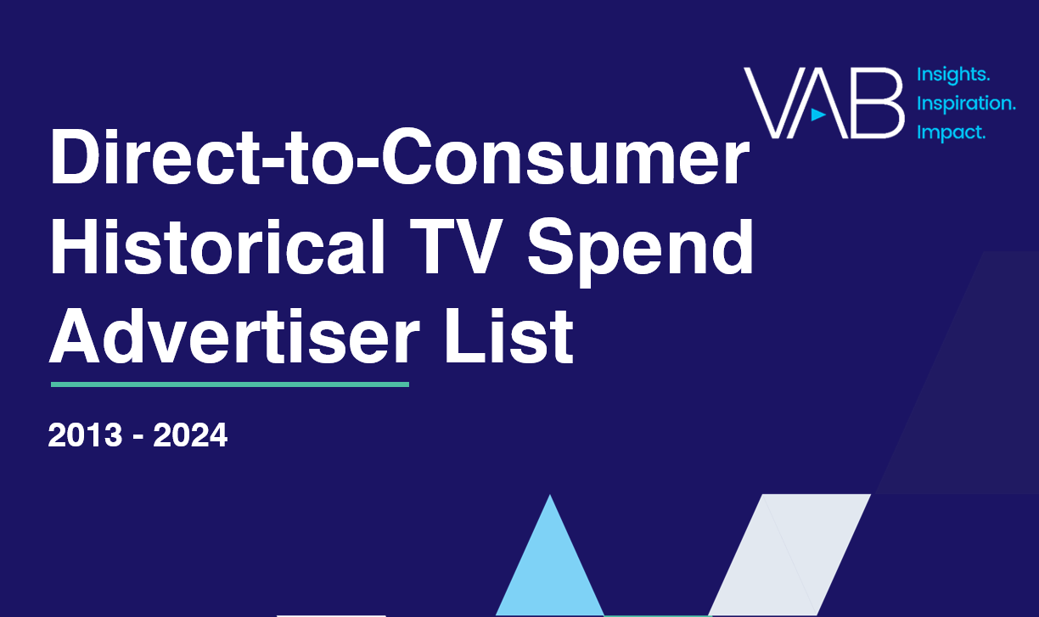
Discover the full list of 789 direct-to-consumer TV advertisers that we have tracked over the last 12 years – now available to marketers & agencies!
Click report cover above to download
This information is exclusively provided to VAB members and qualified marketers
PAGE 28

Slide 29




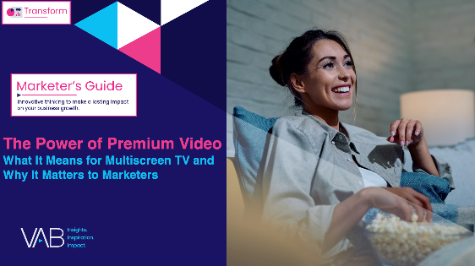


Creators
Jason Wiese
Reed Kiely
EVP, Strategic Insights & Measurement
jasonw@thevab.com
Director, Data Insights & Trends
reedk@thevab.com
A Commanding Presence
How Ad Continuity in Multiscreen TV Drives Incremental Growth for Brands
Breaking Through
How New Advertisers Are Using TV To Ignite Interest & Turn Consumers Into Customers
Discover more
Looking for more data, insights and takeaways? Check out this related VAB content
Visit our Multiscreen TV Attribution Resources Hub for the latest examples and ‘proof’ that premium video campaigns drive a direct impact on brands’ KPIs.
The Secret of My Success
Examining The Winning Marketing Strategy That’s Fueling High-Growth DTC Brands
25 Ways TV Grows Brands
Powering Performance Through
Full-Funnel Business Outcomes
The Power of Premium Video
What It Means for Multiscreen TV
and Why It Matters to Marketers
Best in Show
Five Advantages of Multiscreen TV,
From Brand to Performance
This information is exclusively provided to VAB members and qualified marketers
PAGE 29

Slide 30


About VAB
VAB plays a dual role in the video advertising industry. We are leading the change to bring about a more innovative and transparent marketplace. We also provide the insights and thought leadership that enables marketers to develop business-driving marketing strategies.
Drawing on our marketing expertise, we simplify the complexities in our industry and discover new insights that transform the way marketers look at their media strategy.
We are committed to your business growth and proud to offer VAB members, brand marketers and agencies complimentary access to our continuously-growing Insights library. Get immediate access at theVAB.com.
This information is exclusively provided to VAB members and qualified marketers.
PAGE 30

