Slide 1
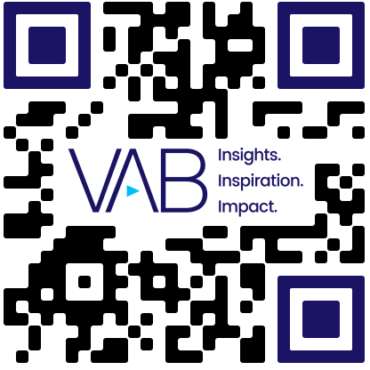

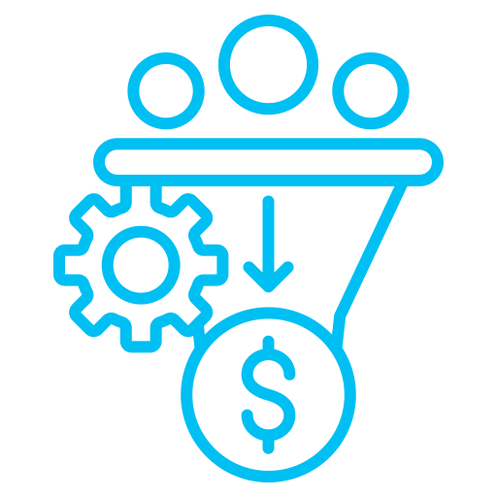



Programmatic: Effectiveness Metrics
Scan or click to access more programmatic insights
Reach & frequency and conversion rates are the two top metrics that marketers focus on for programmatic campaigns
What metrics are you focused on for measuring the effectiveness of programmatic campaigns?
% of marketers that focus on the following metrics
Reach / Frequency
Conversion Rate
Click-Through Rate (CTR)
70%
69%
63%
Return on Ad Spend (ROAS)
Engagement Metrics
(e.g, likes, shares)
58%
46%
Source: Proximic by Comscore, State of Programmatic, 2025.
Click here to download the full report, ‘What is Programmatic TV?’ to learn more
theVAB.com/insights

