Slide 1

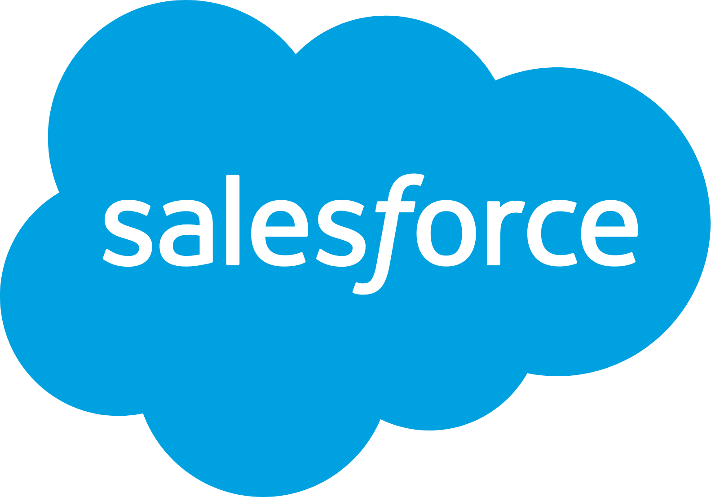

Super Bowl Advertisers: Mid-Funnel Successes
Scan or click to access more outcomes insights
Salesforce returned to the Super Bowl after a two-year hiatus, and saw a direct increase in online searches and website visits
Branded online search doubled on Super Bowl night vs. week prior and was 32% higher than the second highest week over the last 12 months
2x
Weekly Google Trends Index: Salesforce
12-month trend leading up to the Superbowl (Weeks of 2/9/2025 – 2/8/2026)
vs. prior week
Super Bowl
(100 index)
Second Highest Week
(76 index)
“We’ve had over 53M people hit this page since the spot ran. 1.32M in the last 15 minutes. Beyond any expectation
we could have had.”
2025 Super Bowl
(64 index)
Week Before Super Bowl
(51 index)
Marc Benioff
CEO, Salesforce
(X, 2/9/26)
Source: VAB analysis of Google Trends, United States only, All Categories, Web Search, Weeks of 2/9/25 – 2/8/26. Google Search Index represents search interest relative to the highest point on the chart for the given region and time period, a value of 100 is the peak popularity for the term, a value of 50 means that the term is half as popular. Note: Light blue line marks the date of Super Bowl LX. Click here to view Salesforce's Super Bowl commercial (via iSpot.tv).
Click here to download VAB’s full report, ‘How much do Super Bowl ads drive consumer action, like search? – Super Bowl LX (2026)’ to learn more
theVAB.com/insights
PAGE 1

