Slide 1
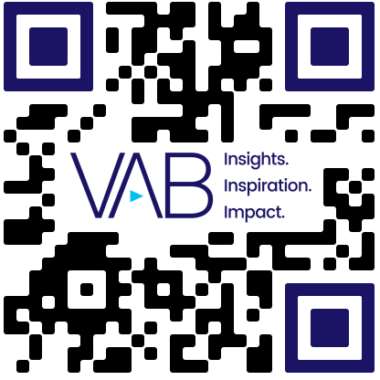
Facebook Fake Accounts vs. Global Population
Scan or click to access transparency insights
The number of fake accounts that Facebook bans have regularly equated to the equivalent of over half the world’s population
Banned Fake Facebook Accounts’ Share of Global Population
2018
2019
2020
2021
2022
2023
2024
2025
Fake Accounts Banned by Facebook
3.34B
6.50B
5.80B
6.50B
5.80B
2.62B
4.33B
3.50B
7.73B
7.81B
7.89B
7.95B
8.02B
8.09B
8.16B
8.23B
Global Population*
Fake Accounts Banned % Share of Global Population
43%
83%
74%
82%
72%
32%
53%
43%
Source: VAB analysis of Meta Transparency Center, Fake Accounts – Facebook, Accounts Actioned, as of 4/28/26. *VAB analysis of United Nations, Department of Economic and Social Affairs, Population Division (2024), World Population Prospects: The 2024 Revision, custom data acquired via UN Data Portal – Population Division website as of 4/28/26. ‘Accounts Actioned’ refers to fake accounts banned.
Click here to download the full report, ‘Friend or Frenemy?: Examining the Reasons Why Facebook Bans Billions of Accounts Each Year’ to learn more
theVAB.com/insights

