Slide 1

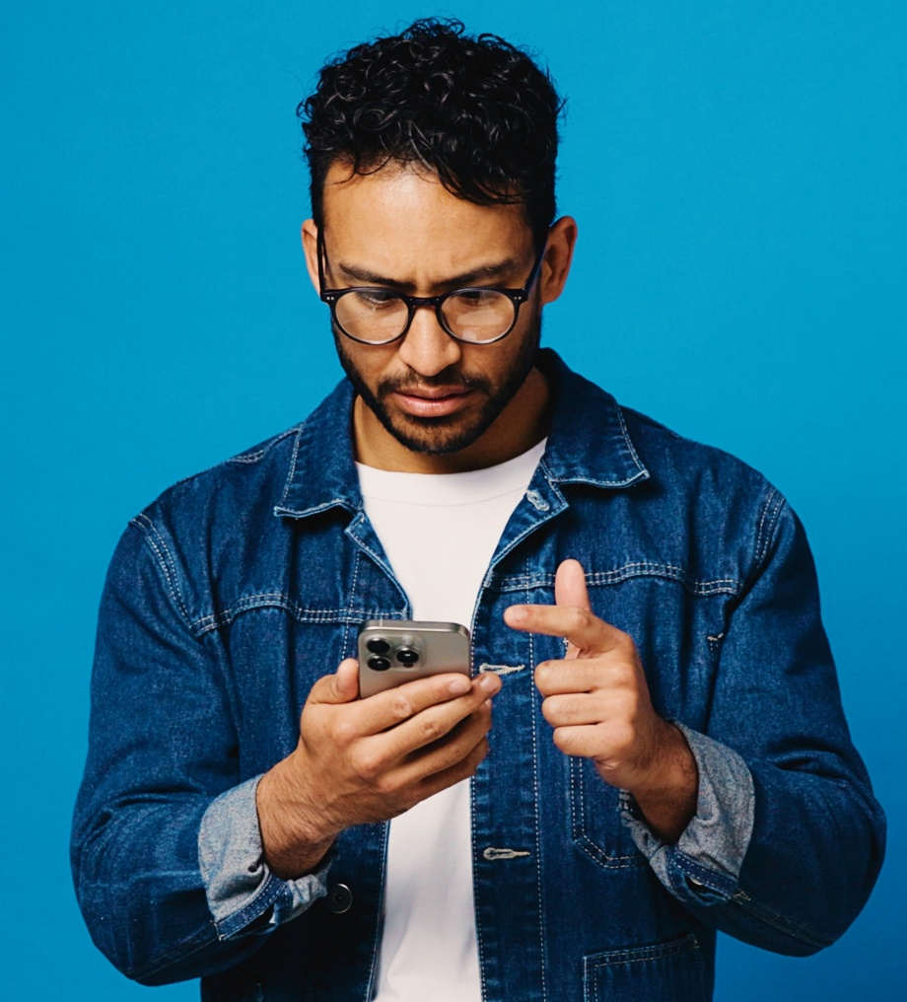




Credibility of TV News vs. Social Media
Scan or click to access more transparency insights
Social media is perceived as a source of misinformation across diverse audiences, underscoring the credibility of TV news
% of respondents who believe the following platforms are the most likely to provide
fake or misleading information
Social Media vs. Traditional TV
Key Groups
Social Media
Traditional TV
Social Media
vs. Traditional TV
x times more likely
Black
38%
14%
2.8x
Hispanic
44%
17%
2.6x
Asian
48%
13%
3.6x
White
52%
19%
2.7x
Source: Dynata, Media Consumption and Political Sentiment survey, fielded December 2025 (n=2,319). Survey base: A18+ U.S. respondents. Q30. Which source do you believe is the most likely to provide fake or misleading information. – ‘Social Media’ (e.g. Instagram, TikTok) vs. ‘Traditional TV’ (cable or satellite). Base = Total Respondents. Black respondents (n=318), Hispanic respondents (n=298), Asian respondents (n=160), White respondents (n=1650).
Click here to download the full report, ‘Community Connection: 10 ways TV news creates trust and impact among diverse audiences’ to learn more
theVAB.com/insights

