Slide 1

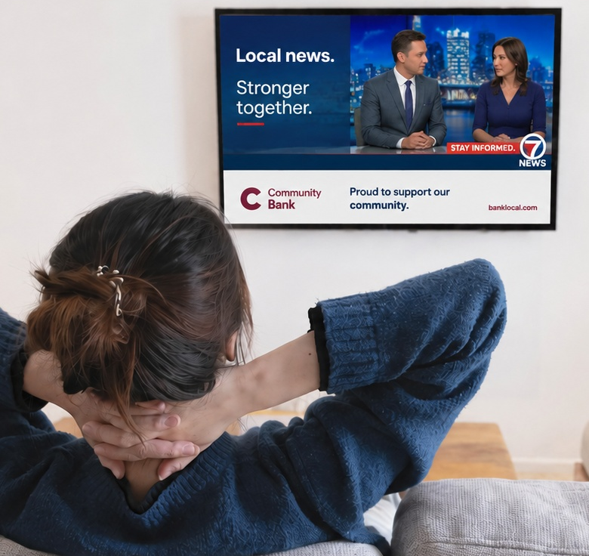




Ad Perceptions in Local TV News
Scan or click to access more local insights
Advertising in local TV news strengthens brand perception, highlighting the impact of messaging alongside trusted content
% of respondents who have a better opinion
of brands that advertise during local TV news
Source: Dynata, Media Consumption and Political Sentiment survey, fielded December 2025 (n=2,319). Survey base: A18+ U.S. respondents. Q9. Please rate your agreement with the following statements - ‘I have a better opinion of brands that advertise during local TV news.’ Base = All News Respondents. Based on respondents who selected ‘strongly agree’ or ‘agree’ [Top 2 Box]. Black respondents (n=168), Hispanic respondents (n=143), Asian respondents (n=85), White respondents (n=941).
Click here to download the full report, ‘Community Connection: 10 ways TV news creates trust and impact among diverse audiences’ to learn more
theVAB.com/insights

