Slide 1
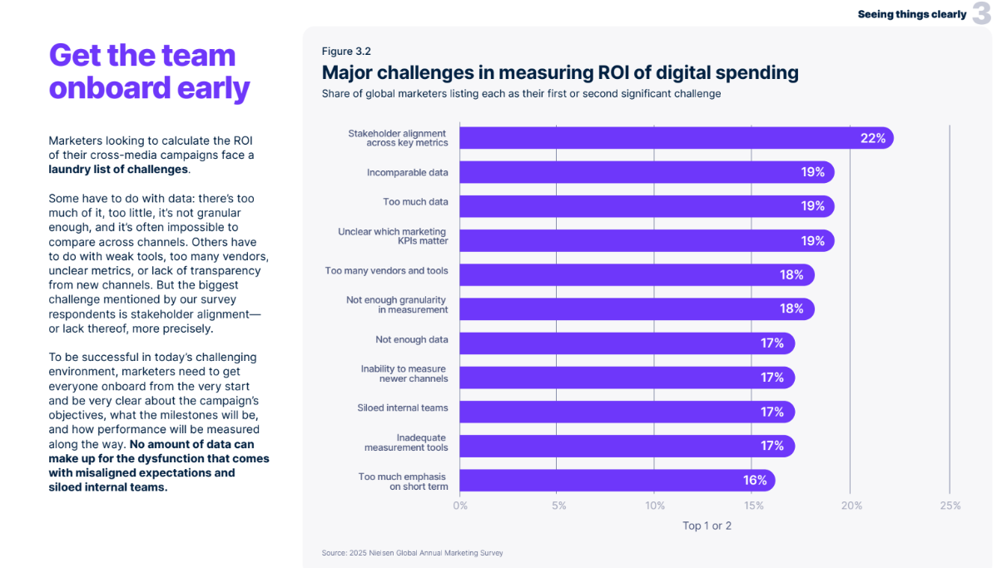

Challenges in Measuring Digital Spending ROI
Scan or click to access more measurement insights
Marketers looking to calculate ROI across digital spending face challenges in data, lack of transparency and more
Major Challenges In Measuring ROI of Digital Spending
Share of global marketers listing each as their first or second significant challenge
Source: Nielsen, Global Annual Marketing Survey, 2025.
theVAB.com/insights

