Slide 1

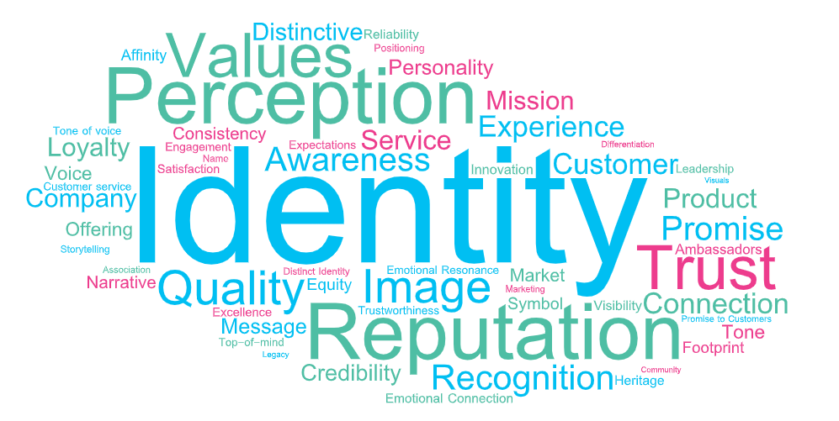
What ‘Brand’ Means to Marketers
Scan or click to access more marketer insights
‘Brand’ is typically defined by how a product or service is seen, identified, perceived and experienced
In your own words, what does ‘brand’ mean to you in the context of your company's products or services?
Based on summary of verbatim responses
Click here to download VAB’s full report, ‘What does ‘brand’ mean and how does it drive growth for my business?’
theVAB.com/insights

