Slide 1

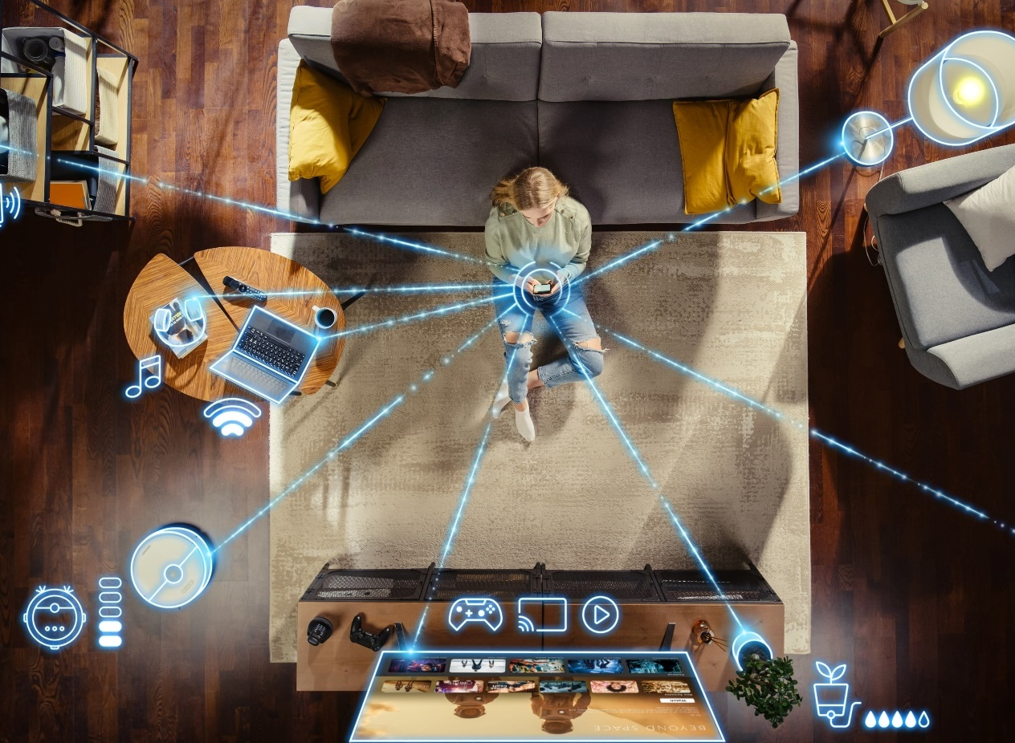
‘Smart’ Home Devices: Attitudes
Scan or click to access more connected device insights
Nearly half of adults believe smart devices have greatly improved their lives and are becoming central to their homes
‘The benefits of ‘smart’ home devices / appliances could significantly improve my quality of life’
% of respondents who agree
‘Smart’ home devices / appliances have
become an important part of my life’
% of respondents who agree
Source: VAB analysis of MRI-Simmons Fall 2021 – 2024 USA Study, A18+. Based on ‘any agree’.
Click here to download the full report , ‘Left to Your Own (Connected) Devices’
theVAB.com/insights

